Slide 1

Vietnam general confederation of labour Ton Duc Thang University Information Technology major
Assignment To Computer Network
Instructor : Mr Jae Young Hur and
Mr Bhagawan Nath
Subject code : 502046
Group: 9
The performer: Nguyễn Tiến Dũng

Slide 2

Build computer’s network for TDTU Dormitory

Slide 3

Build computer’s network
for TDTU Dormitory
DEFINITION OF THE INTERNET
THE INTERNET BUILD GOALS
BULDING THE INTERNET MODEL
ANALOGUE COMPUTER NETWORK ON CISCO PACKET TRACER
1
2
3
4

Slide 4

I - DEFINITION OF THE INTERNET
1
2
3
4
5
What is the internet?
How many configuration networks
What is the most popular
network?
The internet equipment
Equipment
is principle working on the internet?

Slide 5
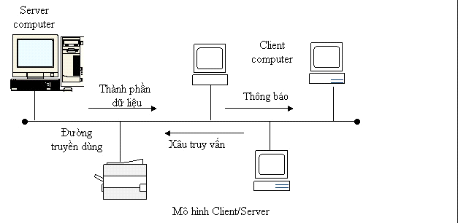
1 - What is the internet?
Internet is a system of many computers which are connected with the internet equipment or media by a structure; so computers can exchange the information to each other.

Slide 6
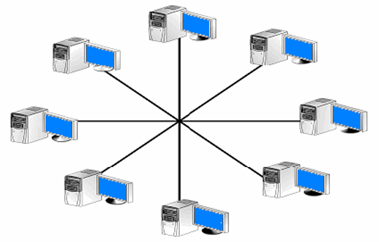
2 - How many configuration networks?
* Configuration network (Topology network):
Star Network: A star network is a local area network (LAN) in which all nodes (workstations or other devices) are directly connected to a common central compute.

Slide 7
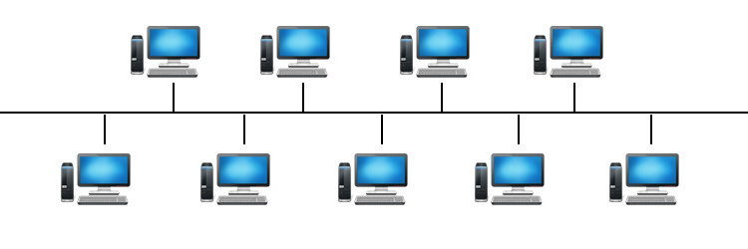
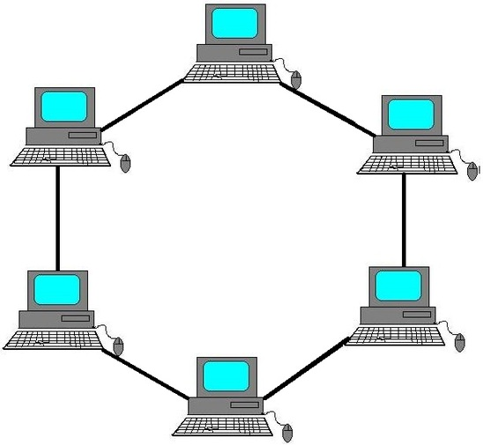
2 - How many configuration networks?
Bus Network : A bus network is a local area network (LAN) topology in which all the nodes are connected to a shared bus.
Ring Network : A ring network is a local area network (LAN) in which the nodes (workstations or other devices) are connected in a closed loop configuration

Slide 8
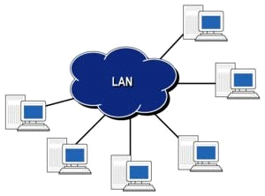
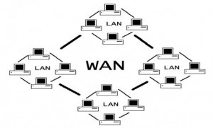
2 - How many configuration networks?
* Network type according to the distribution range:
LAN( Local Area Network) : run in a small area.
WAN ( Wide Area Network): The distance from hundreds to millions kilometers

Slide 9
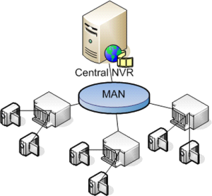
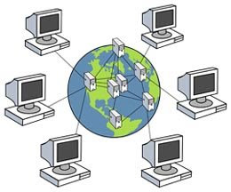
2 - How many configuration networks?
MAN( Metropolitan Area Network): the area is used is bigger than LAN
GAN( Global Area Network): The distance is from some countries

Slide 10
3- What is the most popular network?
The cost is low.
Managing LAN is easy.
WAN ( wide area network)
The area used is big, unlimited.

Slide 11
4 - The internet equipment
* Transmission equipment:
Landline equipment
Wireless
Coaxial cable

Slide 12
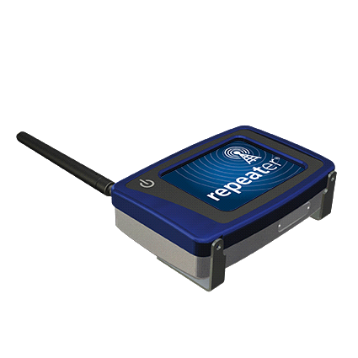
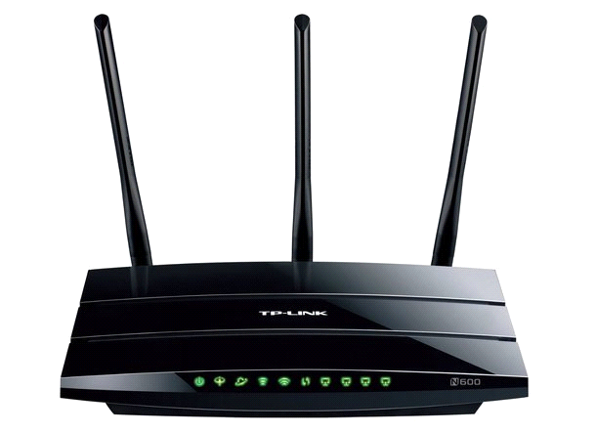
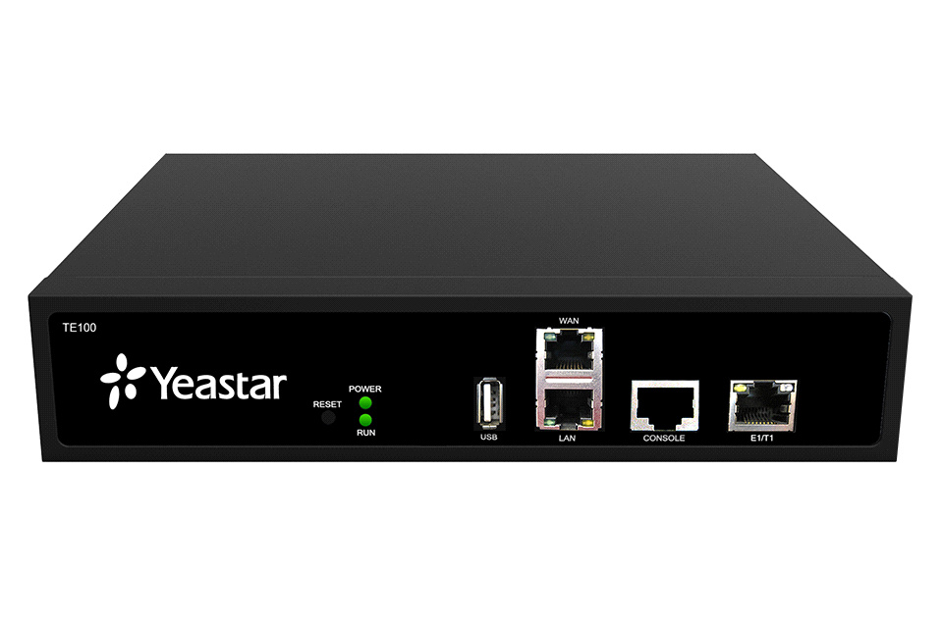
4 - The internet equipment
* Connecting equipment :
Reapeater
Router
Gateway

Slide 13
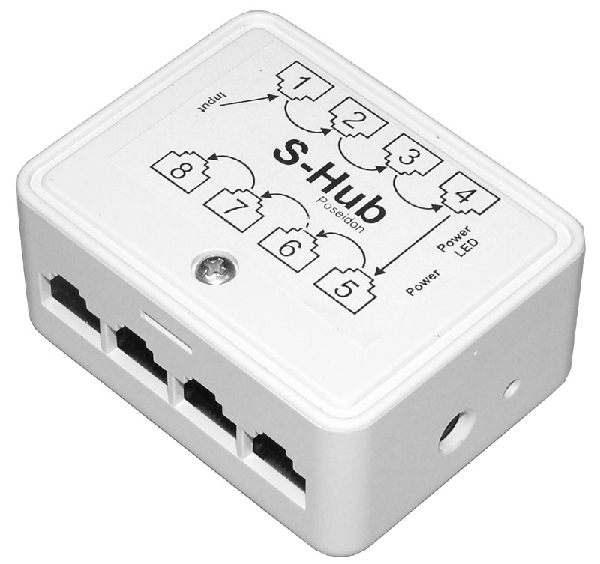
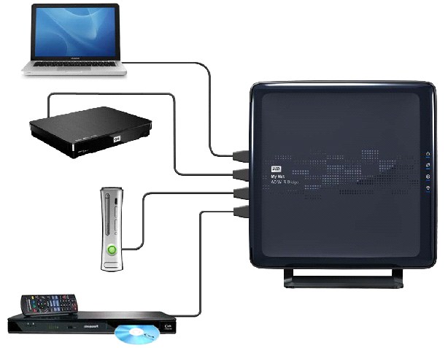
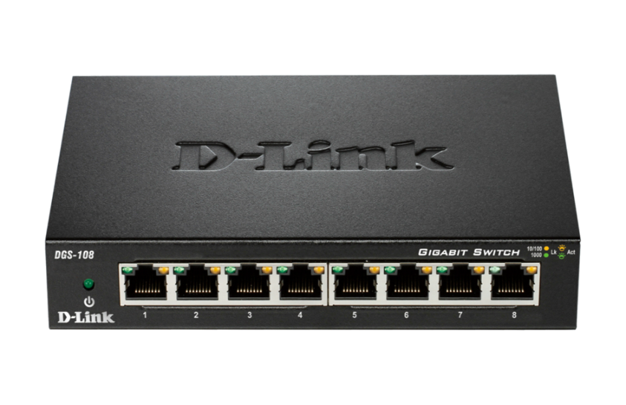
4 - The internet equipment
Hub
Bridge
Switch

Slide 14
5 – Equipment is principle working on the internet?
Reapeate
Hub
Bridge
Switch
Router
Gateway
Modem
Network card

Slide 15
II - THE INTERNET BUILD GOALS
1
The request with the internet
2
Analyzing the requests

Slide 16
1 - The request with the internet
Logical network design.
Design a network diagram at the physical level.
Network settings.
Calculate funding for the network.
Learn the technology popular in the market.
Requirements of network stability and bandwidth.
The network must be secure both in terms of data and information

Slide 17
2 - Analyzing the requests
We have grasped the network of KTX Ton Duc Thang University is implemented as follows:
Ground floor consists of 1 room
1st floor- 10th floor each floor consists of 16 rooms, each with 1wifi and 8 computers.
Equipment needed :
Switch: 24 ports.
Router
Compute

Slide 18
III - BULDING THE INTERNET MODEL
1
Cross section drawing model
2
Arranging and connecting network model
3
How to divide Subnetting?
How to wiring
4

Slide 19
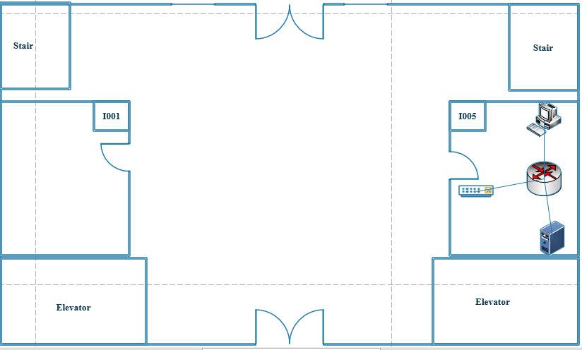
Cross section drawing model.
Ground floor dormitory

Slide 20
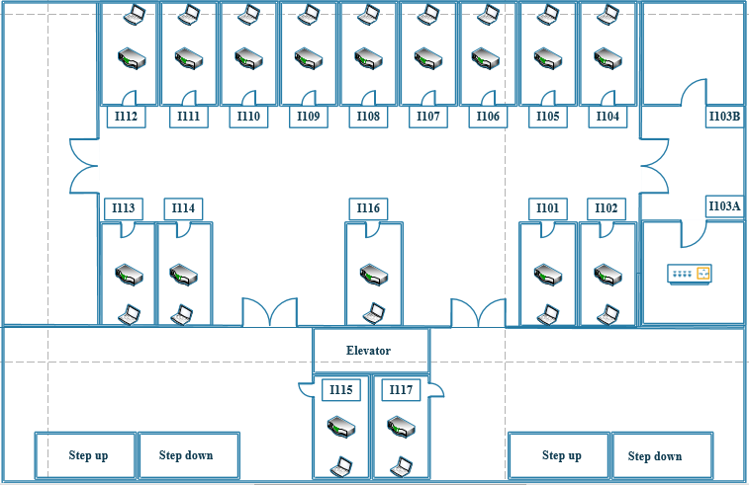
Cross section drawing model.
Floor 1 -> Floor 10

Slide 21
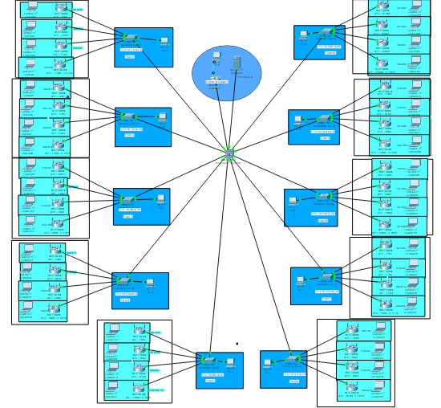
2. Arranging and connecting network model.
Analogue computer network on cisco packet tracer

Slide 22
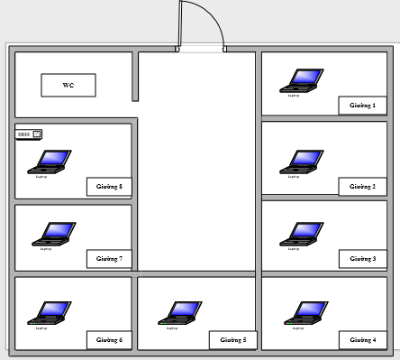
2. Arranging and connecting network model.
Room 1 -> Room 16

Slide 23
3. How to subnet from the command line to match the computer requirements.
Number of subnets created : 2*m( m is the number of bits borrowed from the host ID)
Số Host/Subnet: 2*n ( n is the number of remaining bits of the host ID after being borrowed).
New subnet mask = old subnet mask + m ( the number of bits borrowed).

Slide 24
4. Calculate wiring and other requirements according to the assigned topic.
G floor spacing dormitory

Slide 25
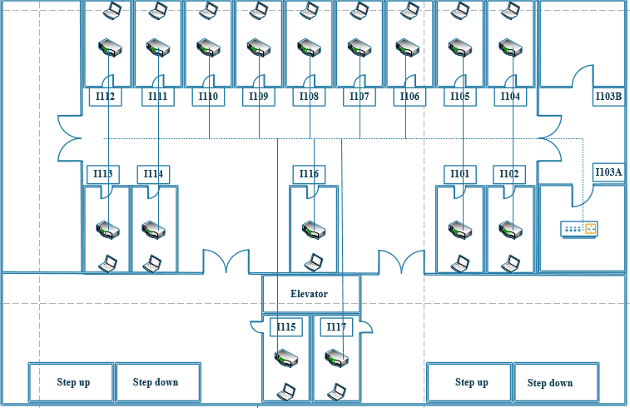
4. Calculate wiring and other requirements according to the assigned topic.
Distance of 1st floor -> 10th floor

Slide 26
IV - ANALOGUE COMPUTER NETWORK ON CISCO PACKET TRACER
1.Building the internet on CSP
2. Configuration of SWITCH and ROUTER
3.Configuration of computer, server

Slide 27
1. Building the internet on Cisco Packet Tracer.
Analogue computer network on cisco packet tracer

Slide 28
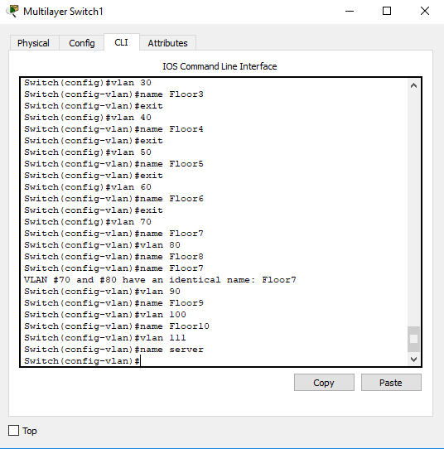
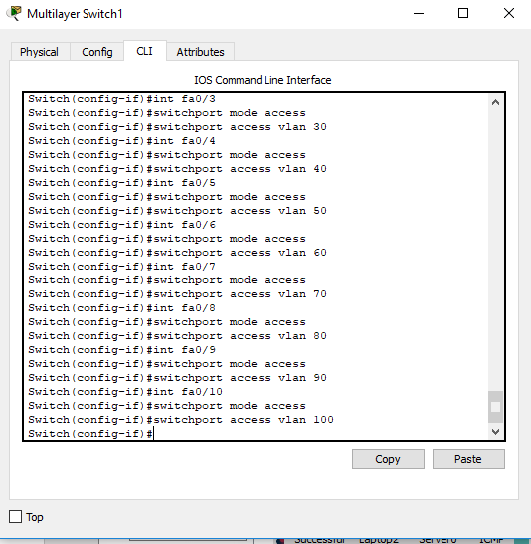
2.Configuration of SWITCH and ROUTER.

Slide 29
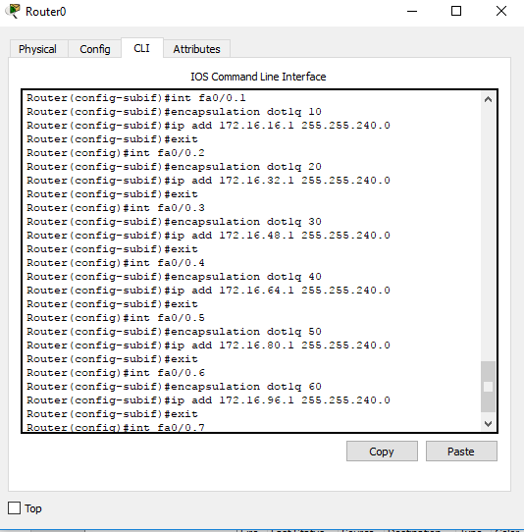
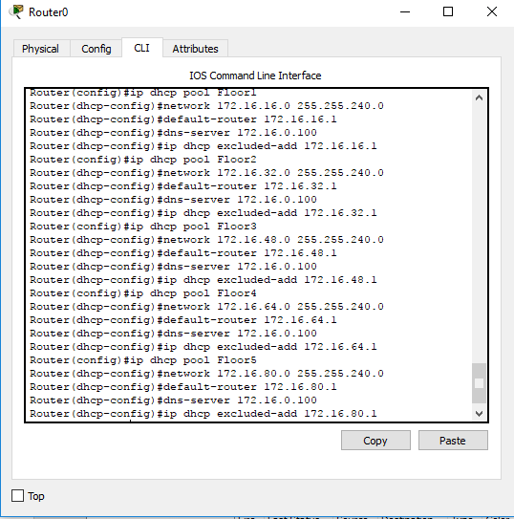
2.Configuration of SWITCH and ROUTER.

Slide 30
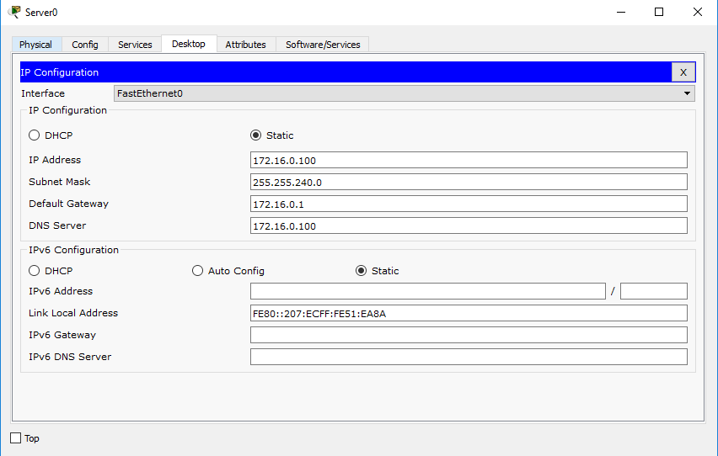
3.Configuration of computer, server
Configure the IP for the server

Slide 31
3.Configuration of computer, server
Expected Device List:
Router Cisco: 1 router.
Switch: 10 Switch 24 port.
Multilayer Switch: 1 Switch 24 port.
Network cables: use the cable STP (Shiel Twist Pair).
Cable connector : use RJ-45 connector.

Slide 32
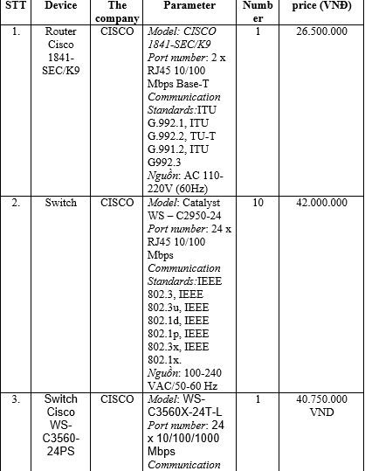
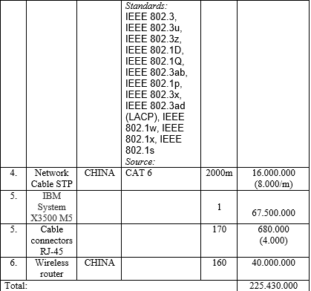
3.Configuration of computer, server

Slide 33
3.Configuration of computer, server
REFERENCES:
NUS Lecture Note, Operating To Computer Network.
http://searchnetworking.techtarget.com/tip/How-to-subnet-Subnetting-calculations-and-shortcuts
http://searchnetworking.techtarget.com/definition/star-network
https://www.lifewire.com/local-area-network-816382
https://www.google.com.vn/search?q=o%09LAN(+Local+Area+Network&tbm=isch&tbo=u&source=univ&sa=X&ved=0ahUKEwjH896JrbjXAhXClJQKHZK3AuUQsAQIRQ

Slide 34


