Slide 1
MatLab API in C++
Christopher Dabney

Slide 2
Purpose
MatLab …
  is an interpreted scripting language
    conversion to object code is at runtime; computation time can be a little slow
  has excellent prototyping and plotting functionality
  contains convenient and very robust matrix operation packages

Slide 3
Purpose (cont)
C++
  is a programming language, optimal and with high speed floating point computation
  is non-trivial to produce visual effects in
    eg. plotting, GUIs, nice tables
  can be difficult to secure a robust vector algebra package for

Slide 4
Purpose (cont)
Solution: C++ invoking MatLab commands
  number crunching in C++
  matrix operations in MatLab
  plotting, graphing, tables in MatLab
For programmers with a robust & complex C++ program intending to plot results they are already obtaining
For MatLab programming with scripts which frequently lag

Slide 5
Interacting with MatLab
Not restricted to C++; Java, Perl, Fortran, and other languages can do it also
Not restricted to the MS Visual Studio environment the demos are written in
Also possible to invoke a C++ routine from MatLab’s environment
Three ways to interact
  Send Data from C++ to MatLab
  Call a MatLab function from C++
  Generate a Dynamic Link Library (dll) file from a .m file
We will use the first one

Slide 6
Demo Requirements
A C++ Compiler
  the demo uses MS Visual C++ v.6.0
MatLab
  the demo uses MatLab v.7.0.1
Assume’s prior programming experience in both MatLab and C++
  no explanations are given for the commands
Following slides explain setting up the demonstration program environment

Slide 7
Setting up the Environment
Creating paths to MatLab:
- Tools -> Options
- Directories Tab
- Select "Include files" from the drop-down list
- Add "C:\MATLAB701\EXTERN\INCLUDE" to the list
- Select "Library Files" from the drop-down list
- Add ”C:\MATLAB701\EXTERN\LIB\WIN32\MICROSOFT\MSVC60“
  Library paths vary depending on the language and compiler

Slide 8
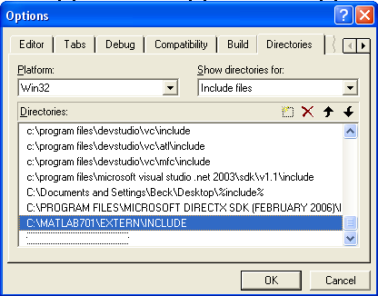
Screenshot

Slide 9
Setting up the Environment (cont)
Two ways to include the appropriate library files:
Method 1) - Project -> Settings
- Links Tab
Under "Object/Library Module:", add three file names:
- Libmx.lib
- libmex.lib
- libeng.lib
Method 2) Add the following lines of code just under the
includes in the source code:
  #pragma comment( lib, "Libmx.lib" )
#pragma comment( lib, "libmex.lib" )
#pragma comment( lib, "libeng.lib" )

Slide 10
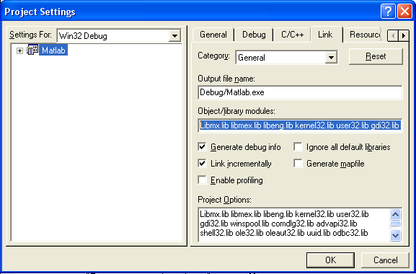
Screenshot

Slide 11
Connecting to MatLab Engine
Header: #include <engine.h>, MatLab’s Engine
In the program, create a pointer to it:
Engine *m_pEngine;
m_pEngine = engOpen(NULL);
if (m_pEngine == NULL)
{
cout << "Error: Not Found”
<< endl;
exit(1);
}

Slide 12
Invoking Commands
engEvalString(Engine* ptr, string cmd);
  engEvalString(m_pEngine, “x = 1:1:10);“ );
  engEvalString(m_pEngine, “y = x.^2;“ );
  engEvalString(m_pEngine, “plot(x,y);“ );
Enables programmer to invoke any command in MatLab from the C++ platform (convenient)
Not special by itself - might as well work straight from MatLab

Slide 13
IO between C++ and MatLab
Use the “matrix array” mxArray data type
Every variable in MatLab is a matrix – for C++ to exchange data with it, a data type that both C++ and MatLab recognize is needed
mxArray can “bundle” C++ variables as matrices, so both platforms recognize this data type

Slide 14
Inserting Values (input)
To pass a variable, eg. x[0], into MatLab, create an mxArray for it
- Allocate the space (mxCreateDoubleMatrix)
- Copy the value (memcpy)
- Name the variable in the Engine (engPutVariable)
  double x[0];
  mxArray *m_X;
  m_X=mxCreateDoubleMatrix(1, 1, mxREAL);
  memcpy((void *)mxGetPr(m_X), (void *)x, sizeof(double)*1);
  engPutVariable(m_pEngine, "x", m_X);
Pointer m_pEngine is used to specify the engine
Variable x in the MatLab Engine gets the value of x[0] in C++

Slide 15
Extracting Values (output)
To extract the MatLab Engine’s variable z, pull it into C++ as a mxArray matrix, then extract the bundled value out of that mxArray and into a C++ variable
double *cresult;
mxArray *mresult;
mresult = engGetVariable(m_pEngine,"z");
cresult = mxGetPr(mresult);
cout << cresult[0];
mxGetPr returns a pointer to a copy of the double value z stored in the MatLab Engine
Warning: Unpredictable fatal errors occur if the data type in MatLab doesn’t closely resemble the data type in C++ eg. Copying a 3x1 vector into a scalar

Slide 16
Passing Arrays & Matrices
To pass arrays (vector), adjust the size parameters of the memory allocation and copy routine to match the dimensions of the array being passed
Pass a vector a of dimensions: 1 x SIZE
  double a[SIZE];
  mxArray *A;
  // assume a gets initialized, all values
  A=mxCreateDoubleMatrix(1, SIZE, mxREAL);
  memcpy((void *)mxGetPr(A), (void *)a, sizeof(double)*SIZE);
  engPutVariable(m_pEngine, "a", A);
Copies entire C++ array a into the MatLab Engine’s a

Slide 17
Passing Arrays & Matrices (cont)
Pass a matrix of dimensions: SIZE x SIZE
  double c[SIZE][SIZE];
  // assume c gets initialized, all of it
  mxArray *mxc;
  mxc = mxCreateDoubleMatrix(SIZE, SIZE, mxREAL);
  memcpy((void *) mxGetPr(mxc), (void *)c, sizeof(double)*SIZE*SIZE);
  engPutVariable(m_pEngine, "c", mxc);
  engEvalString(m_pEngine, "c = c';");
Note: C++ has row-major storage, and MatLab has column-major storage. Thus a matrix being exchanged must be transposed, either before or after the exchange, to maintain the matrix’s semantics

Slide 18
See the Demos Program
Demonstrates all of these features so far in Microsoft Visual Development Studio C++ v.6.0
Demonstrates graph plots, invoking commands, input, output, and passing vectors and matrices.

Slide 19
Internet References
Welcome to Zhenwang's Homepage (Q&A)
  http://www.sfu.ca/~zyao/teaching/ensc488faq.htm
A Tutorial to Call MATLAB Functions from Within A C/C++ Program
  http://prism.mem.drexel.edu/Shah/public_html/c2matlab.htm
Microsoft Visual Studio C++ & Interfacing Matlab with C/C++, Java
  http://www.qcf.gatech.edu/academic/LabDataAccess/C++IntroductionMatLab.Interfacings.doc
MatLab – The Language of Technical Computing, External Interfaces
  http://www.mathworks.com.au/access/helpdesk/help/pdf_doc/matlab/apiext.pdf

Slide 20
Questions? …

Slide 21
Thank You
No MatLab matrices were harmed in the making of this presentation.

