Slide 1

William Stallings Computer Organization and Architecture 9th Edition
Notes:
Lecture slides prepared for “Computer Organization and Architecture”, 9/e, by William Stallings, Chapter 1 “Introduction”.

Slide 2
Chapter 1
Introduction
Notes:
This book is about the structure and function of computers. Its purpose is to present,
as clearly and completely as possible, the nature and characteristics of modern-day
computers. This task is a challenging one for two reasons.
First, there is a tremendous variety of products, from single-chip microcomputers
costing a few dollars to supercomputers costing tens of millions of dollars, that
can rightly claim the name computer. Variety is exhibited not only in cost, but also in
size, performance, and application. Second, the rapid pace of change that has always
characterized computer technology continues with no letup. These changes cover all
aspects of computer technology, from the underlying integrated circuit technology
used to construct computer components to the increasing use of parallel organization
concepts in combining those components.
In spite of the variety and pace of change in the computer field, certain fundamental
concepts apply consistently throughout. To be sure, the application of these
concepts depends on the current state of technology and the price/performance
objectives of the designer. The intent of this book is to provide a thorough discussion
of the fundamentals of computer organization and architecture and to relate these
to contemporary computer design issues. This chapter introduces the descriptive
approach to be taken.

Slide 3
Computer Architecture
Computer Organization
Computer Architecture
Attributes of a system visible to the programmer
Have a direct impact on the logical execution of a program
Architectural attributes include:
Instruction set, number of bits used to represent various data types, I/O mechanisms, techniques for addressing memory
Computer Organization
The operational units and their interconnections that realize the architectural specifications
Organizational attributes include:
Hardware details transparent to the programmer, control signals, interfaces between the computer and peripherals, memory technology used
Notes:
In describing computers, a distinction is often made between computer architecture
and computer organization. Although it is difficult to give precise definitions
for these terms, a consensus exists about the general areas covered by each
(e.g., see [VRAN80], [SIEW82], and [BELL78a]); an interesting alternative view
is presented in [REDD76].
Computer architecture refers to those attributes of a system visible to a
programmer or, put another way, those attributes that have a direct impact on
the logical execution of a program. Computer organization refers to the operational
units and their interconnections that realize the architectural specifications.
Examples of architectural attributes include the instruction set, the number of bits
used to represent various data types (e.g., numbers, characters), I/O mechanisms,
and techniques for addressing memory. Organizational attributes include those
hardware details transparent to the programmer, such as control signals; interfaces
between the computer and peripherals; and the memory technology used.
For example, it is an architectural design issue whether a computer will have
a multiply instruction. It is an organizational issue whether that instruction will
be implemented by a special multiply unit or by a mechanism that makes repeated
use of the add unit of the system. The organizational decision may be based on the
anticipated frequency of use of the multiply instruction, the relative speed of the two
approaches, and the cost and physical size of a special multiply unit.
Historically, and still today, the distinction between architecture and organization
has been an important one. Many computer manufacturers offer a family of
computer models, all with the same architecture but with differences in organization.
Consequently, the different models in the family have different price and performance
characteristics. Furthermore, a particular architecture may span many years and
encompass a number of different computer models, its organization changing with
changing technology.

Slide 4
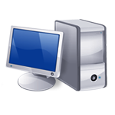
IBM System
370 Architecture
IBM System/370 architecture
Was introduced in 1970
Included a number of models
Could upgrade to a more expensive, faster model without having to abandon original software
New models are introduced with improved technology, but retain the same architecture so that the customer’s software investment is protected
Architecture has survived to this day as the architecture of IBM’s mainframe product line
Notes:
A prominent example of both these phenomena is the IBM
System/370 architecture. This architecture was first introduced in 1970 and included
a number of models. The customer with modest requirements could buy a cheaper,
slower model and, if demand increased, later upgrade to a more expensive, faster
model without having to abandon software that had already been developed. Over
the years, IBM has introduced many new models with improved technology to replace
older models, offering the customer greater speed, lower cost, or both. These newer
models retained the same architecture so that the customer’s software investment was
protected. Remarkably, the System/370 architecture, with a few enhancements, has
survived to this day as the architecture of IBM’s mainframe product line.

Slide 5
Structure and Function
Hierarchical system
Set of interrelated subsystems
Hierarchical nature of complex systems is essential to both their design and their description
Designer need only deal with a particular level of the system at a time
Concerned with structure and function at each level
Structure
The way in which components relate to each other
Function
The operation of individual components as part of the structure
Notes:
A computer is a complex system; contemporary computers contain millions of
Elementary electronic components. How, then, can one clearly describe them?
The key is to recognize the hierarchical nature of most complex systems, including
the computer [SIMO96]. A hierarchical system is a set of interrelated subsystems,
each of the latter, in turn, hierarchical in structure until we reach some lowest level
of elementary subsystem.
The hierarchical nature of complex systems is essential to both their design
and their description. The designer need only deal with a particular level of the
system at a time. At each level, the system consists of a set of components and
their interrelationships. The behavior at each level depends only on a simplified,
abstracted characterization of the system at the next lower level. At each level, the
designer is concerned with structure and function:
• Structure: The way in which the components are interrelated.
• Function: The operation of each individual component as part of the structure.
In terms of description, we have two choices: starting at the bottom and building
up to a complete description, or beginning with a top view and decomposing the
system into its subparts. Evidence from a number of fields suggests that the top-down
approach is the clearest and most effective [WEIN75].
The approach taken in this book follows from this viewpoint. The computer
system will be described from the top down. We begin with the major components
of a computer, describing their structure and function, and proceed to successively
lower layers of the hierarchy. The remainder of this section provides a very brief
overview of this plan of attack.

Slide 6
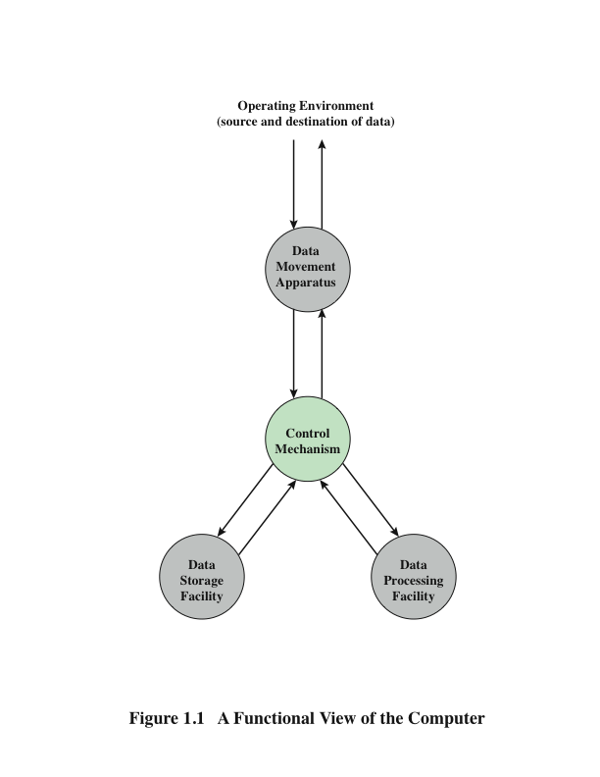
Function
A computer can perform four basic functions:
Data processing
Data storage
Data movement
Control
Notes:
Both the structure and functioning of a computer are, in essence, simple. Figure 1.1
depicts the basic functions that a computer can perform. In general terms, there are
only four:
• Data processing
• Data storage
• Data movement
• Control
The computer, of course, must be able to process data. The data may take a wide
variety of forms, and the range of processing requirements is broad. However, we
shall see that there are only a few fundamental methods or types of data processing.
It is also essential that a computer store data. Even if the computer is processing
data on the fly (i.e., data come in and get processed, and the results go out
immediately), the computer must temporarily store at least those pieces of data
that are being worked on at any given moment. Thus, there is at least a short-term
data storage function. Equally important, the computer performs a long-term data
storage function. Files of data are stored on the computer for subsequent retrieval
and update.
The computer must be able to move data between itself and the outside
world. The computer’s operating environment consists of devices that serve as
either sources or destinations of data. When data are received from or delivered to
a device that is directly connected to the computer, the process is known as input–
output (I/O), and the device is referred to as a peripheral. When data are moved
over longer distances, to or from a remote device, the process is known as data
communications.
Finally, there must be control of these three functions. Ultimately, this control
is exercised by the individual(s) who provides the computer with instructions. Within
the computer, a control unit manages the computer’s resources and orchestrates the
performance of its functional parts in response to those instructions.

Slide 7
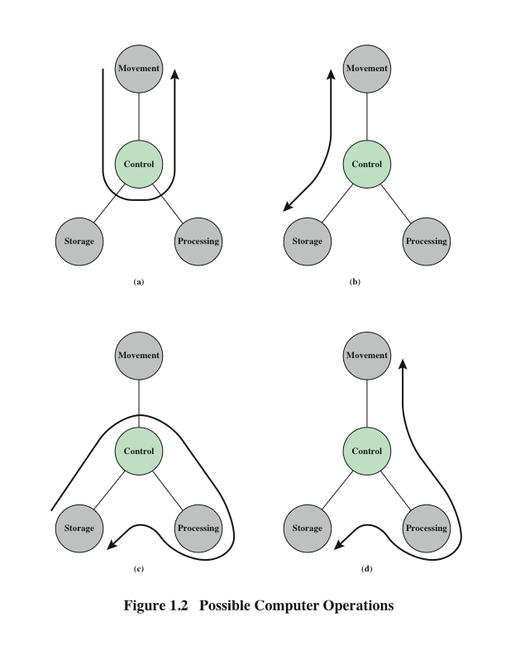
Operations (a) Data movement
Notes:
At this general level of discussion, the number of possible operations that
can be performed is few. Figure 1.2 depicts the four possible types of operations.
The computer can function as a data movement device (Figure 1.2a), simply
transferring data from one peripheral or communication line to another.

Slide 8
Operations (b) Data storage
Notes:
It can also function as a data storage device (Figure 1.2b), with data transferred from
the external environment to computer storage (read) and vice versa (write).

Slide 9
Operations (c) Data processing (1)
Notes:
The final two diagrams show operations involving data processing, on data either in storage (Figure 1.2c)

Slide 10
Operations (d) Data processing (2)
Notes:
En route between storage and the external environment (Figure 1.2d).

Slide 11
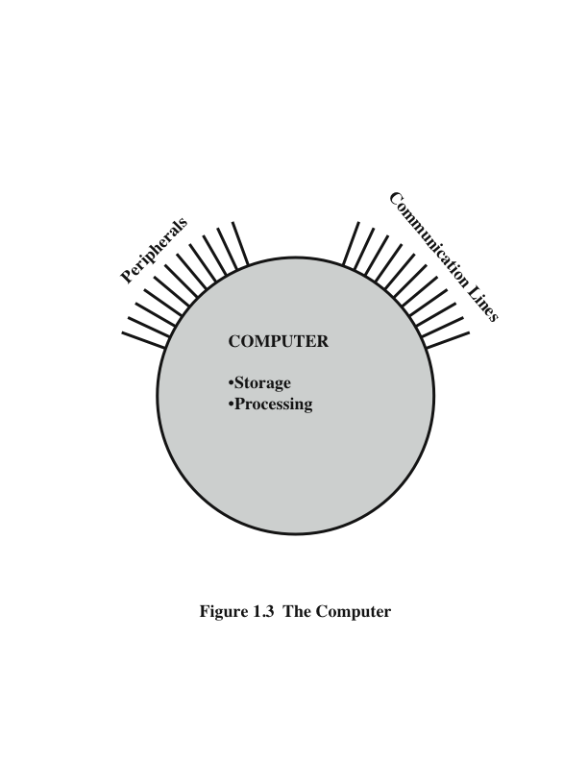
The Computer
Notes:
Figure 1.3 is the simplest possible depiction of a computer. The computer interacts
in some fashion with its external environment. In general, all of its linkages to
the external environment can be classified as peripheral devices or communication
lines. We will have something to say about both types of linkages.

Slide 12
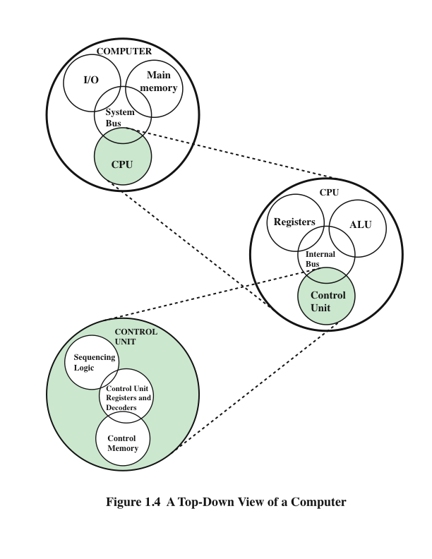
Structure
Notes:
But of greater concern in this book is the internal structure of the computer
itself, which is shown in Figure 1.4. There are four main structural components:
Central Processing Unit (CPU)
Main Memory
I/O
System Interconnection

Slide 13
- CPU – controls the operation of the computer and performs its data processing functions
- Main Memory – stores data
- I/O – moves data between the computer and its external environment
- System Interconnection – some mechanism that provides for communication among CPU, main memory, and I/O
There are four main structural components
of the computer:
Notes:
There are four main structural components:
• Central processing unit (CPU): Controls the operation of the computer and
performs its data processing functions; often simply referred to as processor.
• Main memory: Stores data.
• I/O: Moves data between the computer and its external environment.
• System interconnection: Some mechanism that provides for communication
among CPU, main memory, and I/O. A common example of system interconnection
is by means of a system bus, consisting of a number of conducting
wires to which all the other components attach.

Slide 14
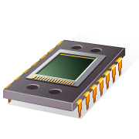
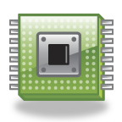
CPU
Control Unit
Controls the operation of the CPU and hence the computer
Arithmetic and Logic Unit (ALU)
Performs the computer’s data processing function
Registers
Provide storage internal to the CPU
CPU Interconnection
Some mechanism that provides for communication among the control unit, ALU, and registers
Major structural components:
Notes:
There may be one or more of each of the aforementioned components.
Traditionally, there has been just a single processor. In recent years, there has been
increasing use of multiple processors in a single computer. Some design issues relating
to multiple processors crop up and are discussed as the text proceeds; Part Five
focuses on such computers.
Each of these components will be examined in some detail in Part Two.
However, for our purposes, the most interesting and in some ways the most complex
component is the CPU. Its major structural components are as follows:
• Control unit: Controls the operation of the CPU and hence the computer.
• Arithmetic and logic unit (ALU): Performs the computer’s data processing
functions.
• Registers: Provides storage internal to the CPU.
• CPU interconnection: Some mechanism that provides for communication
among the control unit, ALU, and registers.

Slide 15
Summary
Introduction
Chapter 1
Computer Organization
Computer Architecture
Function
Data processing
Data storage
Data movement
Control
Structure
CPU
Main memory
I/O
System interconnection
CPU structural components
Control unit
ALU
Registers
CPU interconnection
Notes:
Chapter 1 summary.

Slide 16
Key Terms
Chapter 1
arithmetic and logic unit (ALU)
central processing unit (CPU)
computer architecture
computer organization
control unit
input–output (I/O)
main memory
processor
registers
system bus

Slide 17
Recommended reading
Chapter 1
How a CPU Works - https://www.youtube.com/watch?v=cNN_tTXABUA
Fujitsu TS Mainboard Production Augsburg HD - https://www.youtube.com/watch?v=ylk6VMBLrvM

