Slide 1

MOBILE TIMESHEET MANAGEMENT
DANANG UNIVERSITY
DANANG UNIVERSITY OF TECHNOLOGY
INFORMATION TECHNOLOGY FACULTY
SENIOR PROJECT DEFENSE
PROJECT NAME:
Student : NGUYEN Le Hoai My
Class: 08T1
Instructor: PhD. NGUYEN Tan Khoi

Slide 2
Contents
Introduction
1
Goal of Project
Solution
3
Trien khai
4
Ket luan

Slide 3
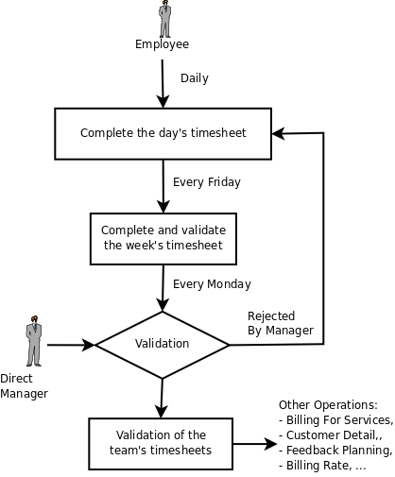
Introduction

Slide 4

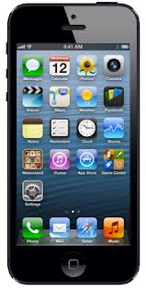
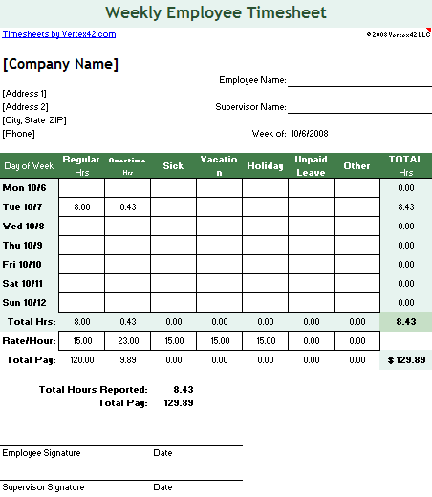
Introduction

Slide 5
Goal of Project
Create
Get review
Manage
Timesheet Application
Report
Notify

Slide 6
Process
Requirement
Design
Analysis
System
Database
Coding
Testing

Slide 7


Solution
Request
Response
Database

Slide 8




Solution

Slide 9


Solution
Create new timesheet
Edit Timesheet
Submit Timesheet
Report
Not submitted
Submitted
Timesheet
Return review
Return report

Slide 10
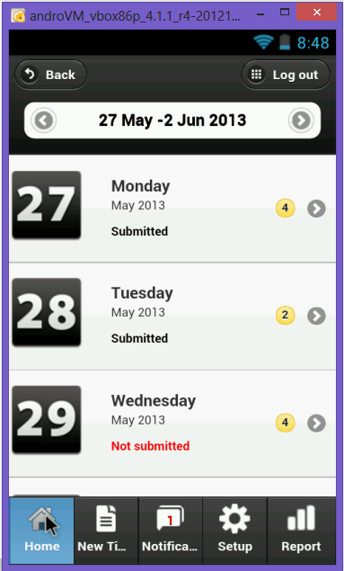
Demo
Main screen

Slide 11
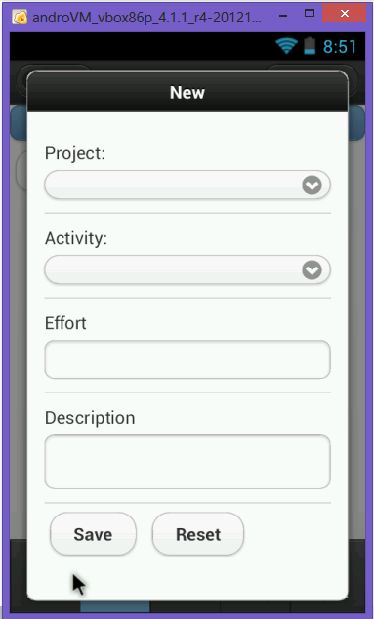
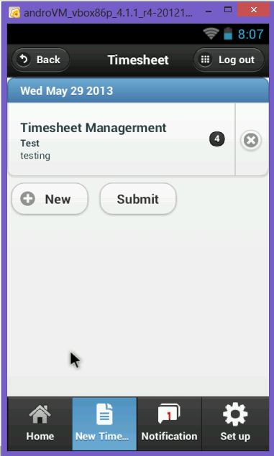
Demo

Slide 12
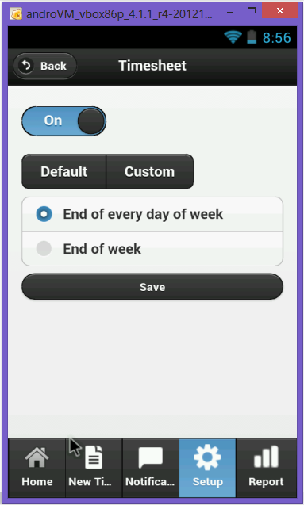
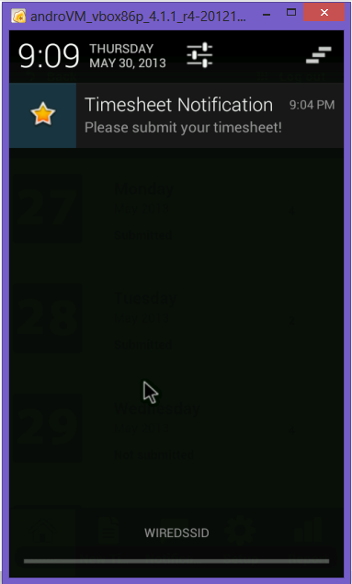
Demo

Slide 13
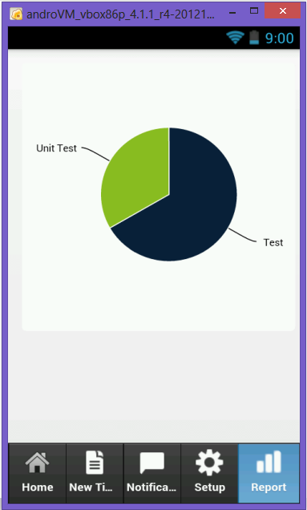
Demo

Slide 14
Conclusion
ACHIEVED RESULT
Finish app on Android Phone
FUTURE WORK
Develop a web site to help managers manage timesheet of his employees

Slide 15
Thank you !

