Slide 1
Smart Lab Digital Twin
Project 1 — The Connected Digital Twin (Foundational)
Course: Digital Twin
Team Members
1. ____________________________________
2. ____________________________________
3. ____________________________________
4. ____________________________________

Slide 2
Objective & Scope
• Goal: build a Connected Digital Twin of a laboratory room with a live, bidirectional Digital Thread.
• A physics-based simulator generates realistic sensor streams (temperature, humidity, occupancy) published over MQTT.
• A real-time dashboard and a 3D WebGL view mirror the room state and let the user act on the twin (AC control, setpoint, occupancy).
• Closed loop: user commands flow back to the simulator, which recomputes state and confirms it — a true Digital Twin, not just a Digital Shadow.
Brief coverage
✓ Asset Virtualization
✓ Synthetic Data Ingestion (MQTT + JSON)
✓ 6-Layer Architecture Mapping
✓ Real-time Dashboard + 30 °C alert
Beyond the brief:
+ Closed-loop PID HVAC control
+ Interactive 3D room view
+ 32 unit tests

Slide 3
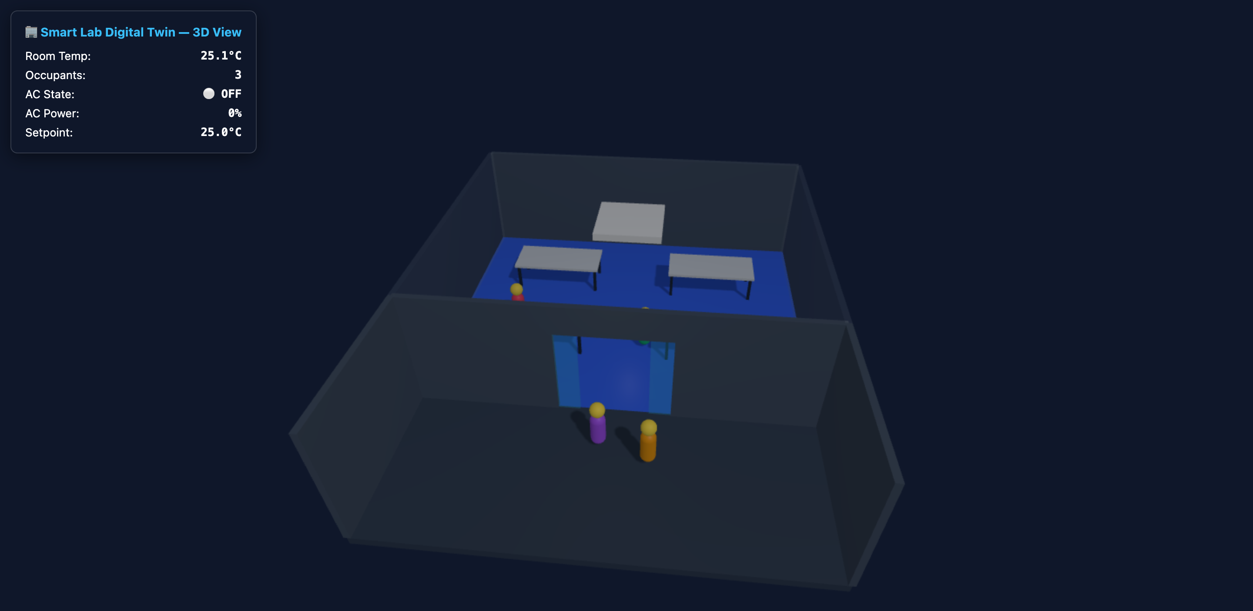
Asset Virtualization
Digital layout of the room and its virtual sensors
• Virtual space: a laboratory room plus an outer corridor with an automatic sliding glass door.
• Virtual sensors:
– Temperature (°C) — thermal model with room heat capacity, occupant heat load (100 W/person), and AC cooling
– Humidity (%RH) — moisture diffusion model coupled to occupancy
– Occupancy (people) — bounded random walk, 0–30 occupants
• Physics engine (physics.py): each tick integrates heat/moisture balance equations, so sensor values respond causally to occupancy and HVAC — not just random noise.
• Actuator: variable-power AC (0–100 %, max 3500 W) with vent output temperature.
3D digital layout: lab room, corridor, sliding door, live occupants

Slide 4
6-Layer Architecture
Sensing → Connectivity → Twin → Dashboard
1. Physical / Simulated Physics simulator + PID controller (temp, humidity, occupancy, HVAC)
Feedback loop (closed twin)
Dashboard publishes commands to twin/room1/cmd/* → broker → simulator recomputes state → confirmed state flows back to all clients.
This upgrades the system from a one-way Digital Shadow to a true bidirectional Digital Twin.
2. Data Acquisition paho-mqtt client publishes sensor + AC state as JSON every 2–5 s
3. Connectivity Eclipse Mosquitto MQTT broker — :1883 (TCP) / :9001 (WebSocket)
4. Data Processing Background MQTT thread buffers messages in a thread-safe deque
5. Application Streamlit dashboard + Three.js 3D view: metrics, charts, controls
6. Interaction User: AC on/off, setpoint, simulation speed, occupancy override

Slide 5
Synthetic Data Ingestion
MQTT topics and JSON payloads
Topic | Direction | Payload / Rate | Retained
twin/room1/temperature | Sim → Dash | JSON, every 3 s | Yes
twin/room1/humidity | Sim → Dash | JSON, every 5 s | Yes
twin/room1/occupancy | Sim → Dash | JSON, every 2 s | Yes
twin/room1/hvac/state | Sim → Dash | hvac_on, ac_power_pct, setpoint | Yes
twin/room1/ac/detail | Sim → Dash | power, vent temp, mode | Yes
twin/room1/status | Sim → Dash | online / offline (LWT) | Yes
twin/room1/cmd/hvac | setpoint | occupancy | timescale | Dash → Sim | control commands | No
Sample payload (JSON)
{
"sensor": "temperature",
"value": 24.5,
"unit": "C",
"timestamp":
"2026-07-17T14:40:00Z"
}
Reliability features
• Retained messages — instant state for new clients
• Last Will & Testament — dashboard shows OFFLINE if the simulator dies

Slide 6
Technical Summary — Why MQTT?
Chosen messaging protocol and its suitability
Decoupling
Publish/subscribe: the simulator never knows who is listening. Streamlit dashboard and the browser-based 3D view both subscribe to the same topics with zero extra load on the simulator.
Low latency & overhead
2-byte fixed header, persistent TCP connection — ideal for continuous telemetry every 2–5 s, far cheaper than REST polling.
Resilience (LWT + retained)
The broker announces simulator crashes instantly via Last Will; retained messages give any newly connected client the latest state immediately.
Bidirectional by design
The same broker carries downstream telemetry and upstream cmd/* control messages — the Digital Thread that closes the twin loop.
vs. alternatives: CSV = static, no live thread. REST polling = high overhead, no push, no offline detection. MQTT is the natural fit for an event-driven digital space.

Slide 7
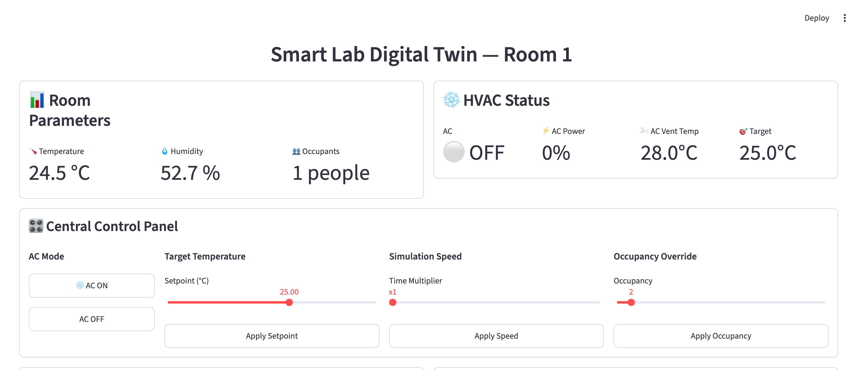
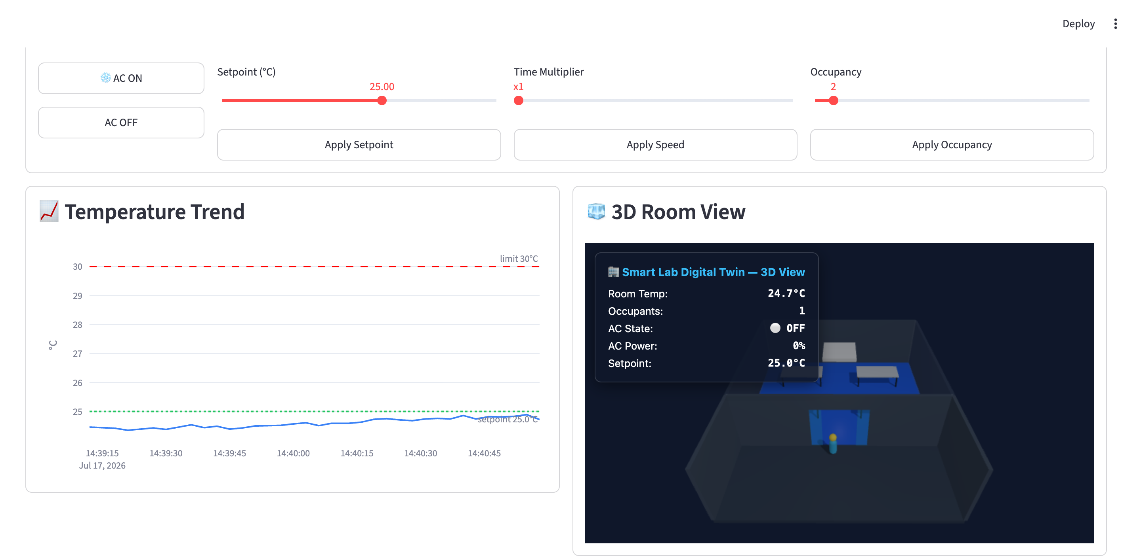
Real-Time Dashboard (Streamlit)
Live sensor readings, threshold alerts, central control
• 1-second refresh via MQTT background thread + Streamlit fragments.
• Live metrics: temperature, humidity, occupancy, HVAC status, AC power %, vent temperature.
• Threshold alert: banner when temperature exceeds 30 °C, with 29.5 °C hysteresis to stop alert flicker.
• Predictive alert: linear trend fit warns before the limit is crossed.
• Offline detection: LWT status turns the dashboard red if the simulator disconnects.
• Central control panel: AC on/off, setpoint slider, simulation speed (×1–×10), occupancy override — commands round-trip through the broker.

Slide 8
Beyond the Brief
Closed-loop PID HVAC control and 3D visualization
• PID controller regulates AC power (0–100 %) to lock room temperature onto the setpoint:
– Kp = 0.40 — fast response proportional to error
– Ki = 0.05 — removes steady-state offset under heavy load
– Kd = 0.05 — damps oscillation and overshoot
– Anti-windup (I_max = 20) + state reset on AC OFF
• Handles extreme loads: 30 occupants ≈ 3000 W of heat — the controller still converges to setpoint.
• 3D room view (Three.js): occupants walk through auto sliding doors; floor color shifts blue → red with temperature. Subscribes to MQTT over WebSocket directly in the browser.
• Quality: 32 unit tests covering physics, PID behaviour, and MQTT command handling.

Slide 9
Working Prototype — How to Run
# 1. Start the MQTT broker (Docker)
docker compose up -d
# 2. Install dependencies
uv sync
# 3. Launch the three components
uv run simulator/publisher.py
uv run streamlit run dashboard/app.py
uv run python -m http.server 8000 --directory room3d
# 4. Open the dashboard
open http://localhost:8501
Stack
• Python 3 + uv
• Eclipse Mosquitto 2 (Docker)
• paho-mqtt (publisher / subscriber)
• Streamlit + Plotly (dashboard)
• Three.js + MQTT.js over WebSocket (3D)
Ports
• 1883 — MQTT (TCP)
• 9001 — MQTT (WebSocket)
• 8501 — Dashboard
• 8000 — 3D room view

Slide 10
Demo
# 1. Start the MQTT broker (Docker)
docker compose up -d
# 2. Install dependencies
uv sync
# 3. Launch the three components
uv run simulator/publisher.py
uv run streamlit run dashboard/app.py
uv run python -m http.server 8000 --directory room3d
# 4. Open the dashboard
open http://localhost:8501
Stack
• Python 3 + uv
• Eclipse Mosquitto 2 (Docker)
• paho-mqtt (publisher / subscriber)
• Streamlit + Plotly (dashboard)
• Three.js + MQTT.js over WebSocket (3D)
Ports
• 1883 — MQTT (TCP)
• 9001 — MQTT (WebSocket)
• 8501 — Dashboard
• 8000 — 3D room view

Slide 11
Conclusion — Deliverables Checklist
Deliverable | Status | Where
Architecture Diagram (6 layers, sensing → dashboard) | ✓ Done | docs/architecture.md + Slide 4
Working Prototype (live dashboard on simulated feed) | ✓ Done | Streamlit + MQTT + simulator (Slide 7)
Technical Summary (protocol choice & suitability) | ✓ Done | docs/architecture.md + Slide 6
Asset virtualization: temp / humidity / occupancy | ✓ Done | physics.py, 3D view (Slide 3)
Threshold alert at 30 °C | ✓ Done | Dashboard with hysteresis (Slide 7)
Extras: PID closed-loop HVAC, 3D view, 32 tests | ＋ Bonus | Slide 8
The system establishes a complete, live Digital Thread: physics-based sensing → MQTT connectivity → real-time twin state → interactive dashboard — with a closed feedback loop that lets the digital twin act back on its (simulated) physical space.

