Slide 1
Click-Through-Rate Prediction Modeling Survey

Slide 2


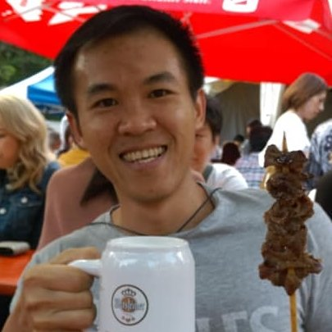
Hello!
We Data Scientists from FJP FWI AAA Team.
@thinhcd
@phucbd
@nguyentp2

Slide 3
Agenda
Introduction
About this project
Click-Through-Rate (CTR) Problem and Challenge
Machine Learning Approach
Overview
FTRL-Proximal Online Learning Algorithm (FTRL)
Field-Aware Factorization Machine (FFM)
Experiment setting and results
Conclusion

Slide 4
1.
Introduction

Slide 5
About this project
What is this?
Machine Learning Method to predict CTR
Performance on some Public Datasets.
Why this project?
A central place to checkout common Modeling method in CTR Prediction.
Support quick Prototype for similar problem in the future.
And…
We do not go deep dive into Mathematic.
We do not cover a how to develop a CTR system in Production.
We expect some Machine Learning knowledge from you.
Notes:
In this project, we study some modeling methods to predict Click Through Rate (CTR) in Online Marketing service. For each method, we will try to test its performance on some Public Datasets.
Our Goal:
A central place to checkout common modeling approach in CTR Prediction.
Quick Prototye for similar problem in future projects.
What this project does not:
Deep study of algorithms regarding Mathematics.
How to develop a full scale CTR system in production.
We assume you should have a basic understanding of Machine Learning (more specifically, Classification), how to train a model, and a basic understanding of CTR problem.

Slide 6
CTR Problem and Challenge
“Click-through rate is the ratio of users who click on a specific link to the number of total users who view a page…” – Wikipedia
CTR is often used to measure the Online Marketing Campaign effectiveness or measure how much user love content on a website.
Large company has spent a great deal of effort into researching for new method to improve the CTR. Because Only Market Industry is Billion Dolar Market.

Slide 7
CTR Problem and Challenge
How Machine Learning can help improve CTR?
Predict Click Probability
Choose Top N
Machine Learning will predict if user is likely to click on each Ads.
Now just simply pick top N Click % Ads to show to users.
Note: There are some more advanced ranking methods than simply sorting click %.
 | Click %
Ads A | 30%
Ads B | 80%
Ads C | 60%
Notes:
Click-Through-Rate Prediction (CTR) plays an important roles in an Online Marketing System. The problem is to predict the probability that a user clicks on a advertise shown in some specific circumstance (such as when you check feed on facebook or when your mom buys stuff on amazon). From the predicted result, the Online Marketing System can choose the advertise which have highest probability that user can click to show up

Slide 8
CTR Problem and Challenge
But using Machine Learning faces some big problems:
Data is HUGE and rapidly changes.
As about over 3 Billion Users on Social Media around the world. New contents (Ads, emails, news, etc.) are introduced every minutes.
ML Algorithm needs to be fast in Realtime prediction.
This is one of key requirement for a CTR method. In production system, algorithms need to make hundreds requests under a second.
Data has large Cardinality.
Most of data are Categorical features with large Cardinality which causes sparsed dataset (The Cursed of Dimensionality).
Evaluation CTR is hard.
Model could be super good in offline evaluation but totally disaster in online testing.
With previous challenging, ML algorithms must be able to train on large-sparsed dataset, has a small memory footrpint and quick inference time in Production system.

Slide 9
2.
Machine Learning Approach

Slide 10
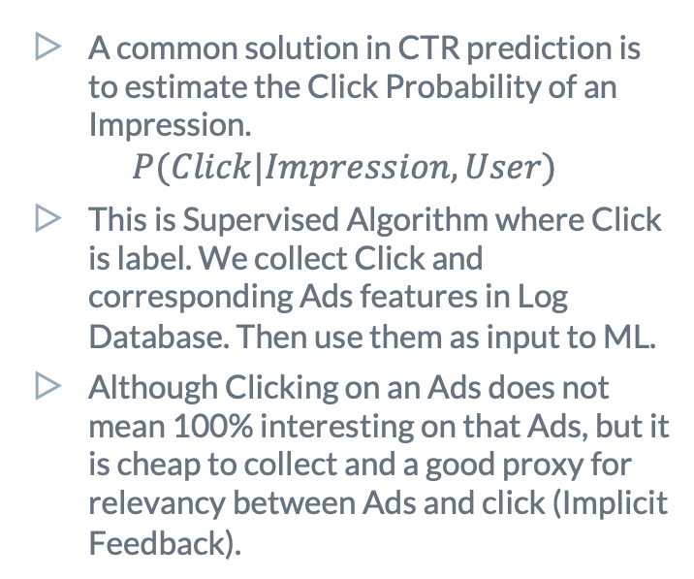
Overview
A common solution in CTR prediction is to estimate the Click Probability of an Impression.
$$P(Click|Impression, User)$$
This is Supervised Algorithm where Click is label. We collect Click and corresponding Ads features in Log Database. Then use them as input to ML.
Although Clicking on an Ads does not mean 100% interesting on that Ads, but it is cheap to collect and a good proxy for relevancy between Ads and click (Implicit Feedback).
Click
Save to log
No Click
Data extraction
Click & Features
Realtime
Prediction
Deploy to Production
Train CTR model
Notes:
At a given time when User access a website, CTR system needs to choose several Ads from thousands or millions Ads in matter of micro-seconds. These Ads should be the one that User is interested at that time. User then has some options to react like: totally unaware Ads, see them then ignore, or click on them. When User click on an Ads, they made an implicit feedback and these feedback will become valuable information to build up CTR model.

Slide 11
Overview
As stated in Challenging, we pick algorithms having some of these technical characteristics:
Candidate algorithms:
FTRL-Proximal Online Learning Algorithm (FTRL)
Field-Aware Factorization Machine (FFM)
Lets go over each algorithm in next slides.
Works on Large scale data.
Can deal with sparsed data.
Work with huge number of dimensions in feature.
Can capture interactions among features.
Online training (good to have).
Notes:
At a given time when User access a website, CTR system needs to choose several Ads from thousands or millions Ads in matter of micro-seconds. These Ads should be the one that User is interested at that time. User then has some options to react like: totally unaware Ads, see them then ignore, or click on them. When User click on an Ads, they made an implicit feedback and these feedback will become valuable information to build up CTR model.

Slide 12
Overview
To make illustration of how ML model works, lets assume we have a sample input like below.
Click | Device (d) | App (a) | Country (c)
1 = Click | iPhone 7 | web | VN
0 = No Click | iPhone X | web | JP
1 = Click | iPhone 7 | Weather | JP

Slide 13
FTRL-Proximal Online Learning Algorithm (FTRL)
Result from Google Research: Ad Click Prediction: a View from the Trenches
In an essence: Logistic Regression with L1 and L2 Regularization.
L1 is implemented more efficiently in term of memory. *
Online Training.
Training with adaptive learning rate may help quick converge.
Work really well with Hashing preprocessing.
Easy to customized like: Allow feature interaction.
* Normally, if we only subtract L1 gradient from Loss function, some of weights are closed to zero but never be zero. Model must keep these weights in their state anyway. Storing these almost-zero-weights makes model have a large memory footprint when running online .
Notes:
At a given time when User access a website, CTR system needs to choose several Ads from thousands or millions Ads in matter of micro-seconds. These Ads should be the one that User is interested at that time. User then has some options to react like: totally unaware Ads, see them then ignore, or click on them. When User click on an Ads, they made an implicit feedback and these feedback will become valuable information to build up CTR model.

Slide 14

FTRL-Proximal Online Learning Algorithm (FTRL)
Notes:
Why One-Hot-Encoding with Hash? Easy. Fast to compute.
3 features, hash to 1million buckets → Number of features after preprocessing is: 3million.
Data Stream
Pick 1 sample from stream
Update Weights by Gradient Descent.
Click | Device (d) | App (a) | Country (c)
1 = Click | iPhone 7 | web | VN
$$loss=−\{ylog\left(p\right)+\left(1−y\right)\log\left(1−p\right)\}$$
Hashing (but works for any kind of preprocessing).
Calculate Loss to tracking training
Make prediction w.r.t Weight w.
Click | Device (d) | App (a) | Country (c)
1 | 777 | 888 | 999
If sample is used in Training
If sample is used in Validation
Train or Validation sample?

Slide 15
Field-Aware Factorization Machine (FFM)
From Field-aware Factorization Machines for CTR Prediction research.
An Extended version of Factorization Machine (FM). *
Proven a strong performance on many CTR Prediction problems.
To understand FFM, we need to work from Degree 2 Polynomial Mapping (Poly2) and Factorization Machine (FM).
But first, lets take a look at training FFM in high level.
* Each feature has more than one Latent Vector to capture different interactions with other features.
Notes:
At a given time when User access a website, CTR system needs to choose several Ads from thousands or millions Ads in matter of micro-seconds. These Ads should be the one that User is interested at that time. User then has some options to react like: totally unaware Ads, see them then ignore, or click on them. When User click on an Ads, they made an implicit feedback and these feedback will become valuable information to build up CTR model.

Slide 16
Field-Aware Factorization Machine (FFM)
Notes:
We train FFM with Gradient Decent algorithm.
To prevent overfitting, we should monitor Validation score after each epoch and do early stopping.
Click | Device (d) | App (a) | Country (c)
1 = Click | iPhone 7 | web | VN
0 = No Click | iPhone X | web | JP
1 = Click | iPhone 7 | Weather | JP
Model weights
One-Hot-Encoding
Training & Eval model
Click | d_iphone7 | d_iphoneX | a_web | A_weather | c_vn | c_jp
1 | 1 | 0 | 1 | 0 | 1 | 0
0 | 0 | 1 | 1 | 0 | 0 | 1
0 | 1 | 0 | 0 | 1 | 0 | 1
Notes:
At a given time when User access a website, CTR system needs to choose several Ads from thousands or millions Ads in matter of micro-seconds. These Ads should be the one that User is interested at that time. User then has some options to react like: totally unaware Ads, see them then ignore, or click on them. When User click on an Ads, they made an implicit feedback and these feedback will become valuable information to build up CTR model.

Slide 17
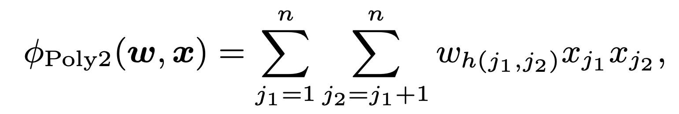
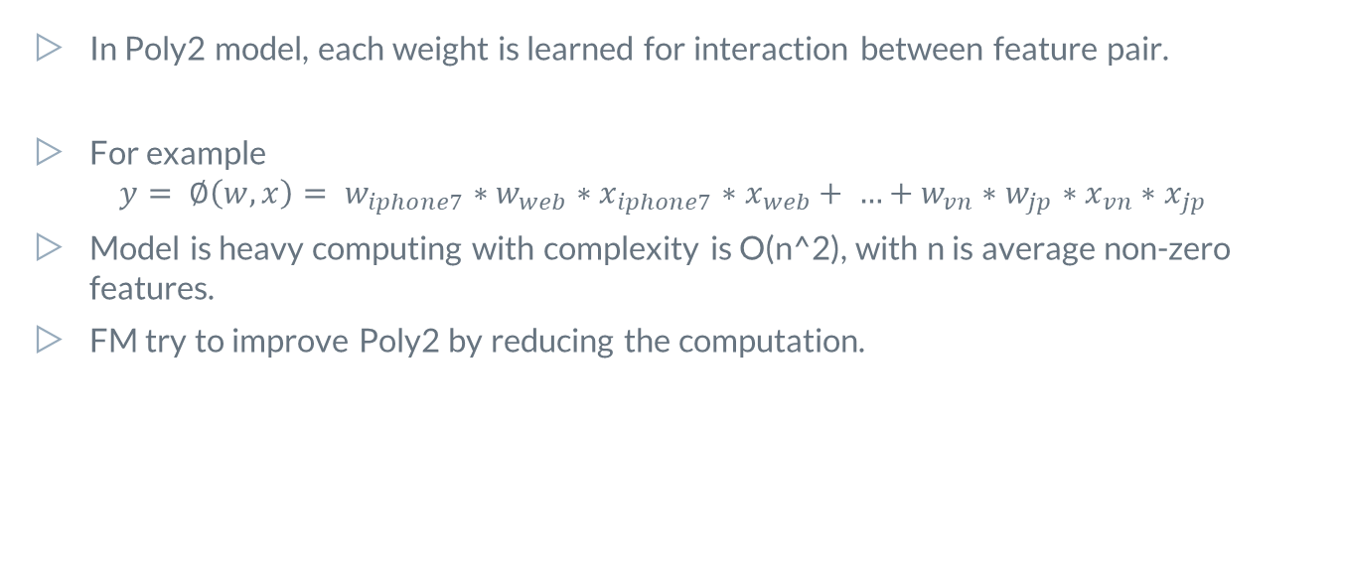
Poly2
In Poly2 model, each weight is learned for interaction between feature pair.
For example $y= ∅\left(w, x\right)= w_{iphone7}∗w_{web}∗x_{iphone7}∗x_{web}+ …+w_{vn}∗w_{jp}∗x_{vn}∗x_{jp}$
Model is heavy computing with complexity is O(n^2), with n is average non-zero features.
FM try to improve Poly2 by reducing the computation.
Notes:
At a given time when User access a website, CTR system needs to choose several Ads from thousands or millions Ads in matter of micro-seconds. These Ads should be the one that User is interested at that time. User then has some options to react like: totally unaware Ads, see them then ignore, or click on them. When User click on an Ads, they made an implicit feedback and these feedback will become valuable information to build up CTR model.

Slide 18
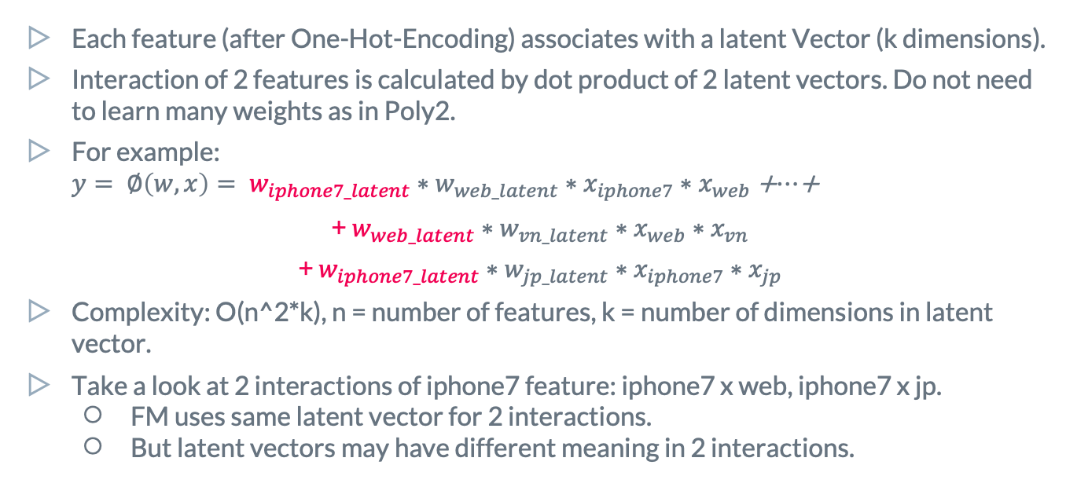
FM
Each feature (after One-Hot-Encoding) associates with a latent Vector (k dimensions).
Interaction of 2 features is calculated by dot product of 2 latent vectors. Do not need to learn many weights as in Poly2.
For example: $y= ∅\left(w, x\right)= w_{iphone7_latent}∗w_{web_latent}∗x_{iphone7}∗x_{web}$ +$…$+
+ $w_{web_latent}∗w_{vn_latent}∗x_{web}∗x_{vn}$
+ $w_{iphone7_latent}∗w_{jp_latent}∗x_{iphone7}∗x_{jp}$
Complexity: O(n^2*k), n = number of features, k = number of dimensions in latent vector.
Take a look at 2 interactions of iphone7 feature: iphone7 x web, iphone7 x jp.
FM uses same latent vector for 2 interactions.
But latent vectors may have different meaning in 2 interactions.
Notes:
At a given time when User access a website, CTR system needs to choose several Ads from thousands or millions Ads in matter of micro-seconds. These Ads should be the one that User is interested at that time. User then has some options to react like: totally unaware Ads, see them then ignore, or click on them. When User click on an Ads, they made an implicit feedback and these feedback will become valuable information to build up CTR model.

Slide 19
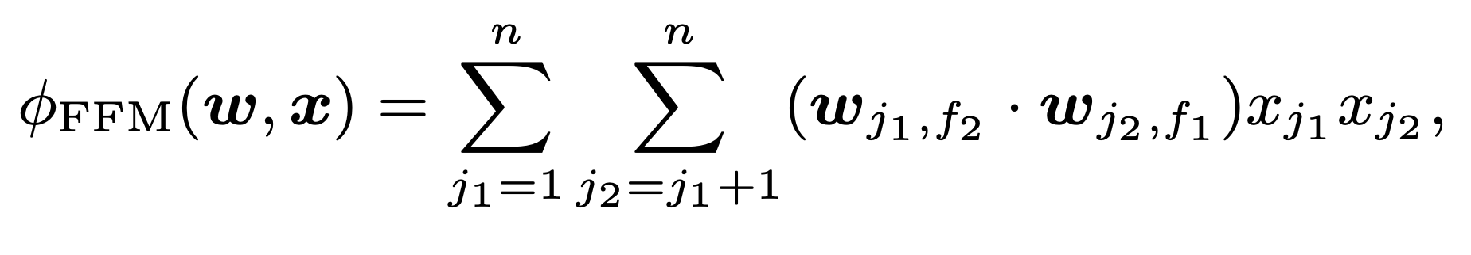
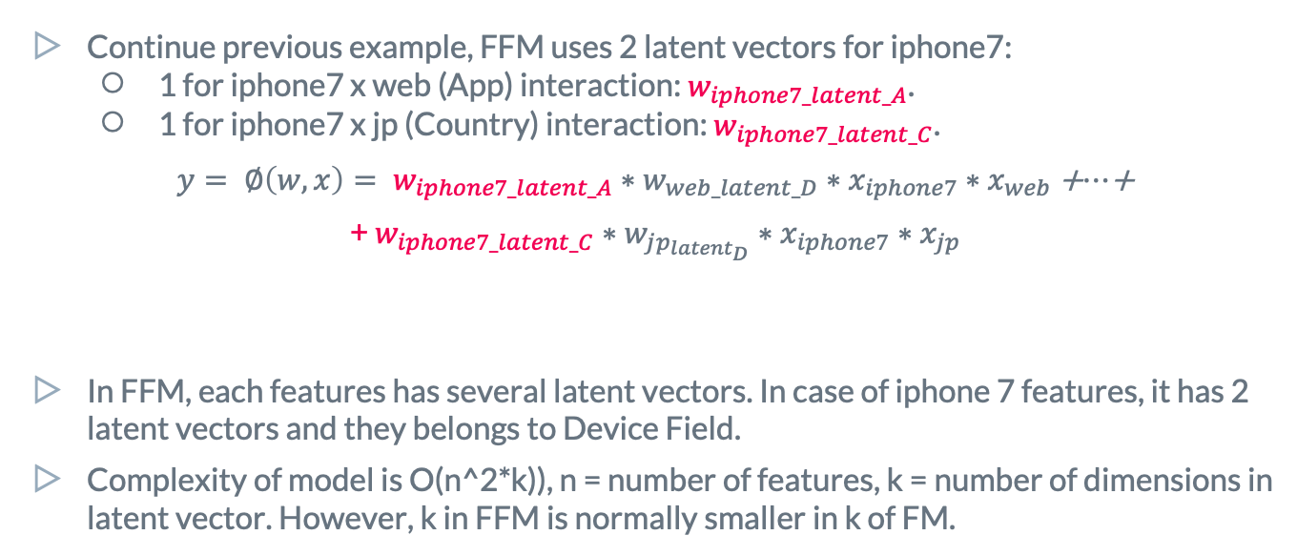
FFM
Continue previous example, FFM uses 2 latent vectors for iphone7:
1 for iphone7 x web (App) interaction: $w_{iphone7_latent_A}$.
1 for iphone7 x jp (Country) interaction: $w_{iphone7_latent_C}$.
$y= ∅\left(w, x\right)= w_{iphone7_latent_A}∗w_{web_latent_D}∗x_{iphone7}∗x_{web}$ +$…$+
+ $w_{iphone7_latent_C}∗w_{jp_{latent_{D}}}∗x_{iphone7}∗x_{jp}$
In FFM, each features has several latent vectors. In case of iphone 7 features, it has 2 latent vectors and they belongs to Device Field.
Complexity of model is O(n^2*k)), n = number of features, k = number of dimensions in latent vector. However, k in FFM is normally smaller in k of FM.
Notes:
At a given time when User access a website, CTR system needs to choose several Ads from thousands or millions Ads in matter of micro-seconds. These Ads should be the one that User is interested at that time. User then has some options to react like: totally unaware Ads, see them then ignore, or click on them. When User click on an Ads, they made an implicit feedback and these feedback will become valuable information to build up CTR model.

Slide 20
3.
Experiment Setting & Results

Slide 21
Datasets
We use Datasets from Kaggle©* to test performance of previous Algorithms.
Why from Kaggle?
A good way to check performance of an algorithm against thousand practitioners.
Realworld datasets and easy to collect.
In next slide, we will give a quick summary of each dataset.
*Kaggle is a Data Science Competition platform.
Notes:
At a given time when User access a website, CTR system needs to choose several Ads from thousands or millions Ads in matter of micro-seconds. These Ads should be the one that User is interested at that time. User then has some options to react like: totally unaware Ads, see them then ignore, or click on them. When User click on an Ads, they made an implicit feedback and these feedback will become valuable information to build up CTR model.

Slide 22
Dataset – Avazu CTR
From Click Through Rate Prediction: “Predict whether a mobile ad will be clicked.” (~1600 competitors)
10 days data in Training, 1 day data for Testing. 1 day worth of data is ~4GB.
All Features values are categories and masked. Some features are anonymous.
CTR in Training data is ~16%.
id | 10000174058809263569 | 19 digits number
click | 0 | 1=click / 0=No-click
hour | 14102100 | YYMMDDHH format
banner_pos | 0 | Int, 0~7
Site_id | 1fbe01fe | Hashing value with 8 characters
App_id | ecad2386 | Hashing value with 8 characters
Device_id | a99f214a | Hashing value with 8 characters
C1, C12, … | 1005 | Several Anonymous columns, values encoded by int.
*(many more columns)
Notes:
At a given time when User access a website, CTR system needs to choose several Ads from thousands or millions Ads in matter of micro-seconds. These Ads should be the one that User is interested at that time. User then has some options to react like: totally unaware Ads, see them then ignore, or click on them. When User click on an Ads, they made an implicit feedback and these feedback will become valuable information to build up CTR model.

Slide 23
Dataset – Avazu CTR
For each Algorithm, we processed input data as below:
FTLR
Extract Hour value.
Hashing each feature into 2^24 buckets.
FFM
Extract Hour value.
Extract IP/Device Count: Number of time a Device ID occurrences, etc.
Extract History click string: “1-0-1-0-0” for each IP and Device pair.
Hash each feature into 1e6 buckets (1million).

Slide 24
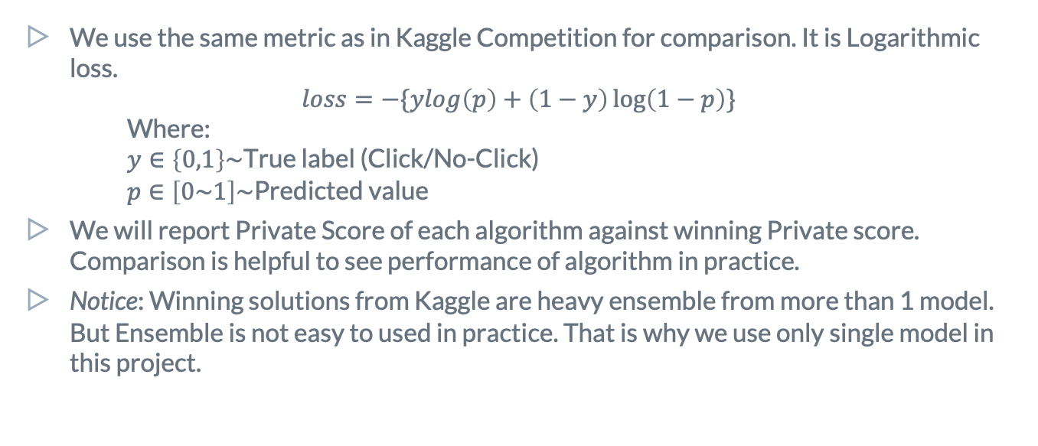
Metrics
We use the same metric as in Kaggle Competition for comparison. It is Logarithmic loss.
$$loss=−\{ylog\left(p\right)+\left(1−y\right)\log\left(1−p\right)\}$$
Where:
$y∈\left\{0,1\right\}\sim$True label (Click/No-Click)
$p∈\left[0\sim 1\right]\sim$Predicted value
We will report Private Score of each algorithm against winning Private score. Comparison is helpful to see performance of algorithm in practice.
Notice: Winning solutions from Kaggle are heavy ensemble from more than 1 model. But Ensemble is not easy to used in practice. That is why we use only single model in this project.
Notes:
At a given time when User access a website, CTR system needs to choose several Ads from thousands or millions Ads in matter of micro-seconds. These Ads should be the one that User is interested at that time. User then has some options to react like: totally unaware Ads, see them then ignore, or click on them. When User click on an Ads, they made an implicit feedback and these feedback will become valuable information to build up CTR model.

Slide 25
Hardware
We use AWS EC2 to train our model. There are 2 instances type used to train model:
GPU instance: G4dn.xlarge, 4CPU, 16GB RAM, 16GB GPU Memory.
CPU instance: C5.2xlarge, 8CPU, 16GB RAM.
For FTRL-Proximal and FFM, we use CPU instance.
Notes:
At a given time when User access a website, CTR system needs to choose several Ads from thousands or millions Ads in matter of micro-seconds. These Ads should be the one that User is interested at that time. User then has some options to react like: totally unaware Ads, see them then ignore, or click on them. When User click on an Ads, they made an implicit feedback and these feedback will become valuable information to build up CTR model.

Slide 26
Results
 | Avazu CTR |  | Dataset 2
 | Our score | 1st Winning Score | Our score | 1st Winning Score
FTLR | 0.396 Top 900th | 0.379 | ### | ###
FFM | 0.384 Top 11th | 0.379 | ### | ###
Notes:
At a given time when User access a website, CTR system needs to choose several Ads from thousands or millions Ads in matter of micro-seconds. These Ads should be the one that User is interested at that time. User then has some options to react like: totally unaware Ads, see them then ignore, or click on them. When User click on an Ads, they made an implicit feedback and these feedback will become valuable information to build up CTR model.

Slide 27
4.
Conclusion

Slide 28
Here are our thoughts on each algorithm
FTLR
Pros
Easy + Quick to implement and deploy.
Online Training.
Cons
Lower performance compare to FFM.
Do not capture Latent features.
FFM
Pros
Strong performance!
Capture Latent features.
Cons
Hard to deploy.
No online Training.
Hard to train: deal with overfitting, long time training.

Slide 29
Thanks!
Any questions?
You can find me at:
@nguyentp2 @phucbd @thinhcd

Slide 30
References
Y.-W. Chang, C.-J. Hsieh, K.-W. Chang, M. Ringgaard, and C.-J. Lin, “Training and testing low-degree polynomial data mappings via linear SVM,” Journal of Machine Learning Research, vol. 11, pp. 1471–1490, 2010
S. Rendle, “Factorization machines,” in Proceedings of IEEE International Conference on Data Mining (ICDM), pp. 995–1000, 2010
Juan, Yuchin & Zhuang, Yong & Chin, Wei-Sheng & Lin, Chih-Jen. (2016). Field-aware Factorization Machines for CTR Prediction. 43-50. 10.1145/2959100.2959134.

Slide 31
Appendix 1 – More details on FFM

Slide 32
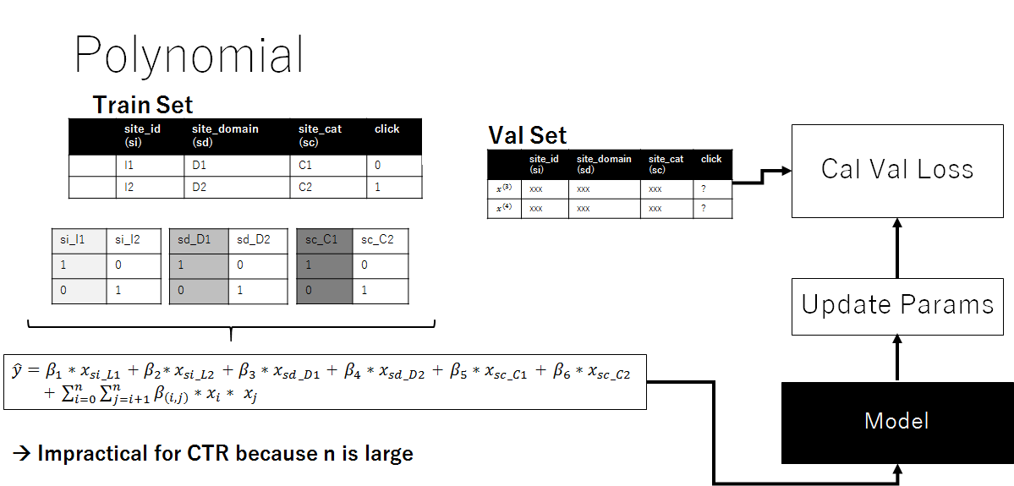
Poly2 Mapping
Models based on degree-2 polynomial mappings are widely used for CTR
Polynomial models are not suitable when number of features are very large

Slide 33
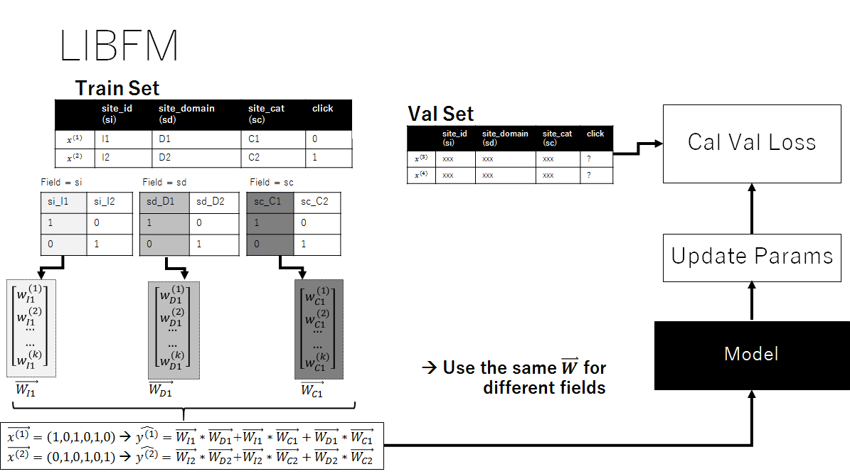
Factorization Machine
Factorization machines (FM) models all interactions between variables using factorized parameters.
FM is able to estimate interactions even in problems with huge sparsity.

Slide 34
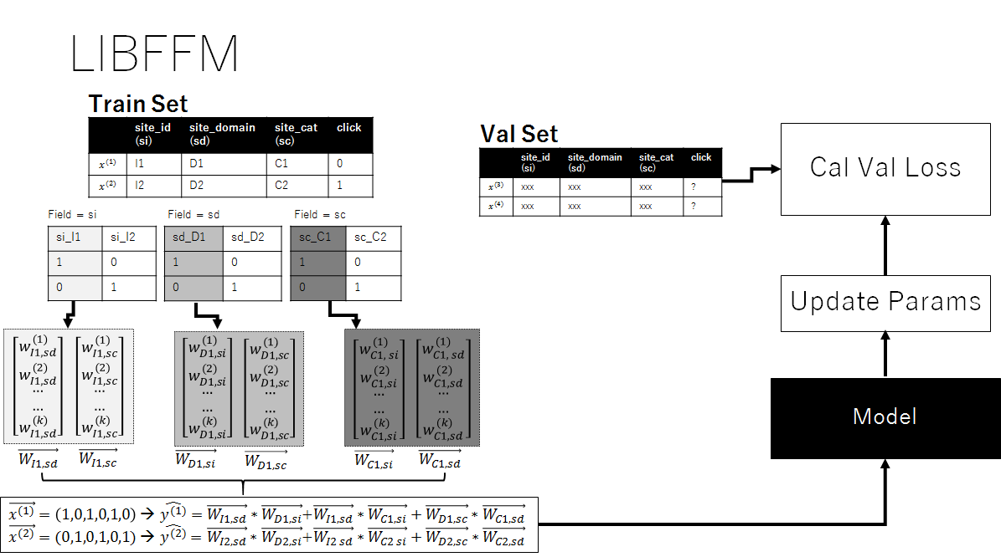
Field-Factorization Machine
FFM is an extended version of FM
FFM models interactions between variables of different “fields” using different factorized parameters
FFM outperforms existing models in some Kaggle competitions.

Slide 35
Credits
Special thanks to all the people who made and released these awesome resources for free:
Presentation template by SlidesCarnival
Photographs by Unsplash

