Slide 1


Data Governance @ SneakerPark
Prepared by:
Submitted on:

Slide 2

How to use this Template
Theses slides are provided as a guide to ensure that you submit all the required components to successfully complete your project. For detailed instruction, please read the instruction in the classroom.
When presenting your project, please only think of this as a guide. We encouraged you to use creative freedom when making changes as long as the required information is present.
Remember to delete this and all of the other example slides before you submit your project.
Remember to add your name and the date to the cover slide
Remove this slide

Slide 3
What you are required to submit:
What we provide:
This Starter Slides Template
Sheets Template with 4 Tabs - Data Dictionary, Data Quality Issues, Standard Naming Convention, and Business Glossary
Workspace with an instance of Postgres and code that will create and populate the database you will be working with.
Grading rubric you can use to ensure you have submitted everything that is required.
Filled out Slides template.
Filled out Sheets template.
Remove this slide

Slide 4
Background
SneakerPark is an online shoe reseller that allows people to buy and sell used and new shoes. Buyers can bid for shoes or buy them outright, and sellers can set a price or sell to the highest bidder.
Each buyer and seller must have an active account in order to sell, bid, or purchase sneakers using SneakerPark’s website.
SneakerPark authenticates the shoes before shipping them to the buyer, so before listing an item, the seller must ship it to SneakerPark’s warehouse. Upon receipt, SneakerPark assigns an item number to each pair of sneakers and notifies the seller that they are now free to list their item. If the item is not listed within 45 days, SneakerPark returns it to the seller and sends an invoice to the seller for the shipping cost.
If the item is found to be inauthentic or in an unacceptable condition, it is also returned back to the seller in a similar fashion.
When the item sells, the buyer’s account is credited with the purchase price minus the SneakerPark service fee and shipping fees to deliver the item to the buyer.
Currently, SneakerPark only supports sales within the United States.

Slide 5
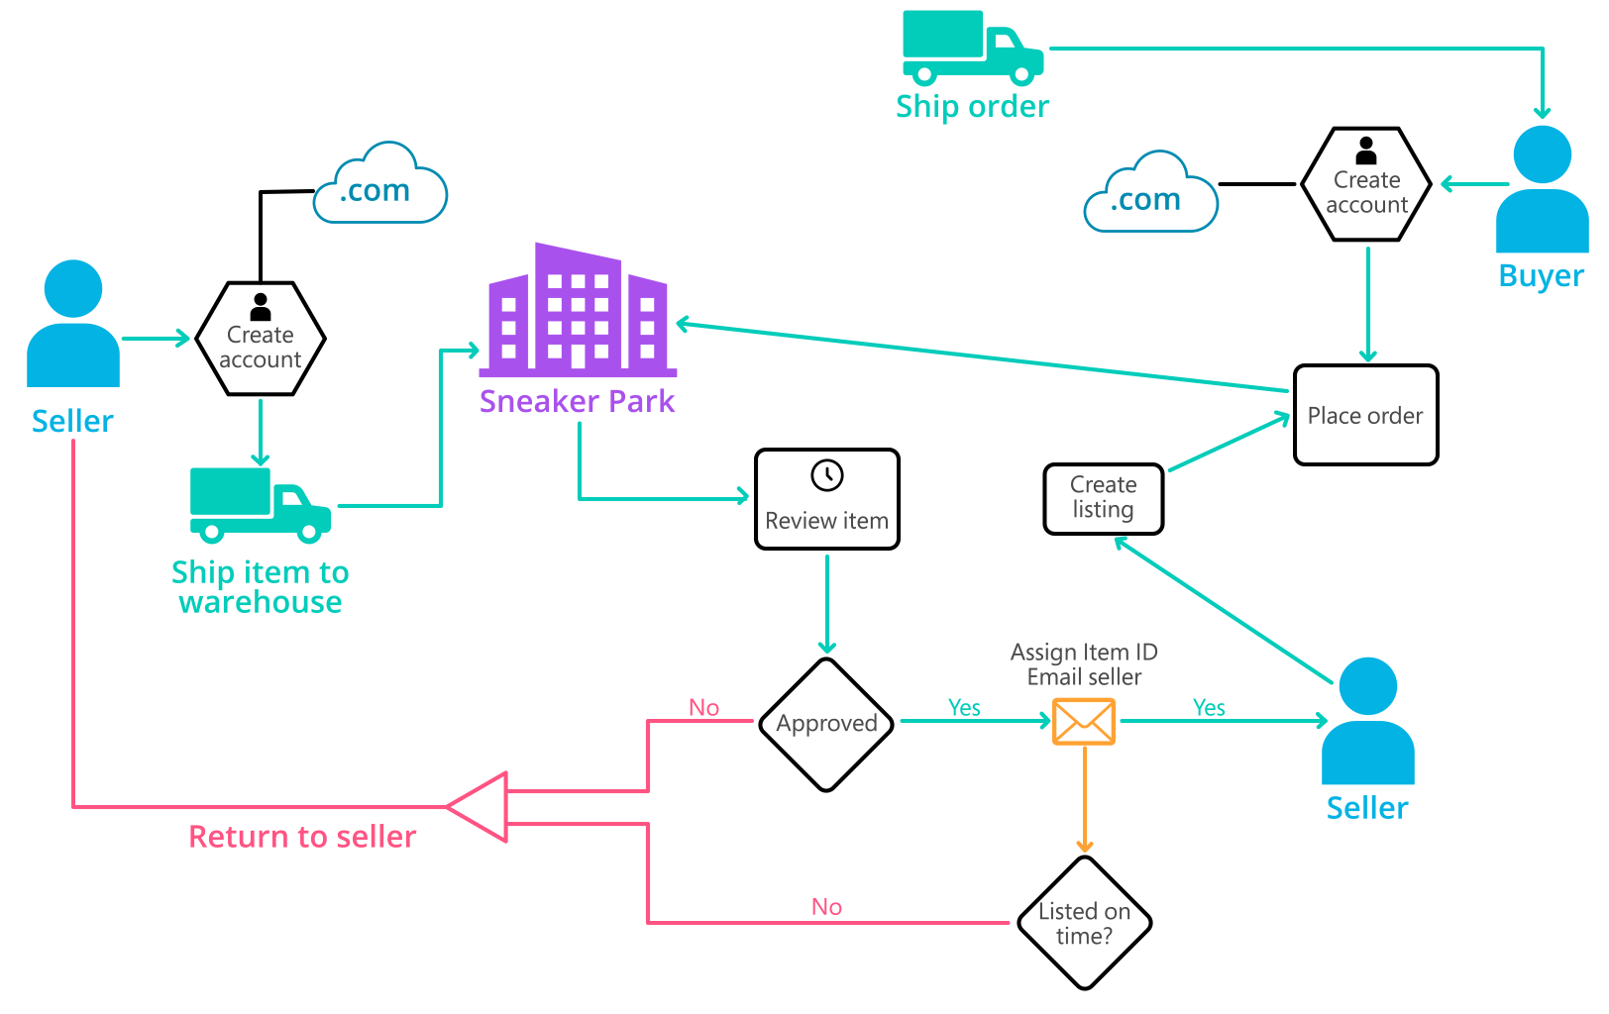
Background (cont’d)
Below you can see a diagram that will hopefully help you visualize some of SneakerPark's business processes. Keep in mind that it does not capture ALL processes and every nuance, but simply serves as another artifact to use in your project.

Slide 6
Step 1
Enterprise Data Catalog Part 1: Enterprise Data Model

Slide 7
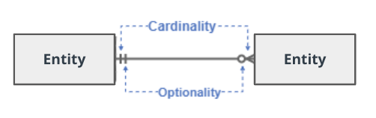
Create a conceptual data model that will provide SneakerPark with a holistic view of its data systems and help you grasp the organization's important entities and relationships, which will be instrumental as you move further in the project. You can use Lucidchart or any other diagramming tool of your choice, but please use the Crow’s Foot/IE Notation and please be sure to indicate both cardinality (the type of a relationship such as 1:N or N:N) and optionality (whether the relationship is optional or mandatory).

Slide 8
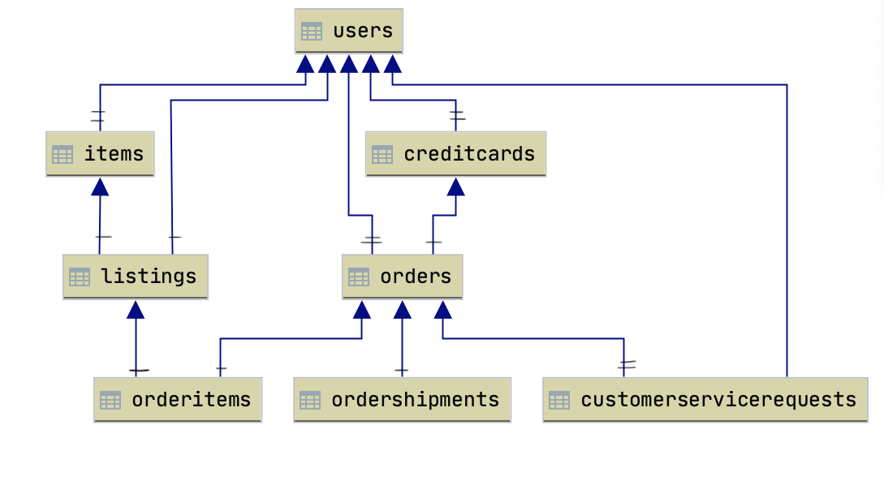

Slide 9
Step 2
Enterprise Data Catalog Part 2: Metadata

Slide 10
Create the first version of the Metadata Catalog by documenting the metadata from all systems in the "Data Dictionary" and the “Enterprise Data Catalog” tabs of the provided Sheets template.

Slide 11
Step 3
Data Quality
Part 1: Profiling and Cleansing

Slide 12
Profile the data to identify at least 3 data quality issues you see in the data. Also provide at least 1 data quality issue that you haven’t yet seen in the data, but can foresee occurring in the future. Based on the issues you’ve identified, come up with the data quality rule for each data quality issue, including for the one that you foresee.

Slide 13
Step 4
Data Quality
Part 2: Monitoring

Slide 14
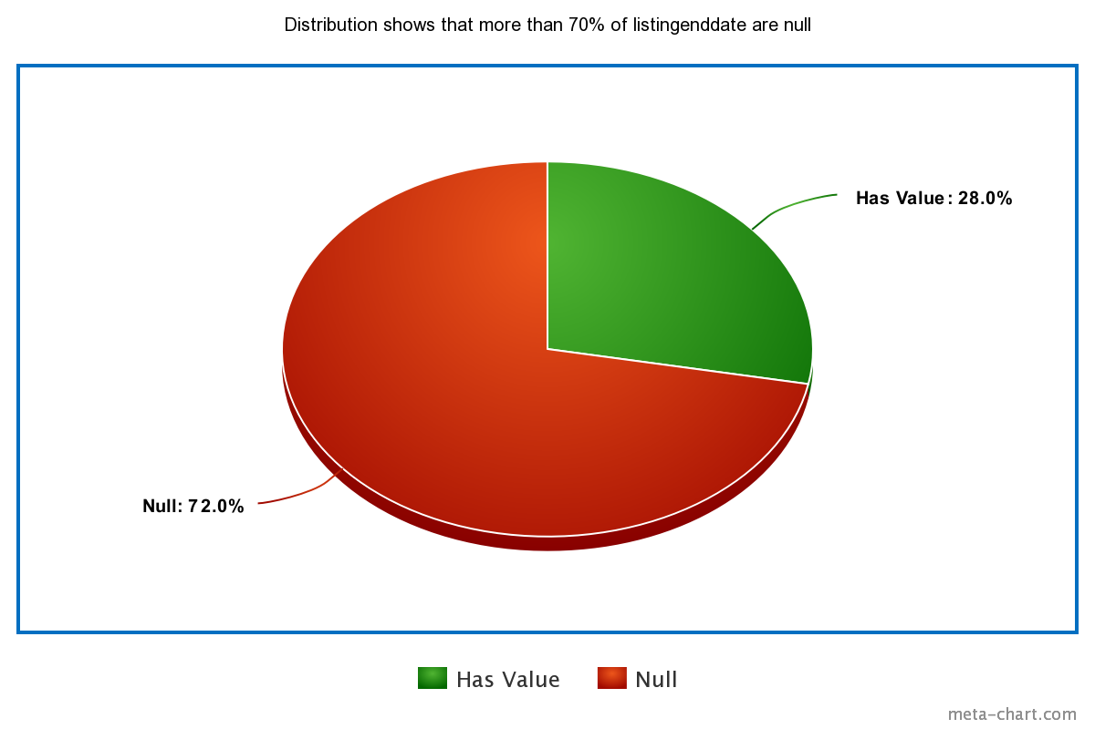
Using the metrics you've created in the last step, please create a mock-up of a data quality monitoring dashboard that will be used to monitor the data to ensure compliance with your data quality rules.
Please make sure to label your metrics clearly on your mock-up.

Slide 15
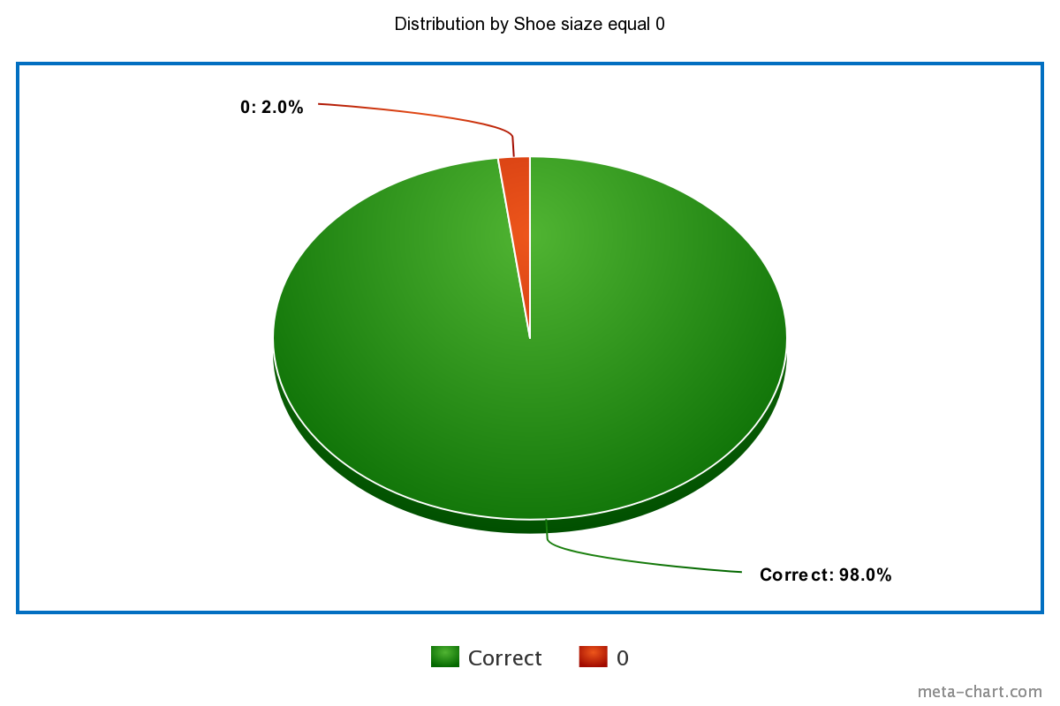
More metrics

Slide 16
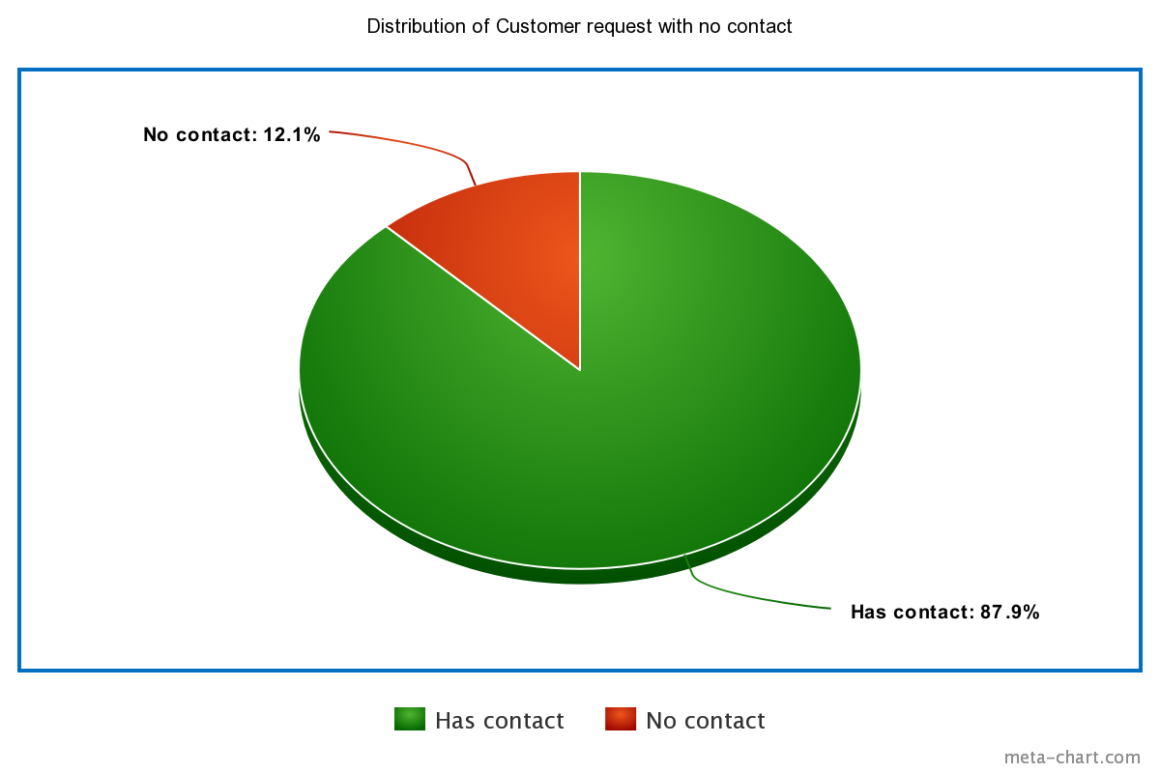
More metrics

Slide 17
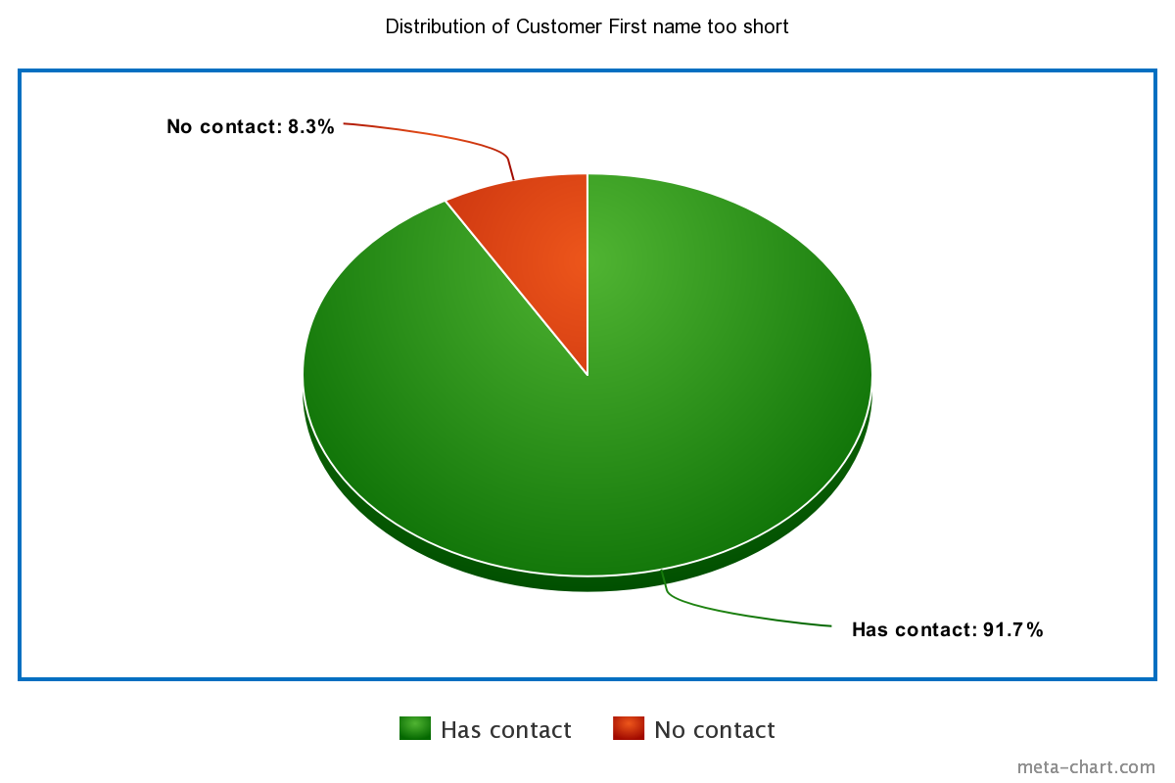
More metrics

Slide 18
Step 5
Master Data Management
Part 1: MDM Architecture

Slide 19
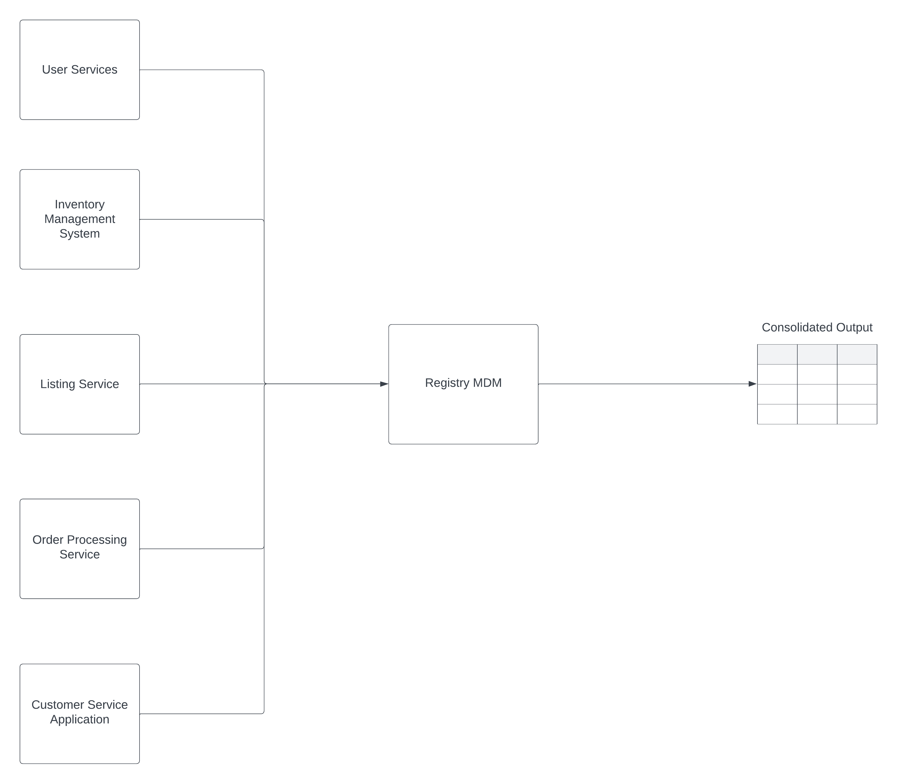
Based on what you’ve read about SneakerPark’s systems and business model, sketch out a proposed MDM implementation architecture, and write a detailed explanation of why you chose this specific approach.

Slide 20
Explanation:
Master Data Management (MDM) is a critical aspect of managing data across different systems within an organization. It involves establishing and maintaining a consistent, accurate, and complete view of key data entities across the enterprise. In the context of SneakerPark and its systems, here's how MDM principles can be applied:
1. User Service:
- Ensure that user data (e.g., user IDs, email addresses, contact information) is consistent and up-to-date across all systems.
- Implement data quality checks and validation rules during user registration and updates.
- Establish a single source of truth for user data to prevent duplicates and inconsistencies.
- Integrate user profiles with other systems to maintain a unified view of customers.
2. Inventory Management System:
- Maintain a centralized repository for inventory data, including product descriptions, SKU codes, sizes, and quantities.
- Implement data governance policies to ensure accurate and consistent inventory information.
- Ensure synchronization of inventory data with other systems to avoid discrepancies.
- Track the lifecycle of inventory items, including additions, removals, and updates.
3. Listing Service:
- Standardize product listing data, including item descriptions, pricing, and images.
- Establish data quality controls to verify that listings meet quality and policy standards.
- Link product listings to inventory items to maintain real-time availability information.
- Enforce consistency in how product information is presented to buyers.
4. Order Processing Service:
- Maintain a centralized repository for order data, including order details, customer information, and payment records.
- Ensure that orders are linked to accurate customer profiles and inventory items.
- Implement data validation to prevent erroneous or incomplete orders.
- Enable cross-system integration to provide real-time order status updates.
5. Customer Service Application:
- Centralize customer support ticket data, including issue descriptions, timestamps, and customer details.
- Implement data quality checks to ensure that support tickets are accurately recorded.
- Link support tickets to customer profiles for context and efficient issue resolution.
- Facilitate collaboration among customer service agents by providing a unified view of support ticket data.

Slide 21
Step 6
Master Data Management
Part 2: Master Record

Slide 22
In this step, you will define a set of matching rules that will be used by the SneakerPark's MDM Hub to match item and customer entities between the company's different systems.
Item | Rule
Items | All items listed in Listing tables have to be recoreded in Items table.
Items | All SellerID in Items table must be recorded in Users table.
Customers | All UserID in CustomerServiceRequests table must be recorded in Users table.
Customers | All BuyerID in Orders table must be recorded in Users table.

Slide 23
Step 7
Data Governance:
Roles and Responsibilities

Slide 24
Write 1-2 paragraphs discussing what data governance roles and responsibilities will be necessary to oversee this new Data Management initiative. Please be sure to discuss the responsibilities in the context of at least 3 different aspects of Data Governance (such as Data Quality Management, Metadata Management, MDM, etc). Based on what you know, do SneakerPark's current employees have the necessary skills for these roles or should the company make new hires?
To oversee the new Data Management initiative at SneakerPark, several data governance roles and responsibilities will be necessary, encompassing various aspects of Data Governance:
1. Data Quality Management:
- Responsibilities: Ensuring data accuracy, consistency, and reliability across systems, implementing data quality standards and validation rules, monitoring data quality metrics, and addressing data quality issues.
- Role: Data Quality Manager.
- Skills: Strong data analysis, data profiling, and problem-solving skills. Knowledge of data quality tools and methodologies. The ability to collaborate with data owners and stakeholders to improve data quality.
- SneakerPark's Workforce: Existing employees may require training and upskilling in data quality management. Consider hiring data quality specialists if the skill gap is significant.
2. Metadata Management:
- Responsibilities: Defining and maintaining metadata standards, documenting data lineage, managing metadata repositories, and ensuring data cataloging for easy data discovery.
- Role: Metadata Manager or Data Steward.
- Skills: Knowledge of metadata management tools, data modeling, and data architecture. Strong communication skills to work with various teams in documenting and maintaining metadata.
- SneakerPark's Workforce: Existing IT or data management teams may have some relevant skills, but specific metadata expertise may be required. Training can be provided to enhance existing skills.
3. Data Engineer - Master Data Management (MDM):
- Responsibilities: Defining MDM strategies and policies, overseeing master data entities (e.g., customer profiles, inventory items), ensuring data consistency across systems, and maintaining a single source of truth.
- Role: MDM Manager or Data Governance Lead.
- Skills: Expertise in MDM principles and tools, understanding of data integration, data modeling, and data governance best practices. Strong leadership and project management skills.
- SneakerPark's Workforce: Depending on the complexity of MDM requirements, hiring a dedicated MDM manager may be necessary if in-house expertise is insufficient.
While SneakerPark may have employees with some relevant skills, it's crucial to assess the current workforce's capabilities against the specific demands of these roles and responsibilities. Investing in training and upskilling existing employees can be cost-effective if the skills gap is not extensive. However, for specialized roles like MDM, hiring external experts may be necessary to ensure the success of the Data Management initiative and the long-term integrity of the company's data assets.

Slide 25
Standout Suggestions

Slide 26
Create a Business Glossary for SneakerPark and define common terms such as Item, Buyer, etc. Think and discuss how SneakerPark can improve on the consistency of the terms that its systems currently use. (You can use the “Business Glossary” tab of the same Sheets template you’ve been using for the other parts of this project to get you started.)
Document SneakerPark’s current naming conventions. Can you think of any improvements? (You can use the “Standard Naming Conventions” tab of the same Sheets template you’ve been using for the other parts of this project to get you started.) Some examples of Naming Conventions include;
Do not use spaces or special characters.
Use only LOWERCASE.
All identifier fields should end in “_id”.
Avoid acronyms and abbreviations.
Write SQL scripts for the matching rules that you’ve created in Step 6.

