Slide 1
A Method of Hand Gesture Recognition Using Kinect Sensor
HVTH: Nguyen Trong Tri -12140051
GVHD: TS. Truong Quang Vinh

Slide 2
Outline
Introduction
The Proposed Method
Constraints
Experimental Results

Slide 3
Introduction

Slide 4
Introduction
In human-computer interaction (HCI) system, recognizing hand and finger gestures are significant.
Computer games
Remote control
Depth-sensing camera (Kinect, Xtion) add a dimension to increase accuracy.

Slide 5
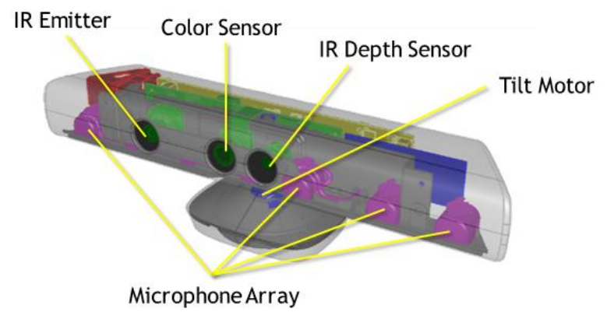
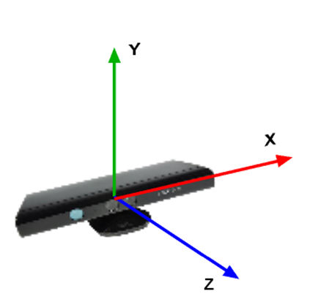
Introduction
Kinect sensor

Slide 6
INtroduction
Application

Slide 7
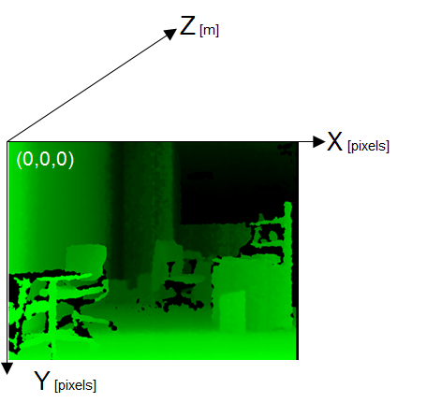
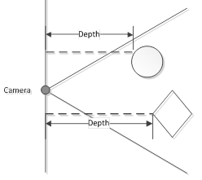
Introduction
Kinect sensor-Depth information

Slide 8
Related Works

Slide 9
Related Works
Hand gesture recognition using color information
Depend on environment (can’t recognition in low light condition or tool (color gloves, color belt)
Difficult to distinguish between face and hand
Complex training with large database

Slide 10
Objectives
Existed problems
objectives

Slide 11
Approach
methods

Slide 12
Research content
Study Kinect camera
Study OpenNI/Nite2, OpenCV
Reasearch previous ogthorigim
Do experiment with Kinect system
Propose agthogiims
Implement and verify the

Slide 13
Scope and constraints
Scope
Recognize 10 hand gestures
Implement proposed algorithm on computer
Use library OpenCV, OpenNI2/Nite2
Constraints
Indoor environment
Hand detection Range is between 0.6m and 1m
Hand direction angle [-45º; 45º]
Hand is right hand or invert left hand

Slide 14
Premier results

Slide 15
The Proposed Method

Slide 16
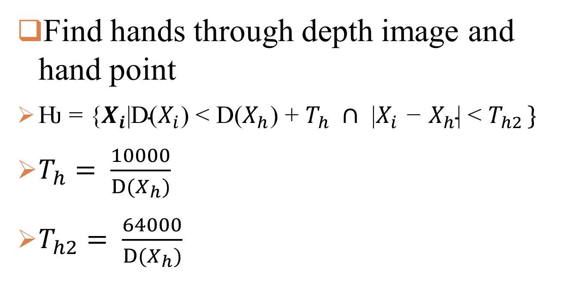
Hand Segmentation
Find hands through depth image and hand point
$\text{Ƕ = \{}X_{i}\text{|}\text{D}\text{(}X_{i}\text{) < }\text{D}\text{(}X_{h}\text{) + }T_{h} ∩ \text{|}X_{i} \text{−} X_{h}\text{|} \text{<} T_{h2 }\}$
$T_{h}= \frac{10000}{D(X_{h})}$
$T_{h2}= \frac{64000}{D(X_{h})}$

Slide 17
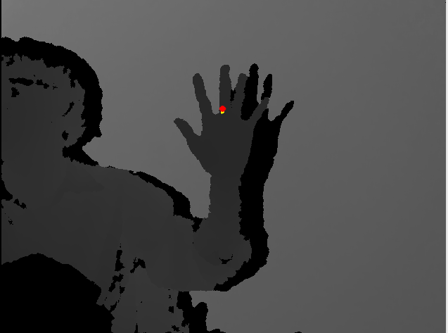

Hand Segmentation
Depth Image with hand point
Hand region

Slide 18

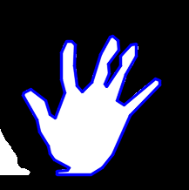
Find Hand Contour
Find hand contour with maximum area
cvFindContour()
Hand contour based on the greatest area

Slide 19
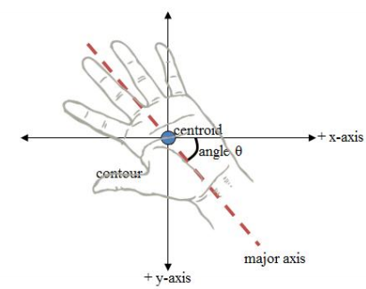
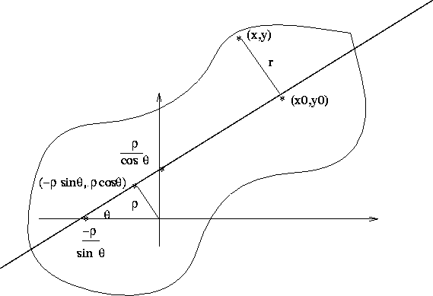
Orientation relative to the horizontal (1)

Slide 20







Orientation relative to the horizontal (2)
Moment of order (p + q) is defined as
Adapting this to scalar (greyscale/binary) image with pixel intensities I(x,y), raw image moments M_{ij} are calculated by
The area is given by the 0th moment of the object:
The center of mass, denoted by is given by the 1st moments of the object:
θ is the angle of its major axis to the horizontal is calculated:

Slide 21


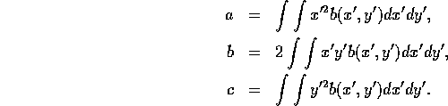

Orientation relative to the horizontal (3)
Generally we use the axis of minimum moment of inertia of the object to identify the orientation. This is the axis of least 2nd moment.
We want to find the line for which the integral is a minimum, where r is the perpendicular distance from (x,y) to the line we want to find
The solution for the equation of this line is made more convenient if we parametrise the line using ⁽¹⁾
We now have to find the value of that minimizes I. To do this, we change coordinates so that we are now working with respect to the centre of mass:
We proved that
Notes:
(1) Will be proved in the next slide (hidden state)

Slide 22



We differentiate with respect to and set the resulting expression to 0, giving
Multiplying and dividing by gives

Slide 23


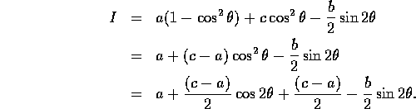




,
We differentiate this expression with respect to and set the result to 0, obtaining
In the case that b=0 and a=c we see that I is unaffected by the direction of axis of orientation, that is, our object is rotationally symmetric.
The ratio gives us some idea of how rounded the object is.
This ratio will be 0 for a line and 1 for a circle.

Slide 24
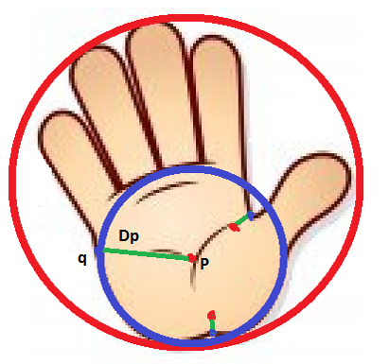
Find Palm Center
Inscribed circle
Minimum inner distance
Maximum element of inner distances set

Slide 25
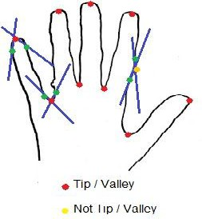

Finger detection
Detect fingertips
K-curvature method, K=20
Find an isosceles triangle with V
V: Every vertex on the hand contour
Set a maximum threshold to the vertex angle
V = 60º
Remove redundant points having distance to hand center is less than 1.5*R
$$K=\frac{10000}{\left.D(X_{h}\right)}$$
Notes:
K=
V=

Slide 26
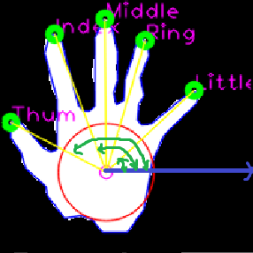
Finger name identification
Name of finger is labeled based on the angle range between the horizontal and the line from hand center to each fingertip.
Finger name | Thumb | Index | Middle | Ring | Little
Max Angle | 200 | 135 | 103 | 90 | 64
Min Angle | 136 | 104 | 91 | 65 | 0

Slide 27
Gesture Representation
All information about hands
Palm center location
Finger number
Fingertips location
Name of fingers
Gestures
Number from 0 to 10

Slide 28
Experimental Results

Slide 29
Experimental Results
Fingertips are detected exactly 100%.
The finger names detection successful rate can reach near 90% with the opening hand.
Confuse gestures when the number of fingers is three.

Slide 30
Conclusion

Slide 31
Conclusion
Present a simple method to detect hands’ positions and gestures
NO training, NO database
Future works
Improve detecting the orientation of the hand to obtain better result
Using training process from feature vector F = {number of fingers, angle between range between horizontal and the line from hand center to each fingertip.}

