Slide 1
Hand gesture recognition using Kinect sensor
Master Thesis
Supervisor : Dr. Truong Quang Vinh
Presented by: Nguyen Trong Tri

Slide 2
Agenda
Introduction
Related Work
Proposed Method
Experimental Results
Conclusion
Future Research

Slide 3
Introduction

Slide 4
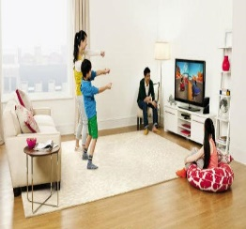
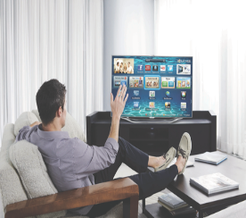
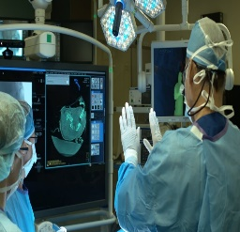
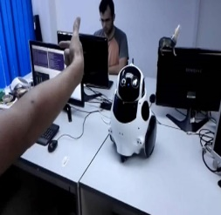
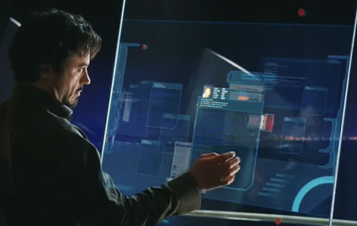
Introduction
In human-computer interaction (HCI) system, recognizing hand gestures are
more and more significant.
an intriguing problem with many applications.

Slide 5
Introduction
A lot of researches on hand gesture recognition from color image but they remain a challenging task due to the complex geometry of hand and difficulties in distinguishing hand from object with same color.
Depth-sensing camera (Kinect, Xtion) add a dimension, provide depth data to improve the accuracy of gesture recognition.

Slide 6
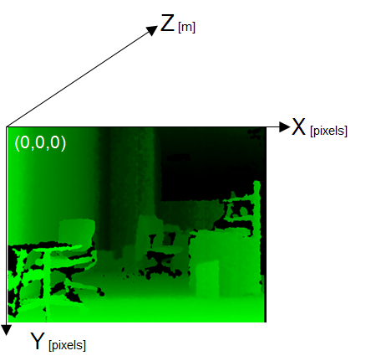
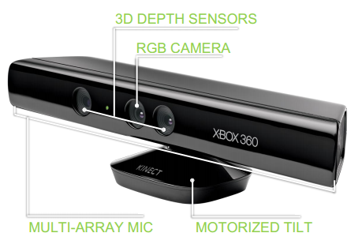
Introduction
Kinect camera

Slide 7
Related Work

Slide 8
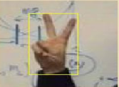
Related Work
RGB image based approaches
[1] Parul Chaudhary, Hardeep Singh Ryait, "Neural Network Based Static Sign Gesture Recognition System," International Journal of Innovative Research in Computer and Communication Engineering, February 2014.
Hand extraction: Using L*a*b color space
Hand feature extraction:
Feature vector =[area, x-centroid, y-centroid, centroid-distance, Average height]
Hand gesture classification: using Neural Network
Result: Depend on number of classification gestures

Slide 9
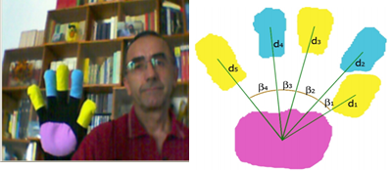
Related Work
RGB image based approaches
[2] Luigi Lamberti, Francesco Camastra, “Real-Time Hand Gesture Recognition Using a Color Glove”, Springer Proceedings of the 16th international conference on Image analysis and processing, Part I ICIAP, (2011).
Hand extraction: Using HSV color space
Hand feature extraction: Nine numerical features formed
by distances from palm to all fingers and four angles between
Hand gesture classification: Learning Vector Quantization
Result: 97.79 % with 13 gestures
Notes:
[1

Slide 10
Related Work
Depth image based approaches
[4] Yi Li, “Hand gesture recognition using Kinect”, Software Engineering and Service Science (ICSESS), IEEE 3rd International Conference on, 2012.
Hand extraction: Using K-means Algorithm with Z-range = [60cm, 80cm]
Hand feature extraction: Number of fingers, finger name, angles between extended fingers and hand center
Hand gesture classification: No training. User needs to open the hand before performing a gesture. Three classifier layers: finger counting, finger name collecting, and vector matching.
[5] Yan Wen, et. al, "A Robust Method of Detecting Hand Gestures Using Depth Sensors," Haptic Audio Visual Environments and Games (HAVE), IEEE International Workshop on, 2012.
Hand Extraction: Use K-means Algorithm with Z-range = Min Depth +-10 cm
Hand Features: Number of fingers, palm center, fingertips.

Slide 11
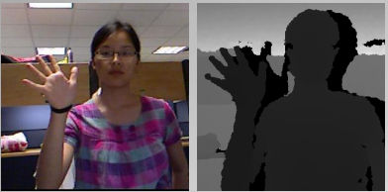
Related Work
RGB image based approaches
[8] Fabio Domini, et al., "Hand Gesture Recognition with Depth Data," ARTEMIS '13 Proceedings of the 4th ACM/IEEE international workshop on, pp. 9-16, 2013.
Hand extraction: Using closest point and CIELAB color space
Hand feature extraction: Distance features computed on the finger samples and Curvature features computed on the hand contour
Hand classification: Using SVM to recognize 10 gestures
Result: 99.5% with 11 gestures

Slide 12
The Proposed Method

Slide 13
The Proposed Method

Slide 14
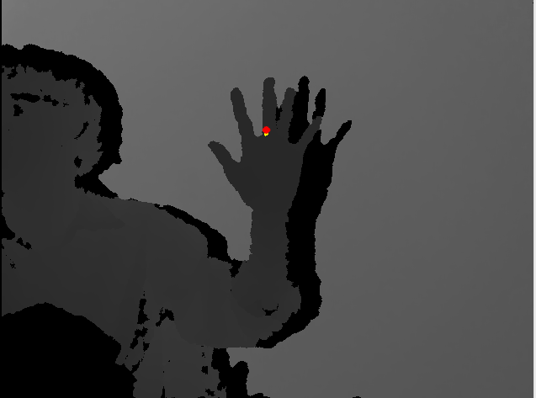


The Proposed Method
Hand Extraction
Find hand using depth image and hand point
$$\text{H} \text{=} \text{\{}P_{i}\text{|} \text{(} \text{(|}x_{i}\text{ − }x_{h}\text{|} \text{<} T_{h1}) ∩ \text{(|}y_{i}\text{ − }y_{h}\text{|} \text{<} T_{h1}))∩(D_{i}\text{ < }D_{h} \text{+} T_{h2})\}$$
${ T}_{h1}= \frac{64000}{D\left(X_{h}\right)}$,${ T}_{h2}=100$ (mm)

Slide 15


The Proposed Method
Hand Extraction
Reduce noise

Slide 16


The Proposed Method
Hand Extraction
Find hand contour

Slide 17
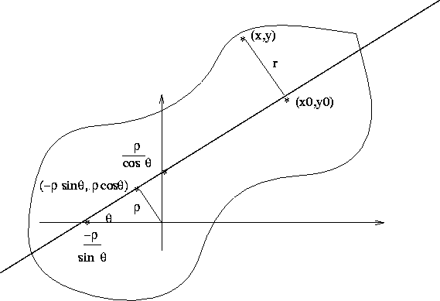

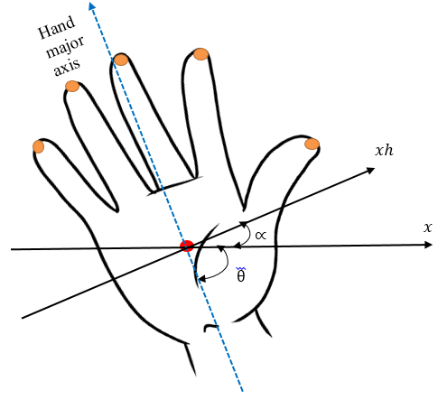

The Proposed Method
Hand feature extraction
Find hand orientation
The moment of order (p + q)
The major axis angle

Slide 18
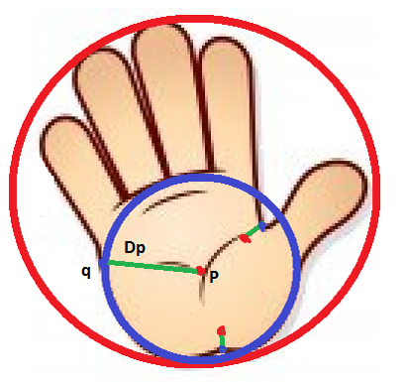
The Proposed Method
Hand feature extraction
Find Inscribed circle
Minimum inner distance
Maximum element of inner distances set

Slide 19
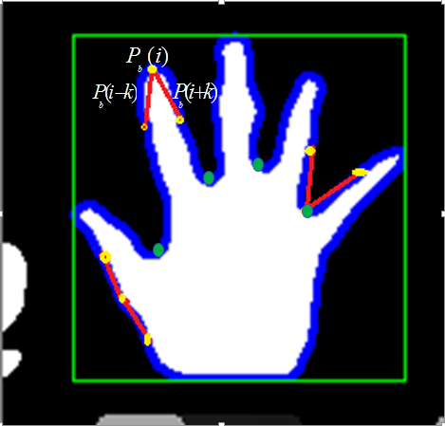


The Proposed Method
Hand feature extraction
Detect fingertips: K-curvature
Find an isosceles triangle on
the hand contour
,
Set a maximum threshold to the vertex angle
Notes:
K=
V=

Slide 20
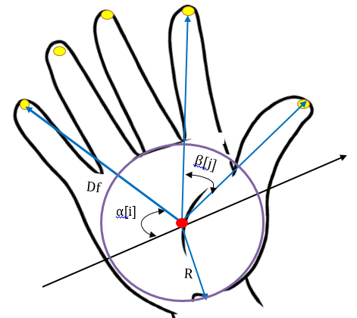
The Proposed Method
Hand feature extraction
Feature Vector
Vf = {N, α[i], β[j], D[i]}

Slide 21
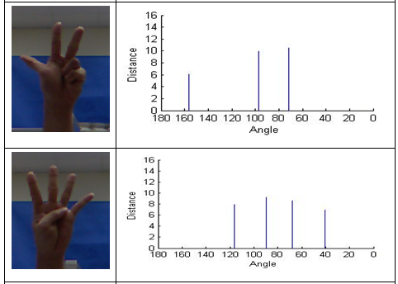
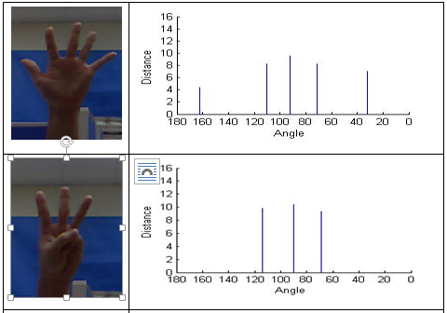
The Proposed Method
Hand feature extraction
Feature Vector Examples

Slide 22
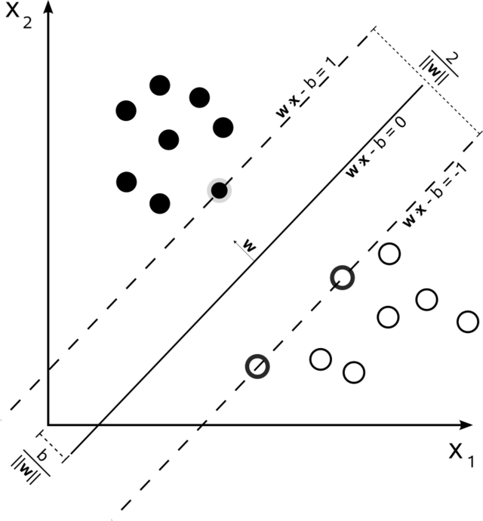
The Proposed Method
Hand gesture classification
Support Vector Machine

Slide 23
Experimental Results

Slide 24
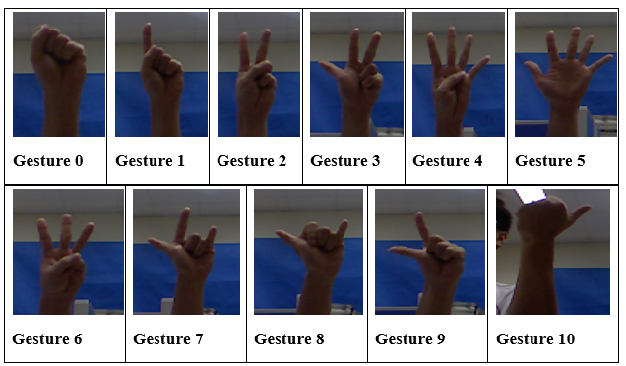
Experimental Results
Sampling Testing
11 gestures: referred from [8]
620 samples of 5 people for training
1926 samples of 9 people for testing

Slide 25
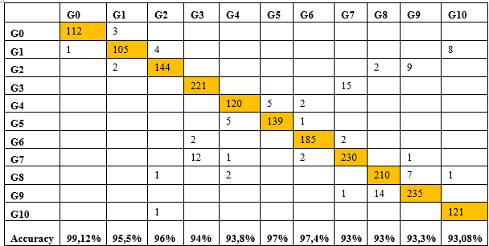
Experimental Results
Sampling Testing
Confusion matrix

Slide 26

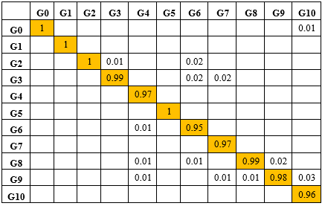
Experimental Results
Visual Testing
Record video with10 people
Confusion matrix

Slide 27
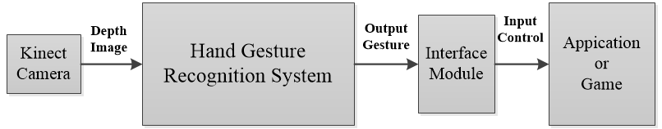
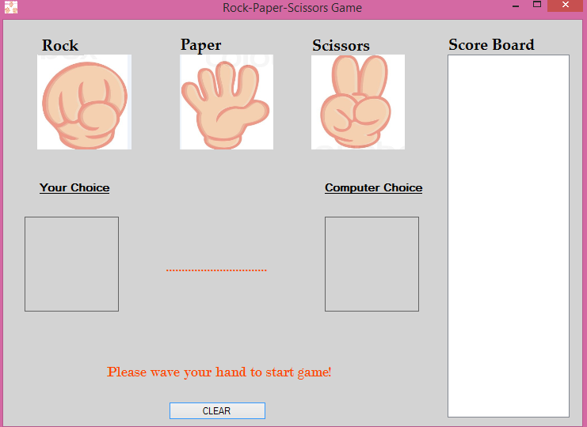
Experimental Results
Application Testing
HCI Application with Kinect
“Rock, paper, scissors” game

Slide 28
Conclusion

Slide 29
Conclusion
Input with a single depth camera
No color markers, tools are required
Independent on light condition
Real-time computation (30 fps)
Hand Feature descriptors
Hand orientation
Palm region
Fingertips
High accuracy (95% with 11 gestures)

Slide 30
Future Research

Slide 31
Future Research
Add more gestures
Add more feature descriptor from depth and color data
Advanced machine learning strategies
Extension to dynamic gestures recognition
Extension to application on Windows
Port to ARM-LINUX for further application

Slide 32
References
[1] Yan Wen, Chuanyan Hu, Guanghui Yu, Changbo Wang, "A Robust Method of Detecting Hand Gestures Using Depth Sensors," Haptic Audio Visual Environments and Games (HAVE), IEEE International Workshop on, 2012.
[2] Parul Chaudhary, Hardeep Singh Ryait, "Neural Network Based Static Sign Gesture Recognition System," International Journal of Innovative Research in Computer and Communication Engineering, February 2014 .
[3] Luigi Lamberti, Francesco Camastra, "Real-Time Hand Gesture Recognition using a Color Glove," Springer Proceedings of the 16th international conference on Image analysis and processing:, 2011.
[4] W.-c. Chen, "Real-Time Palm Tracking and Hand Gesture Estimation," Master Thesis, 2011.
[5] Li Yi, "Hand gesture recognition using Kinect," Software Engineering and Service Science (ICSESS), 2012 IEEE 3rd International Conference on, 2012.
[6] Raheja, J.L. , "Tracking of Fingertips and Centers of Palm Using KINECT," Computational Intelligence, Modelling and Simulation (CIMSiM), 2011 Third International Conference on, 2011.
[7] Suzuki, S. and Abe, K., , "Topological Structural Analysis of Digitized Binary Images by Border Following. CVGIP 30 1, pp 32-46," 1985.
[8] Fabio Domini, et al., "Hand Gesture Recognition with Depth Data," ARTEMIS '13 Proceedings of the 4th ACM/IEEE international workshop on, pp. 9-16, 2013

Slide 33
Thanks for Your Attention

