Slide 1
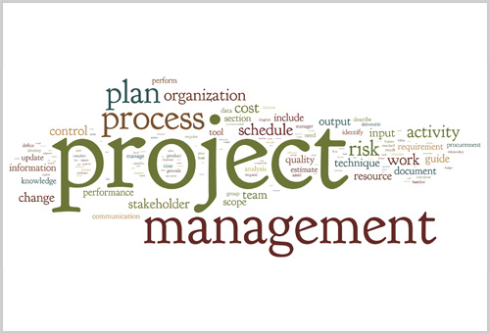
Team Project
Canteen Food Ordering And Management System
Group 3
Team members
Phạm Thế Duyệt
Trần Quang Luận
Phan Nhật Tuấn

Slide 2
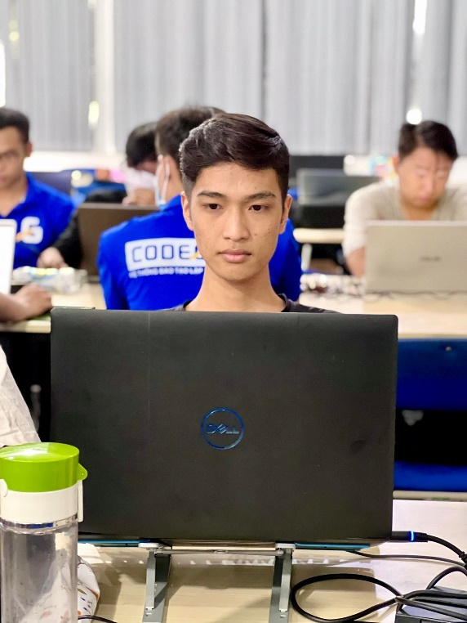

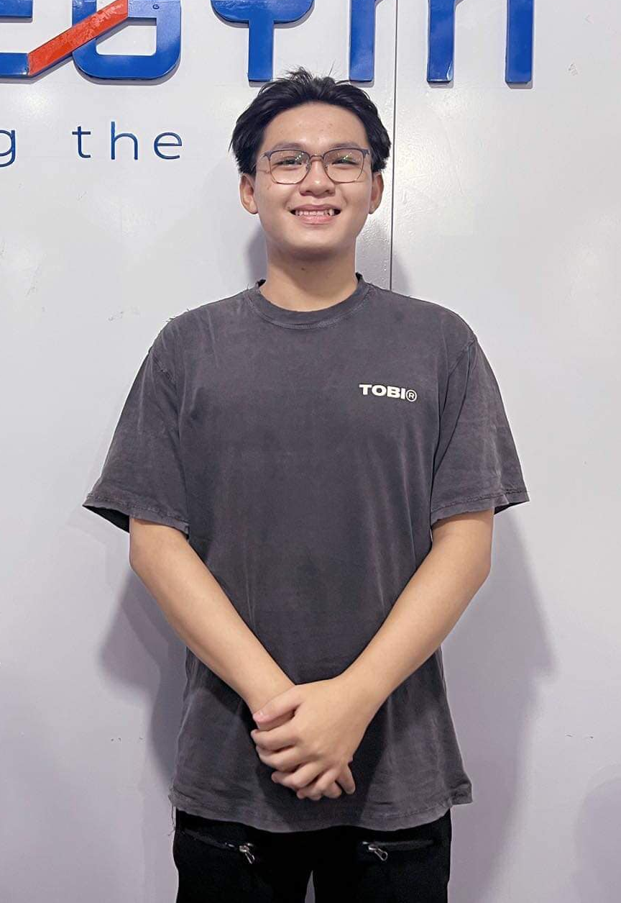
Team members
Phạm Thế Duyệt
Trần Quang Luận
Phan Nhật Tuấn

Slide 3
Content
1.Purpose
2.Goals
3.Main/Key features
4.Work Breakdown Structure(WBS)
5.Overview of Project schedule
6.3 main risks
7.Budget
8.Product backlog
9.Sprint 1 backlog
10.Burndown chart for sprint 1

Slide 4
Purpose
Purpose of document:
This document provides a summary of the project's objectives, division of work, the major milestones, required resources, time and overall schedule and budget allocation used and based on the document proposal to build a Canteen food ordering website on time, according to requirement and plan.

Slide 5
Goals
The goal of the project is to build an ordering and canteen food management system for Duy Tan University with a budget of $24000 and on-time delivery in 3 months.

Slide 6
Main/Key features
Main features for buyers are:
Login with DTU account
Add items into cart
Delete items
Search items
Delivery order
Payment
Logout
Main features for managers are:
Login
Admin management
Category management
Food management
Order management
Check total income
Logout

Slide 7
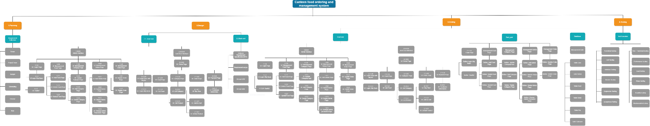
Work Breakdown Structure (WBS)

Slide 8
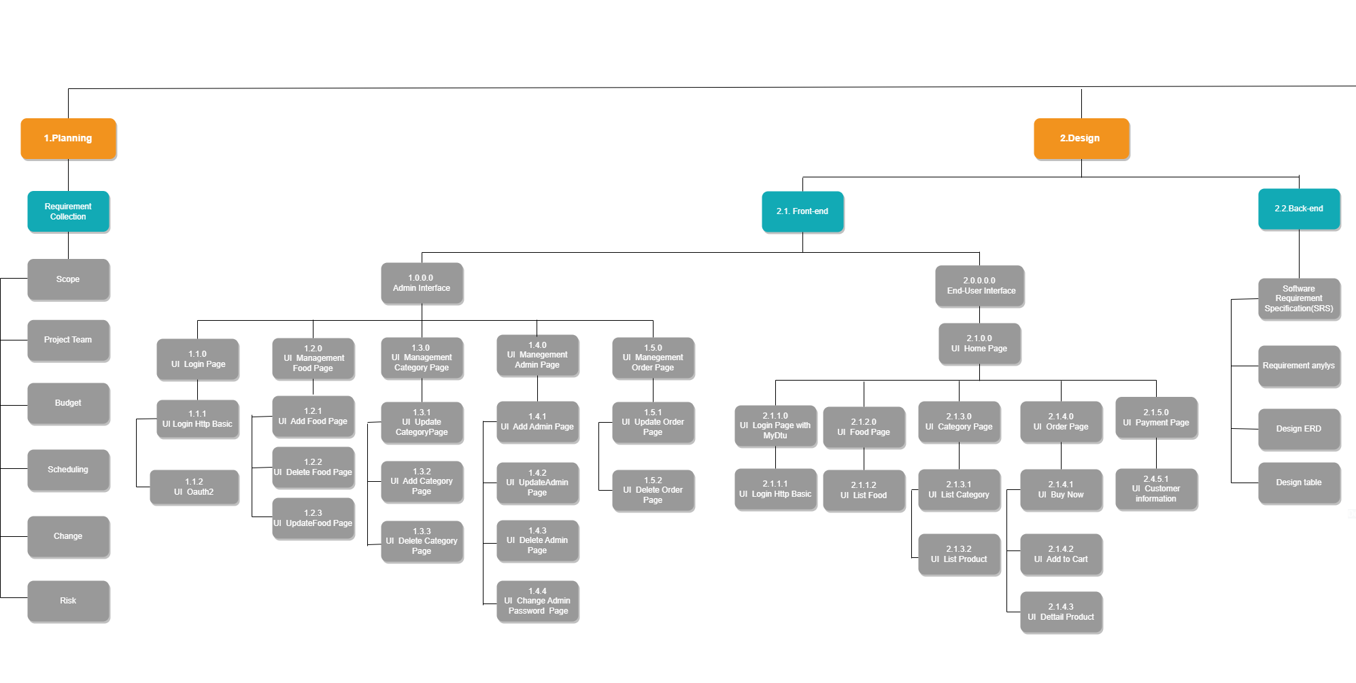
WBS part 1

Slide 9
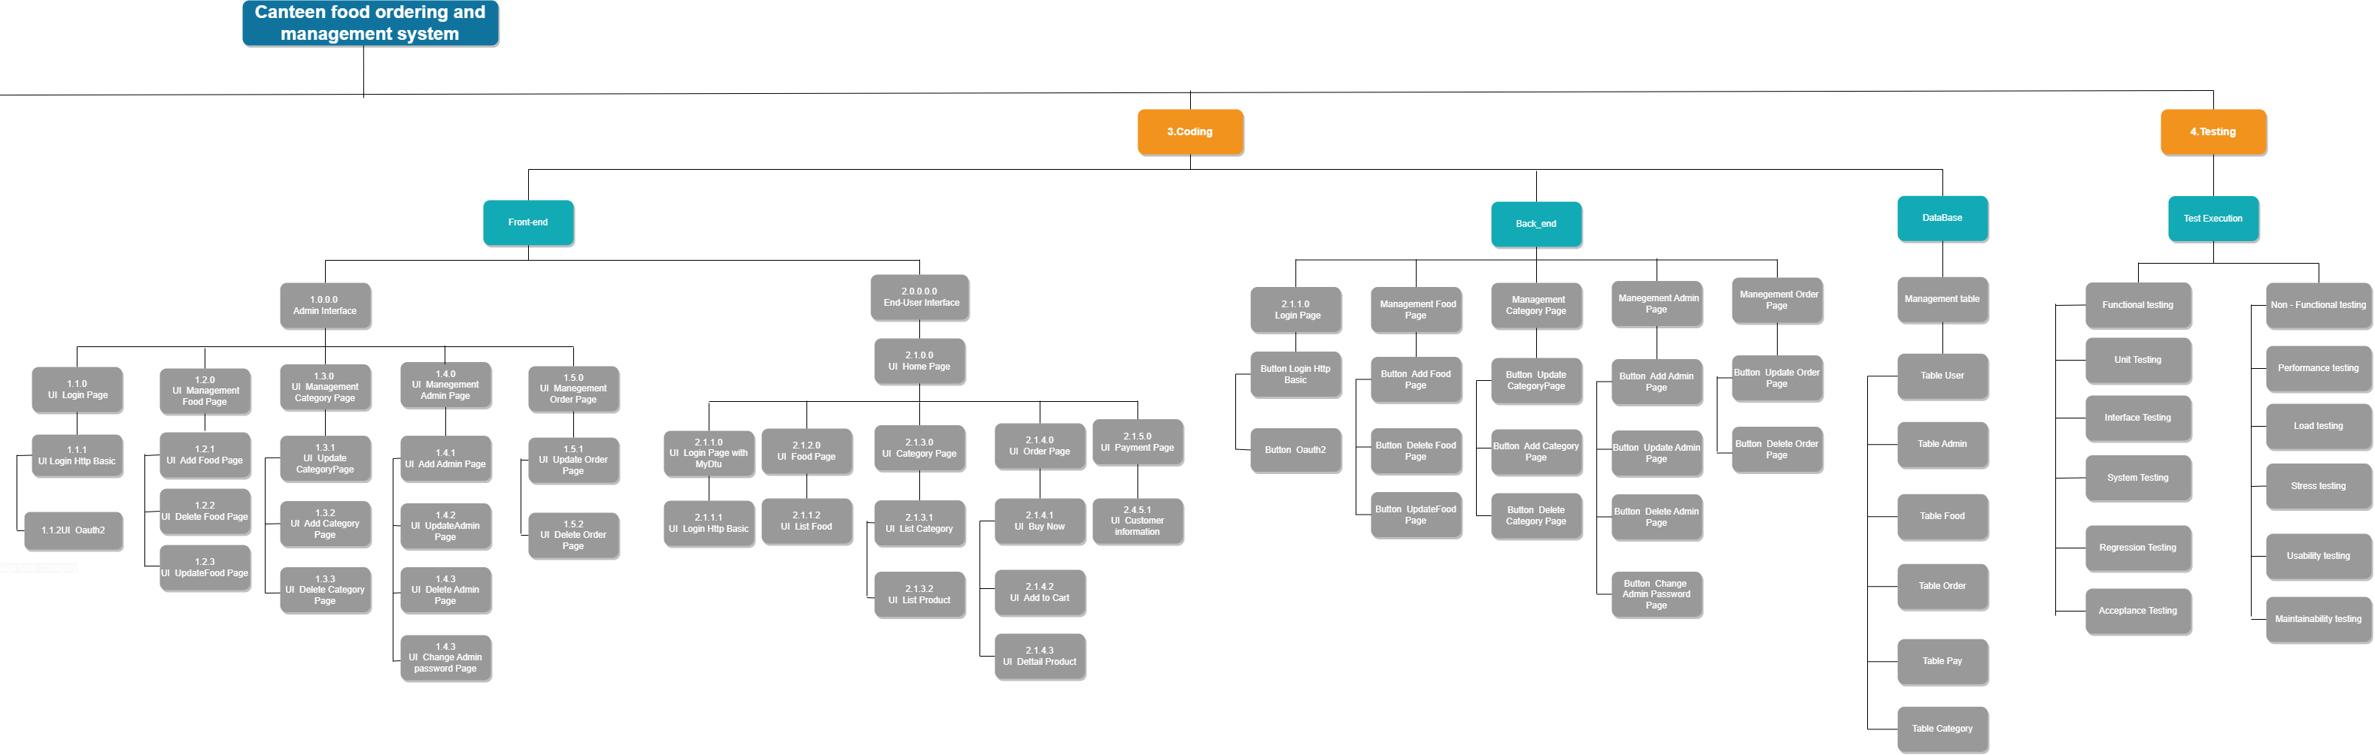
WBS part 2

Slide 10
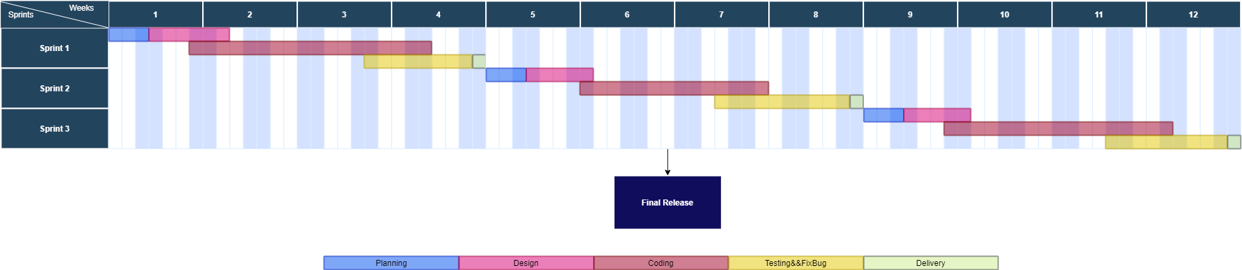
Overview of Project schedule
Gantt Chart (overview of project schedule):
Sprint 1: Start day: 1/10/2022 - End day: 28/10/2022
Sprint 2: Start day: 1/11/2022 - End day: 28/11/2022
Sprint 3: Start day: 1/12/2022 - End day: 28/12/2022
Final Release: 30/12/2022

Slide 11
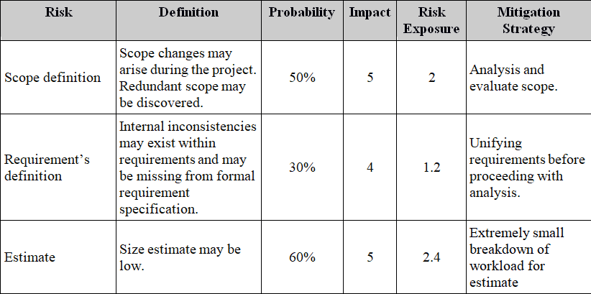
3 main risks

Slide 12
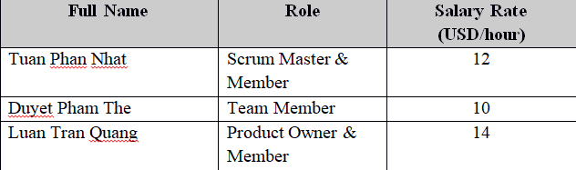
Budget
1. Cost Person/ Hours

Slide 13
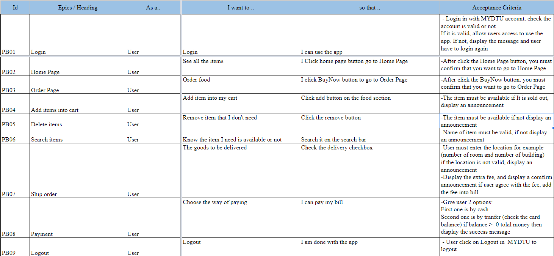
Product backlog
1. User Product Backlog

Slide 14
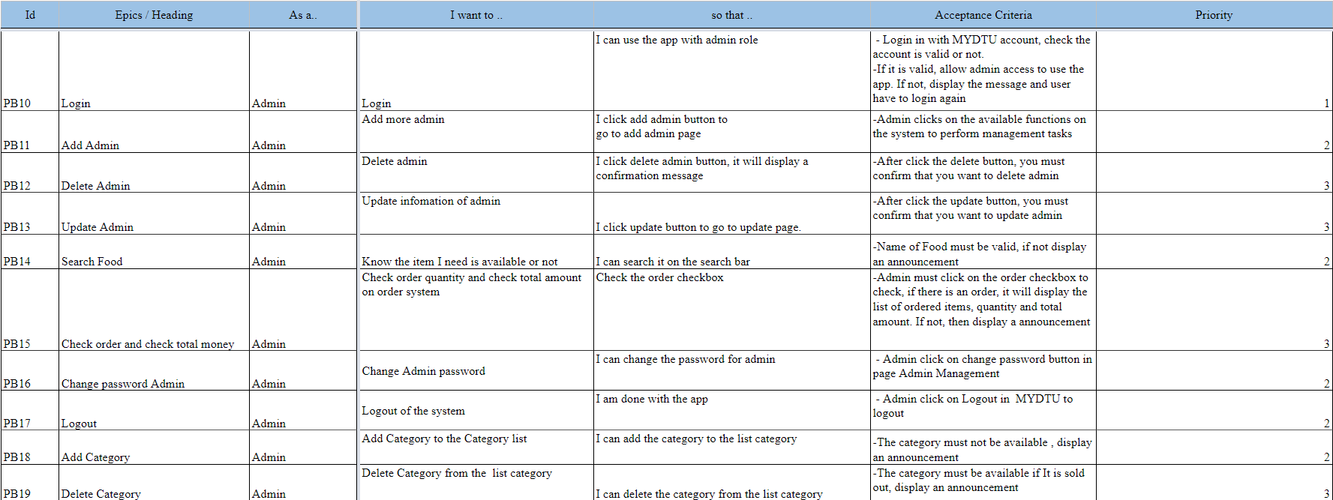
Product backlog
2.Admin Product Backlog

Slide 15
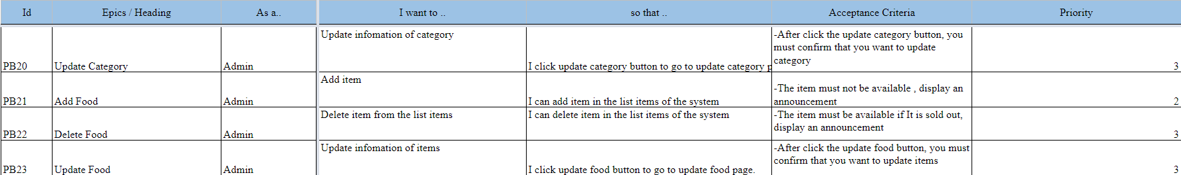
Product backlog

Slide 16
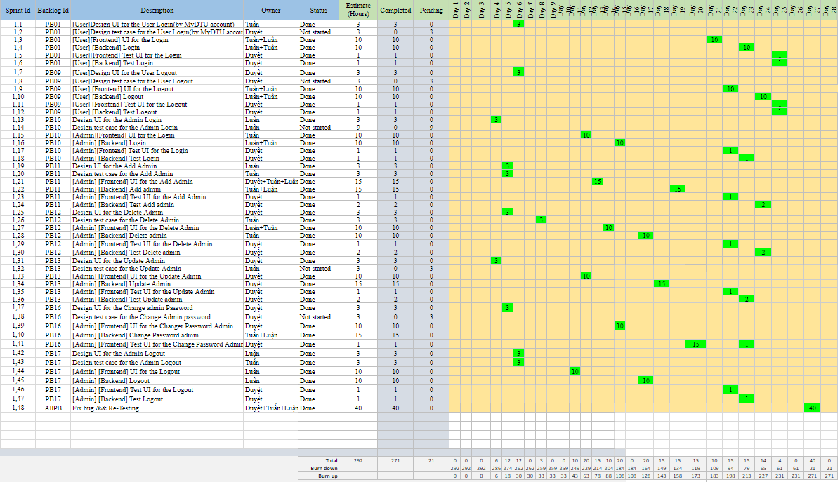
Sprint 1 backlog
Bảng này cho biết tiến độ hoàn thành công việc của các thành viên trong team

Slide 17
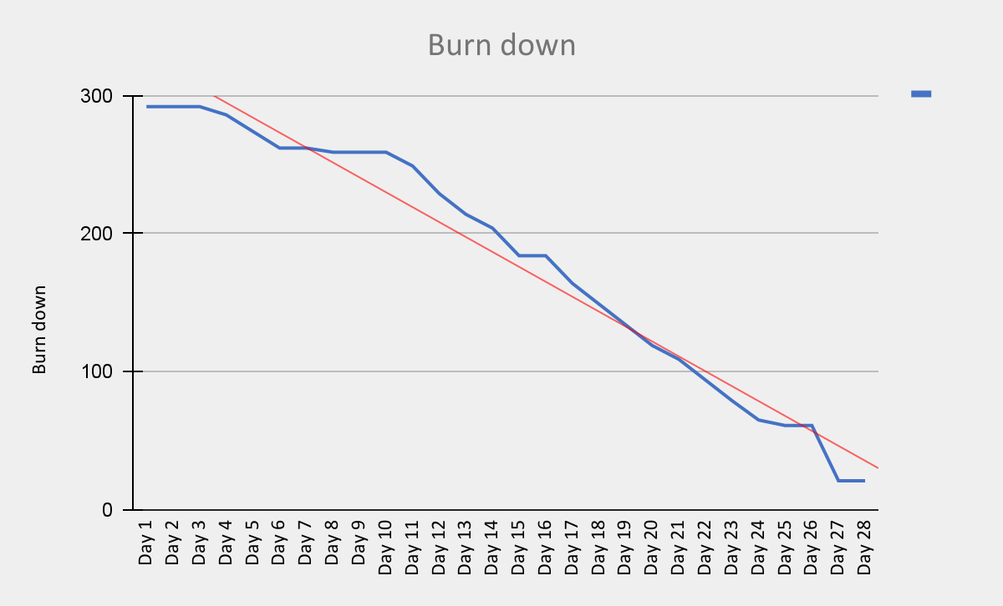
Burndown chart for sprint 1
Biểu đồ tổng quát về tiến độ công việc mà team đã làm

Slide 18


