Slide 1


Slide 2

Version Control System

Slide 3
WHAT IS VERSION CONTROL SYSTEM (VCS)?

Slide 4

LOCAL VERSION CONTROL SYSTEMS

Slide 5
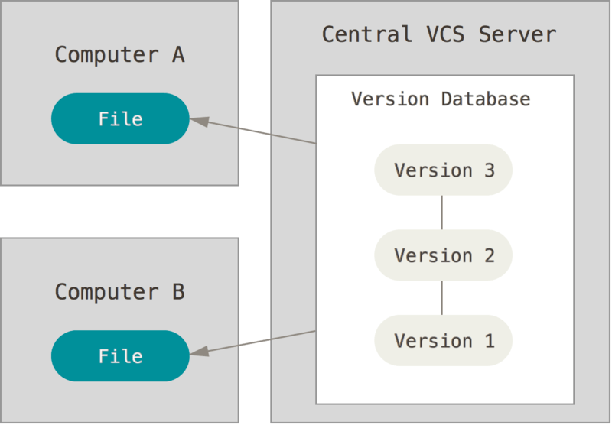
CENTRALIZED VERSION CONTROL SYSTEMS

Slide 6
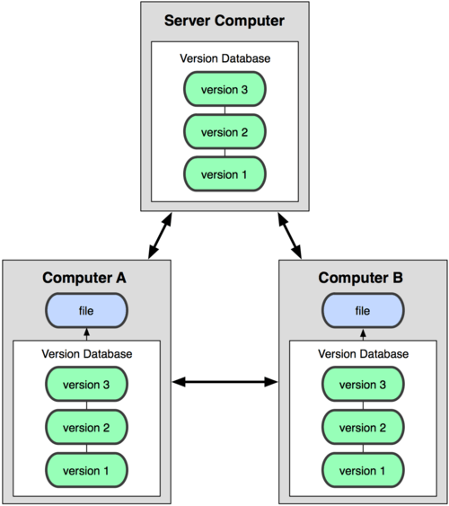
DISTRIBUTED VCS
GIT, MERCURIAL, BAZAAR
or DARCS

Slide 7
A Short History of Git
Speed
Simple design
Strong support for non-linear development (thousands of parallel branches)
Fully distributed
Able to handle large projects like the Linux kernel efficiently (speed and data size)

Slide 8
A Short History of Git
Since its birth in 2005, Git has evolved and matured to be easy to use and yet retain these initial qualities. It’s amazingly fast, it’s very efficient with large projects, and it has an incredible branching system for non-linear development.

Slide 9
A Short History of Git
Speed
Simple design
Strong support for non-linear development (thousands of parallel branches)
Fully distributed
Able to handle large projects like the Linux kernel efficiently (speed and data size)

Slide 10
GIT BASICS
SNAPSHOTS, NOT DIFFERENCES
NEARLY EVERY OPERATION IS LOCAL
GIT HAS INTEGRITY
GIT GENERALLY ONLY ADDS DATA
THE THREE STATES

Slide 11
SNAPSHOTS, NOT DIFFERENCES
The major difference between Git and any other VCS (Subversion and friends included) is the way Git thinks about its data.
Most other systems store information as a list of file-based changes. These other systems (CVS, Subversion, Perforce, Bazaar, and so on) think of the information they store as a set of files and the changes made to each file over time (this is commonly described as delta-basedversion control).

Slide 12
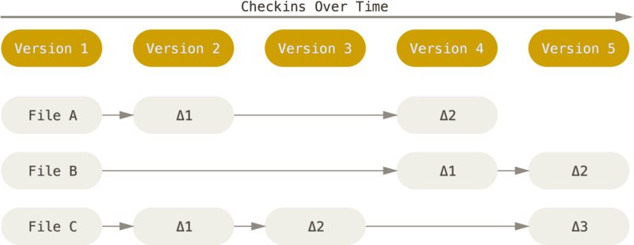
SNAPSHOTS, NOT DIFFERENCES

Slide 13
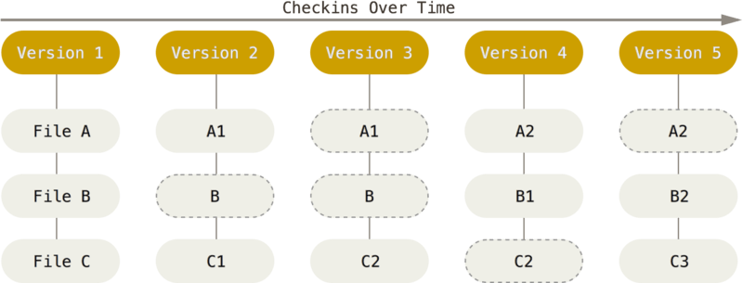
SNAPSHOTS, NOT DIFFERENCES

Slide 14
NEARLY EVERY OPERATION IS LOCAL

Slide 15
GIT HAS INTEGRITY

Slide 16
THE THREE STATES
Pay attention now — here is the main thing to remember about Git if you want the rest of your learning process to go smoothly.
Git has three main states that your files can reside in: committed, modified, and staged:

Slide 17
THE THREE STATES
Committed means that the data is safely stored in your local database.
Modified means that you have changed the file but have not committed it to your database yet.
Staged means that you have marked a modified file in its current version to go into your next commit snapshot.

Slide 18
THE THREE STATES
The basic Git workflow goes something like this:
You modify files in your working tree.
You selectively stage just those changes you want to be part of your next commit, which adds only those changes to the staging area.
You do a commit, which takes the files as they are in the staging area and stores that snapshot permanently to your Git directory.

Slide 19
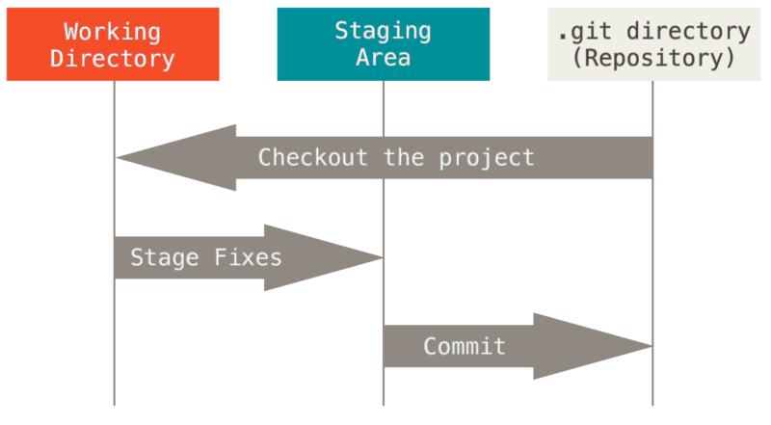
THE THREE STATES
This leads us to the three main sections of a Git project: the Git directory, the working tree, and the staging area.

Slide 20
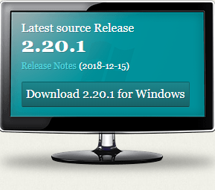
DOWNLOAD AND INSTALL GIT
https://git-scm.com/
GitBash→ git --version

Slide 21
FIRST TIME GIT SETUP
Git comes with a tool called git config that lets you get and set configuration variables that control all aspects of how Git looks and operates. These variables can be stored in three different places:
/etc/gitconfig file: Contains values applied to every user on the system and all their repositories. If you pass the option --system to git config, it reads and writes from this file specifically. (Because this is a system configuration file, you would need administrative or superuser privilege to make changes to it.)

Slide 22
FIRST TIME GIT SETUP
~/.gitconfig or ~/.config/git/config file: Values specific personally to you, the user. You can make Git read and write to this file specifically by passing the --global option, and this affects all of the repositories you work with on your system.
config file in the Git directory (that is, .git/config) of whatever repository you’re currently using: Specific to that single repository. You can force Git to read from and write to this file with the --local option, but that is in fact the default. (Unsurprisingly, you need to be located somewhere in a Git repository for this option to work properly.)

Slide 23
YOUR IDENTITY
The first thing you should do when you install Git is to set your user name and email address.
git config –global user.name “your name”
git config –global user.email “your email”

Slide 24
YOUR EDITOR
git config --global core.editor "'C:\Program Fil es\Notepad++\notepad++.exe' -multinst -nosession"

Slide 25
CHECKING YOUR SETTING
git help
git clone --help
git config --help

Slide 26
REPOSITORY

Slide 27
REPOSITORY
Initailizing a Repository in an Existing Directory
Cloning an Existing Repository

Slide 28
REPOSITORY
git init
git status (-s, --short)
git add readme.txt
git commit –m ‘initial project version’
git log

Slide 29
CLONING AN EXISTING REPOSITORY
git clone “url”
https://github.com/nguyentrongtiencntt/git-hub-demo.git

Slide 30
RECORDING CHANGES TO THE REPOSITORY
Checking the Status of your Files
Tracking New Files
Staging Modified Files
Short Status
Ignoring files

Slide 31
RECORDING CHANGES TO THE REPOSITORY
Viewing Your Staged and Unstaged Changes
Committing Your Changes
Skipping the Staging Area
Removing Files
Moving Files

Slide 32
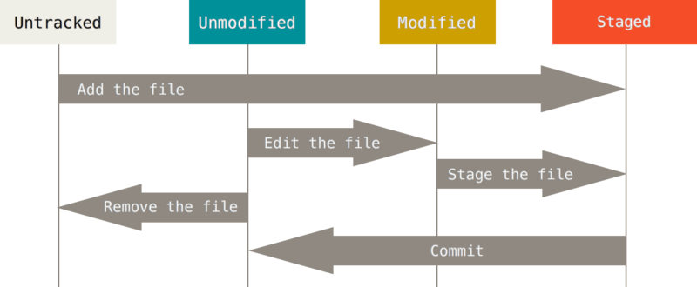
LIFECYCLE OF THE STATUS OF YOUR FILES

Slide 33
REPOSITORY CHANGES
git init
git status (-s, --short)
git add readme.txt
git commit –m ‘initial project version’
git log

Slide 34
IGNORING FILES
Git ignore file has name .gitignore
https://github.com/github/gitignore
touch .gitignore
bin/
Android.gitignore

Slide 35
VIEWING YOUR STAGED AND UNSTAGED CHANGES
$ git diff
$ git diff --staged

Slide 36
SKIPPING THE STAGING AREA
$ git add --all
$ git commit --a --m “at all file”

Slide 37
COMMITTING YOUR CHANGES
$ git config –global core.editor
$ git commit –m “Message”
$ git log

Slide 38
REMOVING FILES
$ git rm: to remove a file from GIT, you have to remove it from your tracked files (more accurately, remove it from your staging area) and then commit.
$ git rm <tenfile>
$ git rm –cache <tenfile>
$ git rm bin/\*.log (bin dir, all file .log)

Slide 39
MOVING FILES
If you want to rename a file in Git, you can run something like:
$ git mv file_from file_to

Slide 40
LOCAL CODE TO REPOSITOTY
git init
git add README.md
git commit -m "first commit"
git remote add origin https://github.com/nguyentrongtiencntt/DemoTestPrivate.git
git push -u origin master

Slide 41
Viewing the commit History

Slide 42
VIEWING THE COMMIT HISTORY
$ git log
$ git log -p -2
(2 commit only)
$ git log --stat

Slide 43
VIEWING THE COMMIT HISTORY
$ git log –pretty = oneline
Git output format
search Git option git log command

Slide 44
UNDO THINGS

Slide 45
UNDO THINGS
Undoing Things
Unstaging a Staged File
Unmodifying a Modified File

Slide 46
UNDO THINGS
$ git commit -amend
For example:
$ git commit –m “initial commit”
$ git add forgotten_file
$ git commit –amend

Slide 47
UNSTAGING A STAGED FILE
How can you unstage one of the two?
$ git add *
$ git status
To unstaged a file:
$ git reset HEAD <tenfile>→ to unstage

Slide 48
RESET and CHECKOUT

Slide 49
THE THREE TREES
An easier way to think about reset and checkout is through the mental frame of Git being a content manager of three different trees.
By “tree” here, we really mean “collection of files”, not specifically the data structure.
Git as a system manages and manipulates three trees in its normal operation:

Slide 50
THE THREE TREES
BRANCHING means you diverge from the main line of development and continue to do work without messing with that main line.
Nearly every VCS has some form of branching support.
Understanding and mastering this feature gives you a powerful and unique tool and can entirely change the way that you develop.

Slide 51
THE THREE TREES
Tree | Role
HEAD | Last commit snapshot, next parent
Index | Proposed next commit snapshot
Working Directory | Sandbox

Slide 52
THE HEAD
HEAD is the pointer to the current branch reference, which is in turn a pointer to the last commit made on that branch.
That means HEAD will be the parent of the next commit that is created. It’s generally simplest to think of HEAD as the snapshot of your last commit on that branch.
git cat-file -p HEAD
git ls-tree -r HEAD

Slide 53
THE INDEX
The index is your proposed next commit. We’ve also been referring to this concept as Git’s “Staging Area” as this is what Git looks at when you run git commit.
git ls-files -s

Slide 54
THE WORKING DIRECTORY
Finally, you have your working directory (also commonly referred to as the “working tree”).
The other two trees store their content in an efficient but inconvenient manner, inside the .git folder. The working directory unpacks them into actual files, which makes it much easier for you to edit them. Think of the working directory as a sandbox, where you can try changes out before committing them to your staging area (index) and then to history.

Slide 55
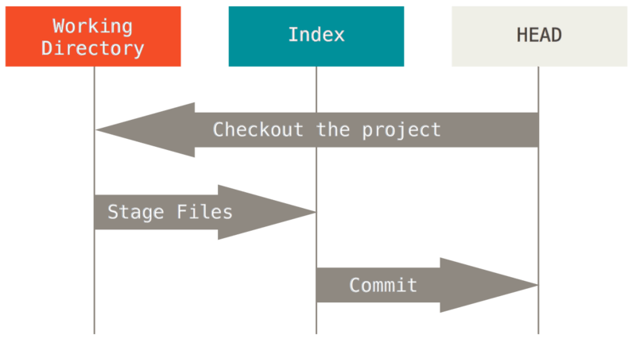
THE WORKFLOW

Slide 56
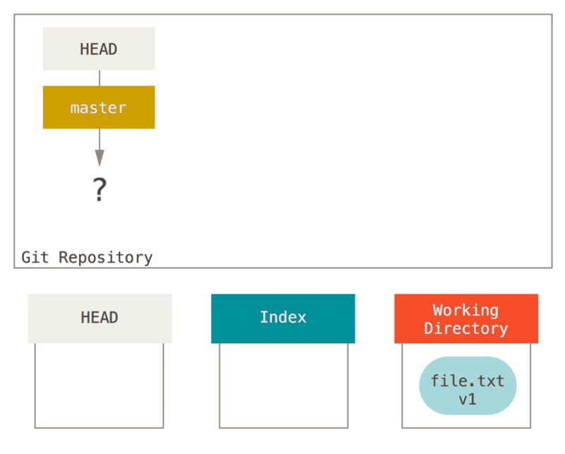
THE WORKFLOW

Slide 57
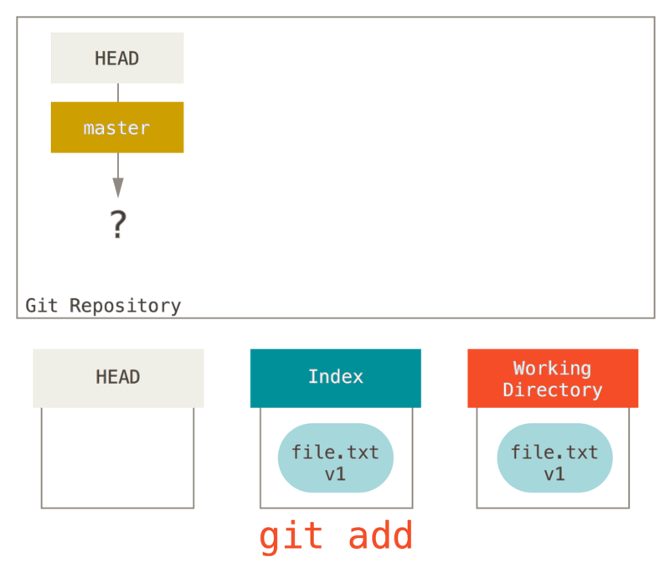
THE WORKFLOW

Slide 58
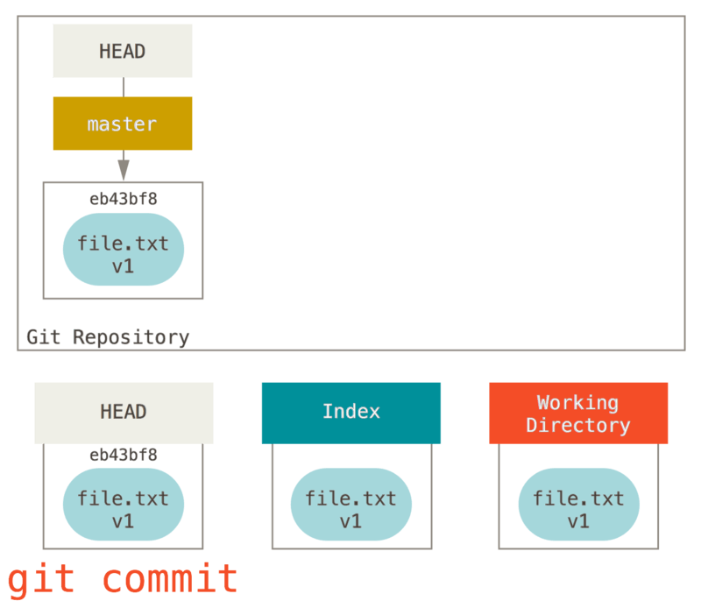
THE WORKFLOW

Slide 59
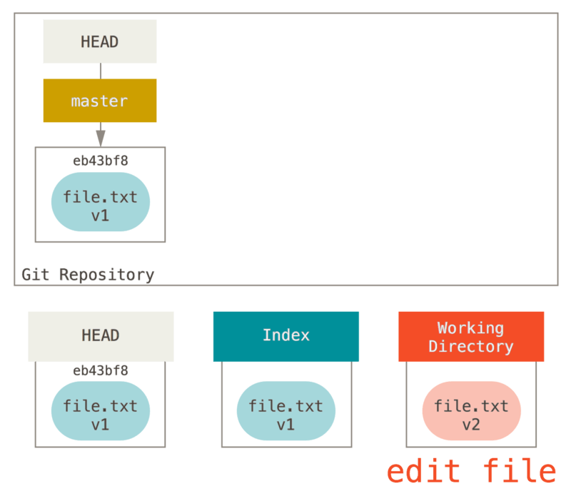
THE WORKFLOW

Slide 60
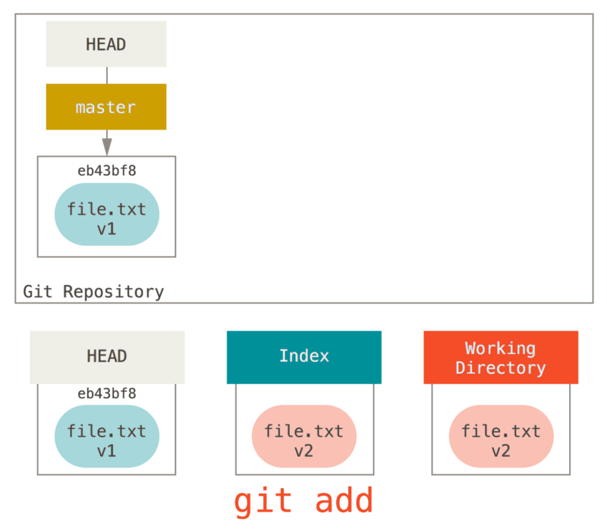
THE WORKFLOW

Slide 61
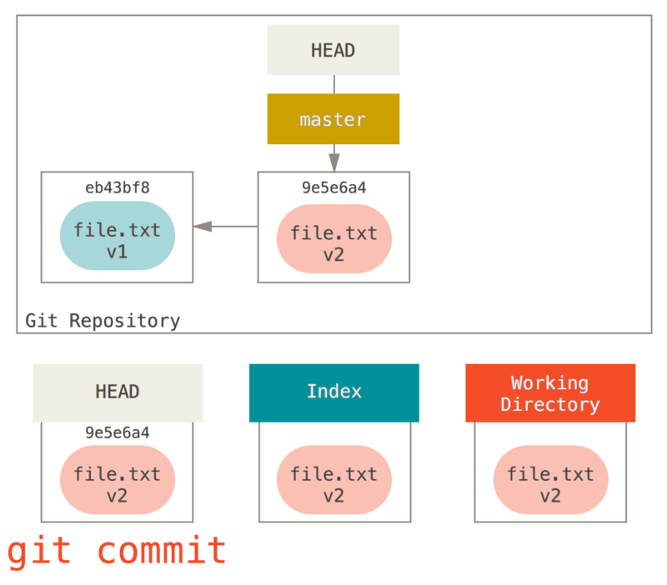
THE WORKFLOW

Slide 62
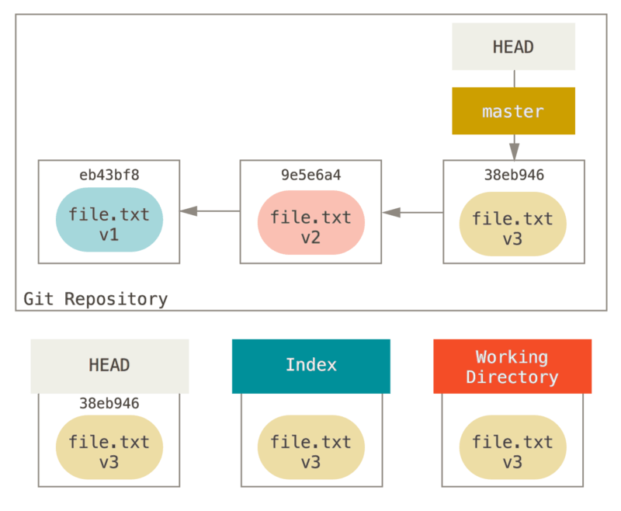
THE ROLE OF RESET

Slide 63
STEP 1: MOVE HEAD

Slide 64
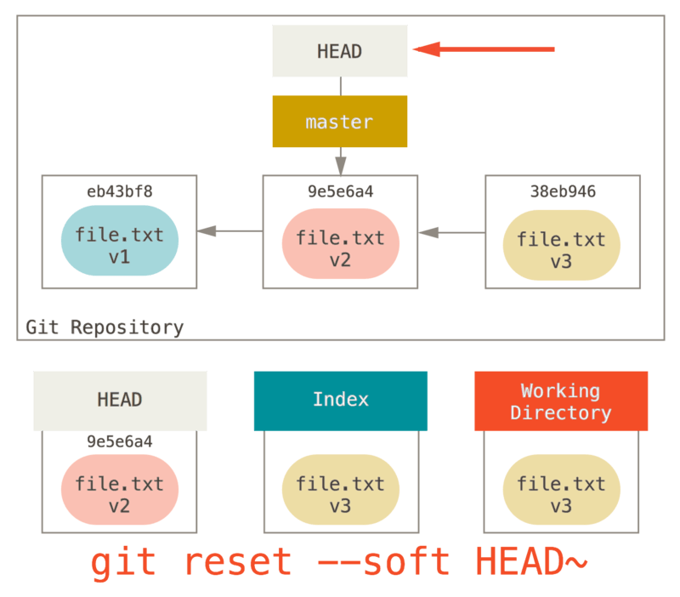
STEP 1: MOVE HEAD

Slide 65
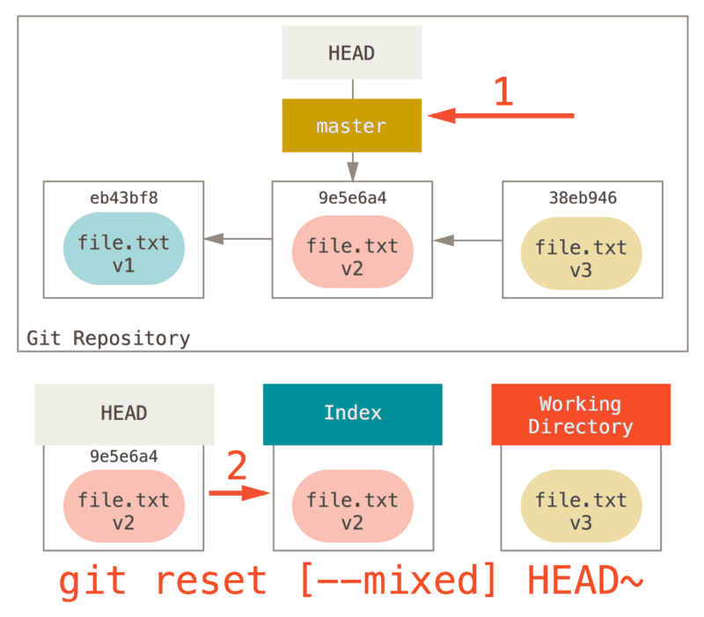
STEP 2: UPDATING THE INDEX (--MIXED)

Slide 66
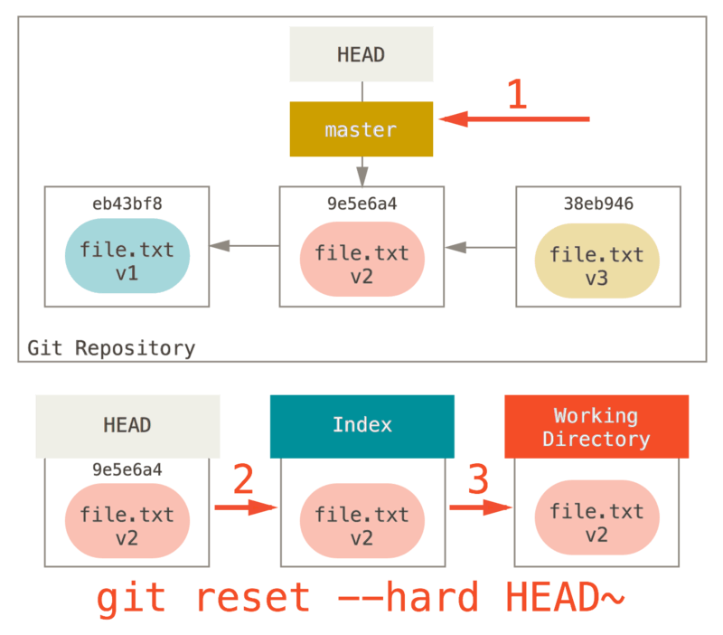
STEP 3: UPDATING THE WORKING DIRECTORY (--HARD)

Slide 67
GIT BRANCHING

Slide 68
GIT BRANCHING
BRANCHING means you diverge from the main line of development and continue to do work without messing with that main line.
Nearly every VCS has some form of branching support.
Understanding and mastering this feature gives you a powerful and unique tool and can entirely change the way that you develop.

Slide 69
BASIC BRANCHING AND MERGING

Slide 70
BRANCH MANAGEMENT

Slide 71
GIT BRANCHING
BRANCHING means you diverge from the main line of development and continue to do work without messing with that main line.
Nearly every VCS has some form of branching support.
Understanding and mastering this feature gives you a powerful and unique tool and can entirely change the way that you develop.

Slide 72
GIT BRANCHING
BRANCHING means you diverge from the main line of development and continue to do work without messing with that main line.
Nearly every VCS has some form of branching support.
Understanding and mastering this feature gives you a powerful and unique tool and can entirely change the way that you develop.

Slide 73
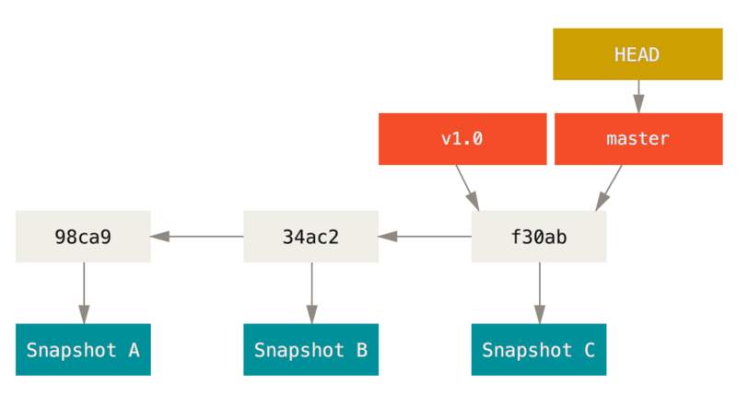
GIT BRANCHING

Slide 74
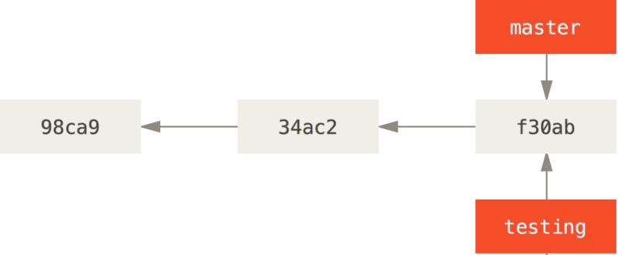
CREATING A NEW BRANCH
$ git brach testing

Slide 75
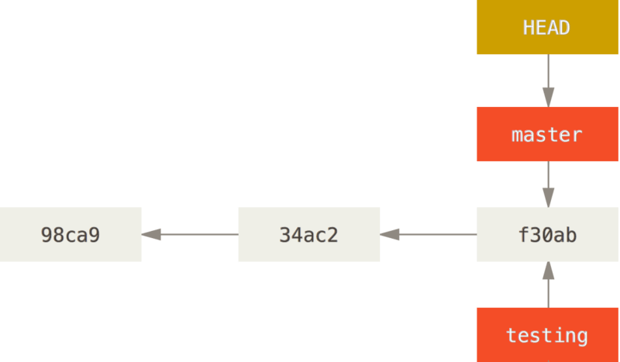
CREATING A NEW BRANCH
$ git log --oneline --decorate

Slide 76
BASIC BRANCHING AND MERGING
Let’s go through a simple example of branching and merging with a workflow that you might use in the real world. You’ll follow these steps:
Do some work on a website.
Create a branch for a new story you’re working on.
Do some work in that branch.

Slide 77
BASIC BRANCHING AND MERGING
At this stage, you’ll receive a call that another issue is critical and you need a hotfix. You’ll do the following:
Switch to your production branch.
Create a branch to add the hotfix.
After it’s tested, merge the hotfix branch, and push to production.
Switch back to your original story and continue working.

Slide 78
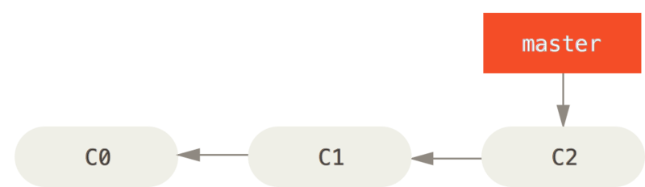
BASIC BRANCHING
First, let’s say you’re working on your project and have a couple of commits already on the masterbranch.

Slide 79
BASIC BRANCHING
You’ve decided that you’re going to work on issue #53 in whatever issue-tracking system your company uses. To create a new branch and switch to it at the same time, you can run the git checkout command with the -b switch:
$ git checkout -b iss53 Switched to a new branch "iss53”
This is shorthand for:
$ git branch iss53
$ git checkout iss53

Slide 80
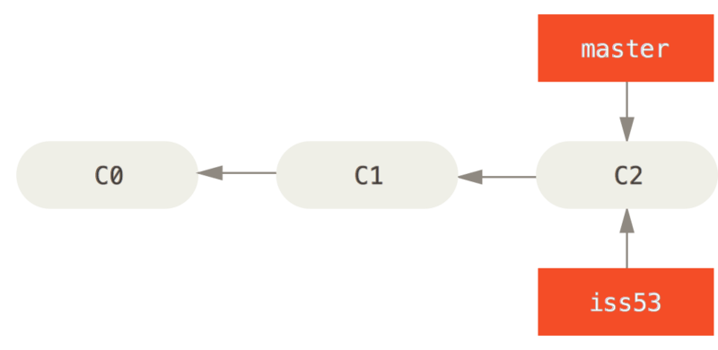
BASIC BRANCHING

Slide 81
BASIC BRANCHING

Slide 82
BASIC BRANCHING
You work on your website and do some commits. Doing so moves the iss53 branch forward, because you have it checked out (that is, your HEAD is pointing to it):
$ vim index.html
$ git commit -a -m 'added a new footer [issue 53]'

Slide 83
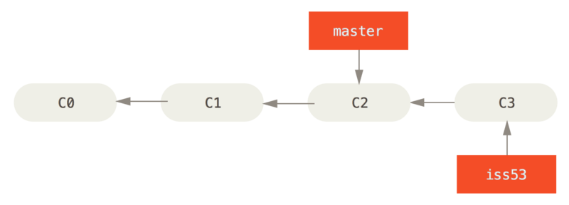
BASIC BRANCHING

Slide 84
BASIC BRANCHING
Next, you have a hotfix to make. Let’s create a hotfix branch on which to work until it’s completed:
$ git checkout -b hotfix
Switched to a new branch 'hotfix'
$ vim index.html
$ git commit -a -m 'fixed the broken email address'

Slide 85
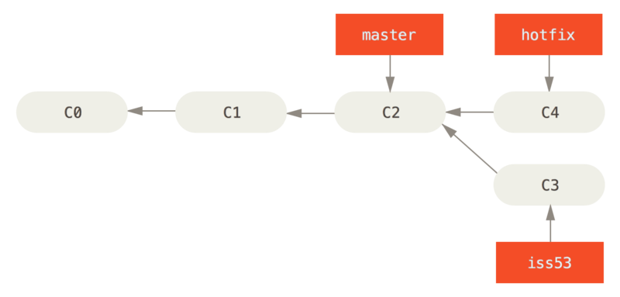
BASIC BRANCHING

Slide 86
BASIC BRANCHING
$ git checkout master
$ git merge hotfix

Slide 87
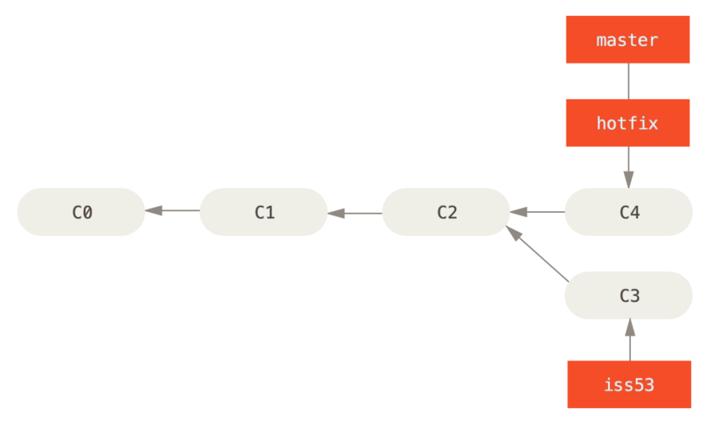
BASIC BRANCHING

Slide 88
BASIC BRANCHING
$ git branch -d hotfix Deleted branch hotfix (3a0874c).
Now you can switch back to your work-in-progress branch on issue #53 and continue working on it.
$ git checkout iss53
Switched to branch "iss53"
$ vim index.html
$ git commit -a -m 'finished the new footer [issue 53]'

Slide 89
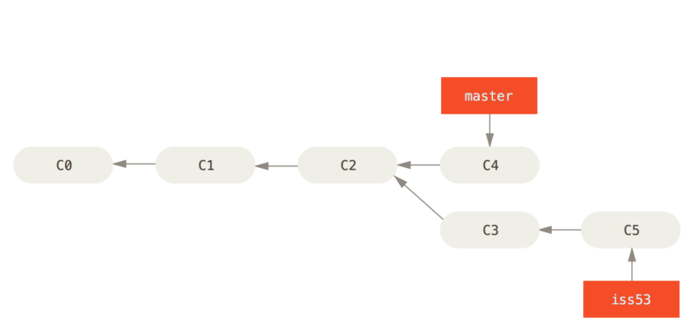
BASIC

Slide 90
Basic Merging
Suppose you’ve decided that your issue #53 work is complete and ready to be merged into your master branch.
In order to do that, you’ll merge your iss53 branch into master, much like you merged your hotfix branch earlier.
All you have to do is check out the branch you wish to merge into and then run the git merge command:

Slide 91
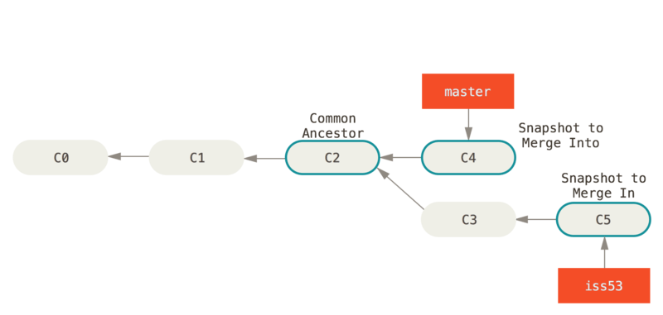
Basic Merging

Slide 92
Basic Merging

Slide 93
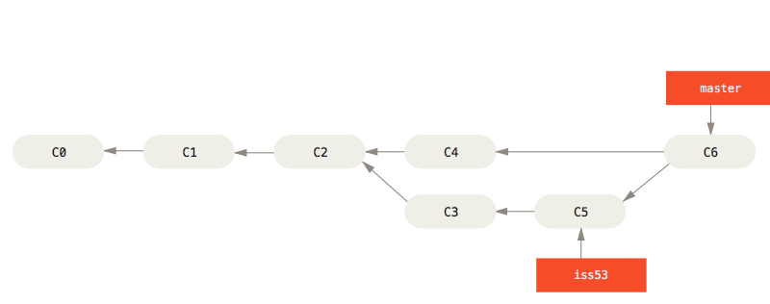
Basic Merging

Slide 94
Basic Merging
Now that your work is merged in, you have no further need for the iss53 branch. You can close the ticket in your ticket-tracking system, and delete the branch:
$ git branch -d iss53

Slide 95
Basic Merge Conflicts
Now that your work is merged in, you have no further need for the iss53 branch. You can close the ticket in your ticket-tracking system, and delete the branch:
$ git branch -d iss53

Slide 96
Basic Merging
$ git checkout master
Switched to branch 'master'
$ git merge iss53
Merge made by the 'recursive' strategy.

Slide 97
SOME COMMANDS
$ git branch -v
$ git branch –merged
$ git branch –no—merged
$ git branch –d testing

Slide 98
1. Vừa chỉnh code xong, chưa add
$ git clean -df
$ git checkout -- .

Slide 99
2. Lỡ tay add nhưng chưa commit
$ git reset HEAD
$ git clean -df
$ git checkout -- .

Slide 100
3. Commit rồi, mà hên chưa push
$ git reset HEAD~1 --hard

Slide 101
4. Commit rồi, lỡ tay push luôn
Push lên rồi, có nghĩa là có thể đã có người fetch về sử dụng rồi, mà người ta đã lấy rồi thì không có chuyện giựt lại. Trong trường hợp này bạn cần đính chính lại: "À, nãy tao nhầm, lấy cái này nè".
Vì thế, ta push 1 commit khác, nội dung là ngược lại cái vừa push để đính chính.
$ git revert HEAD~1..HEAD

