Slide 1
JWT in Spring Boot

Slide 2
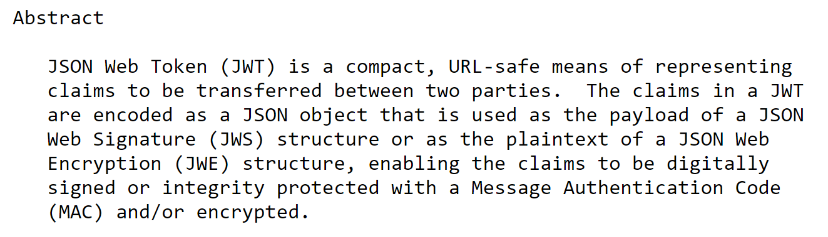
What is jwt?

Slide 3
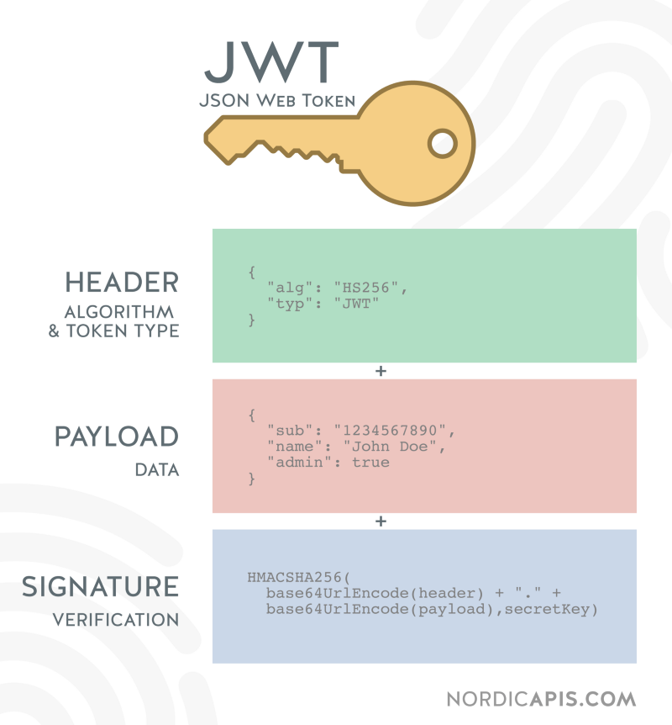
JWT-Json Web Token

Slide 4
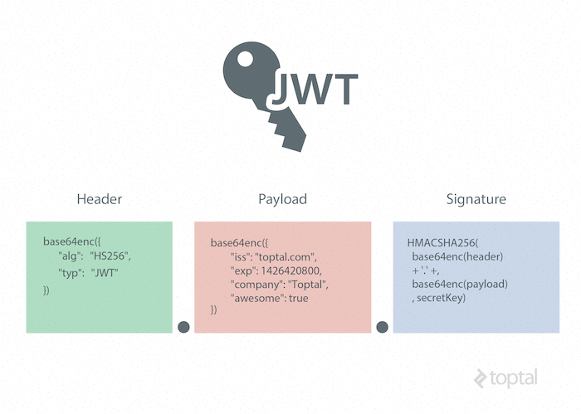
JWT-Json Web Token

Slide 5
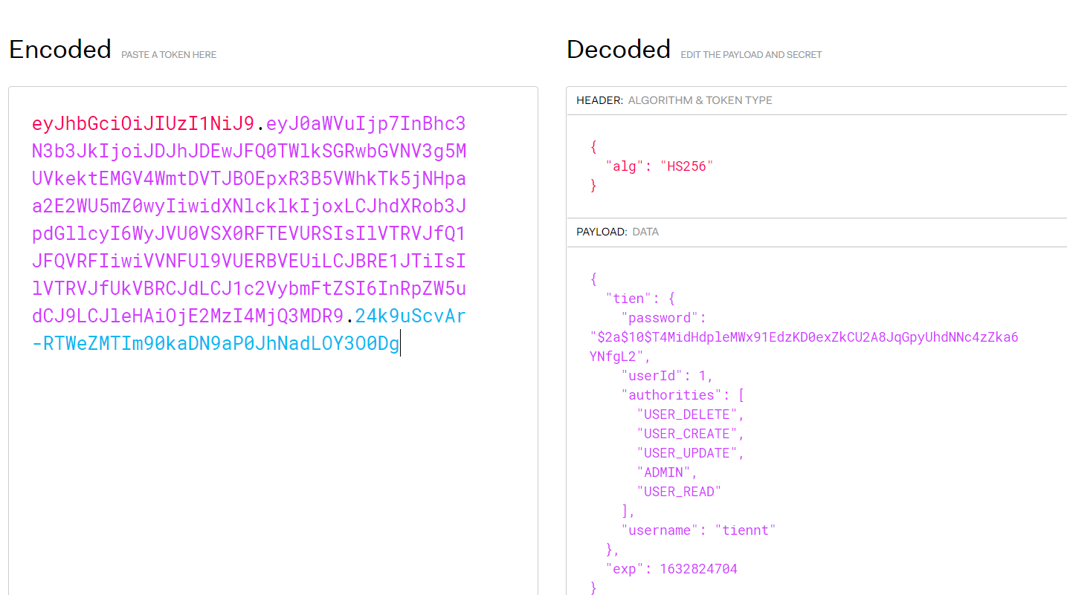
JWT-Json Web Token
https://jwt.io/#debugger-io

Slide 6
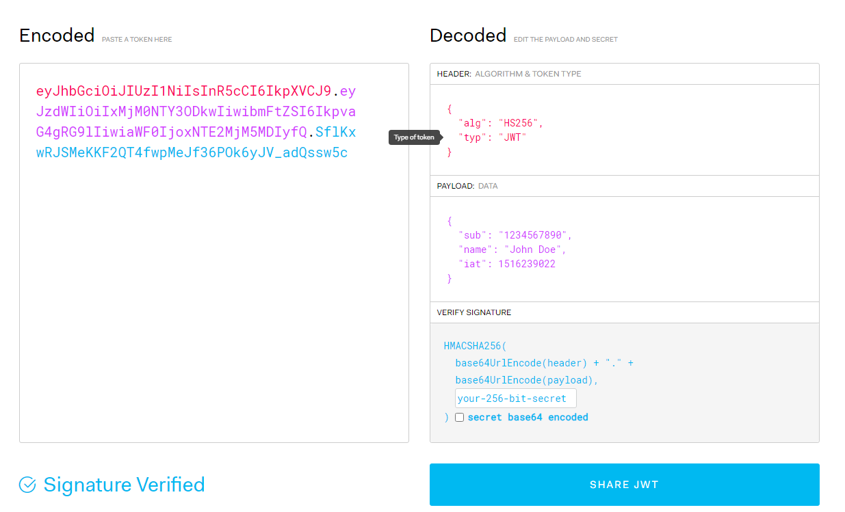
JWT-Json Web Token
https://jwt.io/#debugger-io
encode

Slide 7
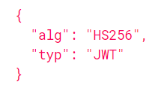
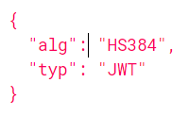
JWT
eyJhbGciOiJIUzI1NiIsInR5cCI6IkpXVCJ9
eyJpc3MiOiJqb2UiLCJleHAiOjEzMDA4MTkzODAsImh0dHA6Ly9leGFtcGxlLmNvbS9pc19yb290Ijp0cnVlfQ

Slide 8
JWT Claims
Reserved claims
Public Claims
Private Claims

Slide 9
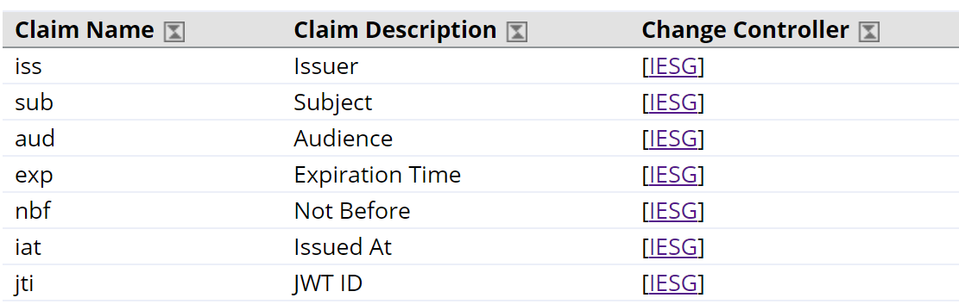
Reserved claims
https://www.iana.org/assignments/jwt/jwt.xhtml#claims

Slide 10
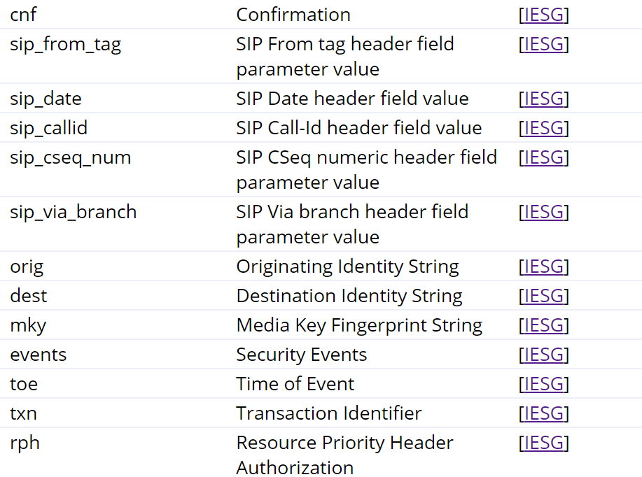
Reserved claims
https://www.iana.org/assignments/jwt/jwt.xhtml#claims

Slide 11
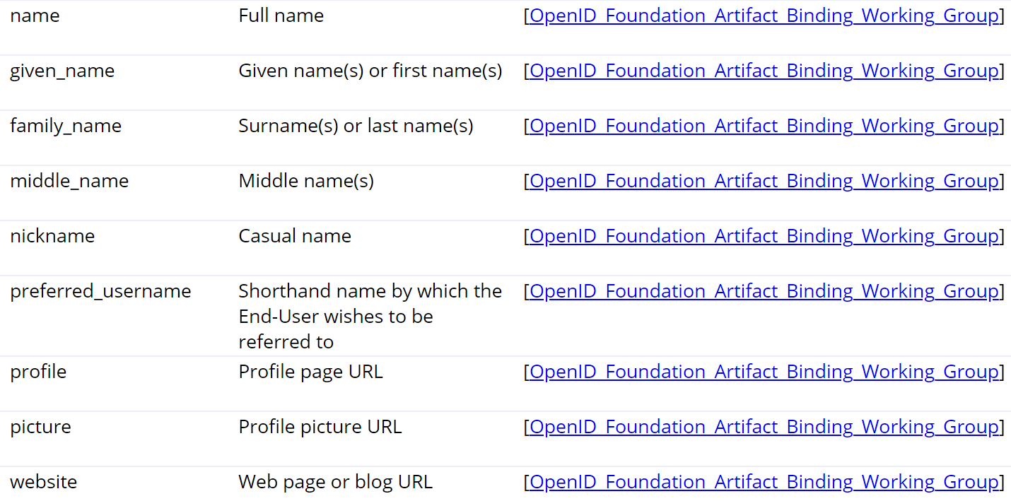
Public Claims
https://www.iana.org/assignments/jwt/jwt.xhtml#claims

Slide 12
Authentication JWT vs Session ID
- JWT → stateless
- Session → state

Slide 13
How jwt work?

Slide 14
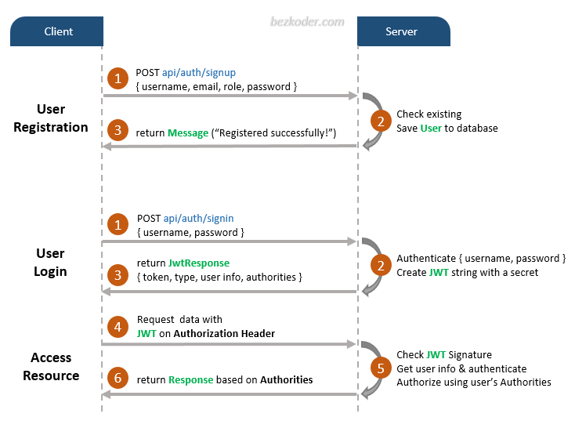
JWT-Json Web Token

Slide 15
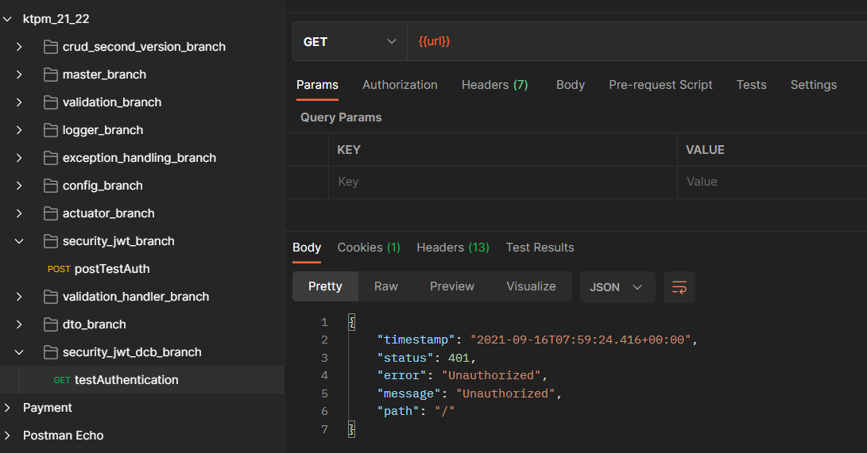
Authentication

Slide 16
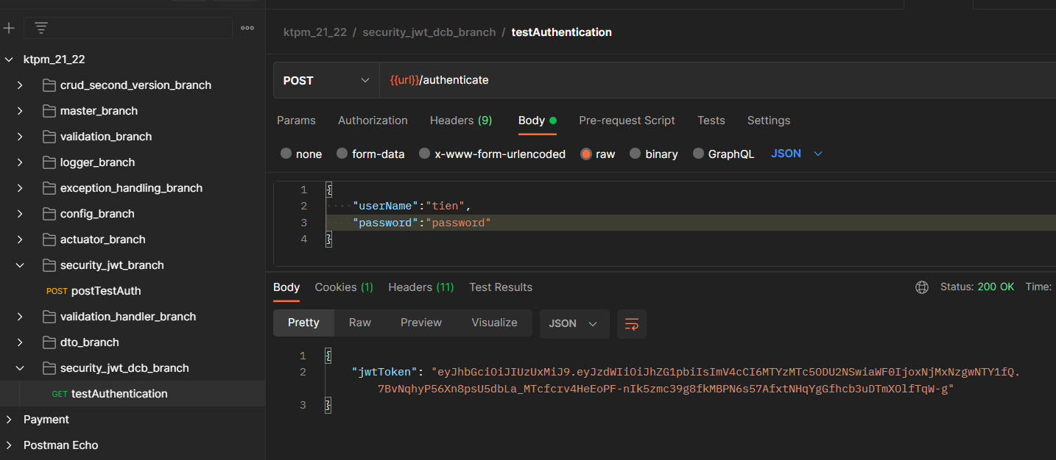
Authentication

Slide 17
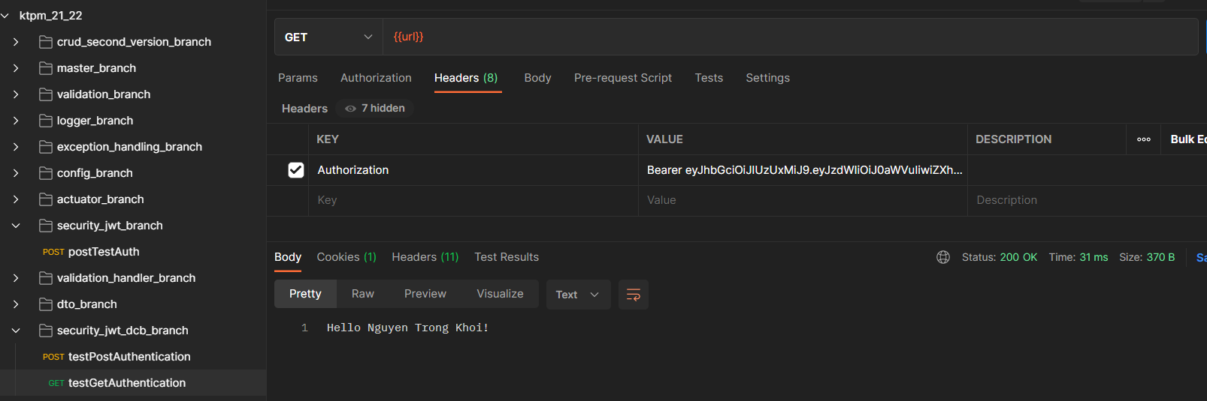
Authentication

Slide 18
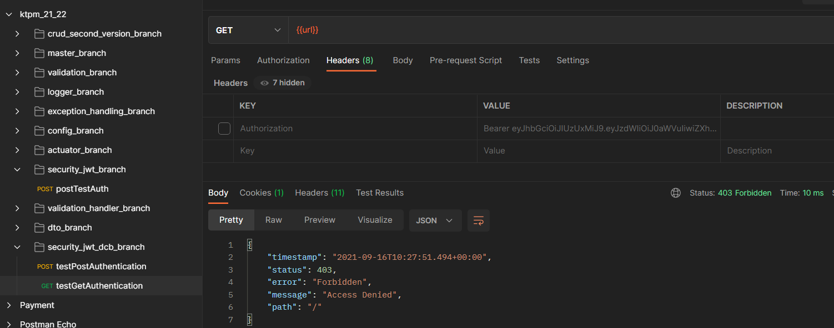
Authentication

Slide 19
Step by Step Basic

Slide 20
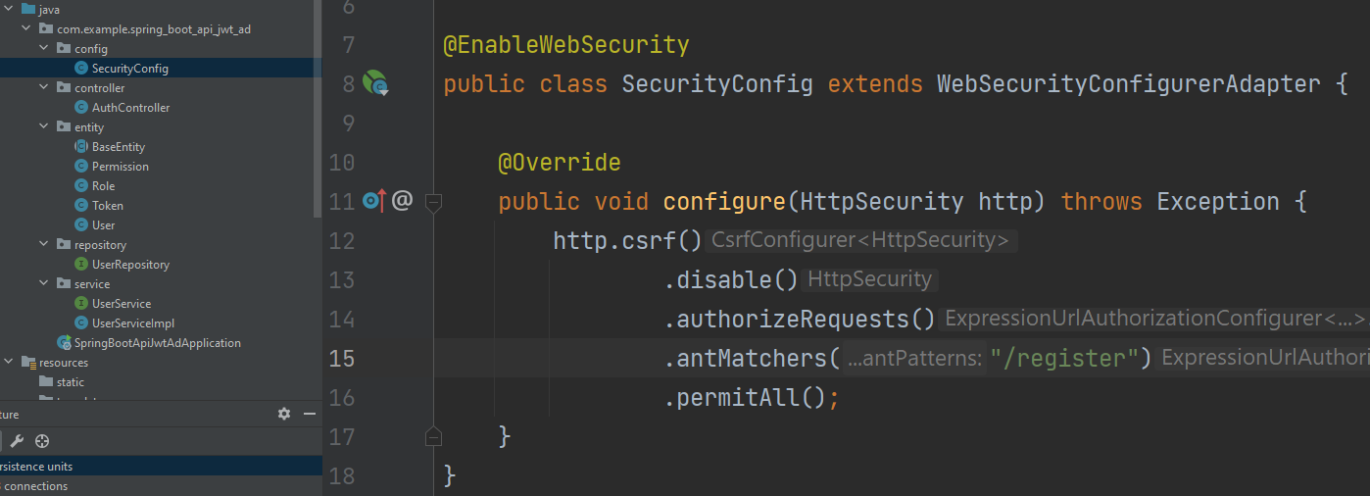
Step 01-Add user
Notes:
Branch master add basic some thing for prepare

Slide 21
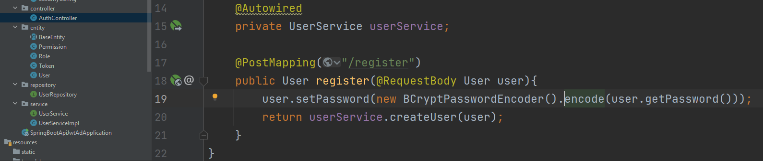
Step 01-Add user
Notes:
Branch master add basic some thing for prepare

Slide 22
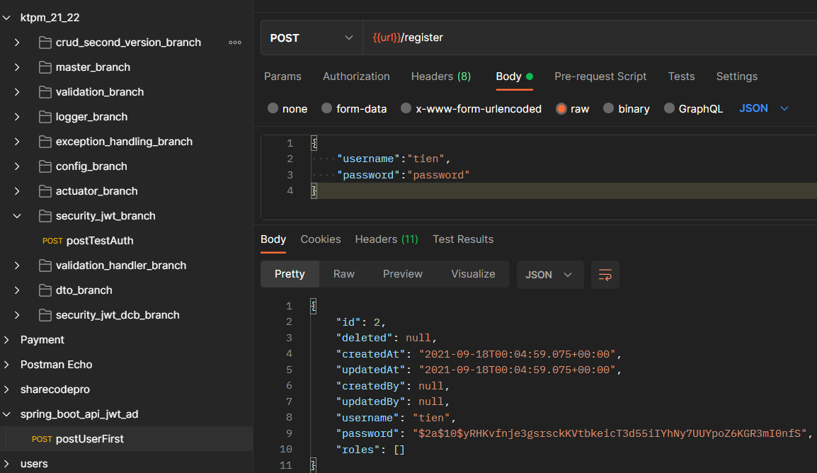

Step 01-Add user
Notes:
Branch master add basic some thing for prepare

Slide 23
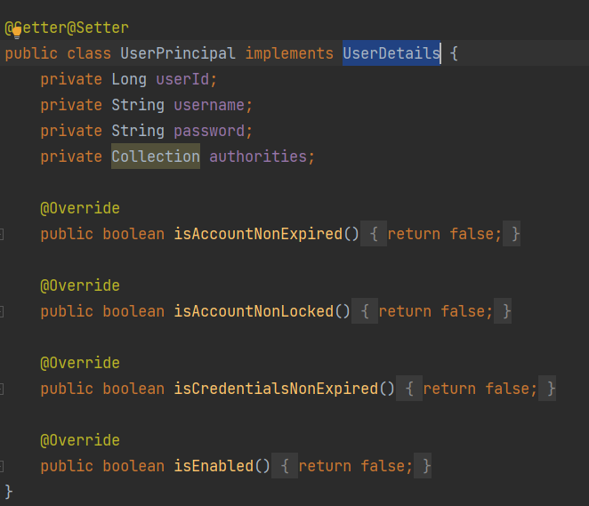
Step 02-Authen package
Notes:
Branch master add basic some thing for prepare

Slide 24
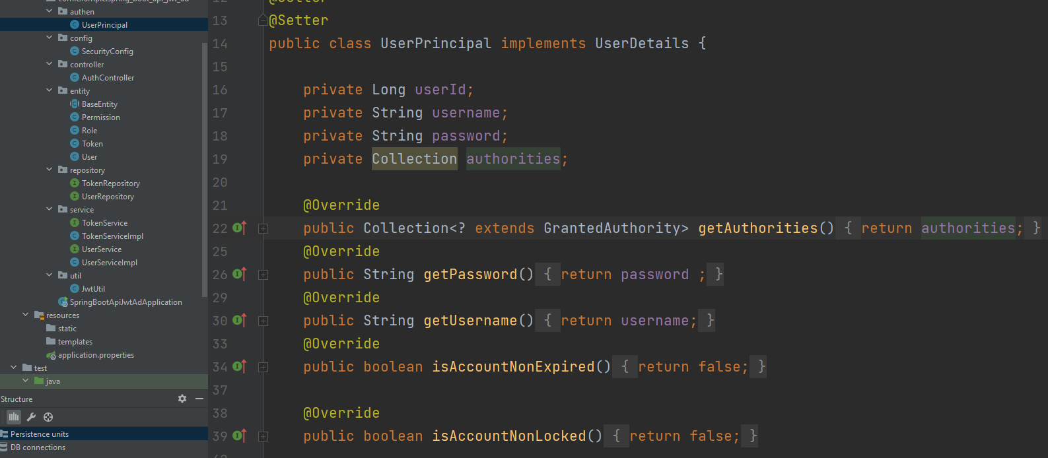
Step 02-Add UserPrincipal
Notes:
Branch master add basic some thing for prepare

Slide 25
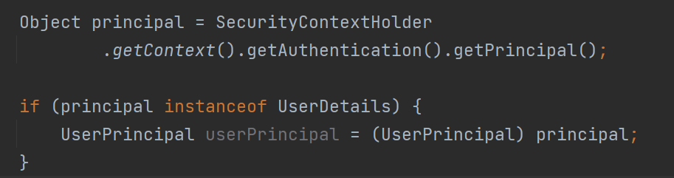
Explan step 02

Slide 26
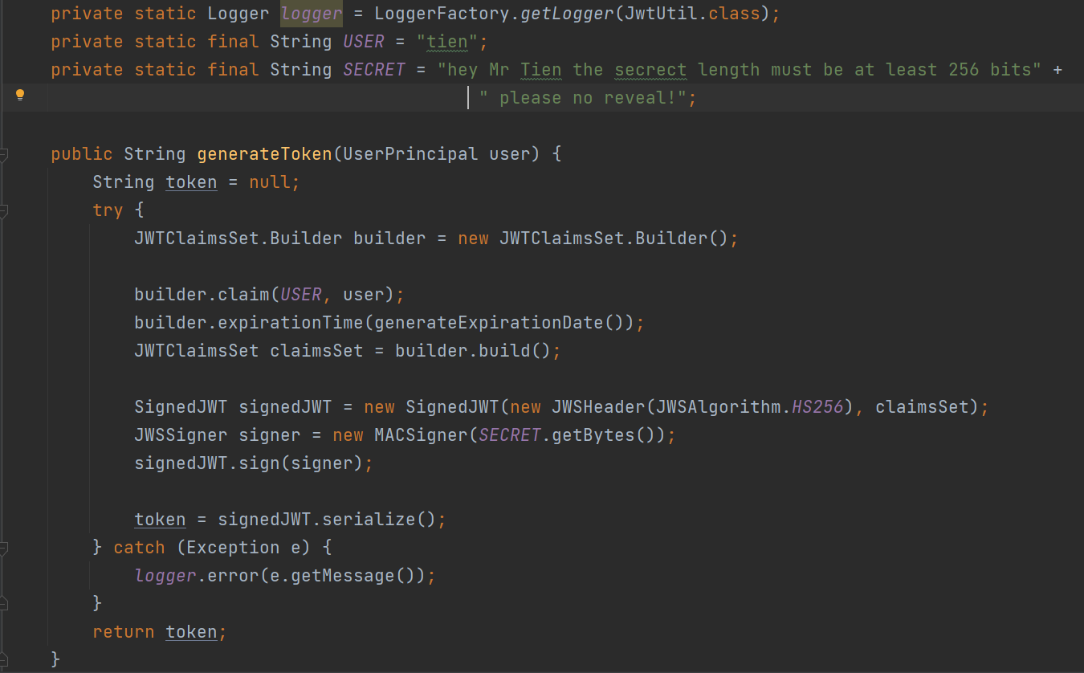
Step 03-JwtUtil class

Slide 27
Explain: Login-Logout
Login → client save token
Logout → client clear token

Slide 28
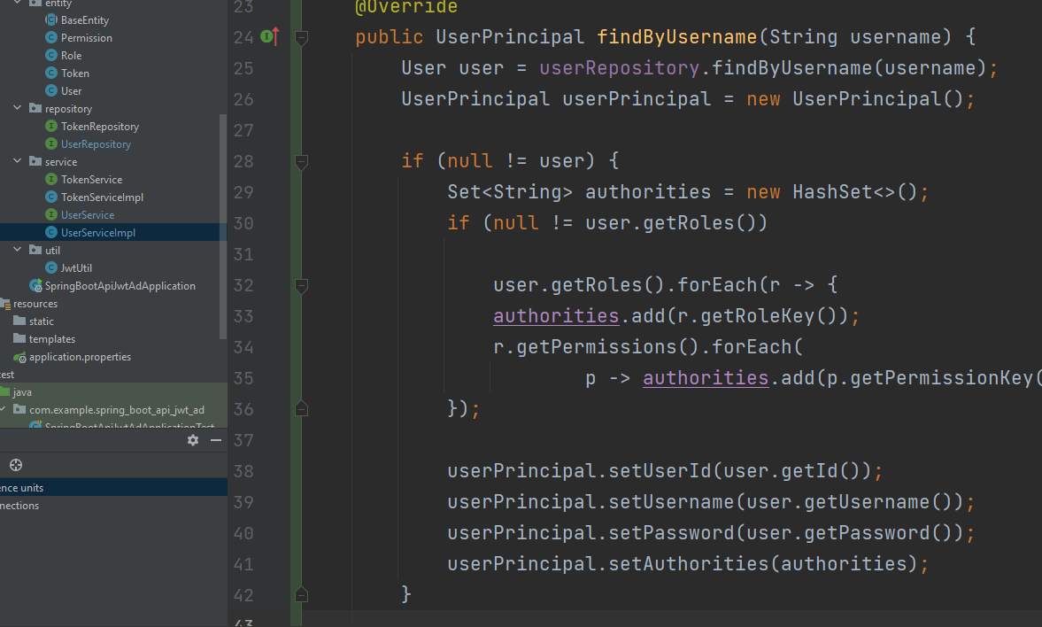
Step 04-findByUsername

Slide 29
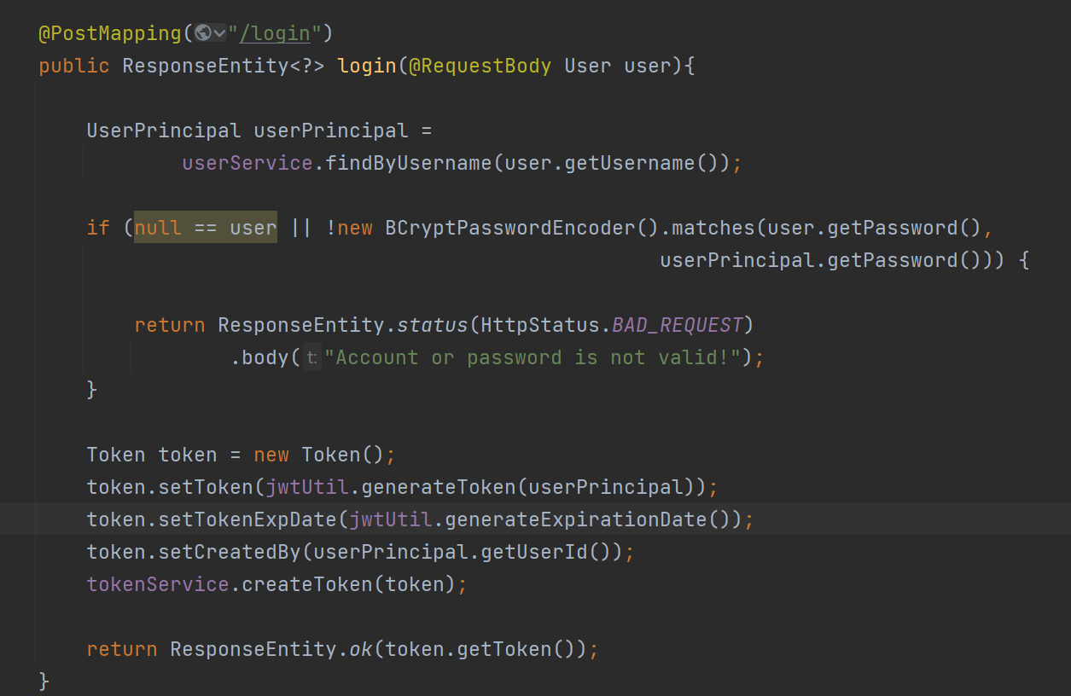
Step 05-make PostMapping Login

Slide 30
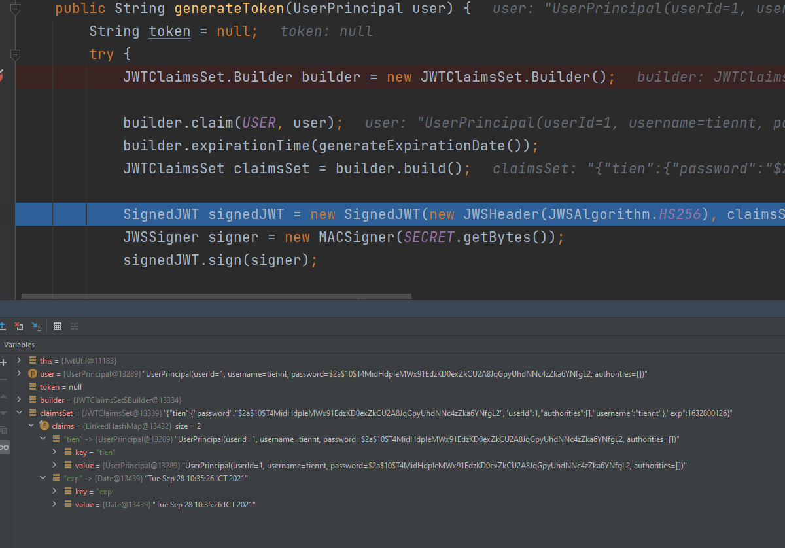
Generate Token

Slide 31
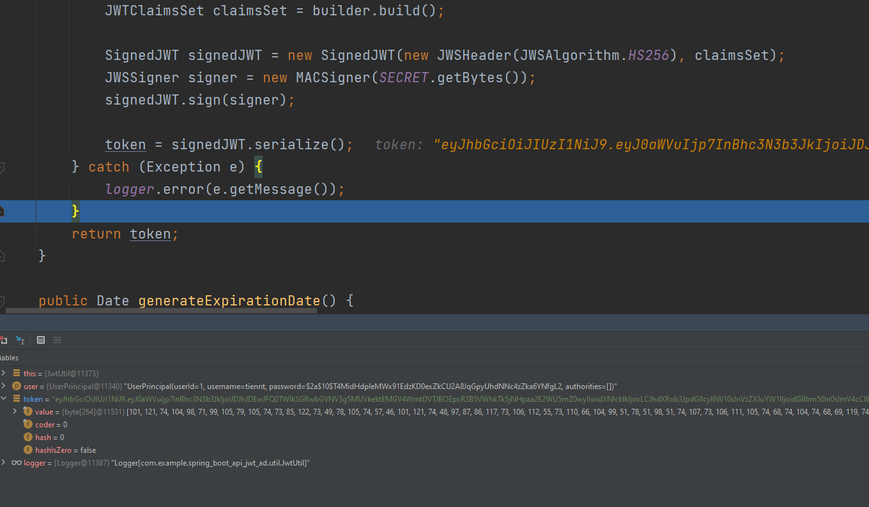
Generate Token

Slide 32
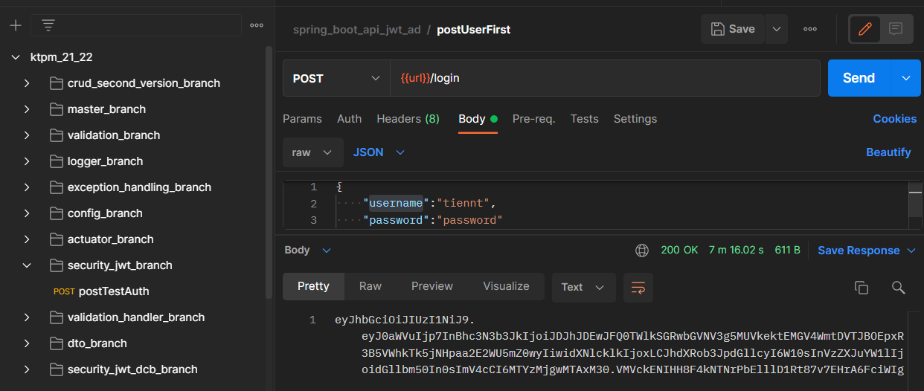
Step 06-Postman request

Slide 33
Explain flow! Debug
Register
Login
Return token

Slide 34
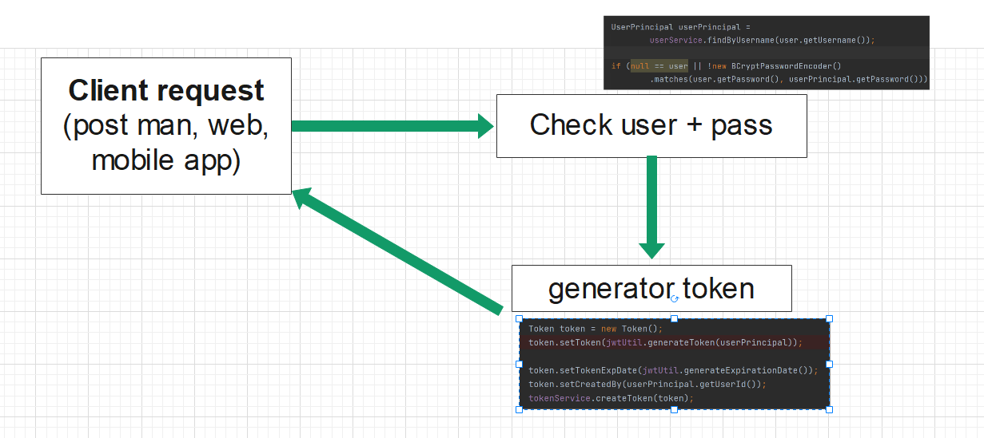
Explain flow! Debug

Slide 35
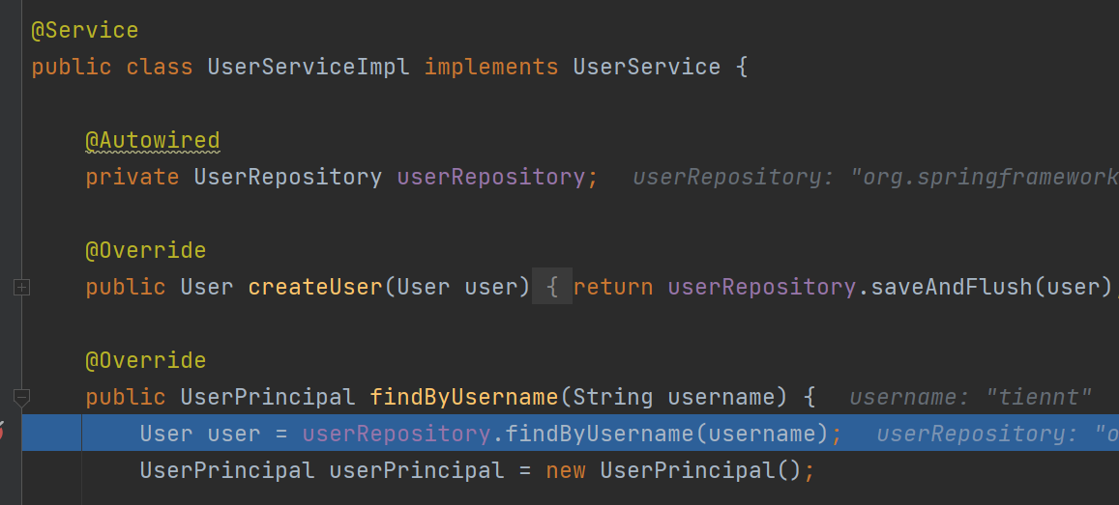
Explain flow! Debug

Slide 36
JWT Read Token, Authentication-Authorization-Role-Permission

Slide 37
Question
How we can read Token to know some thing? Such as: which account? exp? which permission?
How to add permission over method in program?

Slide 38
More Detail JWT Authentication-Role-Permision

Slide 39
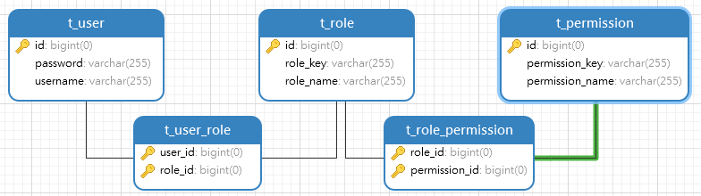
Explain Role, Permission!

Slide 40
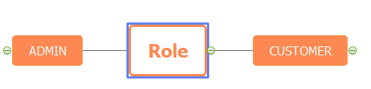
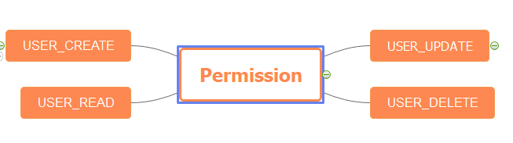
Detail Role, Permission!

Slide 41
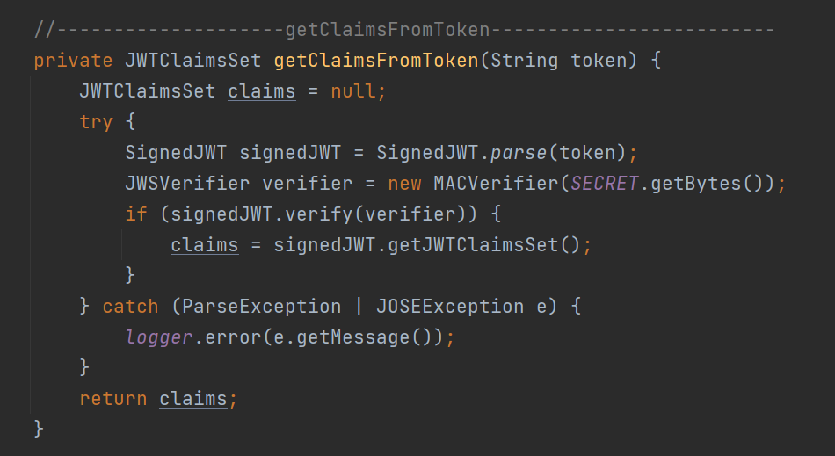
getClaimsFromToken

Slide 42
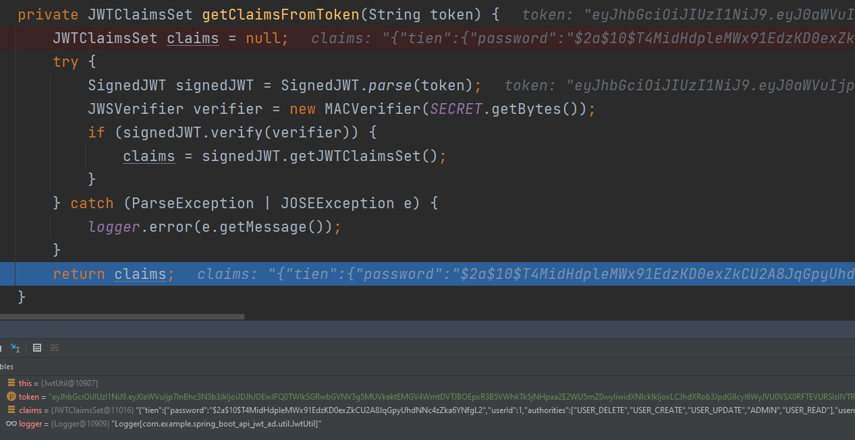
Some method to Read JWT

Slide 43
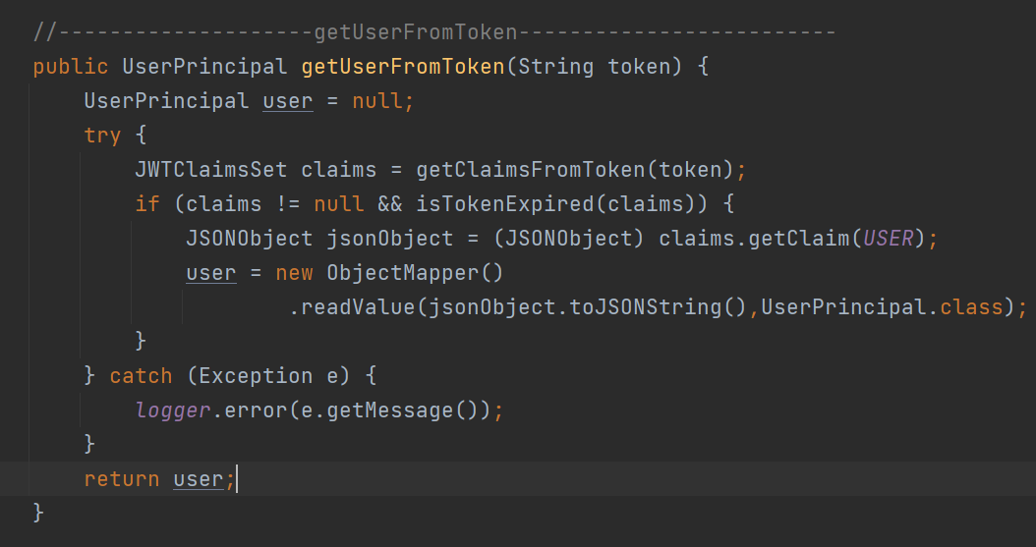
Some method to Read JWT

Slide 44
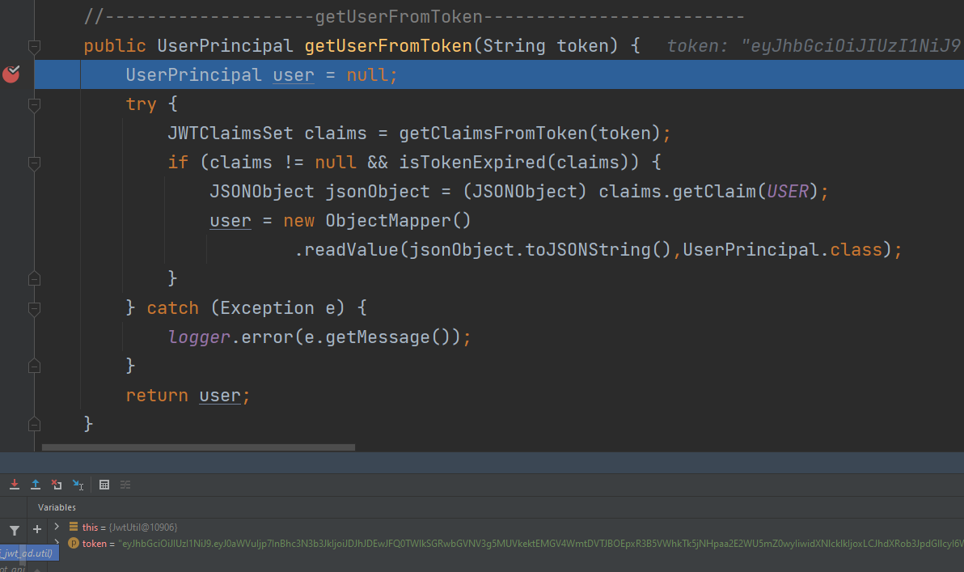
getUserFromToken

Slide 45
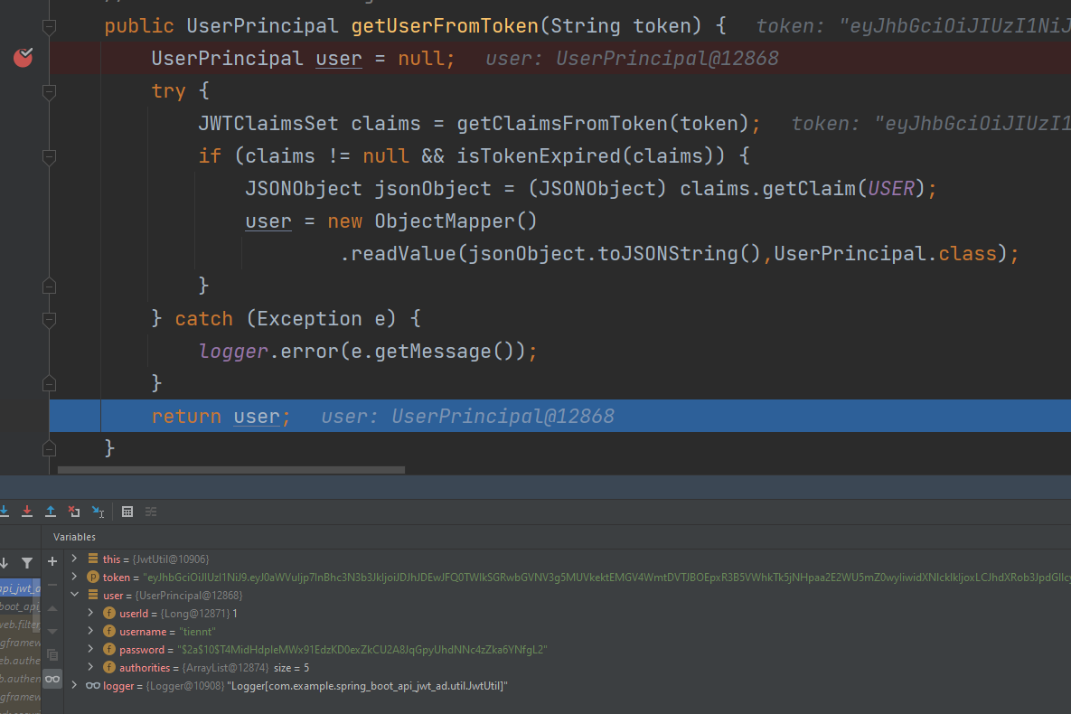
getUserFromToken

Slide 46
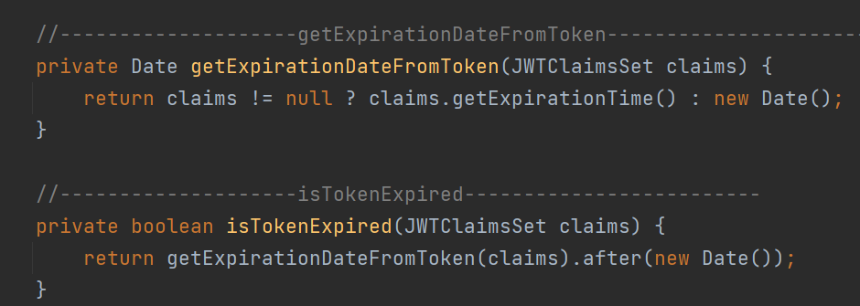
Some method to Read JWT

Slide 47
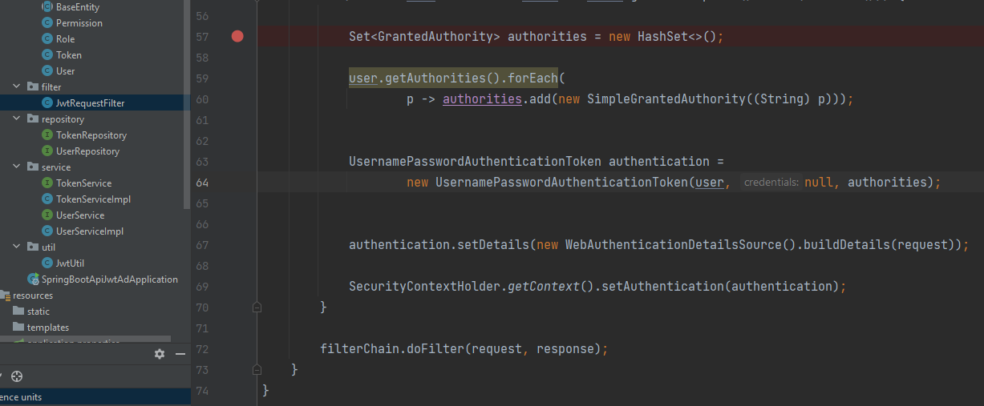
Make class to filter

Slide 48
Make class to filter

Slide 49
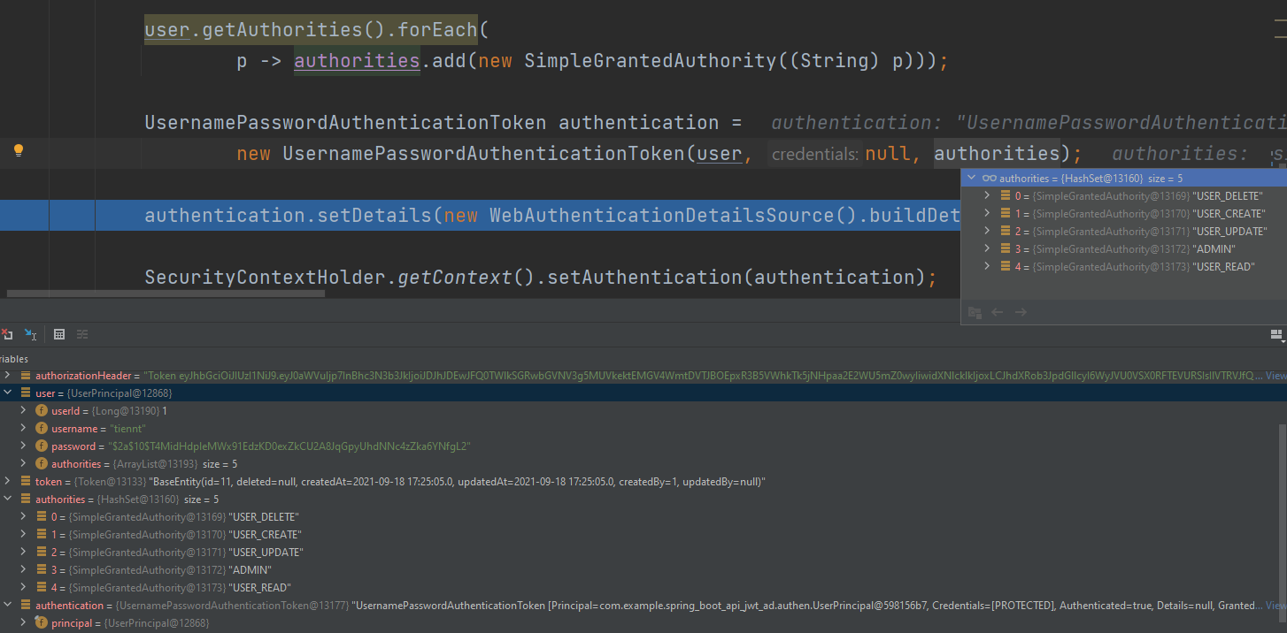
Make class to filter

Slide 50
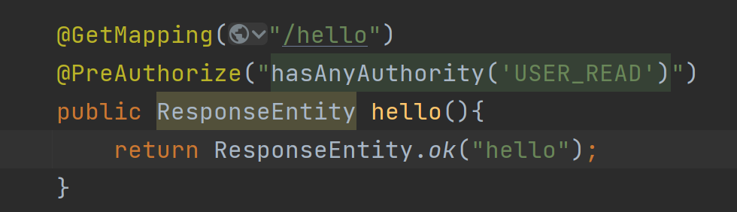
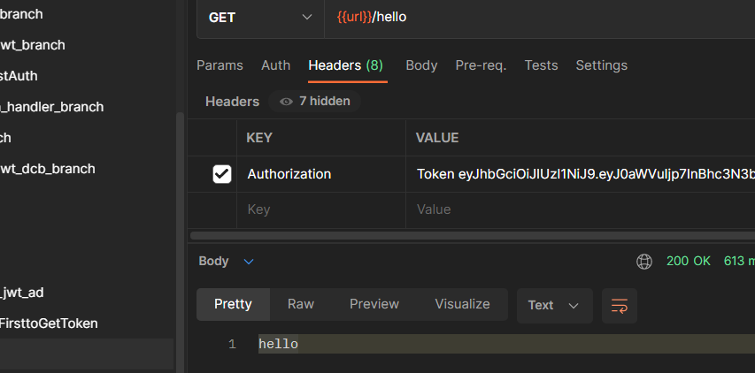
Postman to test!

Slide 51
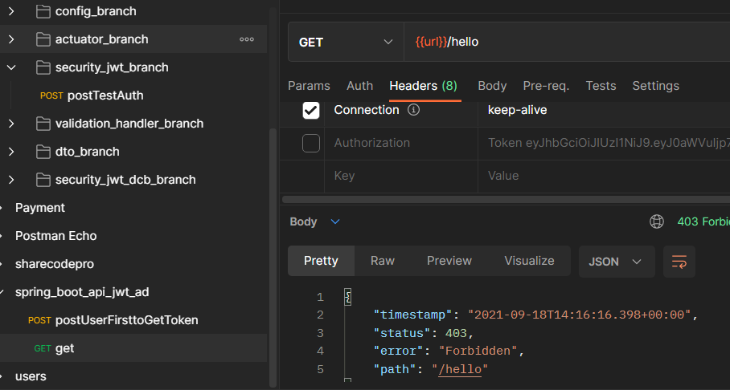
Postman to test!

Slide 52
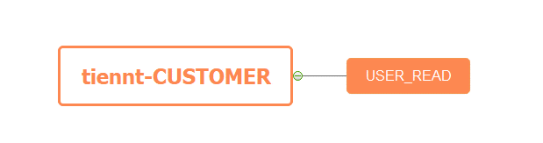
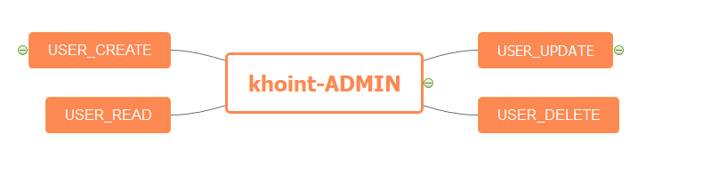
Test role and permission!

Slide 53
Run test Role→ADMIN debug

Slide 54
ADMIN JWT-Postman

Slide 55
Run test Role→CUSTOMER debug

Slide 56
CUSTOME JWT-Postman

Slide 57
Refesh Token

Slide 58
Actuator

Slide 59
Thank you!

