Slide 1
Spring Boot API

Slide 2
List
CRUD
Exception Handling
Data Transfer Object
Advance Query
Validation
Profiles
Logger
Security jwt
Actuator

Slide 3

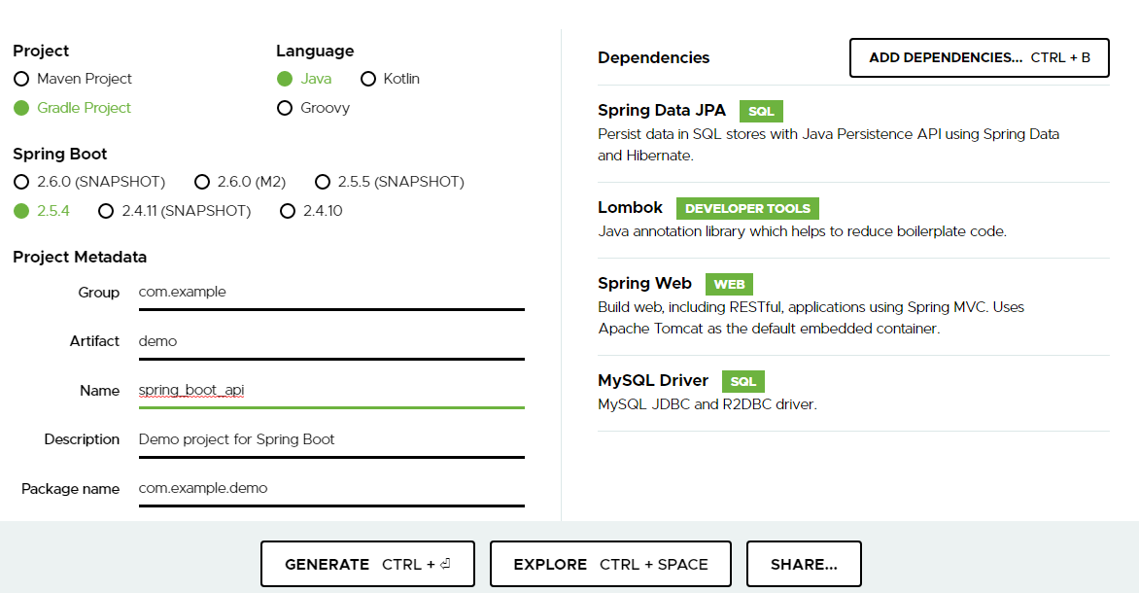
Creating a New Spring Boot Project

Slide 4
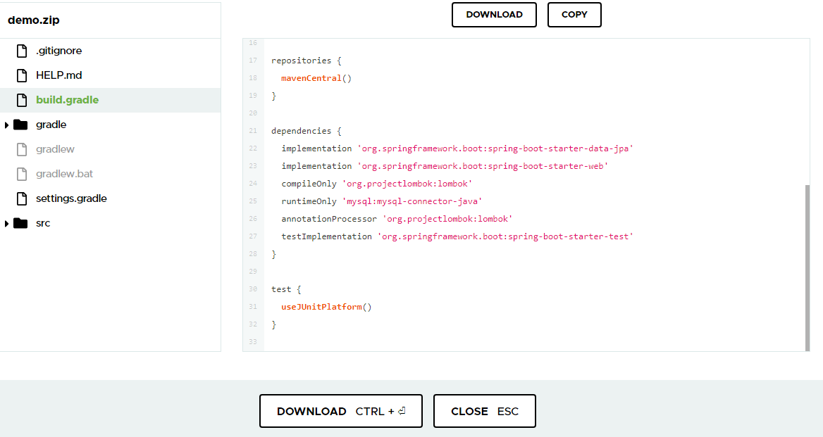
Gradle Dependency

Slide 5
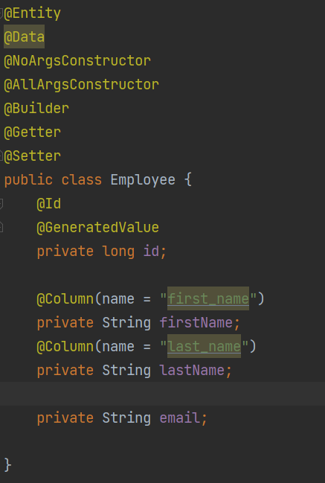
Creating an Employee Entity

Slide 6
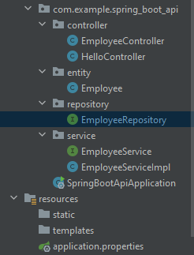
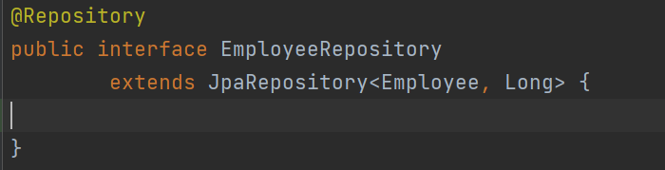
Creating a Repository Interface

Slide 7
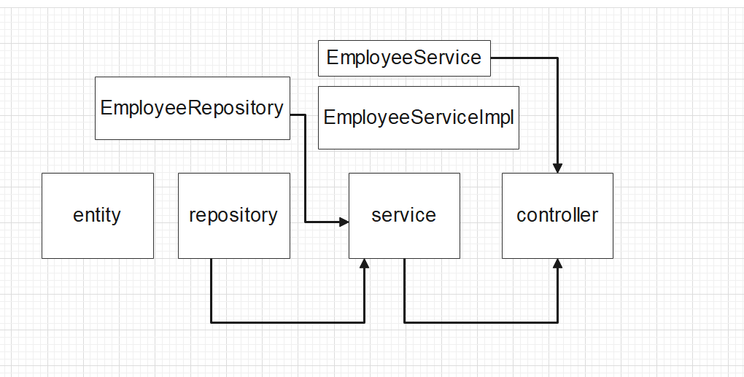
Structure of project basic

Slide 8
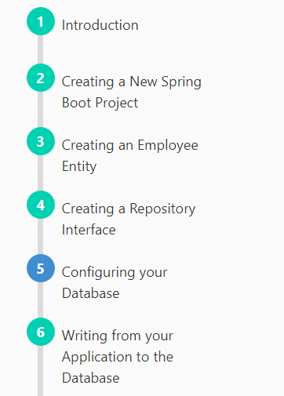
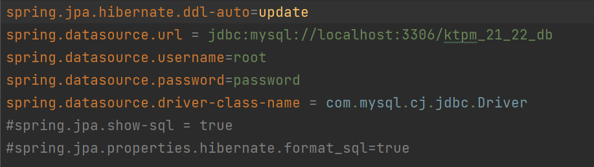
application.properties

Slide 9
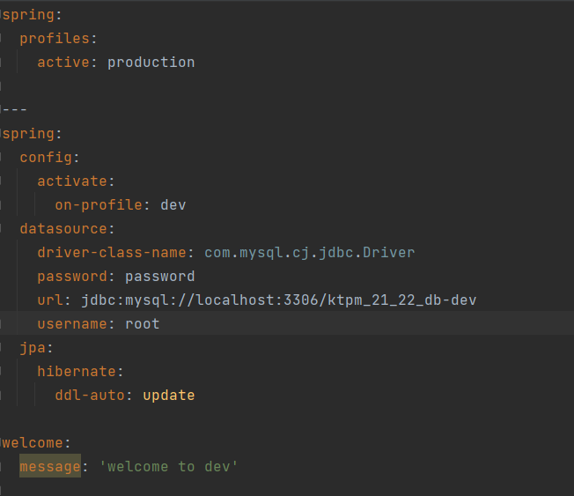

application.yml

Slide 10
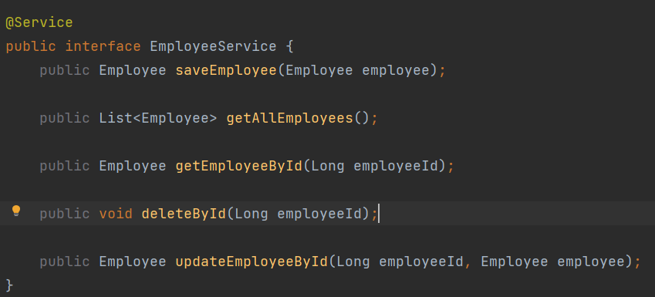

EmployeeService

Slide 11
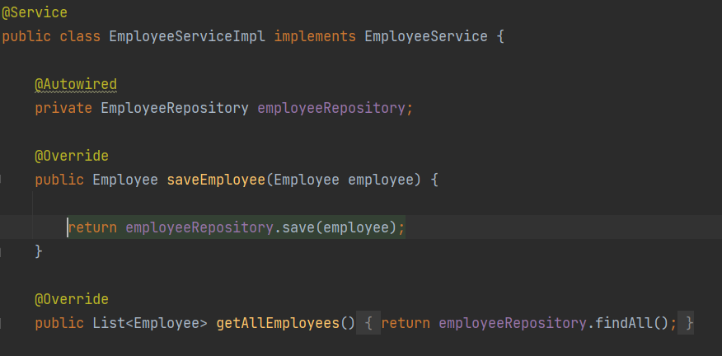
Implements EmployeeService

Slide 12
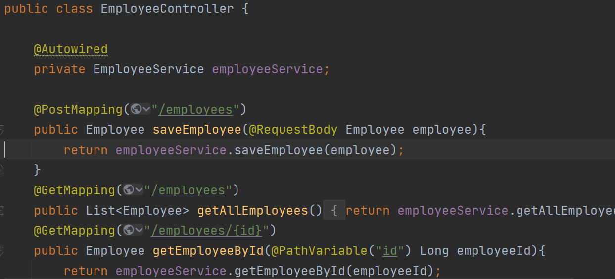

EmployeeController

Slide 13
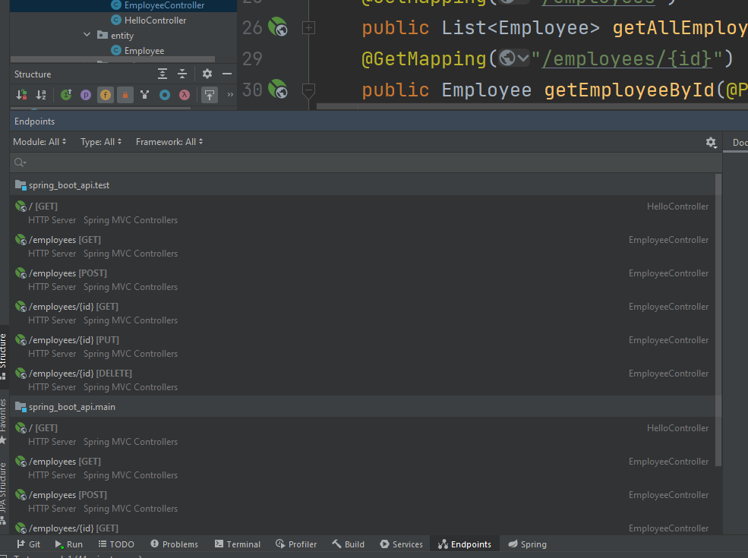

Endpoint

Slide 14
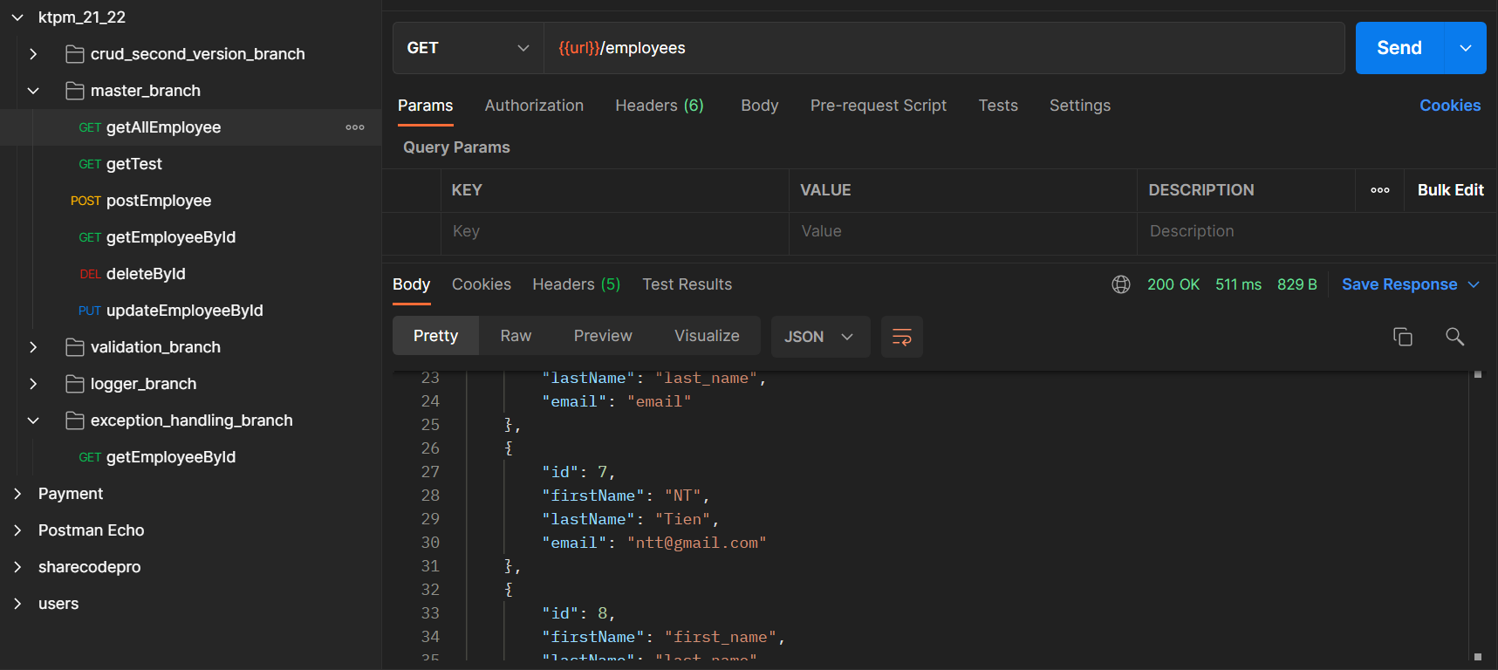
Postman

Slide 15
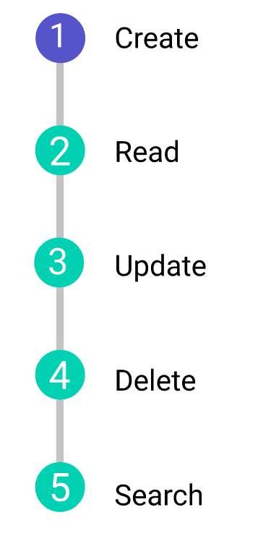
Send a request

Slide 16
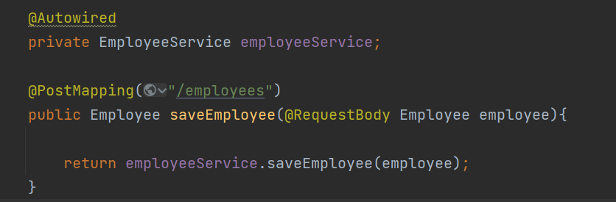

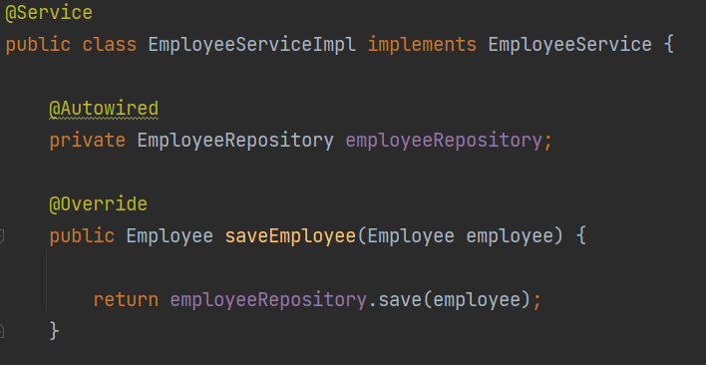
Save entity-POST

Slide 17
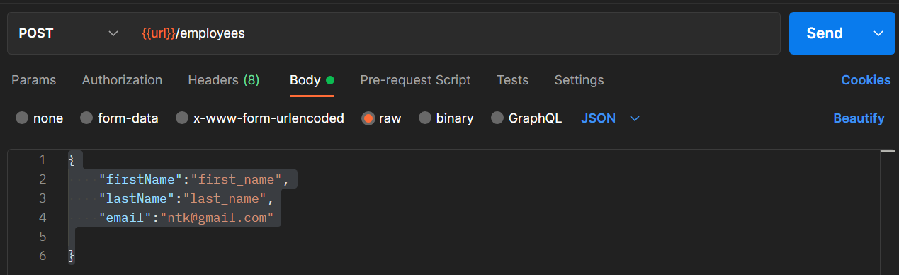
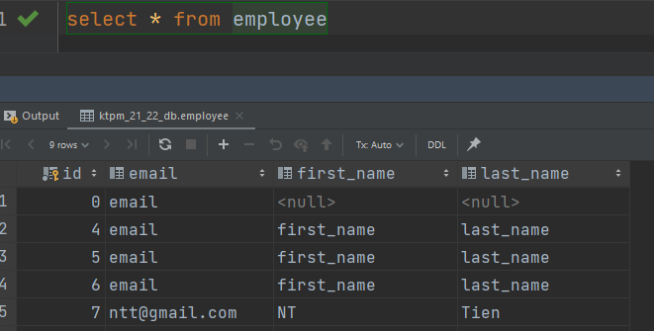
Save entity-POST

Slide 18
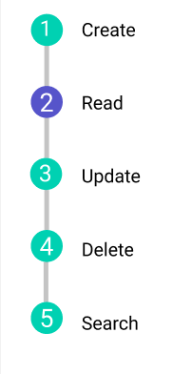
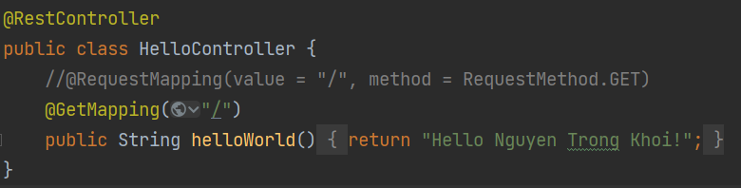
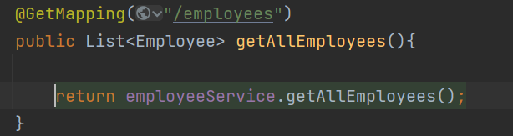
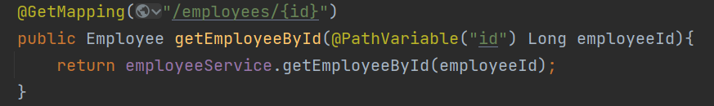
Read

Slide 19
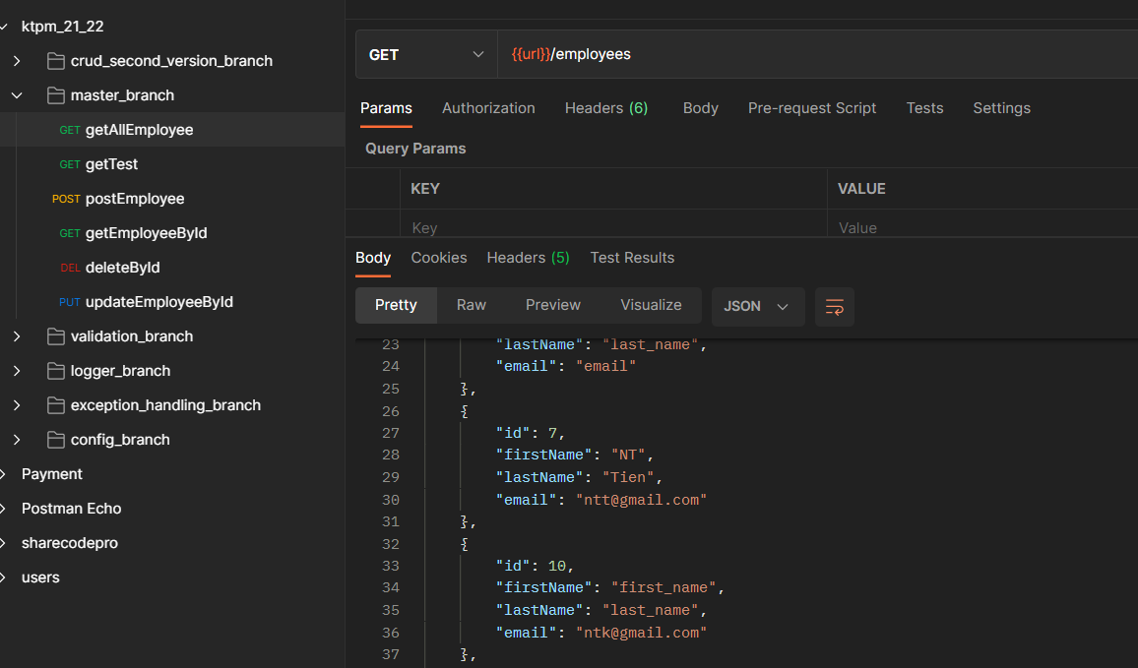

Read result

Slide 20
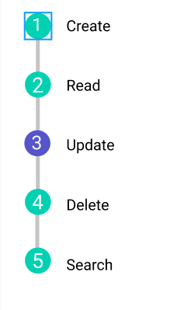
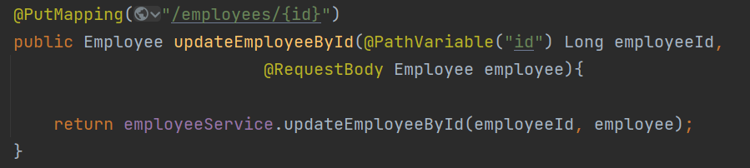
Update by Id

Slide 21
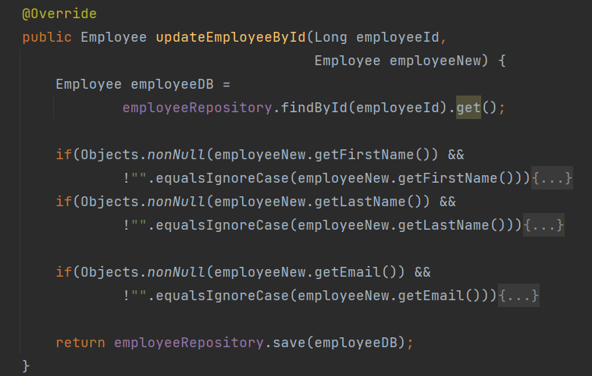
Update result

Slide 22
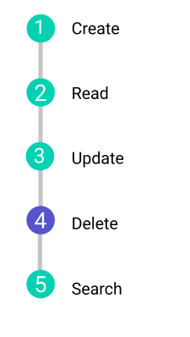
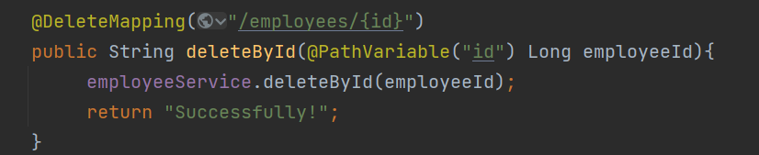
Delete by Id

Slide 23
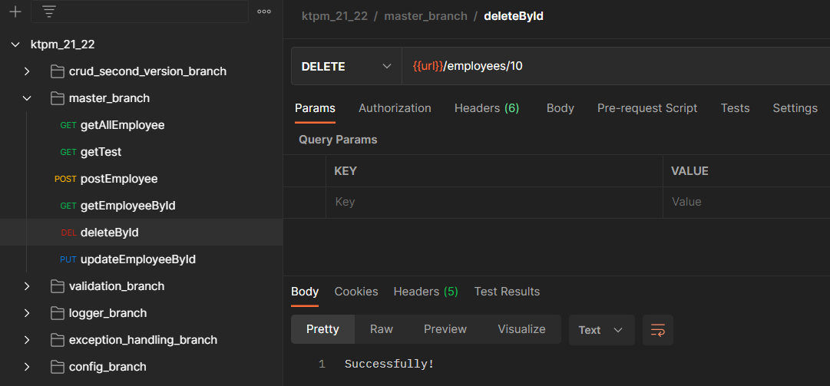
Delete by Id

Slide 24
Validation

Slide 25
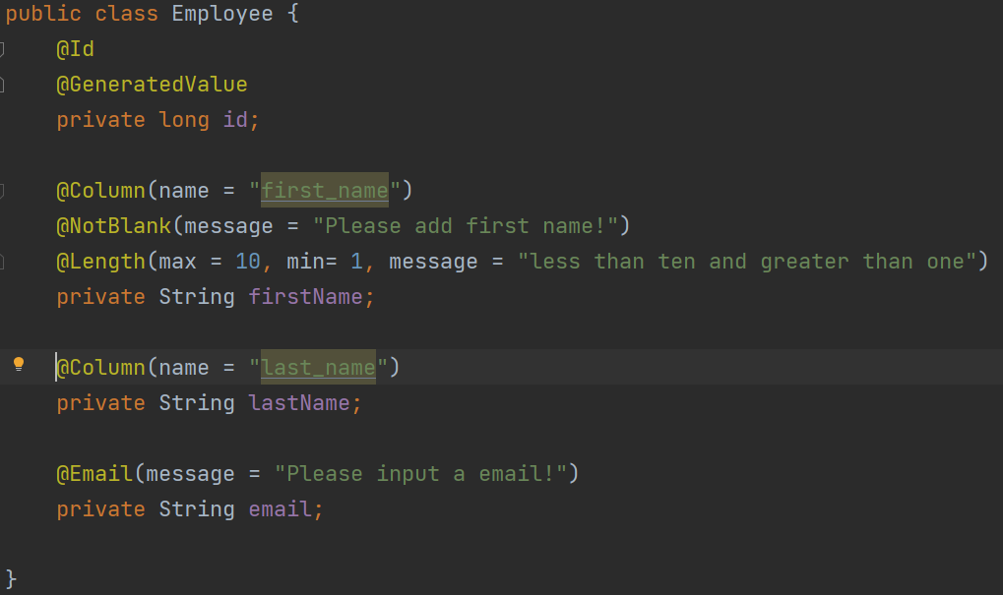
Validation

Slide 26
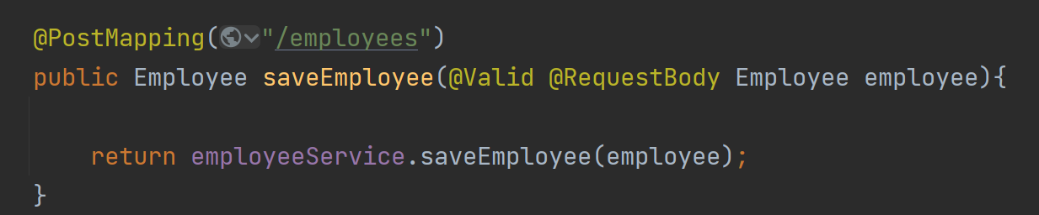
Validation

Slide 27
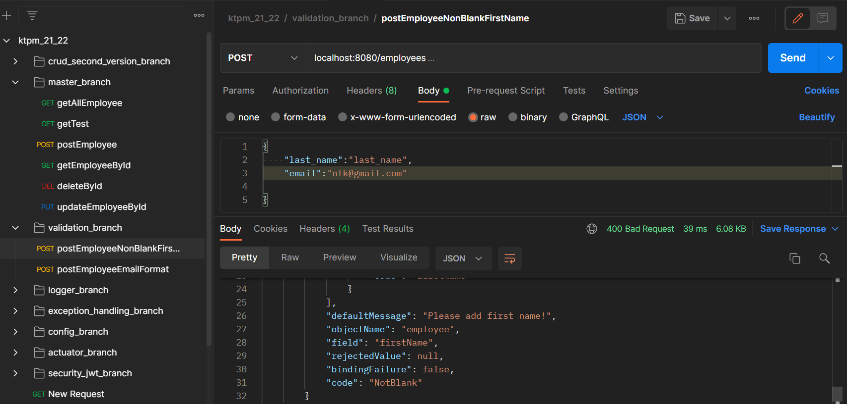
Validation

Slide 28
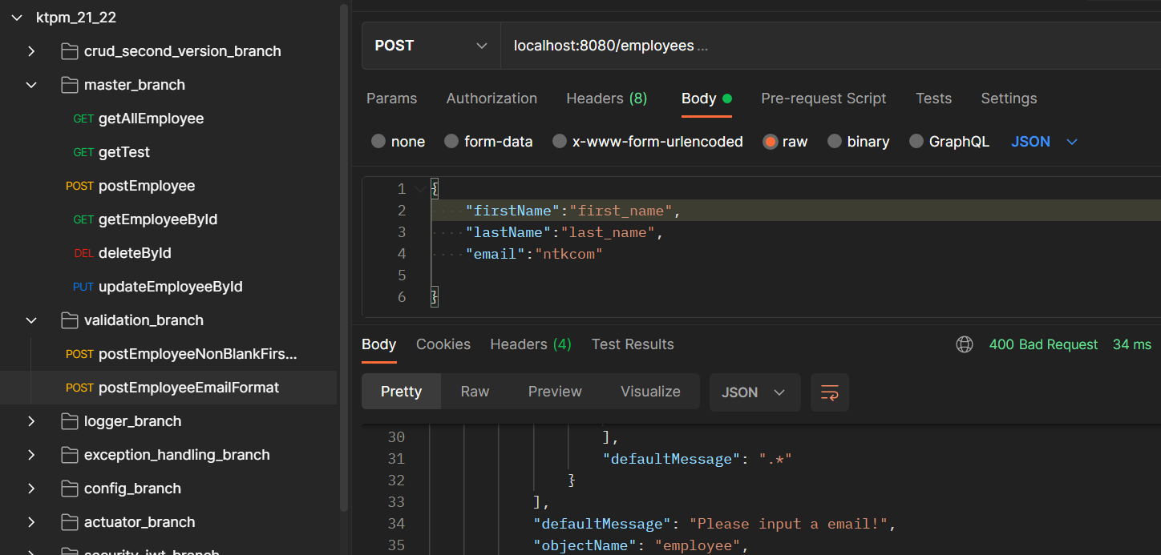
Validation

Slide 29
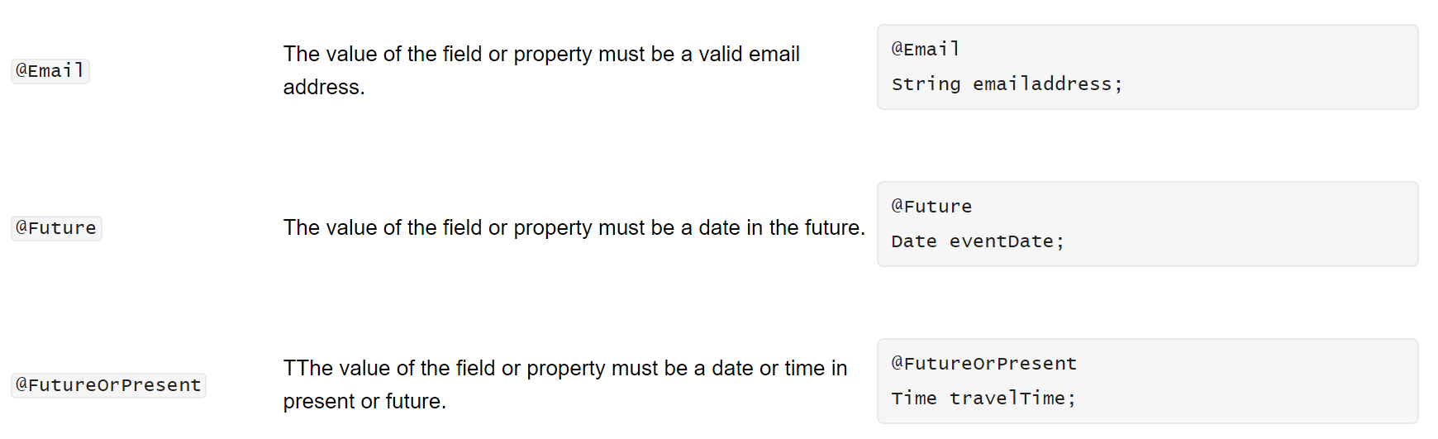
Validation
https://javaee.github.io/tutorial/bean-validation002.html

Slide 30
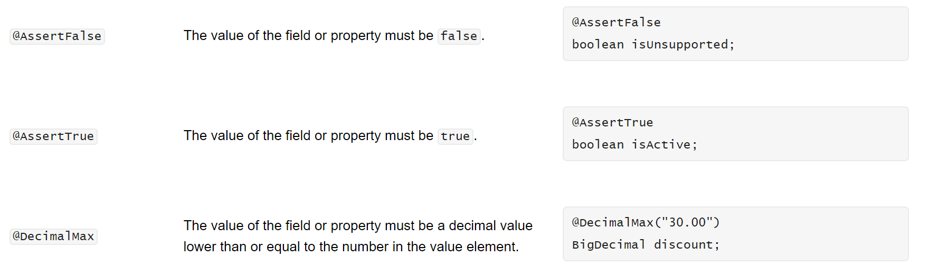
Validation
https://javaee.github.io/tutorial/bean-validation002.html

Slide 31
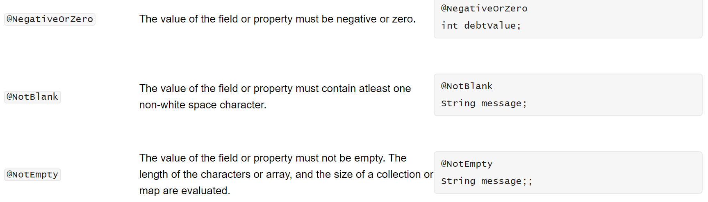
Validation
https://javaee.github.io/tutorial/bean-validation002.html

Slide 32
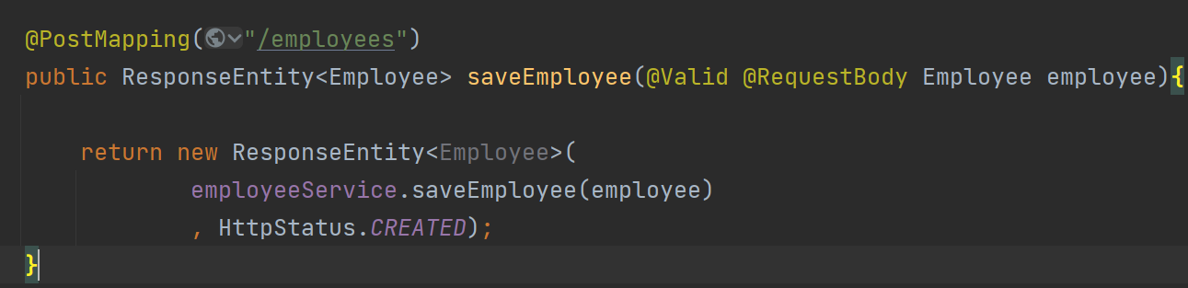
ValidationHandler

Slide 33
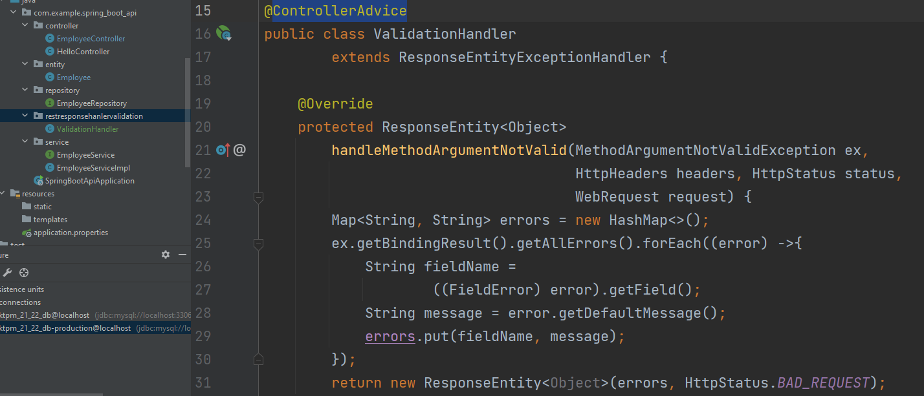
ValidationHandler

Slide 34
ValidationHandler

Slide 35
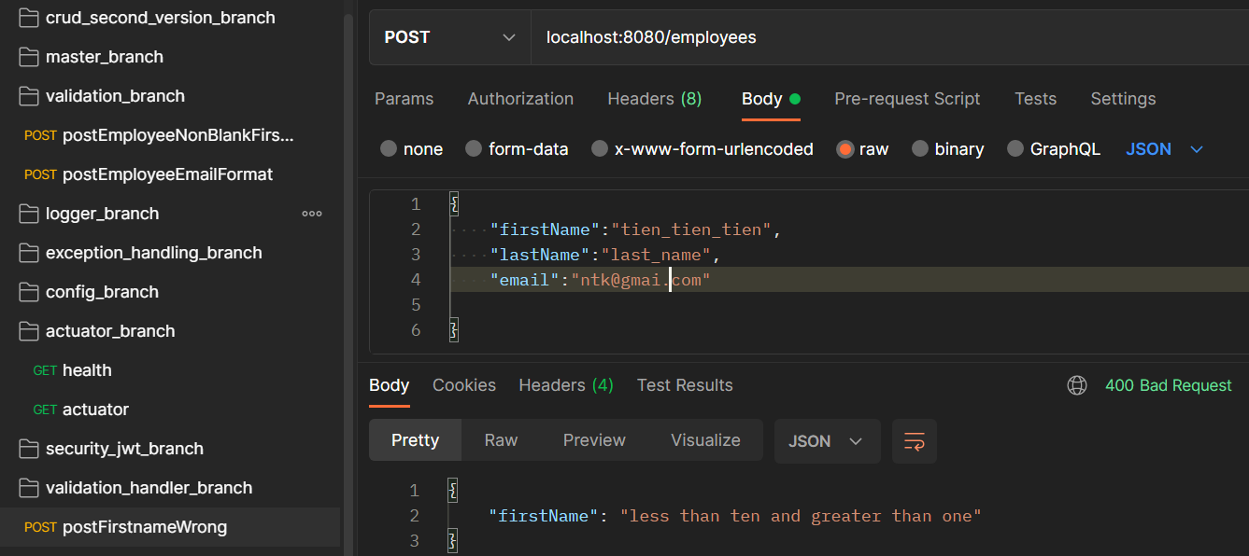
Result

Slide 36
Data Transfer Object-DTO

Slide 37
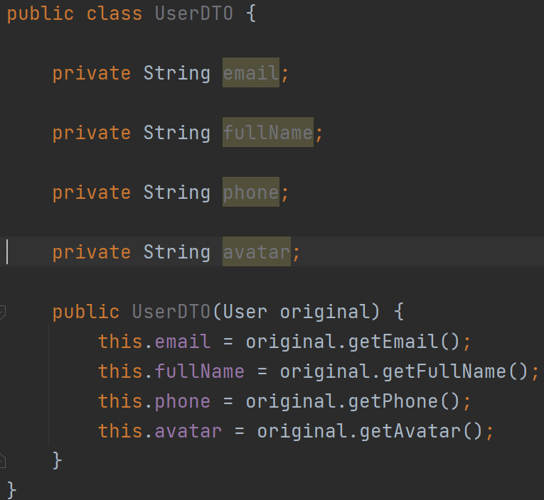
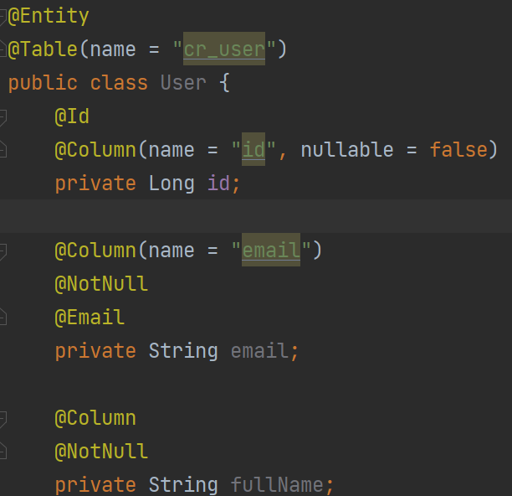
What is Data Transfer Objec?

Slide 38
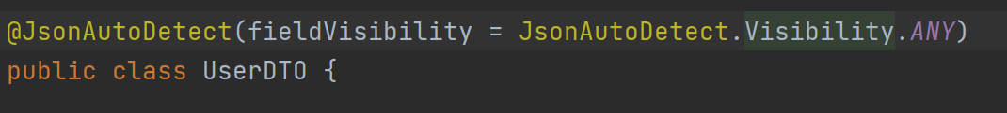
What is Data Transfer Objec?

Slide 39
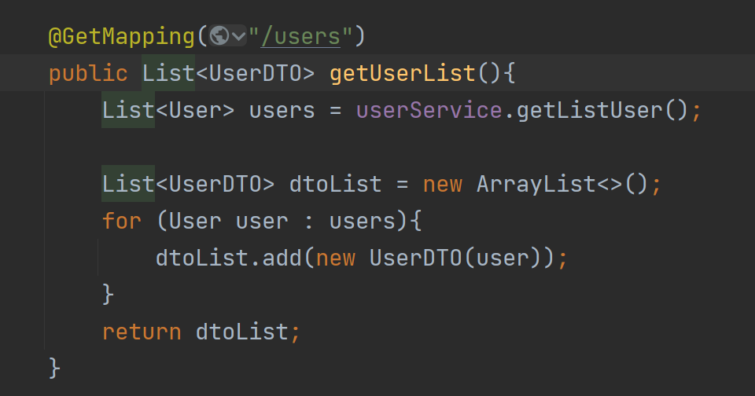
What is Data Transfer Objec?

Slide 40
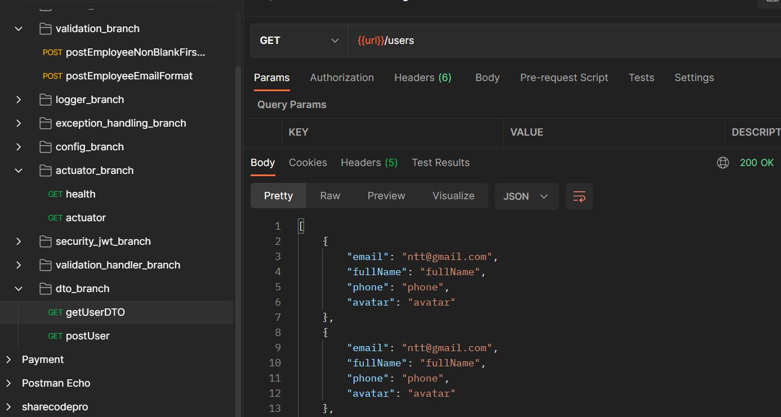
What is Data Transfer Objec?

Slide 41
Logger

Slide 42
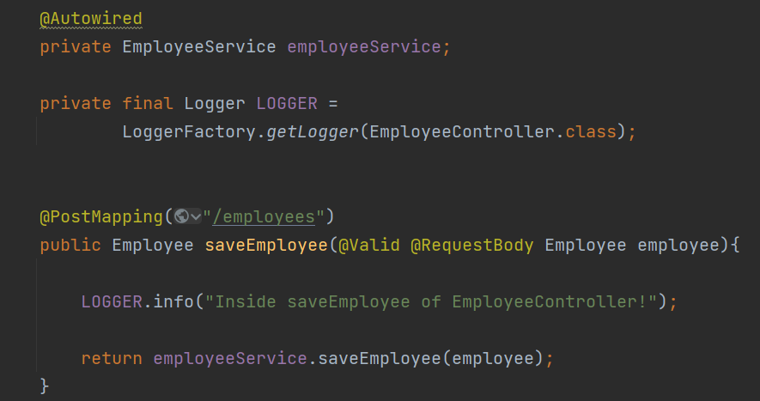
Logger

Slide 43
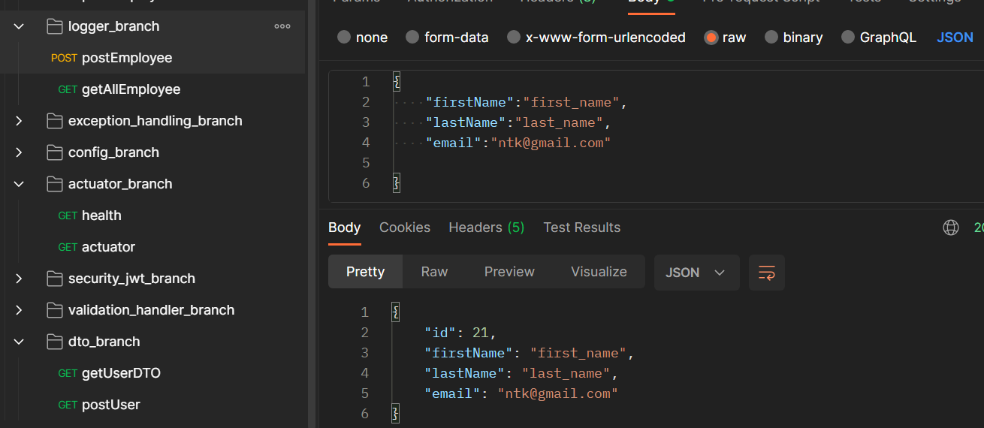
Logger

Slide 44
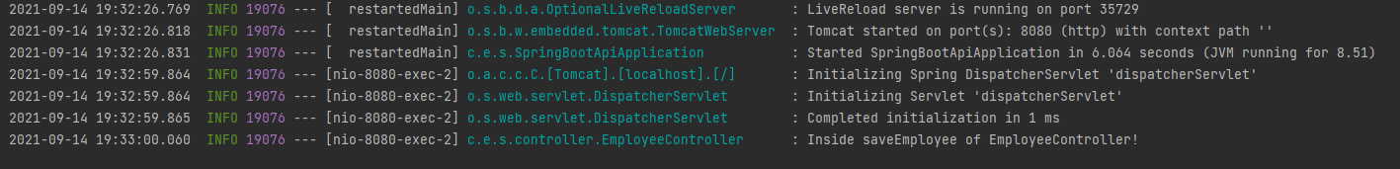
Logger

Slide 45
Profiles

Slide 46
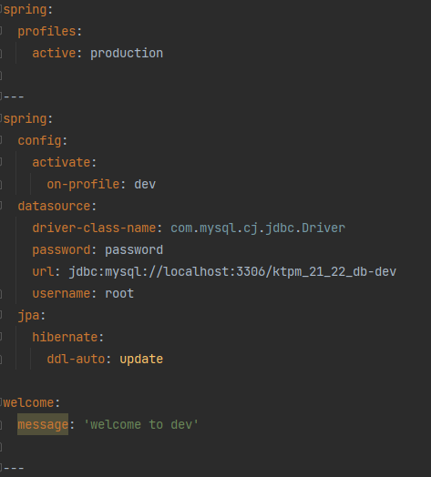
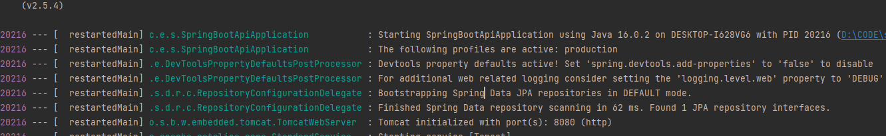
Logger

Slide 47


Logger

Slide 48

Logger

Slide 49
swagger

Slide 50
Exception Handling

Slide 51
Actuator

Slide 52
Security jwt

Slide 53
Thank you!

