Slide 1
Bird N
<
55
Observations
+
-

Slide 2
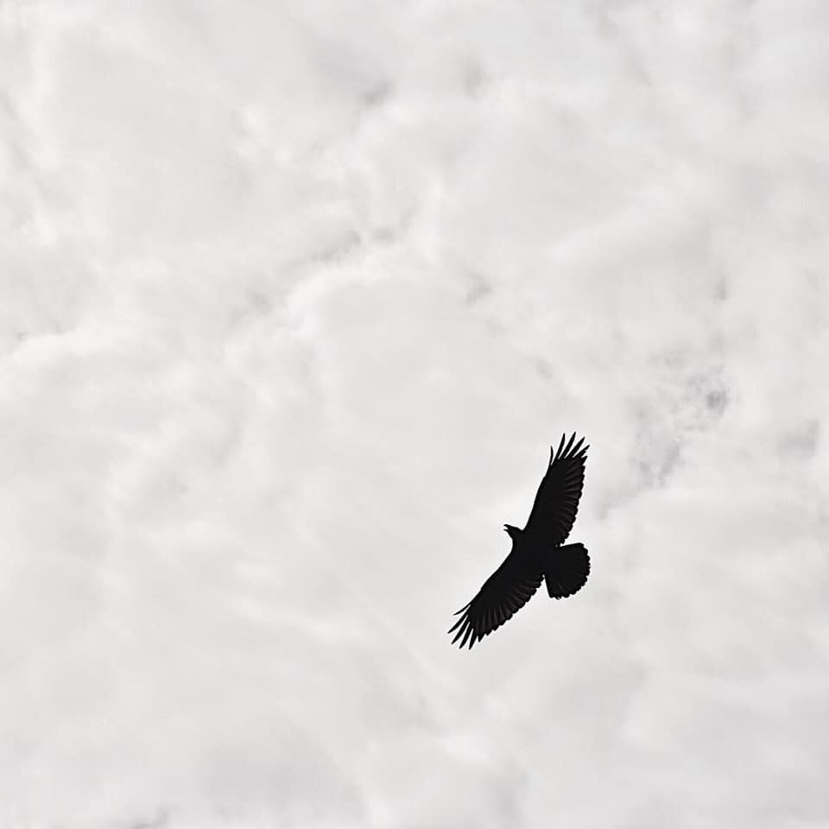
Edit
<
Change Photo
Name
Eagle
Remove bird

Slide 3
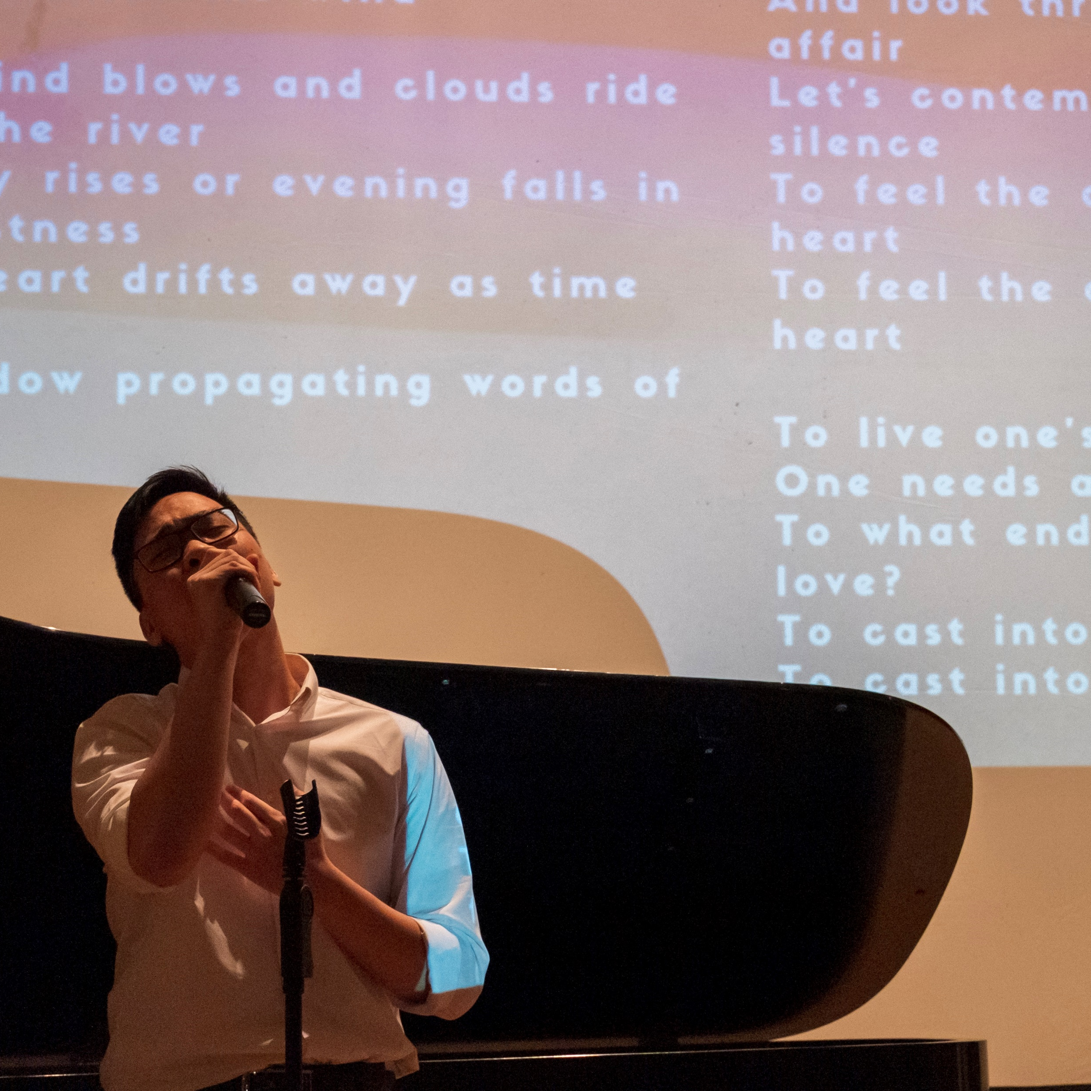
Edit
<
Change Photo
Name
Nathan Truong
Bio
Augustana College

