Slide 1

People Analytics Case Study Thien-Trang Nguyen

Slide 2
Agenda
I.
Problem Statement
II.
New Hire Analysis
III.
Turnover Analysis
IV.
Bad Hire Analysis
V.
Recommendation

Slide 3
I. Problem Statement

Slide 4
Case Study: ABC Business Unit
This case study is dedicated to analyses of new hires, turnover rates and bad hires for an ABC business unit. Insights provided in these areas will allow the business unit to better understand its workforce and thereby acquiring opportunities to improve operations accordingly.

Slide 5
II. New Hire Analysis

Slide 6
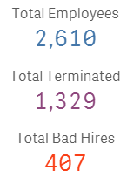
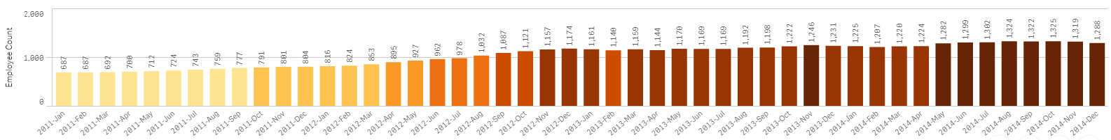
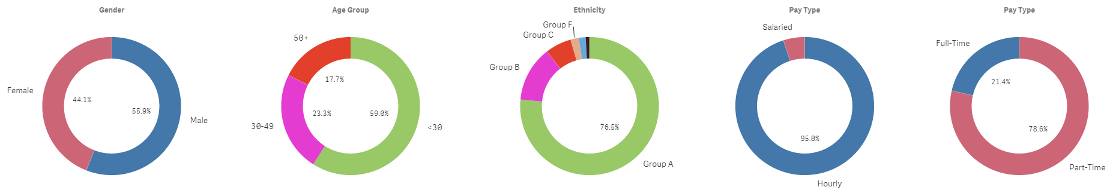
Employee Base
To understand new hire trends, we would like to show what the employee base looks like on a monthly basis for the time periods covered in the dataset, which is 2011-2014 and also in terms of distributions by gender, age group, ethnicity, pay type and full/part-time.

Slide 7
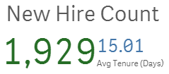
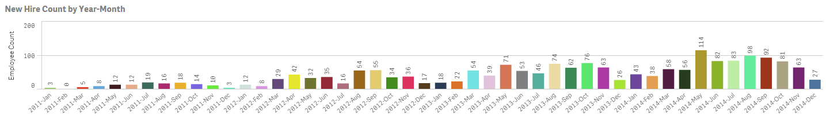
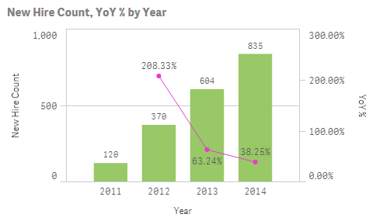
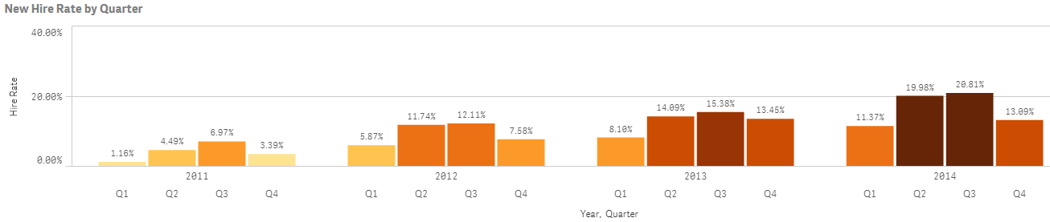
New Hire: Definition
Under the isNewHire definition, employees who are flagged as a “new hire” is anyone with a hire date that is within the month of the reporting date—the date field. All new hires happened in 2011-2014. New Hire Rate below is total new hire / avg of employee count at beginning and end of that quarter.

Slide 8
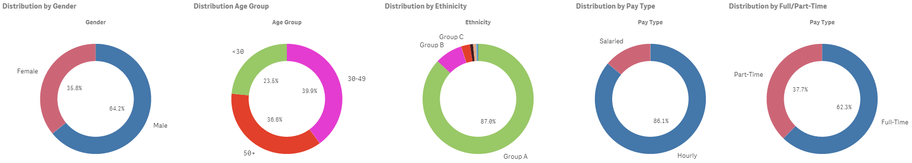
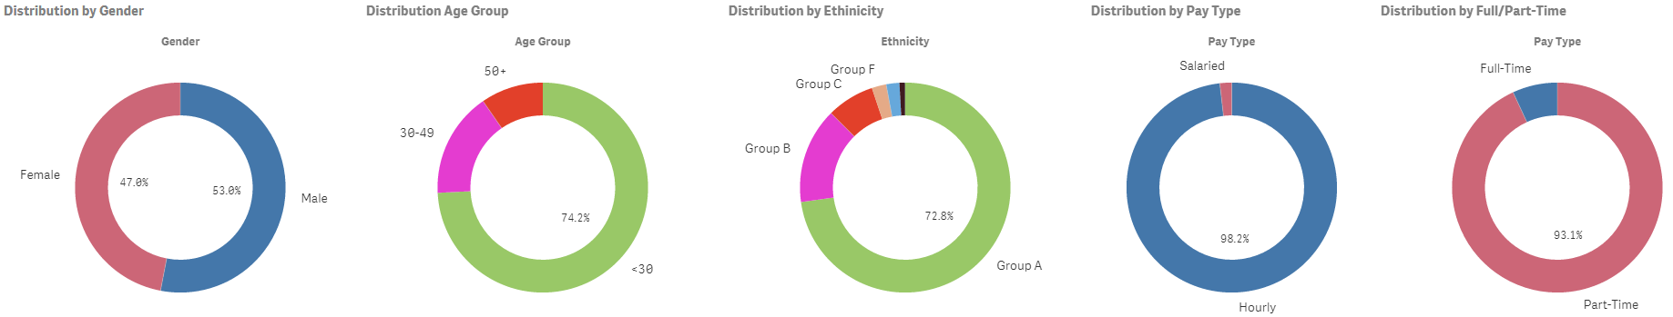
New Hire: Distribution
All new hires happened in 2011-2014, hence we can compare the employee distributions in terms of gender, age group, ethnicity, pay type and full/part-time for new hires against the distributions for those hired before 2011.
Pre 2011 Hires
New Hires

Slide 9
New Hire: Trends
1
All new hires happened in 2011-2014, totaling 1,929 employees with an avg tenure of 15 days.
Q2, Q3 tend to have higher New Hire Rate
2012 had the highest % growth in new hire
2
There were more equality in terms of gender for new hires, but overwhelming portion (75%+) were below 30 yrs old, of Group A descent, hourly, and part-timers
3
Conclusion: New hires are different from those hired prior to 2011. Hires in earlier years were more male, but more diverse in age groups and full/part-time roles.
**The BU seems to have hired younger, and more part-time employees in 2011-2014

Slide 10
III. Turnover Analysis

Slide 11
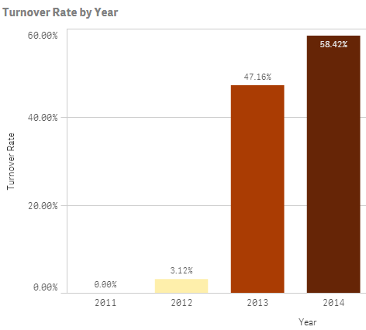
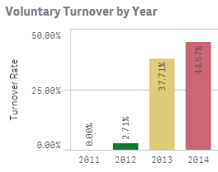
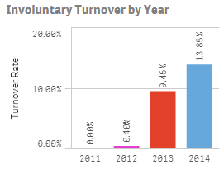
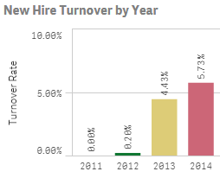
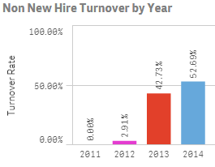
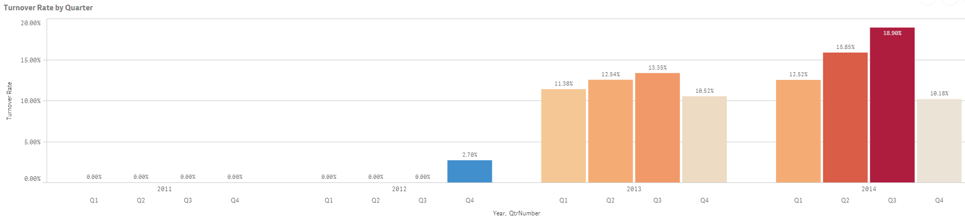
Turnover Rate: Definition
Turnover Rate is defined as total terminated employees / avg of employee count at beginning and end of that time period. For our analysis we chose to look at the annual and quarterly turnover rates.

Slide 12
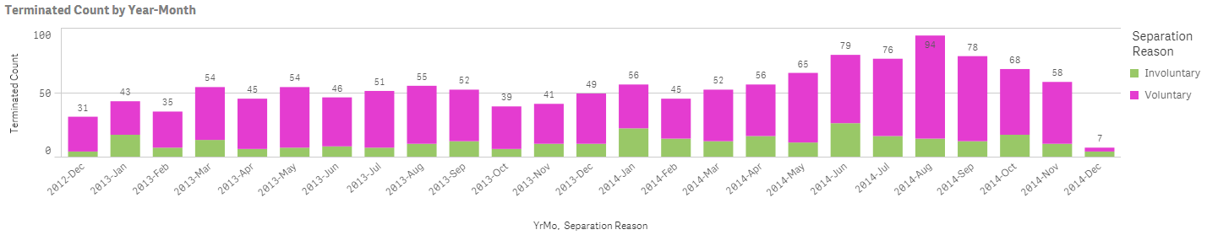
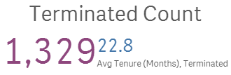
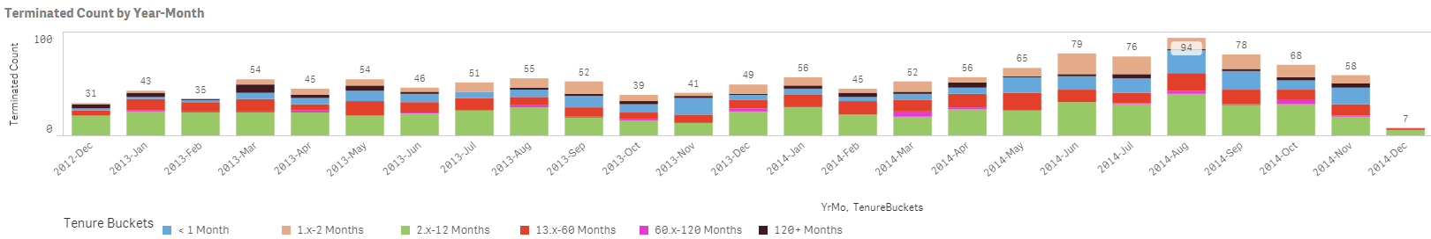
Termination
In addition to turnover rates, we would like to examine terminations from different angles such as termination count in each month, broken down by separation reason and tenure.

Slide 13
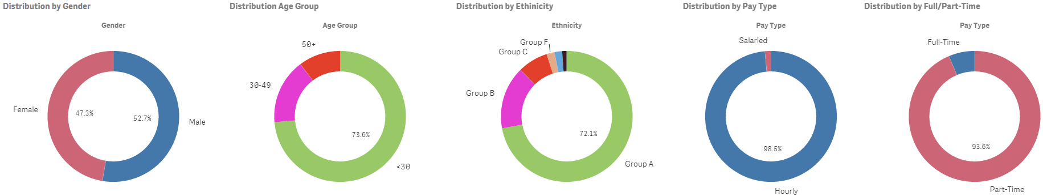
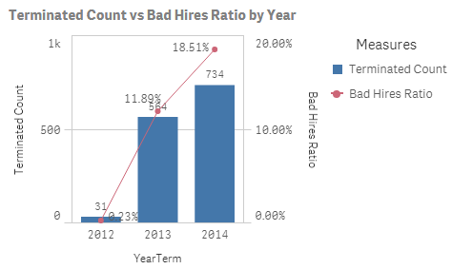
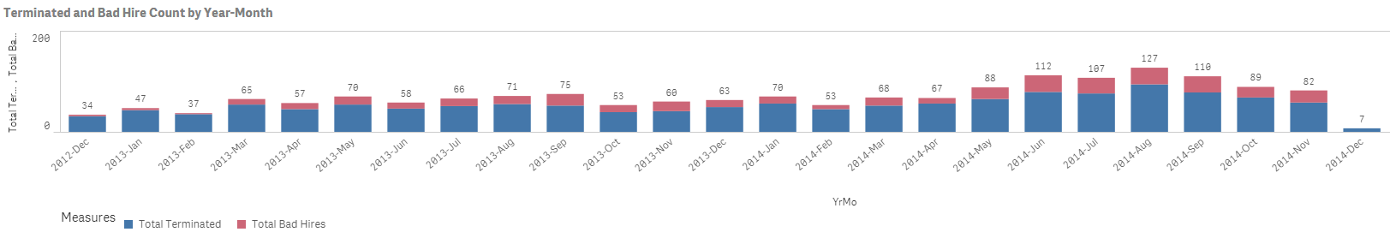
Termination: Distribution
We’d like to compare the employee distributions in terms of gender, age group, ethnicity, pay type and full/part-time for new hires against the distributions for those terminated. Additionally, bad hire as a portion of total terminations is reviewed at the year and month level.

Slide 14
Turnover: Trends
1
Turnover rates dramatically increased in 2013 and steadily rises in 2014, as hire rates were higher in Q2, Q3 of 2013-2014, so were turnovers
Most terminated were Voluntary and non New Hires
2
Although terminated employees were not new hires, most quit within a few months to a year
Bad hires make up a higher % in terminations over time
3
Conclusion: It is possible the BU intended to hire more from <30 age group and part-timers who never intended to stay long, but it could be that the BU was not prepared well for the aggressive hiring in 2012-2014. Factors such as inadequate training and onboarding could leave employees disgruntled.

Slide 15
IV. Bad Hire Analysis

Slide 16
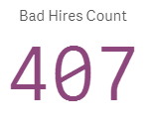
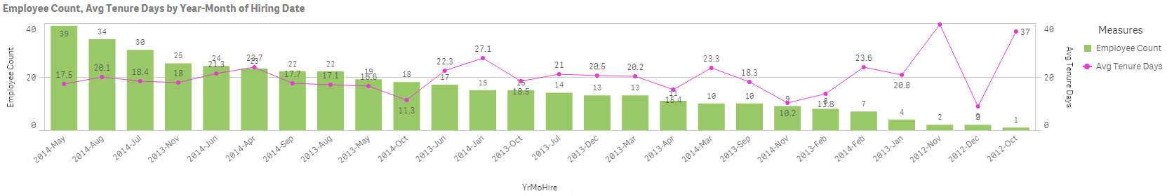


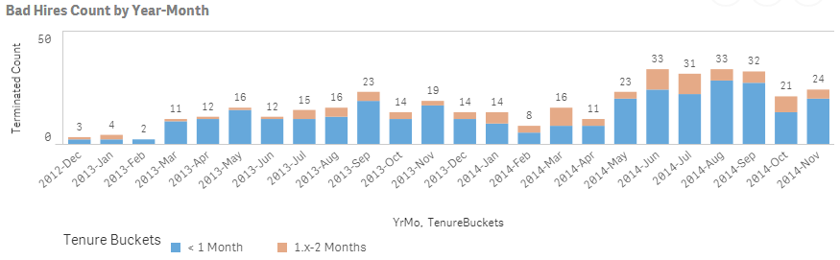
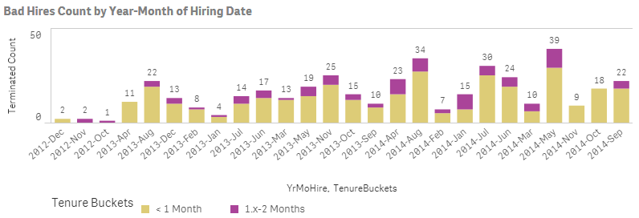
Bad Hire: Definition
BadHires are associated with termination dates only, so we know it is defined based on termination and not job performance factors. Max tenure of 58 days suggest that an employee is considered a “bad hired if s/he terminated less than two months.

Slide 17
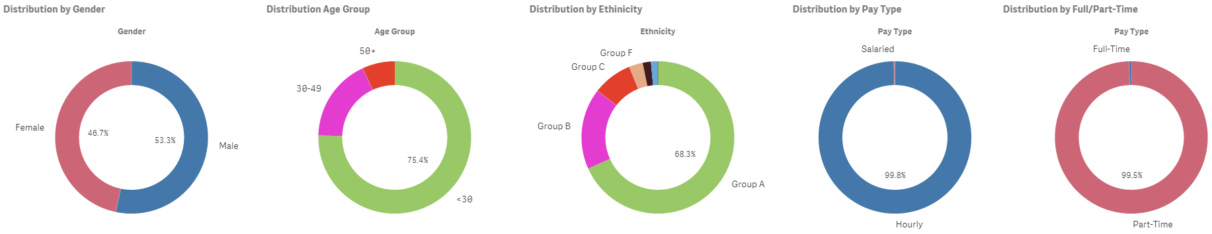
Bad Hire: Distribution
We’d like to compare the employee distributions in terms of gender, age group, ethnicity, pay type and full/part-time for bad hires.

Slide 18
Bad Hire: Trends
1
- There were 407 employees flagged as “bad hires”. An overwhelming portion of this group was hired in May, Jul, and Aug 2014. 99% was hired in 2013, 2014.
2
Most bad hires had tenure of less than one month
Majority of bad hires was hired/terminates in Q2, Q3 of 2014
3
Conclusion: Although a lot more hires happened in Q2, Q3 of 2013 and 2014, which would naturally have more bad hires, the fact that many terminations are those who have been on the job for less than a year shows the BU can focus on factors that can make relatively new employees more successful.

Slide 19
V. Recommendation

Slide 20
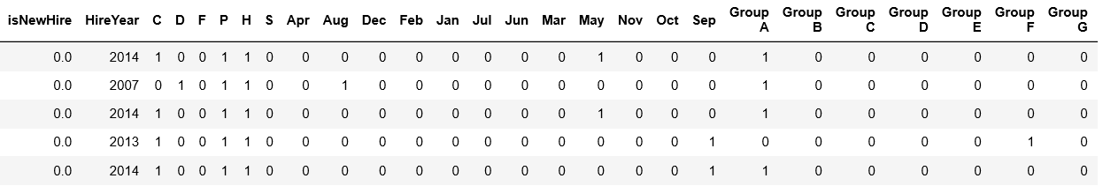
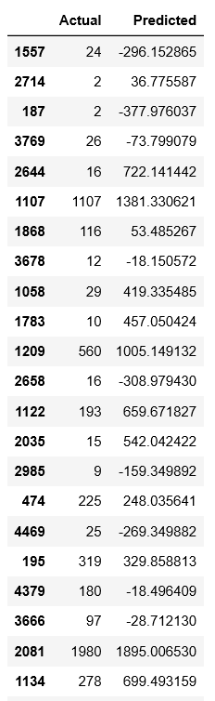
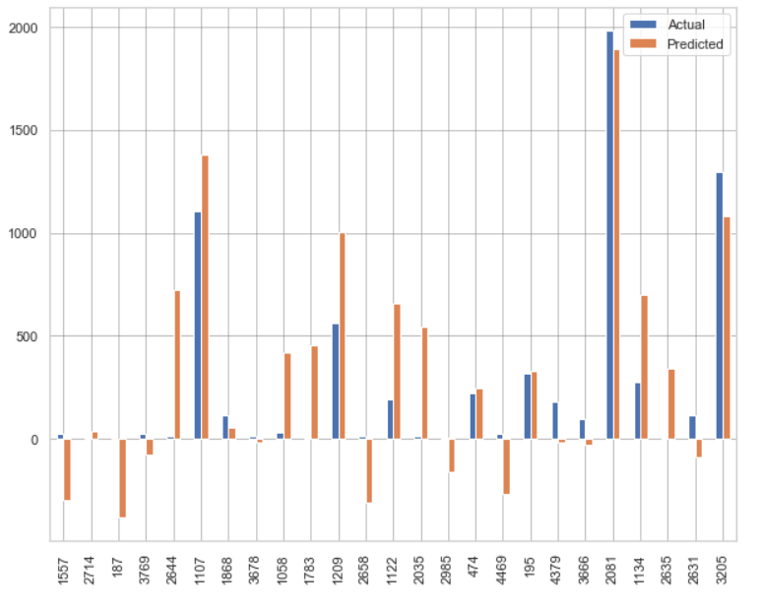
Predictive Modeling: Tenure Days Prediction
In addition to insights above, we can leverage predictive algorithms to build a model that can predict how long an employee is likely to stay, which can be represented by tenure (days). We built regression model leveraging features in the dataset. (see Appendix for full notebook)
The model included features such as new hire flag, year of hire, male, female, full/part-time, salary, hourly, hire months, ethnicities, and different age groups
Actuals vs. Predicted values can be improved but the model were good at predicting longer tenured profiles

Slide 21
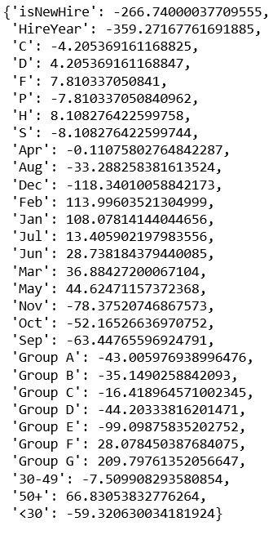
Predictive Modeling: Coefficients
4
3
2
Being male, full-time, and 50+ years of age, of Group F and G ethnicities are factors that will increase tenure
1
Being in Age group <30 also likely to lower tenure
Q3 and Q4 negatively affects tenure
Year Hire and whether the employee is new tremendously decreases tenure days

Slide 22
Conclusion
We can see from our analyses that hiring was aggressive in years 2011-2014, and particularly from 2012-2014. Though aggressive, the demographics of these new hires were not as diverse as the employee base that was hired prior to 2011. New hires were overwhelmingly <30 years old, and part-timers.
In parallel with more hiring, terminations were also high in years that had more new higher, which were 2013-2014. More specifically, those terminations happened more in Q2 and Q3 by employees who were on the job for a few months to less than a year, but quit, since most were voluntary terminations. Bad hires were those terminated within two months and were mainly hired in Q2 and Q3 of 2014.
Predictive modeling for how long an employee is likely to stay on the job, measured by tenure days, confirm that factors such as <30 years old, part-times, later higher years and quarters contribute to lower tenure. The model also reveals being full-time, male, 50+ and of Group F and G ethnicities positively increases tenure.
**Recommendation
While it is possible that higher terminations and bad hires are inevitable when hiring increases, but it is worthwhile for ABC business unit to look into what occurs in Q2 and Q3 more so than other quarters that can lead to employees leaving. Also, since the BU hires a lot more part-timers and from <30 age group, look into how these groups can be prepped to succeed on the job in their first year, since these are the demographics more at risk to leave and be a bad hire.

