Slide 1
FUNDAMENTAL PROJECT 1
Topic: Design and Implementation of a Book Introduction Website
Student’s Full Name: Nguyễn Thị Trang
Student ID: 25CEB061
Class: 25CE
Major: Computer Engineering Technology

Slide 2
OPERATING SYSTEMS
Reason for Topic Selection
Research Objectives
Main Functions of the System
System Analysis and Design
Technologies Used
Limitations and Future Development

Slide 3
Reason for Topic Selection
Digitalization: Vietnamese literature goes online.
Current Limitations: Websites lack depth & focus.
Search Issues: No clear filters by author/genre/period.
Youth Demand: Young readers search via Internet.

Slide 4
II. Research Objectives
Research Objectives
Design a user-friendly interface
Develop search and filtering functions
Create a content management system
Deploy the website in a real environment
Research Subjects and Scope
Subjects: Readers, pupils, students
Scope: Vietnamese literature books

Slide 5
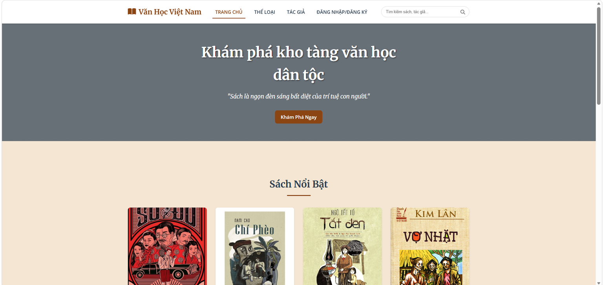
III. Main Functions of the System
a) Homepage
Shows latest & featured books by category
Layout: banner, navigation menu, grid cards

Slide 6
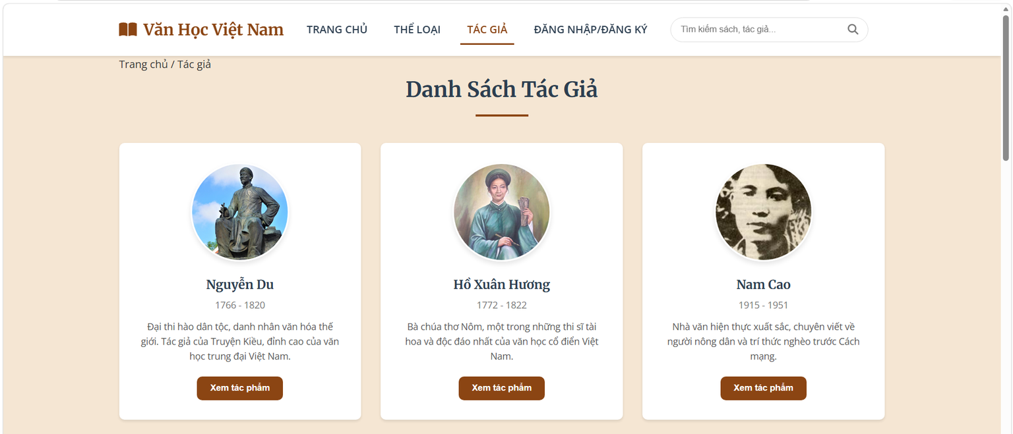
III. Main Functions of the System
b) Author Page
Grid layout: 3 columns, 12 cards
Each card: round avatar + basic info (name, years)

Slide 7
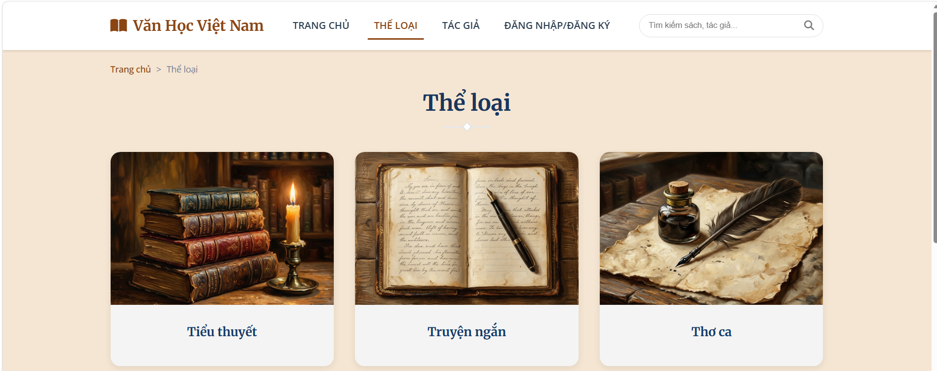
III. Main Functions of the System
c) Category Page
Layout: 2 columns (sidebar + main content)
Sidebar: checkboxes from CATEGORIES_DATA
Main: results display
Toolbar: result count + sort dropdown (Newest, Oldest, A–Z, Top rated)

Slide 8
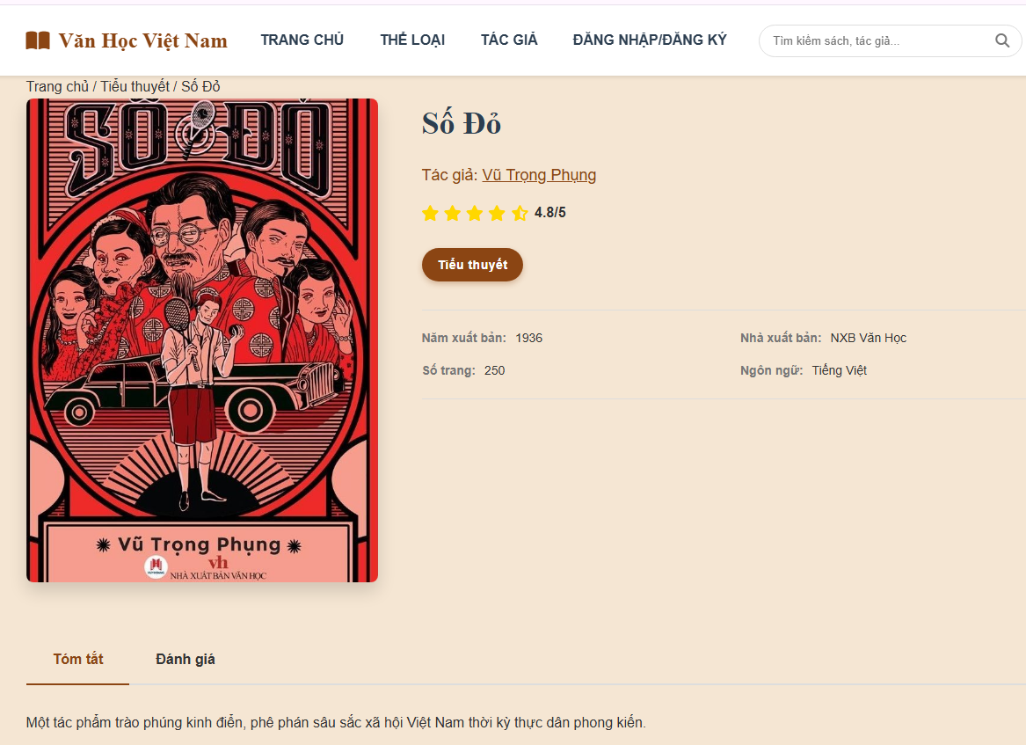
III. Main Functions of the System
d) Book Detail Page
Full info: cover, title, author, genre, year, publisher, pages, summary
Layout: 2 columns (left image, right details)

Slide 9
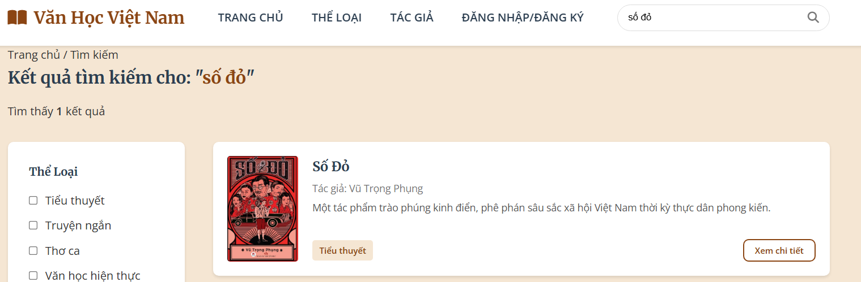
III. Main Functions of the System
e) Search Page
Search books by title or author (header bar)
Results shown as list, similar to book list page

Slide 10
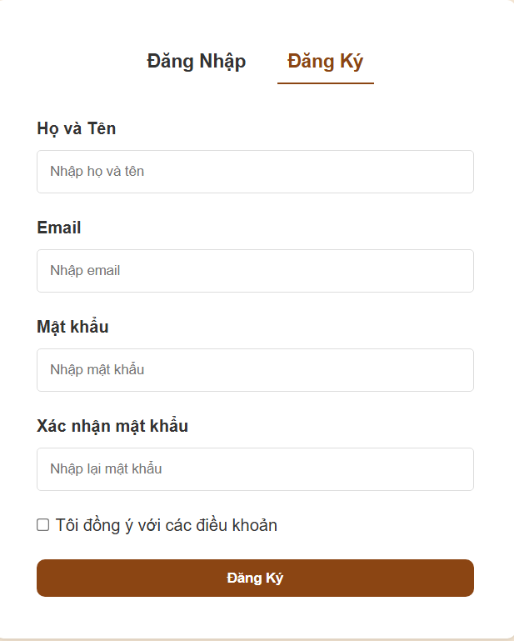
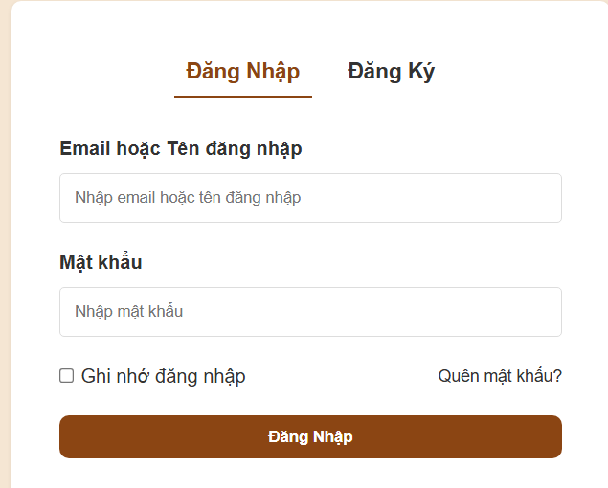
III. Main Functions of the System
f) Login/Register Page
Tabs: switch between login & register
Login: Email/Username, Password, Remember, Forgot link
Register: Name, Email, Password, Confirm, Terms

Slide 11
IV. System Analysis and Design
Functional Requirements
View book list by category Search by title/author View book details (title, author, year) Manage data (JavaScript Object) Real-time processing, no reload | Performance: load ≤ 3s UI: friendly, responsive Compatibility: major browsers Scalability: easy to add features
Functional Requirements
Non-Functional Requirements

Slide 12
Data Structure Design
IV. System Analysis and Design
Book Object
Attributes | Data Types | Description
id | Number | Unique Identifier of Book
title | String | Book Title
authorId | Number | Author ID
authorName | String | Author Name
category | String | Book Category
year | Number | Publication Year
publisher | String | Publisher

Slide 13
IV. System Analysis and Design
Data Structure Design
Author Object
Attributes | Data Types | Description
Id | Number | Author Unique Identifier
name | String | Author Name
years | String | Birth–Death Years (e.g., 1936–2018)
avatar | String | Author Image Path
booksCount | Number | Number of Works in the System

Slide 14



V. Technologies Used
.

Slide 15
VI. Limitations and Future Development
Limitations
Static data, no back-end → cannot dynamically add new books.
Login is only simulated → no real authentication.
Local Storage data is lost when browser cache is cleared.

Slide 16
VI. Limitations and Future Development
Future Development
Integrate back-end (Node.js/MongoDB or PHP/MySQL) for dynamic data.
Build real login with JWT authentication.
Add comments & ratings stored in database.
Use Google Books API to expand data.
Develop smart book recommendations.
Create mobile app (React Native/Flutter).
Enable online reading for free works.

Slide 17
THANK YOU
Student’s Full Name: Nguyễn Thị Trang
Student ID: 25CEB061
Class: 25CE
Major: Computer Engineering Technology

