Slide 1
SET
HashSet
LinkedHashSet
TreeSet

Slide 2
SET
Set don't allow to store duplicate values.
Comprise 4 main types:
+ Enumset
+ HashSet => linkedHashSet
+ SoredtedSet => navigableSet => Treeset and ConcurrentSkipListSet(java.util.Concurren)
+ CoppyandWriteSet (java.util.Concurrent)

Slide 3
HashSet
- Implementation is Linked Lists
- Hashset stores information by using mechanism called Hashing. In Hashing , the information content of key is used to determine unique values, called hash code.
- The hash code is then used as index in which ,The transformation of key into its hash code is automatically.
- It doesn't maintain any kinds of order.

Slide 4
LinkedHashSet
- Inherit from HashSet
- FIFO mechanism
- It is implementation of Hashtable and Linked List
- Permit null element.
- Maintain insertion order
- It holds a value, a reference to the previous element and reference to the next element

Slide 5
CopyOnWriteArraySet
- Threadd safety.
- Mutitive removation.

Slide 6
EnumSet
- Enum constants are unique and have pre-defined length, as you can not define a new enum constant at runtime
- java.util.EnumSet.of(E e) method creates an enum set initially containing the specified element.

Slide 7
SortedSet
- All elements inserted into a sorted set must implement the Comparable interface (or be accepted by the specified Comparator) and If you try to sort a set of elements which do not implement Comparable or not has a specific Comparator, a ClassCastException will be thrown
- Java Sorted Set is a Set that further provides a total ordering on its elements. The elements are ordered using their natural ordering, or by a Comparator typically provided at sorted set creation time.

Slide 8
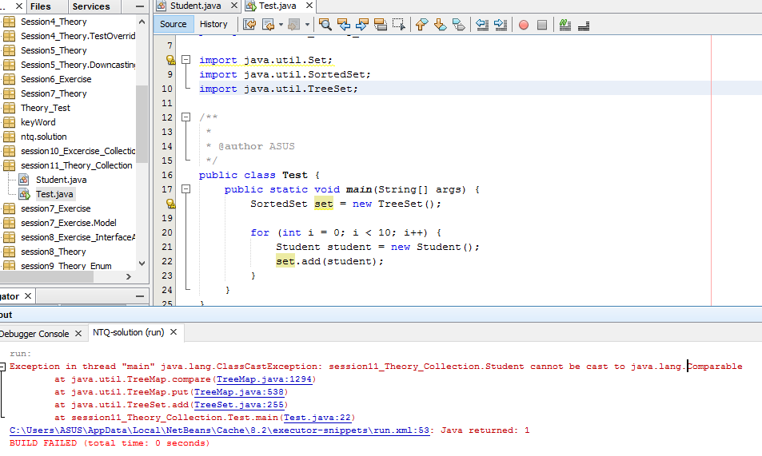
SortedSet

Slide 9
NavigableSet
Lower(E): returns the greatest element which is less than the specified element E, or null if there is no such element.
floor(E): returns the greatest element which is less than or equal to the given element E.
ceiling(E): returns the least element which is greater than or equal to the given element E.
higher(E): returns the least element which is strictly greater than the specified element E.
descendingSet(): returns a reverse order view of the elements contained in the set.
……

Slide 10
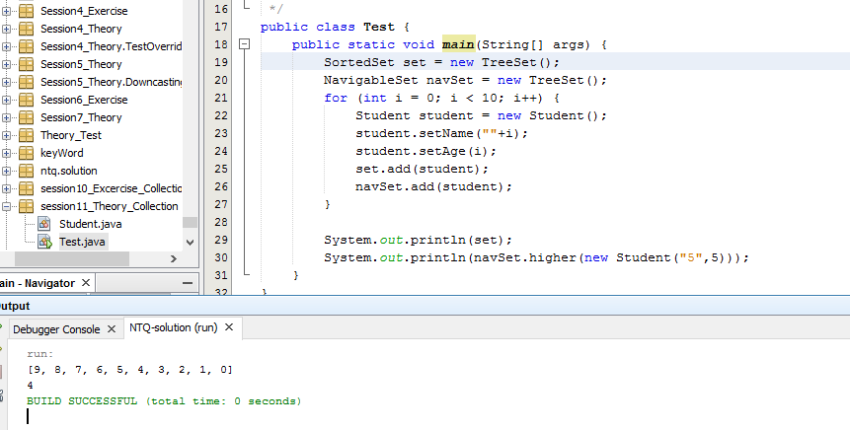
NavigableSet

Slide 11
Difficult between TreeSet – HashSet:
HashSet can save object null when TreeSet does not allow null object throw NullPoiterExaption.
HashSet have performance (faster) than TreeSet.
HashSet does not maintain any order of elements while TreeSet elements are sorted in ascending order by default.

