Slide 2
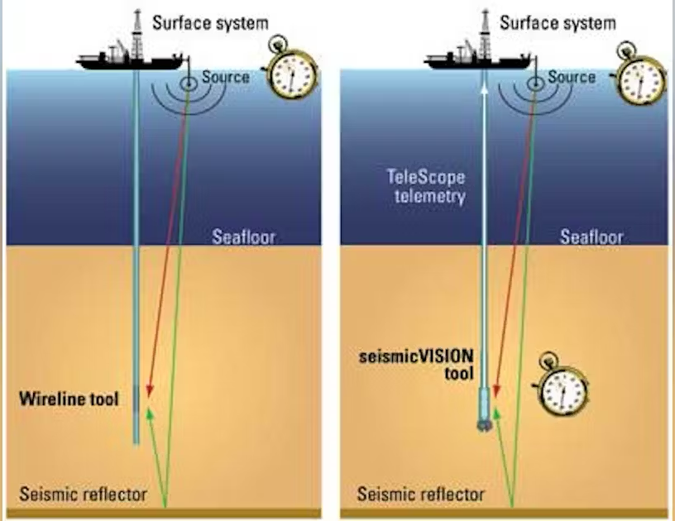
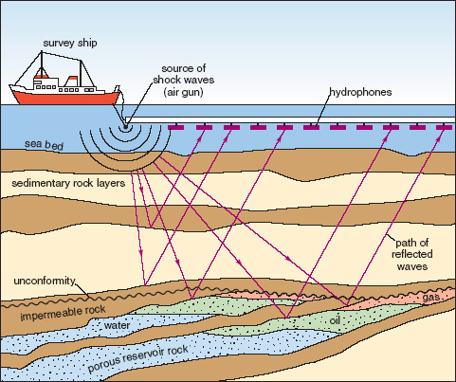
In many scientific engineering applications
  Real-time forward/inverse solvers are crucial
  Data is costly and not always ample
Approaches for forward/inverse problems | Pros | Cons
Numerical methods | Accurate | Computationally expensive Time-consuming
Machine learning surrogate models | Can be used as fast solvers | A lot of data for training Non-physics solutions
Can we learn fast forward/inverse surrogate models with limited data and respect physics?

Slide 3
 | Approaches | Speed up | Data | Generalization
Inverse | (1) PINN [Raissi M.] | Yes | 1sample | No
 | (2) Data-driven ML [Yue Wu] | Yes | >> 1 sample_ | Yes
 | (3) Physics-based ML [Gregory O.] | Yes | > 1 sample | Yes
 | (4) Leaning Regularizer [Yaniv R.] | No | >> 1 sample_ | Yes
 | TAEN | Yes | 1sample | Yes
Forward | (1) PINN [Raissi M.] | Yes | - | No
 | (2) Data-driven ML [Iakovlev V.] | Yes | >> 1 sample_ | Yes
 | (3) Physics-based ML [Li Zijie] | Yes | > 1 sample | Yes
 | (4) Operator Learning [Li Z.], [Lu Lu] | Yes | > 1 sample | Yes
 | (5) Neural ODE/RNN [Chen R. T.] | Yes | > 1 sample | Yes
 | TAEN | Yes | 1sample | Yes
TAEN: trained with 1 sample + offers real-time forward/inverse solvers + generalizable

Slide 4
Encoder
Decoder

Slide 6
Please see our preprint for why not train both encoder and decoder simultaneously!

Slide 7
Training Encoder

Slide 8
Training Decoder
with pre-trained encoder

Slide 12
replicate
collect
…
…
…
…
…
…
…
…
…
Compute
From [1], is full row rank
[1] Feng, X., & Zhang, Z. (2007). The rank of a random matrix.
Applied mathematics and computation, 185(1), 689-694.

Slide 17
Inverse solutions
Forward solutions

Slide 21
Inverse solutions
Forward solutions

