Slide 1
bus stop status
MENU
ANALYSIS
CONTACT
2022 SWEDU
광화문
STH2D Team

Slide 2
TABLE OF CONTENT
Introduction
Elemental idea
01
02
process
result
03
04
MENU
ANALYSIS
CONTACT
2022 SWEDU

Slide 3
01
MENU
ANALYSIS
CONTACT
2022 SWEdu
introduction

Slide 4
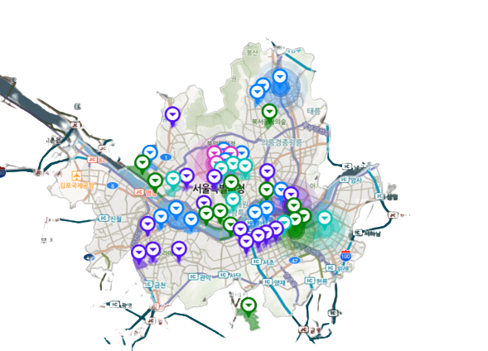


THIS IS Seoul MAP
MENU
ANALYSIS
CONTACT
2022 SWEDU
Bus station
Name – ID – Location
route
Name – ID – Section
Congestion – Schedule

Slide 5
Bus arrival Information
MENU
ANALYSIS
CONTACT
2022 SWEDU
Bus Stop name | route | Expected arrival time | congestion
광화문 (01009) | 6002 | 11분3초후 | 보통
광화문 (01010) | 270 | 4분18초후 | 여유
종로1가 (01012) | 470 | 2분8초후 | 여유
경복궁 (01117) | 7025 | 2분54초후 | 여유
KT광화문지사 (01118) | 1020 | 곧도착 | 여유

Slide 6
02
MENU
ANALYSIS
CONTACT
2022 SWEDU
Elemental idea

Slide 7








MENU
ANALYSIS
CONTACT
2022 swedu

Slide 8
03
MENU
ANALYSIS
CONTACT
2022 SWEDU
PROCESS

Slide 9

MENU
ANALYSIS
CONTACT
2022 swedu

Slide 10
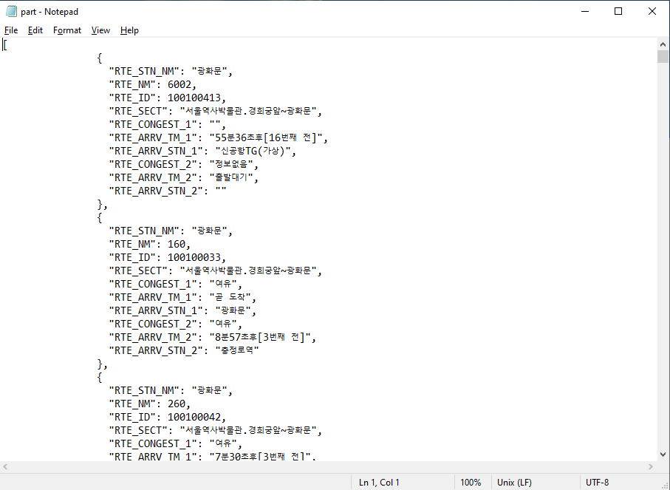
Collect data
MENU
ANALYSIS
CONTACT
2022 swedu
From 서울 열린데이터 광장.

Slide 11
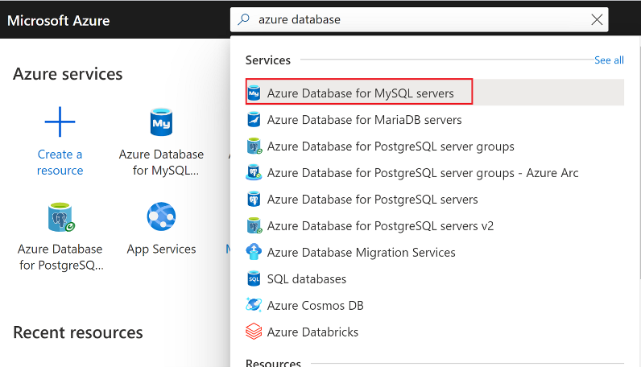
Using Azure
MENU
ANALYSIS
CONTACT
2022 swedu
Create an Azure Database for MySQL servers.

Slide 12
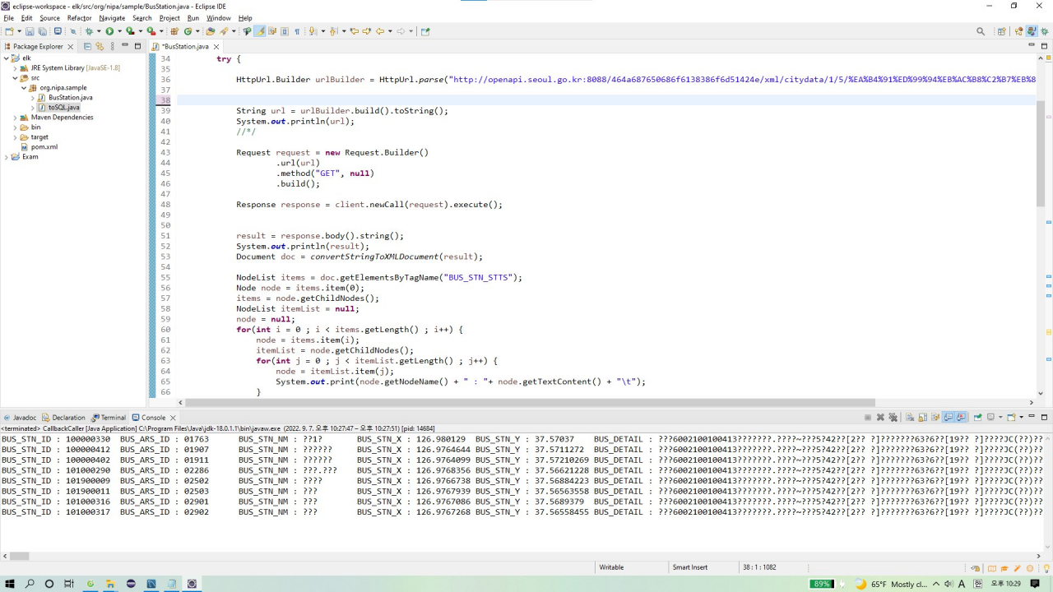
Using java
MENU
ANALYSIS
CONTACT
2022 swedu
Connect to the Data API.

Slide 13
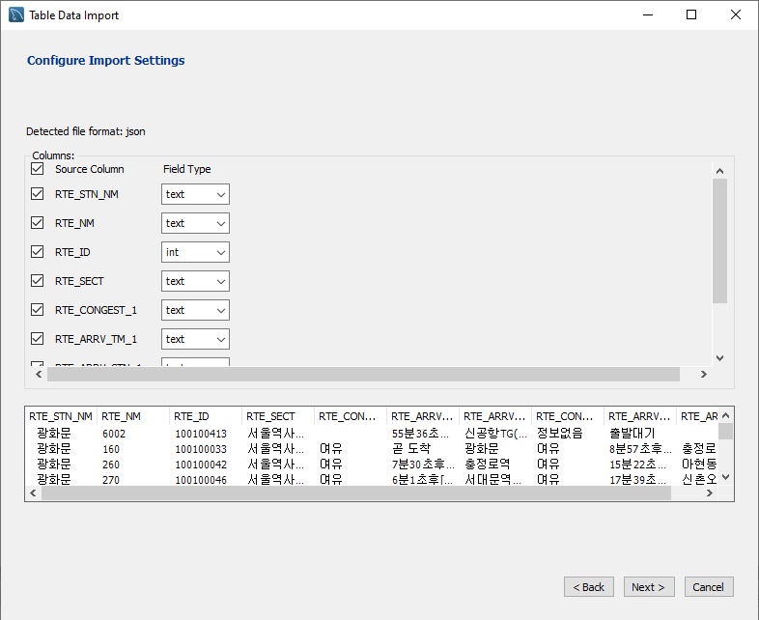
Using mysql
MENU
ANALYSIS
CONTACT
2022 swedu
Create Database.

Slide 14
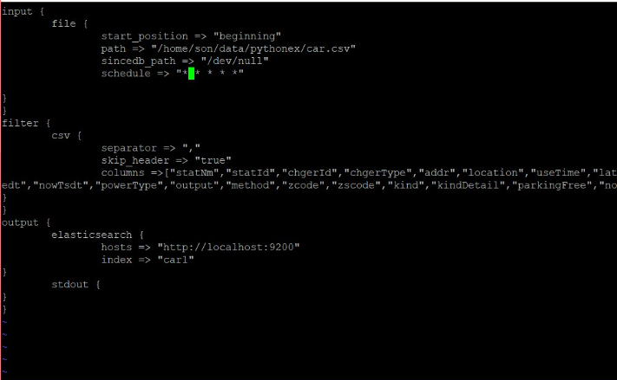
Using CLI
MENU
ANALYSIS
CONTACT
2022 swedu
Load the data to Logstash.

Slide 15
Using kibana
MENU
ANALYSIS
CONTACT
2022 swedu
Visualization the data.

Slide 16
display
MENU
ANALYSIS
CONTACT
Data ANALYSIS
A simple Web Page to display our result.

Slide 17
04
MENU
ANALYSIS
CONTACT
2022 SWEDU
result

Slide 18
THANKs!
MENU
ANALYSIS
CONTACT
2022 swedu
Do you have any questions?

