Slide 1
An improved genetic algorithm for bi-level multi-objective Q-coverage in directional sensor networks
Authors: Nguyen Thi Hanh, Huynh Thi Thanh Binh, Nguyen Van Son, Ban Ha Bang, Trinh Van Chien
Presenter: Nguyen Van Son
Notes:
Hello everyone, I am Hanh. Today, I am thrilled to be here to share with you our latest research findings on wireless sensor networks. My research named “ resource – balanced ….”.

Slide 2
Outline
Introduction
Problem Folmulation
Related Work
Proposed Algorithm
Experiments Results
Conclution
Notes:
The conents of my presentation consist of 6 past: as see on the slide

Slide 3
Introduction
Notes:
The first section is Introduction

Slide 4
1. Introduction Multi-coverage in WSNs Q-coverage
Multi-coverage:
Enhance sensor intensity
Enhance coverage for important targets
Focus on Q-coverage
➔Each sensor having difference coverage requirements
Target
Sensor
Notes:
Mạng cảm biến không dây đã và đang không ngừng có nhiều ứng dụng trong đời thực tiễn. Tuy nhiên để triển khai được 1 mạng cảm biến hiệu quả gặp rất nhiều thách thức và phụ thuộc vào nhiều yếu tố. Một trong số đó là vấn đề bao phủ trong mạng cảm biến <lack of coverage, weak securities, unreliable information>. Một trong số cách khắc phục tình trạng đó, là triển khai 1 mạng sensor networks đa bao phủ cho mỗi đối tượng để tăng cường sự giám sát của mạng, giúp các thông tin thu thập trở nên đáng tin cậy và chính sác hơn. Trong đó, bài toán thỏa mãn bao phủ cho các đối tượng có mức độ quan trọng khác nhau là 1 bài toán quan trọng. Để giải quyết bài toán này, chúng ta có thể triển khai 1 mạng cảm biến Q-bao phủ. Trong số đó, các đối tượng sẽ được thỏa mãn mức độ bao phủ khác nhau tùy trên mức độ quan trọng của chúng.
Wireless sensor networks have become widely used in real-life applications. However, deploying an effective sensor network comes with many challenges and depends on various factors. One of these challenges is the coverage issue, which includes problems like not enough coverage, weak security, and unreliable information. To overcome these challenges, we can deploy a sensor network that provides multiple layers of coverage for each object. This helps to enhance network monitoring and make the collected information more reliable and accurate. Specifically, we focus on satisfying the coverage requirements for objects with different levels of importance. To solve this problem, we can implement a Q-coverage sensor network, where objects are covered differently based on their importance.

Slide 5


1. Introduction Q-coverage in Direction Sensor Network(DSNs)
Direction Sensor
Target
Suit for Video Sensors or Camera Sensors
Enhance sensor intensity
Energy Saving in not rechargeable Networks
Notes:
Một trong những thể loại mạng cảm biến mà cần thiết triển khai Q-bao phủ nhất đó chính là mạng cảm biến không dây có hướng. <Như quan sát trên hình>, mạng cảm biến không dây có hướng là loại mạng mà các sensor chỉ cảm biến hoặc giám sát theo 1 phương nhất định để gia tăng cường độ giám sát trên 1 hướng. Ngoài ra sensor có hướng sẽ tiết kiệm năng lượng hơn khi không phải sensing tất cả xung quanh, Tuy nhiên khi triển khai ở những vùng địa hình khó khăn <ex: khu vực quân sự, đồi núi, khó triển khai chính xác vị trí sensor>, loại mạng này có nhược điểm trong việc khó giám sát các mục tiêu ở gần nhưng lệch hướng. Bên cạnh đó, các tình huống cần triển khai loại mạng này, chủ yếu cần gia tăng tính giám sát cho đối tượng, nên thường cần phải triển khai Q-coverage, để gia tăng chất lượng giám sát và gia tăng tỉ lệ giám sát. Đây cũng chính là vấn đề chính mà chúng tôi nghiên cứu trong bài báo này!
One of the most essential types of sensor networks that require Q-coverage deployment is directional wireless sensor networks. As observed in the figure, a directional wireless sensor network is a type of network where sensors only sense or monitor in a specific direction to increase monitoring intensity in that particular direction. Additionally, directional sensors save energy by not having to sense in all directions. However, when deployed in challenging terrains such as military areas or hilly regions where accurate sensor positioning is difficult, this type of network has a drawback in monitoring targets that are nearby but deviate from the sensor's direction. Furthermore, in situations where this type of network is deployed, the main objective is to increase the monitoring capability for the target, hence the need for Q-coverage deployment to enhance monitoring quality and increase the monitoring ratio. This is also the main issue addressed in our research article!

Slide 6
1. Introduction Challenges of Q-coverage in DSNs
Cost of Deployment
Power Consuming
Fault-tolerant
Balancing of networks
Coverage Quality
….
Notes:
Hai thách thức mà chúng tôi address trong bài toán này chính là tối ưu năng lượng sử dụng, và tối ưu cân bằng bao phủ cho các targets. Trong đó tối ưu năng lượng tiêu thụ thông qua việc minizing số lươngj target sử dụng; còn cân bằng tải thì thông qua cân bằng bao phủ giữa các target. Chúng tôi xem xét tối ưu 2 mục tiêu trên, trong cả 2 miền under-provision and overprovison. Trong đó under-provision được định nghĩa là mạng thiếu sự giám sát của sensors, còn over-provision thì ngược lại.
The two challenges that we address in this problem are energy optimization and coverage balancing for targets: In this context, energy optimization is achieved by minimizing the number of active sensors. Meanwhile, coverage balancing is achieved through balancing the coverage among the targets. We consider optimizing both objectives in two domains: under-provisioning and over-provisioning. Under-provisioning is defined as a network where there is insufficient monitoring coverage by sensors. On the other hand, over-provisioning refers to a network where there is excessive monitoring coverage.

Slide 7
2. Problem Folmulation
Notes:
The next sesion, we folmuate the abow problem by a Q- coverage problem with bi-level objective of Resource balance and minizing number of active sensor nodes.

Slide 8



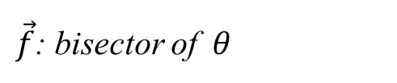


2. Problem Folmulation Direction Sensor Model
$$\vec{f}$$
O
$$θ$$
$$\vec{v}$$
$θ$: Angle of View
$\vec{f}$: bisector of $θ$
$\vec{v}$: vector from O towards target
Sensor : $s=(O\left(x_{s},y_{s}\right), θ,R,\vec{f})$
Notes:
First, Let me introduce about the model of direction sensor network:
It contain: a center O at coordinate (xs,ys); a Sensing range :R; a angel of view ( the area sensor can sense target) like a setor of a circle;
We also define some important information to definte the oriented of sensor: vetor F is bisector- vector of the theta. And v is the vector from O to a target.

Slide 9
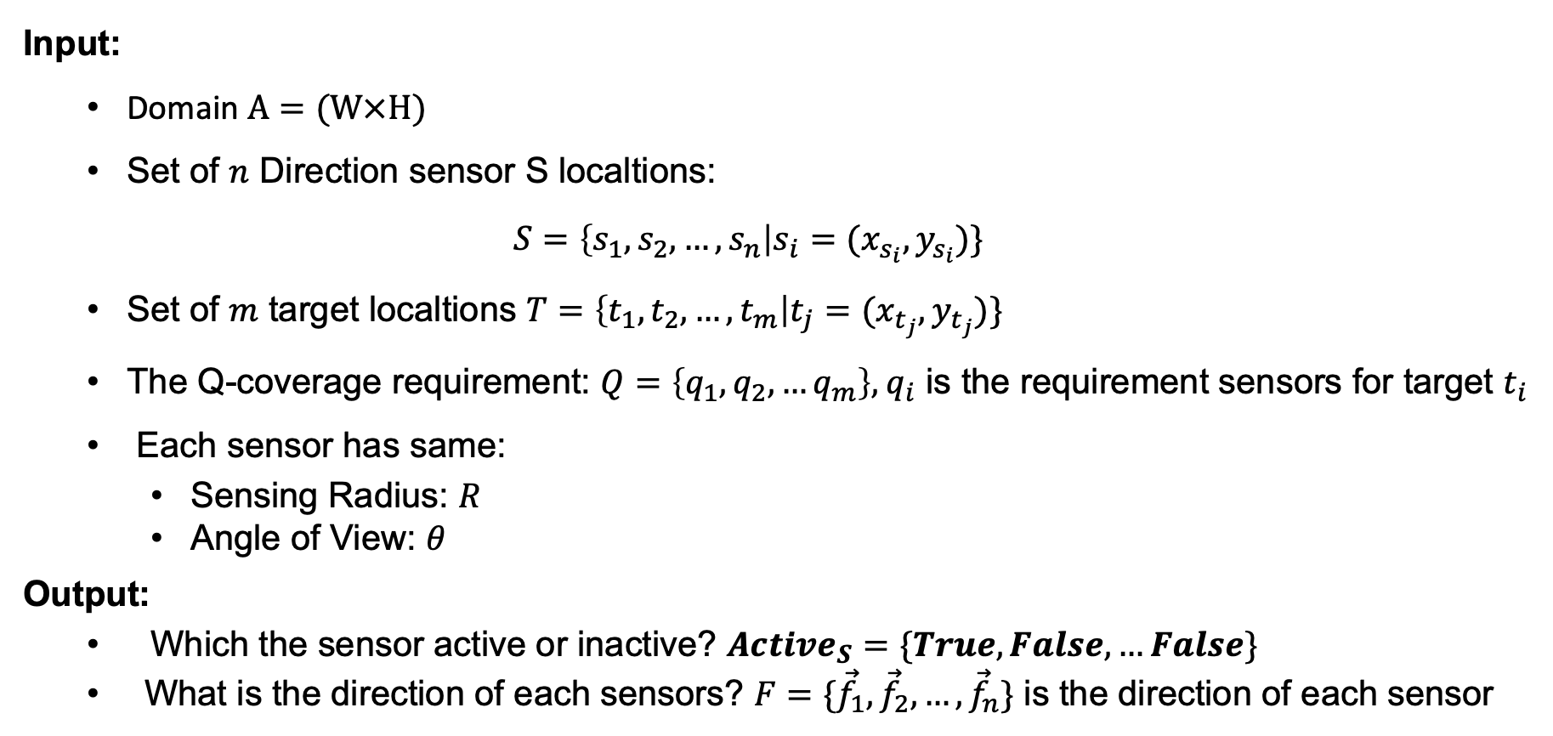
2. Problem Folmulation Sensor Direction Determining Problem
Input:
Domain $A=(W×H)$
Set of $n$ Direction sensor S localtions:
$$S=\left\{s_{1},s_{2},…,s_{n}\right|s_{i}=(x_{s_{i}},y_{s_{i}})\}$$
Set of $m$ target localtions $T=\left\{t_{1},t_{2},…,t_{m}\right|t_{j}=(x_{t_{j}},y_{t_{j}})\}$
The Q-coverage requirement: $Q=\left\{q_{1},q_{2},…q_{m}\right\},{ q}_{i}$ is the requirement sensors for target $t_{i}$
Each sensor has same:
Sensing Radius: $R$
Angle of View: $θ$
Output:
Which the sensor active or inactive? $Active_{S}=\{True,False,…False\}$
What is the direction of each sensors? $F=\{{\vec{f}}_{1},{\vec{f}}_{2},…,{\vec{f}}_{n}\}$ is the direction of each sensor
Notes:
With these information, we define this problem as you can see on the slide:
Input:
…
Output:
…

Slide 10
2. Problem Folmulation Sensor Direction Determining Problem
Objective:
If the number available sensor is under-provision:
Maximize the Q-balancing Index of networks (QBI): represent for the balance of
the coverage rate/ the required coverage among sensors.
If the number available sensor is over-provision:
Minimize the number of the active sensors (No.Active)
Others metric considered: Power Consumming (PC), Distance Index (DI), Coverage Quality (CQ).
Notes:
The objective of The problem are:
…
…

Slide 11

2. Problem Folmulation Metrics
Q-Balancing Index: $QBI = \frac{{\left(\sum_{i=1}^{m}{c_{i}}\right)}^{3}}{{\left(\sum_{i=1}^{m}{q_{i}}\right)}^{3}}×\frac{\sum_{i=1}^{m}{q_{i}^{2}}}{\sum_{i=1}^{m}{c_{i}^{2}}}$ ${,c}_{i},q_{i} is actual coverage and required coverage of target i$
Power Consumming: $PC=No.Ss×p_{s}+No.As×p_{a}+No.Is×p_{i};$ $p_{s},p_{a}, p_{i} are pc of sleep, active$ and idle mode.
Distance Index: $DI=$ $\frac{\sum_{i=1}^{m}{q_{i}^{2}} − \sum_{i=1}^{m}{{\left(q_{i}−c_{i}\right)}^{2}}}{\sum_{i=1}^{m}{q_{i}^{2}}}$
Coverage Quality:
$CQ=$ $\sum_{i=1}^{n}{\sum_{k=1}^{m}{cq(i,k)}}$
$cq\left(i,k\right)= \left\{\begin{aligned}1−\frac{\left\|{\vec{v}}_{i,k}\right\|}{R} \\ 0\end{aligned}\right., if s_{i} cover t_{k}$
Notes:
The detail computation of metrics are shown on slide.
Beside evalute the quality of a setting –networks; we also using some metric: PC. DI and CQ .
In this:
PC means …
DI means …
CQ means …

Slide 12
3. Related Work

Slide 13
3. Related Work
[1] Folmulate the Q-coverage problem with minimum sensors and high balance covered in DSNs:
Proposed a ILP model for simple solutions
Proposed a IQP folmular to minimize the Euclidean distance between the required vector for coverage and obtained vector
Proposed a Greedily-method to solve the mimize IQP and maximum the balance in the network when under-provision
[2] Proposed two GA-based Alogrithms to solve the Q-coverage problem with minimum sensors, and maximum the balancing coverage in DSNs:
Proposed QBI metric to estimate the balancing of coverage in networks
Solving the critical target coverage firstly.
[1] Al Zishan, A., et al., Maximizing heterogeneous coverage in over and under 916 provisioned visual sensor networks. 124 (2018) 44-62
[2] allah Mottaki, Nemat, Homayun Motameni, and Hosein Mohamadi. "A genetic algorithm-based approach for solving the target Q-coverage problem in over and under provisioned directional sensor networks." Physical Communication 54 (2022): 101719.

Slide 14
3. Related Work
[1],[2] Only using the simply method to solve this problem, the solution has not been effective.
Propose an Improved GA to solve the Q-coverage problem with minimum no.sensor and maximum balancing
[2] Can not determine the area is under-provision or over-provision, solve must using 2 GA algorithm for each domain.
Propose a combination of checking the “status” of networks and solving the problem in each status.
Besides that,
Solving the Q-coverage problem in the other mode of sensor: Adjustable-orientation (ADODSN)
[1] Al Zishan, A., et al., Maximizing heterogeneous coverage in over and under 916 provisioned visual sensor networks. 124 (2018) 44-62
[2] allah Mottaki, Nemat, Homayun Motameni, and Hosein Mohamadi. "A genetic algorithm-based approach for solving the target Q-coverage problem in over and under provisioned directional sensor networks." Physical Communication 54 (2022): 101719.

Slide 15
4. Proposed Algorithm

Slide 16
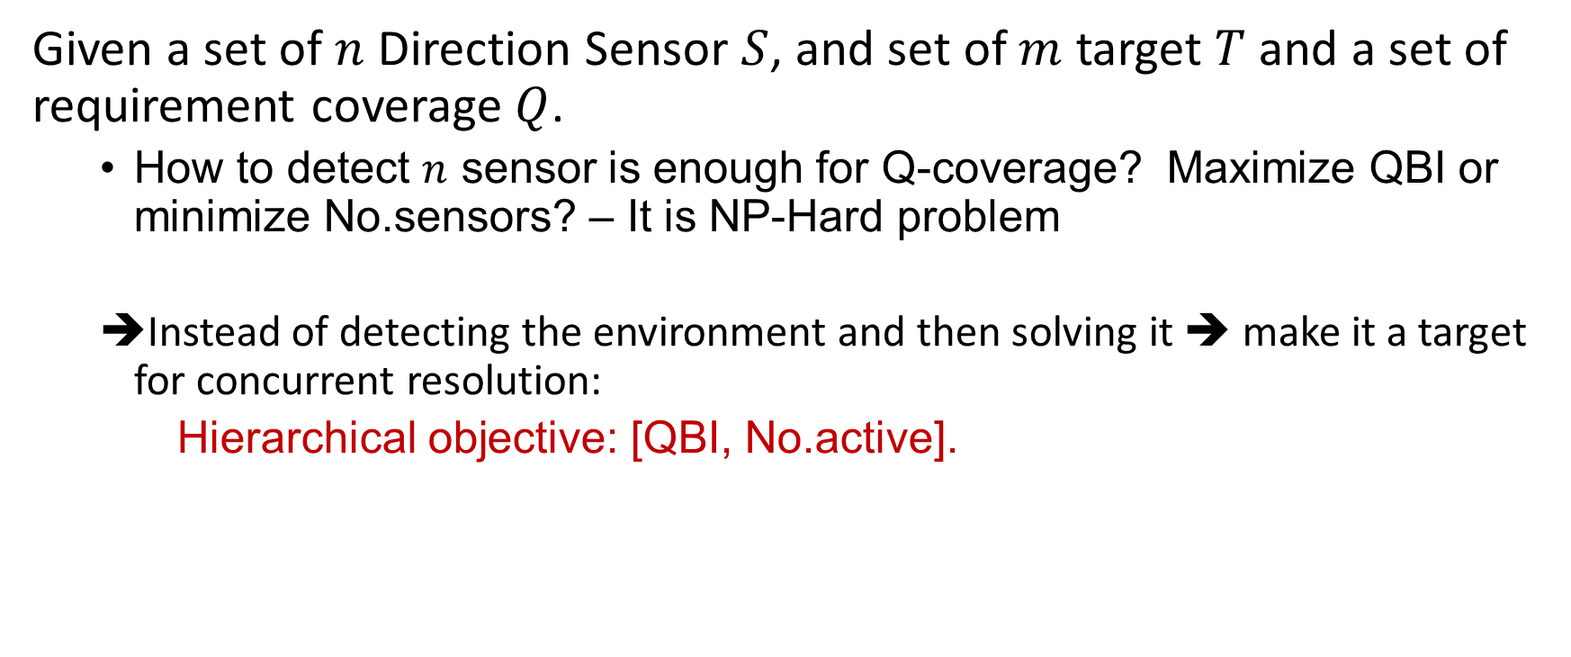
4. Proposed Algorithm IGA solving the Sensor Direction Determining
Given a set of $n$ Direction Sensor $S$, and set of $m$ target $T$ and a set of requirement coverage $Q$.
How to detect $n$ sensor is enough for Q-coverage? Maximize QBI or minimize No.sensors? – It is NP-Hard problem
Instead of detecting the environment and then solving it ➔ make it a target for concurrent resolution:
Hierarchical objective: [QBI, No.active].

Slide 17
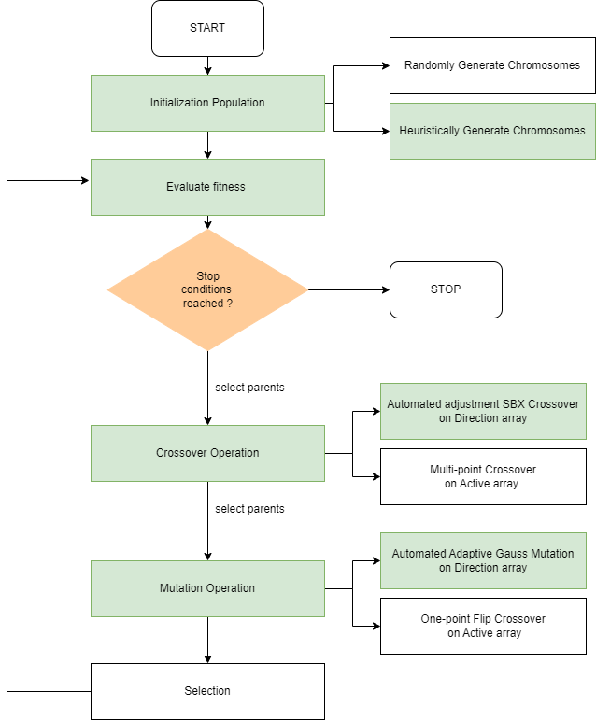
4. Proposed Algorithm SSD-IGA overviews
SSD-IGA is based on a hypothesis: the ”health” of the individuals is very importance with the mutation and crossover.

Slide 18
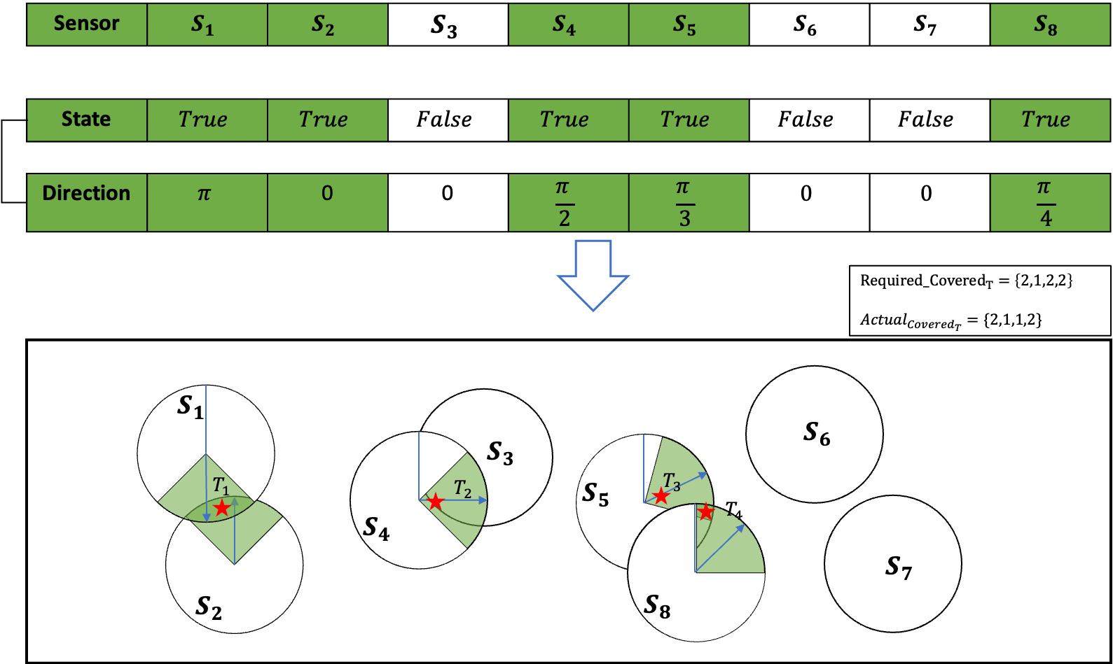
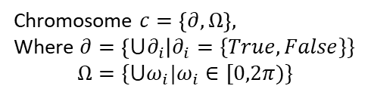
4. Proposed Algorithm SSD-IGA Chromosome representation
Chromosome $c=\left\{∂, Ω\right\},$
Where $∂=\left\{{⋃∂}_{i}\right|∂_{i}=\{True,False\}\}$
$$Ω=\{⋃ω_{i}|ω_{i}∈[0,2π)\}$$
Direction Sensor
Target

Slide 19
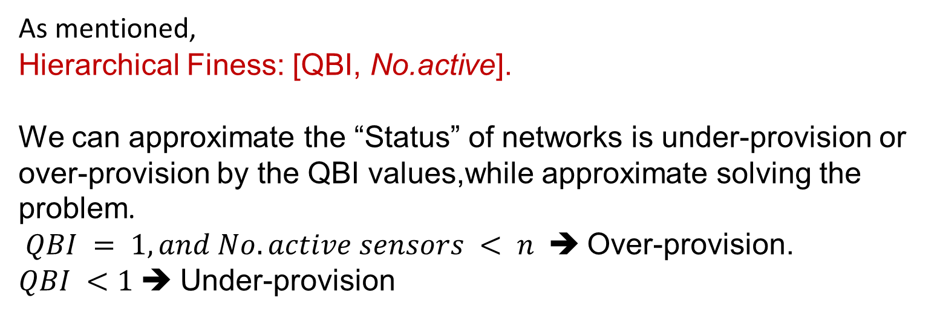
4. Proposed Algorithm SSD-IGA Fitness Function
As mentioned,
Hierarchical Finess: [QBI, No.active].
We can approximate the “Status” of networks is under-provision or over-provision by the QBI values,while approximate solving the problem.
$QBI = 1, and No.active sensors < n$ ➔ Over-provision.
$QBI <1$ ➔ Under-provision

Slide 20
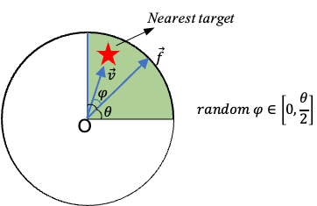
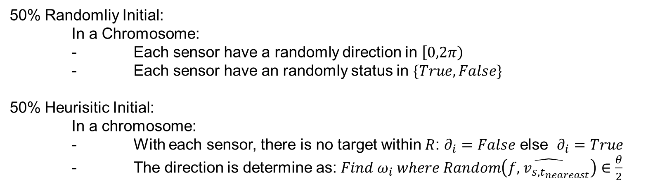
4. Proposed Algorithm SSD-IGA Initialization Population
50% Randomliy Initial:
In a Chromosome:
- Each sensor have a randomly direction in $\left[0,2π\right)$
- Each sensor have an randomly status in $\{True, False\}$
50% Heurisitic Initial:
In a chromosome:
- With each sensor, there is no target within $R$: $∂_{i}=False$ else $∂_{i}=True$
- The direction is determine as: ${Find ω}_{i} where Random\left(\hat{f,{ v}_{s,t_{neareast}}}\right)∈\frac{θ}{2}$

Slide 21
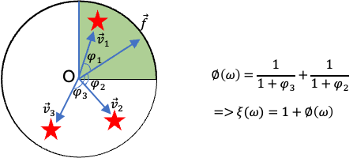

4. Proposed Algorithm SSD-IGA : Coverage quality difference of 2 direction
With a sensor have a direction $ω$ ,estimate $ξ\left(ω\right) is the coverage quality as figure:$
The Coverage quality difference (CQD) of 2 direction:

Slide 22
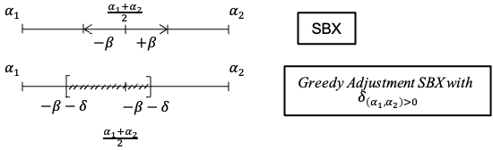
4. Proposed Algorithm SSD-IGA : Crossover opreation
On State array: using multi-point crossover
On Direction array: Greedily-tuned SBX Crossover base on CQD value:

Slide 23


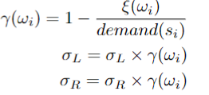
4. Proposed Algorithm SSD-IGA : Mutation opreation
On State array: one point crossover
On Direction array: Adaptive Polynomial Mutation based on CQD value:
The base Polynomial Mutation:
The Adaptive Polynomial Mutation:

Slide 24
4. Proposed Algorithm SSD-IGA : Selection
Combination of:
Oulette wheel selection
Elite selection technique

Slide 25
5. Experiments and Results

Slide 26
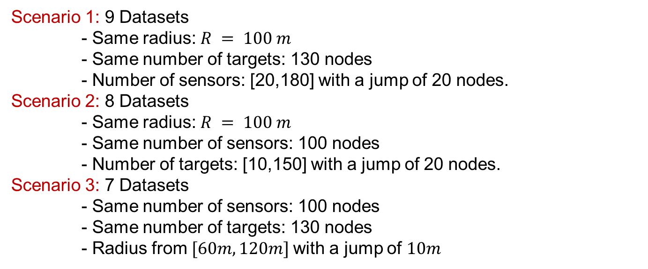
5. Experiments and Results Problem instances
Scenario 1: 9 Datasets
- Same radius: $R = 100 m$
- Same number of targets: 130 nodes
- Number of sensors: [20,180] with a jump of 20 nodes.
Scenario 2: 8 Datasets
- Same radius: $R = 100 m$
- Same number of sensors: 100 nodes
- Number of targets: [10,150] with a jump of 20 nodes.
Scenario 3: 7 Datasets
- Same number of sensors: 100 nodes
- Same number of targets: 130 nodes
- Radius from $[60m,120m]$with a jump of $10m$

Slide 27
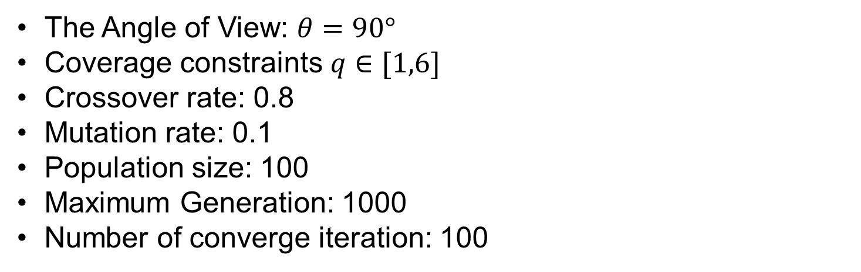
5. Experiments and Results Algorithm Parameters
The Angle of View: $θ=90°$
Coverage constraints $q∈[1,6]$
Crossover rate: 0.8
Mutation rate: 0.1
Population size: 100
Maximum Generation: 1000
Number of converge iteration: 100

Slide 28
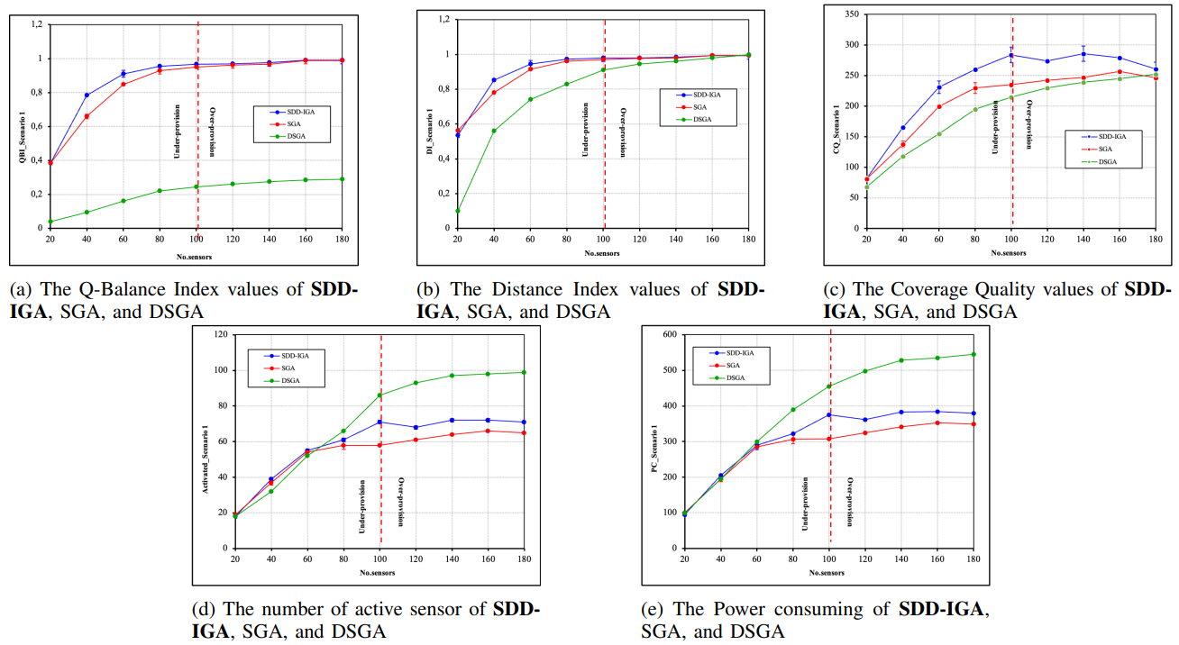
5. Experiments and Results Results Experiment 1

Slide 29
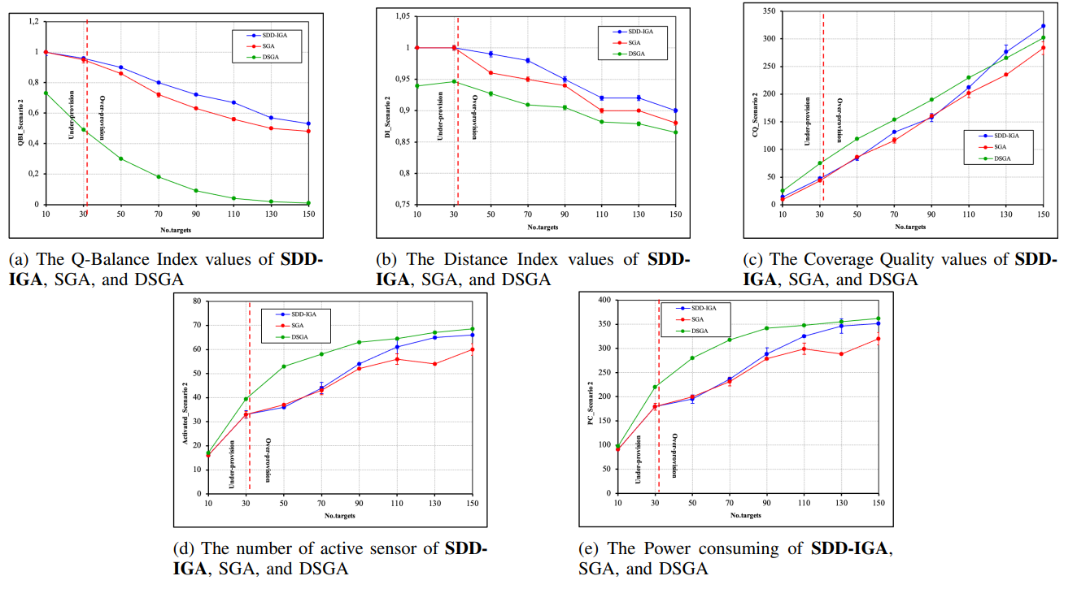
5. Experiments and Results Results Experiment 2

Slide 30
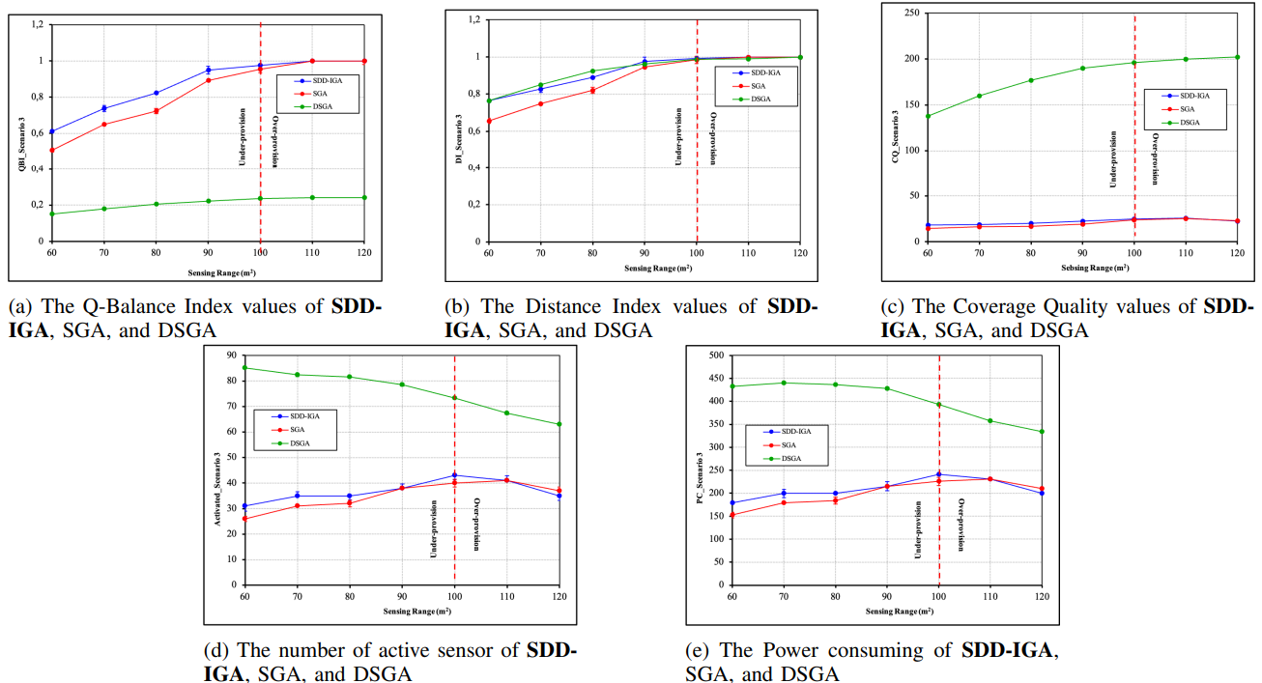
5. Experiments and Results Results Experiment 3

Slide 31
6. Conclusion

Slide 32
6. Conclusion
In this work, we study the Q-coverage problem, which is one of the main challenges in DSNs:
Proposed SDD-IGA for both over-provisioned and under-provisioned environments.
Various experiments based on multiple scenarios
Ours technique could efficiently solve problems and outperform the latest works
Testing the “health” hypothesis with SDD-IGA algorithm and demonstrate it is effective to improve the solution
Future works:
Expanding our research to deal with the simultaneous placement of sensors and adjustment of the orientation angle of the sensors
Real-time coverage for moving targets

