Slide 1

An Improved Genetic Algorithm for bi-level multi-objective Q-Coverage in Directional Sensor Network
Nguyen Thi Hanh, Nguyen Van Son, Huynh Thi Thanh Binh, Ban Ha Bang, Trinh Van Chien
Notes:
Hello everyone. My name is Hanh, I’m from Phuong Dong University, Vietnam.
Today, I will present about my research work named “An Improved Genetic Algorithm for bi-level multi-objective Q-Coverage in Directional Sensor Network”.

Slide 2
Outline
Introduction
Related works
Problem Formulation
Proposed methods
Experimental results
Conclusion
Notes:
My presentation contains 6 parts
as you can see in the slide.
Let’s move on to the first part, Introduction and background

Slide 3
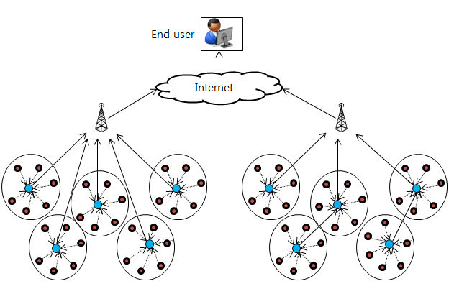
1. Introduction
Wireless sensor network (WSN)
Notes:
WSNs consists of two main components: a set of sensor nodes, scattered on the monitoring field and a base station. WSNs are applicable in many terrains and environments

Slide 4
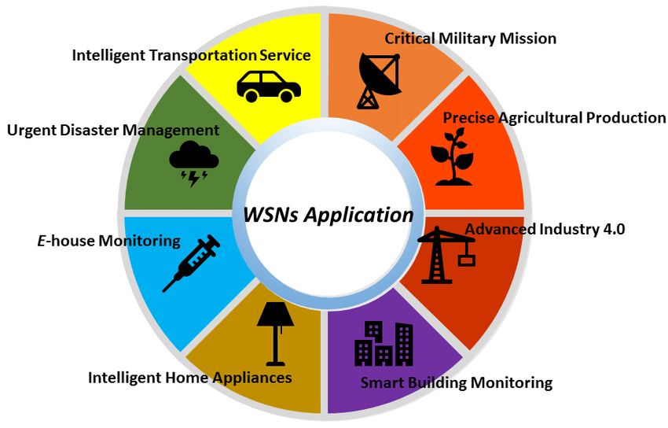
1. Introduction
Applications in WSNs
Notes:
WSN has many applications such as: smart city, Health care, Intelligent home, intelligent transportation service, smart building monitoring

Slide 5
1. Introduction
Advantage
Saving cost
Flexible deployment
Applications
…
Challenges
Coverage
Connectivity
Fault - Tolerance
Network lifetime
…
Notes:
Wireless sensor networks with low cost, easy to deploy in variety conditions: topographic, environment, There are many major optimization criteria in constructing a WSN: Coverage
Connectivity, Fault – Tolerance, Network lifetime
This research focuses on optimizing target Coverage in DSNs

Slide 6
1. Introduction
Challenges of coverage
Not enough coverage
Weak security
Unreliable information
Multi-coverage for each target
Enhance sensor intensity
Enhance coverage for important targets.
Focus on Q-coverage where each target has difference coverage requirements
Target
Sensor
Notes:
There are a lot of challenges of coverage such as: …
To overcome these problems, we can deploy a sensor network that provides multiple layers of coverage for each target. This enhance sensor intensity and coverage for important targets.
Therefore, this research focus on Q-Coverage where in Q coverage each target has difference coverage requirements.

Slide 7


1. Introduction
Q-coverage in Directional Sensor Network(DSNs)
A directional wireless sensor network is a type of network where sensors only monitor in a specific direction.
Q-coverage deployment enhance monitoring quality for each target.
Direction Sensor
Target
Notes:
Let talk about A directional sensor network.
This network is a type of network where sensors only monitor in a specific direction.
Q-coverage deployment enhance monitoring quality for each target.
Our paper focus on optimizing Q coverage in DSN.

Slide 8
1. Introduction
Challenges of Q-coverage in DSNs
Cost of Deployment
Power Consuming
Fault-tolerant
Coverage Balancing
Coverage Quality
….
Notes:
There are many challenges of Q coverage in DSNs for example: …
In this research, we consider power consuming and coverage balancing
Where power consuming relate to the number of active sensors in network
And coverage balancing ensure coverage ratio of targets is balance to each other.
The two challenges that we address in this problem are energy optimization and coverage balancing for targets: In this context, energy optimization is achieved by minimizing the number of active sensors. Meanwhile, coverage balancing is achieved through balancing the coverage among the targets. We consider optimizing both objectives in two domains: under-provisioning and over-provisioning.
Under-provisioning is defined as a network where there is insufficient monitoring coverage by sensors
over-provisioning refers to a network where there is excessive monitoring coverage.
Hai thách thức mà chúng tôi address trong bài toán này chính là tối ưu năng lượng sử dụng, và tối ưu cân bằng bao phủ cho các targets. Trong đó tối ưu năng lượng tiêu thụ thông qua việc minizing số lươngj target sử dụng; còn cân bằng tải thì thông qua cân bằng bao phủ giữa các target. Chúng tôi xem xét tối ưu 2 mục tiêu trên, trong cả 2 miền under-provision and overprovison. Trong đó under-provision được định nghĩa là mạng thiếu sự giám sát của sensors, còn over-provision thì ngược lại.

Slide 9
Outline
Introduction
Related works
Problem Formulation
Proposed methods
Experimental results
Conclusion
Notes:
In this session, I present some related works:

Slide 10
2. Related works
[1] Formulate the Q-coverage problem with minimum sensors and high balance covered in DSNs:
Proposed a Integer Linear Programming (ILP) model for simple solutions
Proposed a Integer Quadratic Programming (IQP) formular to minimize the Euclidean distance between the required vector for coverage and obtained vector
Proposed a Greedily-method to solve the minimizing IQP and maximum the balance in the network when under-provision
[2] Proposed two GA-based Algorithms to solve the Q-coverage problem with minimum sensors, and maximum the balancing coverage in DSNs:
Focusing on ensuring the coverage of critical targets.
Proposed Q-balancing Index metric to estimate the balancing of coverage in networks
[1] Al Zishan, A., et al., Maximizing heterogeneous coverage in over and under 916 provisioned visual sensor networks. 124 (2018) 44-62
[2] allah Mottaki, Nemat, Homayun Motameni, and Hosein Mohamadi. "A genetic algorithm-based approach for solving the target Q-coverage problem in over and under provisioned directional sensor networks." Physical Communication 54 (2022): 101719.
Notes:
The first paper focuses on formulating the Q-coverage problem with minimum sensors and high balance covered in DSNs:
The authors proposed Integer Linear Programming, Integer Quadratic Programming and Greedily-method to solve the minimizing IQP and maximum the balance in the network
The second paper Proposed two GA-based Algorithms to solve the Q-coverage problem with minimum sensors, and maximum the balancing coverage in DSNs
The proposed GA prioritize ensuring the coverage of critical targets and use QBI metric to estimate the balancing of coverage in networks

Slide 11
2. Related works
Disadvantage:
[1],[2] Only using the simply method to solve this problem. Therefore, the solutions are not effective.
[2] Proposed GA is not effective for both under-provision and over-provision domains.
Propose:
[1] Al Zishan, A., et al., Maximizing heterogeneous coverage in over and under 916 provisioned visual sensor networks. 124 (2018) 44-62
[2] allah Mottaki, Nemat, Homayun Motameni, and Hosein Mohamadi. "A genetic algorithm-based approach for solving the target Q-coverage problem in over and under provisioned directional sensor networks." Physical Communication 54 (2022): 101719.
An Improved GA to solve the Q-coverage problem with minimum number of sensor and maximum balancing.
The our proposed GA is effective for both under-provision and over-provision domains
Notes:
But these related work also have some limits.

Slide 12
Outline
Introduction
Related works
Problem Formulation
Proposed methods
Experimental results
Conclusion
Notes:
this problem formulated as follows.

Slide 13
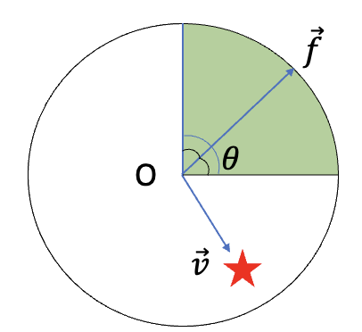
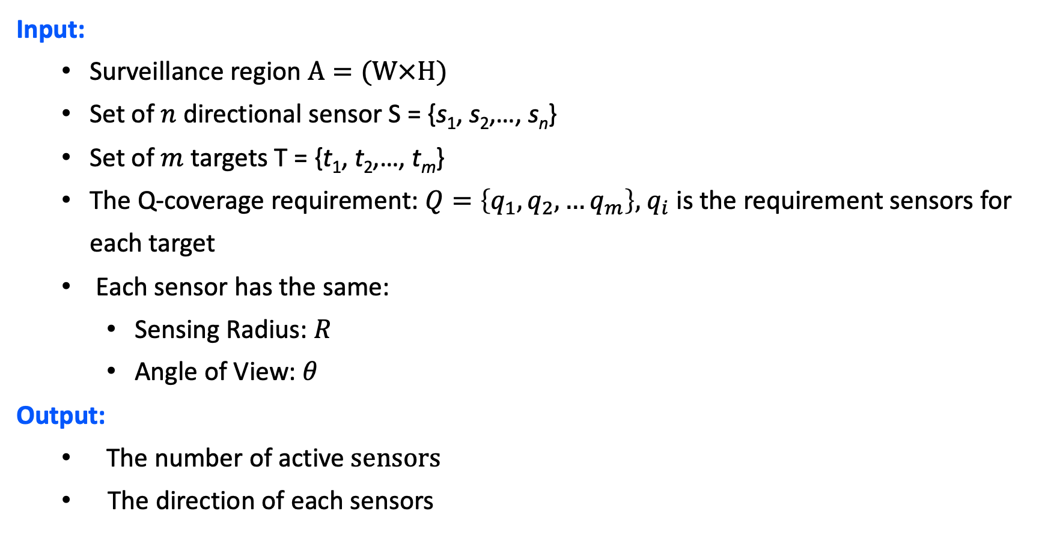
3. Problem Folmulation
Input:
Surveillance region $A=(W×H)$
Set of $n$ directional sensor S = {s₁, s₂,…, s_{n}}
Set of $m$ targets T = {t₁, t₂,…, t_{m}}
The Q-coverage requirement: $Q=\left\{q_{1},q_{2},…q_{m}\right\},{ q}_{i}$ is the requirement sensors for each target
Each sensor has the same:
Sensing Radius: $R$
Angle of View: $θ$
Output:
The number of active$sensors$
The direction of each sensors
Notes:
The ta
vetor F is bisector- vector of the theta. And v is the vector from O to a target.

Slide 14
3. Problem Folmulation
Objective:
If the number available sensor is under-provision:
Maximize the Q-balancing Index of networks (QBI): represent for the balance of
the coverage rate/ the required coverage among sensors.
If the number available sensor is over-provision:
Minimize the number of active sensors (No.Active)
Others metric considered: Power Consumming (PC), Distance Index (DI), Coverage Quality (CQ).

Slide 15
Outline
Overview
Related works
Problem formulation
Proposed algorithm
Experiment results
Conclusion
Notes:
Solving this model, we propose a bilevel objective Genetic Algorithm. The following are detail of this algorithm

Slide 16
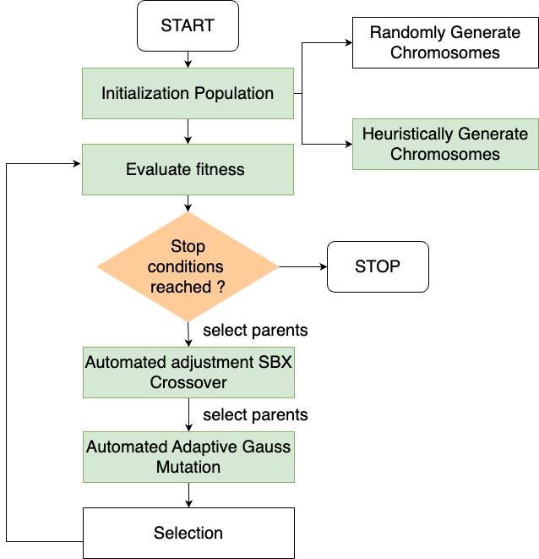
4. Proposed Algorithm (SSD-IGA)
The steps of SSD-IGA
Individual representation
Fitness function
Population initialization
Genetic operator:
Crossover
Mutation
Selection operator
Notes:
we propose an Improved Genetic Algorithm (IGA) to solve the Sensor Direction Determining (SDD) problem called SDD-IGA
. The outline of this algorithm is shown in the slide.

Slide 17

Individual representation
4. Proposed Algorithm (SSD-IGA)
Sensor | $$S_{1}$$ | $$S_{2}$$ | $$S_{3}$$ | $$S_{4}$$ | $$S_{5}$$ | $$S_{6}$$ | $$S_{7}$$ | $$S_{8}$$
Figure (a)
State | $$1$$ | $$1$$ | $$0$$ | $$1$$ | $$1$$ | $$0$$ | $$0$$ | $$1$$
Direction | $$π$$ | 0 | 0 | $$\frac{π }{2}$$ | $$\frac{π }{3}$$ | $$0$$ | $$0$$ | $$\frac{π }{4}$$
$$S_{1}$$
Figure (b)
$$S_{6}$$
$$S_{3}$$
$$T_{1}$$
$$T_{2}$$
$$S_{5}$$
$$T_{3}$$
$$S_{4}$$
$$T_{4}$$
Direction Sensor
$$S_{7}$$
$$S_{2}$$
$$S_{8}$$
Target
Notes:
Each solution is encoded as a chromosome having 2 parts:
Part one is the state of sensor: Active or inactive
Part two represent Direction sensor.
Is shown in the slide
the space of encodings is figure a and the space of solutions is figure b

Slide 18
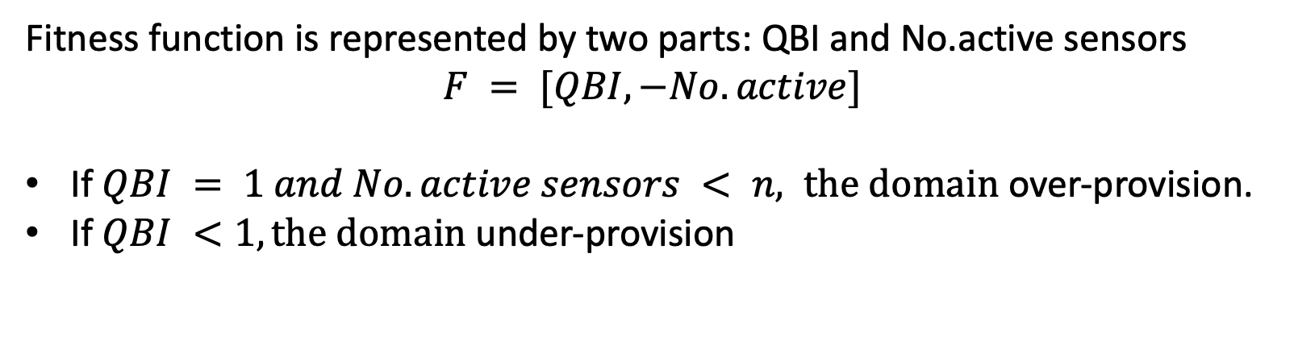
Fitness Function
4. Proposed Algorithm (SSD-IGA)
Fitness function is represented by two parts: QBI and No.active sensors
$$F = [QBI,−No.active]$$
If $QBI = 1 and No.active sensors < n, the domain$ over-provision.
If $QBI <1, the domain$ under-provision
Maximize QBI index first, then minimize active sensor index
Notes:
Fitness function is represented by two parts: QBI and No.active sensors
when QBI equal to 1 and number active sensor is less than n then the domain is over provision
If QBI is less than 1 then domain is under provision
In this algorithm we Maximize QBI index first, then minimize active sensor index

Slide 19
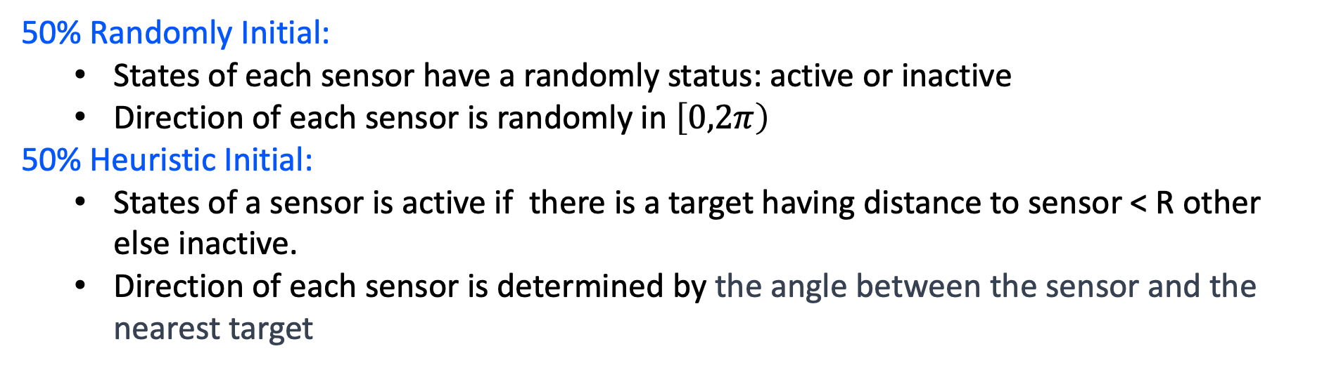
4. Proposed Algorithm (SSD-IGA)
Population initialization:
50% Randomly Initial:
States of each sensor have a randomly status: active or inactive
Direction of each sensor is randomly in $\left[0,2π\right)$
50% Heuristic Initial:
States of a sensor is active if there is a target having distance to sensor < R other else inactive.
Direction of each sensor is determined by the angle between the sensor and the nearest target
Notes:
To diversify the population, we employ two initialization strategies with a 50% random and 50% heuristic ratio.

Slide 20
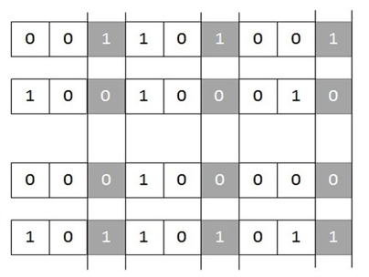


4. Proposed Algorithm (SSD-IGA)
Crossover operator
State gene: using multi-point crossover (shown in figure a)
Direction gene: using Greedily tuned SBX Crossover (shown in figure b)
$$\frac{α_{1}+α_{2}}{2}$$
$$p_{1}$$
$$p_{2}$$
SBX
$$p_{1}$$
$$−β$$
$$+β$$
$$p_{2}$$
Offspring₁
$$\frac{α_{1}+α_{2}}{2}$$
$$p_{1}$$
$$p_{2}$$
Greedily-tuned SBX with
Offspring₂
$${Δ(ξ_{i})}_{\left(p_{1},p_{2}\right)}>0$$
$$−β−Δ(ξ_{i})$$
$$+β−Δ(ξ_{i})$$
Figure (a)
Figure (b)
Notes:
Crossover operator have two parts:
State gene use multi-point crossover that is shown in figure a
Direction gene use Greedily tuned SBX Crossover that is given in figure b.
In this research we use Greedily tuned SBX Crossover in stead of basic SBX to focus on better genes. So, next generations can improve quality solutions

Slide 21
4. Proposed Algorithm (SSD-IGA)
Mutation operation
0 | 1 | 0 | 1 | 1 | 1 | 0 | 1 | 0
State gene: one point mutation (shown in figure a)
Direction gene: Adaptive Polynomial Mutation based on coverage quality distance:
if parents have good quality, offspring will have less differences compared to parents.
If parents have bad quality, offspring will have more differences compared to parents.
0 | 1 | 0 | 1 | 0 | 1 | 0 | 1 | 0
Figure (a)
$$\frac{α_{1}+α_{2}}{2}$$
$$p_{2}$$
$$−β$$
$$+β$$
Notes:
Muation operator have two parts:
State gene: one point crossover.
Direction gene: Adaptive Polynomial Mutation based on coverage quality distance:
if parents have good quality, offspring will have less differences compared to parents.
If parents have bad quality, offspring will have more differences compared to parents.

Slide 22
4. Proposed Algorithm (SSD-IGA)
Selection operator
Selection operator is combination:
Roulette wheel selection
Elite selection technique
Elite 10%
Individual | Value
1 | 3
2 | 11
3 | 7
4 | 20
5 | 9
6 | 5
7 | 9
8 | 18
9 | 5
10 | 13
Individual | Value
4 | 20
8 | 18
10 | 13
2 | 11
5 | 9
7 | 9
3 | 7
6 | 5
9 | 5
1 | 3
10
1
3%
2
9
13%
11%
5%
3
7%
SPIN
8
18%
20%
4
9%
9%
5%
7
5
SPIN
6
Notes:
The selection is Combination of:
In Roulette wheel selection
The individual have better fitness value it will have more chance to be selected to next generations

Slide 23
Outline
Introduction
Problem Formulation
Related works
Proposed methods
Experimental results
Conclusion

Slide 24
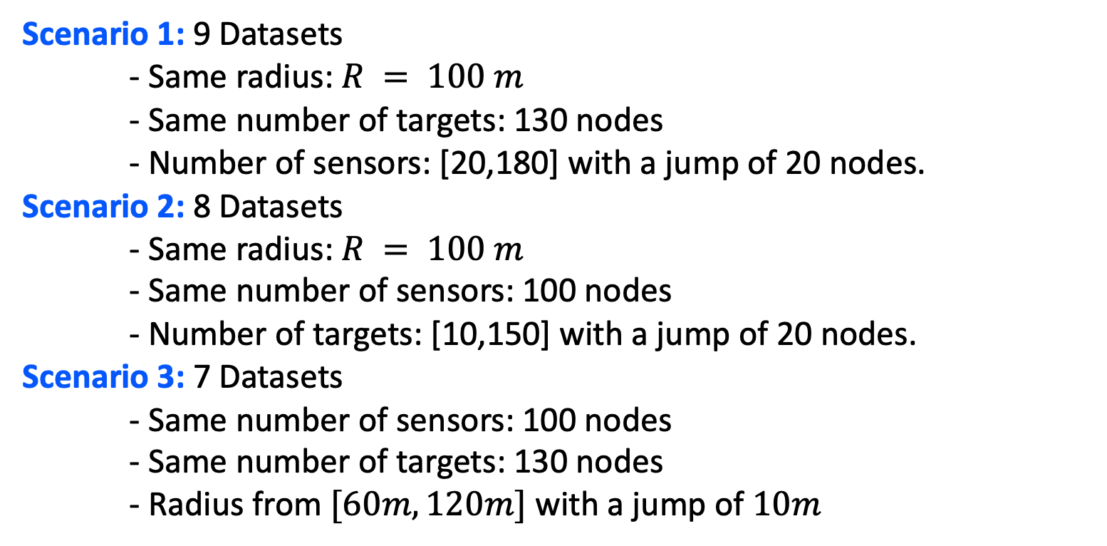
5. Experiments and Results
Problem instances
Scenario 1: 9 Datasets
- Same radius: $R = 100 m$
- Same number of targets: 130 nodes
- Number of sensors: [20,180] with a jump of 20 nodes.
Scenario 2: 8 Datasets
- Same radius: $R = 100 m$
- Same number of sensors: 100 nodes
- Number of targets: [10,150] with a jump of 20 nodes.
Scenario 3: 7 Datasets
- Same number of sensors: 100 nodes
- Same number of targets: 130 nodes
- Radius from $[60m,120m]$with a jump of $10m$

Slide 25
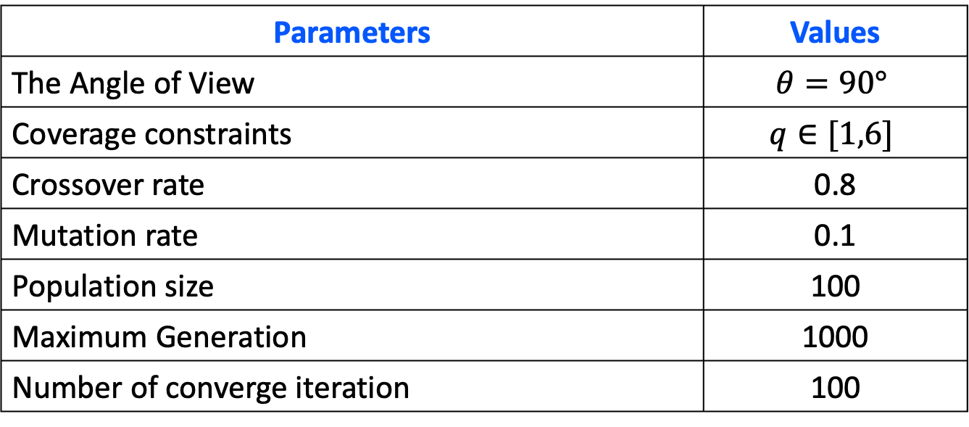
5. Experiments and Results
Algorithm Parameters:
Parameters | Values
The Angle of View | $$θ=90°$$
Coverage constraints | $$q∈[1,6]$$
Crossover rate | 0.8
Mutation rate | 0.1
Population size | 100
Maximum Generation | 1000
Number of converge iteration | 100

Slide 26
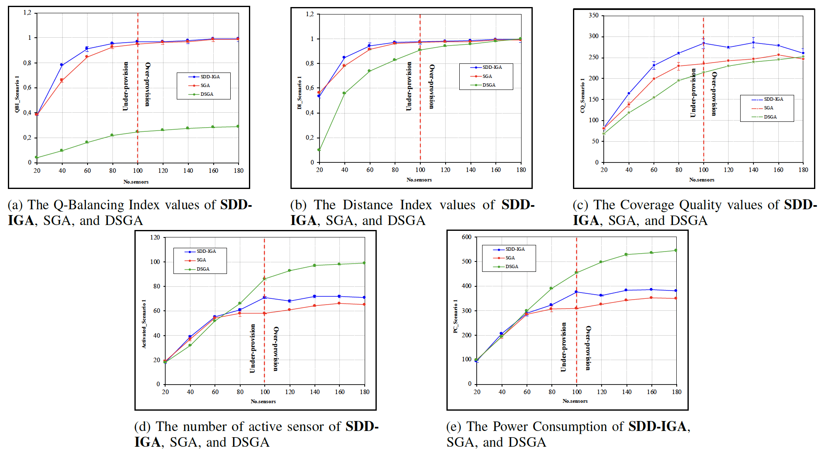
5. Experiments and Results
Experiment 1: The effect of the number of sensors on the performance of the algorithms
SDD-IGA required 101% the number of sensor active compared to DSGA but yielded better QBI (262%), DI (8%) and CQ (14%)

Slide 27
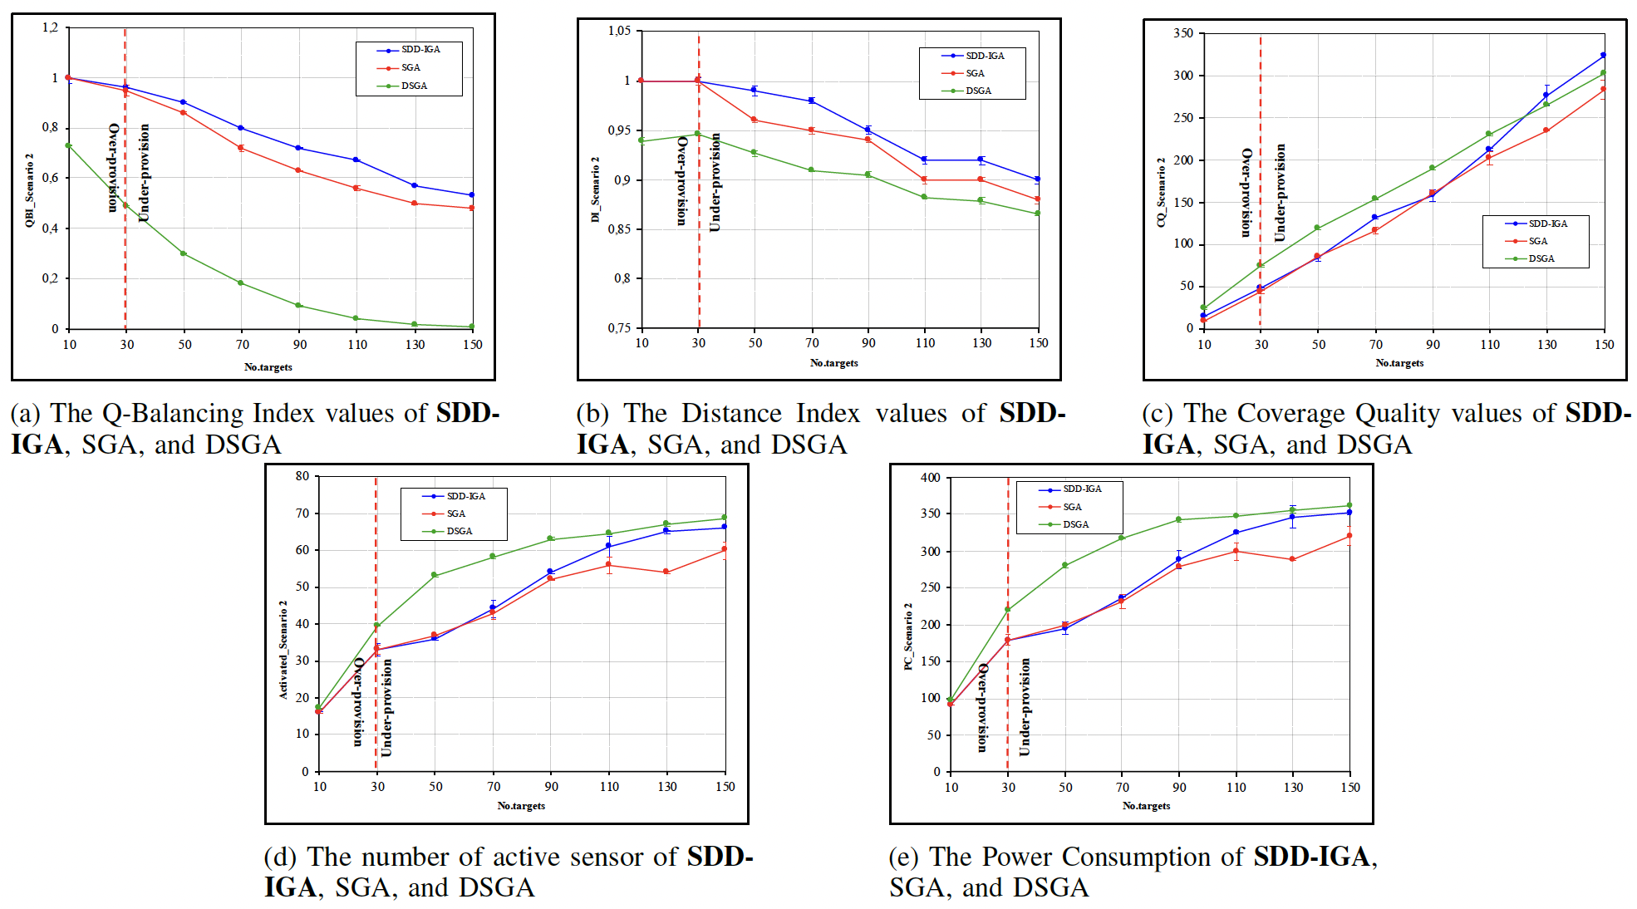
5. Experiments and Results
Experiment 2: used the under-provisioned dataset to evaluate the impact of target numbers on QBI and the Q-coverage ability DI
SDD-IGA is better than 231% and 6% for QBI and DI. Moreover, SDD-IGA also produces better results than DSGA in terms of number of sensor active and PC.

Slide 28
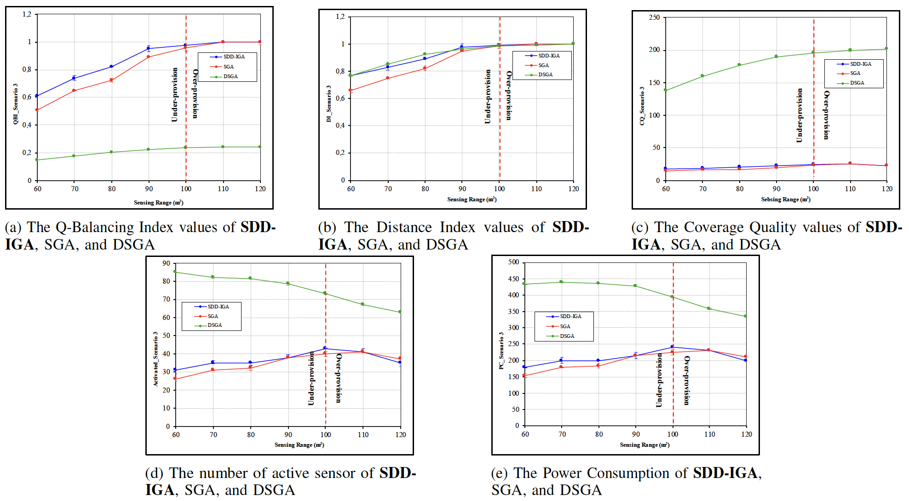
5. Experiments and Results
Experiment 3: In an under-provisioned environment (sensing range R$≤$ 90m), focused on comparing QBI and DI of the three algorithms
SDD-IGA outperform both SGA and DSGA on these metrics. Specifically, SDD-IGA beats SGA by 25% on QBI and 18% on DI. SDD-IGA is better than DSGA 297% on QBI.

Slide 29
6. Conclusion
Contribution:
Proposed SDD-IGA for both over-provisioned and under-provisioned environments.
Various experiments based on multiple scenarios
Ours technique could efficiently solve problems and outperform the latest works
Testing the “health” hypothesis with SDD-IGA algorithm and demonstrate it is effective to improve the solution
Future works:
Expanding our research to deal with the simultaneous placement of sensors and adjustment of the orientation angle of the sensors
Real-time coverage for moving targets
Notes:
In this work, we study the Q-coverage problem, which is one of the main challenges in DSNs:

Slide 30


