Slide 1
PRU221m - Group 1
TOWER DEFENSE
SE1613
Nguyen Van Tien Nguyen Tran Quoc AnH Le Minh Dung Do Son Tung Tran Van Tuan | HE163008 (Leader) HE163282 HE160721 HE150203 HE151203
TEACHER: THUYBT26

Slide 2
Content
1. Understand The Solution
2. Design a solution | Sprite Audio Audio Controller Tower BuildManager Plot Turret SlowTurret Menu LevelManager Bullet EnemyController EnemyMovement EnemySpawner
3. Write test case

Slide 3
Work assignment
 | Iteration 1 | Iteration 2 | Iteration 3
Nguyen Van Tien | Understand the game | Putting all together | Test
Nguyen Tran Quoc Anh | Find sprite and prefab, template | Code Player Settings | Test
Le Minh Dung | Build the base of project | Code, Design UI | Fix bug
Do Son Tung | Find about third party for the game | Code Object pool | Fix bug
Tran Van Tuan | Understand the game | Code Tower controller | Fix bug

Slide 4
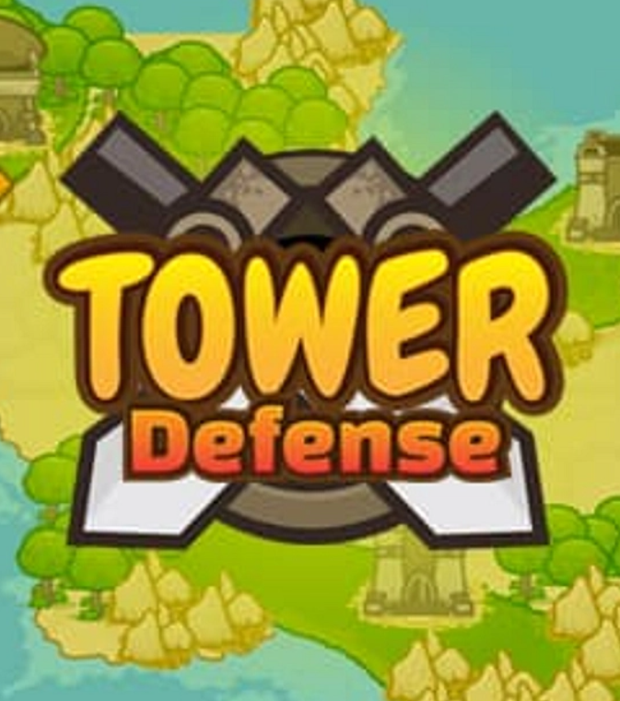
Understand The Solution
Implement a game called Tower Defense. In the game, the player chose the tile to place the tower.There are four kinds of tower with different powers and you must combine them wisely to kill all the monsters. The monster will spawn in many ways to your castle. You can also upgrade your tower to get to a new level of strength. When the game finishes because the player ran out of health the player discovers whether or not they just achieved a new high score.

Slide 5
SE1613
02
Design
a solution
PRU221m - Group 1

Slide 6
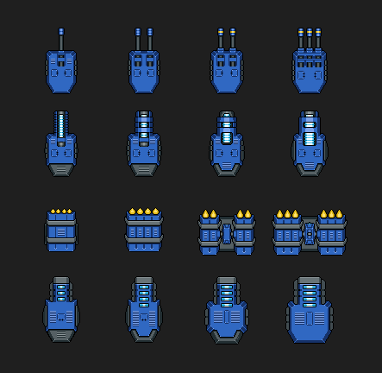
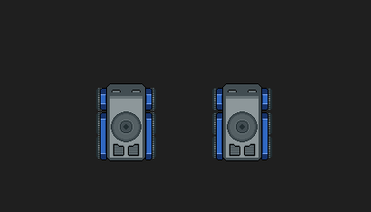
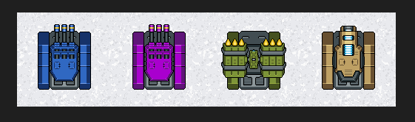
02. Design a solution
SE1613
b. Gameplay / 1. Sprite - Turret

Slide 7


02. Design a solution
SE1613
-Low speed
-High heath point
-Normal speed
-Normal heath point
b. Gameplay / 2. Sprite - Enemy

Slide 8

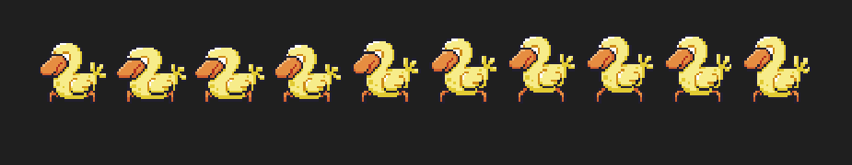
02. Design a solution
SE1613
-High speed
-Low heath point
-Normal speed
-High heath point
-Dodge bullet
b. Gameplay / 3. Sprite - Enemy

Slide 9
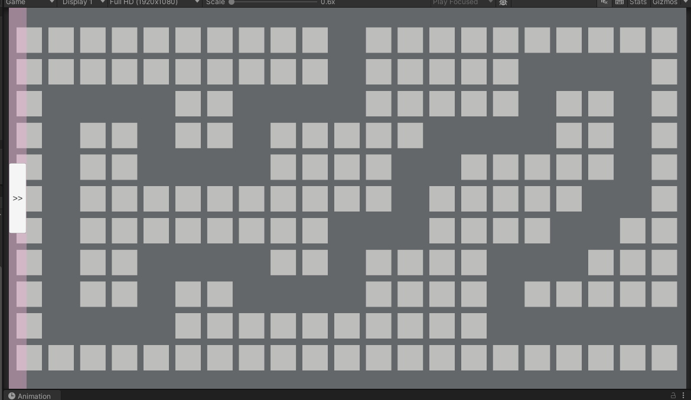
02. Design a solution
SE1613
b. Gameplay / 4. Sprite - Map Layout

Slide 10
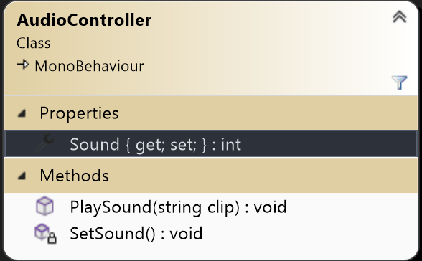
02. Design a solution
SE1613
5. AudioController
Properties | Usage
Sound | Save Sound value
Methods | Usage
SetSound | Enable/Disable game sound
PlaySound | Play sound based on a string parameter
a. Audio

Slide 11
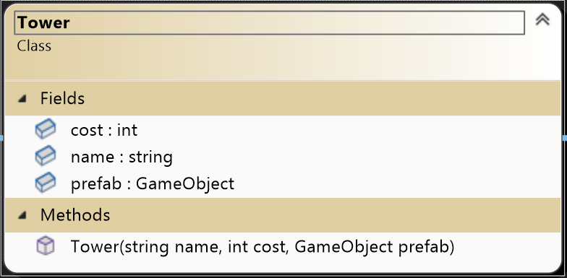
02. Design a solution
SE1613
6. Tower
Fields | Usage
Cost | The cost of the tower
Name | Name of the tower
Prefab | GameObject to build
Methods | Usage
Tower | Constructor
b. Gameplay

Slide 12
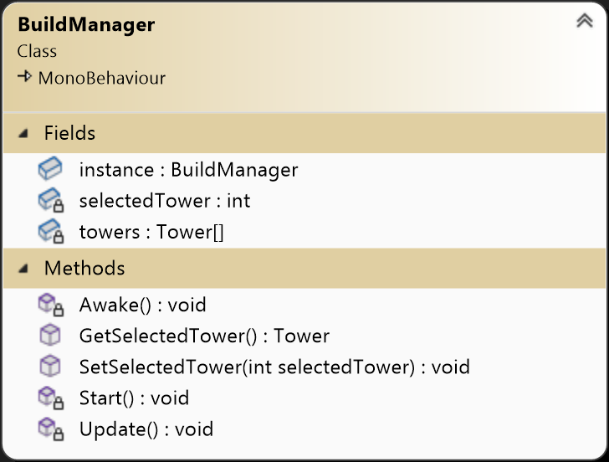
02. Design a solution
SE1613
7. Build Manager
Fields | Usage
instance | Singleton Pattern
selectedTower | Index of the tower going to be built
towers | Array of builtable tower
Methods | Usage
Awake | Singleton Pattern
GetSelectedTower | Return Tower object being selected
SetSelectedTower | Set the selectedTower variable to a index
b. Gameplay

Slide 13
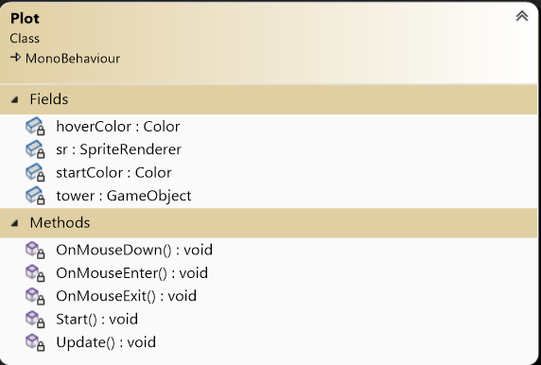
02. Design a solution
SE1613
8. Plot
Fields | Usage
Hover Color | Color to change when hover mouse
Sr | SpriteRender of the plot
Start Color | Color of the Plot when game start
Tower | The tower is built on plot
Methods | Usage
OnMouseDown | Handler plot interaction when press the plot
OnMouseEnter | Change color when mouse enter plot
OnMouseExit | Change color when mouse exit plot
Start | Init the color of plot
b. Gameplay

Slide 14
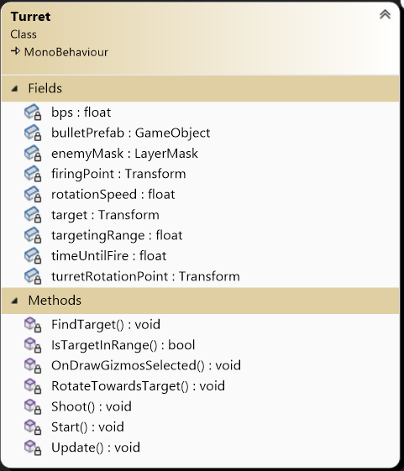
02. Design a solution
SE1613
Fields | Usage
bps | Number of bullet per second
BulletPrefab | The prefab of the bullet
enemyMask | The layer of the enemy to target
firingPoint | The position of the bullet to spawn
rotationSpeed | The speed that the head of the turret to spin
target | The target that the turret is going to hit
targetingRange | The range of the turret can shot
timeUntilFire | Time between shoot
turretRotationPoint | The point that the gun spin around
b. Gameplay / Turret

Slide 15
02. Design a solution
SE1613
Methods | Usage
FindTarget | Find the target to shoot
IsTargetInRange | Check if target is in range
OnDrawGizmosSelected | Draw the range of turret
RotateTowardsTarget | Rotate the gun to the target
Shoot | Shoot the bullet
Update | Update the target
b. Gameplay / Turret

Slide 16
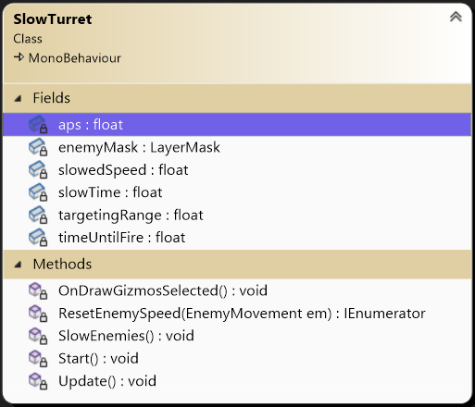
02. Design a solution
SE1613
Fields | Usage
aps | Attack per second
enemyMask | The layer of the enemy to target
slowedSpeed | Speed of enemy is slow to
slowTime | The duration the enemy is slow
targetingRange | The range of the turret can slow
timeUntilFire | Time between slow
b. Gameplay / Slow Turret

Slide 17
02. Design a solution
SE1613
Methods | Usage
SlowEnemies | Slow enemies
ResetEnemySpeed | Reset the speed of the enemy
OnDrawGizmosSelected | Draw the range of turret
Update | Update the slow
b. Gameplay / Slow Turret

Slide 18
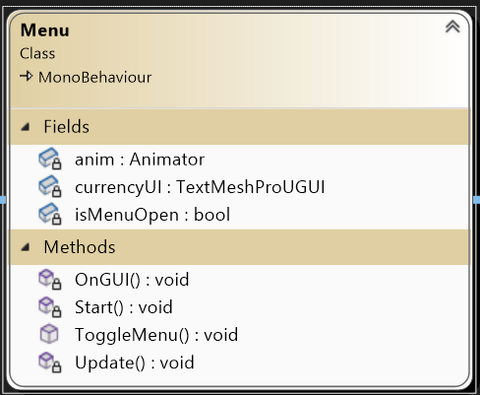
02. Design a solution
SE1613
Fields | Usage
anim | Animator of the menu
currencyUI | UI currency
isMenuOpen | Check if Menu is open
Methods | Usage
OnGUI | Change currency text UI
ToggleMenu | Change Menu state
b. Gameplay / Menu

Slide 19
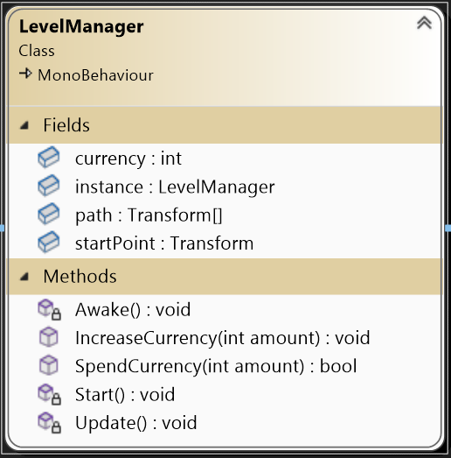
02. Design a solution
SE1613
Fields | Usage
Currency | currency of player
instance | Singleton pattern
path | Enemy’s path
startPoint | Enemy spawn point
Methods | Usage
Awake | Singleton pattern
IncreaseCurrency | Increase the currency of player
SpendCurrency | Decrease the currency of player
Start | Start currency
b. Gameplay / LevelManager

Slide 20
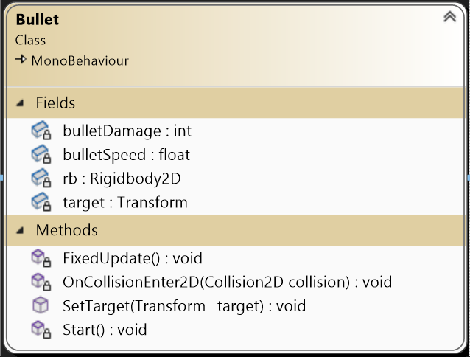
02. Design a solution
SE1613
Fields | Usage
bulletDamage | Damage of bullet
bulletSpeed | Speed of bullet
rb | Rigidbody of the bullet
target | Target of bullet
Methods | Usage
FixedUpdate | Update position of bullet
OnCollisionEnter2D | When bullet collide with enemy
SetTarget | Set the target for bullet
b. Gameplay / Bullet

Slide 21
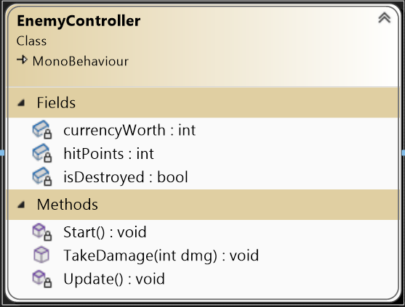
02. Design a solution
SE1613
Fields | Usage
currencyWorth | Worth when kill enemy
hitPoints | HIt need to kill the enemy
isDestroyed | Check enemy is destroy
Methods | Usage
TakeDamage | The enemy take damage
b. Gameplay / EnemyController

Slide 22
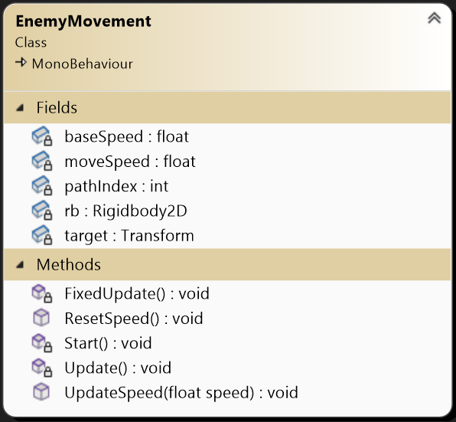
02. Design a solution
SE1613
Fields | Usage
baseSpeed | Base speed of Enemy
moveSpeed | Move speed of Enemy
pathIndex | Index of the path to travel to
rb | Rigidbody of Enemy
target | Target to move to
b. Gameplay / EnemyMovement

Slide 23
02. Design a solution
SE1613
Methods | Usage
FixedUpdate | Update the position of Enemy
ResetSpeed | Reset the speed of the enemy
Start | Init speed and target
Update | Update the target
UpdateSpeed | Update new speed for the enemy
b. Gameplay / EnemyMovement

Slide 24
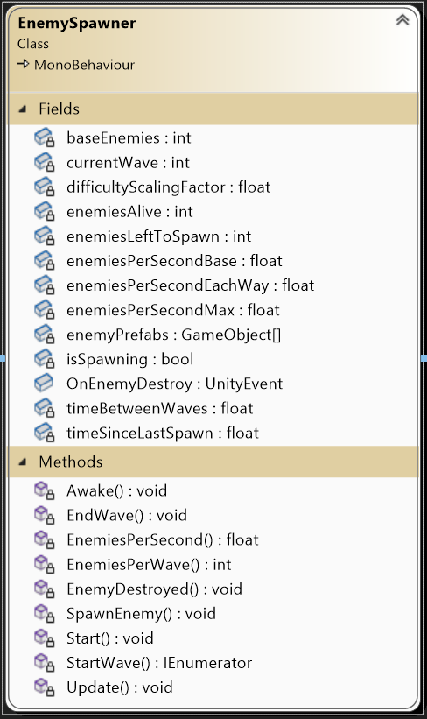
02. Design a solution
SE1613
Fields | Usage
baseEnemies | Base number of enemies
currentWave | The current wave number
difficultyScalingFactor | How the game become more difficult each round
enemiesAlive | The number of enemies left alive
enemiesLeftToSpawn | The number of enemies not yet spawn
enemiesPerSecond | The base number of enemies to spawn per second
enemiesPerSecondMax | The maximum number of enemies allowed to spawn per second
enemiesPrefabs | Enemy prefabs
b. Gameplay / EnemySpawner

Slide 25
02. Design a solution
SE1613
Fields | Usage
isSpawning | Flag to check if the enemies wave has finished spawning
OnEnemyDestroy | Trigger an event when an enemy is destroyed
timeBetweenWaves | Time between enemies spawning waves
timeSinceLastSpawn | Time since the last enemy has been spawned
b. Gameplay / EnemySpawner

Slide 26
02. Design a solution
SE1613
Methods | Use for
Awake | Init event listener
EndWave | End a enemy wave
EnemiesPerSecond | Count enemies per second scaling with waves
EnemiesPerWave | Count enemies per wave scaling with waves
EnemyDestroyed | Reduce number of enemies currently alive
SpawnEnemy | Spawn a random enemies
Start | Start spawn enemies
StartWave | Spawn a wave of many enemies
Update | Update the state
b. Gameplay / EnemySpawner

Slide 27
SE1613
03
Write
test case
PRU221m - Group 1

Slide 28
03.Write test case
Test Case 1 | Click new game button
 | Step 1 | Click new game button on the screen
 | Expected Result | Redirect to the map and start the gameplay.

Slide 29
03.Write test case
Test Case 2 | Increase game speed by 2 times
 | Step 1 | Enter new game
 | Step 2 | Once started the game, click the double arrow button on the top right of the screen to increase the speed of the game to x2.
 | Expected Result | Increase the gameplay pace 2 times.

Slide 30
03.Write test case
Test Case 3 | Increase game speed by 4 times
 | Step 1 | Enter new game
 | Step 2 | Once inside the game, click the double arrow button on the top right of the screen twice to increase the speed of the game to x4.
 | Expected Result | Increase the gameplay pace 4 times.

Slide 31
03.Write test case
Test Case 4 | Reset game speed
 | Step 1 | Enter new game
 | Step 2 | Once inside the game, click the double arrow button on the top right of the screen three times.
 | Expected Result | Gameplay pace speed up by x2, then x4, then reset back to normal.

Slide 32
03.Write test case
Test Case 5 | Click pause button
 | Step 1 | Click the pause button on the right corner of the screen.
 | Expected Result | The pause screen appears and displays 4 buttons including ”Home”, ”Restart”, “Continue”, and “Save and Quit”.

Slide 33
03.Write test case
Test Case 6 | Click the “Home” button during pausing the game.
 | Step 1 | Click the pause button on the right corner
 | Step 2 | Click the “Home” button
 | Expected Result | Redirect to the main screen

Slide 34
03.Write test case
Test Case 7 | Click the “Restart” button during pausing the game.
 | Step 1 | Click the pause button on the right corner
 | Step 2 | Click the “Restart” button
 | Expected Result | Restart everything from the beginning.

Slide 35
03.Write test case
Test Case 8 | Click the “Continue” button during pausing the game.
 | Step 1 | Click the pause button on the right corner.
 | Step 2 | Click the “Continue” button.
 | Expected Result | Continue the game.

Slide 36
03.Write test case
Test Case 9 | Click the “Save and Quit” button during pausing the game.
 | Step 1 | Click the pause button on the right corner.
 | Step 2 | Click the “Save and Quit” button
 | Expected Result | Save the progress and redirect to Home screen.

Slide 37
03.Write test case
Test Case 10 | Build defense tower
 | Step 1 | Click the rounded position on the screen.
 | Step 2 | Choose one of four types of towers
 | Expected Result | The tower displayed on the map

Slide 38
03.Write test case
Test Case 11 | Upgrade defense tower
 | Step 1 | Click the tower that you want to upgrade.
 | Step 2 | Click the upgrade button.
 | Expected Result | If you have enough money, then you’ll be able to upgrade the tower.

Slide 39
03.Write test case
Test Case 12 | Sell defense tower
 | Step 1 | Click the tower that you want to sell.
 | Step 2 | Click the sell button.
 | Expected Result | The tower gets destroyed and money returned to the player.

Slide 40
03.Write test case
Test Case 13 | Lose all HP point and click Home button
 | Step 1 | The player loses all of his/her HP points, then the defeat announcement appears on the screen.
 | Step 2 | Click Home button
 | Expected Result | The defeat scene appears and displays 2 buttons “Home” and “Retry”. Players choose the Home button and redirect to the main screen.

Slide 41
03.Write test case
Test Case 14 | Lose all HP point and click Retry button
 | Step 1 | The player loses all of his/her HP points, then the defeat announcement appears on the screen.
 | Step 2 | Click Retry button
 | Expected Result | The defeat scene appears and displays 2 buttons “Home” and “Retry”. Players choose the Retry button and the game starts from the beginning.

Slide 42
Thanks!
Do you have any questions?
Please keep this slide for attribution

