Slide 1

IMPLEMENT SNN ON SOC
Nguyễn Việt Thi - EDABK

Slide 2
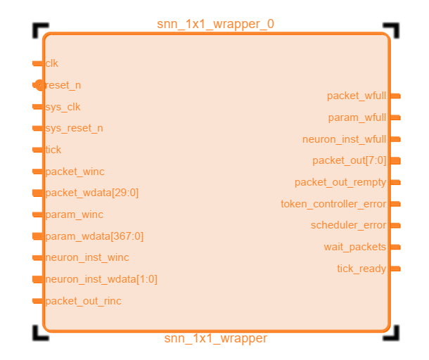
TOP DIAGRAM
clk | SNN clock signal
reset_n | SNN Asynchronous signal, active LOW
sys_clk | SOC clock signal
sys_reset_n | SOC Asynchronous signal, active LOW
tick | Trigger signal
packet_winc | Enable writing Input spike packet
packet_wdata | Input spike packet
packet_wfull | Flag to indicate that Spike packet FIFO is FULL
param_winc | Enable writing Neuron parameter
param_wdata | Neuron parameter data
param_wfull | Flag to indicate that Neuron parameter FIFO is FULL
neuron_inst_winc | Neuron instruction enable
neuron_inst_wdata | Neuron instruction data
neuron_inst_wfull | Flag to indicate that Neuron instruction FIFO is FULL
packet_out | Output spike packet
packet_out_rinc | Enable reading output spike packet
packet_out_rempty | Flag to indicate that output spike packet FIFO is EMPTY
token_controller_error | The token controller is error
scheduler_error | The scheduler is error
wait_packets | Wait for packet to put on snn/ Time to read packetout
tick_ready | Flag to indicate that tick is ready

Slide 3
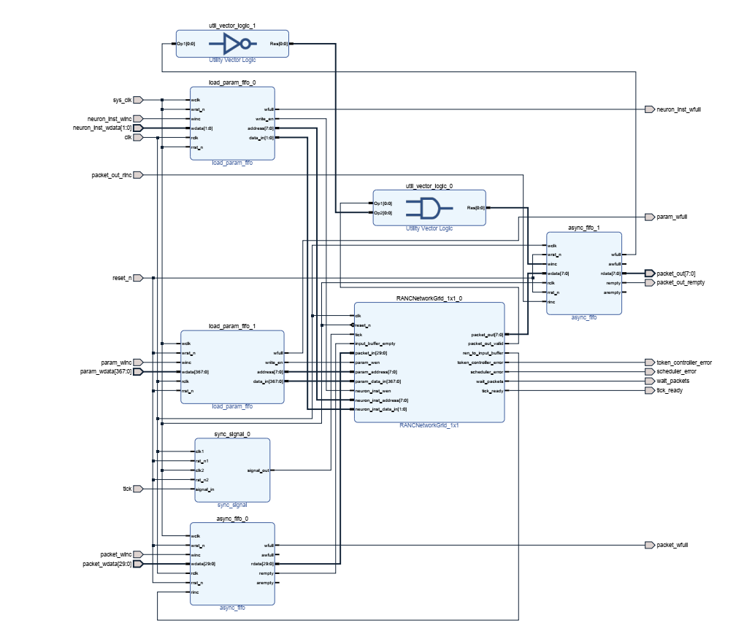
ARCHITECTURE

Slide 4
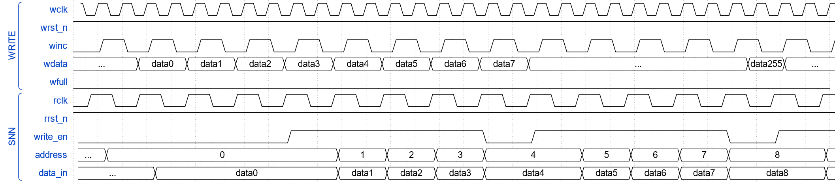
WAVEFORM
Load neuron parameter and neuron instruction waveform

Slide 5
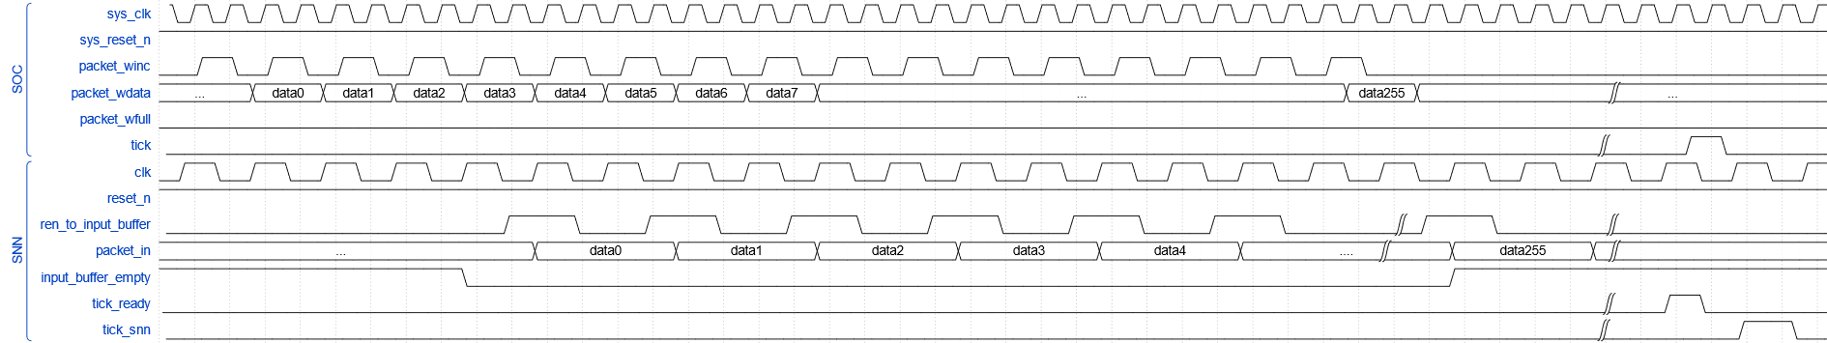
WAVEFORM
Load packet in waveform

Slide 6
WAVEFORM
Read packet out waveform

Slide 7
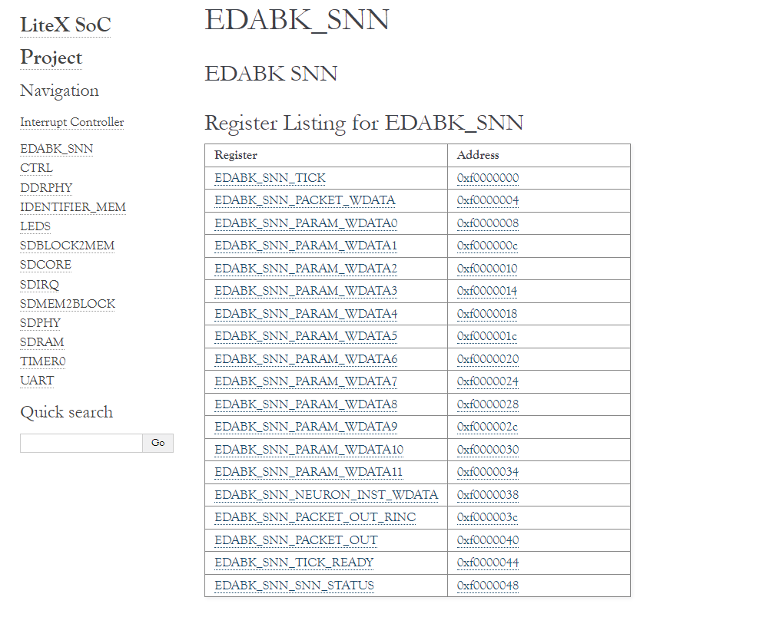
REGISTER BLOCK

Slide 8
THANK YOU !

