Slide 1
Fast convergence of MCMC algorithms
Nguyen Vo, Jeffrey Jenkins, Sarah Baldwin
Notes:
1
Good afternoon everyone,
In today’s presentation, our group will cover two chapters. Chapter 8 is about Fast convergence of MCMC algorithms and Chapter 9 is about approximate counting.
My team members
Jeff and Sarah will cover approximate counting.

Slide 2
Content
MCMC simulation of q-coloring problem
Observations and Demo
Proof
Conclusion
2
2

Slide 3
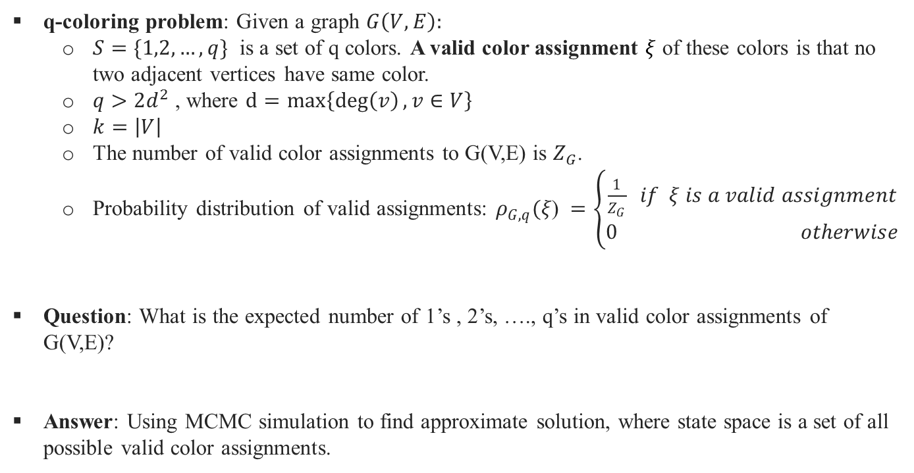
MCMC simulation
q-coloring problem
q-coloring problem: Given a graph $G\left(V, E\right):$
$S=\{1,2,…,q\}$ is a set of q colors. A valid color assignment $ξ$ of these colors is that no two adjacent vertices have same color.
$q>2d^{2}$ , where $d=max\left\{\deg\left(v\right), v∈V\right\}$
$k=\left|V\right|$
The number of valid color assignments to G(V,E) is $Z_{G}$.
Probability distribution of valid assignments: $ρ_{G,q}(ξ\text{) }=\left\{\begin{aligned}\frac{1}{Z_{G}} if ξ is a valid assignment \\ 0 otherwise\end{aligned}\right.$
Question: What is the expected number of 1’s , 2’s, …., q’s in valid color assignments of G(V,E)?
Answer: Using MCMC simulation to find approximate solution, where state space is a set of all possible valid color assignments.
3
Notes:
Rather than picking a vertex uniformly, we will pick a vertex based on systematic sweep Gibbs sampler.

Slide 4
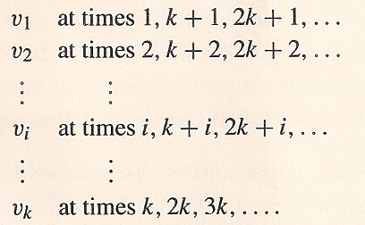
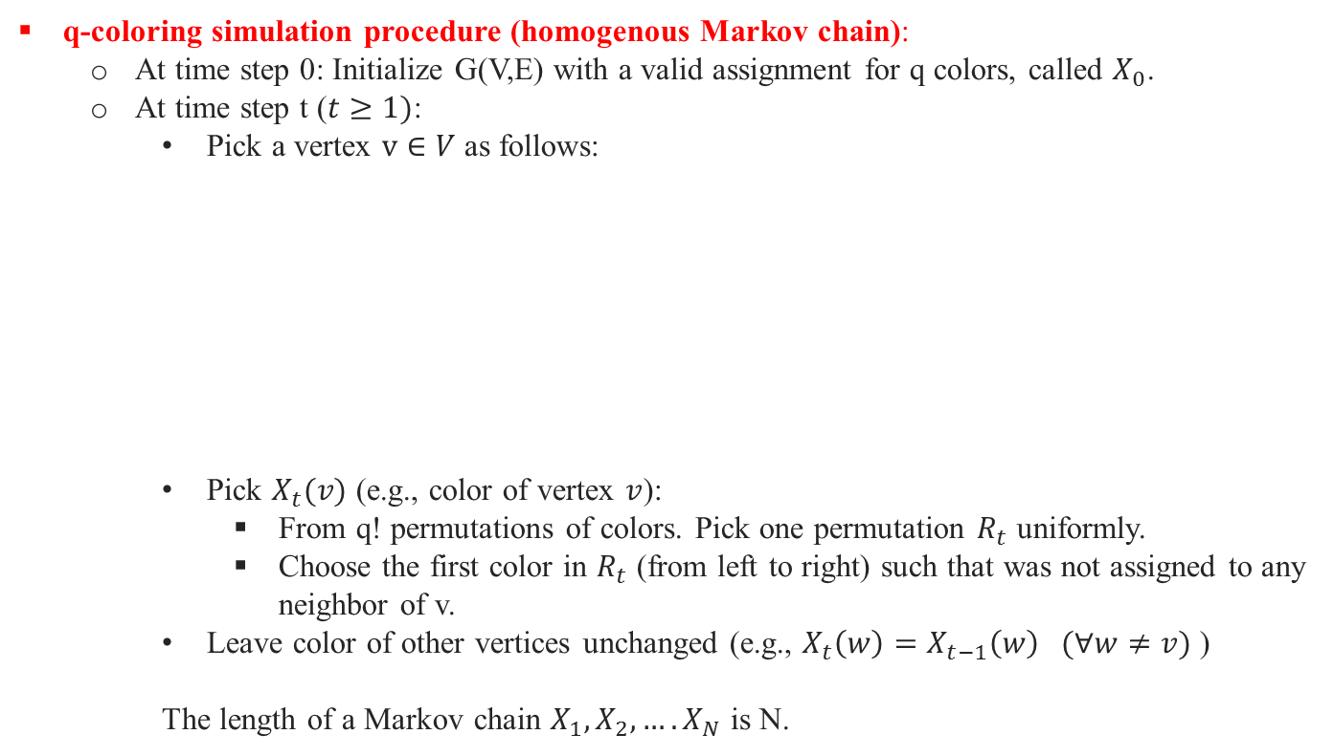
MCMC simulation
q-coloring problem
q-coloring simulation procedure (homogenous Markov chain):
At time step 0: Initialize G(V,E) with a valid assignment for q colors, called $X_{0}$.
At time step t ($t≥1)$:
Pick a vertex $v∈V$ as follows:
Pick $X_{t}(v)$ (e.g., color of vertex $v$):
From q! permutations of colors. Pick one permutation $R_{t}$ uniformly.
Choose the first color in $R_{t}$ (from left to right) such that was not assigned to any neighbor of v.
Leave color of other vertices unchanged (e.g., $X_{t}\left(w\right)=X_{t−1}\left(w\right) (∀w≠v)$ )
The length of a Markov chain $X_{1},X_{2},….X_{N}$ is N.
Systematic Sweep Gibbs sampler
4
Notes:
It can be implemented in O(q) by using Fisher Yates shuffle.
Rather than picking a vertex uniformly, we will pick a vertex based on systematic sweep Gibbs sampler. we can cycle
systematically through the vertex set
First, you initialize graph G(V, E) with a valid color assignment called X_0
At every time step t later, you will do same procedure.
First,

Slide 5
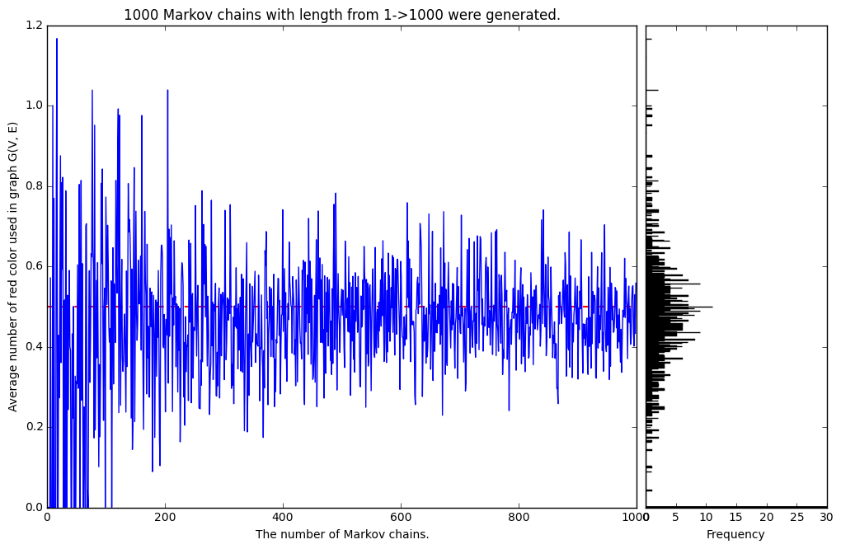
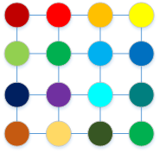
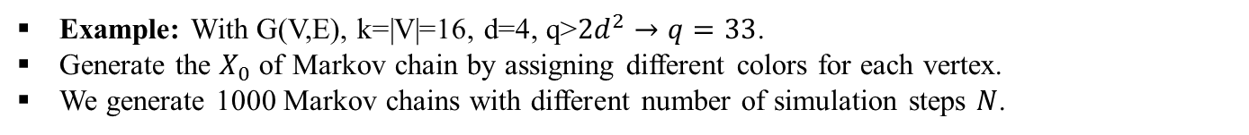
MCMC simulation
q-coloring problem
Example: With G(V,E), k=|V|=16, d=4, q>$2d^{2}→q=33$.
Generate the $X_{0}$ of Markov chain by assigning different colors for each vertex.
We generate 1000 Markov chains with different number of simulation steps $N$.
The longer Markov chain is, the more accurate results we obtain.
What is the length of each Markov chain we should use?
5
Notes:
Rather than picking a vertex uniformly, we will pick a vertex based on systematic sweep Gibbs sampler.

Slide 6
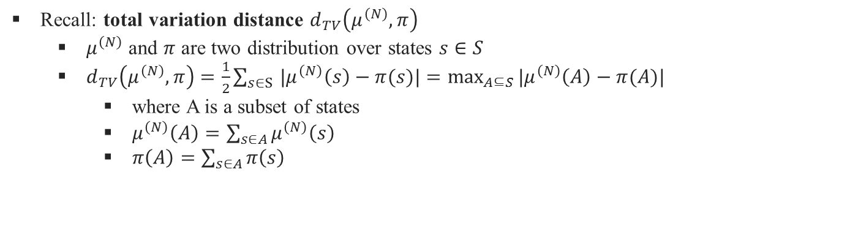
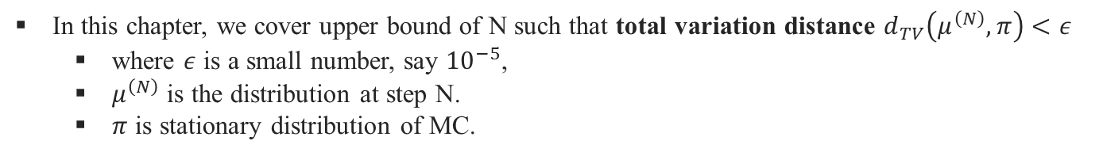
MCMC simulation
How large N is enough?
In this chapter, we cover upper bound of N such that total variation distance $d_{TV}\left(μ^{\left(N\right)},π\right)<ε$
where $ε$ is a small number, say ${10}^{−5}$,
$μ^{\left(N\right)}$ is the distribution at step N.
$π$ is stationary distribution of MC.
Recall: total variation distance $d_{TV}\left(μ^{\left(N\right)},π\right)$
$μ^{\left(N\right)}$ and $π$ are two distribution over states $s∈S$
$d_{TV}\left(μ^{\left(N\right)},π\right)=\frac{1}{2}\sum_{s∈S }{|μ^{\left(N\right)}\left(s\right)−π(s)|}=\max_{A⊆S}{|μ^{\left(N\right)}\left(A\right)−π(A)|}$
where A is a subset of states
$μ^{\left(N\right)}\left(A\right)=\sum_{s∈A}{μ^{\left(N\right)}\left(s\right)}$
$π\left(A\right)=\sum_{s∈A}{π\left(s\right)}$
6
Notes:
Total variation distance: The sum of absolute differences of two distributions. In this case it is $μ^{\left(N\right)} and π$
(1 min)

Slide 7
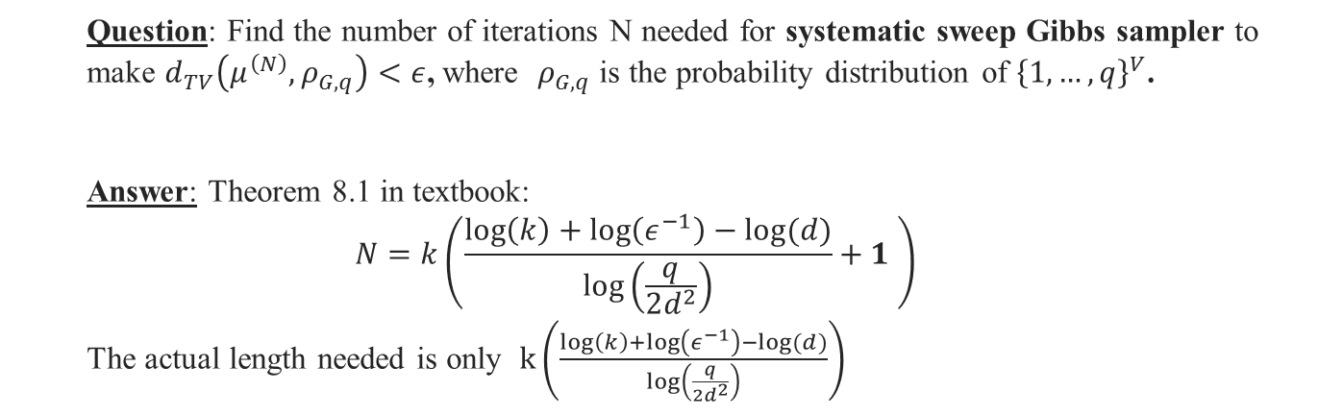
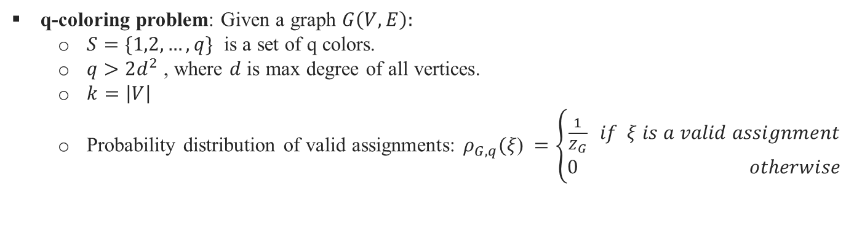
MCMC simulation
How large N is enough?
q-coloring problem: Given a graph $G\left(V, E\right):$
$S=\{1,2,…,q\}$ is a set of q colors.
$q>2d^{2}$ , where $d$ is max degree of all vertices.
$k=\left|V\right|$
Probability distribution of valid assignments: $ρ_{G,q}(ξ\text{) }=\left\{\begin{aligned}\frac{1}{Z_{G}} if ξ is a valid assignment \\ 0 otherwise\end{aligned}\right.$
Question: Find the number of iterations N needed for systematic sweep Gibbs sampler to make $d_{TV}\left(μ^{\left(N\right)},ρ_{G,q}\right)<ε$, where $ρ_{G,q}$ is the probability distribution of ${\left\{1,…,q\right\}}^{V}$.
Answer: Theorem 8.1 in textbook:
$$N=k\left(\frac{\log\left(k\right)+\log\left(ε^{−1}\right)−log⁡(d)}{\log\left(\frac{q}{2d^{2}}\right)}+1 \right)$$
The actual length needed is only $k\left(\frac{\log\left(k\right)+\log\left(ε^{−1}\right)−log⁡(d)}{\log\left(\frac{q}{2d^{2}}\right)}\right)$
7
Notes:
Finding number of iterations such that the distribution at step N has total variation distance smaller than a threshold.
Or in other words, we need to simulate Markov chain how many times to make Markov chain converges. $ρ_{G,q}(ξ\text{) }=\left\{\begin{aligned}\frac{1}{Z_{G}} if ξ is a valid assignment \\ 0 otherwise\end{aligned}\right.$ , in other words, valid assignments are uniformly distributed.
${\left\{1,…,q\right\}}^{V}$.=> assign q colors to |V| = k vertices in G(V, E).

Slide 8
Content
MCMC simulation of q-coloring problem
Observations and Demo
Proof
Conclusion
2
8

Slide 9
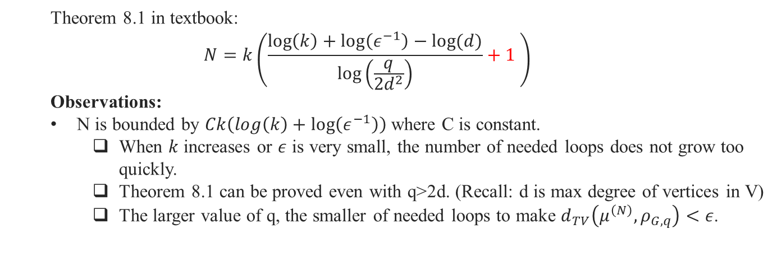
Observations
Theorem 8.1 in textbook:
$$N=k\left(\frac{\log\left(k\right)+\log\left(ε^{−1}\right)−log⁡(d)}{\log\left(\frac{q}{2d^{2}}\right)}+1 \right)$$
Observations:
N is bounded by $Ck\left(log\left(k\right)+\log\left(ε^{−1}\right)\right)$where C is constant.
When $k$ increases or $ε$ is very small, the number of needed loops does not grow too quickly.
Theorem 8.1 can be proved even with q>2d. (Recall: d is max degree of vertices in V)
The larger value of q, the smaller of needed loops to make $d_{TV}\left(μ^{\left(N\right)},ρ_{G,q}\right)<ε$.
9
Notes:
When $k=\left|V\right|$ increases or $ε$ is very small, the number of needed loops does not grow too quickly. In other words, it is feasible to simulate with computer.
The larger value of q, the smaller of needed loops to make MC converge. => This is obvious, because the larger number of colors, the easier to label a graph.

Slide 10
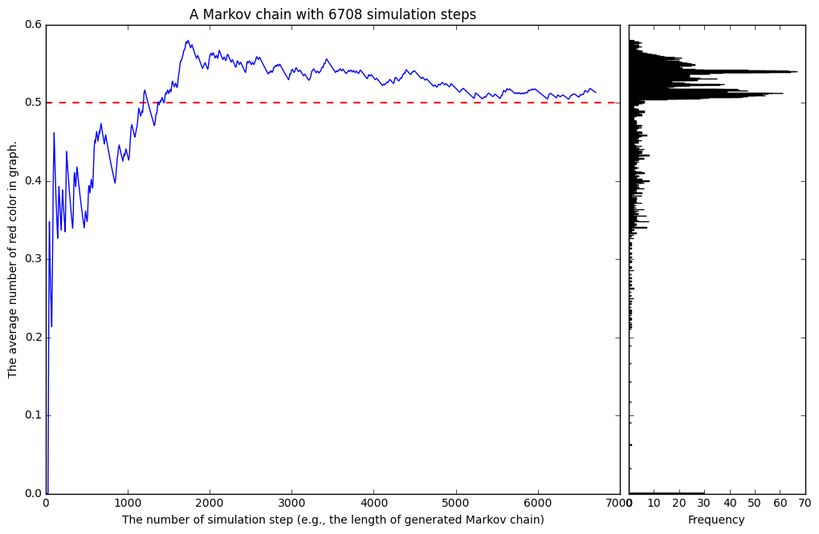
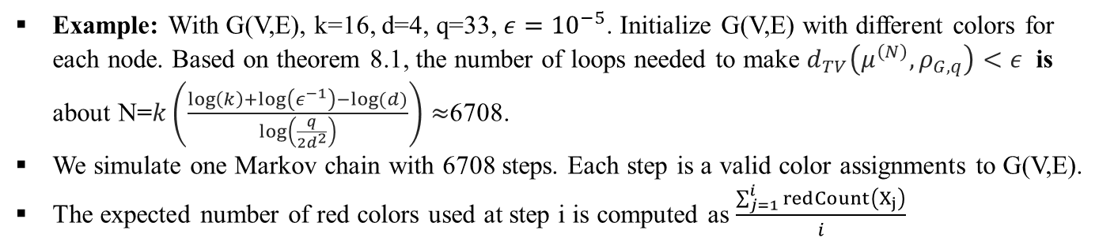
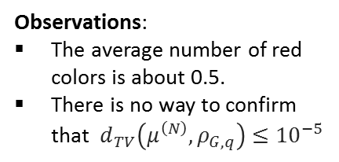
Demo
Example: With G(V,E), k=16, d=4, q=33, $ε={10}^{−5}$. Initialize G(V,E) with different colors for each node. Based on theorem 8.1, the number of loops needed to make $d_{TV}\left(μ^{\left(N\right)},ρ_{G,q}\right)<ε$ is about N=$k\left(\frac{\log\left(k\right)+\log\left(ε^{−1}\right)−log⁡(d)}{\log\left(\frac{q}{2d^{2}}\right)}\right)≈$6708.
We simulate one Markov chain with 6708 steps. Each step is a valid color assignments to G(V,E).
The expected number of red colors used at step i is computed as $\frac{\sum_{j=1}^{i}{redCount\left(X_{j}\right)}}{i}$
Observations:
The average number of red colors is about 0.5.
There is no way to confirm that $d_{TV}\left(μ^{\left(N\right)},ρ_{G,q}\right)≤{10}^{−5}$
10
Notes:
We cannot compute $d_{TV}\left(μ^{\left(N\right)},ρ_{G,q}\right)$ because we don’t know what exactly $ρ_{G,q}$ is.
The larger value of q, the smaller of needed loops to make MC converge. => This is obvious, because the larger number of colors, the easier to label a graph.

Slide 11
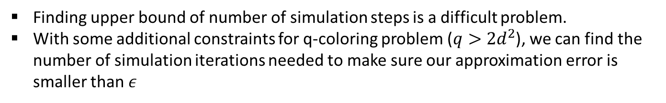
Conclusions
Finding upper bound of number of simulation steps is a difficult problem.
With some additional constraints for q-coloring problem ($q>2d^{2}$), we can find the number of simulation iterations needed to make sure our approximation error is smaller than $ε$
11

Slide 12


Slide 13
Approximate Counting

Slide 14
The Problem
Combinatorics is the branch of mathematics which deals with finite objects or sets, and the ways in which there can be combined.
Basic objects may be graphs and permutations.
Ex: Given a set S what is the number of elements in S.

Slide 15
Ex: q-colorings (Recall)
G=(V,E) is a graph
q>=2
A q-coloring of the graph G is an assignment of values from {1,….q}
Probability is uniformly distributed
No two adjacent vertices have the same color (value)
Problem:
How many different q-colorings are there for G?

Slide 16
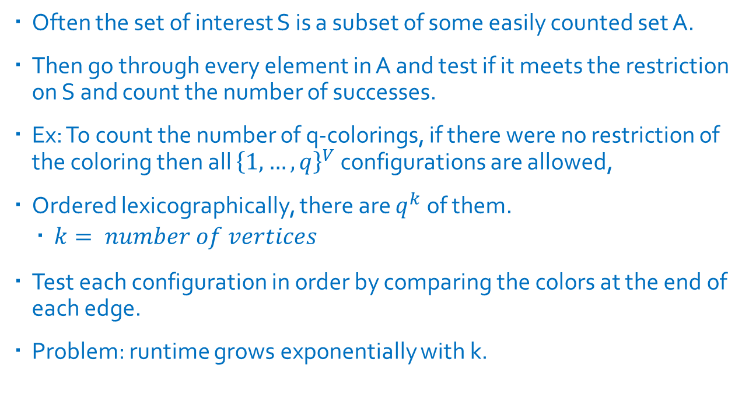
A naïve solution
Often the set of interest S is a subset of some easily counted set A.
Then go through every element in A and test if it meets the restriction on S and count the number of successes.
Ex: To count the number of q-colorings, if there were no restriction of the coloring then all ${\left\{1,…,q\right\}}^{V}$ configurations are allowed,
Ordered lexicographically, there are $q^{k}$ of them.
$k= number of vertices$
Test each configuration in order by comparing the colors at the end of each edge.
Problem: runtime grows exponentially with k.

Slide 17
Types of Counting algorithms
Polynomial time counting scheme
Running time is bounded by polynomial p(k)
Polynomial time approximation scheme
Allowed relative error of ε>0
Randomized polynomial time approximation scheme
with probability at least 2/3, it outputs an answer between
(1 − ε)N and(1 + ε)N
N is the true answer to the counting problem, and

Slide 18
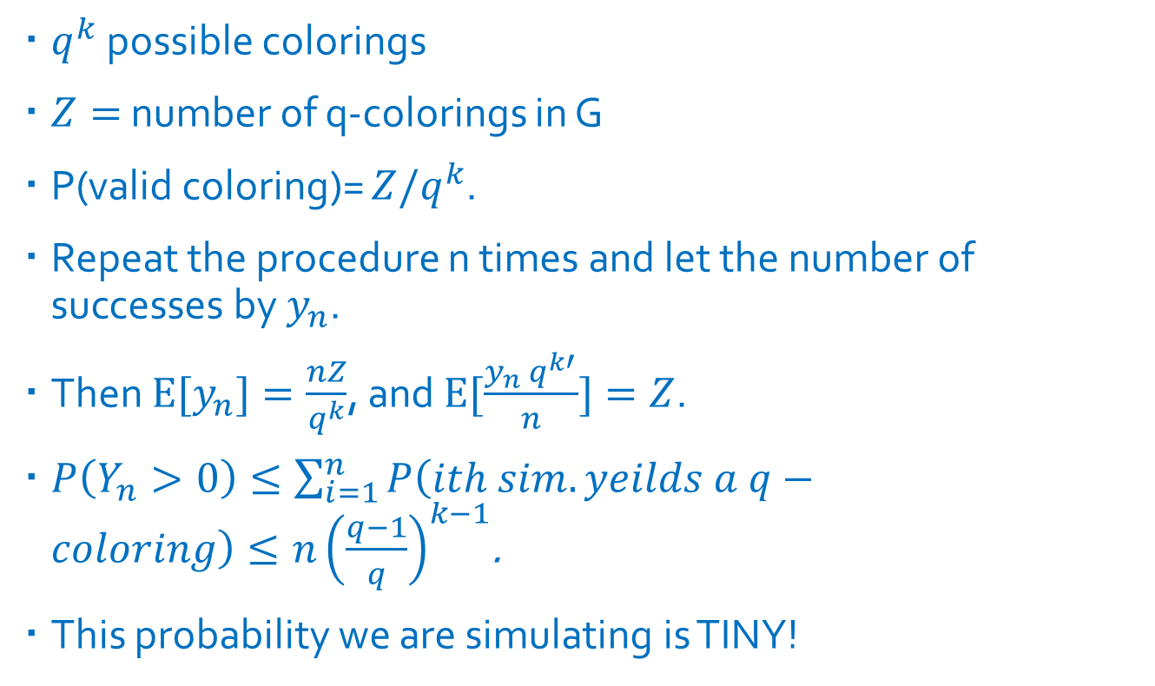
Naïve random approximation scheme
$q^{k}$ possible colorings
$Z=$ number of q-colorings in G
P(valid coloring)= $Z/q^{k}$.
Repeat the procedure n times and let the number of successes by $y_{n}$.
Then $E[y_{n}]=\frac{nZ}{q^{k}}$, and $E[\frac{y_{n} q^{k′}}{n}]=Z$.
$P\left(Y_{n}>0\right)≤\sum_{i=1}^{n}{P\left(ith sim. yeilds a q−coloring\right)≤n{\left(\frac{q−1}{q}\right)}^{k−1}}$.
This probability we are simulating is TINY!

Slide 19

Theorem 9.1
Considering the problem of counting q-colorings for graphs.
Fix $d≥2 and q>2d^{2}$.
no vertex has more than d neighbors
There exists a randomized polynomial time approximation scheme for this problem.

Slide 20
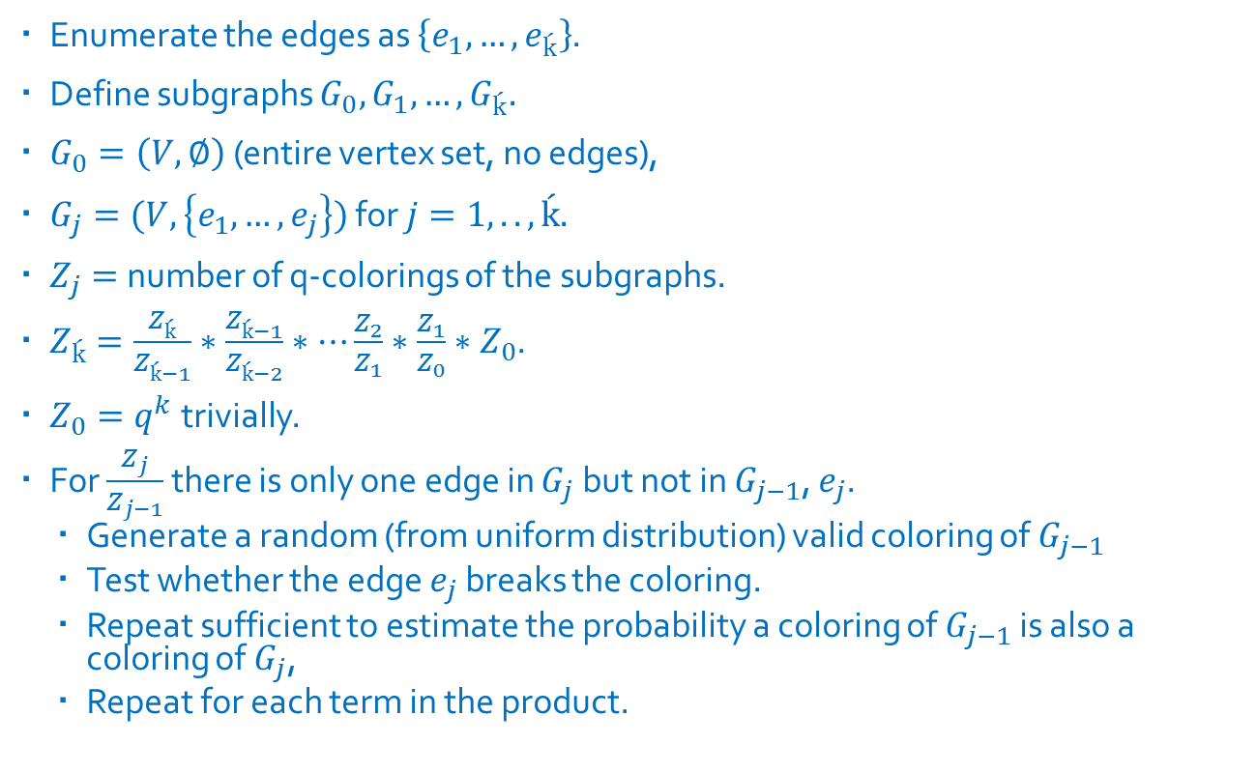
Better Algorithm
Enumerate the edges as $\left\{e_{1},…, e_{ḱ}\right\}$.
Define subgraphs $G_{0},G_{1},…, G_{ḱ}.$
$G_{0}=\left(V,∅\right)$ (entire vertex set, no edges),
$G_{j}=(V,\left\{e_{1},…, e_{j}\right\})$ for $j=1,..,ḱ.$
$Z_{j}=$ number of q-colorings of the subgraphs.
$Z_{ḱ}=\frac{Z_{ḱ}}{Z_{ḱ−1}}∗\frac{Z_{ḱ−1}}{Z_{ḱ−2}}∗…\frac{Z_{2}}{Z_{1}}∗\frac{Z_{1}}{Z_{0}}∗Z_{0}$.
$Z_{0}=q^{k}$ trivially.
For $\frac{Z_{j}}{Z_{j−1}}$ there is only one edge in $G_{j}$ but not in $G_{j−1}$, $e_{j}$.
Generate a random (from uniform distribution) valid coloring of $G_{j−1}$
Test whether the edge $e_{j}$ breaks the coloring.
Repeat sufficient to estimate the probability a coloring of $G_{j−1}$ is also a coloring of $G_{j}$,
Repeat for each term in the product.

Slide 21
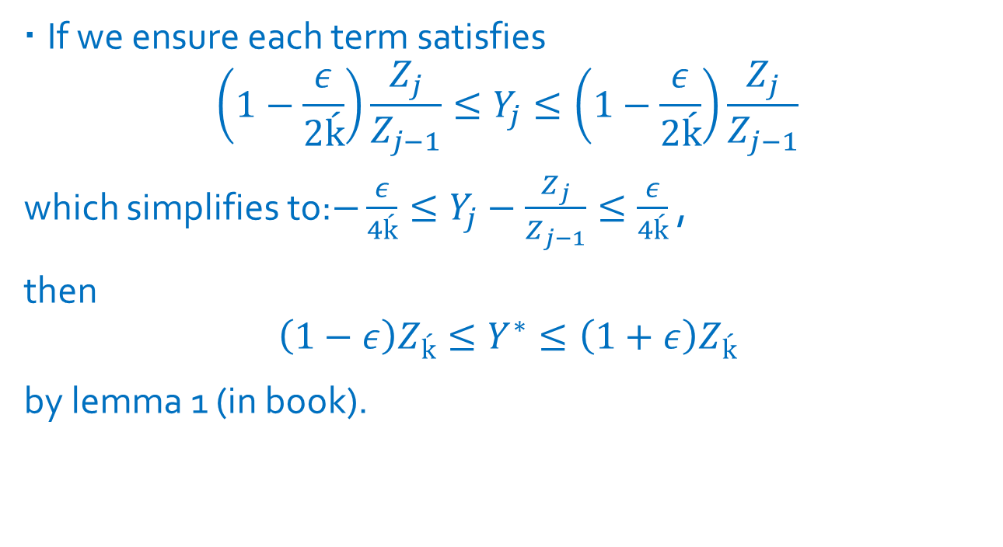
How many times do we need to run this to get a good approximation?
If we ensure each term satisfies
$$\left(1−\frac{ε}{2ḱ}\right)\frac{Z_{j}}{Z_{j−1}}≤Y_{j}≤\left(1−\frac{ε}{2ḱ}\right)\frac{Z_{j}}{Z_{j−1}}$$
which simplifies to:$−\frac{ε}{4ḱ}≤Y_{j}−\frac{Z_{j}}{Z_{j−1}}≤\frac{ε}{4ḱ}$ ,
then
$$\left(1−ε\right)Z_{ḱ}≤Y^{∗}≤\left(1+ε\right)Z_{ḱ}$$
by lemma 1 (in book).

Slide 22
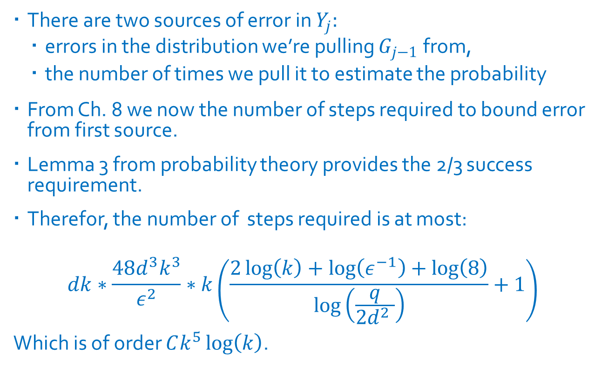
Conclusion
There are two sources of error in $Y_{j}:$
errors in the distribution we’re pulling $G_{j−1}$from,
the number of times we pull it to estimate the probability
From Ch. 8 we now the number of steps required to bound error from first source.
Lemma 3 from probability theory provides the 2/3 success requirement.
Therefor, the number of steps required is at most:
$$dk∗\frac{48d^{3}k^{3}}{ε^{2}}∗k\left(\frac{2\log\left(k\right)+\log\left(ε^{−1}\right)+\log\left(8\right)}{\log\left(\frac{q}{2d^{2} }\right)}+1\right)$$
Which is of order $Ck^{5}\log\left(k\right)$.

Slide 23
Questions

Slide 24
Content
Background
MCMC simulation of q-coloring problem
Observations
Proof
Conclusion
2
24
Notes:
Let’s move on proof.

Slide 25
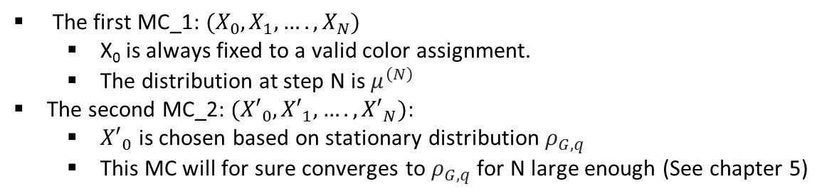
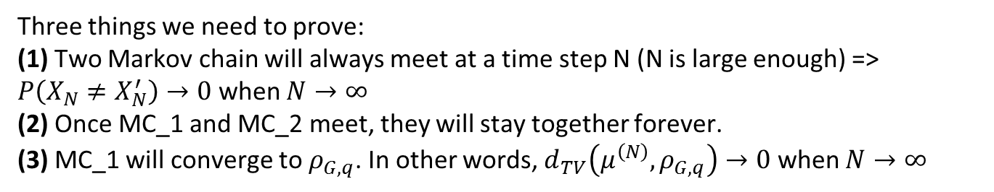
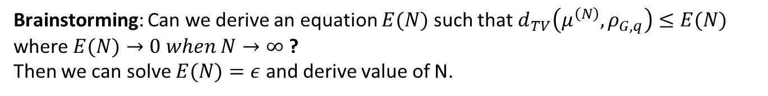
Proof
Ideas
Main ideas of the proof is to run two Markov chains simultaneously. These two Markov chains will be generated based on q-coloring simulation procedure introduced previous slides.
The first MC_1: $(X_{0},X_{1},….,X_{N})$
X₀ is always fixed to a valid color assignment.
The distribution at step N is $μ^{\left(N\right)}$
The second MC_2: $({X′}_{0},{X′}_{1},….,{X′}_{N})$:
${X′}_{0}$ is chosen based on stationary distribution $ρ_{G,q}$
This MC will for sure converges to $ρ_{G,q}$ for N large enough (See chapter 5)
Three things we need to prove:
(1) Two Markov chain will always meet at a time step N (N is large enough) => $P\left(X_{N}≠X_{N}^{′}\right)→0$ when $N→∞$
(2) Once MC_1 and MC_2 meet, they will stay together forever.
(3) MC_1 will converge to $ρ_{G,q}$. In other words, $d_{TV}\left(μ^{\left(N\right)},ρ_{G,q}\right)→0$ when $N→∞$
Brainstorming: Can we derive an equation $E(N)$ such that $d_{TV}\left(μ^{\left(N\right)},ρ_{G,q}\right)≤E(N)$ where $E(N)→0 when N→∞$ ?
Then we can solve $E(N)=ε$ and derive value of N.
25
Notes:
Because of homogenous Markov chain (e.g., systematic sweep Gibbs sampling) we used in simulating Markov chain, whatever initialized state, we will always end up distribution $ρ_{G,q}$.
Because any Markov chain generated by q-coloring simulation procedure is reversible (see Chapter 7), MC_1 and MC_2 must converge to stationary distribution $ρ_{G,q}$ =>
Two Markov chain will always meet at a time step N (N is large enough)

Slide 26
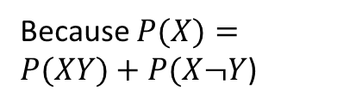
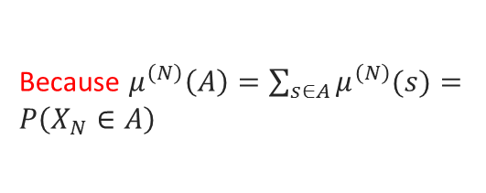
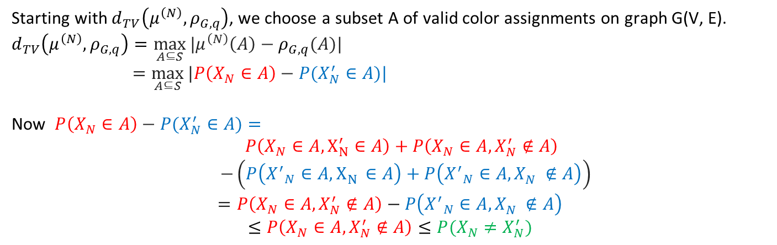
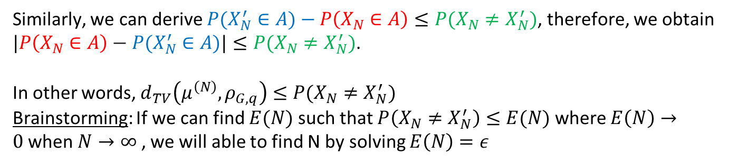
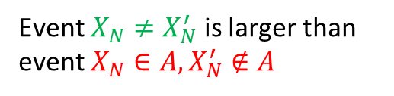
Proof
Ideas
Starting with $d_{TV}\left(μ^{\left(N\right)},ρ_{G,q}\right)$, we choose a subset A of valid color assignments on graph G(V, E).
$d_{TV}\left(μ^{\left(N\right)},ρ_{G,q}\right)=\max_{A⊆S}{|μ^{\left(N\right)}\left(A\right)−ρ_{G,q}(A)|}$
$=\max_{A⊆S}{|P\left(X_{N}∈A\right)−{P(X}_{N}^{′}∈A)|}$
Now $P\left(X_{N}∈A\right)−{P(X}_{N}^{′}∈A)=$
$P\left(X_{N}∈A, X_{N}^{′}∈A\right)+P\left(X_{N}∈A, X_{N}^{′}∉A\right)$
$−\left(P\left({X^{′}}_{N}∈A, X_{N}^{}∈A\right)+P\left({X^{′}}_{N}∈A, X_{N}^{}∉A\right)\right)$
$$=P\left(X_{N}∈A, X_{N}^{′}∉A\right)−P\left({X^{′}}_{N}∈A, X_{N}^{}∉A\right)$$
$$≤P\left(X_{N}∈A, X_{N}^{′}∉A\right)≤P(X_{N}≠X_{N}^{′})$$
Definition of total variation distance
Because $μ^{\left(N\right)}\left(A\right)=\sum_{s∈A}{μ^{\left(N\right)}(s)}=P\left(X_{N}∈A\right)$
Because $P(X)=P(XY)+P(X¬Y$)
Event $X_{N}≠X_{N}^{′}$ is larger than event $X_{N}∈A, X_{N}^{′}∉A$
Similarly, we can derive ${P(X}_{N}^{′}∈A)−P\left(X_{N}∈A\right)≤P(X_{N}≠X_{N}^{′})$, therefore, we obtain
$|P\left(X_{N}∈A\right)−{P(X}_{N}^{′}∈A)|≤P(X_{N}≠X_{N}^{′})$.
In other words, $d_{TV}\left(μ^{\left(N\right)},ρ_{G,q}\right)≤P(X_{N}≠X_{N}^{′})$
Brainstorming: If we can find $E(N)$ such that $P\left(X_{N}≠X_{N}^{′}\right)≤E(N)$ where $E\left(N\right)→0$when $N→∞$ , we will able to find N by solving $E\left(N\right)=ε$
26
Notes:
Because of homogenous Markov chain (e.g., systematic sweep Gibbs sampling) we used in simulating Markov chain, whatever initialized state, we will always end up distribution $ρ_{G,q}$.
Because any Markov chain generated by q-coloring simulation procedure is reversible (see Chapter 7), MC_1 and MC_2 must converge to stationary distribution $ρ_{G,q}$ =>
Two Markov chain will always meet at a time step N (N is large enough)

Slide 27
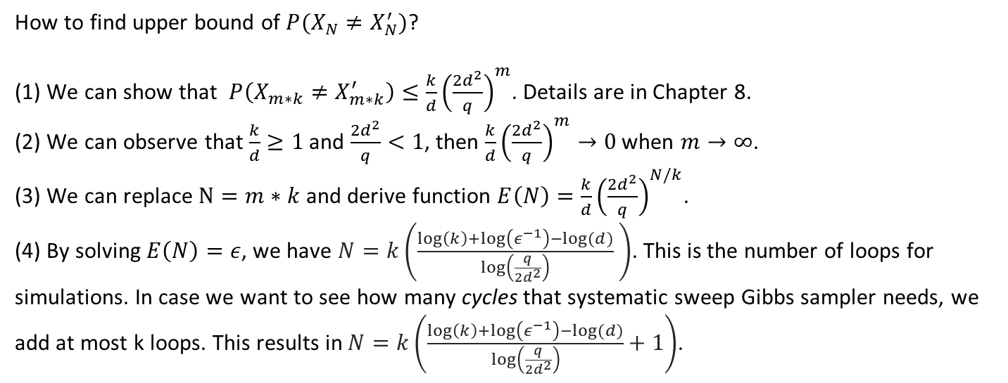
Proof
Ideas
How to find upper bound of $P(X_{N}≠X_{N}^{′})$?
(1) We can show that $P\left(X_{m∗k}≠X_{m∗k}^{′}\right)≤\frac{k}{d}{\left(\frac{2d^{2}}{q}\right)}^{m}$. Details are in Chapter 8.
(2) We can observe that $\frac{k}{d}≥1$ and $\frac{2d^{2}}{q}<1$, then $\frac{k}{d}{\left(\frac{2d^{2}}{q}\right)}^{m}→0$ when $m→∞$.
(3) We can replace $N=m∗k$ and derive function $E\left(N\right)=\frac{k}{d}{\left(\frac{2d^{2}}{q}\right)}^{N/k}$.
(4) By solving $E\left(N\right)=ε$, we have $N=k\left(\frac{\log\left(k\right)+\log\left(ε^{−1}\right)−log⁡(d)}{\log\left(\frac{q}{2d^{2}}\right)} \right)$. This is the number of loops for simulations. In case we want to see how many cycles that systematic sweep Gibbs sampler needs, we add at most k loops. This results in $N=k\left(\frac{\log\left(k\right)+\log\left(ε^{−1}\right)−log⁡(d)}{\log\left(\frac{q}{2d^{2}}\right)}+1\right)$.
27
Notes:
Because of homogenous Markov chain (e.g., systematic sweep Gibbs sampling) we used in simulating Markov chain, whatever initialized state, we will always end up distribution $ρ_{G,q}$.
Because any Markov chain generated by q-coloring simulation procedure is reversible (see Chapter 7), MC_1 and MC_2 must converge to stationary distribution $ρ_{G,q}$ =>
Two Markov chain will always meet at a time step N (N is large enough)

Slide 28

Efficiency- Is it polynomial time?
Necessary Lemmas:
Fix $ε∈[0,1]$, let k be a positive integer, and let $a_{1}, a_{2},…, a_{k}$ and $b_{1}, b_{2},…, b_{k}$ be positive numbers satisfying :
$(1−\frac{ε}{2k})≤\frac{a_{j}}{b_{j}}≤(1+\frac{ε}{2k})$ for $j=1,2,…,k$.
Define $a=\prod_{j=1}^{k}{a_{j}} and b=\prod_{j=1}^{k}{b_{j}}$.
Then we have: $1−ε≤\frac{a}{b}≤1+ε$.

Slide 29

Efficiency- Is it polynomial time?
Necessary Lemmas cont:
Fix $d≥2 and q>2d^{2}$.
Let $G=(V,E)$ be a graph in which no vertex has more than d neighbors
Pick a random q-coloring $X$ for $G$ according to the uniform distribution $ρ_{G,q}$.
Then for any two distinct vertices $x,y∈V$, the probability that $X(x)≠X\left(y\right)$ satisfies: $ρ_{G,q}(X(x)≠X\left(y\right))≥\frac{1}{2}$.

Slide 30

Efficiency- Is it polynomial time?
Necessary Lemmas cont:
Fix $p∈\left[0,1\right]$ and a positive integer $n$. Toss a coin n times with independent probability $p.$
Let $H$ be the number of heads.
Then for any $a>0$, we have $P(|H−np|≥a)≤\frac{n}{4a^{2}}$

Slide 31
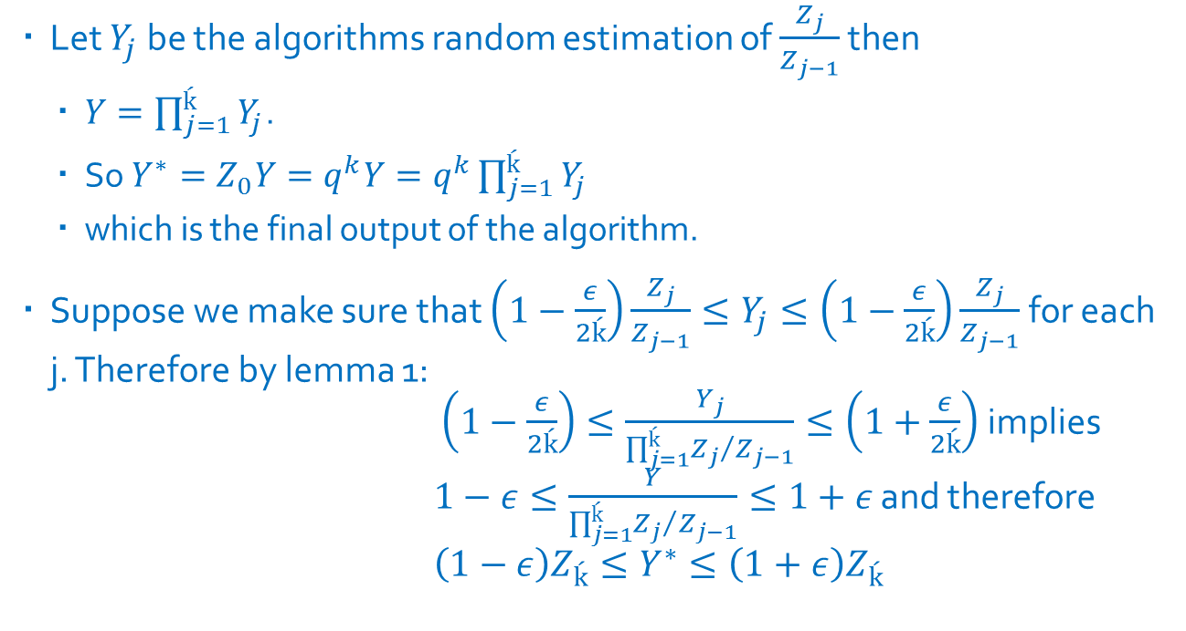
Efficiency- Is it polynomial time?
Let $Y_{j}$ be the algorithms random estimation of $\frac{Z_{j}}{Z_{j−1}}$ then
$Y=\prod_{j=1}^{ḱ}{Y_{j}}$.
So $Y^{∗}=Z_{0}Y=q^{k}Y=q^{k}\prod_{j=1}^{ḱ}{Y_{j}}$
which is the final output of the algorithm.
Suppose we make sure that $\left(1−\frac{ε}{2ḱ}\right)\frac{Z_{j}}{Z_{j−1}}≤Y_{j}≤\left(1−\frac{ε}{2ḱ}\right)\frac{Z_{j}}{Z_{j−1}}$ for each j. Therefore by lemma 1: $\left(1−\frac{ε}{2ḱ}\right)≤\frac{Y_{j}}{\prod_{j=1}^{ḱ}{{Z_{j}}/{Z_{j−1}}}}≤\left(1+\frac{ε}{2ḱ}\right)$ implies $1−ε≤\frac{Y}{\prod_{j=1}^{ḱ}{{Z_{j}}/{Z_{j−1}}}}≤1+ε$ and therefore $\left(1−ε\right)Z_{ḱ}≤Y^{∗}≤\left(1+ε\right)Z_{ḱ}$

Slide 32
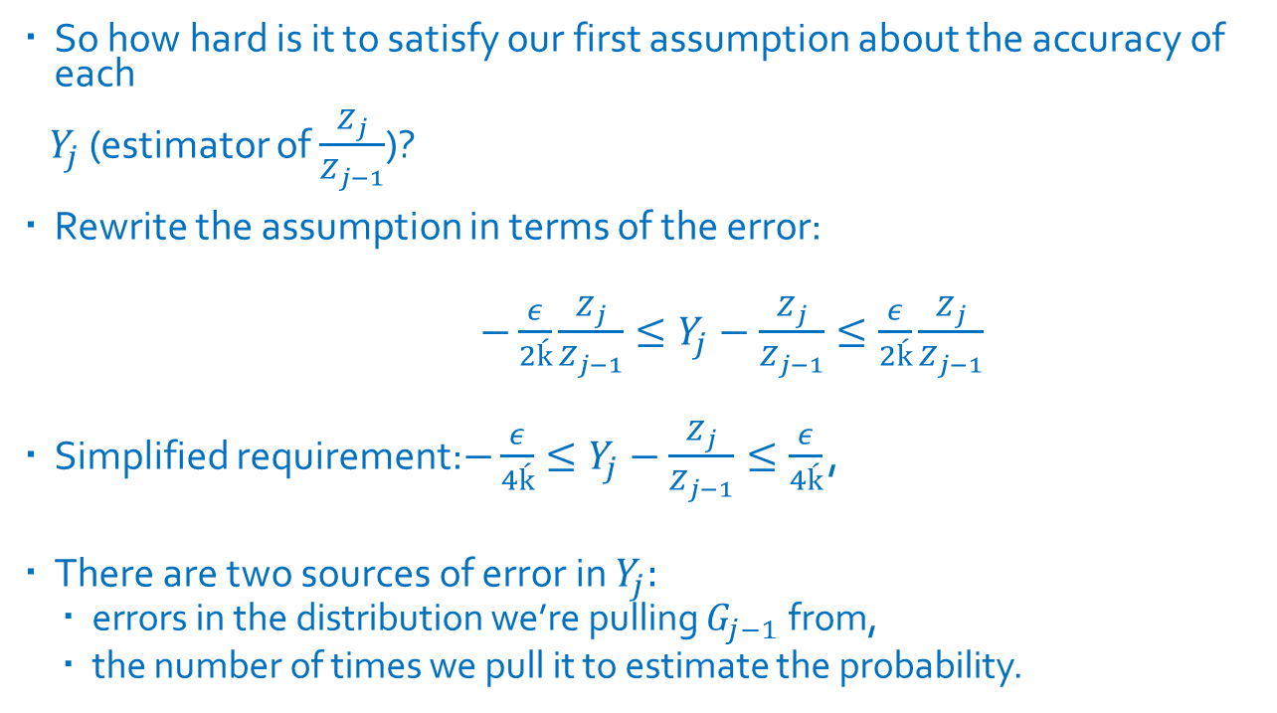
Efficiency- Is it polynomial time?
So how hard is it to satisfy our first assumption about the accuracy of each
$Y_{j}$ (estimator of $\frac{Z_{j}}{Z_{j−1}}$)?
Rewrite the assumption in terms of the error:
$−\frac{ε}{2ḱ}\frac{Z_{j}}{Z_{j−1}}≤Y_{j}−\frac{Z_{j}}{Z_{j−1}}≤\frac{ε}{2ḱ}\frac{Z_{j}}{Z_{j−1}}$
Simplified requirement:$−\frac{ε}{4ḱ}≤Y_{j}−\frac{Z_{j}}{Z_{j−1}}≤\frac{ε}{4ḱ}$ ,
There are two sources of error in $Y_{j}:$
errors in the distribution we’re pulling $G_{j−1}$from,
the number of times we pull it to estimate the probability.

Slide 33
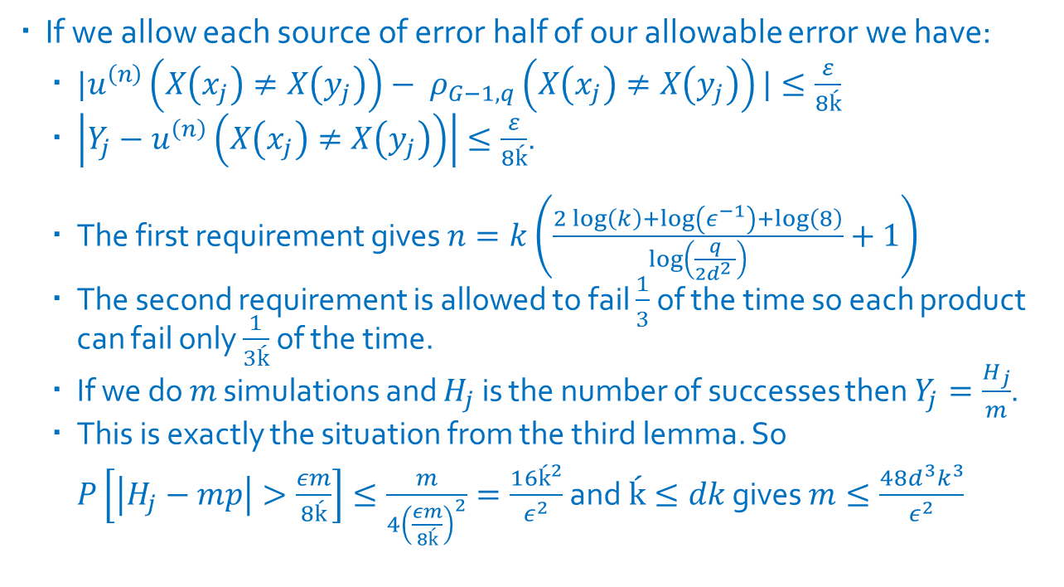
Efficiency- Is it polynomial time?
If we allow each source of error half of our allowable error we have:
$|u^{\left(n\right)}\left(X\left(x_{j}\right)≠X\left(y_{j}\right)\right)− ρ_{G−1,q}\left(X\left(x_{j}\right)≠X\left(y_{j}\right)\right)|≤\frac{ε}{8ḱ}$
$\left|Y_{j}−u^{\left(n\right)}\left(X\left(x_{j}\right)≠X\left(y_{j}\right)\right)\right|≤\frac{ε}{8ḱ}$.
The first requirement gives $n=k\left(\frac{2\log\left(k\right)+\log\left(ε^{−1}\right)+\log\left(8\right)}{\log\left(\frac{q}{2d^{2} }\right)}+1\right)$
The second requirement is allowed to fail $\frac{1}{3}$ of the time so each product can fail only $\frac{1}{3ḱ}$ of the time.
If we do $m$ simulations and $H_{j}$ is the number of successes then $Y_{j}=\frac{H_{j}}{m}$.
This is exactly the situation from the third lemma. So $P\left[\left|H_{j}−mp\right|>\frac{εm}{8ḱ}\right]≤\frac{m}{4{\left(\frac{εm}{8ḱ}\right)}^{2}}=\frac{16ḱ^{2}}{ε^{2}}$ and$ḱ≤dk$ gives $m≤\frac{48d^{3}k^{3}}{ε^{2}}$

