Slide 1






Sales Conversion Optimization
Chu Hoang Duong
20194429
Nguyen Vu Thien Trang
20194459
Nguyen Van Thanh Tung
20190090
Group 9 | DSAI K64
Introduction to Business Analytics | 20221

Slide 2
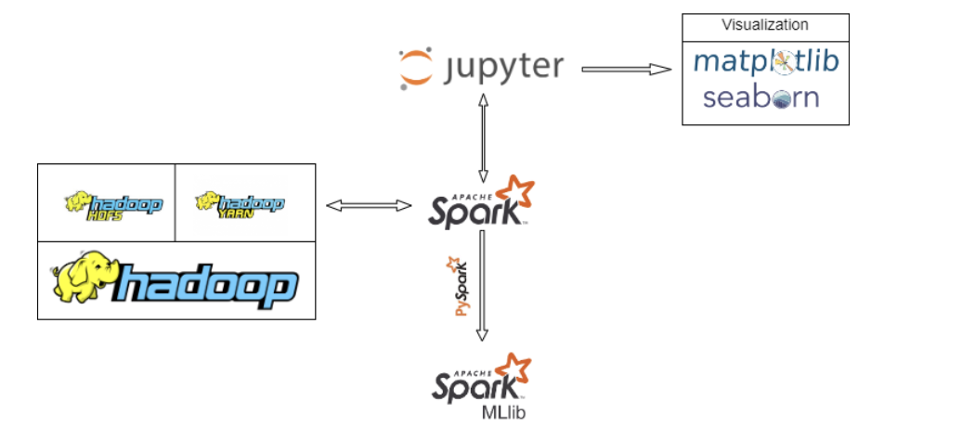
System Architecture

Slide 3
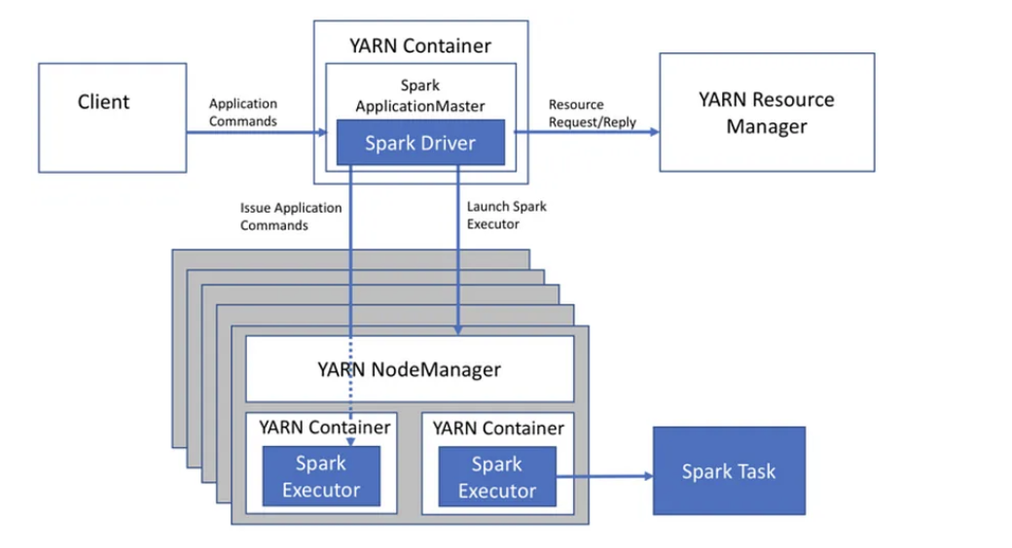
Jupyter Lab - Spark Driver

Slide 4
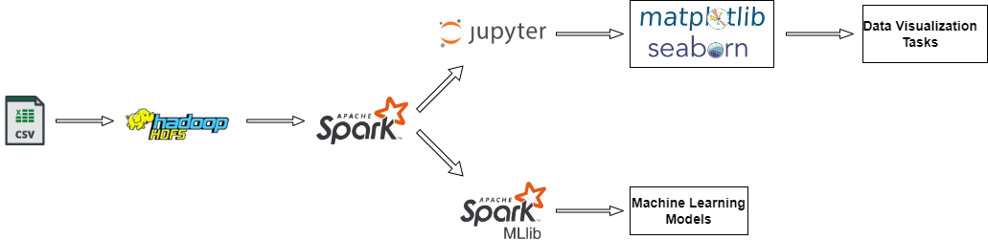
Data Pipeline

Slide 5
Projects Pipeline
Data Collecting
Sanity Check
Exploratory Data Analysis
ML and Testing

Slide 6
Data Collecting
|-- fb_campaign:
| |-- 1. fb_campaign_id: string (primary_key)
| |-- 2. age: string
| |-- 3. gender: string
| |-- 4. interest: string
| |-- 5. xyz_campaign_id: string
|-- Conversion:
| |-- 1. fb_campaign_id: string (primary_key)
| |-- 2. Spent: double (primary_key)
| |-- 3. Impressions: integer
| |-- 4. Clicks: integer
| |-- 5. Total_Conversion: integer
| |-- 6. Approved_Conversion: integer
The data used in this project is from an anonymous organisation’s social media ad campaign.
The data contains total of 1143 observations in 11 variables.
No demographics on customers or details on the campaign was linked to the data.
ad_id | xyz_ campaign_ id | fb_ campaign_ id | age | gender | interest | Impressions | Clicks | Spent | Total_ Conversion | Approved_ Conversion
708746 | 916 | 103916 | 30-34 | M | 15 | 7350 | 1 | 1.43 | 2 | 1
708749 | 916 | 103917 | 30-34 | M | 16 | 17861 | 2 | 1.82 | 2 | 0
708771 | 916 | 103920 | 30-34 | M | 20 | 693 | 0 | 0 | 1 | 0
708815 | 916 | 103928 | 30-34 | M | 28 | 4259 | 1 | 1.25 | 1 | 0
708818 | 916 | 103928 | 30-34 | M | 28 | 4133 | 1 | 1.29 | 1 | 1
Notes:
First of all, I'll give a brief introduction to our dataset. The data used in this project is from an incognito organization, so we have neither information on this organization nor the characteristics of their campaigns. This organization markets their campaign through Facebook ads, which is a platform that allows businesses to broadcast their ads to a set of predefined audiences, and of course, it's a paid service.
In normal form theory, our dataset should be broken down into two subtables for a better understanding of the data. We first have the Facebook campaign table, which contains details on the settings of the target audience that correspond to different campaigns. Secondly, we have a conversion table, in which records are uniquely defined by the Facebook campaign and the amount of money spent. The return values provided in this table are things that the business wants to maximize with a reasonable budget.
In practice, we join the two tables for more effective queries and add a column called ad_id as the primary key of the final tables. In short, our dataframe contains a total of 1143 observations and 11 variables, which is kind of small for such complex fields as ads and conversions. Another challenge is that the data is entirely anonymous; hence, we cannot find any demographic information on customers or details on the campaign linked to the data. So let's see what we can do to help the campaign enhance its reputation and sales while dealing with the aforementioned challenges.

Slide 7
Sanity Check
Missing data
Redundant data
Constraints Violation
Notes:
Before diving into any feature engineering or exploratory data analysis, a sanity check is a must for a qualified dataset.

Slide 8
Sanity Check
Checking for null values
Missing data
The data frame contains no null/nan values.
Redundant data
Constraints Violation
Notes:
We checked for missing data and discovered that there were no null values.

Slide 9
Sanity Check
Checking for duplicate values
Missing data
The data frame contains no duplicate values, the number of unique records is equal to the number of rows.
Redundant data
Constraints Violation
Notes:
Also, no duplicates were found. That is very fortunate, because our data is already small enough.

Slide 10
Sanity Check
Checking for constraints violation
Missing data
Some constraints that can be inferred from the definition of columns:
If Spent = 0 then Impressions, Clicks, Total_Conversion, Approved_Conversion = 0
Approved_Conversion < Total Conversions < Clicks < Impressions
Redundant data
Constraints Violation
Notes:
However, the definition of the data was so vague that it's hard to generalize for all cases.
At the beginning, we inferred some constraints from the definition of the anonymous provider. It is straightforward that if no money was paid, then the return values should be zero. Additionaly, in common sense, the audience should see the ads (which are the impressions) and then click on the ads if they are appealing to them. Then some may want to buy the advertised product and ask the company, this is the total conversion. And based on their needs, they might end up approving the conversion and buying it. As a result, the constraint "Approvals > Asks > Clicks > Impressions" applies.

Slide 11

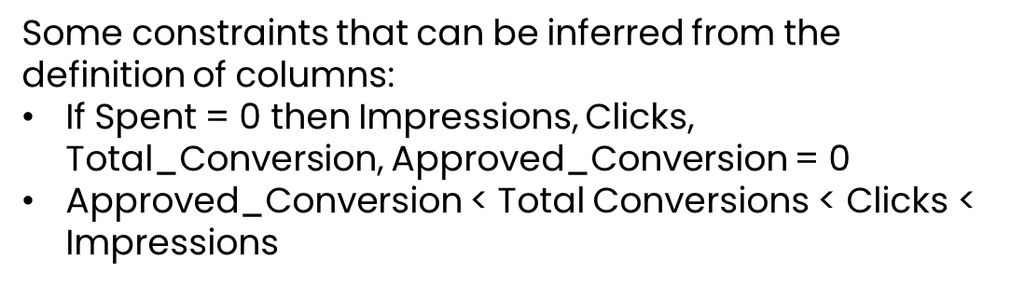
Sanity Check
Checking for constraints violation
Missing data
Some constraints that can be inferred from the definition of columns:
If Spent = 0 then Impressions, Clicks, Total_Conversion, Approved_Conversion = 0
Approved_Conversion < Total Conversions < Clicks < Impressions
Redundant data
$$⇒$$
There are 207 records does not satisfy the first constraints.
There are some none-clicked ads but still have conversions. We can see that not all inquiries/sales comes from the ads.
Constraints Violation
Notes:
These are things that we have thought of when first looking at the data, right? However, there are a lot of cases that violate these constraints. Some have spent $0 but are still gaining impressions and conversions, maybe thanks to the auto-recommender system on Facebook. You know it: when the users in your friend list interact with the ads, you tend to have a better chance of seeing the ads on your feed, even though you are not the target audience of the campaign. Some are never clicked on, but they still receive inquiries and sales. So from these violations, we should understand that not all the inquiries and sales come from the ads.

Slide 12
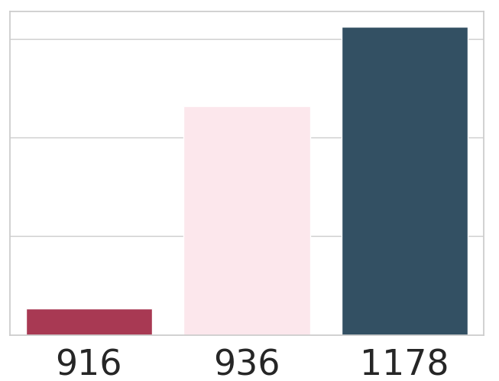
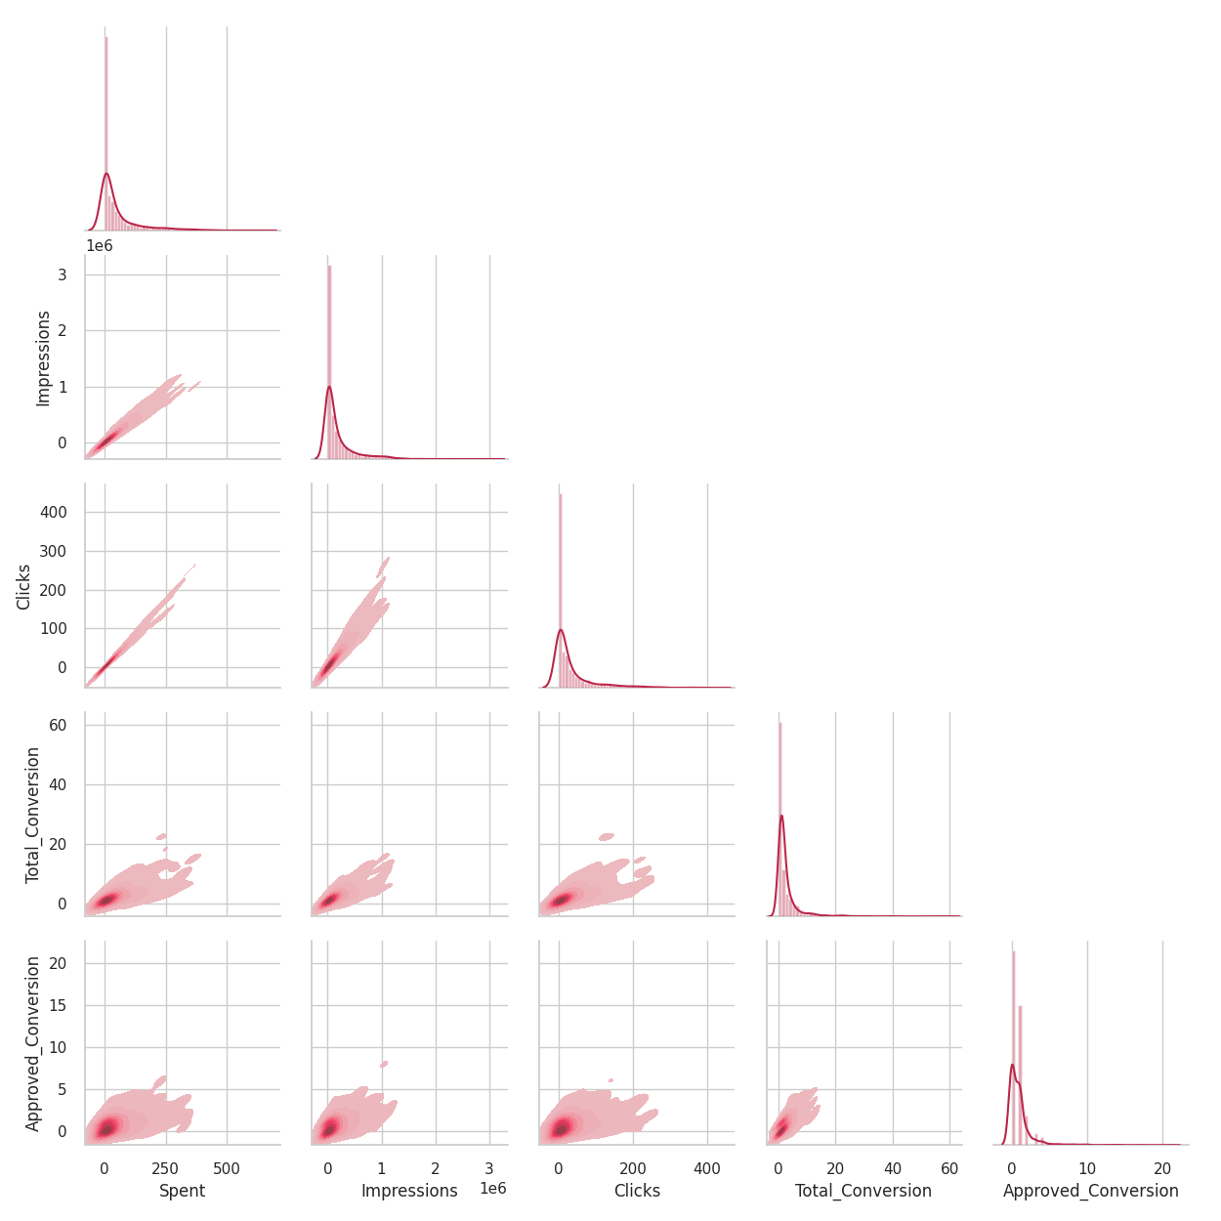
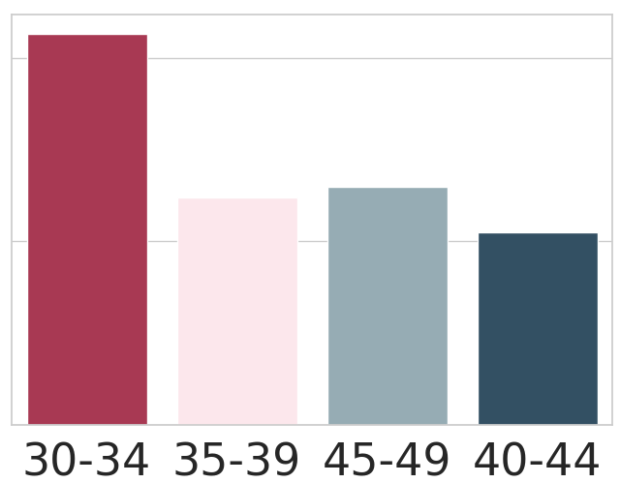
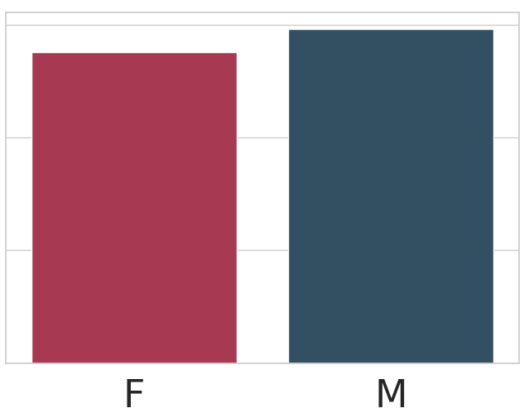
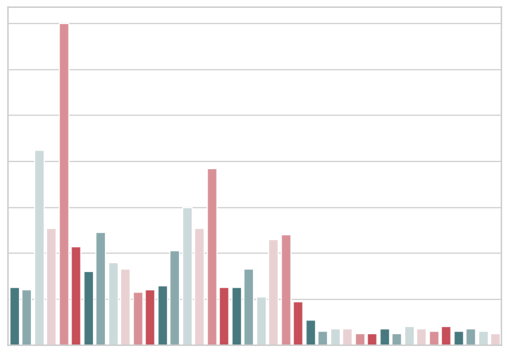
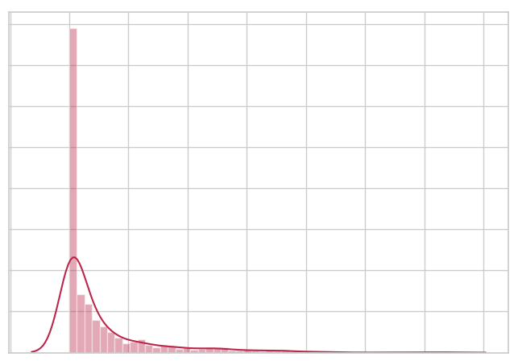
Exploratory Data Analysis
Independent variables
3 campaigns
Dependent variables
4 age ranges
2 genders
40 interest
Up to 650$ on ads
Notes:
Alright, after having a better insight into the data, we get into the EDA step, exploratory data analysis. Basically, we have five independent variables, which are the settings we can customize when running a campaign on Facebook. These include the campaign itself, the characteristics of the target audience like age, gender, and interest, and the budget we have for the campaign.
The impressions (the views on the ads), the number of clicks on the ads, the number of inquiries on the product in the ads, and the final sales of the products are the values of these campaign returns. These are dependent variables that we want to optimize in this project.
If you look at the correlogram on the left, it is clear that all the return values are going down with the money spent on the ads. The correlation seems to be stronger for Spent, Clicks and Impressions, and not as strong for the two left conversions. The graph already explains quite well the relationship between the numerical variables. However, we wish for a more systematic tool that can evaluate how the dependent variables depend on the independent variables. And this is called regression analysis.

Slide 13
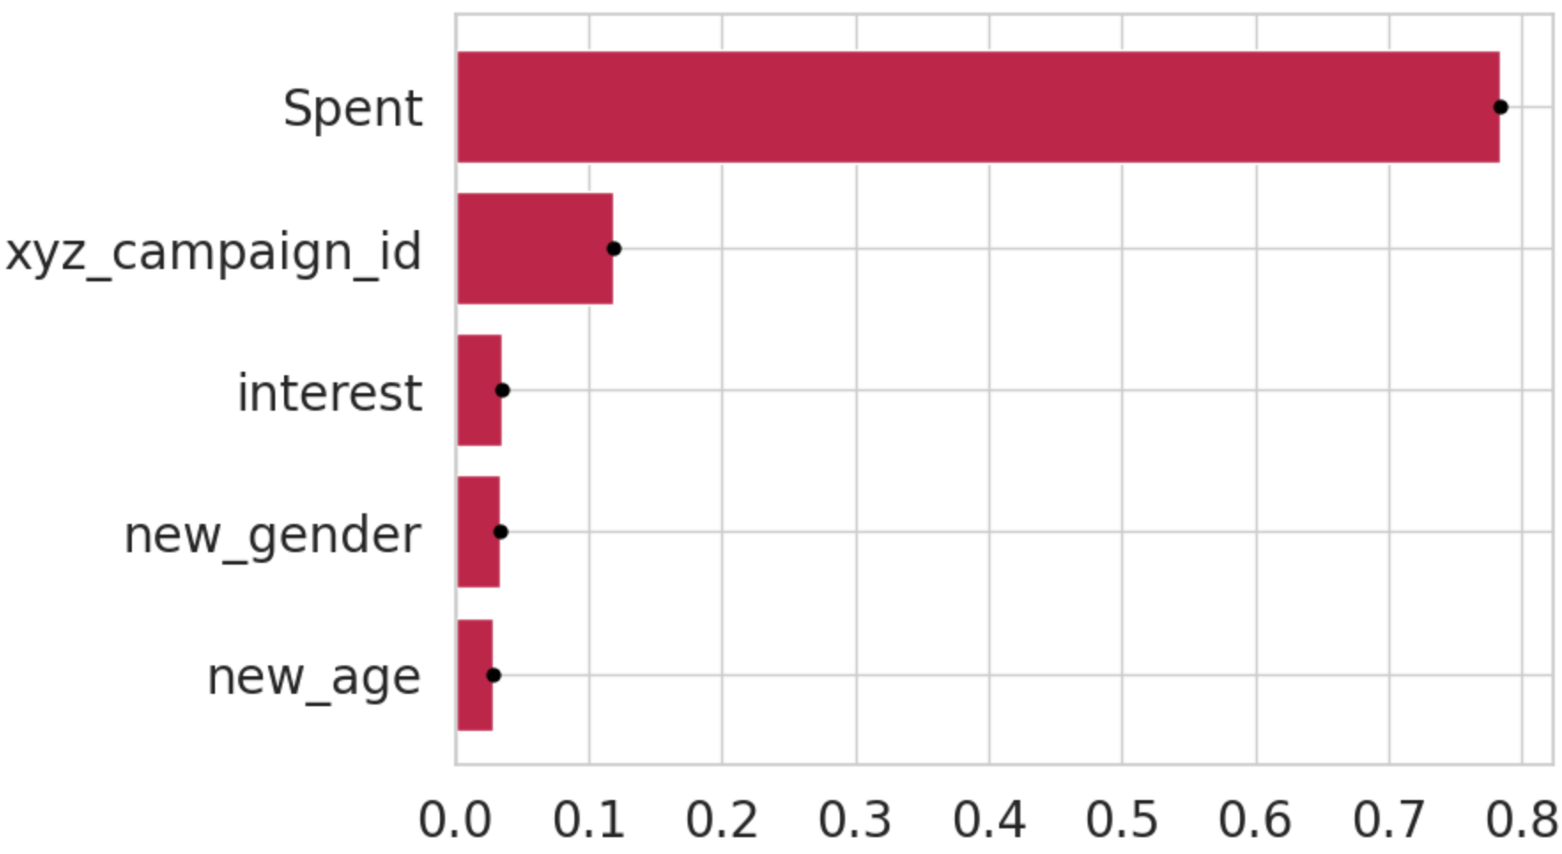
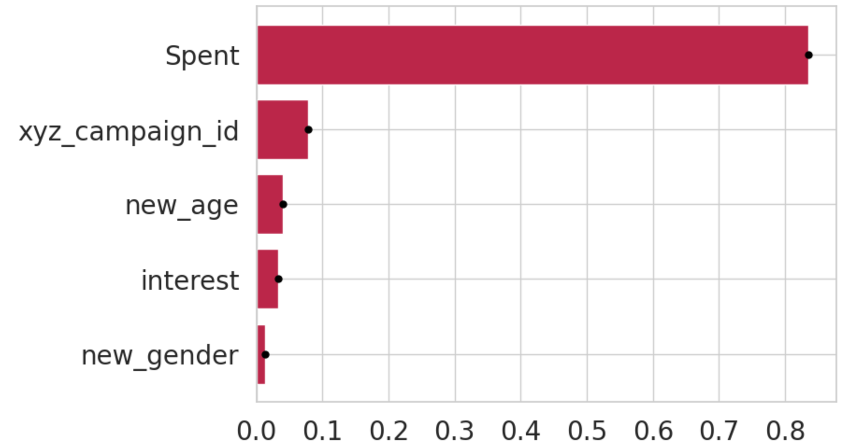
Regression Analysis
Feature Importance on Impressions
Feature Importance on Clicks
Evaluated by RandomForestRegressor
Accuracy = 96.4%
Evaluated by RandomForestRegressor
Accuracy = 97.8%
Notes:
There are a lot of ways to do regression analysis; here we use a regressor that can estimate the importance of the independent variables on return values. A very popular way to calculate the feature importance is the reduction in entropy or the purity gain when splitting the data using a variable. This is also the way that decision trees split nodes when building the tree. Exploiting this, we train a random forest regressor to predict the return values based on the independent variables. After growing the forests, we get the calculated feature importance on Clicks and Impressions. And for both calculations, the importance of Spent dominates the other factors. You might notice that we only put Impression and Clicks here since, despite all our efforts, the accuracy of the Random Forest Regressor was not high, just about 70%. This is easily explained by the fact that spent has the greatest influence on return values; however, as stated in the previous slide, the correlation between spent and the two conversions is not as strong as the correlation between clicks and impressions.

Slide 14
ML and Testing
Tracker
Use case 1: Personalize Spent on Audience
Metric
Exploit the Random Forest built before to predict the returns based on a given setting.
Continuously track the influence of the Spent on the returns with a given step size.
Given a budget or a range of amount available for spending on ads, return the amount of spent that most effective or can balance the most between spent and return values (impressions, clicks, etc.)
Return
Spent
Notes:
This analysis yields the first use case: personalizing the spent amount for each group of audiences. Normally, we can try things like AB testing to see which setting performs the best. However, we do not have control over the campaigns and the ads, so we cannot directly track the return values with different versions of the setting. As a result, it necessitates the apperance of a virtual tracker capable of predicting the outcome given a predefined customization. Luckily, we have trained a regressor when doing EDA, and it can be used right away, playing the role of the tracker in this section.
Secondly, as in other testing strategies, we need metrics to evaluate which version or which value is the best. A metric that should balance the money spent and the return values. Let's plot an example. With the output being this curve, where the x-axis is the amount spent and the y-axis is the return value, this point might be the best since it can balance between the two.

Slide 15

ML and Testing
Tracker
Use case 1: Personalize Spent on Audience
Metric
Exploit the Random Forest built before to predict the returns based on a given setting.
Continuously track the influence of the Spent on the returns with a given step size.
Given a budget or a range of amount available for spending on ads, return the amount of spent that most effective or can balance the most between spent and return values (impressions, clicks, etc.)
Use derivative as the metric:
$$\frac{f\left(s\right)−f\left(s−△s\right)}{△s}$$
Notes:
Fortunately, this type of point is easily found using derivatives. As a result, we determine that our metrics are the derivative wrt to Spent. It sounds complex, but to a more comprehensive extent, it's just the point that has the strongest increase in the return value by one unit of spent.

Slide 16
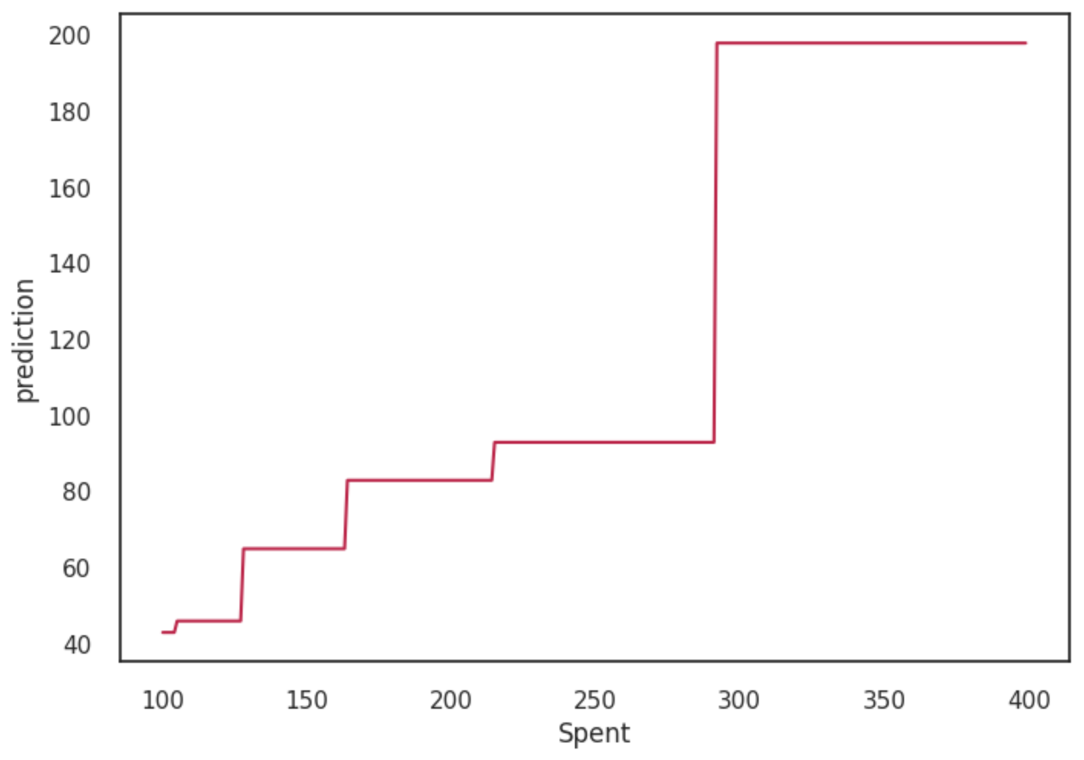

ML and Testing
Personalize Spent on different group of Customers
Pipeline
Pre-define a target group of audience/customer.
Choose a target return value and get the corresponding tracker.
Loop over a given range of budget to track the most effective amount of Spent.
Different metrics can be used. In this project, we use derivative to track the most significant influence when increase by a unit of spent.
$$\frac{f\left(s\right)−f\left(s−△s\right)}{△s}$$
Notes:
We summarize our pipeline for the first use case as follows:
To begin, we define a target audience group and select a target return value between clicks and impressions (conversions are not recommended because the model cannot learn its distribution well). Then we loop over the given budget range with a predefined step size. The best value for Spent is the point that has the highest jump on the return values when increasing by a unit.

Slide 17
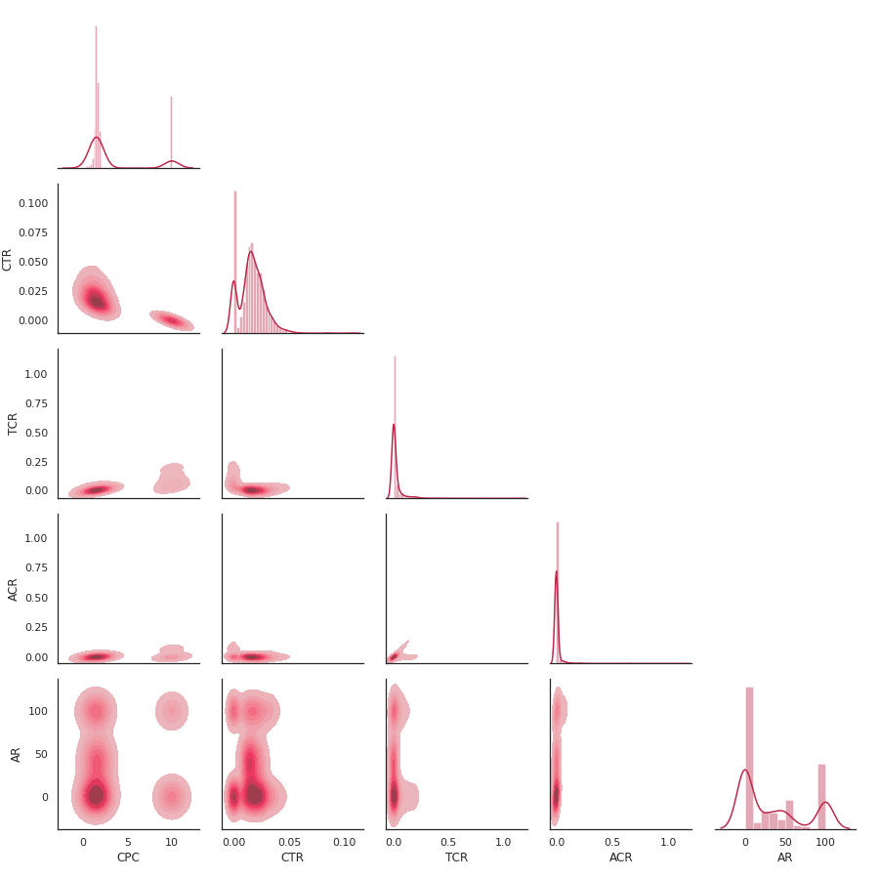
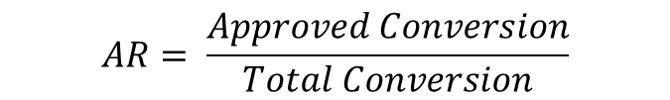
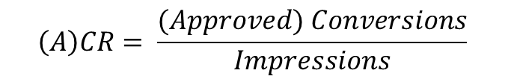
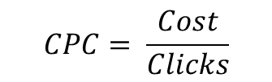
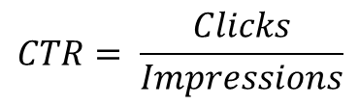
Feature Engineering
Adding Conversion Features
$$CTR= \frac{Clicks}{Impressions}$$
: Click through rate
$$CPC= \frac{Cost}{Clicks}$$
: Cost per Click
$$AR= \frac{Approved Conversion}{Total Conversion}$$
: Conversion Rate
$$\left(A\right)CR= \frac{(Approved) Conversions}{Impressions}$$
: Approved Rate
Notes:
We have been diving deep into the spent variable, but there are still 4 independent variables remaining that we should work on more. Unfortunately, these variables do not have a significant influence on the current return values. Getting back to the name of the projects, the target is to optimize the conversion rate. The conversion rate can be estimated by converting spent values to return values. We are now defining additional features for conversion rate optimization. To begin, the click-through rate is the conversion of impressions into clicks. In addition, we should consider the cost per click, or the amount spent for each click gained; these are the variables related to the brand's reputation.
We also should convert the impressions and clicks into inquiries and sales. However, as stated in the sanity check, not all sales come from clicks, so we only take into account the leads from impressions to sales. We have the impression conversion rate and the approval rate.

Slide 18
Feature Engineering
Adding Conversion Features
$$CTR= \frac{Clicks}{Impressions}$$
: Click through rate
$$CPC= \frac{Cost}{Clicks}$$
: Cost per Click
$$AR= \frac{Approved Conversion}{Total Conversion}$$
: Conversion Rate
$$\left(A\right)CR= \frac{(Approved) Conversions}{Impressions}$$
: Approved Rate
Notes:
The correlogram comes in handy right now, the correlation seems to be weak. However, if we look closer at the distribution of the new features, the CTR and CPC have two modes, and the AR have three modes, so we might think of clustering the customers based on these modes.

Slide 19
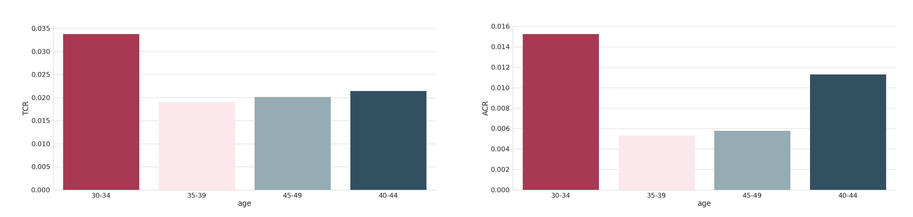
Hypothesis Testing
Notes:
We use the well-known K-means algorithm for clustering.
For CTR and CPC, we clustered and got two clusters: the cluster with higher CTR and lower CPC corresponded to audiences that had actually clicked on the ads, and the remaining corresponded to those that hadn’t.
For approval rate, we get three audience clusters that correspond to different levels of approval percent.

Slide 20
Summary
The solution to optimize the return values and conversion rate:
Get the best value for Spent for using a Virtual Tracker and derivative
Focus on the cluster of audience that have higher Click through Rate and Approval Rate
The age group “30-34” are more likely to be converted from Impressions
Notes:
We use the well-known K-means algorithm for clustering.
For CTR and CPC, we clustered and got two clusters: the cluster with higher CTR and lower CPC corresponded to audiences that had actually clicked on the ads, and the remaining corresponded to those that hadn’t.
For approval rate, we get three audience clusters that correspond to different levels of approval percent.

