Slide 1
DISTRIBUTED IMAGE PROCESSING SYSTEM
IMG
Group 1
Nguyen Thi Minh Nguyet
Nguyen Quynh Trang
Nguyen Ky Khai
Vu Gia Bach
Vuong Ngoc Duy
Tran Anh Dung
Nguyen Hai An

Slide 2

01
PROBLEM

Slide 3

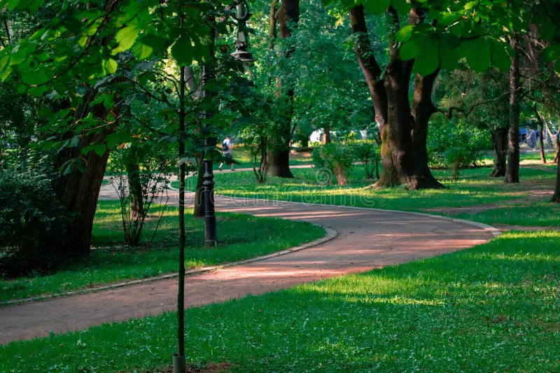
PROBLEM
High resolution images are slow to process

Slide 4
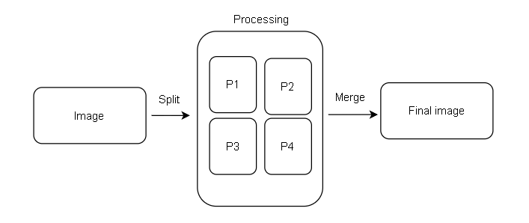
PROBLEM
Image slicing

Slide 5

02
ARCHITECTURE

Slide 6



TECHNOLOGY
Language
Backend API
Socket communication
Main programming language
Used for image handling , threading and socket logic
Lightweight Python web framework
Handle image upload and connect frontend-backend
TCP socket used for sending/receiving image chunks

Slide 7
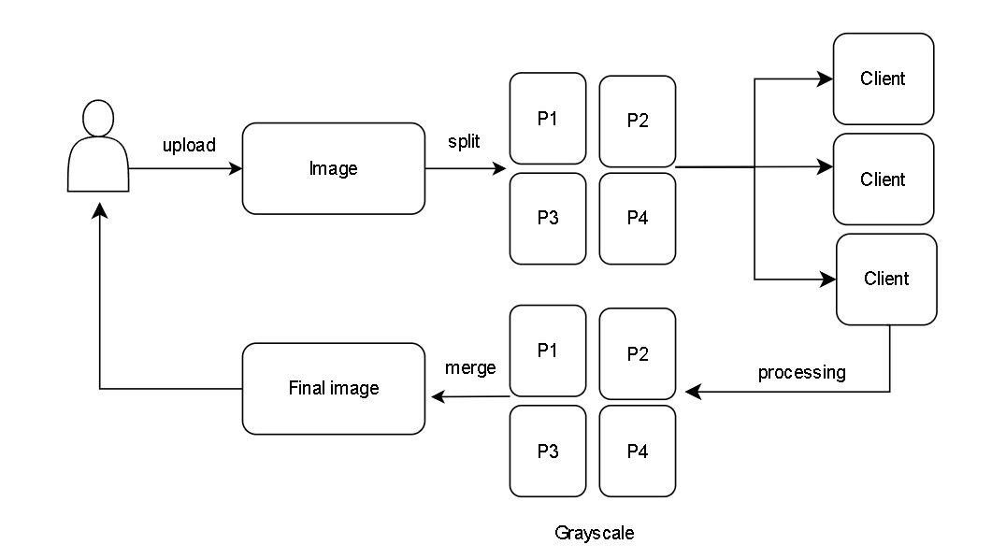
WORKFLOW

Slide 8
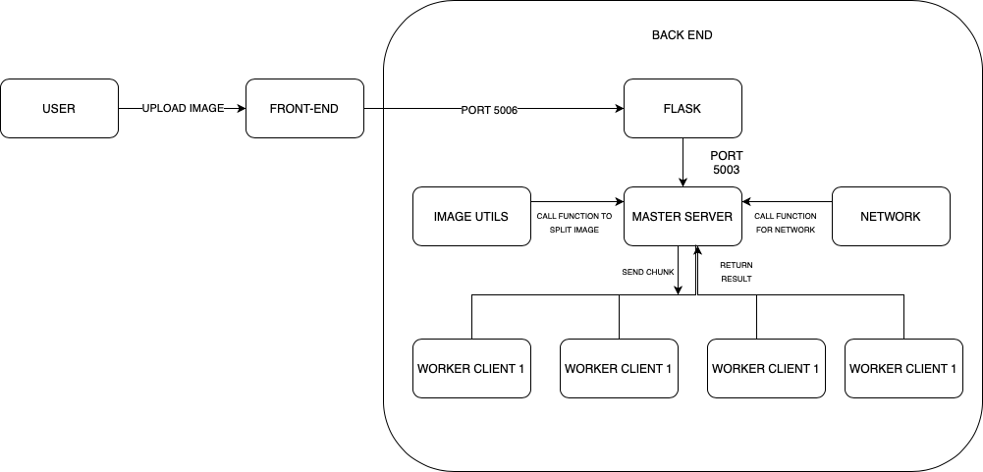
ARCHITECTURE

Slide 9

03
SOCKET COMMUNICATION

Slide 10
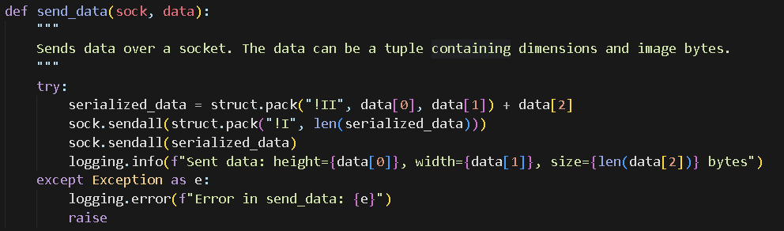
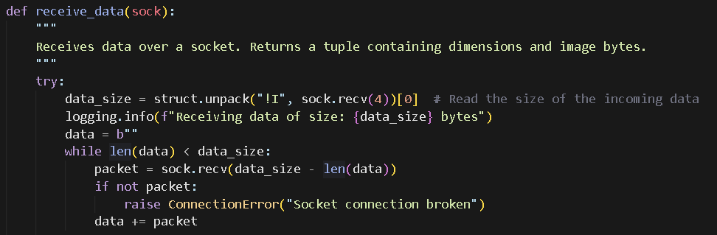
SOCKET COMMUNICATION
Sending data
Each image segment is converted into raw bytes, then using a custom protocol
Receiving data
Implement _recvall() to safely receive the full byte stream
Avoids data truncation
Ensures the complete image chunk is received before processing

Slide 11
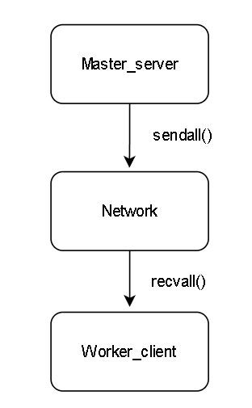
SOCKET COMMUNICATION
Two – way communication
Master → Worker: sends image segment for processing
Worker → Master: returns processed grayscale result

Slide 12

04
IMPLEMENTATION

Slide 13
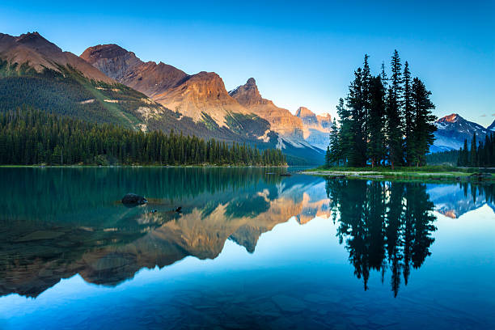
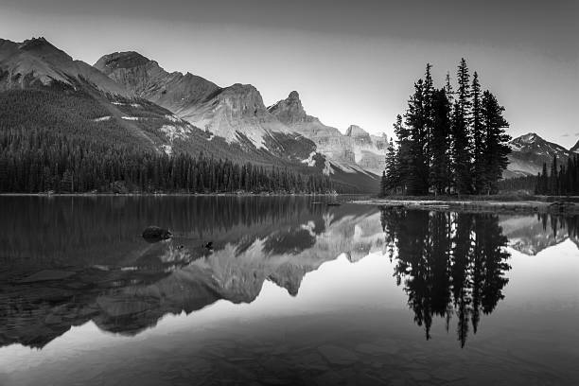
Original
Grayscale image

Slide 14
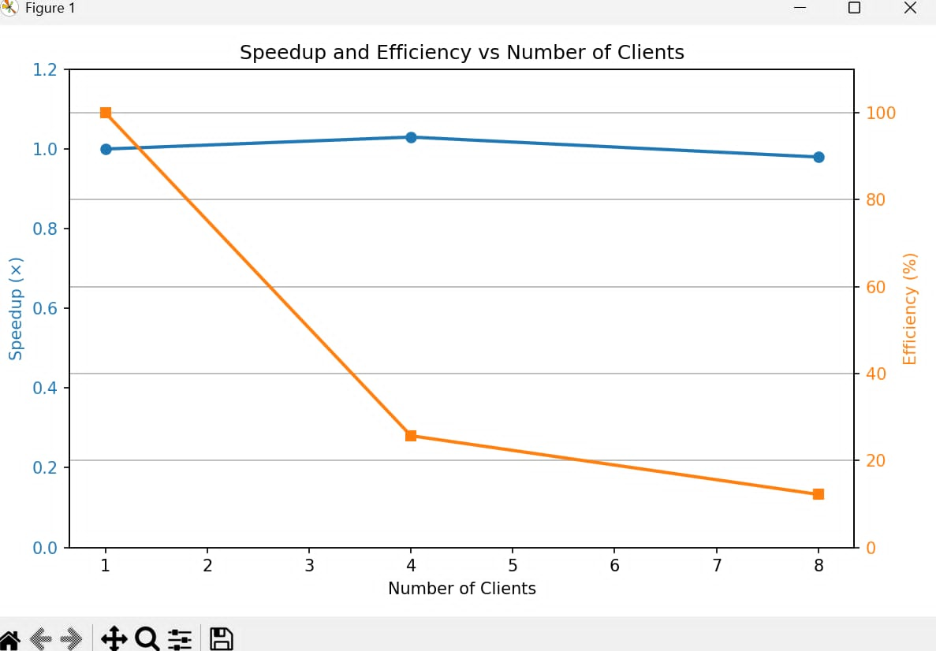
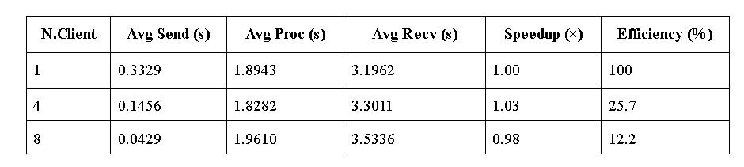
Comparison
Comparison of Image Processing with Varying Client Count

Slide 15
THANKS FOR LISTENING!

