Slide 1
Gradient Descent
Step size: .9

Slide 2
Gradient Descent
Step size: .2

Slide 3
Gradient Descent
Step size matters!

Slide 4
Gradient Descent
Step size matters!

Slide 5
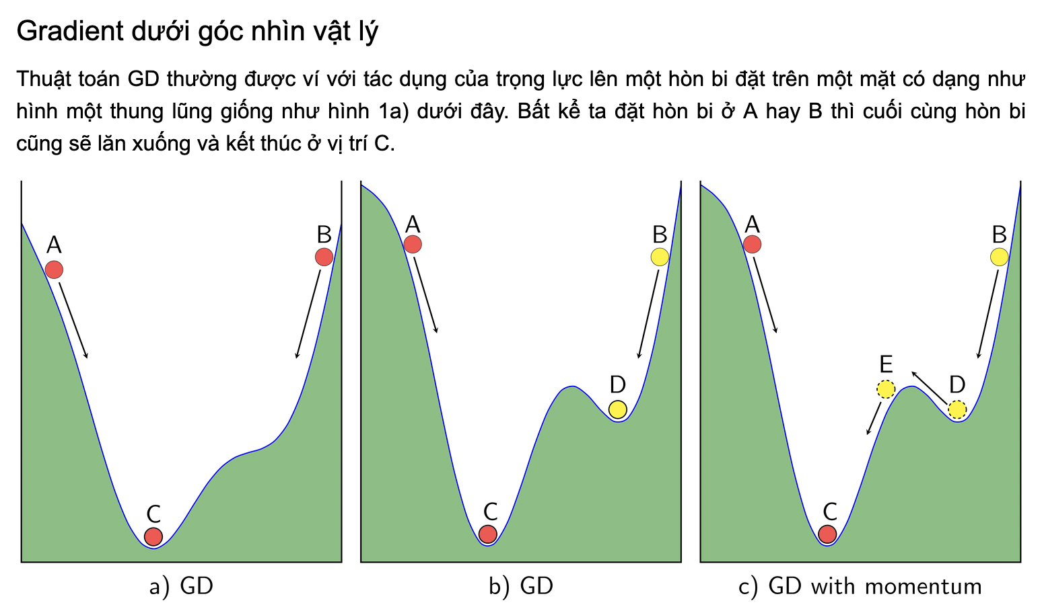
Momentum GD

Slide 6
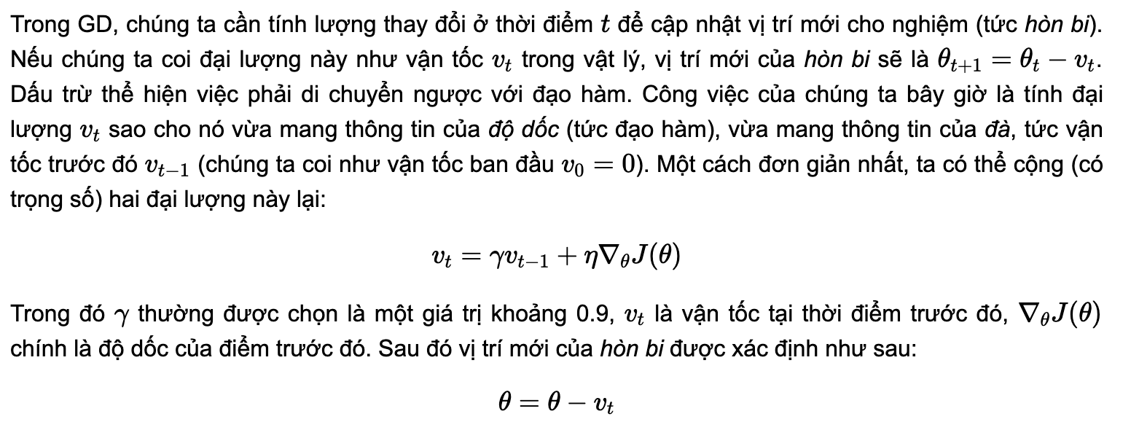

Slide 7


