Slide 1
Fundamental Network Programming
Introduction
Lecturer: MSc. Dang Le Bao Chuong
Spring 2022

Slide 2
Agenda
Review basic knowledge base about Network programming (week 1-2)
TCP/IP stack, common application protocol HTTP, FTP and UDP/TCP protocol
Introduction to network application programming (week 2-10)
Client-server vs. peer-to-peer, design principles for an application protocol
Handling of I/O streams of data on the network, reading files , typing
Socket programming (port, IP): listener, client …
Multi-threading in a network application (problem when sending/handling big chunks of data, long processing task): async, non-blocking; How to handling concurrency,..
...
Seminar/final project reports (Week 11 – end)

Slide 3
Assesment criteria
No mid-term test
Doing the lab will be accounted for 20%
Attendance and weekly assignment report(incl. source code) are accounted for 30 %
Final seminar of group project is 50 %
Each group is only allowed to has maximum of 3 members
All members must work on the project (workload table must be written in the final report)
The draft/idea of the group project must be presented to lecturer in a mid-term report session on week 6-7 (mid-term project report and 5-minute short seminar)
The detailed requirements of the final Network application will be described in the following slide.

Slide 4
Programming language and toolings
Main lectures will be taught in C# and C# Window Form as User-Interface (UI) for the network application (OS: Window, Visual Studio 2019 )
However, other Socket-supported language are welcome. Recommendations are: Java (JavaFX as UI/Qt as UI → NetBean IDE), Python (Qt as UI), C++, …
Students are free to choose development environment and tools/IDE
3D: Unity 3D C#

Slide 5
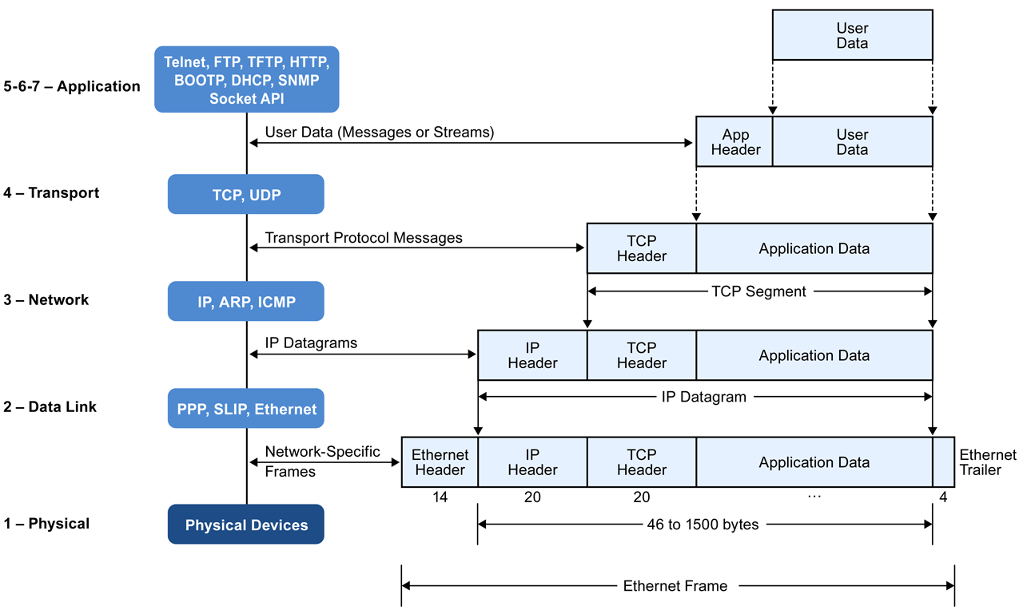
Review the ”computer networking”

Slide 6
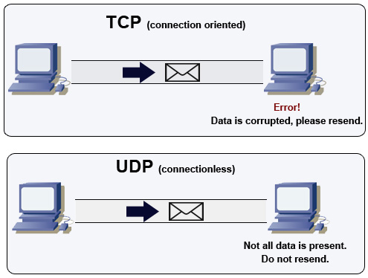
Which one to choose TCP/UDP for each type of application?

Slide 7
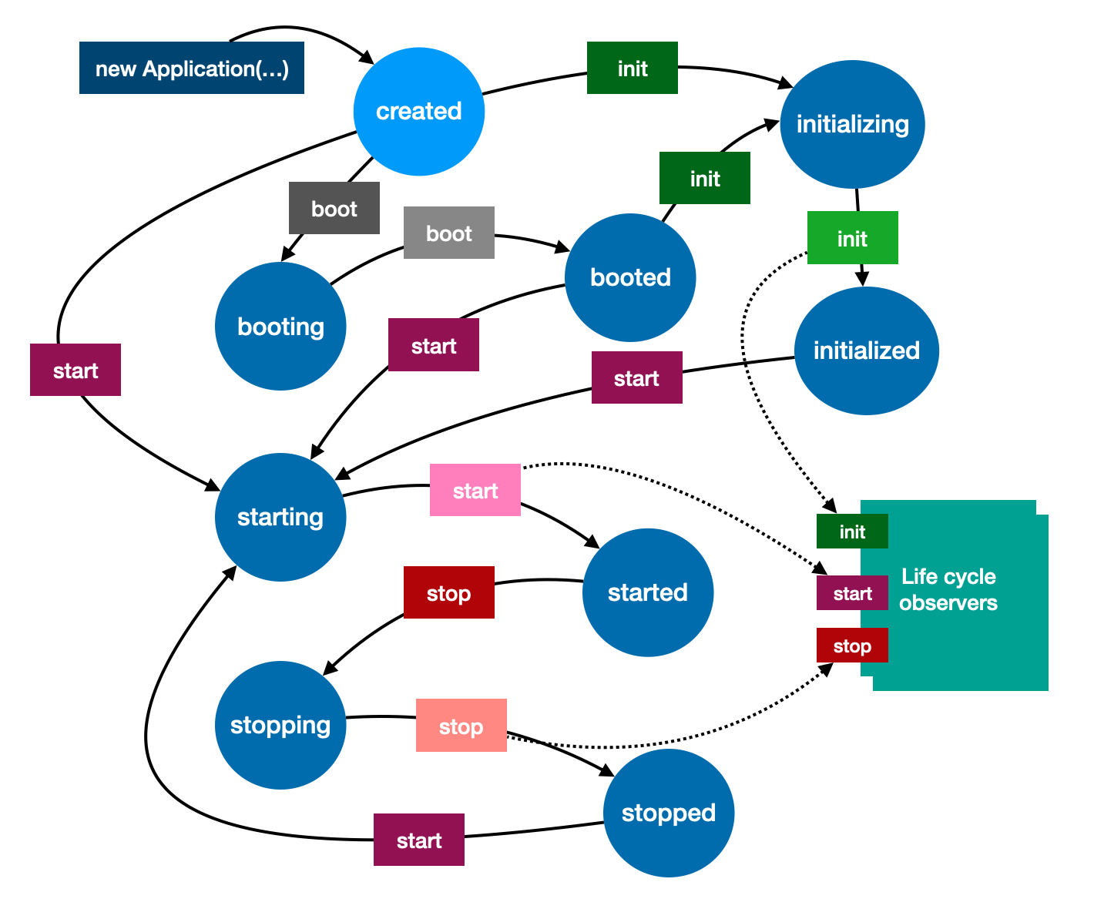
An application life-cycle
Which ones are events?
Which are states?

Slide 8
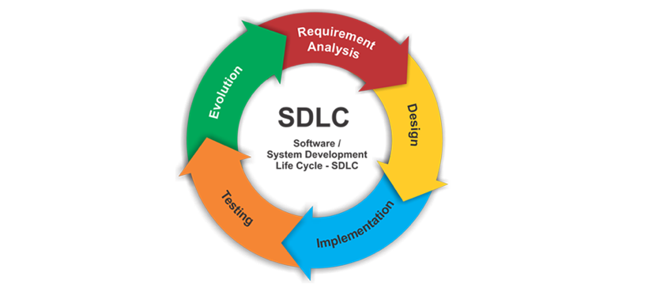
The Software Development Life Cycle (SDLC)
Git VCS:
Service: Github, gitlab, bitbucket
Git tool: source tree, git bash,…

Slide 9
Group project – final network application requirement
Using external/3rd party network library are not allowed
All network-related functions must be developed using the native Socket API of the chosen programming language
GUI library, sketch, skeleton project, UI framework are allowed to be referenced and resused from any sources
Program logic that unrelated to network (e.g., chess playing logic ) can be reused from other sources.
The final application should at least (mandatory):
Run application protocol developed by your own group
Be able to operate in client-server model in LAN mode
The server can handle multiple connections from multiple clients; state management and control the connected client.
The group can (optionally):
Using a non-blocking / asynchronous programming technique to enhance the final application
Make the application operate in both LAN/Internet mode.

Slide 10
Q&A
Google sheet to register your group members:
NT106.M22.MMCL
NT106.M21.MMCL
Note: any changes on project’s name, content and members must be submitted to lecturer before week 9

