Slide 1


OPERATING SYSTEM PRESENTATION
Course: HK212_CC05
Member :
Lưu Quốc Vinh 2052319
Phạm Châu Thanh 2052254 Nguyễn Viết Hòa 2052486

Slide 2



SCHEDULER
MEMORY MANAGEMENT
IMPLEMENTATION
ANSWER THE QUESTION

Slide 3

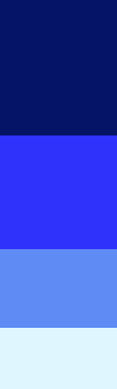

SCHEDULER
IMPLEMENTATION
Queue.c
Sched.c
Question

Slide 4

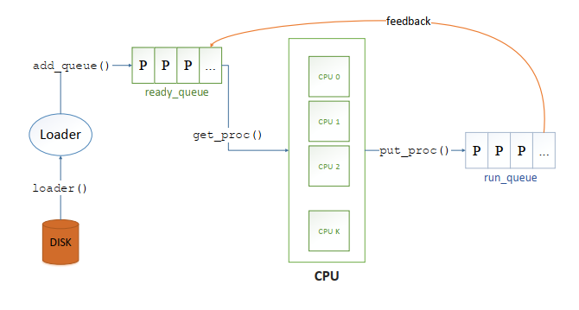
IMPLEMENTATION
o Concept

Slide 5
IMPLEMENTATION
o queue.c: enqueue()
queue
0
1
2
3
4
queue->size++
If (queue->size >= MAX_QUEUE_SIZE)
0
1
2
3
4

Slide 6
IMPLEMENTATION
o queue.c: dequeue()
*Highest_priority ⬄ max_value of priority
queue
5
10
2
8
max_value of priority
queue
queue->size == 0
10
*toReturn
NULL
queue
5
2
8
queue->size--

Slide 7
IMPLEMENTATION
o sched.c: get_proc()
Case 1: ready_queue non-empty
0 1 2 3
ready_queue
ready_queue
5
10
2
8
max_value of priority
CPU
process = dequeue(&ready_queue);

Slide 8
IMPLEMENTATION
o sched.c: get_proc()
Case 2: ready_queue empty
ready_queue
CPU
while(empty(&run_queue) == 0){
struct pcb_t * tmp = dequeue(&run_queue);
enqueue(&ready_queue, tmp);
}
0 1 2 3
run_queue
10
8
5
2

Slide 9
IMPLEMENTATION
o sched.c: get_proc()
Case 2: ready_queue empty
0
ready_queue
10
CPU
while(empty(&run_queue) == 0){
struct pcb_t * tmp = dequeue(&run_queue);
enqueue(&ready_queue, tmp);
}
0 1 2
run_queue
8
5
2

Slide 10
IMPLEMENTATION
o sched.c: get_proc()
Case 2: ready_queue empty
0 1
ready_queue
10
8
CPU
while(empty(&run_queue) == 0){
struct pcb_t * tmp = dequeue(&run_queue);
enqueue(&ready_queue, tmp);
}
0 1 2 3
run_queue
5
2

Slide 11
IMPLEMENTATION
o sched.c: get_proc()
Case 2: ready_queue empty
0 1 2 3
ready_queue
10
8
5
CPU
while(empty(&run_queue) == 0){
struct pcb_t * tmp = dequeue(&run_queue);
enqueue(&ready_queue, tmp);
}
0 1 2 3
run_queue
2

Slide 12
IMPLEMENTATION
o sched.c: get_proc()
Case 2: ready_queue empty
0 1 2 3
ready_queue
10
8
5
2
CPU
while(empty(&run_queue) == 0){
struct pcb_t * tmp = dequeue(&run_queue);
enqueue(&ready_queue, tmp);
}
run_queue

Slide 13
IMPLEMENTATION
o sched.c: get_proc()
Case 2: ready_queue empty
0 1 2 3
ready_queue
10
8
5
2
CPU
Return to case 1 to get process to CPU

Slide 14
MEMORY MANAGEMENT
Question
What is the advantage of using priority feedback queue in comparison with other scheduling algorithms you have learned?
No starvation
Fast response time
Priority oriented

Slide 15
MEMORY MANAGEMENT
IMPLEMENTATION
Mem.c
Question

Slide 16

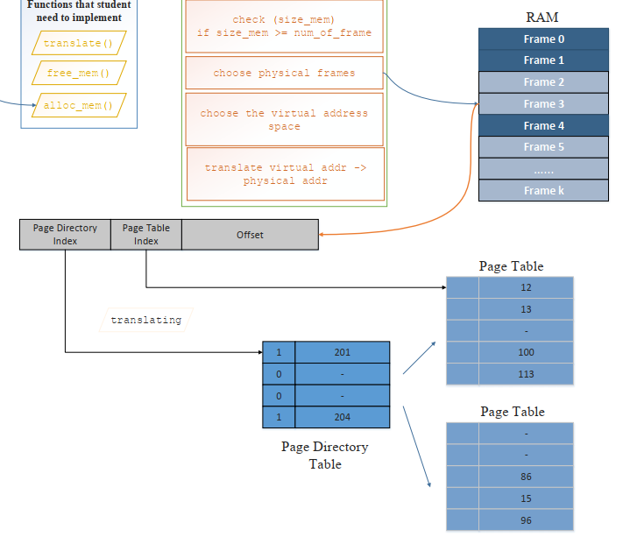
IMPLEMENTATION
o Concept

Slide 17
IMPLEMENTATION
o Concept
p1
p2
offset
Logical address
P_index
offset
Physical address
Segment table
Frame table ⬄ _mem_stat
Idx pages
P_index process
Page table
Idx p_index
.
.
.

Slide 18

IMPLEMENTATION
o mem.c: get_page_table()
p1
p2
offset
Segment table
Idx pages
table
for i = 0; i < seg_table->size; i++
if table[i].idx == p1
return table[i].pages;
Return

Slide 19
IMPLEMENTATION
o mem.c: translate()
p1
get_first_lv()
p2
get_second_lv()
Logical address
Segment table
get_offset()
Idx pages
Page table
offset
Idx p_index
P_index
offset
Physical address
P_index << OFFSET_LEN + offset

Slide 20
IMPLEMENTATION
mem.c: alloc_mem( size, process)
Allocate [size] byte in the memory for the process and save the address of the first byte in the allocated memory region to [ret_mem].
Check the free resources
Allocate memory region to the process

Slide 21

IMPLEMENTATION
mem.c: alloc_mem()
*Check the free resources
1/free memory in virtual address space
num_pages = (size % PAGE_SIZE == 0) ? size / PAGE_SIZE : size / PAGE_SIZE + 1;
RAM
Current memory
num_pages * PAGE_SIZE
Process->bp
Return (ret_mem = 0);
Check the physical one

Slide 22
IMPLEMENTATION
mem.c: alloc_mem()
*Check the free resources
2/free memory in physical address space
Frame table ⬄ _mem_stat
P_index process
proc
index
next
Count num_page_free (pages having _mem_stat[i].proc == 0)
num_page_free < num_pages
Return (ret_mem = 0);
Start allocation
.
.
.

Slide 23
IMPLEMENTATION
mem.c: alloc_mem()
*Allocate memory region to the process
Frame table ⬄ _mem_stat
- Proc = process->pid - Update index of the process’s frame - Update next (p_index of the next frame)
For_loop_condition: i < NUM_PAGES num_page_free > 0
P_index process
Proc = 0
- Allocate virtual part
Proc = 0
Virtual memory allocate
Proc = 0
.
.
.
PAGE_SIZE

Slide 24
IMPLEMENTATION
mem.c: alloc_mem()
*Allocate memory region to the process
Page table
Idx p_index
address
get_first_lv()
Logical address
get_page_table()
get_second_lv()

Slide 25
IMPLEMENTATION
mem.c: alloc_mem()
*Allocate memory region to the process
Page table == NULL
Segment table
Page table
Idx pages
Idx p_index
malloc()
process->seg_table->size++;
p1

Slide 26
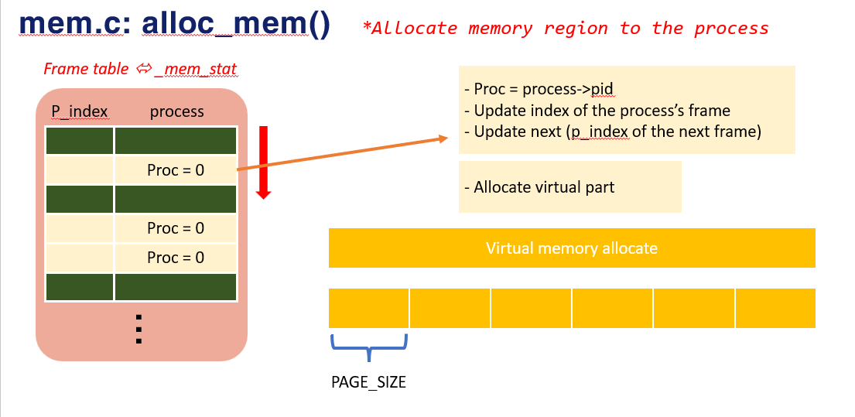
IMPLEMENTATION
mem.c: alloc_mem()
*Allocate memory region to the process
Page table
- Update the index = p2 - Update p_index
Idx p_index
p2
if (num_page_free == 0) _mem_stat[prev_p_index].next = -1;

Slide 27
IMPLEMENTATION
mem.c: free_mem( address, process)
Current virtual address
Released part
address
*
First virtual address

Slide 28
IMPLEMENTATION
o mem.c: free_mem()
1/check whether the physical address is exist
Virtual address
Physical address
Return
Virtual address
Physical address
Release

Slide 29
IMPLEMENTATION
o mem.c: free_mem()
Frame table ⬄ _mem_stat
2/Release memory
P_index process
Physical address
release
>> OFFSET_LEN
P_index
While ( != -1) {
/* releasing code */
}
release
release
.
.
.
Released part
Process->bp

Slide 30
IMPLEMENTATION
o mem.c: free_mem()
Frame table ⬄ _mem_stat
2/Release memory
P_index process
Physical address
release
>> OFFSET_LEN
While ( != -1) {
/* releasing code */
}
P_index
release
release
.
.
.
process->bp -= num_pages * PAGE_SIZE;
Process->bp

Slide 31
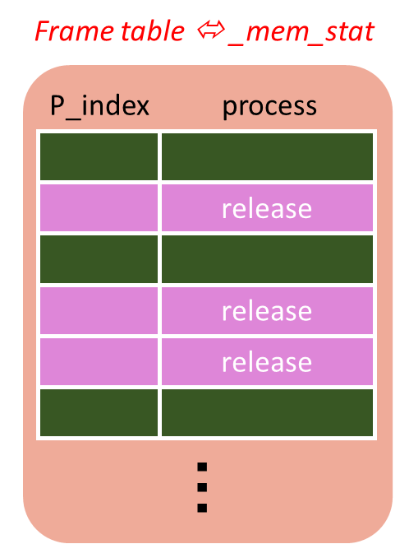
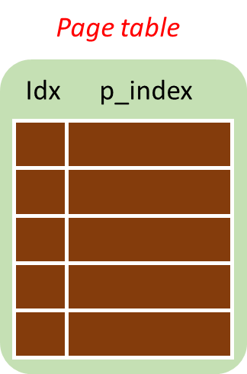
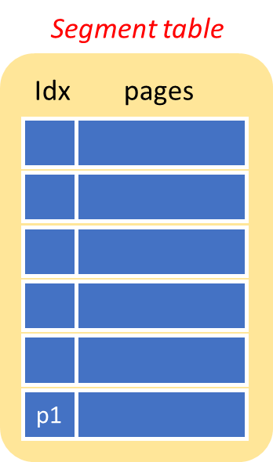
IMPLEMENTATION
o mem.c: free_mem()
/* releasing code */
1/
_mem_stat[ ].proc = 0;
P_index
get_first_lv()
2/
2/
Virtual address
get_page_table()
3/
if (page_table != NULL)
➔ remove the page that p_index ==
P_index
4/
if (page_table->size == 0) ➔ free the segment page that have idx == p1

Slide 32
IMPLEMENTATION
o mem.c: free_mem()
/* releasing code */
P_index
= _mem_stat[ ].next;
5/
P_index
Update virtual address
num_pages++; // the number of frame have been released

Slide 33
QUESTION
What is the advantage and disadvantage of segmentation with paging?
Advantage - The page table doesn’t grow very large compared to just using one-level paging - Reduces external fragmentation - Fewer entry in the segment tables compared to two-level paging
Disadvantage - Still can have internal fragmentation - Extra level of paging causes delay - High level of complexity

