Slide 1

TypeScript Fundamentals

Slide 2
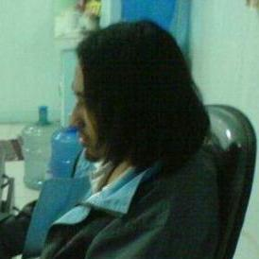


Arjay Elbore
Front-end Developer
@virtualoverride
https://github.com/ngvirtualoverride

Slide 3
About Me
Front End Developer
Trainor/Speaker
Javascript/Angular/Node and .Net Technology

Slide 4
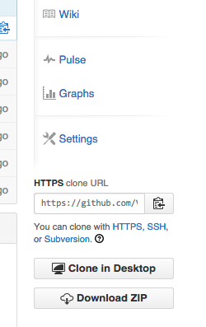
Demo
git clone
https://github.com/ngvirtualoverride/manilaJSng1xTS15
Or go to
https://github.com/ngvirtualoverride/manilaJSng1xTS15
Click the download button

Slide 5

Agenda
What is TypeScript?
Pros and Cons
Features
Using TypeScript In text Editors
Demo
TODO App example code

Slide 6
Target Audience
Developers with experience using the following
Javacript
OOP

Slide 7
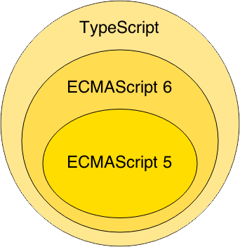
What is TypeScript?
TypeScript lets you write JavaScript the way you really want to.
TypeScript is a typed superset of JavaScript that compiles to plain JavaScript.
Any browser. Any host. Any OS. Open Source.
http://www.typescriptlang.org/

Slide 8
TypeScript Pros
Superset of Javascript allows easy transition from Javascript to typed versions of the code.
Open source from the start, using the Apache License.
Strong types assist developers catch errors before the deploy the code, this is a very welcome addition to the developer toolches
Classes, interfaces, visibility are first class citizens. It formalizes them for those of us that like this model instead of the roll-your-own prototype system
TypeScript is distributed as a Node.JS package, and it can be trivially installed on Linux and MacOS

Slide 9
TypeScript Cons/Bad
In order to run the application in the browser, a compile step is required to transform TypeScript into JavaScript.

Slide 10
Main Features
Classes
Interface
Type Definitions (http://definitelytyped.org/)
Compile to Javascript
ES6/7 Features

Slide 11
Using TypeScript In Text Editors
Sublime Text 3
https://packagecontrol.io/packages/TypeScript
https://packagecontrol.io/packages/ArcticTypescript
Visual Studio Code

Slide 12
Demo

Slide 13
TODO App example code
Using BackBone
http://todomvc.com/examples/typescript-backbone/
Using AngularJS
http://todomvc.com/examples/typescript-angular/

Slide 14


Slide 15


