Slide 1

{{ AngularJS Fundamentals }}

Slide 2



{{ Arjay Elbore }}
Front-end Developer
@virtualoverride
https://github.com/ngvirtualoverride

Slide 3
{{ About Me }}
Front End Developer
Trainor/Speaker
Almost 2 years on AngularJS
Node and .Net Tech

Slide 4
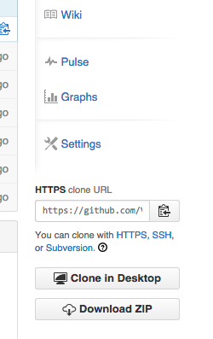
{{ Exercises and Demo App }}
git clone https://github.com/ngvirtualoverride/ngUnitTest.git
Or go to
https://github.com/ngvirtualoverride/ngUnitTest/tree/unit-test-karma
Click the download button

Slide 5

{{ Course Agenda }}
AngularJS Fundamentals Part 1 Review
Custom Filters
Custom Directives

Slide 6
{{ Target Audience }}
Developers with experience using the following
HTML
CSS
Javacript

Slide 7
{{ Custom Directives }}
Getting Started
Shared & Isolate Scope
The Link Functions
Using Controllers

Slide 8
{{ Getting Started }}
Roles of Directives
Creating Hello World
Directives Categories
Directives Building Blocks

Slide 9

{{ Roles of Directives }}
Markers on a DOM element that tell AngularJS's HTML compiler ($compile) to attach a specified behavior to that DOM element.

Slide 10
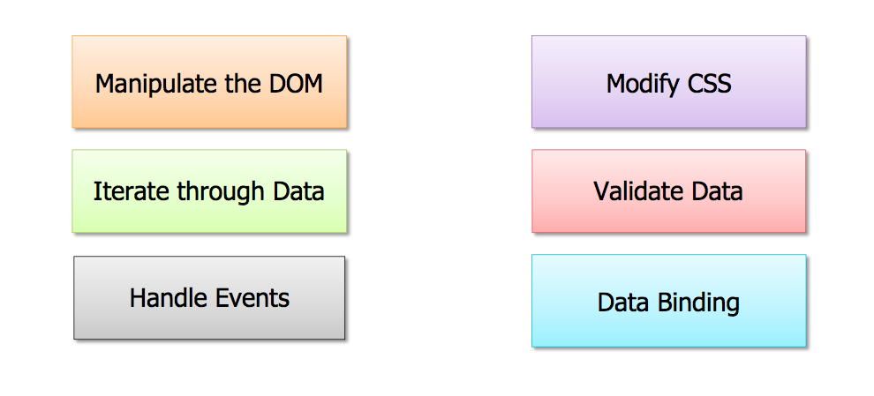
{{ What can Directives Do? }}

Slide 11

What if there’s isn’t a directive that meets you need?

Slide 14


Slide 15


