Slide 1

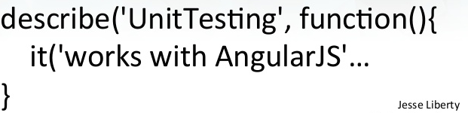
{{ AngularJS Unit Test }}

Slide 2



{{ Arjay Elbore }}
Front-end Developer
@virtualoverride
https://github.com/ngvirtualoverride

Slide 3
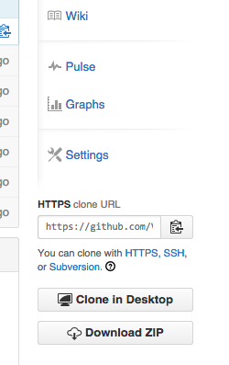
{{ Exercises and Demo App }}
git clone https://github.com/ngvirtualoverride/ngUnitTest.git
Or go to
https://github.com/ngvirtualoverride/ngUnitTest/tree/unit-test-karma
Click the download button

Slide 4

{{ Agenda }}
Unit Test & TDD Overview
Advantages & Dis-advantages of TDD
Demo

Slide 5
{{ Target Audience }}
Developers with experience using the following
HTML
CSS
Javacript
AngularJS
https://www.youtube.com/watch?v=i9MHigUZKEM

Slide 6
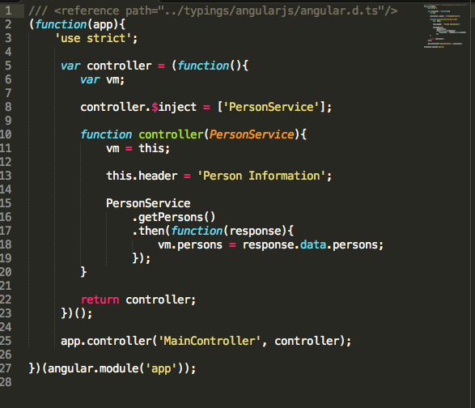
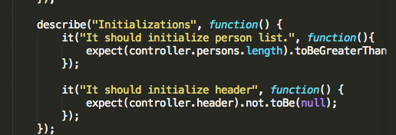
Unit Test
Step-1 Step-2
Create a logic code Create unit test

Slide 7
{{ TDD }}

Slide 8
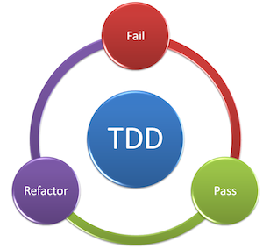
{{ What is TDD? }}

Slide 9
{{ What is TDD? }}
Red — Write a test that expresses how you’ll use the code and what you need it to do. This test will fail, producing a red bar on many UI’s.
Green — Write enough code to get the test to pass, but no more. If you need more code, for example, to check for errors, first write another test to demonstrate that feature. For now, just write enough code to get the test to pass.
Refactor — Clean up the code to remove redundancy and improve the design. Then re-run the tests to make sure you didn’t break anything.

Slide 10
{{ What is TDD? }}
Test-driven development (TDD) is a software development process that relies on the repetition of a very short development cycle: first the developer writes an (initially failing) automated test case that defines a desired improvement or new function, then produces the minimum amount of code to pass that test, and finally refactors the new code to acceptable standards

Slide 11
Advantages of TDD?
Creates a detailed specification
Reduced time in rework
Less time spent in the debugger and when it is required you usually get closer to problem quickly
Creates SOLID code (Articles: Bob Martin and Chad Myers)

Slide 12
Dis-advantages of TDD?
TDD is hard to learn, especially on your own. You can expect reduced productivity for 2-4 months after starting.
Time cosuming.

Slide 13
DEMO
Controller
Factory & Services
API calls

Slide 14

Getting Hands Dirty
NO PAIN, NO GAIN

Slide 15
Project Setup.
Install dependecies.
Create configuration
https://youtu.be/YRzr27Bpx_g?list=PLw5h0DiJ-9PDbh2i6knU4FybWA63PPbVi
https://youtu.be/poRfmxCouVo?list=PLw5h0DiJ-9PDbh2i6knU4FybWA63PPbVi

Slide 16

Create Unit Tests

Slide 17
References
Twelve Benefits of Writing Unit Tests First
http://sd.jtimothyking.com/2006/07/11/twelve-benefits-of-writing-unit-tests-first/

Slide 18


Slide 19


