Slide 2
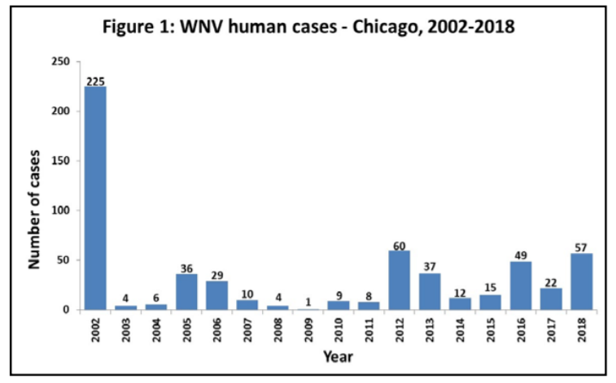
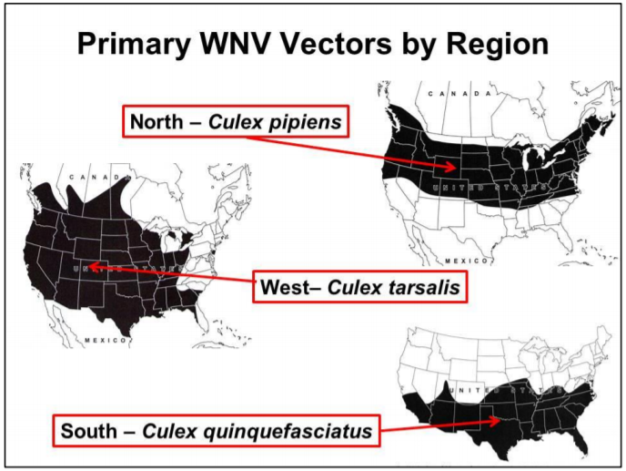
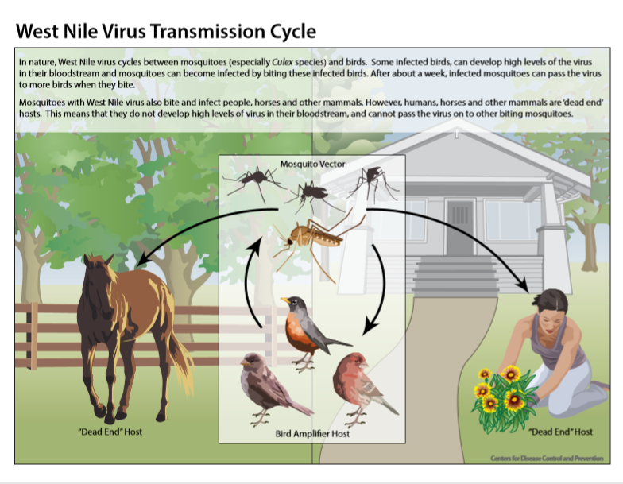
West Nile Virus (WNV)
West Nile virus (WNV), which is most commonly spread by the bite of an infected Culex mosquito, first emerged in the eastern U.S. in 1999. In 2002, WNV reached Chicago for the first time with 225 human cases reported that summer.
While most people infected with WNV do not have symptoms, about one in five develop a fever and/or mild symptoms. About one in 150 infected people develop a serious illness that affects the central nervous system and can result in death. Serious illness can occur in people of any age but those over the age of 60 and those with certain medical conditions are at greater risk.
WNV is maintained in nature in a bird-mosquito cycle with birds acting as amplifying hosts
WNV infects mostly mosquitoes from the Culex genus
Source: Chicago Department of Public Health

Slide 3
Chicago Department of Public Health (CDPH)s Response
City‐wide surveillance and mosquito control measures:
From June to September, adult mosquitos were collected from 83 traps across the city, examined under microscopes to determine species and sex, “pooled” with mosquitos that could carry WNV and then tested for the virus on a weekly basis.
When a substantial density of WNV was detected in mosquito pools for 2 consecutive weeks, CDPH sprayed implicated geographic areas to control adult mosquitos.

Slide 4
Specimen Handling and Processing
mosquito-based WNV surveillance relies on identifying WNV in the collected mosquitoes through detection of viral proteins, viral RNA, or live virus. Optimally, a cold chain should be maintained from the time mosquitoes are removed from the traps to the time they are delivered to the processing laboratory, and through any short-term storage and processing. efforts should be made to handle and process the specimens in a way that minimizes exposure to conditions (e.g., heat, successive freeze-thaw cycles) that would degrade the virus. O
Sort and identify the mosquitoes to species on a chill-table if available.
Mosquitoes are generally tested in pools of 50 to 100 specimens grouped by species, date, and location of collection. Larger pool sizes may result in a loss of sensitivity
Usually only female mosquitoes are tested in routine WNV surveillance programs
https://www.cdc.gov/westnile/resources/pdfs/wnvGuidelines.pdf

Slide 5
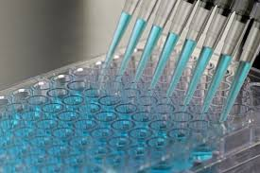
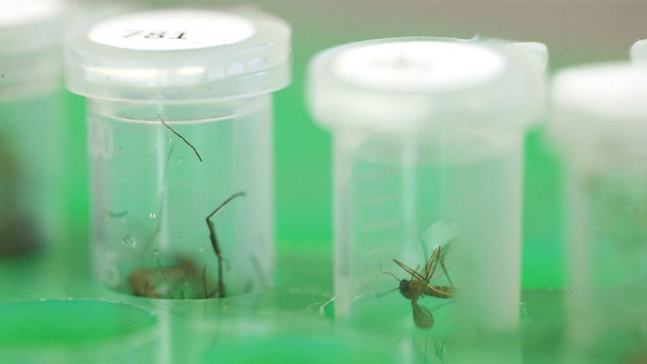
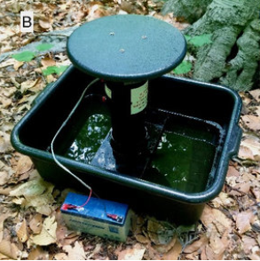

Homogenisation
&
Centrifugation
Sorting & Pooling
Testing
Collection
Species 1
(Jose M. Osorio/Chicago Tribune)
Species 2
Species 3
Species 4
Species 5
Species 6
By species
By sex
Laboratory

Slide 6
CDC miniature light trap | lightweight use batteries to provide power to a light source and fan motor. CO2 (usually dry ice) is frequently used as an additional attractant. In some programs, the light sources are removed to minimize the capture of other nocturnal insects that are attracted to light, such as moths and beetles. In those cases CO2 is the only attractant used. | collect a wide range of mosquito species may consist largely of unfed, nulliparous individuals not all mosquito species are attracted to light traps are of little use in sampling day-active time mosquitoes such as Ae. Albopictus The three major WNV vectors (Cx. pipiens, Cx. quinquefasciatus and Cx. tarsalis) can be collected in light traps, and some surveillance programs rely on light traps alone. effective in collecting large numbers of Cx. tarsalis, light traps typically collect relatively few Cx. pipiens or Cx. quinquefasciatus and the resulting small sample sizes may reduce the ability to accurately estimate WNV infection rates.
Notes:
provides information about both primary and secondary vectors and a better understanding of the species composition in an area

Slide 7
Gravid traps | target gravid females (i.e., those carrying mature eggs) of the Cx. pipiens complex Gravid traps can be baited attractants such as fresh or dry grass clippings infusions, rabbit chow infusions, cow manure, fish oil, or other materials that mimic the stagnant water in habitats where these species lay eggs. The different infusions vary in attractiveness | gravid females have previously taken a blood meal, which greatly increases the likelihood of capturing WNV infected individuals and thus detecting virus One limitation of gravid traps is that they selectively capture mosquitoes in the Cx. pipiens complex, and therefore provide limited information on species composition within a region

Slide 8
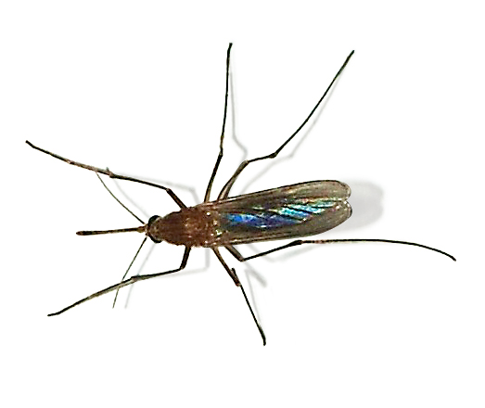
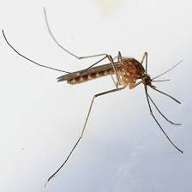
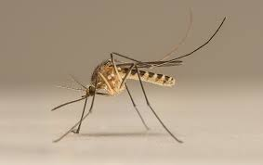

Slide 9
Evaluation Metric – Infection Rate
“Research and operational experience shows that increases in WNV infection rates in mosquito populations can provide an indicator of developing outbreak conditions several weeks in advance of increases in human infectins.”
- CDC WNV Guidelines

Slide 10
Mosquito-Based Surveillance Indicators
Vector abundance | total number of mosquitoes of a particular species collected, divided by the number of trapping nights conducted during a specified sampling period, and is expressed as the number/trap night Vector abundance provides a measure of the relative number of mosquitoes in an area during a particular sampling period
Number of positive pools | total of the number of WNV positive mosquito pools detected in a given surveillance location and period It is sometimes separated by species, or may be a tally of the total number of positive pools for all species tested. Expressing WNV activity as the number of positive pools is not recommended since the same data can be used to produce more informative indices.
Percent of pools positive | expressing the number of WNV-positive pools divided by the total number of pools tested
Infection rate | an estimate of the prevalence of WNV-infected mosquitoes in the population and is a good indicator of human risk. The minimum infection rate (MIR) for a given mosquito species is calculated by dividing the number of WNV-positive pools by the total number of mosquitoes tested (not the number of pools tested). number of positive pools / total specimens tested x 1000 - per species The MIR uses the assumption that a positive pool contains only one infected mosquito, an assumption that may be invalid when infection rates are high, as has been observed during West Nile virus epidemics The maximum likelihood estimate (MLE) of the infection rate does not require the assumption of one positive mosquito per positive pool, and provides a more accurate estimate when infection rates are high (
Vector index

Slide 11
Weather Elements

Slide 12
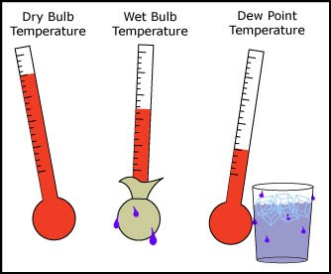
Station | Station 1: Chicago O’Hare INTL Airport at (41.995, -87.933) Station 2: CHICAGO Midway INTL Airport at (41.786, -87.752)
Date | Data collection date
Tmax, Tmin, Tavg | Daily extremes and averages of temperature
Depart | Temperature Departures from normal The difference between the average temperature and the 30-year normal temperature for this date (climate change measurement)
DewPoint | Average dew point temperature
WetBulb | Average wet bulb temperature
Heat | Heating Degree Days = Tavg – baseline
Cool | Cooling Degree Days = baseline – Tavg A gauge of the energy demand for heating or cooling a building (baseline = 65 ⁰F)
Sunrise, Sunset | SUNSET (Calculated, not observed)
CodeSum | Significant weather condition (coded remarks)
Depth | ?
Water1 | Water equivalent of the rainfall and melted snow
SnowFall | The depth of snowfall
PrecipTotal | Total precipitation
StnPressure, SeaLevel | station and sea level pressure in unit of INCHES OF HG
ResultSpeed | Resultant Wind Speed (Calculated speed based on other wind speed measurements)
ResultDir | Resultant Wind Direction (calculated based on other wind direction measurements)
AvgSpeed | Average Speed
https://w2.weather.gov/climate/f6.php
https://www.ncdc.noaa.gov/news/defining-climate-normals-new-ways
https://w2.weather.gov/climate/f6.php
https://www.tceq.texas.gov/cgi-bin/compliance/monops/daily_info.pl?parameter:61103
Notes:
The magnitude of the difference is the number of days.
Resultant wind speed values are obtained by converting the x-minute wind speeds and directions for the hour into a single hourly vector. Resultant wind speed is the magnitude of this vector

Slide 13
Missing Data
Wrong Data Type
# Date, Sunrise, Sunset: should be in datetime format
M: Missing
T: Trace, some precipitation fell but not enough to measure
Tavg | Calculate by the average of Tmax and Tmin | Calculate
Depart | “M”: 50% - station 2 doesn’t have this data We can reverse engineer the ‘normal’ by Tavg (station1) – Depart (station1) Then Depart(station2) = Tave(station2) - normal | Calculate
WetBulb | 4 “M” | ?
Heat | Can be imputed by Heating Degree Days = Tavg – baseline, but redundant | Calculate or remove col
Cool | Can be Imputed by Cooling Degree Days = baseline – Tavg, but redundant | Calcluate or remove col
CodeSum | Significant weather condition (coded remarks) | Remove col?
Depth | “M” or “0” - | Remove Col
Water1 | All “M” | Remove Col
SnowFall | Mostly ‘M’ or ‘0”, only 12 “T” and 1 row of 0.1 | Remove Col
PrecipTotal | 318 “T” and 2 “M” | Impute T= 0, drop “M” rows?
StnPressure SeaLevel | 4 “M” 9 “M” | ?
AvgSpeed | 3 “M” | ?

Slide 14
