Slide 1
Direct Marketing Optimization Summary of Results
Ng Wei Xuan

Slide 2
Agenda
Objectives
Overview of Results
Data Analysis
Data Transformation
Modelling Approach
Revenue Calculation
Future Work

Slide 3
Objectives
Build Purchase Propensity Models: Develop three separate models to predict the likelihood that a customer will purchase: a. A Consumer Loan b. A Credit Card c. A Mutual Fund
Design Revenue-Optimized Targeting Strategy: Identify the optimal set of clients to receive marketing offers to maximize total revenue, while strictly adhering to all specified constraints.

Slide 4
Overview of results
Potential Expected Revenue through optimization for top 15% of customers:
$ 2976
Best Propensity Models:
Credit Card (xgboost): Targeting top 15% yields 50% response, 2.35× better than random, with decent prediction confidence (ECE 0.14).
Consumer Loan (random forest): Top 15% targeting gives 57% response, 2.07× lift, and very reliable predictions (ECE 0.05).
Mutual Fund (xgboost): Top 15% targeting gets 43% response, 1.49× lift, decent separation (AUC 0.66), moderate prediction confidence (ECE 0.18).

Slide 5
Exploratory Data Analysis
Exploratory Step | Rationale | Result
Missing values check | Missing values need to be dropped or treated. | New customer may have “missing” transaction data Sex has 2 rows of missing information
Outlier analysis using IQR | Outliers may negatively impact the performance of some models | - Several transaction data have large “outlier” values
Predictive strength with labels using mutual information | Can aid in feature selection to help alleviate overfitting | Most predictive features for MF: , for CC , for CL
Correlation between labels | Labels too correlated might be de-prioritized to reduce overfitting | Transaction/balances data are correlated May consider future feature engineering to drop or aggregate this data
Age-Tenure Check | Business logic check | 34 samples which tenure exceeds age.
To perform a distribution check (KS Test) between clients with labels and without labels | Not all points are labelled | ActBal_CA might have deviation. To perform further business / monitoring checks but included for modelling at the moment.
Label distribution | Imbalanced classes may result in poor model performance. | None of the classes are majorly imbalanced (at most 20%), but future augmentation can be considered.

Slide 6
Data cleaning and Transformation
Transformation Step | Rationale
Select labelled clients. | Not all points are labelled. Assumption that labelled points are not biased / representative.
Handle Missing Value: Drop rows with missing sex Fill 0 for the rest | Sex only has 2 missing points Others are transaction or balance data which 0 can represent no previous transaction. For existing customer with accounts but no balance, we still include account information for modelling
Remove points which tenure > age | Assumption: Erroneous points
Log transform numeric columns with high values (and non-negatives), normalize for those with negatives | Reduce effect of outliers
Standardize and perform PCA for numeric data | Reduce dimensionality, model performance is poor without transformation

Slide 7
Modelling Results
Data is split 80% training, 10% validation and 10% test set.
Top15 Precision / Lift: Directly measures accuracy on target subset (top 15%) for maximum ROI.
AUC: Ensures good overall ranking of prospects for flexible thresholding.
Expected Calibration Error: Ensures predicted probabilities are reliable for revenue optimization.
Metric | RF (CC) | XGB (CC) | RF (CL) | XGB (CL) | RF (MF) | XGB (MF)
Top 15% Precision | 0.3571 | 0.5000 | 0.5714 | 0.5714 | 0.3571 | 0.4286
Top 15% Lift | 1.6786 | 2.3500 | 2.0659 | 2.0659 | 1.2434 | 1.4921
ECE | 0.0780 | 0.1407 | 0.0502 | 0.2019 | 0.0887 | 0.1754
AUC | 0.6007 | 0.5845 | 0.7381 | 0.6199 | 0.6108 | 0.6639
Brier Score | 0.1592 | 0.1726 | 0.1730 | 0.2233 | 0.2050 | 0.2256
F1 | 0.2400 | 0.3380 | 0.5484 | 0.4375 | 0.4151 | 0.4688
Precision | 0.6000 | 0.2353 | 0.4722 | 0.3684 | 0.2785 | 0.4054
Recall | 0.1500 | 0.6000 | 0.6538 | 0.5385 | 0.8148 | 0.5556
Top 15% Recall | 0.2500 | 0.3500 | 0.3077 | 0.3077 | 0.1852 | 0.2222
Observations:
- Both models show sign of overfitting (training scores >> val and test), especially XGBoost
- Models capture true positives effectively but have variable precision and calibration across products.
- Discrimination and lift show good targeting; further tuning needed to balance accuracy and confidence.

Slide 8
Revenue calculation and Optimization
Limited Outreach: The bank is restricted to contacting just 15% of its customer base
One Offer Per Customer: Each customer is eligible to receive only a single marketing offer t
Assumptions:
Historical revenue is used as a proxy for expected revenue.
No further constraints: Both greedy and optimization method yield the same result.
Optimization Method
Greedy Method
Objective: Maximize the total expected revenue from all selected client-offer pairs.
Constraints:
Only contact up to 15% of all clients
Each client can receive at most one offer (no multiple offers per person).
Each client-offer decision is yes/no (either assign or don’t assign).
Total number of assigned clients must not exceed the contact limit.
Only valid offers based on client eligibility or predicted scores are considered.
Select Best Offer per Client for each client, keep only the offer with the highest predicted score. This ensures the “one offer per client” constraint.
Rank Clients by Score: Sort clients by their selected offer’s predicted score in descending order.
Apply Contact Limit: Select the top N clients (e.g., top 15% or top 100).

Slide 9
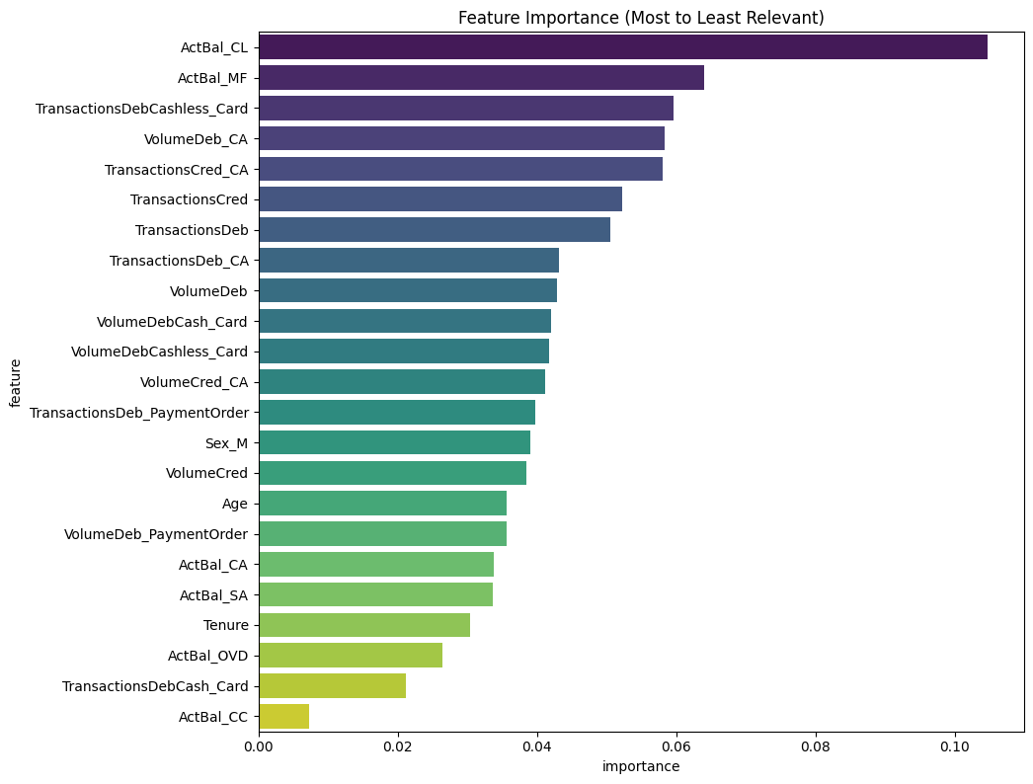
Future work
Top Features for MG, XGBoost
Feature Selection: ablation study for features include removing feature with low feature importance score. This can be done along with error analysis.
More models and hyperparameter tuning: Simpler models ie. Logistic regression may help alleviate overfitting
Multi-task modelling for both revenue and propensity: Either create separate models to predict revenue or utilize dual-objective heads (using deep learning models) for modelling expected revenue.

Slide 10
Appendix

Slide 11
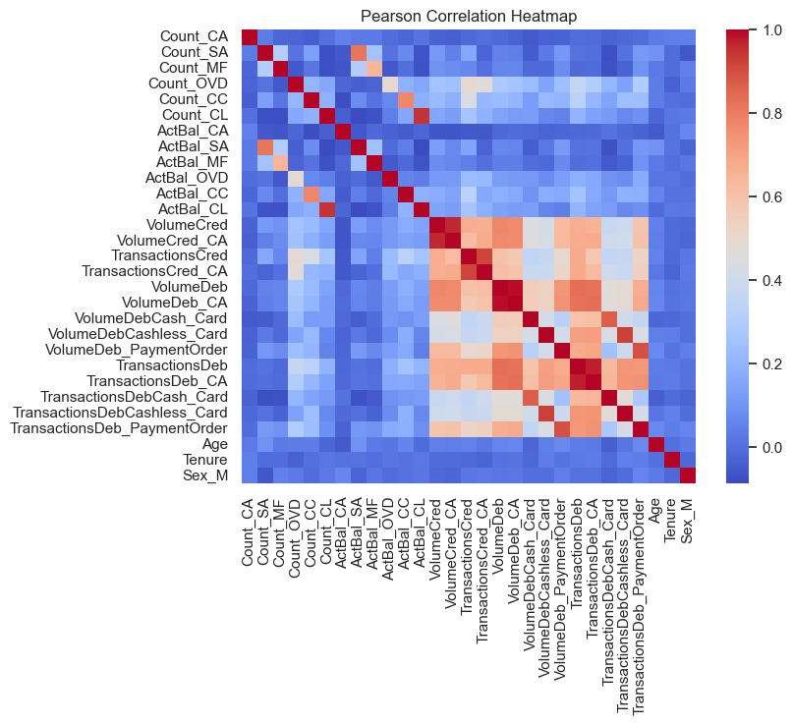
Correlation Analysis

