Slide 1

Nathan Wells Project

Slide 2
Exec Summary and Agenda
Problem Statement: Currently, there is no predictive model for determine who will purchase tax software.
Goals:
Determine features that contribute to sales
Create a predictive model for generating sales
Define next steps for reporting and continuous improvements
Executive Summary:
Feature were identified that contribute to determining sales.
Created an initial machine learning model to generate a ~6% increase for identifying which customers are primed for a purchase
Identified missed opportunities and next steps to improve model performance while initial model is deployed.
Deployed model sent as Full_model.pkl
Agenda:
Review data assumptions initial baseline findings.
Identify risks and targets when deploying ML models
Model performance
Discussion

Slide 3
Data and Assumptions
Data collected over a two year period
No data dictionary was shared, columns name were used a descriptions to be the best of our ability
Data contains no identifying information or meta data ; it is reasonable to assume 1 row = 1 independent individual
Customers are equivalent, no customer is more valuable than another
Data contains no time dependent information
"Date" Features are considered categorical and independent
Data is considered complete and true
Response variable : 'successful_sale' (yes = sale:1, no= no sale:0)
Features: All other columns (Continuous and Categorical)
Categorical Features 'dummy' encoded for each unique value in the category (1: value, 0 otherwise) Ifor each unique value
Total Samples: 4640:sale, 36,548:no sale
Data is considered imbalances with an abundance of 'no sale' entries.
Note: feature c10 is identical to the response variable and will be excluded from the analysis.

Slide 4
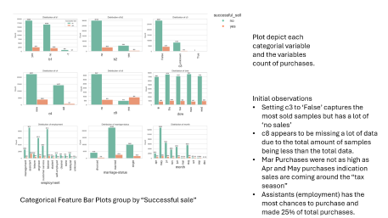
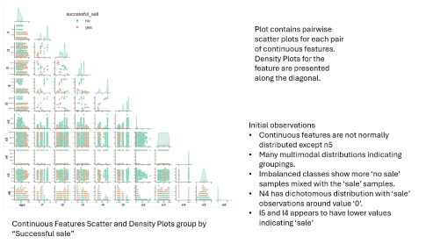
Exploratory Analysis and Baseline
Exploratory Data Analysis (EDA) is an initial approach to analyzing data sets to summarize their main characteristics, often using visual methods.
Baselining is the process to establish a simple model starting point.
Decision Stump Analysis (single value thresholding) conducted to determine baseline model.
Utilizing a costume model selection process, n4 was determine to be the best baseline model.
Model selection was based using quantiles of the following criteria:
Metric | Direction | Definition
True Positive Rate | Higher | Proportion of actual positive cases that the model correctly identified
True Negative Rate | Higher | Proportion of actual negative cases that the model correctly identified as Negative
Positive Predictive Value | Higher | Proportion of positive predictions made by the model that were actually correct
Global Accuracy | Higher | Overall percentage of correct predictions

Slide 5
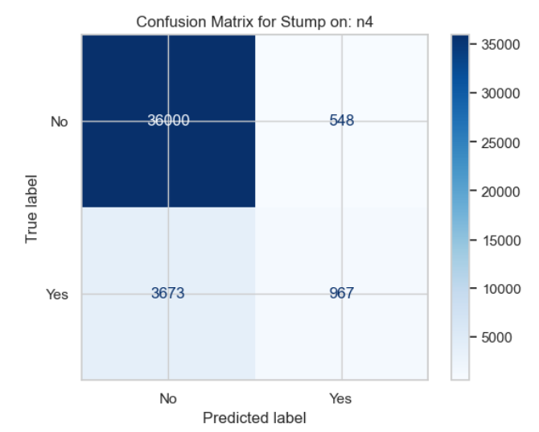
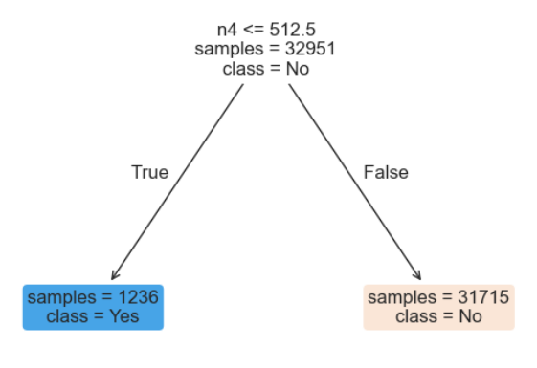
Baseline Model Establishment
Each feature was run through a 5-fold CV Decision Stump Model
Model selection as conducted by find the quantiles for each metric then averaging them together.
Metrics are weighted equally.
Rank | feature | Mean quantile score | Global accuracy | True positive rate (TPR) | True negative rate (TNR) | Positive predictive value
1 | n4 | 0.79 | 0.90 | 0.21 | 0.99 | 0.64
2 | c8_yes | 0.78 | 0.90 | 0.19 | 0.99 | 0.65
3 | month_mar | 0.75 | 0.89 | 0.06 | 0.99 | 0.51
4 | i5 | 0.74 | 0.87 | 0.48 | 0.92 | 0.45
5 | month_dec | 0.73 | 0.89 | 0.02 | 1.00 | 0.49
6 | month_sep | 0.72 | 0.89 | 0.06 | 0.99 | 0.45
7 | month_oct | 0.72 | 0.89 | 0.07 | 0.99 | 0.44
8 | i3 | 0.71 | 0.88 | 0.24 | 0.96 | 0.43
9 | i2 | 0.70 | 0.88 | 0.22 | 0.96 | 0.40
10 | age | 0.70 | 0.88 | 0.10 | 0.98 | 0.41
Good – never going to purchase
Not Great
Risk- Resource Waste
Missed Opportunity
Risk-Lose Sales
Great
Correctly identified sales
Modeling Efforts will be to Lift TPR and NPR while lowering Risks

Slide 6
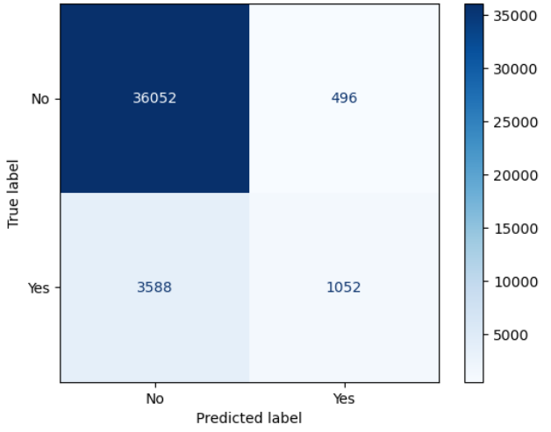
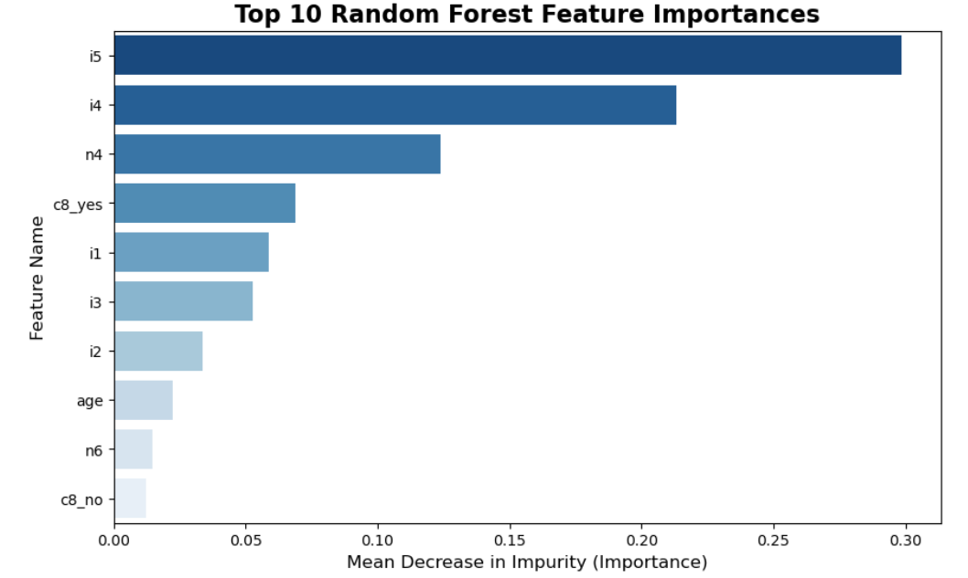
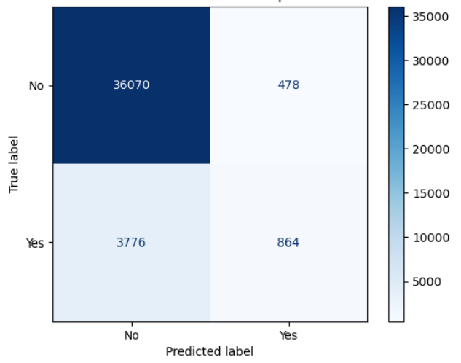
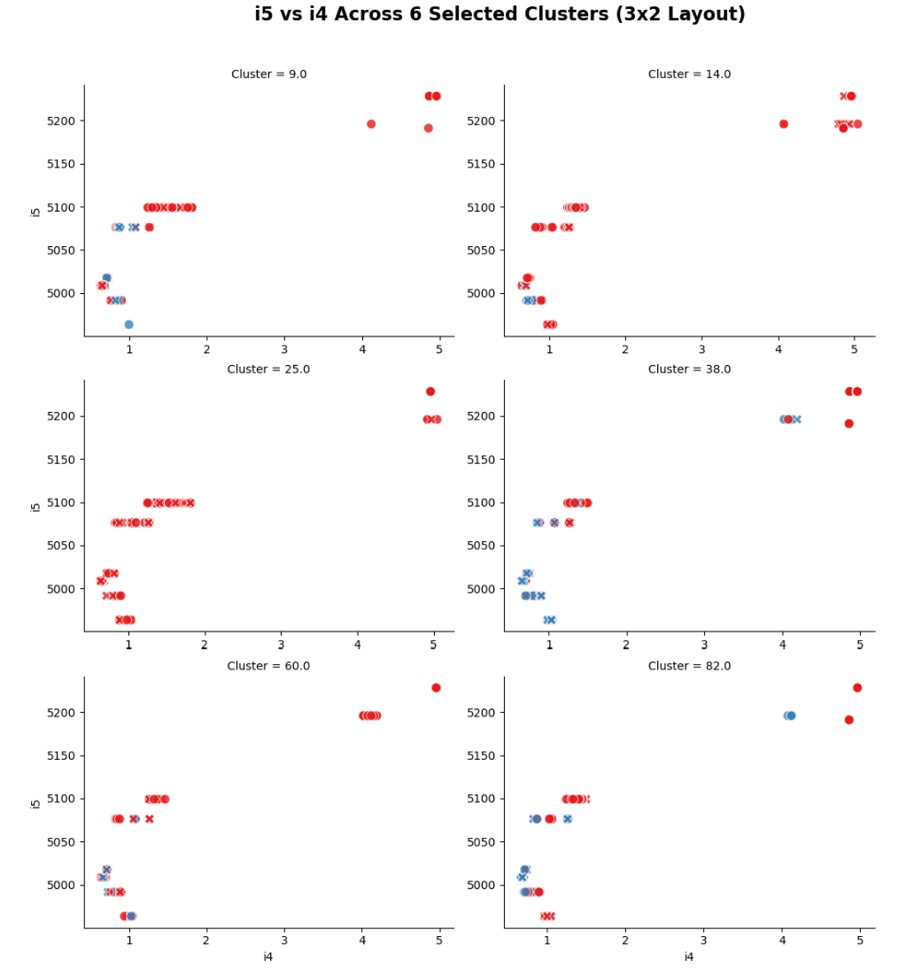
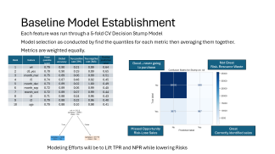
Initial Model Results
Random Forest Model
Supervised Tree-based Ensemble
Robust Results
Training:
5-Fold CV (each sample is held out once)
Randomized grid search (reduce training iterations)
Imbalance classes handling – duplicate methods
Missing values – Categorical values handled during encoding
K-Means Clustering
Unsupervised and unlabeled
Majority of training cluster assigned to hold out
Training:
5-Fold CV (each sample is held out once)
Randomized grid search (reduce training Iterations)
Imbalance classes handling – none
Missing values – Categorical values handled during encoding
Models are driven by utilizing the lower values of features i5 and i4
Inference driven by important features generating the purest splits and clusters having the highest sales

Slide 7
Model Cpomparisons
Comparing ML models to the Baseline Model
 | Baseline: n4 | RandomForest | % Change to Baseline | K-Means | % Change to Baseline
Global Accuracy | 0.90 | 0.90 | 0.38 | 0.90 | -0.09
True Positive Rate | 0.21 | 0.23 | 8.79 | 0.19 | -10.65
True Negative Rate | 0.99 | 0.99 | 0.14 | 0.99 | 0.19
Positive Predative Value | 0.64 | 0.68 | 6.47 | 0.64 | 0.87
RandomForest model is outperforming the baseline in terms of True Positive Rate and Positive Predictive Value
The model captures more sales correctly and when a prediction is made, its ~6.5% more likely to be correct

Slide 8
Proposed Reporting Process
Process designed to report sales predictions based upon new data.
Twice Daily Batch Reporting Avoid over alerting
User Access
Batched Trigger: New Data Only
Data encoding validation
ML Model Call
Prediction
New Sales Data
Direct Email
Client (Raw) Database
Historical and new data
Client (Prediction) Database
Model metadata
Model Performance Monitoring
Run logs
Model Repository
Model logs/versioning
Training results
Run logs/Error logs
Transformation logic
Parameter recipes
Dashboard and Reporting
Design pending requirements and funding approval

Slide 9
Discussion/Data Enhancement/Services
Refinement of the data and model are required to improve model performance
Data Enhancement
Additional data context: Definitions of all columns
Time-based source: Capture changes over time
Engagement methods and history of each client
Model Improvements
Additional model test and feature engineering recommended for optimizing performance
Continuous Improvement and post hoc analysis on missed opportunities to boost model performance
Agentic Implementations
Improving model prediction per client entry with additional description of the entry could create customized engagement plans and set customer priorities.
Action Triggered off prediction model results

Slide 10
Accomplishments and Next Steps
Accomplishments
Features were identified that contribute to determining sales predictions
Example: low values of the features provided prediction accuracy in for features i4 and i5
Created an initial machine learning model to generate a ~6.5% increase for identifying which customers are primed for a purchase
The proposed RandomForest model provided a robust prediction model that outperformed a baseline model
Deployed model sent as Full_model.pkl
Next Steps
Identify ownership and requirements for a reporting system
Accept the proposed work of conducting data enhancement to improvement performance and create agent pipeline to triggered by the reporting system’s predictions.

Slide 11
Questions?

Slide 12
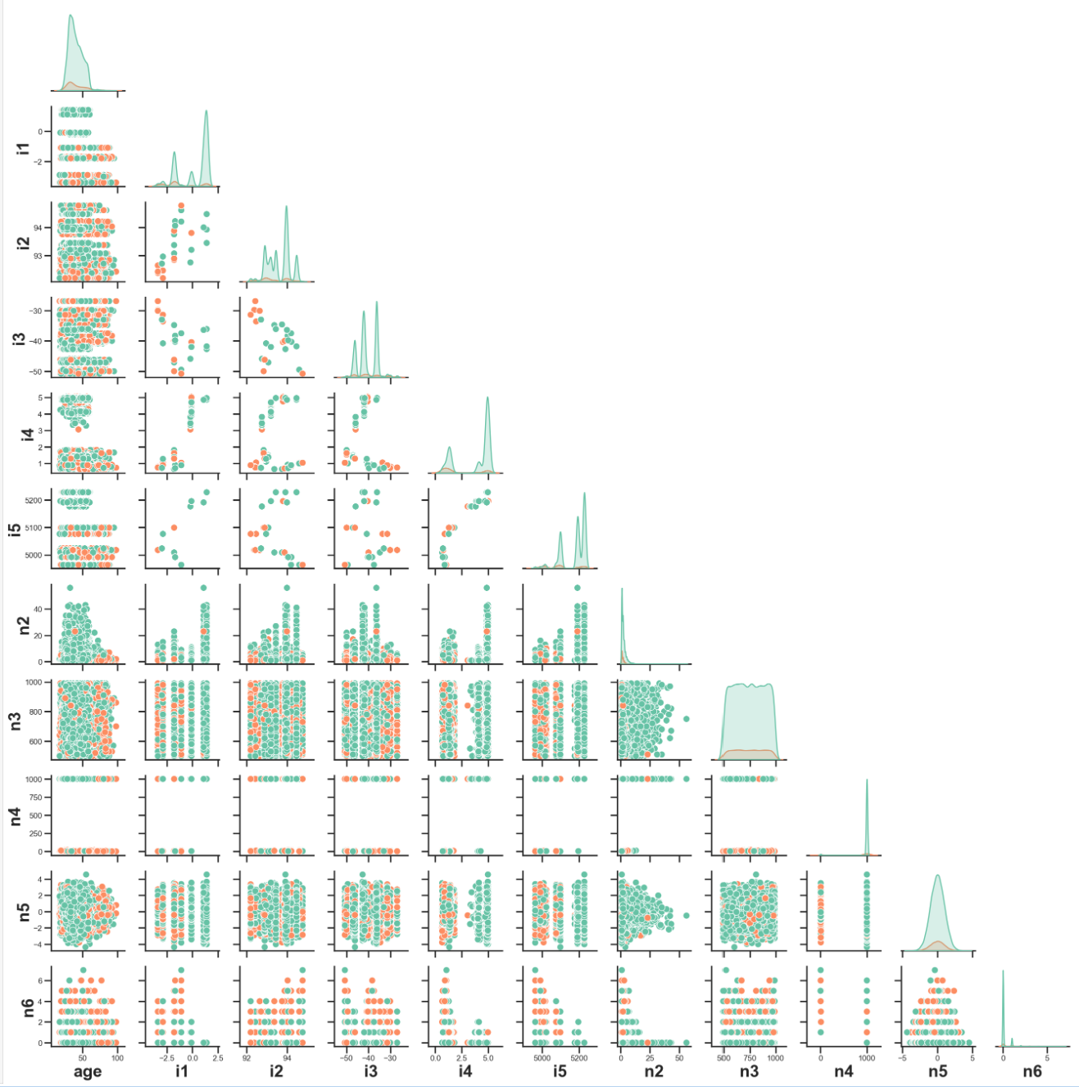

Plot contains pairwise scatter plots for each pair of continuous features.
Density Plots for the feature are presented along the diagonal.
Initial observations
Continuous features are not normally distributed except n5
Many multimodal distributions indicating groupings.
Imbalanced classes show more ‘no sale’ samples mixed with the ‘sale’ samples.
N4 has dichotomous distribution with ‘sale’ observations around value ‘0’.
I5 and I4 appears to have lower values indicating ‘sale’
Continuous Features Scatter and Density Plots group by “Successful sale”

Slide 13
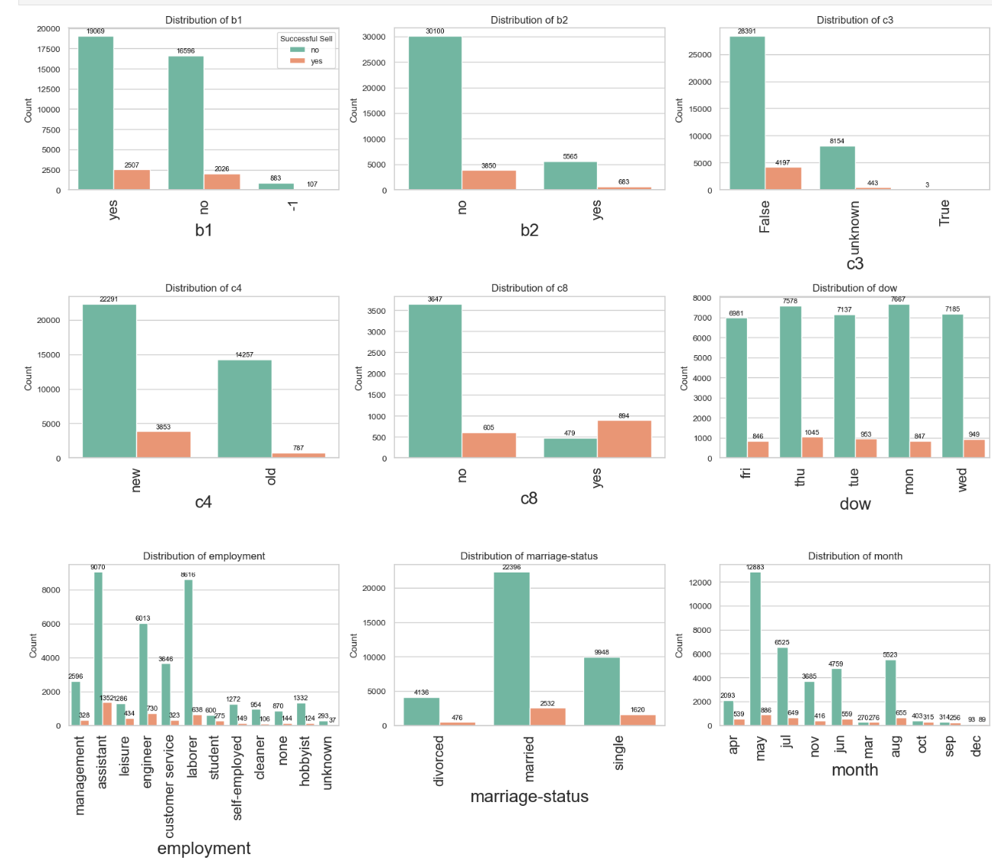
Plot depict each categorial variable and the variables count of purchases.
Initial observations
Setting c3 to ‘False’ captures the most sold samples but has a lot of ‘no sales’
c8 appears to be missing a lot of data due to the total amount of samples being less than the total data.
Mar Purchases were not as high as Apr and May purchases indication sales are coming around the “tax season”
Assistants (employment) has the most chances to purchase and made 25% of total purchases.
Categorical Feature Bar Plots group by “Successful sale”

