Slide 1

Technical Presentation Nathan Wells
Project

Slide 2

About me
Education:
MS: San Diego State (Statistics)
BS: Cal Poly Pomona (Mathematics/Statistics)
Experience:
Cymer/ASML
D.O.D. (NSWC: Crane)
Upper Deck
UCSD
Highlights:
4 First Authored Patents (AI/ML applications and methods) (8 total, link)
2024 Speaker at ASML Tech Conference (VHV)
Interests: Sports, Cooking, Coaching Youth Soccer
Family: Andrea (Wife), Olivia, Bernadette, Nolan

Slide 3
Data and Assumptions
Data collected over a two year period
No data dictionary was shared, columns name were used a descriptions to be the best of our ability
Data contains no identifying information or meta data ; it is reasonable to assume 1 row = 1 independent individual
Customers are equivalent, no customer is more valuable than another
Data contains no time dependent information
"Date" Features are considered categorical and independent
Data is considered complete and true
Response variable : 'successful_sale' (yes = sale:1, no= no sale:0)
Features: All other columns (Continuous and Categorical)
Categorical Features 'dummy' encoded for each unique value in the category (1: value, 0 otherwise) Ifor each unique value
Total Samples: 4640:sale, 36,548:no sale
Data is considered imbalances with an abundance of 'no sale' entries.
Note: feature c10 is identical to the response variable and will be excluded from the analysis.

Slide 4
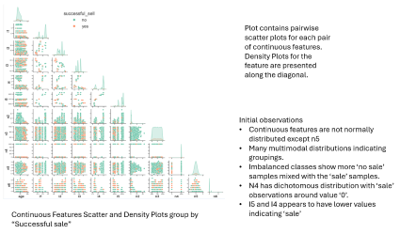
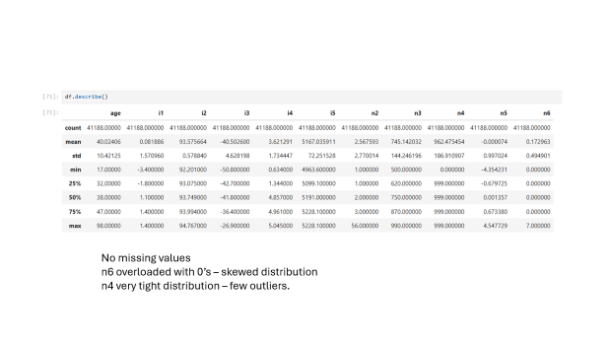
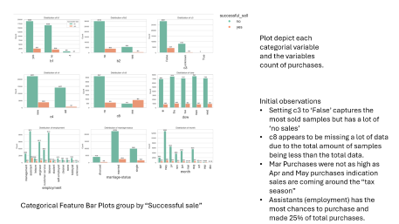
Exploratory Analysis and Baseline
Exploratory Data Analysis (EDA) is an initial approach to analyzing data sets to summarize their main characteristics, often using visual methods.
Baselining is the process to establish a simple model starting point.
Decision Stump Analysis (single value thresholding) conducted to determine baseline model.
Utilizing a costume model selection process, n4 was determine to be the best baseline model.
Model selection was based using quantiles of the following criteria:
Metric | Direction | Definition
True Positive Rate | Higher | Proportion of actual positive cases that the model correctly identified
True Negative Rate | Higher | Proportion of actual negative cases that the model correctly identified as Negative
Positive Predictive Value | Higher | Proportion of positive predictions made by the model that were actually correct
Global Accuracy | Higher | Overall percentage of correct predictions

Slide 5
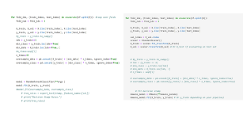
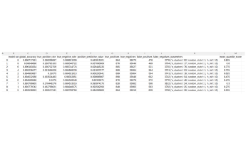
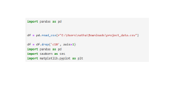
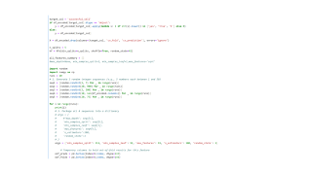
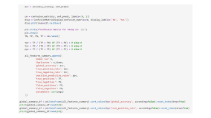
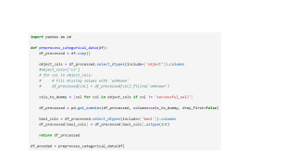
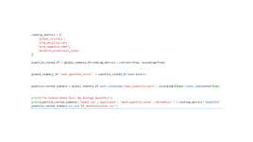
MLOps Training Pipeline
Acquire data
Validate
Wrangle Data
Prep CV
Loop over Each Fold
Prep CV
Loop over Each Fold
Feedback and Repeat
Model Selection
Store Metrics and Model Meta Data
Calculate Metrics
Data Preparation
Transformations

Slide 6
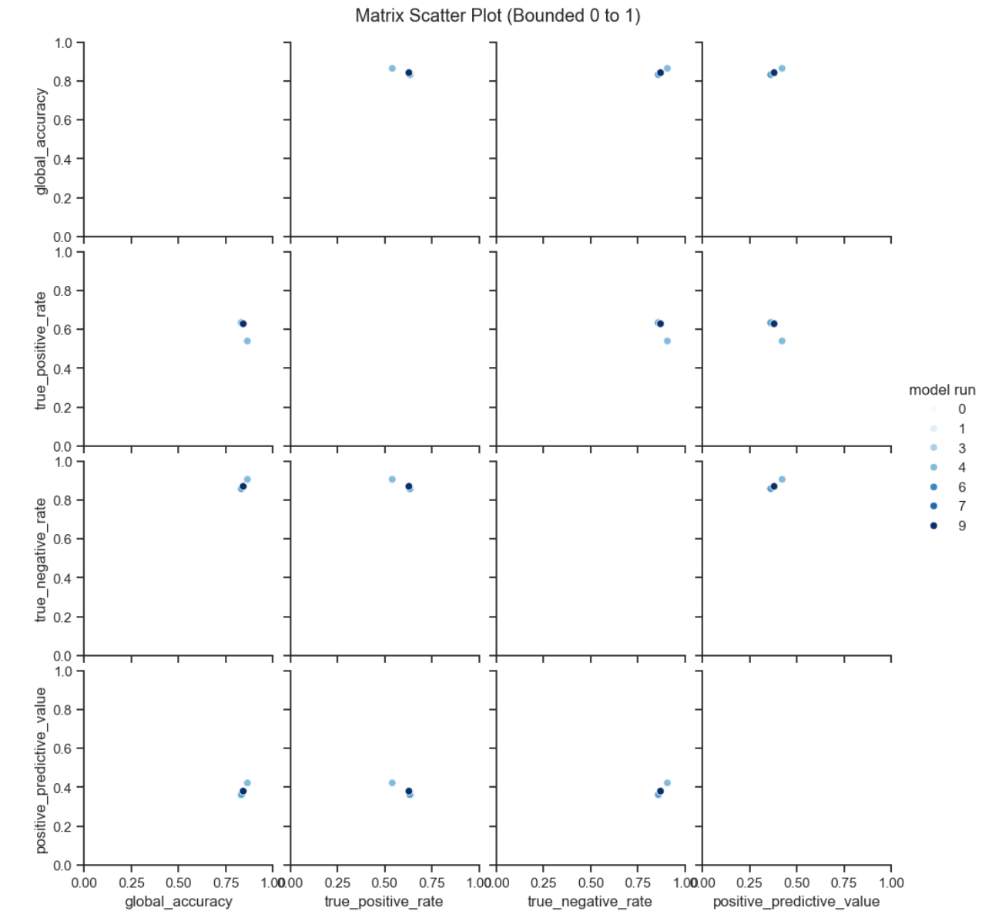
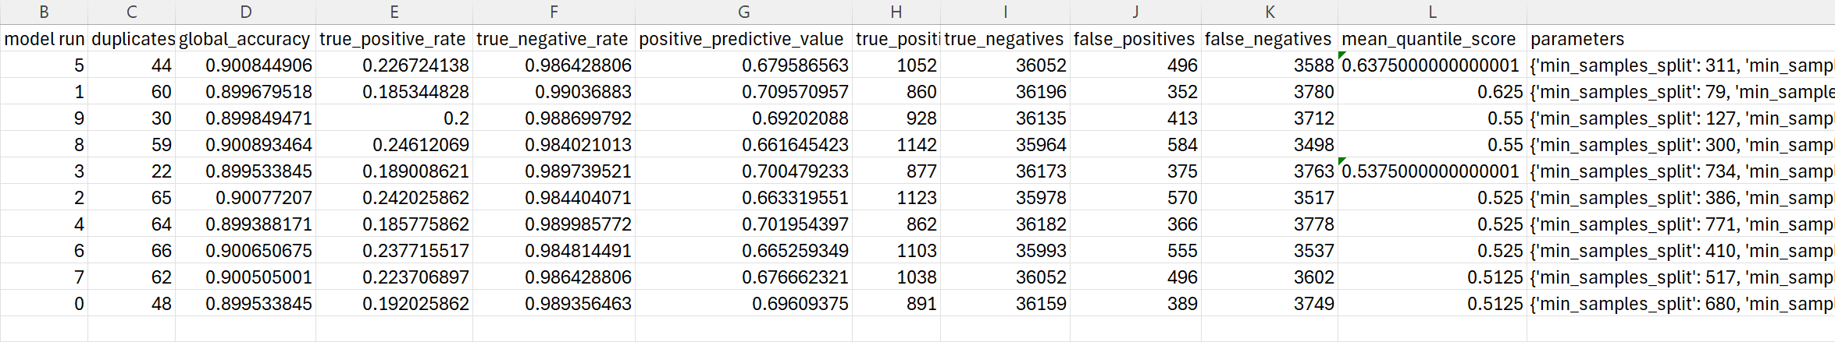
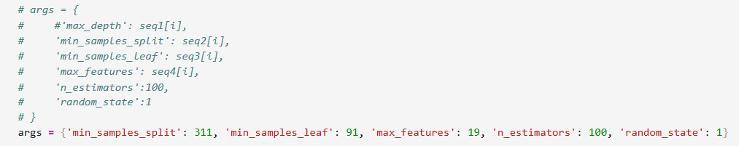
Proposed Pipeline
Pairwise Plot ALL model metrics
Random Grid Search
Archiving Results and Recipes (meta data)
Repeatability
Auto training and model selection
See Trade offs and determine Investigate parameters caused them
1:Select Best Model and Parameters
2.Extract Utilize in pipeline

Slide 7
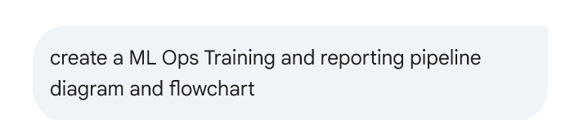
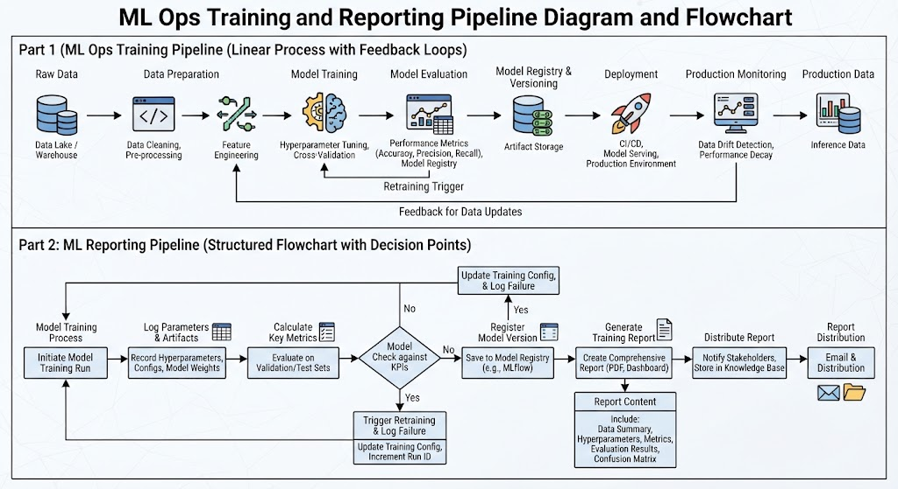
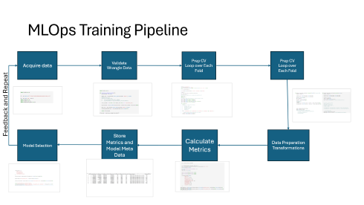

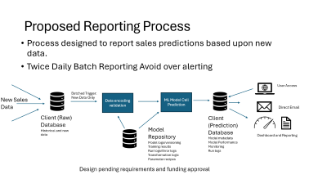
Reporting Pipeline and Monitoring Discussion
Simple Pipelines Set Up Automation on a per fold basis to avoid Data Leakage
Comments:
Monitoring requires a trigger to initial action: Data drift methods including statistical testing (p-values? Thresholds?)
AI Agentic reporting and inference opportunities occur at end of pipelines. Require model results but all data sources at the beginning of the pipeline.

Slide 8
Discussion/Data Enhancement/Services
Refinement of the data and model are required to improve model performance
Data Enhancement
Additional data context: Definitions of all columns
Time-based source: Capture changes over time
Engagement methods and history of each client
Any type of meta data on the purchase process could be included in problem formation and modeling
Model Improvements
Additional model test and feature engineering recommended for optimizing performance
Post hoc analysis on missed opportunities entries with sensitivity analysis
Implementation can include certainty score: model.predict_proba: set priorities based on resource allocation
Risk: Customer impact of soliciting “sale” material. If intervening, what is the impact?
Agentic Implementations
Improving model prediction per client entry with additional description of the entry could create customized engagement plans and set customer priorities.
Action Triggered off prediction model results
Implementation can have different owners and costs. Need to be considered with Client.

Slide 9
Questions?

Slide 10
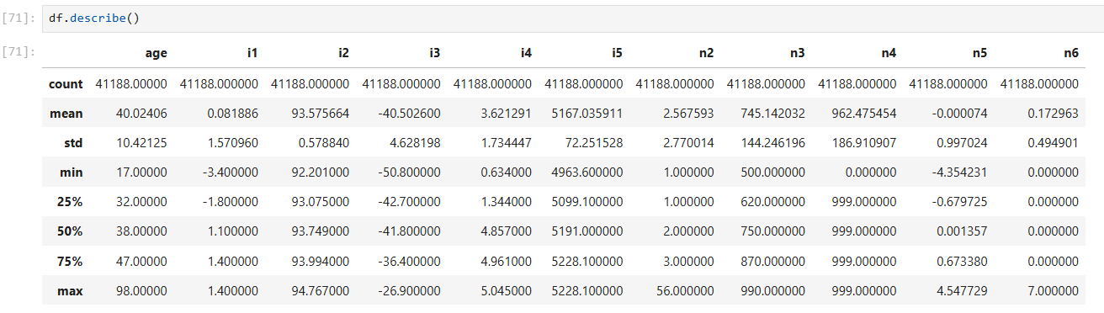
No missing values
n6 overloaded with 0’s – skewed distribution
n4 very tight distribution – few outliers.

Slide 11
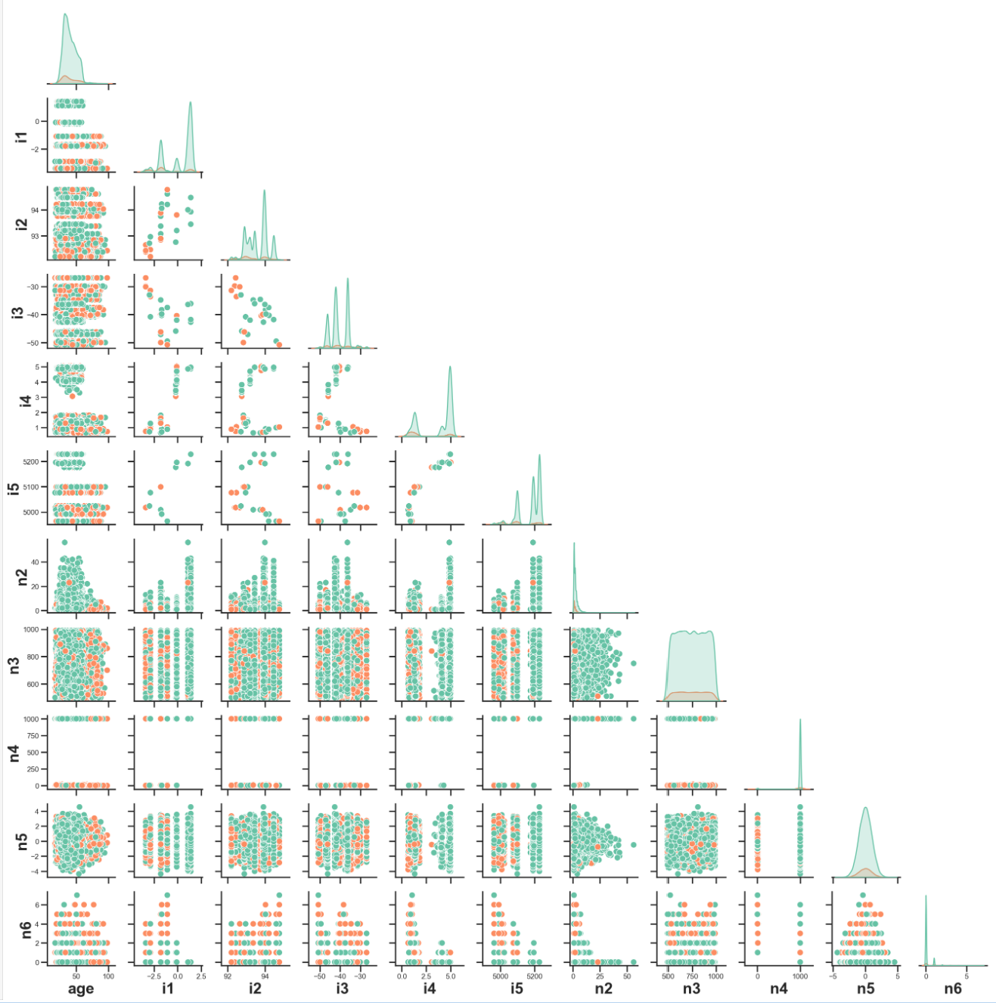

Plot contains pairwise scatter plots for each pair of continuous features.
Density Plots for the feature are presented along the diagonal.
Initial observations
Continuous features are not normally distributed except n5
Many multimodal distributions indicating groupings.
Imbalanced classes show more ‘no sale’ samples mixed with the ‘sale’ samples.
N4 has dichotomous distribution with ‘sale’ observations around value ‘0’.
I5 and I4 appears to have lower values indicating ‘sale’
Continuous Features Scatter and Density Plots group by “Successful sale”

Slide 12
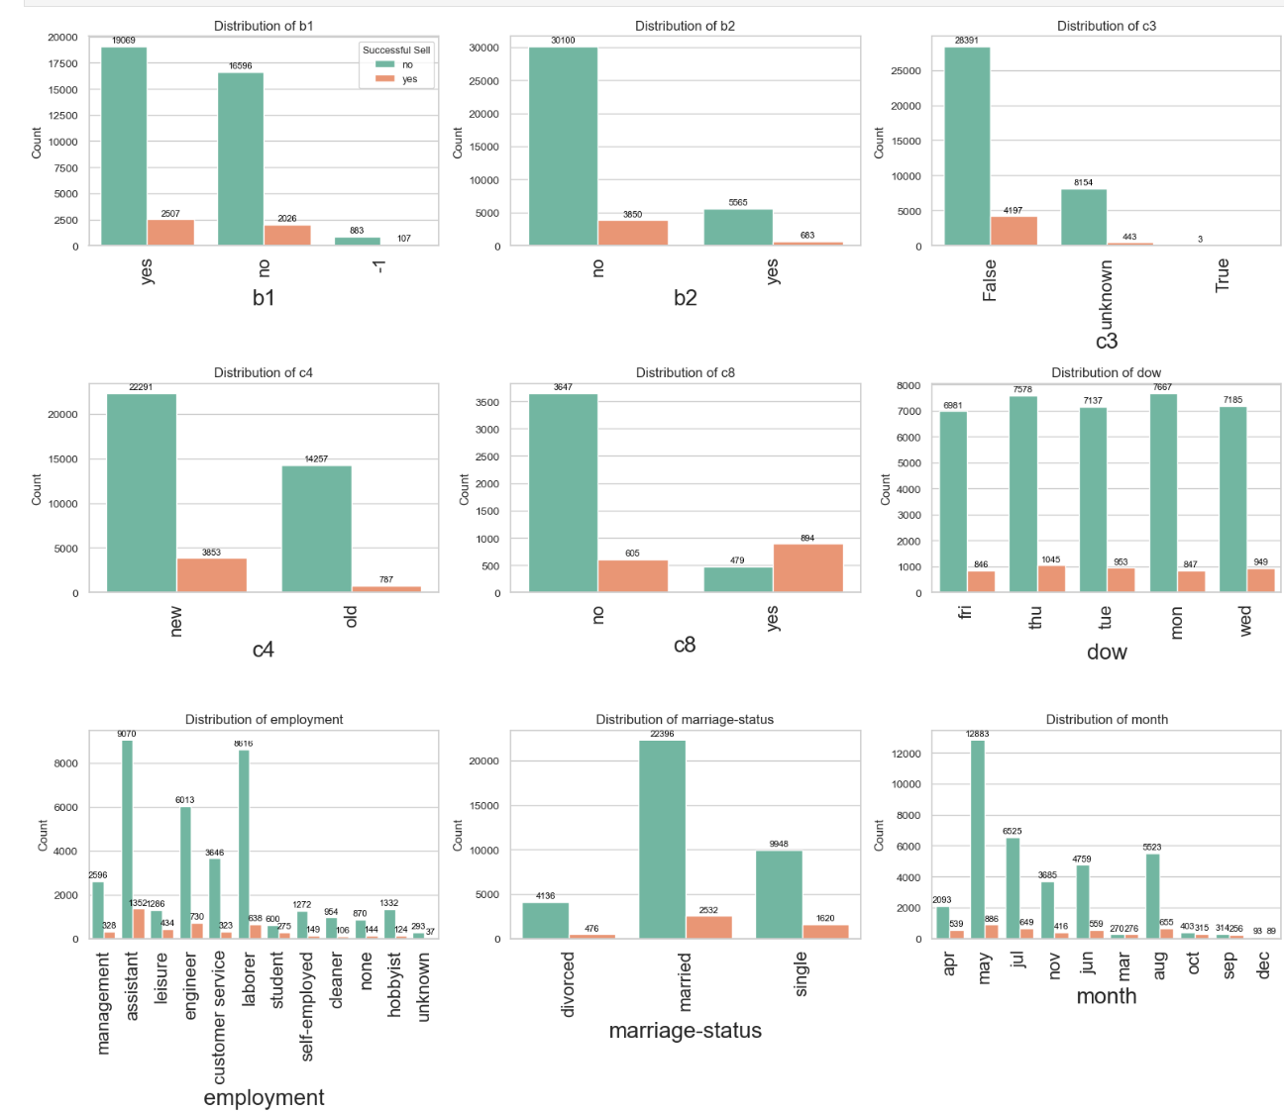
Plot depict each categorial variable and the variables count of purchases.
Initial observations
Setting c3 to ‘False’ captures the most sold samples but has a lot of ‘no sales’
c8 appears to be missing a lot of data due to the total amount of samples being less than the total data.
Mar Purchases were not as high as Apr and May purchases indication sales are coming around the “tax season”
Assistants (employment) has the most chances to purchase and made 25% of total purchases.
Categorical Feature Bar Plots group by “Successful sale”

Slide 13
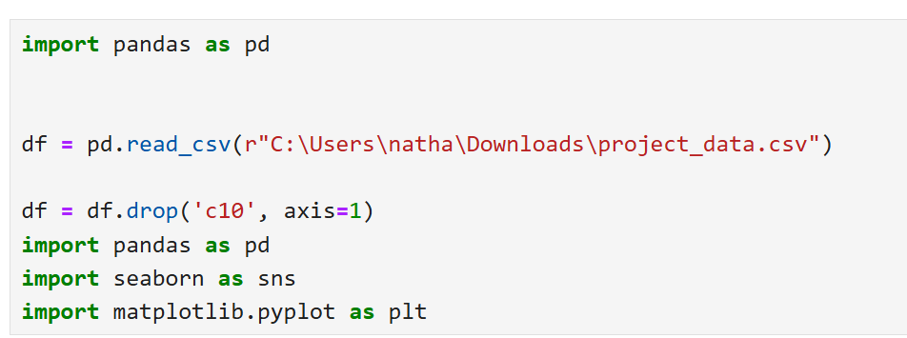

Slide 14
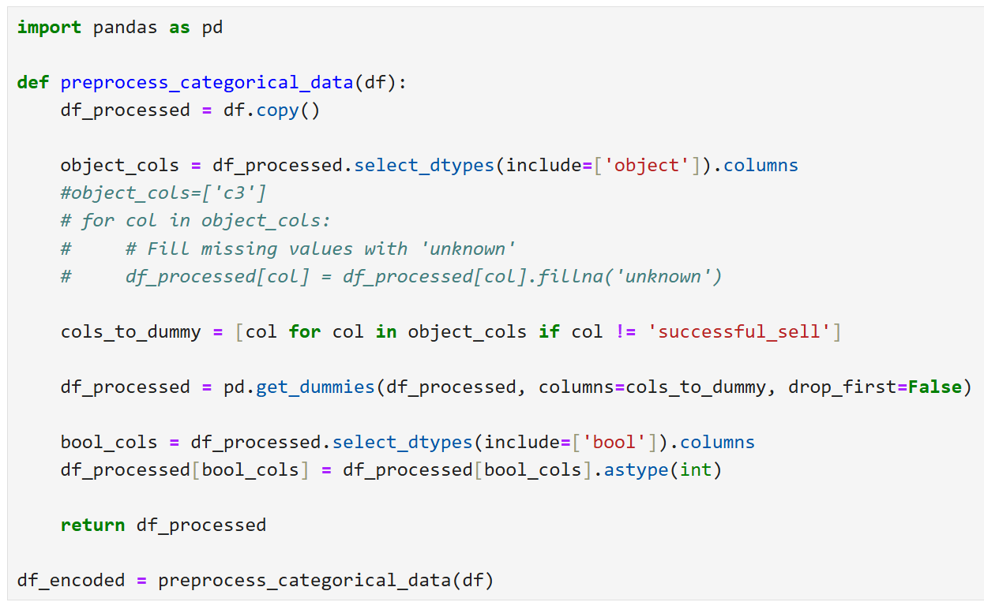

Slide 15
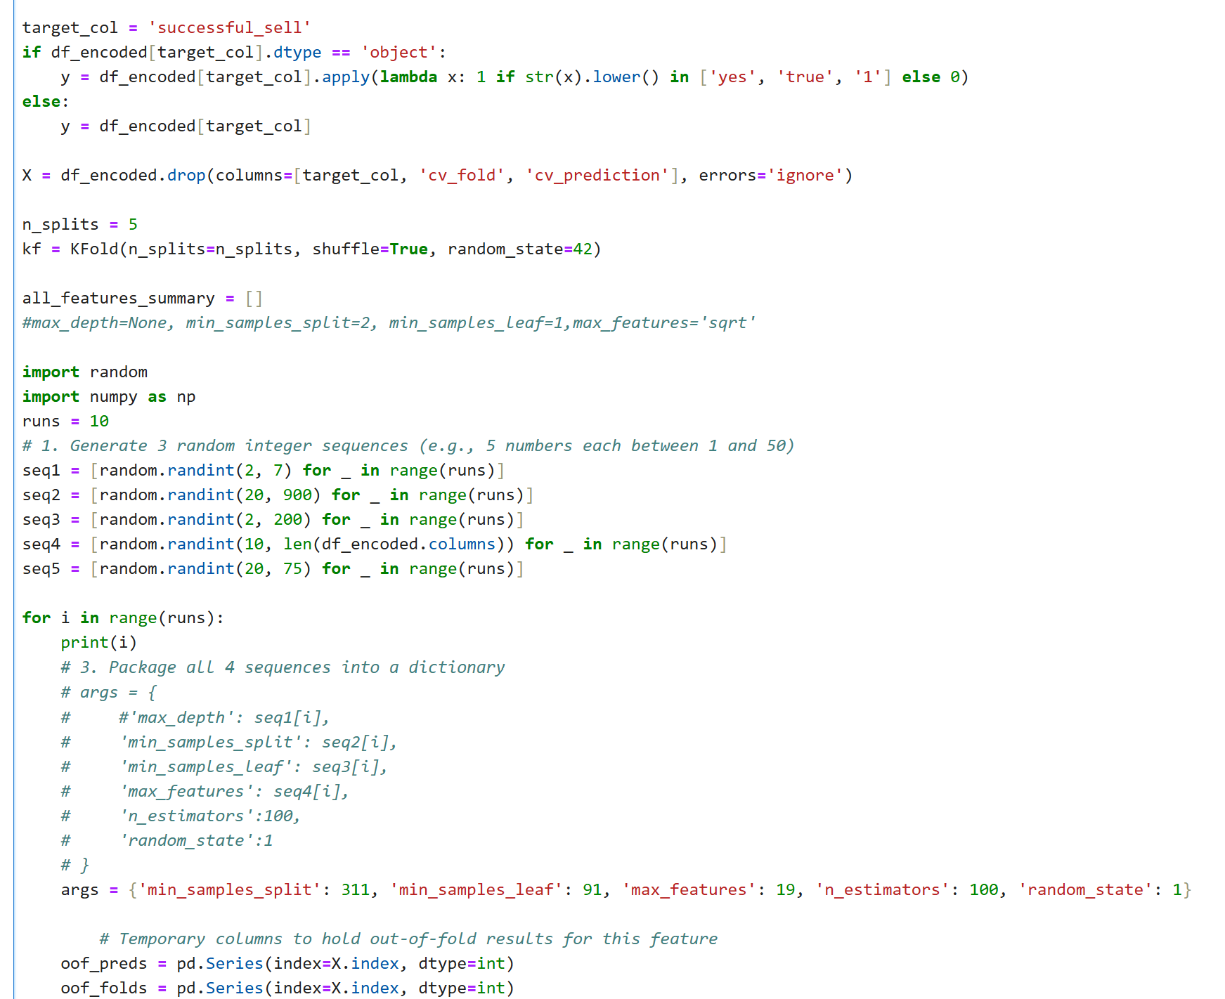

Slide 16
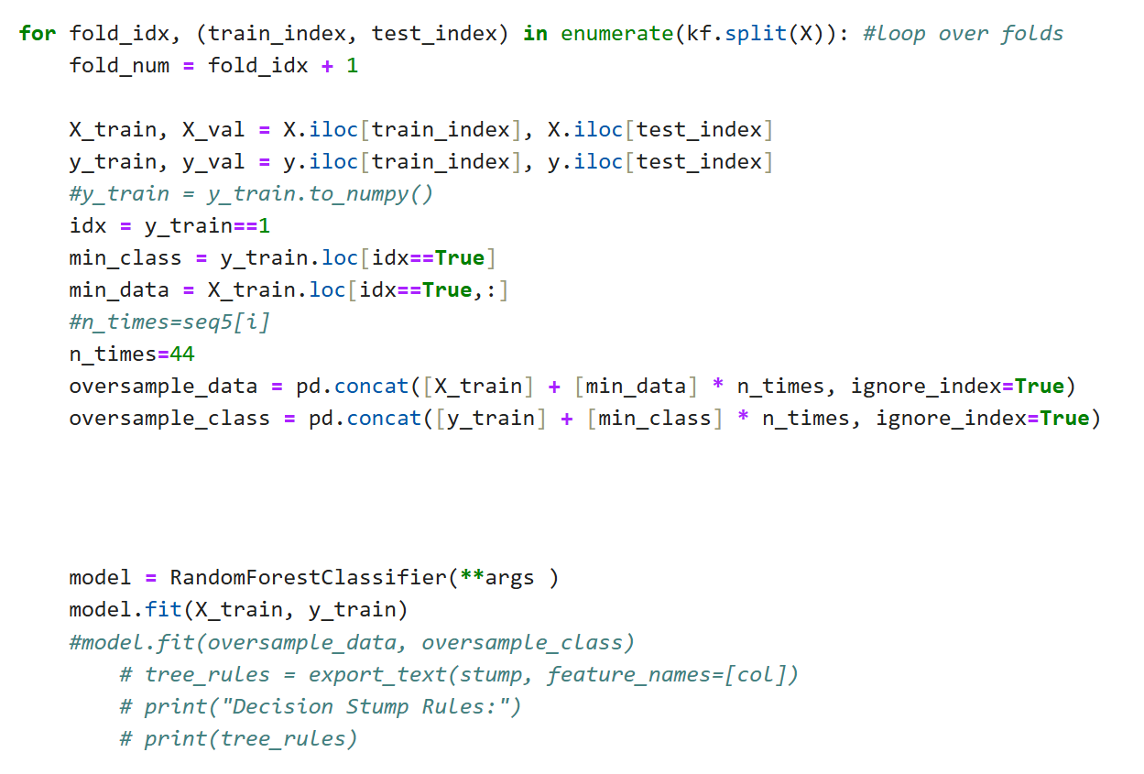
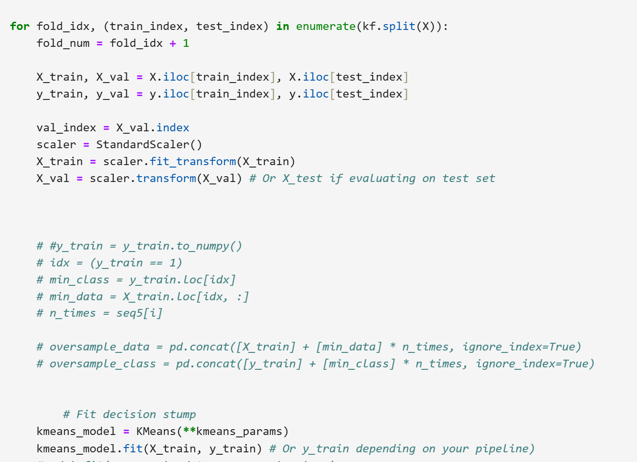

Slide 17
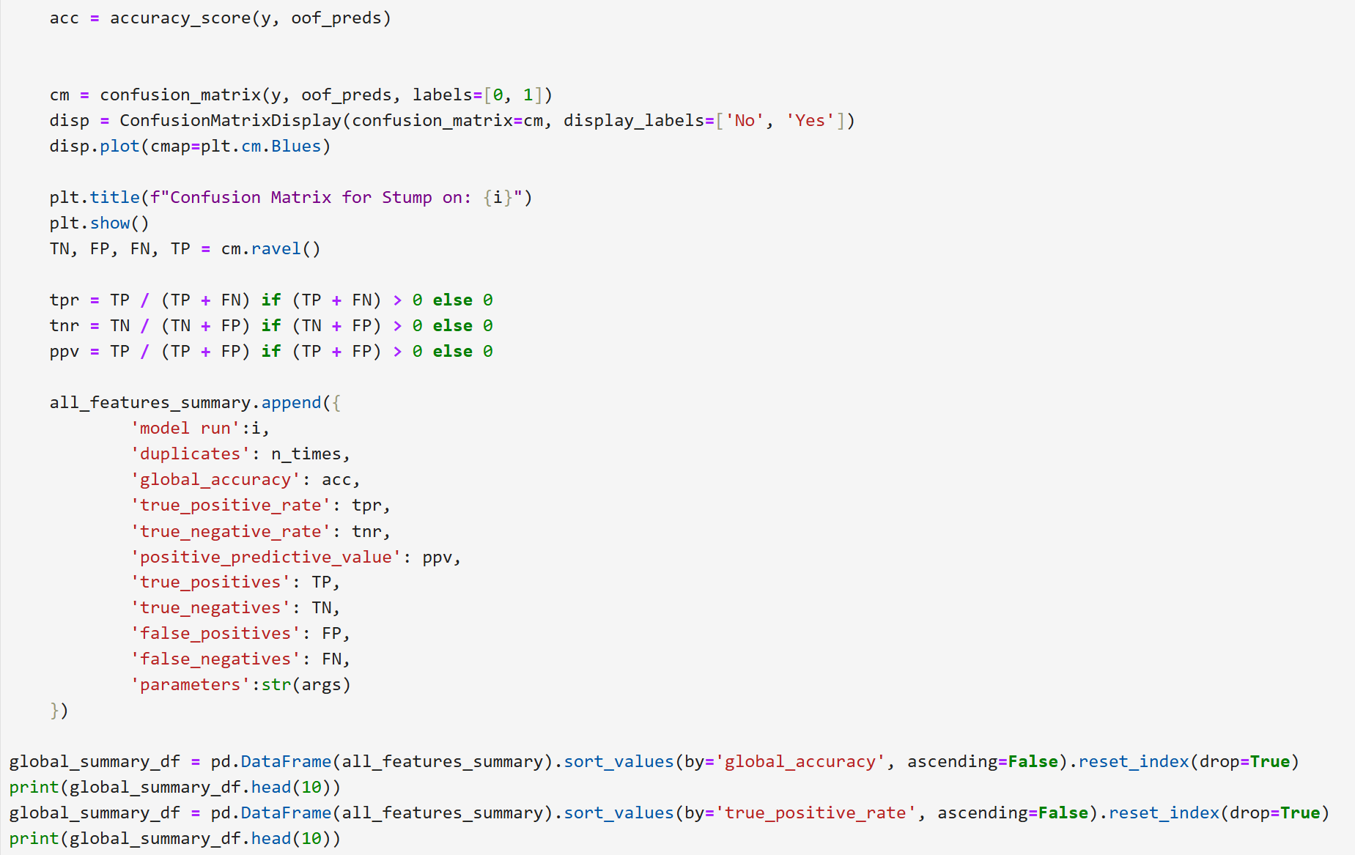

Slide 18
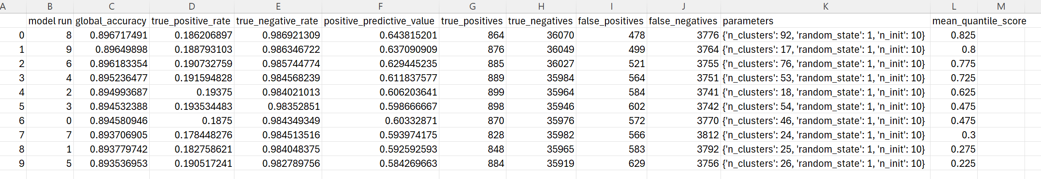

Slide 19
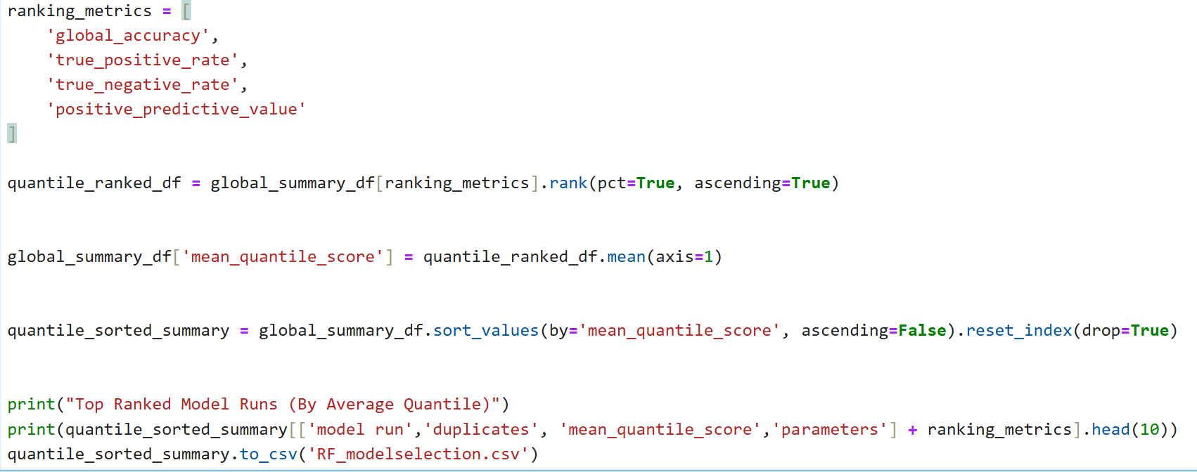

Slide 20
Proposed Reporting Process
Process designed to report sales predictions based upon new data.
Twice Daily Batch Reporting Avoid over alerting
User Access
Batched Trigger: New Data Only
Data encoding validation
ML Model Call
Prediction
New Sales Data
Direct Email
Client (Raw) Database
Historical and new data
Client (Prediction) Database
Model metadata
Model Performance Monitoring
Run logs
Model Repository
Model logs/versioning
Training results
Run logs/Error logs
Transformation logic
Parameter recipes
Dashboard and Reporting
Design pending requirements and funding approval

