Slide 1


Python : Decision Making and Looping Compiled By Madalane Oscar

Slide 2
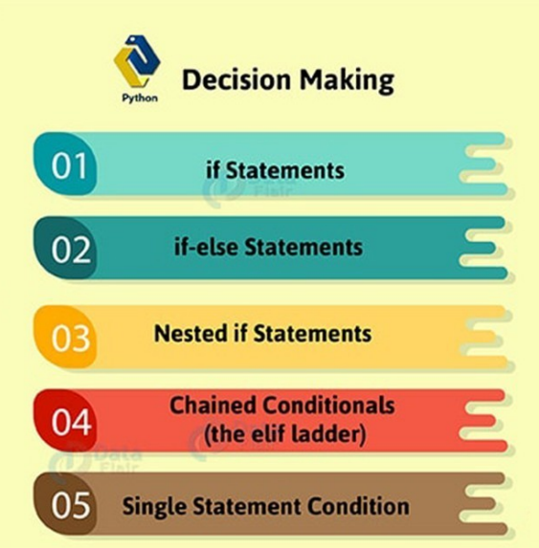
Decision Making Statement

Slide 3
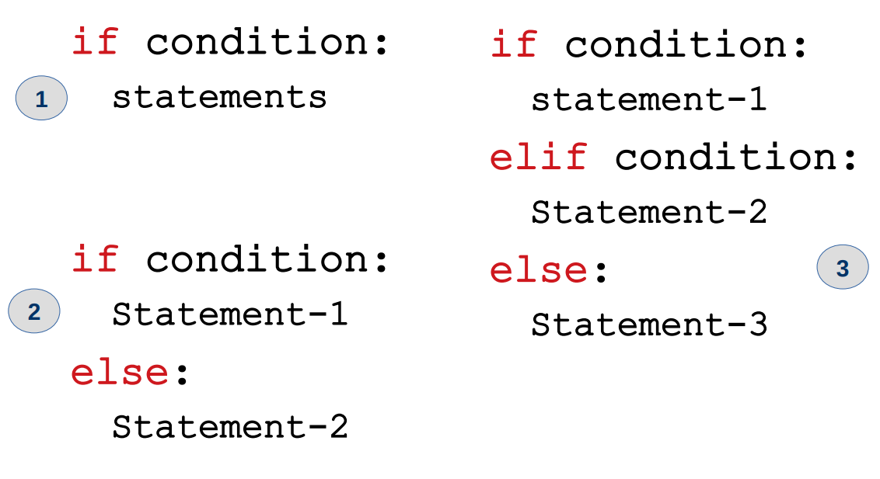
if-elif-else

Slide 4
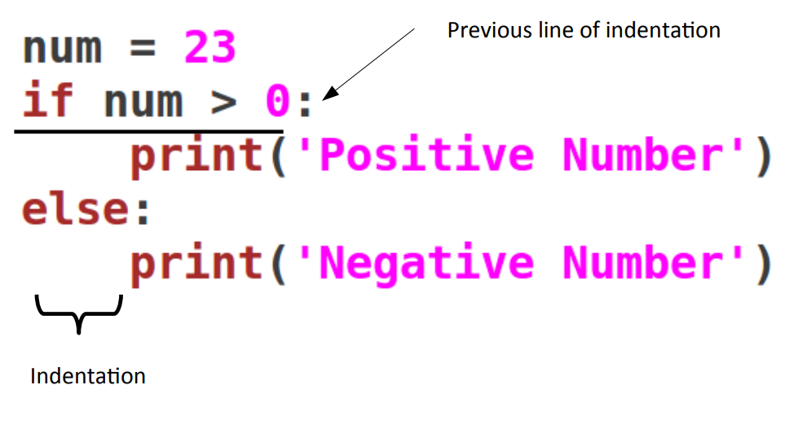
if-else

Slide 5
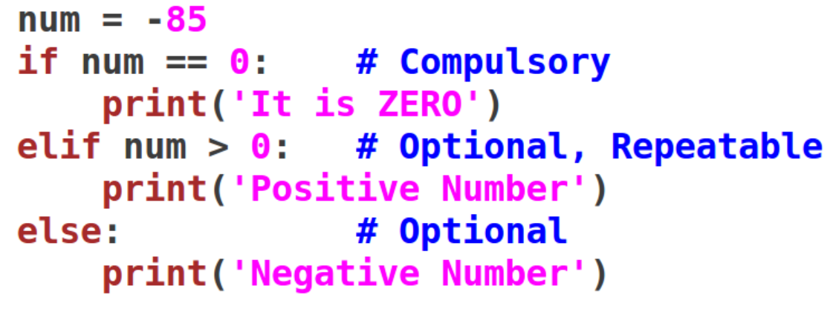
if-elif-else

Slide 6
Condition in if-else
The condition in if-statement is parenthesis free.
The condition can have ‘and’ and ‘or’ operator.
It should end with a colon.
It must return either True or False.
The zero value is considered as False otherwise True.
– Example:
if True:

Slide 7
Exercise
Write a program to read a number from user and find whether number is odd or even.

Slide 8
Nesting of if-else
Example: Read three numbers from keyboard and find largest of them. You are not allowed to use ‘and’ and ‘or’ operators.

Slide 9
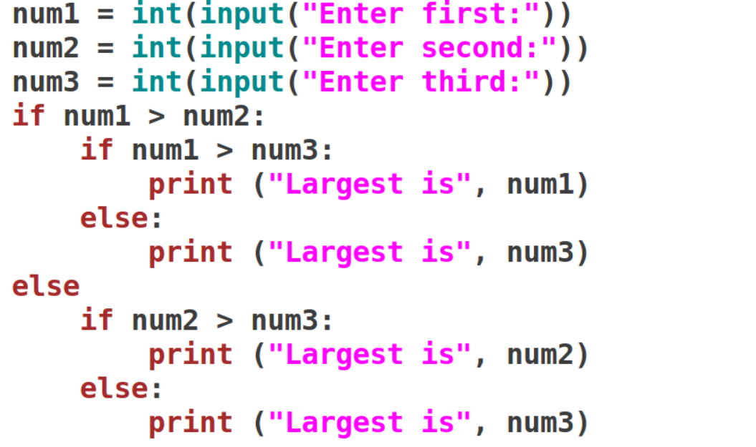
Example:

Slide 10
Example:
Read an year and find whether that year is leap or not?
Conditions for being leap year:
– It should be divisible by four.
– If its a century year, it should be divisible by 400 also.

Slide 11
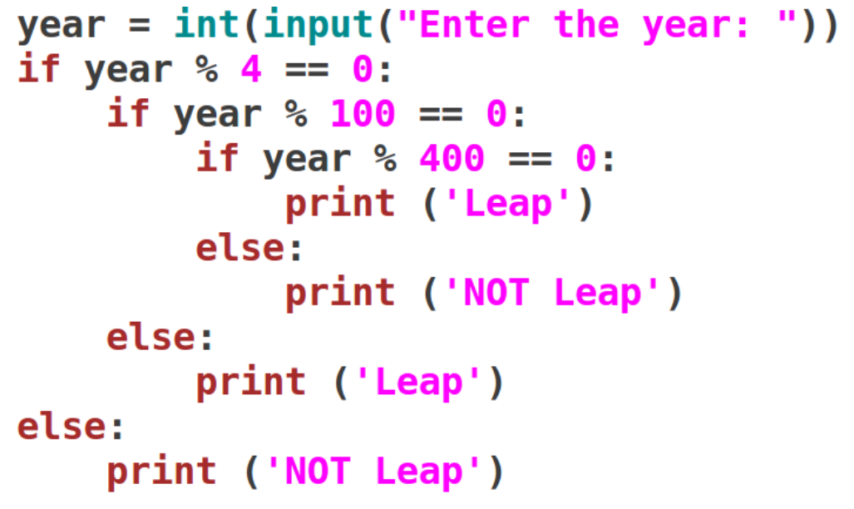
Solution:

Slide 12
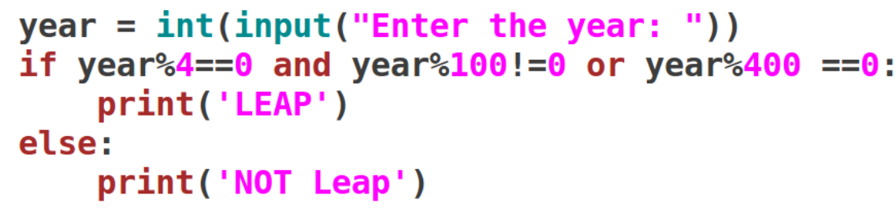
Using ‘and’ and ‘or’

Slide 13
Repeatable elif
Read marks in percentages from student and find the grade of it as per below condition:
– Above 75% : ‘Distinction’
– 60% to below 75%: ‘First Class’
– 50% to below 60%: ‘Second Class’
– 40% to below 50%: ‘Pass Class’
– Below 40%: ‘Failed’

Slide 14
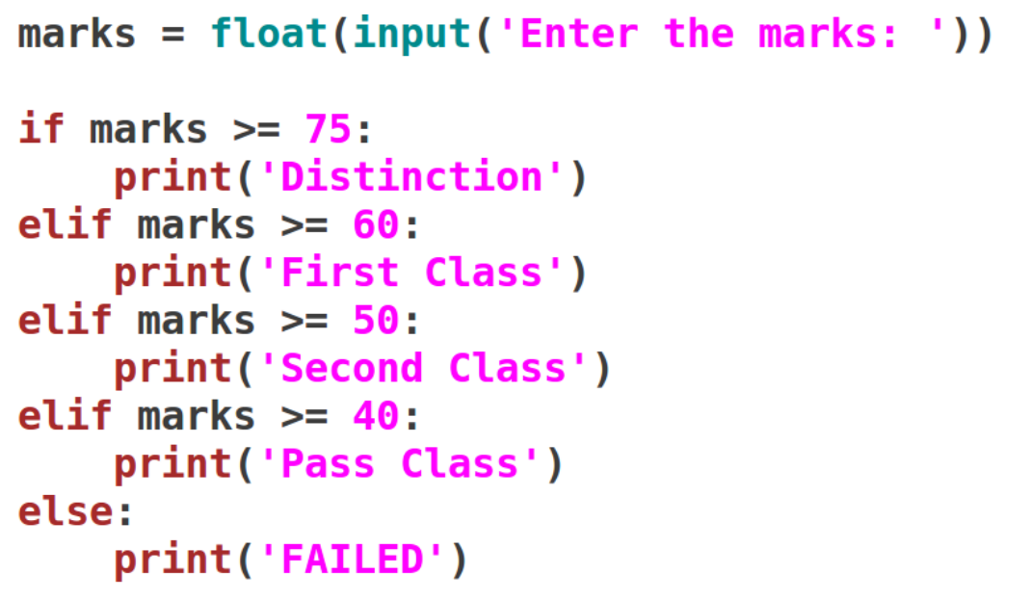
Solution

Slide 15
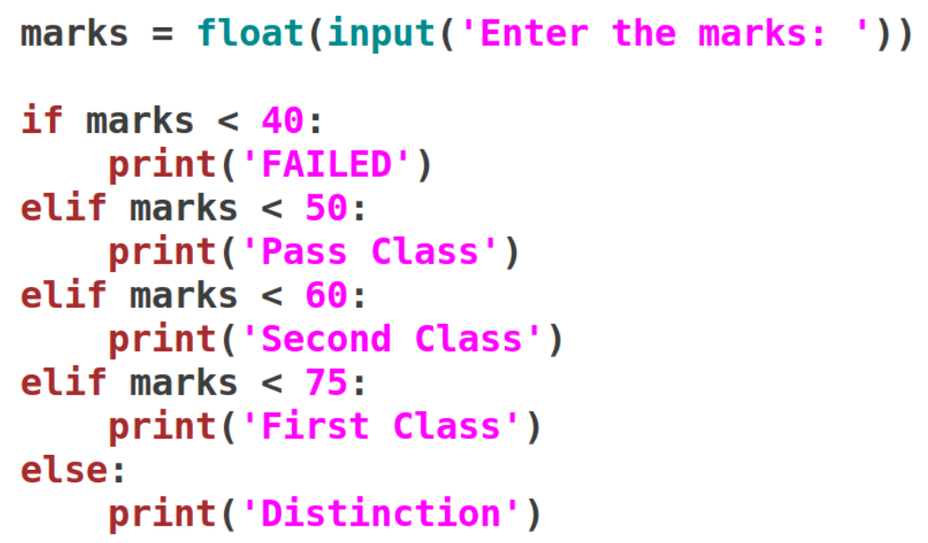
Another way

Slide 16
Creating menu based programs
Python does not have switch-case statement. So menu based programs are created simply using if-elif-else.
Example:
– Read a number from user and do the following by showing menu:
Find its square
Find cube
Check odd / even
Check positive / negative

Slide 17
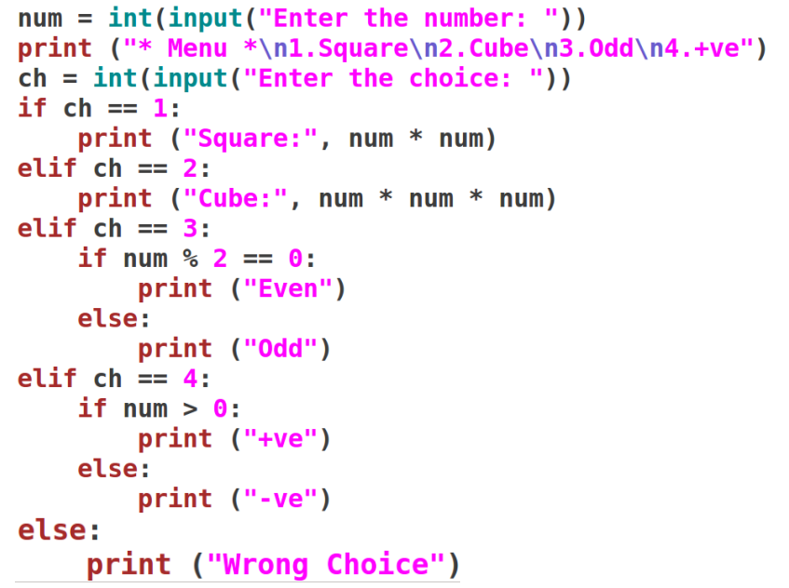
Solution:

Slide 18
Exercises
Write a Python program to calculate profit or loss. Input is selling cost and actual cost.
Write a Python program to check whether a character is uppercase or lowercase alphabet.
Write a Python program to input electricity unit charges and calculate total electricity bill according to the given condition:
– For first 50 units Rs. 0.50/unit
– For next 100 units Rs. 0.75/unit
– For next 100 units Rs. 1.25/unit
– For unit above 250 Rs. 1.50/unit
– An additional surcharge of 17% is added to the bill

Slide 19
Exercises
Input -> basic salary
Output -> gross salary
DA = 75% of basic
HRA = 20% of basic
Conditions:
< 10000 : gross = da + basic
>= 10000 and < 20000 : gross = da + basic + 50% of hra
>= 20000 : gross = basic + da + hra
Sample: Input and Output
5000 : 3750 + 5000 = 8750
12000 : 9000 + 12000 + 1200 = 22200
24000 : 18000 + 24000 + 4800 = 46800

Slide 20
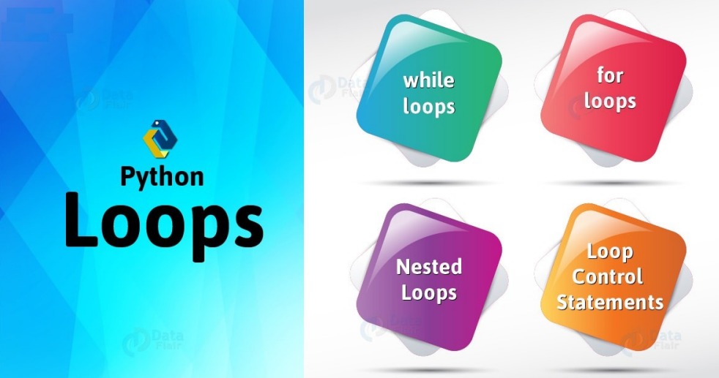
Loops

Slide 21
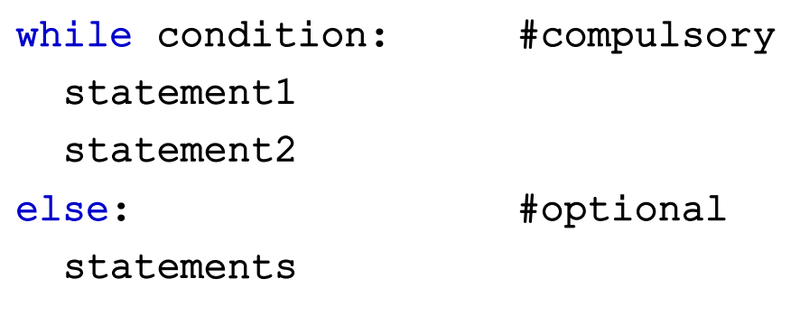
The while loop

Slide 22
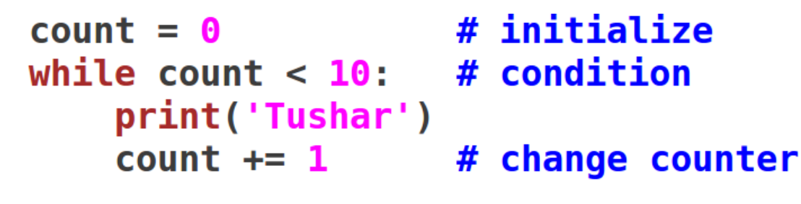
Example-1
Print your name for 10 number of times.

Slide 23
Exercise
Find addition of first ten natural numbers. That is, find addition of numbers from 1 to 10.

Slide 24
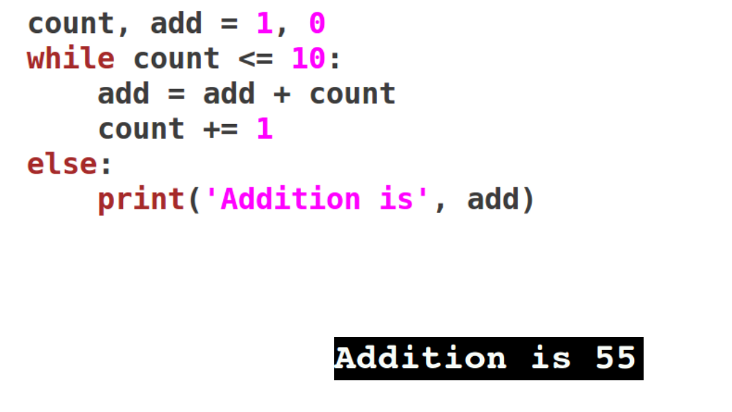
Solution

Slide 25
Exercise
Find addition of all the odd numbers from 1 to 20. That is, find addition of numbers 1, 3, 5 … 19.

Slide 26
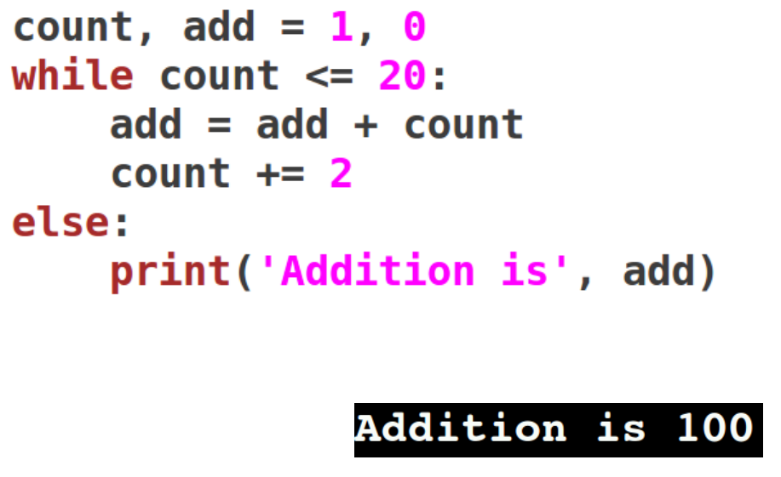
Solution

Slide 27
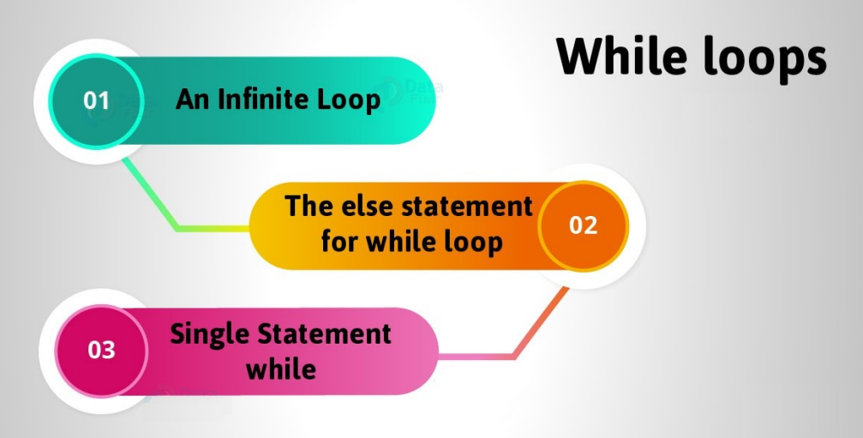
More about ‘while’

Slide 28
Infinite loop
Be careful while using a while loop. Because if you forget to increment the counter variable in python, or write flawed logic, the condition may never become false.
In such a case, the loop will run infinitely, and the conditions after the loop will starve.
To stop execution, press Ctrl+C. However, an infinite loop may actually be useful.
While is the only loop where we can make while loop intentionally infinite.

Slide 29
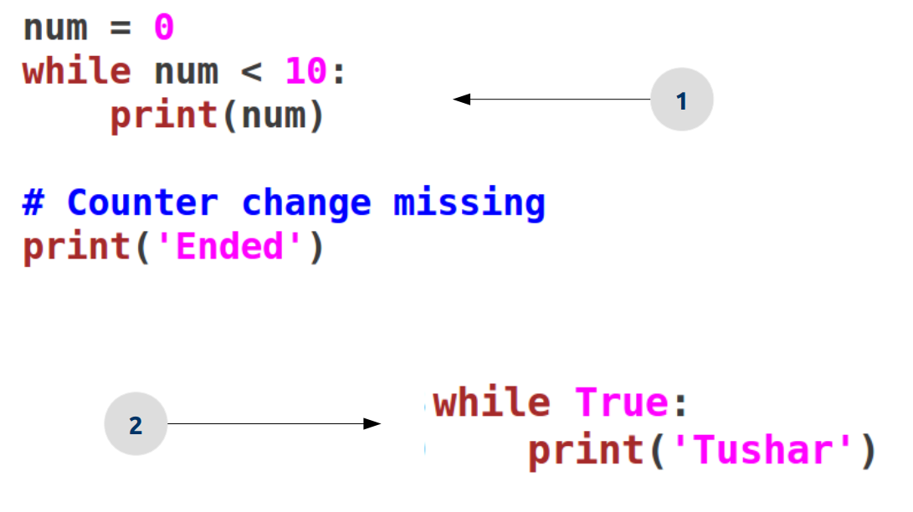
Examples:

Slide 30
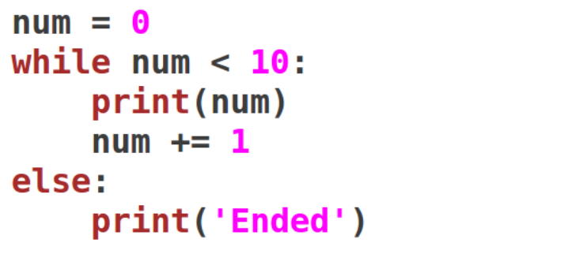
The else statement
A while loop may have an else statement after it. When the condition becomes false, the block under the else statement is executed.
However, it doesn’t execute if you break out of the loop or if an exception is raised.

Slide 31
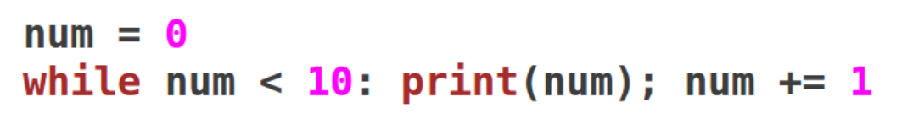
Single statement while
We can write single statement in while loop. This statements will be separated by semicolon.

Slide 32
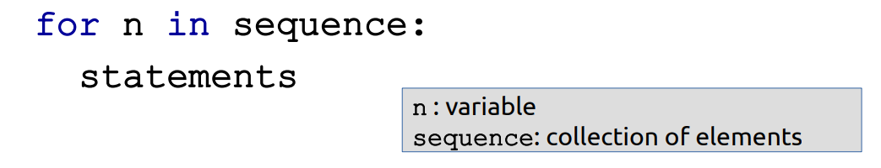
The ‘for’ loop
Python for loop can iterate over a sequence or collection of items.
The structure of a for loop in Python is different than that in C++ or Java.
That is, for(int i=0;i<n;i++) won’t work here. In Python, we use the ‘in’ keyword.
Syntax:

Slide 33
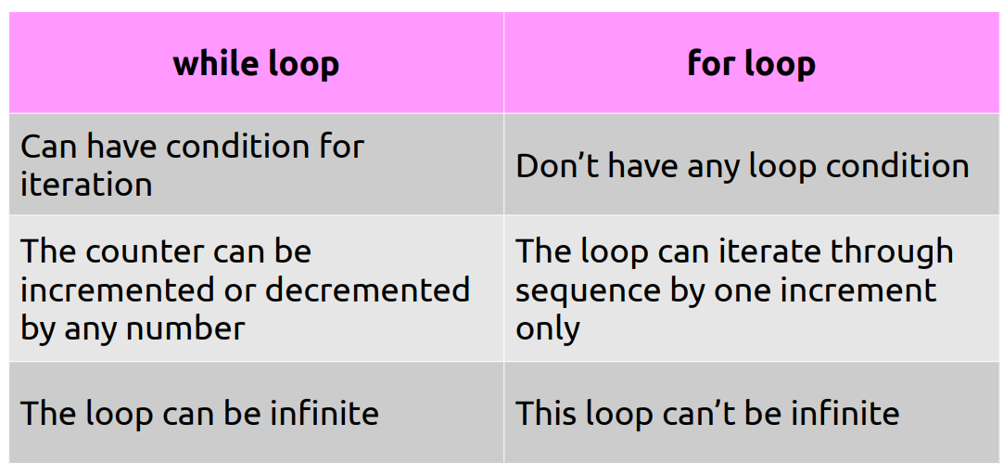
while vs for loop

Slide 34
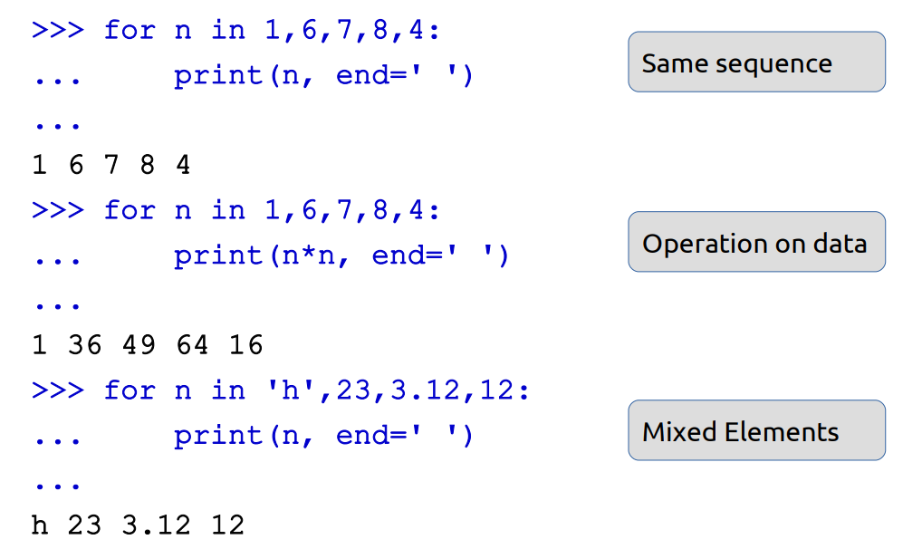
Examples:

Slide 35
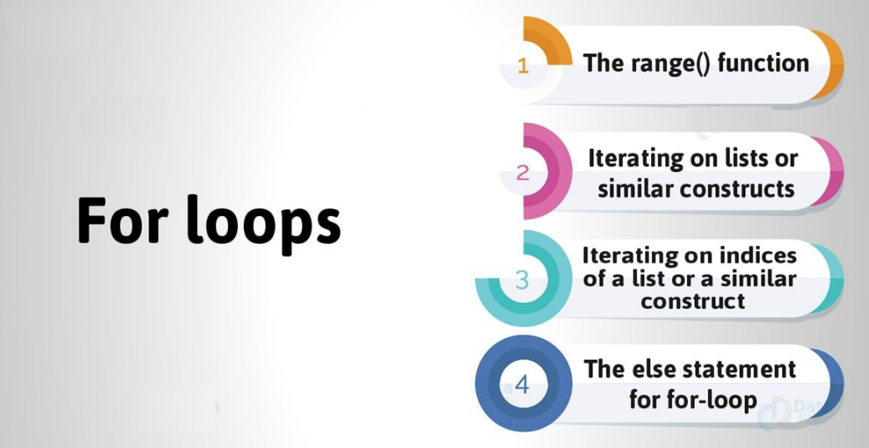
More on ‘for’ loop

Slide 36
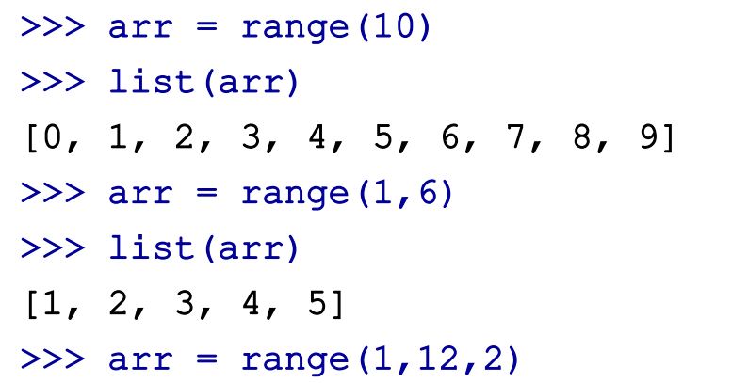
The range( ) function
This function yields a sequence of numbers. When called with one argument, say n, it creates a sequence of numbers from 0 to n-1.
Example:

Slide 37
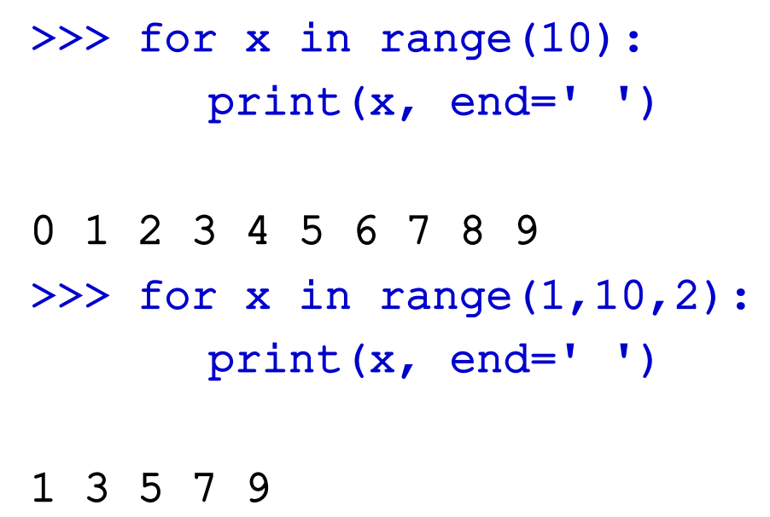
Using range( ) function

Slide 38
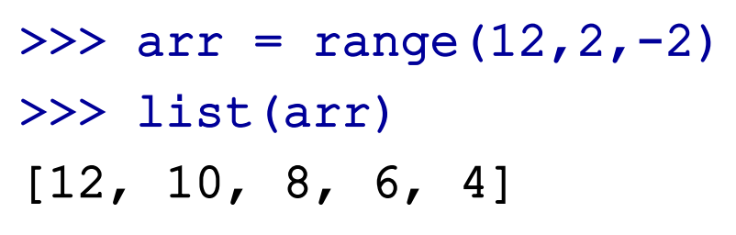
The range( ) decrement operation

Slide 39
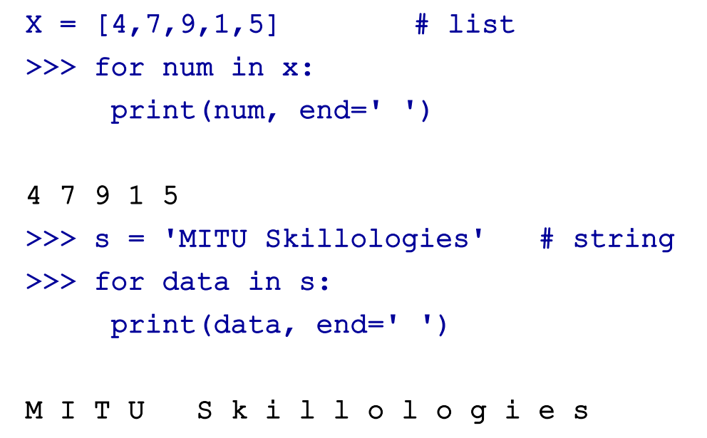
Iterating through sequence

Slide 40
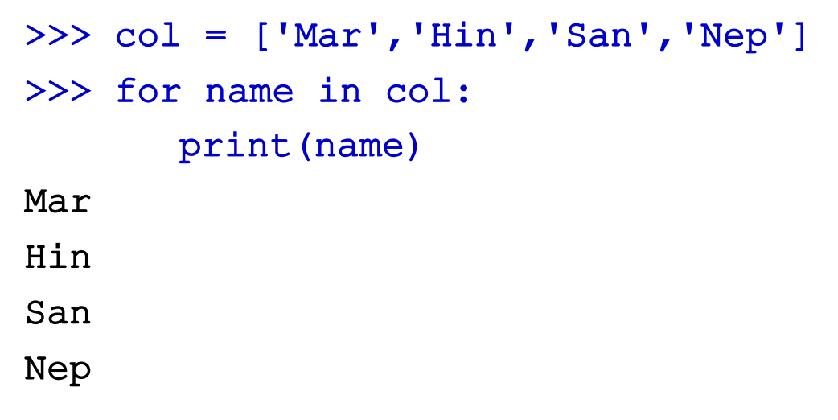
Collection of strings

Slide 41
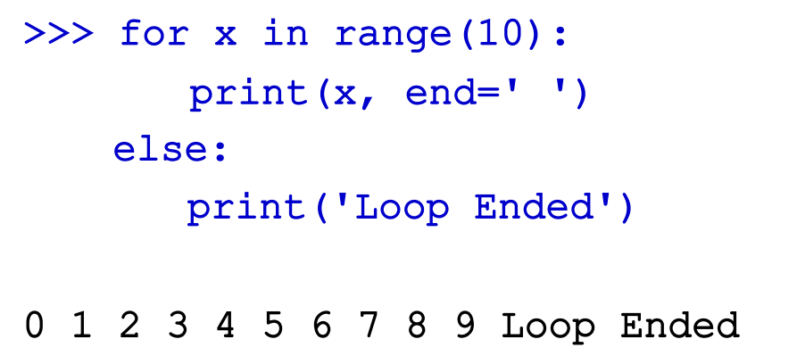
The else statement
Like a while loop, a for-loop may also have an else statement after it. When the loop is exhausted, the block under the else statement executes.

Slide 42
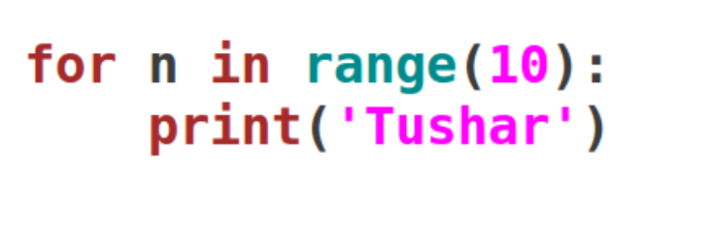
Example:
Print your name 10 times using for loop.

Slide 43
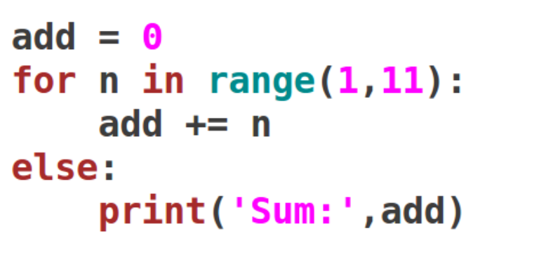
Example:
Find addition of first 10 natural numbers using for loop.

Slide 44
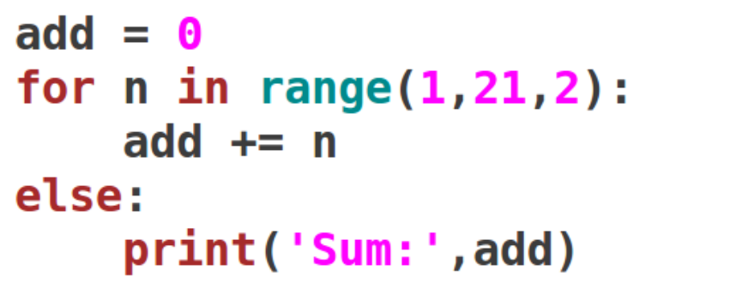
Example:
Find addition of all odd numbers from 1 to 20 using for loop.

Slide 45
Exercises
Read a number from user and find the factorial of the number.
Take a number user input and find sum of digits of this number.
Write a program to print all the odd numbers from 10 to 30.
Read a number from keyboard and print it in reverse.
Write a program to print Fibonacci series up to n terms.

Slide 46
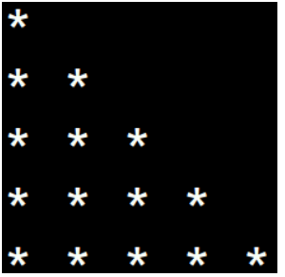
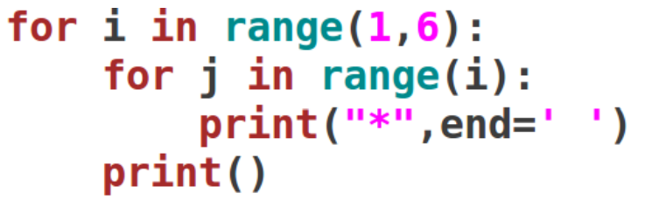
Nesting of loops
You can also nest a loop inside another.
You can put a for loop inside a while, or a while inside a for, or a for inside a for, or a while inside a while.
Or you can put a loop inside a loop inside a loop. You can go as far as you want.

Slide 47
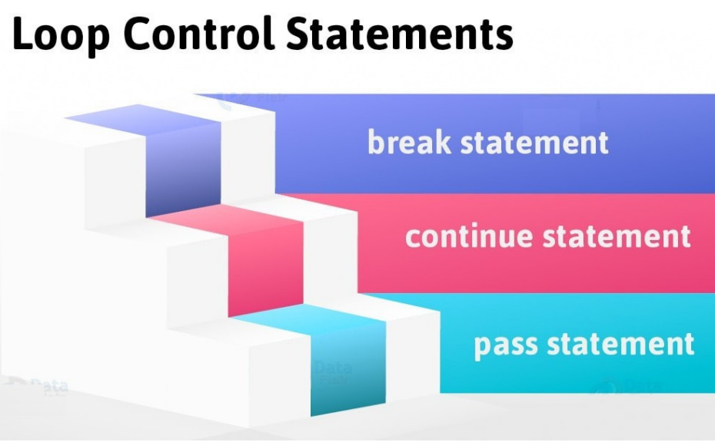
Nesting of loops

Slide 48
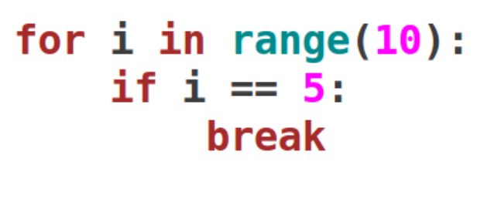
The ‘break’ statement
When you put a break statement in the body of a loop, the loop stops executing, and control shifts to the first statement outside it. You can put it in a for or while loop.

Slide 49
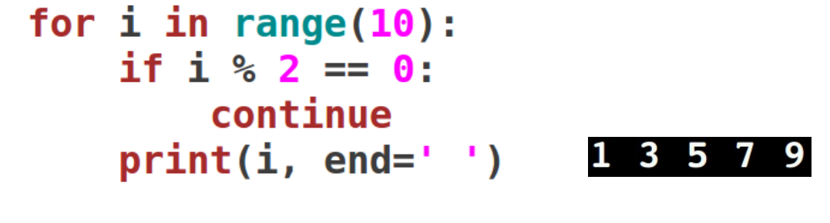
The ‘continue’ statement
When the program control reaches the continue statement, it skips the statements after ‘continue’.
It then shifts to the next item in the sequence and executes the block of code for it. You can use it with both for and while loops.

Slide 50
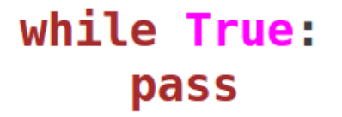
The ‘pass’ statement
We use the pass statement to implement stubs.
When we need a particular loop, class, or function in our program, but don’t know what goes in it, we place the pass statement in it.
It is a null statement.
The interpreter does not ignore it, but it performs a no-operation (NOP).
It is used to fill indented space

Slide 51
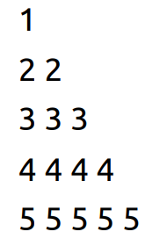
Exercises
Write a program to check whether entered number if prime or not.
Write a program to print all the prime numbers from 5 to 50.
Print following pattern:
Find power of x raised to y from user input.

Slide 52
Thank you

