Slide 1

Race and Standardized Tests
DSI-24 Project 1
By Ethan Leow

Slide 2
Hypothetical Background and Problem Statement
We are a student advocacy group looking for donors to give us grant money to investigate if standardized tests are discriminatory. Our long-term goal is to find out if Blacks and other minorities from comparable socioeconomic backgrounds score lower than their White peers.
Using some publicly-available data and EDA, we hope to show hints of negative relationships between ACT/SAT results and minority races, so that we can pique donor interest to fund our long-term study.

Slide 3
Data Sources
ACT and SAT scores for all 50 U.S. states¹
ACT and SAT participation rates for all 50 U.S. states¹
Population breakdown by race, for all 50 U.S. states²
Mean household income for all 50 U.S. states³
Gini coefficient for all 50 U.S. states³
Measure of income inequality
A Gini coefficient of 1.0 implies perfect inequality
A Gini coefficient of 0.0 implies perfect equality
All above data are available for calendar years 2017 and 2018
¹ From General Assembly
² From Kaiser Family Foundation
³ From US Census Bureau

Slide 4
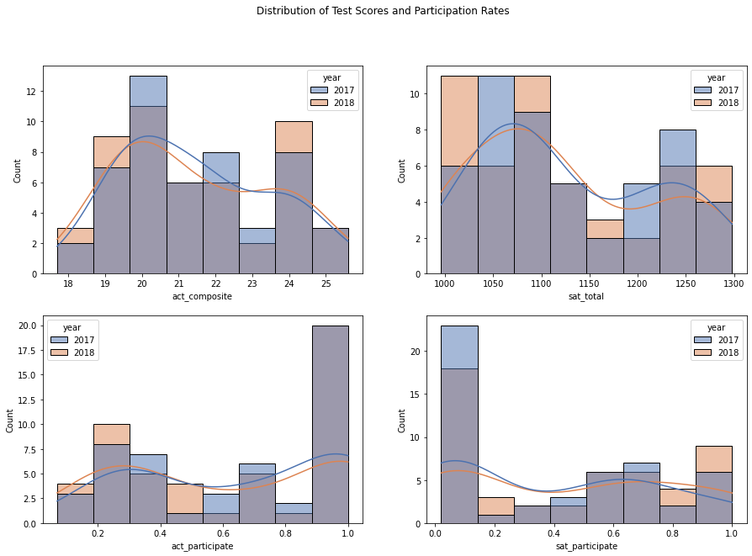
Description of ACT/SAT scores and participation rate across all 50 U.S. states
The most common average state-level ACT composite scores lie between 19.5 to 20.5. There seem to be a slight drop in statewide ACT performance from 2017 to 2018.
The most common SAT total scores lie between 1050 and 1100. There seem to be a slight decay in statewide ACT performance from 2017 to 2018.
ACT seems to be a more common or popular test to take than SAT. About 20 states have 90-100% ACT participation rates, as opposed to 10 states for SAT. About 3-4 states have less than 10% ACT participation rates while 17-22 states have less then 10% SAT participation rates.

Slide 5
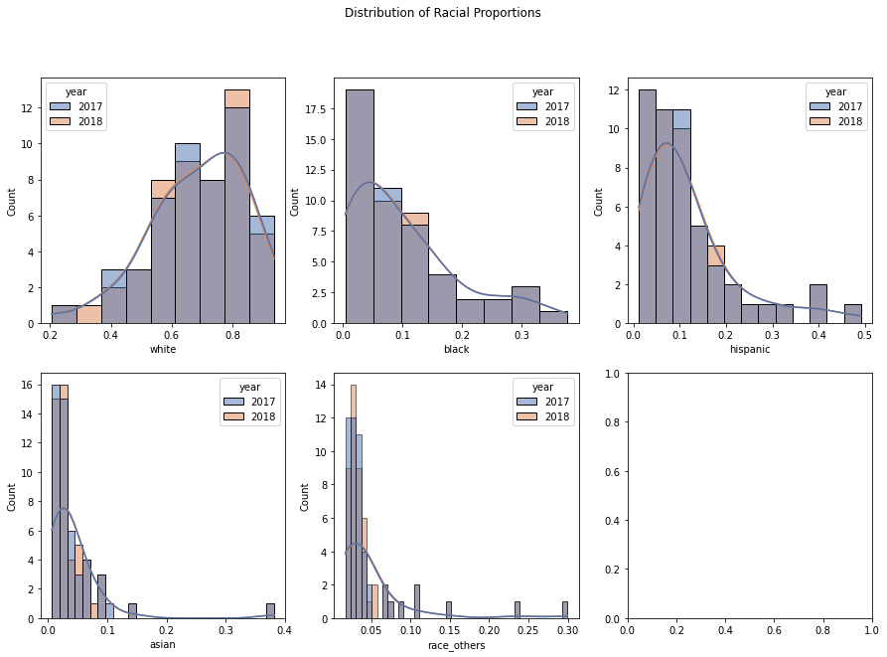
Description of racial distribution across all 50 U.S. states
White is the majority race in the U.S., with an average proportion of 70% for most states, and its distribution across states is left-skewed.
Being minority races, the distribution of all other races are right-skewed. Blacks and Hispanics are the next largest racial groups, with average proportions of approximately 10% across all states.
Asians is the fourth largest racial group. Their average proportion is approximately 4%, with an outlier in Hawaii constituting 40% of its state population.
The fifth group (race_others) consists of American Indians, Alaskan Natives, Pacific Islanders and other races. They make up approximately 4% across all states, with outliers in Alaska, Hawaii, Oklahoma.

Slide 6
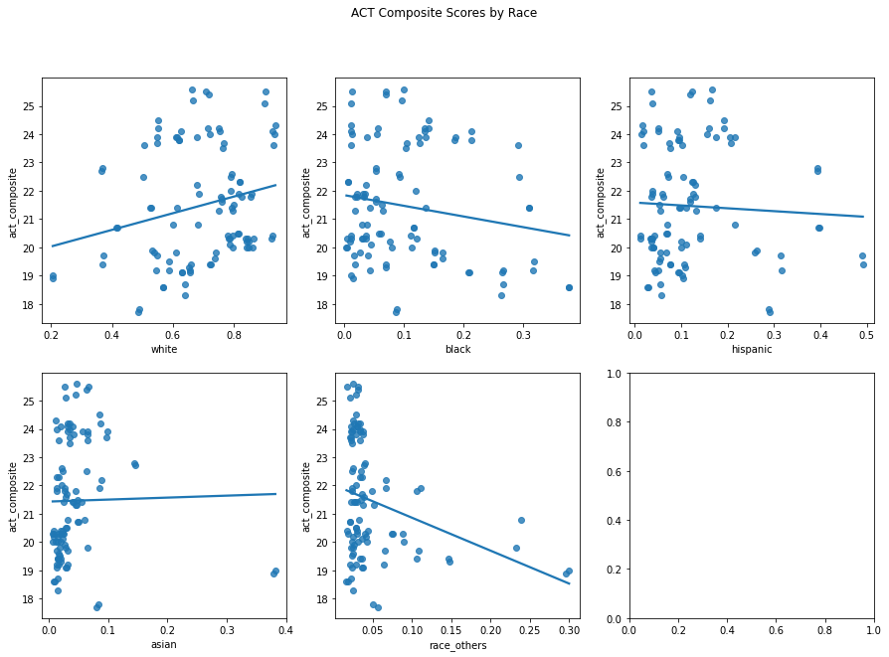
States with high proportion of Whites perform better in ACT tests
The “Whitest” states do the best
“Asian” states do slightly better
Other minority-heavy states do worse, especially those with high proportions of American Indians, Alaskan Natives and Pacific Islanders (race_others)

Slide 7
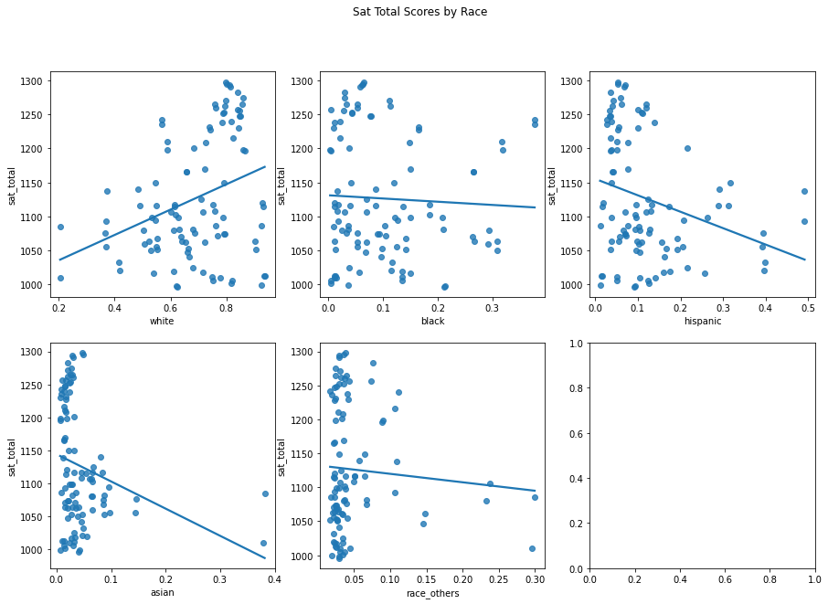
States with high proportion of Whites perform better in SAT tests
The “Whitest” states do even better on SAT than ACT
“Asian” states now perform the worst on SAT
Other minority-heavy states also do worse on SAT, with Hispanic-heavy states coming second-lowest after “Asian” states

Slide 8
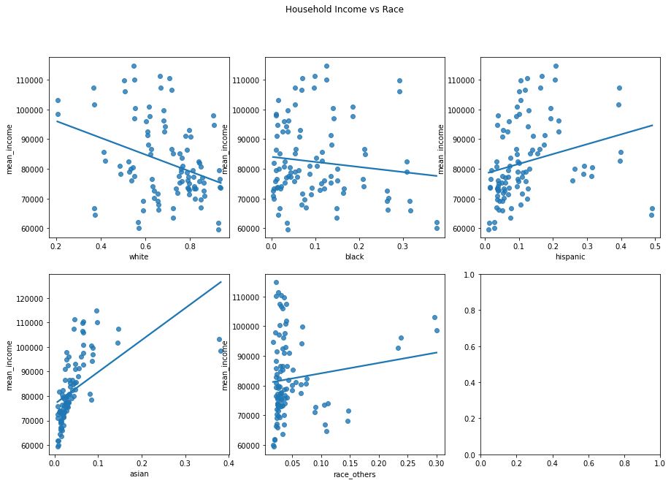
Potential criticisms of comparing test scores and state racial demographics
Donors might claim that states that are “Whiter” are more hardworking and earn higher income, thereby providing more educational resources for their children to do well in tests
Not true:
“Whiter” states tend to have lower household income..!
“Hispanic” and “Asian” states have higher household income!!!

Slide 9
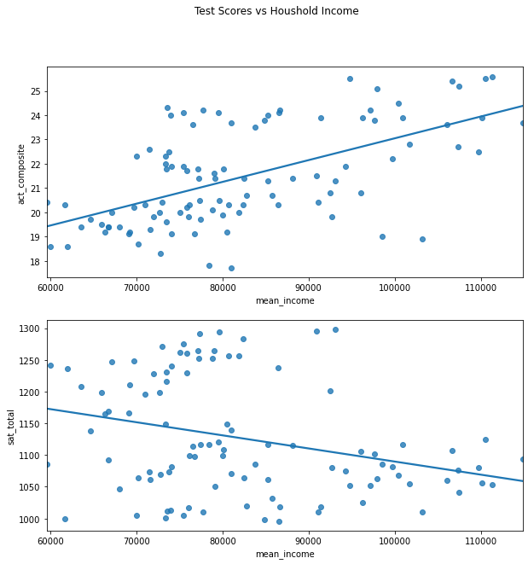
Income levels do not predict (or correlate) with standardized test scores
Another way to address potential donor criticisms is to look at the relationship between standardized test scores and household income levels.
We see that higher income does not predict (or correlate) with higher test scores… otherwise both charts would have upward sloping lines.

Slide 10
Conclusions and Recommendations
We show that states with higher proportions of minority races tend to perform worse in standardised test.
States with high proportion of Black and Native American races perform the worst in ACTs, and
States with high proportion of Asian and Hispanic races perform the worst in SATs
We invalidate a potential “racist” argument that Whites are more hard-working than Blacks and other minorities, and thus earning larger incomes to provide better educational resources for their kids to do well in standardised tests.
Higher income levels do not necessarily correlate with higher test scores
States with higher proportions of Whites actually have lower income levels, not higher (maybe Whites are lazier than Blacks and other minorities?)
Please give us a grant to fund a further study to investigate if standardised tests are truly discriminatory
We want to study if Blacks and other minority races from comparable socioeconomic backgrounds do worse than their White counterparts

