Slide 1

Understanding the cross-section of U.S. REIT returns
DSI 24 Capstone Project
by
Ethan Leow

Slide 2


Problem Statement
I am a portfolio manager at a real estate investment fund
According to Campbell and Thompson (2008), small improvements in R² lead to large gains in investment performance, where expected gain =
S is the Sharpe ratio earned by a passive buy-and-hold investor
My goal is to use machine learning to improve the R² of my portfolio holdings of U.S. REITs.
R² = R-squared of portfolio

Slide 3
What are REITs
Real Estate Investment Trusts
Really boring stocks…typically owned by retirees or pension funds
need to give out >90% of their annual income (mostly rental yield)
this asset class tends to behave more like bonds than stocks…
Hence, REITS are typically ignored by financial literature

Slide 4
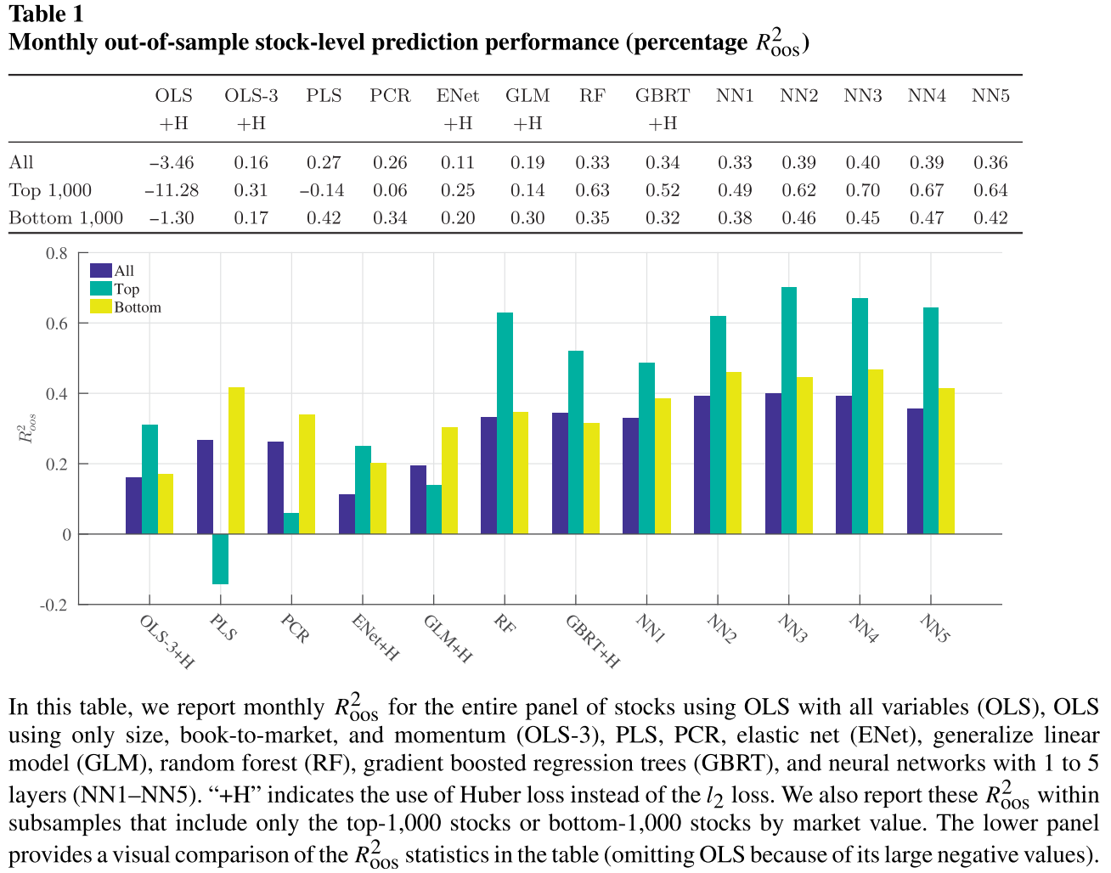
Empirical Asset Pricing and Machine Learning
Nascent subject in financial research
Portfolio managers don’t like ‘black box’ models that they don’t understand, or explain to investors
Gu, Kelly, Xiu (2020)

Slide 5
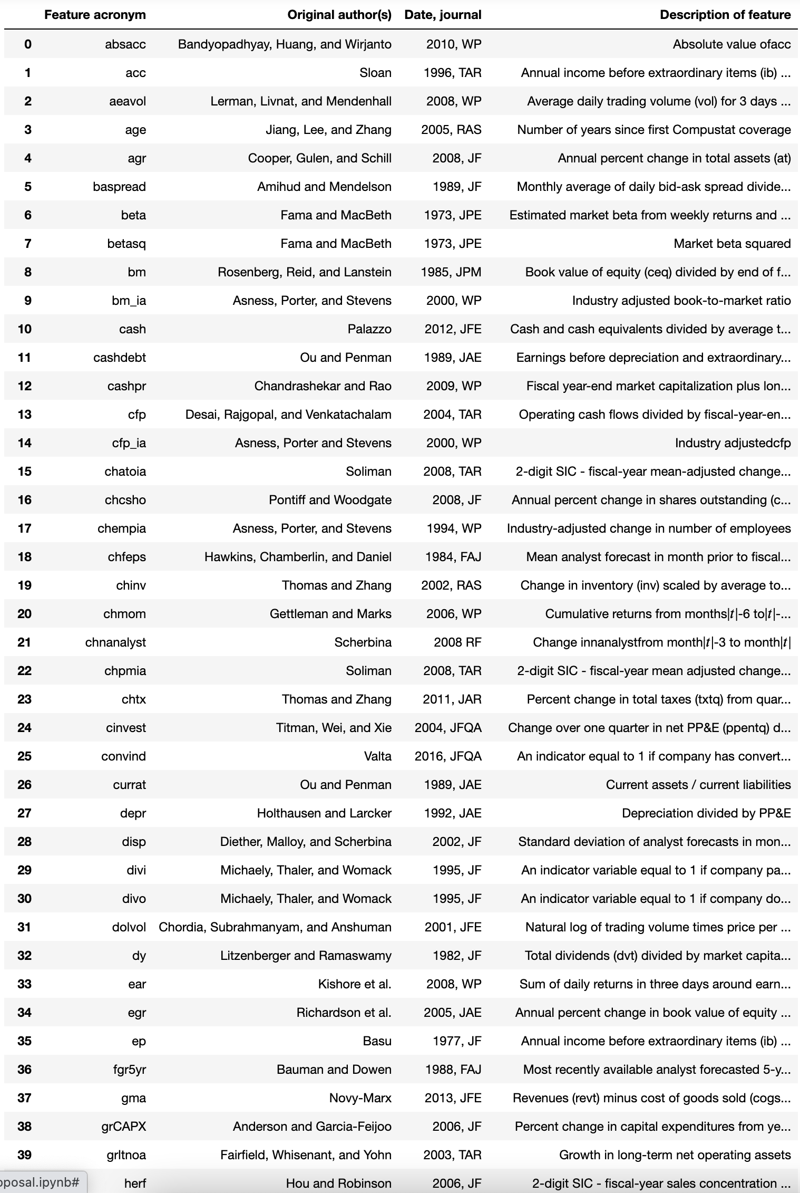
Modelling Approach
94 stock-level features
15 machine-learning models
Plenty of sweat, blood and pain
…including a total hard disk wipeout

Slide 6
Anchored walk-forward procedure
31 years of data: 1990 – 2020
In-sample data (16 years)
Training period: 1990 – 2000
Validation period: 2001 – 2005
Out-of-sample data (15 years)
Test period: 2006 – 2020
1990 | … | 2000 | 2001 | 2002 | 2003 | 2004 | 2005 | 2006 | 2007 | 2008 | 2009 | 2010
Train |  |  | Validate and Optimise |  |  |  |  | Test
Train |  |  |  | Validate and Optimise |  |  |  |  | Test
Train |  |  |  |  | Validate and Optimise |  |  |  |  | Test
Train |  |  |  |  |  | Validate and Optimise |  |  |  |  | Test
Train |  |  |  |  |  |  | Validate and Optimise |  |  |  |  | Test

Slide 7
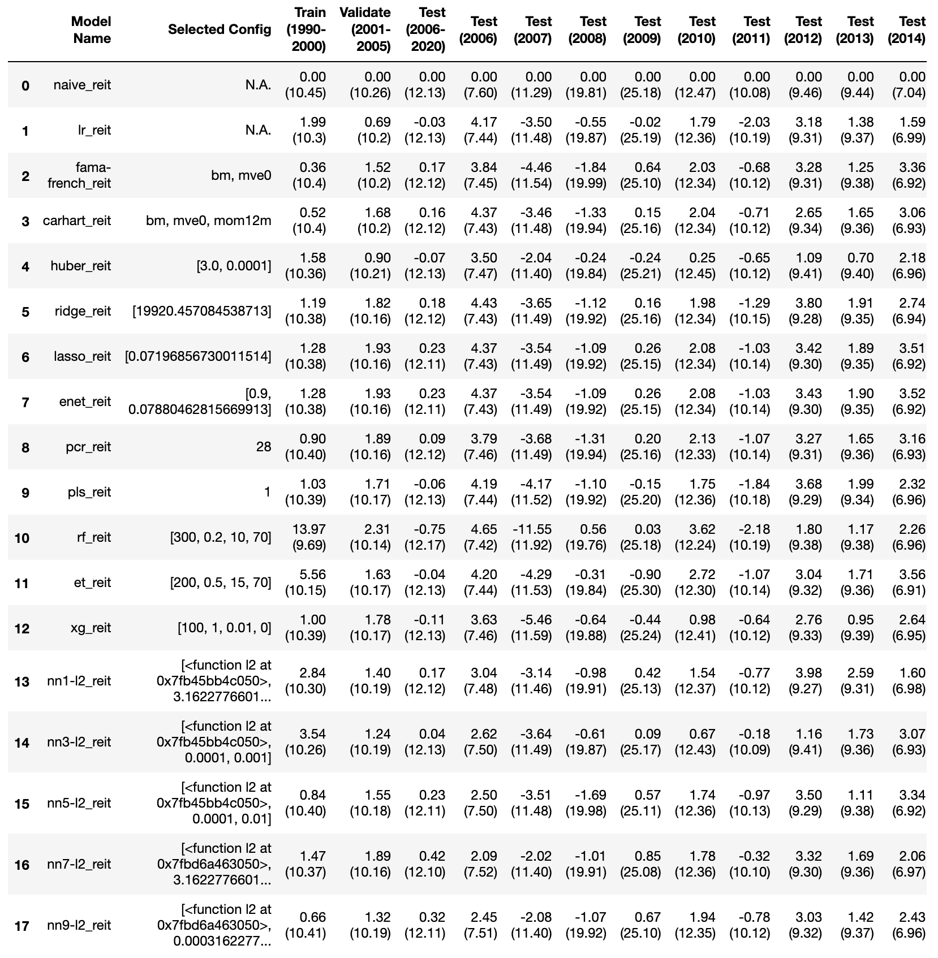
Results
Plain OLS can’t work…overfits
Tree regressors are worse
Regularized regression are better
Neural networks are the champs
All models cannot deal with 2007’s subprime crisis

Slide 8
Results
Linear Regression
OLS severely overfits to 94 features
Regularisation
Large jump in performance
R² of 0.18-0.23
Trees and Forests
Worst performing models
Neural Networks
Dimension Reduction
Negative R²
Low R² of -0.06 to 0.09
PCA – Reduced to 28 components
PLS – 1 component!
Low R² of -0.04 to -0.75!
Struggled in 2007
Best performing, but only for five layers and above
Highest R2 of 0.23 to 0.42
1. Ordinary least squares
2. Huber
3. Ridge
4. Lasso
5. Elastic net
6. Principal components
7. Partial least squares
8. Random forest
9. Extra trees
10. XGBoost
11. NN-1
12. NN-3
13. NN-5
14. NN-7
15. NN-9

Slide 9
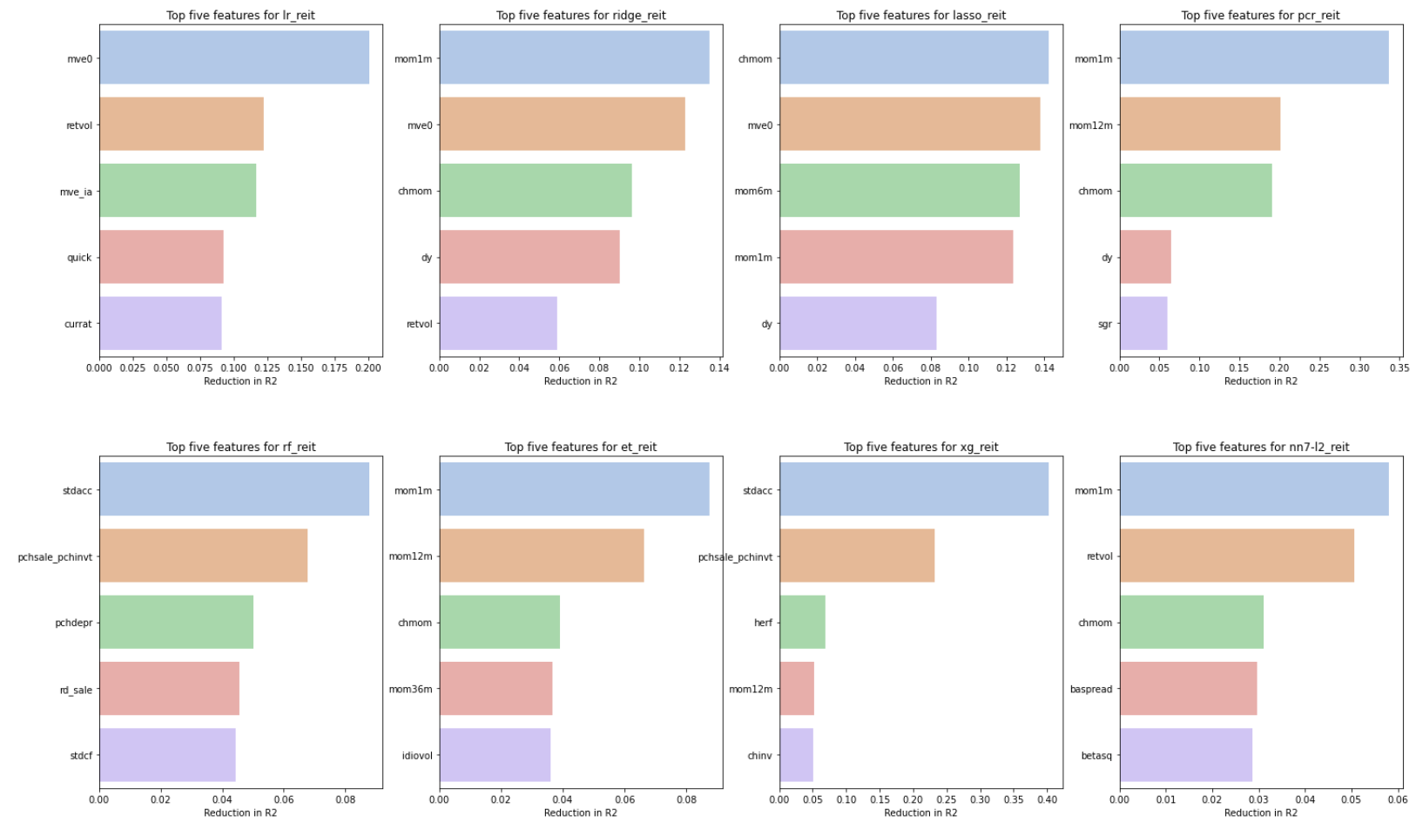
Features of importance
The most common features of importance are
Market capitalisation (mve0)
Momentum-related factors (mom1m, mom6m, mom12m, chmom)
Tree-based models pick up totally ‘wrong’ features to apply the heaviest weights
Standard deviation of accruals??
Change in sales minus change in inventory??
Measures the drop in R² by setting the feature of interest to 0 (all features are already standard-scaled)
Allows ‘black box’ models such as Principal Component Regression, XGBoost and Neural Networks to be assessed on an apple-to-apple footing with regression models such as OLS and Elastic Net

Slide 10
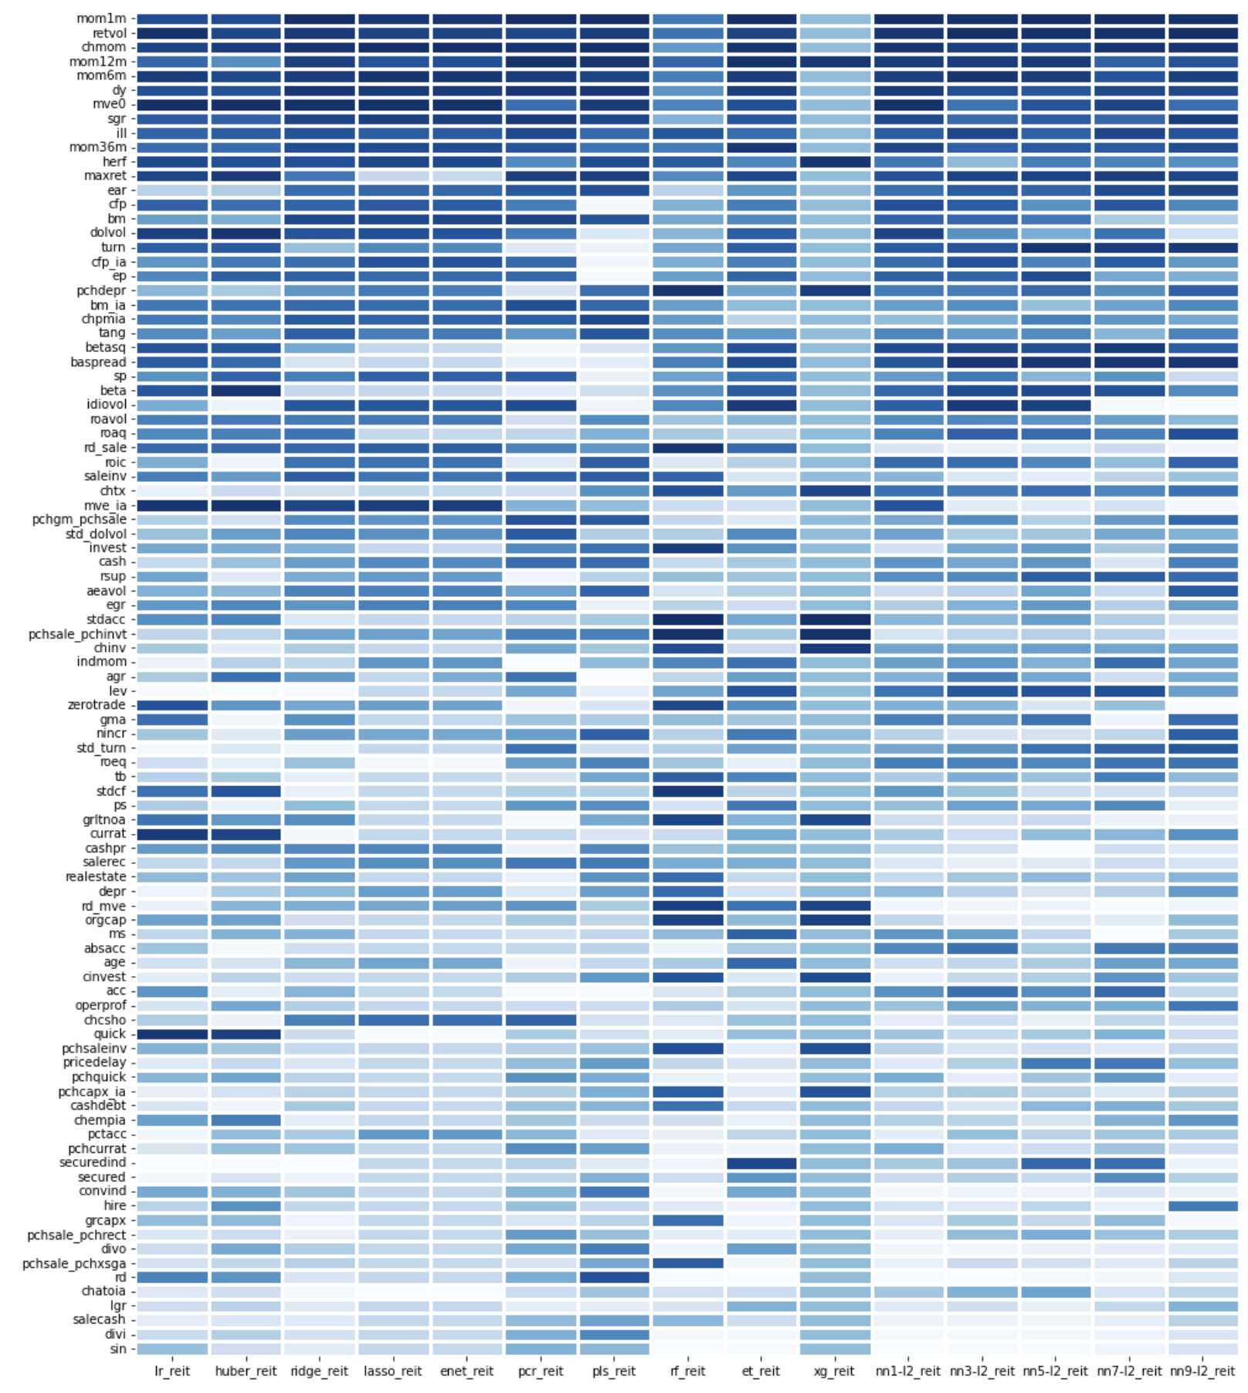
Features of importance
On average, 1-month momentum (mom1m) is the highest-ranked feature across all models
Followed by volatility of returns (retvol) is next highest
Random Forest and XGBoost disagree with other models…all of their important features contradict other models

Slide 11
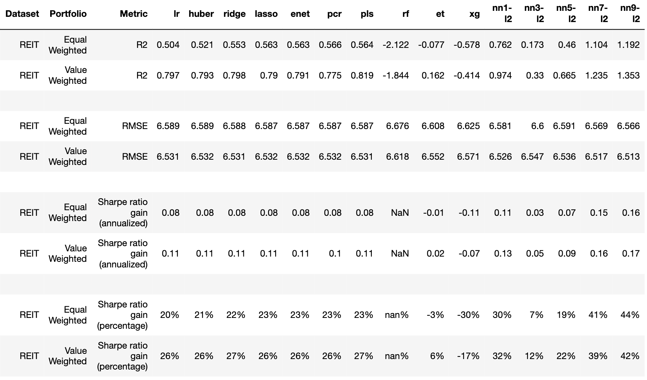


Portfolio Performance
Plain OLS is not too bad at the portfolio-level, despite overfitting at the stock-level
Tree regressors are terrible
Neural networks are the champs…even better on a portfolio level!!

Slide 12
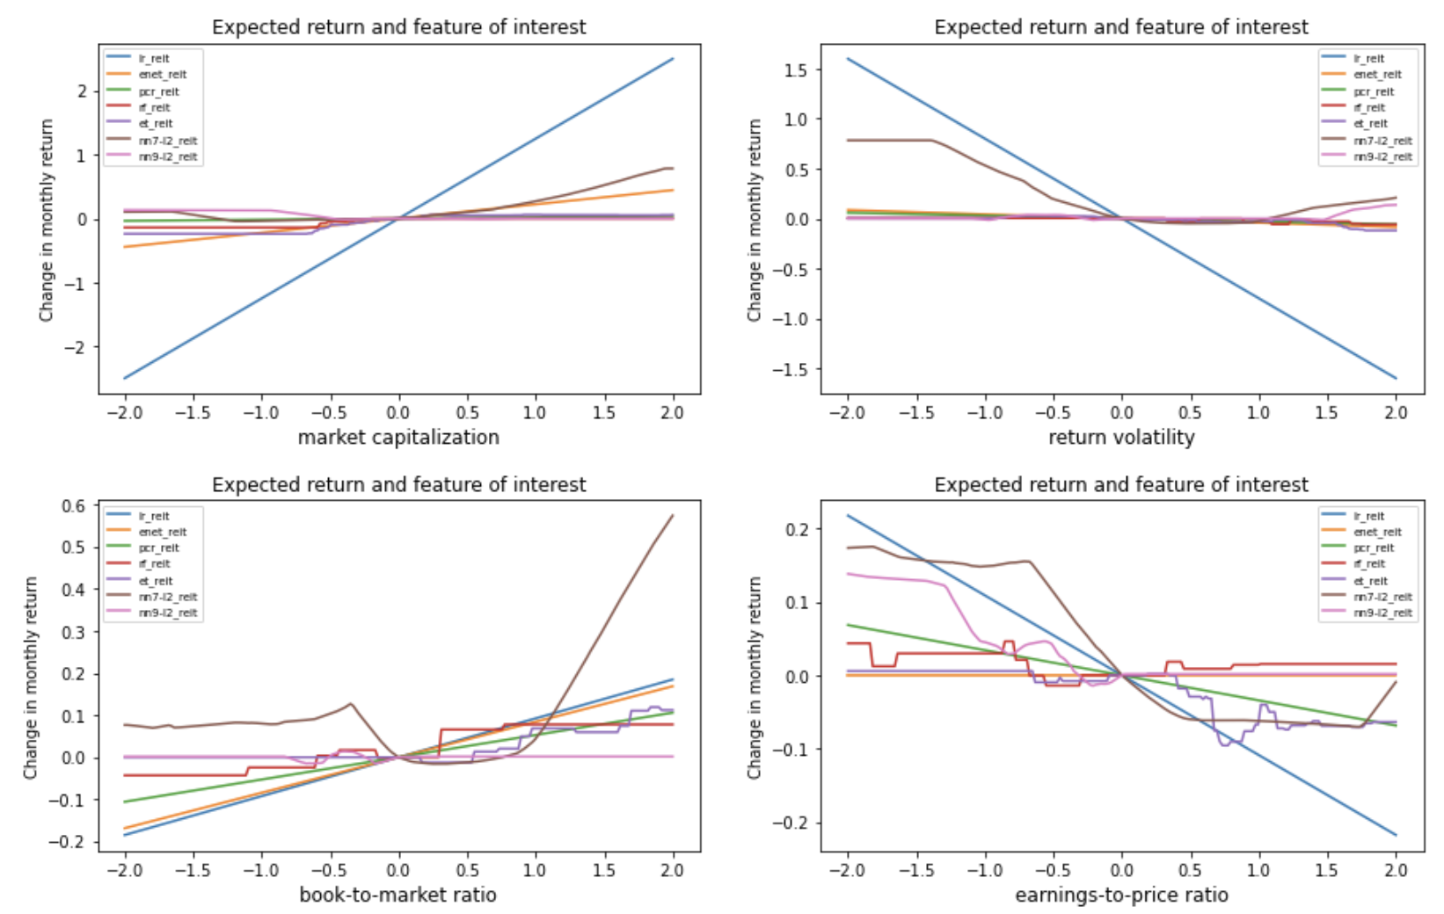
Marginal effects (Part 1)
Life is not so simple like a straight line
For example, traditional theory says that large book-to-market ratios (‘cheap stocks’) imply higher expected returns while low ratios imply lower returns
However, neural networks says chotto matte… yes, higher positive b/m ratios imply higher returns, but please ignore low b/m ratio companies, otherwise you might suffer badly if you go against them (think Tesla and FAANG stocks)

Slide 13
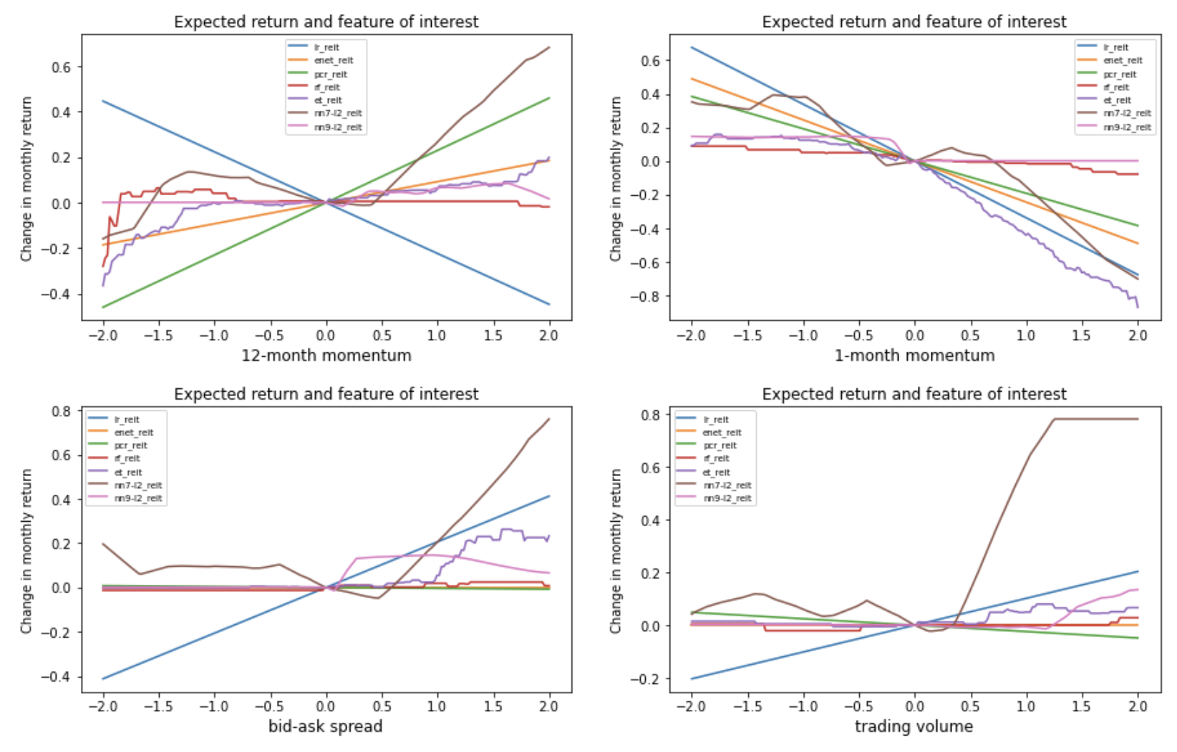
Marginal effects (Part 2)
Same for other variables
OLS say REITs with high trading volume imply higher expected returns and low volume imply lower returns
BUT… neural network say: leave REITs with low trading volume alone… short them at your own risk
Focus on those with high trading volume, they should have higher expected returns

Slide 14
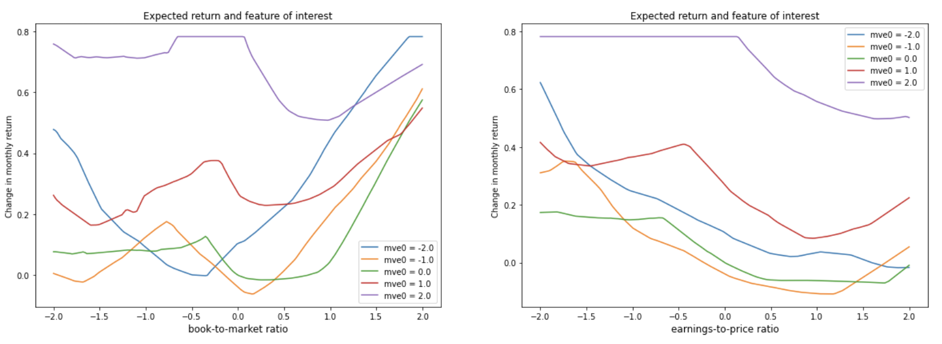
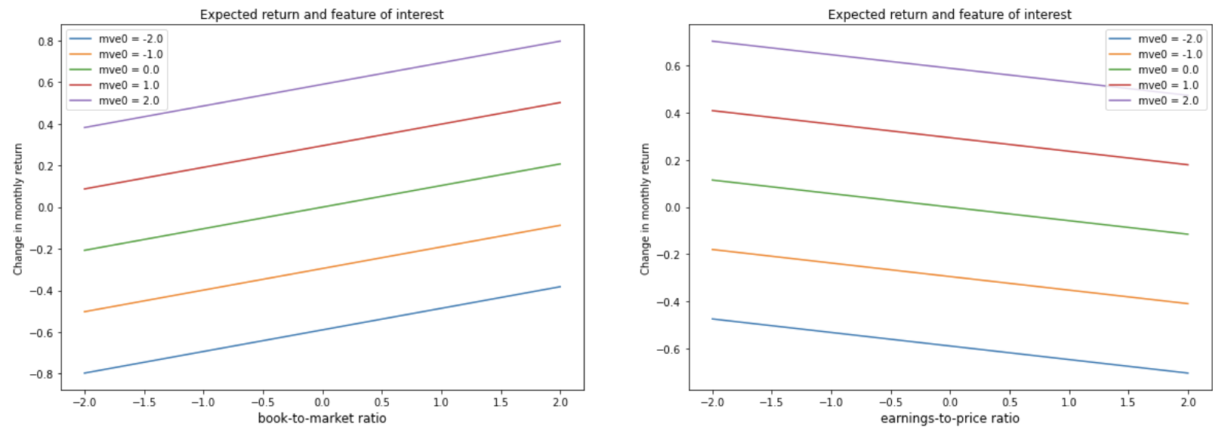
Interaction effects (Part 1)
Regression-based models are unable to deal with unordered behavior
E.g. if it says larger companies (mve0 = 2) have larger b/m effect on expected returns than smaller companies (mve0 = -2), it is always true for all ranges of b/m ratios, i.e.
Neural network is more flexible
At low b/m values, large companies outperform small companies, but at high b/m values…it switches!
NN - 7 Layers
Ridge

Slide 15
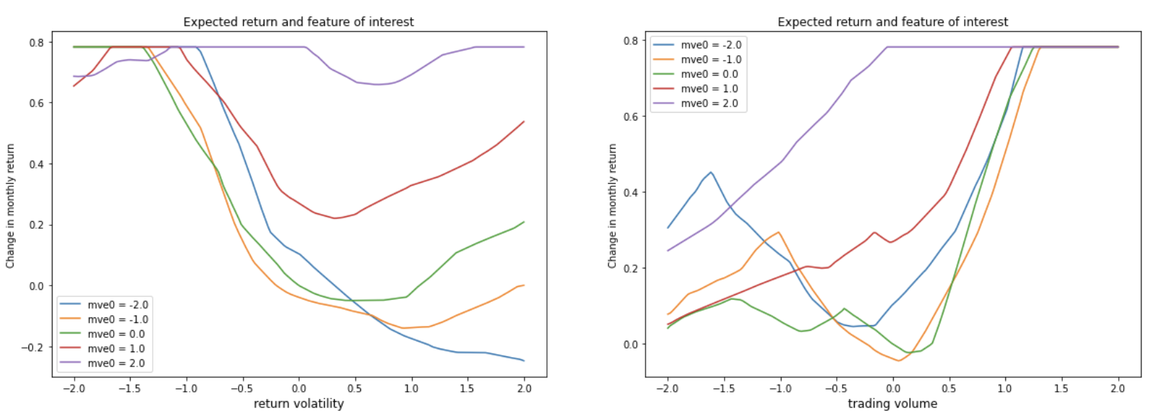
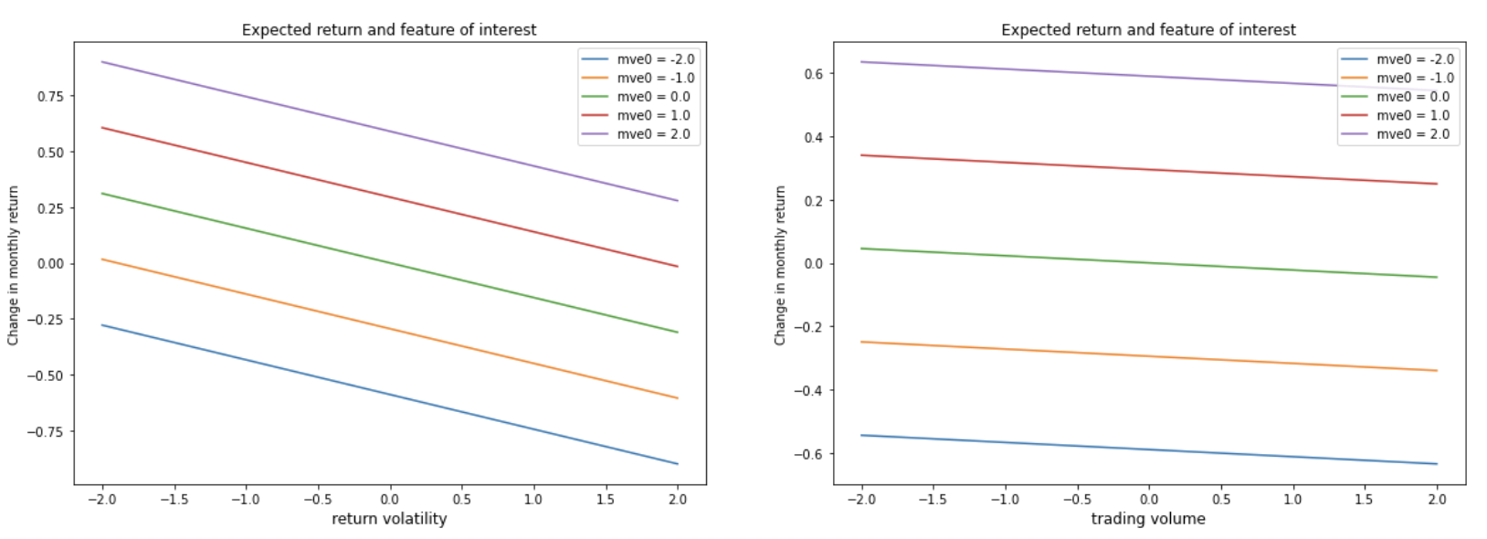
Interaction effects (Part 2)
We observe the same non-linear behavior for trading volume
3 segments:
Low trading volume (-2 to -1.5 S.D.): Large REITs underperform small REITs
Medium (-1.5 to +1.0 S.D.): Large REITs outperform small REITs
High trading volume (>1.0 S.D.): No difference between large and small REITs
NN - 7 Layers
Ridge

Slide 16
Lessons learnt (in context of financial time series)
Classical tree bagging regressor is extremely slow, followed by random forest. ExtraTrees is the fastest and most accurate amongst tree-based regression models
AdaBoost is slow to run, XGBoost is faster and has comparable performance Neural networks are expensive to run, and prone to crashes
Do not set n_jobs = -1 and let your computer run overnight
Limit to 2 or 4 cores, if you have a 6-core computer
Neural network lessons:
Use batch optimization at every layer if you have a lot of features
Early stopping significantly improves performance (from large negative R² to the best R² amongst all machine learning models
Dropouts did not work as well, regularisation seems to perform better (and L2 is better than L1 regularisation)
Ensemble method helps a lot too, but it is computationally expensive

Slide 17
Conclusion
Back to problem statement
Yes! I am confident of constructing a better portfolio of boring REITs, with a 40% improvement in Sharpe ratio over a buy-and-hold portfolio
I have a better understanding of the relationship between REIT returns and underlying features such as book-to-market ratios, market cap, turnover, etc
Areas for improvement:
Recurrent neural network (long short-term memory models)
Hierarchical time series forecasting (Meta, Uber)
Non-trivial to execute with panel data, but payoffs can be huge if one can figure out time-based cross-sectional predictive ability!

