Slide 1

DSI24 Project 2
By Ethan Leow

Slide 2
Problem Statement
I work for a real estate consultancy in Ames, IA. My boss has tasked me to come up with a good predictive model for house prices in my city. The main purpose is to help our clients, i.e. buyers of homes, shortlist undervalued houses in the city. To do so, I need to generate an expected value for a property given all its attributes, and the client can compare it with the asking price of the seller.
The secondary purpose is to help our clients appreciate features of a property that are important drivers of sale prices, so I cannot create a “black box” model that cannot be easily understood by our clients.

Slide 3
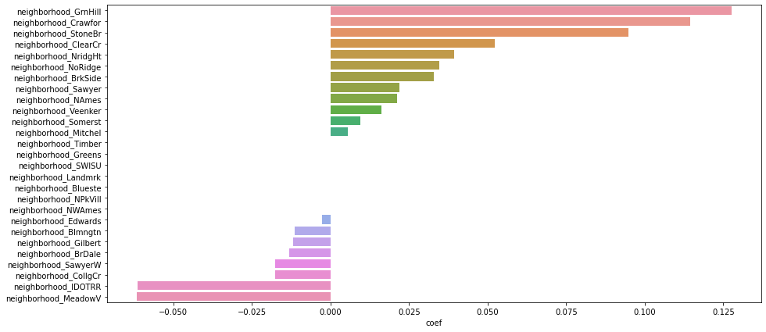
Neighborhoods
Green Hills, Crawford, Stone Brook, Clear Creek and Northridge Heights are the most desirable neighborhoods.
Meadow Village and Iowa DOT and Rail Road are the least desirable neighborhoods

Slide 4
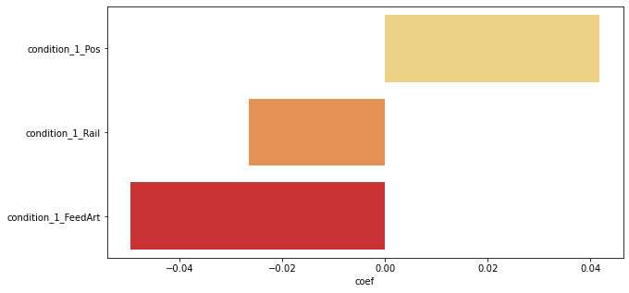
Proximity to external conditions
Proximity to ”positive” conditions such as parks and greenbelts is worth 4% of sale price.
Proximity to railroads can cause a property to be worth 3% less than one that isn’t
Proximity to arterial and feeder roads are least desirable, responsible for shaving 5% off a property’s value

Slide 5
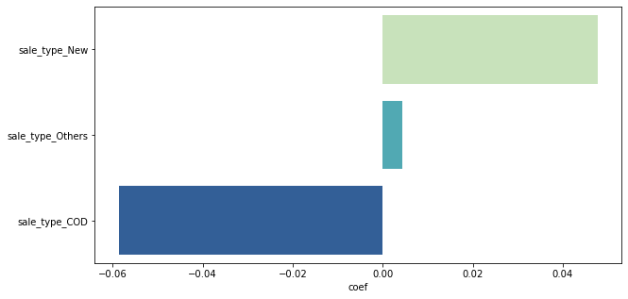
Sale Type
New houses command a premium of 5%, all else equal. Clients are encouraged to find houses that have equivalent physical attributes but are not new to avoid paying such a high premium, as they will immediately “lose” a 5% value the moment they move in, a bit similar to new cars losing value the moment they drive out of the showroom.
Clients are encouraged to look for houses sold by court-appointed fiduciaries, as they are usually priced at a discount of 6% over an equivalent house that is not under distress.

Slide 6
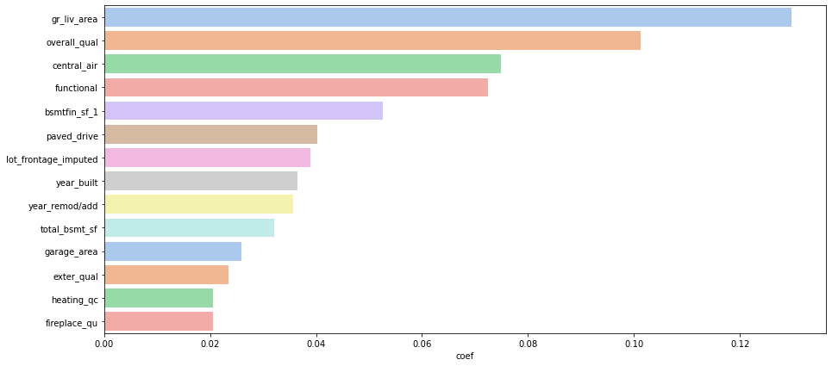
Other features of importance
Gross living area is the most significant predictor of Ames housing prices, following by overall quality of house.
Central air conditioning is a surprisingly important factor,, houses are worth an extra 7.5% if they have it.
In terms of size-related features, basement area ranks above lot frontage and garage area. In terms of quality-related features, external quality rank above heating or fireplace quality. These are variables a client should consider when deciding which part of the house to renovate or improve first, if budget is limited.

