Slide 1
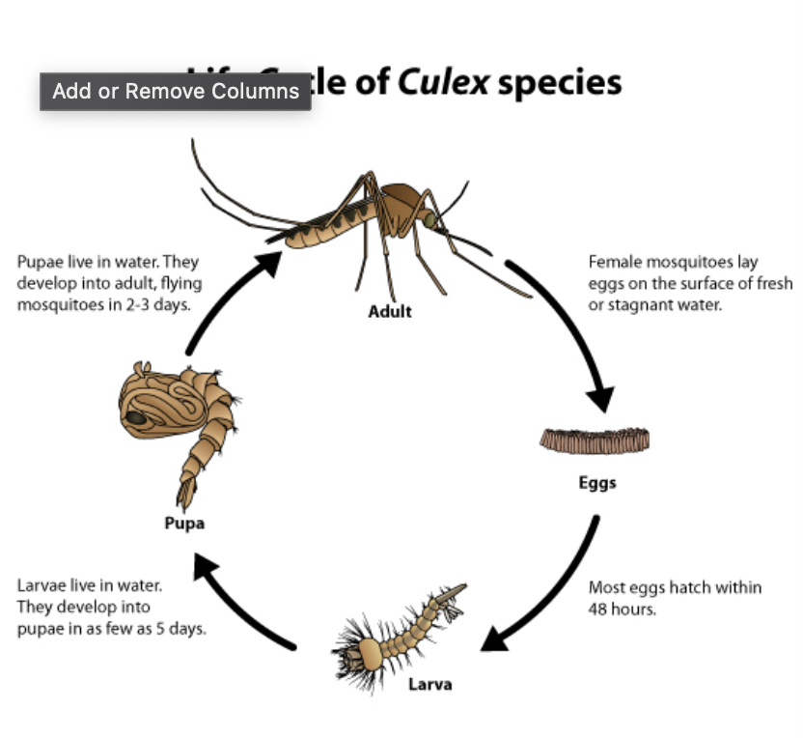
Modeling Assumptions
Species: 3 out of 7 are historically WNV-positive
Trap ID: Not all traps are equal (e.g. T115)
Longitude and latitude: Areas towards the east seem to be less prone to WNV
Weather-related features: Temperature, Dew Point, Wet Bulb, Total Precipitation
Our research shows that mosquitoes have a life cycle of 7 days
Any effect on mosquito-breeding due to changes in weather might be seen only a few days later
Weather variables lagged by up to 7 days
Month and week of the year: August seems to be most prone to WNV, followed by September

Slide 2
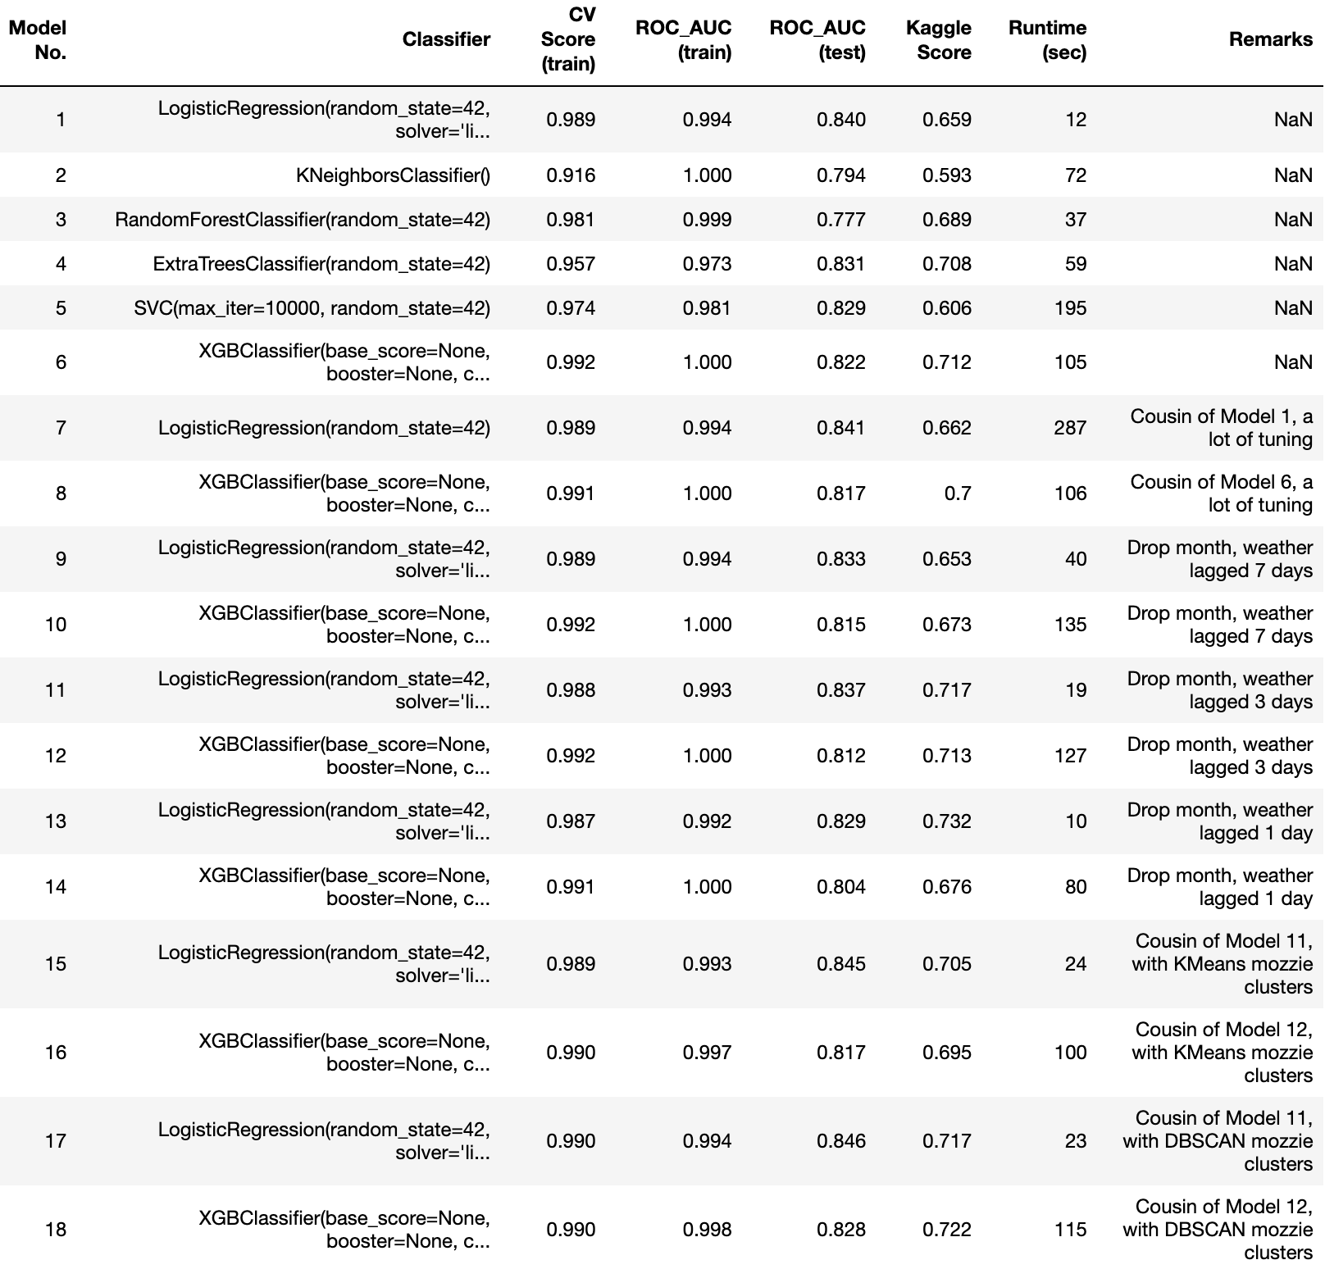
Results
BASELINE ACCURACY: 0.95
BASELINE ROC_AUC: 0.50
Step 1: Test six baseline models. Pick the best two models for intensive hyperparameter tuning.
Step 2: Intensive grid search of hyperparameters seems to work slighter better for Logistic model but worse for XGBoost
Step 3: Drop `month` which has 95% correlation to `week`. But results worsen.
Steps 4 and 5: Play around number of lagged days for weather variables. Jump in Kaggle scores. Lagged up to 3 days work best.
Steps 6 and 7: Drop GPS coordinates, create ‘mosquito-infection clusters’. DBSCAN works better than KMeans.

Slide 3
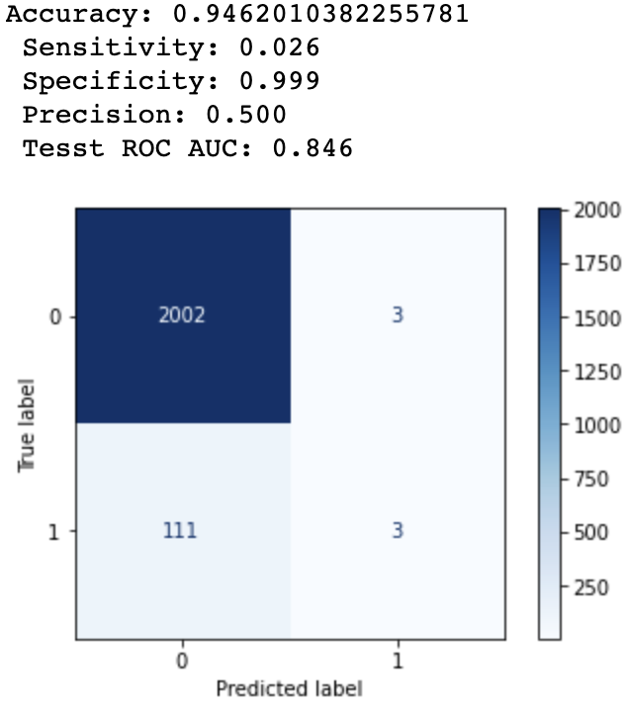
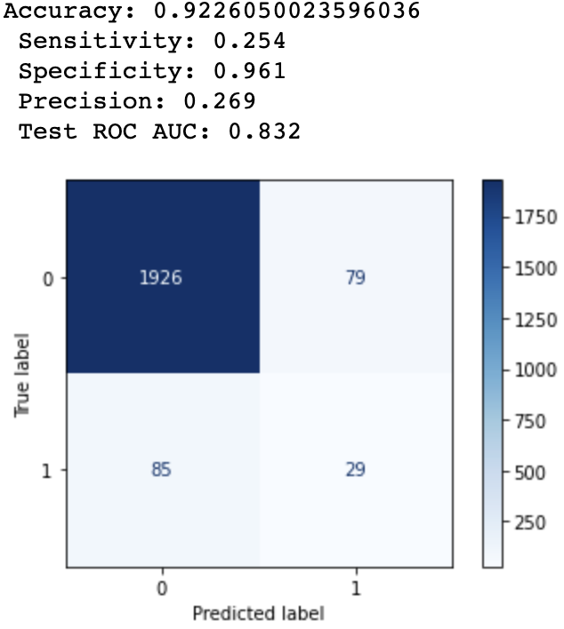
Model Selection: Not just AUC_ROC
Model 17: Logistic, weather lagged 3 days, DBSCAN clusters
A naïve model: accuracy 0.95, AUC 0.50
Model 17 (logistic regression): accuracy 0.95, AUC 0.85
Model 18 (XGBoost): accuracy of 0.92, AUC score 0.83
On paper, one should pick Model 17 over Model 18, however...
Model 17 does not seem to be useful for city officials when deciding where to focus their spraying efforts
6 out of 2119 cases are predicted to be positive (99.9% negative predictions)
Model 18 is braver, choosing 79+29 = 108 predictions to be positive (94.9% negative predictions)
Model 18’s sensitivity of 0.254 is more than 800% higher than Model 17’s sensitivity of 0.026!
Selected model: XGBoost, weather variables lagged 1-3 days, DBSCAN clusters
Model 18: XGBoost, weather lagged 3 days, DBSCAN clusters

Slide 4
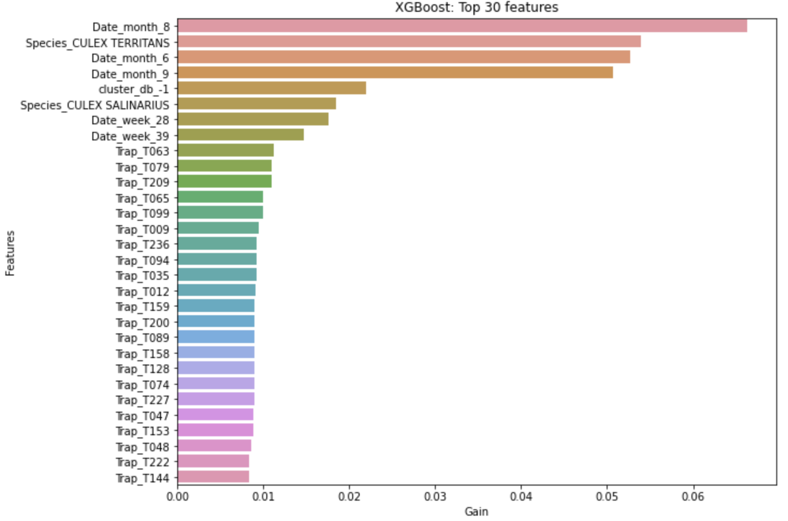
Features of Importance
IN ORDER OF IMPORTANCE
Month: Most important predictor, August responsible for improving AUC_ROC score by 6.5%
Species: Next most important, with Culex Territans responsible for 5.5% of improvement
Mozzie cluster: DBSCAN cluster ‘-1’ is next on the list, 2.5% of improvement. The locations are in the Northwest and South of Chicago.
Week: #28 and #39
Trap: Generally responsible for <1% of the score improvement
Weather: Interestingly, not in the Top 30 chart

