Slide 1
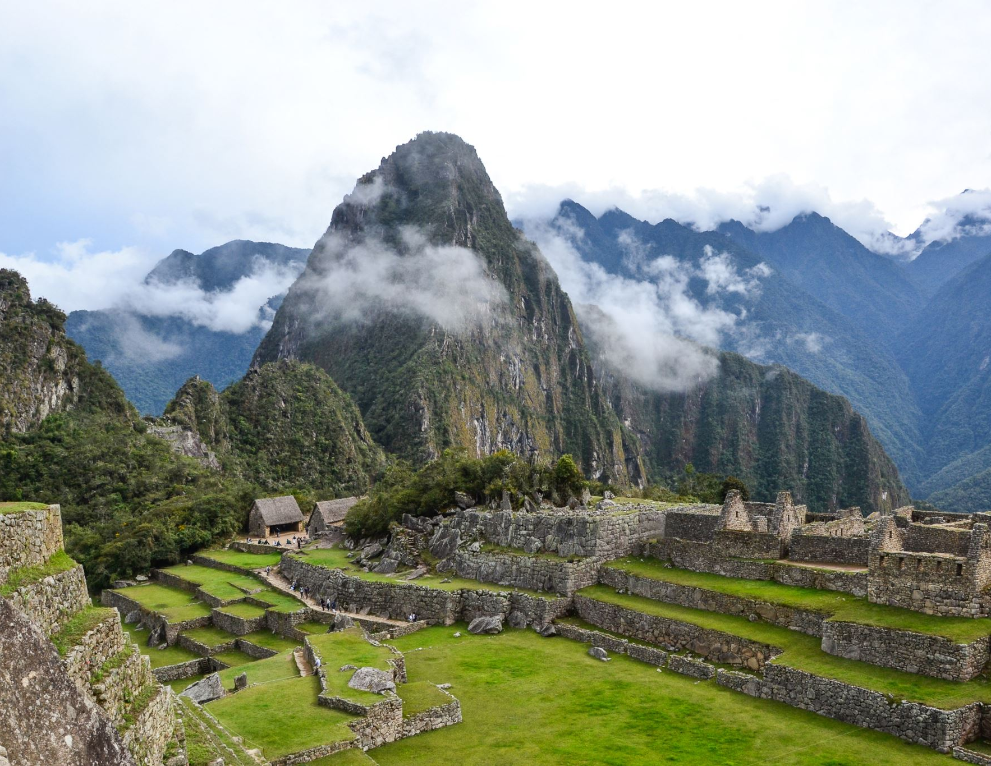
DSI24 Project 3: a runner’s dream
By Ethan Leow

Slide 2
Problem Statement
I am a marathon runner who is itching to do my first ultramarathon (defined as any run beyond 42.195km) and have prepared a series of posts to ask running veterans for advice. Two popular reddit communities for advanced types of running are: r\ultrarunning and r\AdvancedRunning. A quick scan of their recent posts is not very helpful. Both communities have a lot of posts about how to train for 50k and beyond:
A recent post from r\ultrarunning: "Should I run my second ultra in 7 weeks? I just finished my first ultra this Saturday (Sept 25) in 8 hours (50Km)....I'm debating to do an ultra, either 60Km or 50 Miles (80Km) on November 13th. That will be the last race of the year."
A recent post from r\AdvancedRunning from yesterday: "Last week I completed my first 100 mile race. It has been a goal of mine for the last few years... I hope to use this race as a stepping stone for longer and harder miles. There is truly something addicting about completing such an extraordinary goal.”
Time to deploy my data science skills to produce an algorithm to decide which running community is most suited to post my training-related questions...
r\AdvancedRunning: “It's a mindset”
r\ultrarunning : “sometimes a marathon isn't far enough”

Slide 3
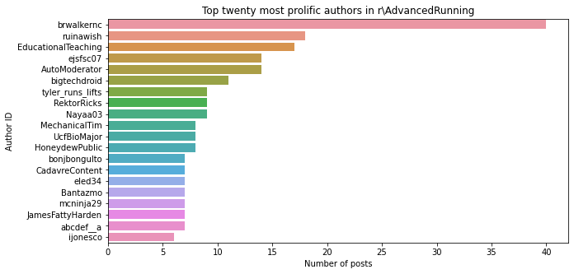
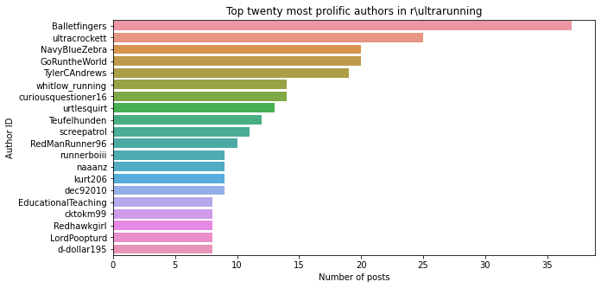
EDA – Author count
The author with the highest number of posts on r\AdvancedRunning is brwalkernc with 31 posts
The author with the highest number of posts on r\ultrarunning is ultracrockett with 25 posts
They make up <=3% of their sample sets respectively (out of 2500 posts in each subreddit), so not a big problem
However, I notice that there is a weird-sounding author called "AutoModerator" on r\AdvancedRunning (ranked #5). Upon further analysis, I found out that it is an AI-bot trying to keep readers interested, so those posts are removed
P.S. About 20% of the posts are videos/pictures, [removed] by Reddit or reposts by authors, so these were automatically filtered out at the scrapping stage → a total of 2,500 decent-quality posts scrapped from each subreddit community

Slide 4
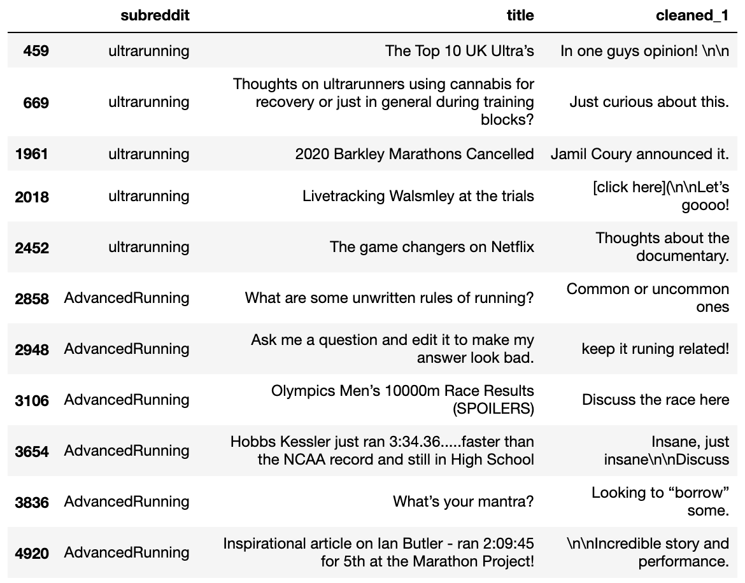
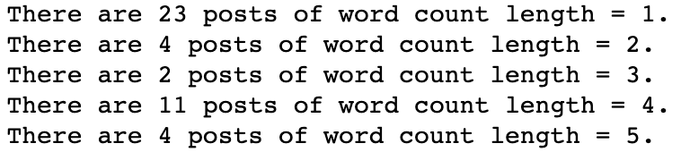
EDA – Word count
I analyze posts with low word counts and some are removed for lack of useful content
Specifically, those that are 1-, 2-, 3- and 4-word posts
In total, about 70 posts (<2% of scrapped posts) were removed

Slide 5
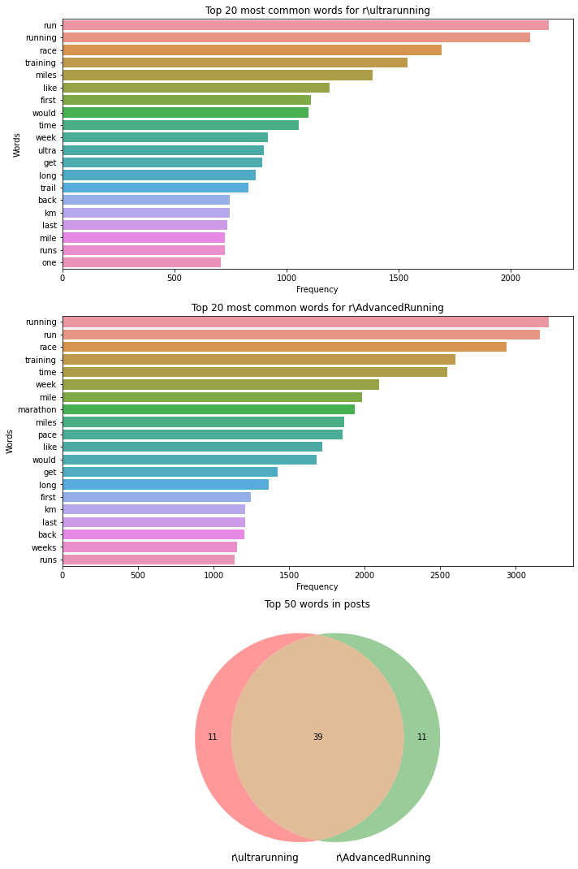
EDA – Common text
I have 39 overlapping words amongst the top 50 most common words in each subreddit community
I remove "ultrarunning" and "advancedrunning" from both subreddits, to avoid giving the model an unfair predictive advantage
Also removed common running words such as "run", "running", "race", "training", "miles", "mile”
But I have to be careful not to remove all intersected words as they may be constituents of meaningful bigrams or trigrams that can add predictability to my models

Slide 6
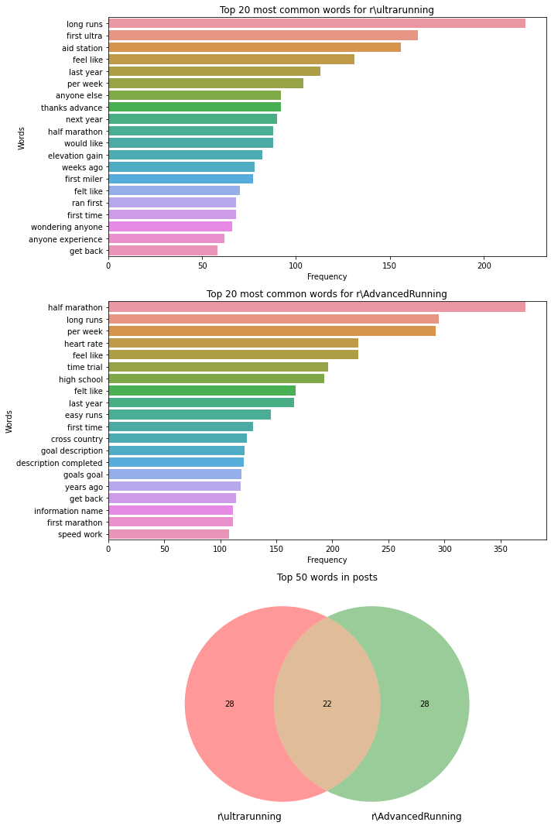
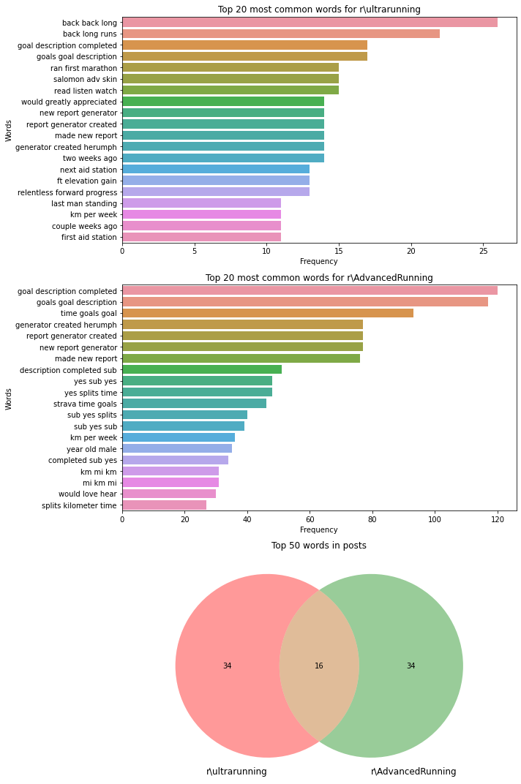
EDA – Bigrams, Trigrams

Slide 7
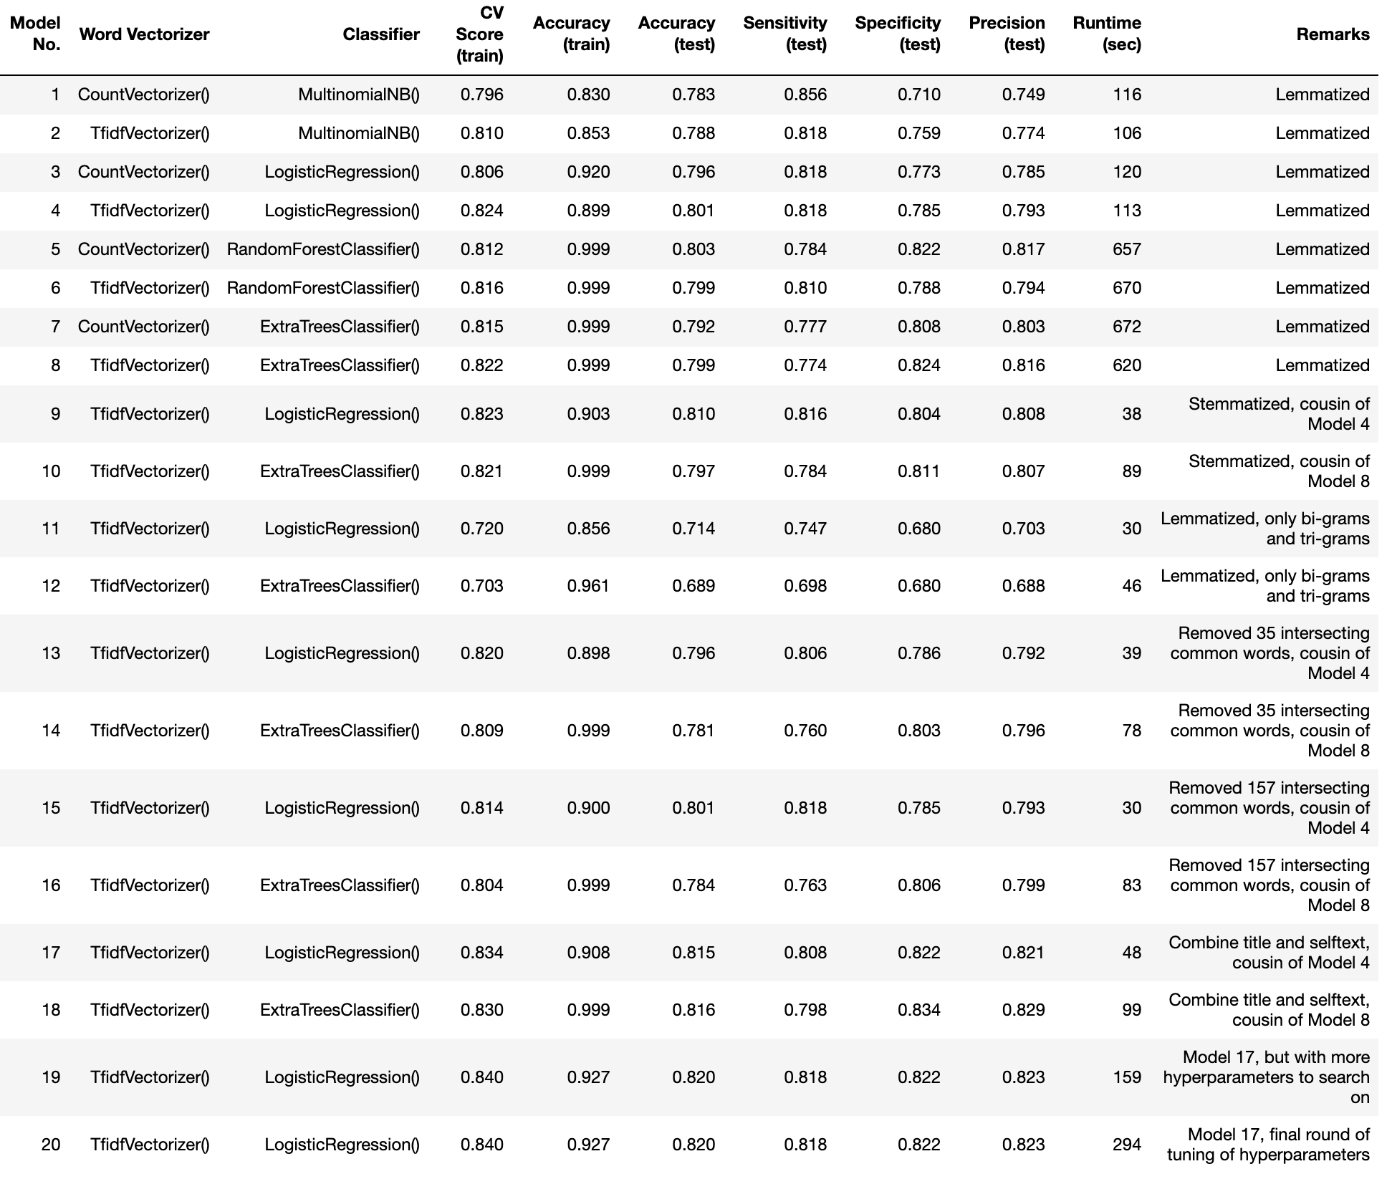
Results
BASELINE ACCURACY0.502
First iteration, using GridSearchCV on 2 types of word vectorizer, 2 parametric models and 2 non-parametric models
Try out stemmer instead of lemmatizer,
Results did not improve
Tried removing intersecting words aggressively
Added title to selftext, created 16,840 more words (or 4% more)
Two more rounds of tuning hyperparameters until it is impossible to further improve accuracy scores

Slide 8
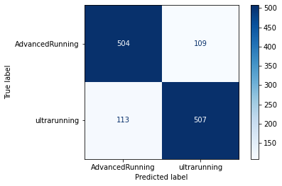
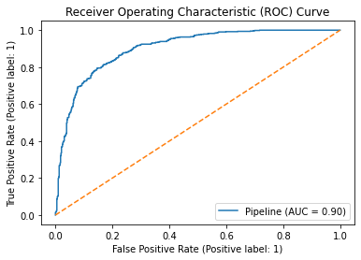
Selected Model: TF-IDF vectorization + Logisitic regression
My model has an accuracy of 82%. Out of 1,233 posts in the test set, it got assigned 1,011 correctly [504 + 507]
Only 18% of posts are misclassified.
It also seems to be equally good in predicting r\AdvancedRunning posts [504 / (504+109)] = 82.2% = specificity…
as it is in predicting r\ultrarunning posts [507/(507+113)] = 81.8% = sensitivity (as I had arbitrarily set r\ultrarunning as "1" and r\AdvancedRunning as "0" earlier on)

Slide 9
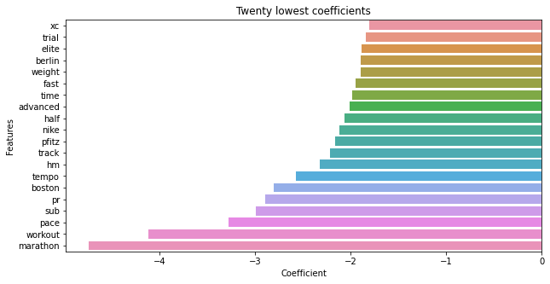
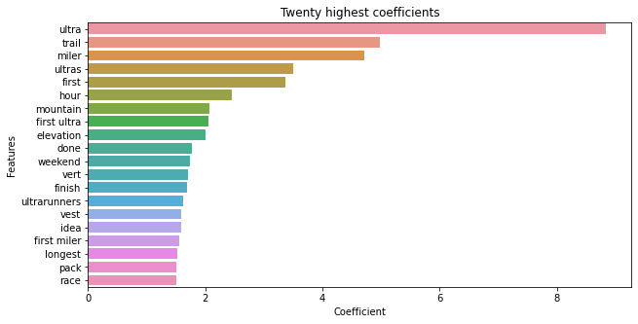
Features of Importance
While I am not surprised to see words such as 'ultra' and 'ultras' listed for features that predict r\ultrarunning, I am surprised to see words such as 'trail', 'mountain' and 'elevation' listed. This suggests that runners who tend to like to run in natural surroundings instead of road flock to r\ultrarunning.
For r\AdvancedRunning, I am surprised to see words such as 'workout', 'pace', 'sub', tempo', 'fast' listed as features that predict r\AdvancedRunning. It suggests that this community is perhaps more serious about training-related matters!
For my problem statement, which is to find out where to post training questions for my first ultra-marathon , it sounds like I should probably do it on r\AdvancedRunning!
Increase odds of appearing in r\AdvanceRunning
Increase odds of appearing in r\ultrarunning

Slide 10
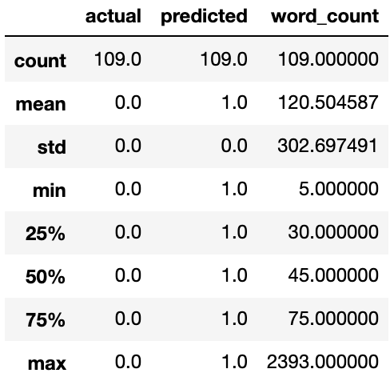
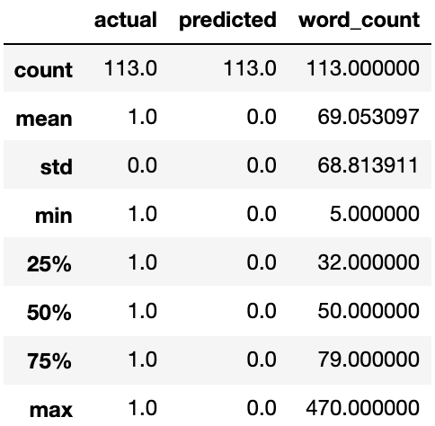
Misclassification Analysis
Initially, I was suspecting low word count as the reason for misclassification, but it seems like most misclassfied posts are quite verbose. As there are too many false predictions, I sampled a few of them to observe pattern:
One observation is that false negatives have multiple mentions of "marathon" in the selftext, and as seen in my features of importance analysis, "marathon" has the strongest negative coefficient in my selected logit model, meaning that the model strongly believes that the odds of the post being a positive (i.e. in r\ultrarunning) is very low.
For false positives, I cannot observe any real pattern to the posts, but some of them do seem to have quite a number of "mountain" mentioned, which has the 8th largest coefficient in my selected model.
False positives
False negatives

Slide 11
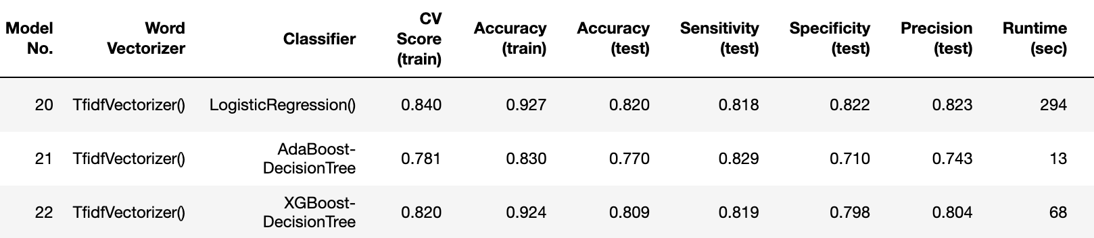
Comparison to AdaBoost and XGBoost
GridSearchCV picked a max_depth of 1 among choices of [1,2,3]
GridSearchCV picked a max_depth of 3 among choices of [1,2,3,4,5,6,7,8,9,10]
Observations: When comparing top 30 features of importance, both XGBoost and Logit models have many common features, but ordering / ranking is quite different!

Slide 12
Reflections
Before the project started, I naively thought that well-regarded non-parametric models in Kaggle contests such as RandomForest would do the best. That was my baseline assumption.
Within the parametric space, I am surprised to see that a simple model such as Logistic Regression would outpeform a more complicated model like Multinomial Naive Bayes. When it didn't, my thought is that the independence condition among word features is probably grossly violated since real data sets are never perfectly independent, so it can't perform as well. A paper by Andrew Ng (we watched one of his videos in class) and Michael Jordan (the professor, not the Chicago Bulls legend) states that logistic regression should perform better than Naive Bayes as training size gets larger, though I am not sure if my sample size is considered 'large' enough.
When I moved my analysis to the non-parametric space, I am also pleasantly surprised to see that RandomForest and popular techniques such as XGBoost couldn't outperform Logistic Regression. I can't find any papers online to explain why this is the case, but the old-fashioned person in me instinctively says that:
If one can achieve the same results using a simple and easy-to-understand model, we should go for it as it reduces the risks of overfitting and it is easier to dissect the model if things go wrong in future

Slide 13
Applications and Next Steps
My model can be made freely available to running ‘newbies’ who can’t decide where to post their training-related questions. There are unintuitive differences between the two subreddit communities that can’t be gleaned by a newcomer at first glance...
For example, r\ultrarunning users like to talk about mountains and trails, while r\AdvancedRunning like to talk about trial (not trail), workout, weight, pace, Nike…
For model improvement, I would like to collect a lot more data to see if a difference can be made. For example, I was a bit disappointed that XGBoost could not outperform Logistic Regression but I was told that boosters are meant to work on very large data sets. More hyper-tuning and sentiment analysis probably can’t work as well.

