Slide 1
Ames House Prices
Problem Statement: Given a set of inputs, can we accurately predict the prices of a house?

Slide 2
Dataset description
2051 entries, 81 unique features.
2006 – 2010
Lots of null, empty and repeated values.

Slide 3
Model
The model predicts home prices with 84% accuracy and with an error of
±$32,000
RMSE: $ 32,000 (ave root squared error between actual model prediction)
R²: 0.84 (Goodness of fit between actual and model, 1.0 being a perfect model)

Slide 4
Factors that affected the model
Quality
Size
Location
Age

Slide 5
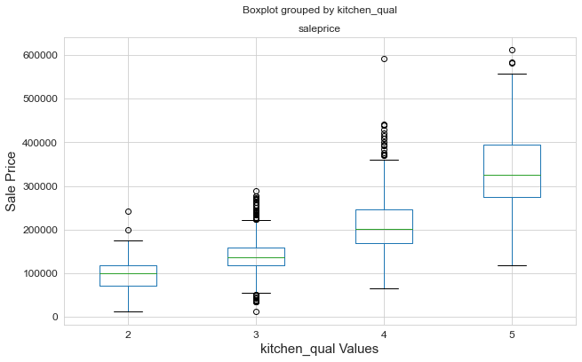
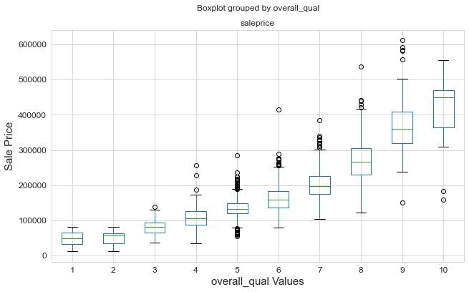
Quality

Slide 6
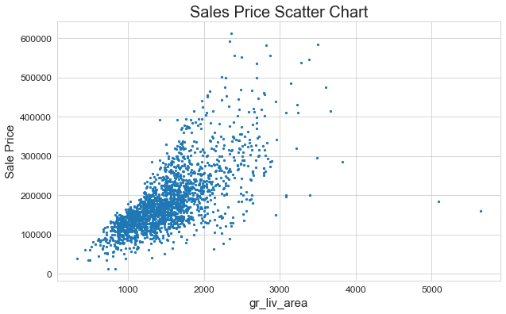
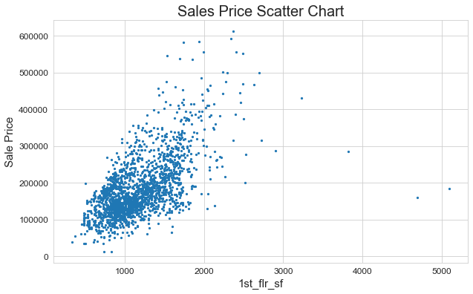
Size

Slide 7
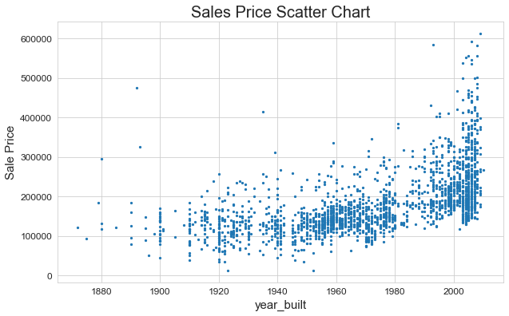
Age

Slide 8
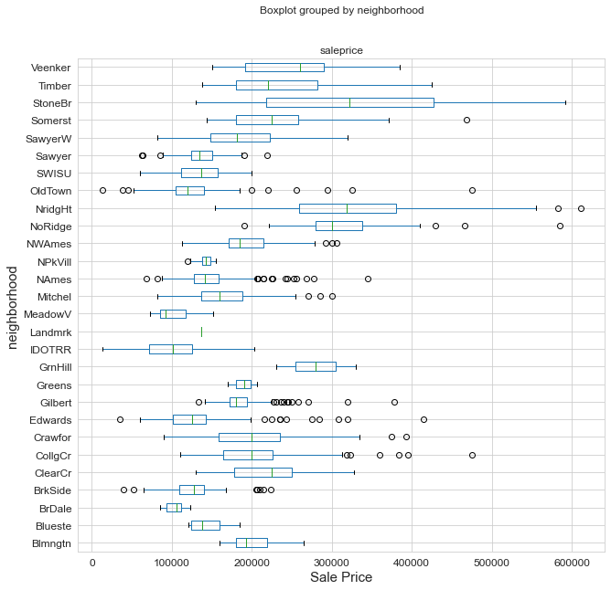
Location

Slide 9
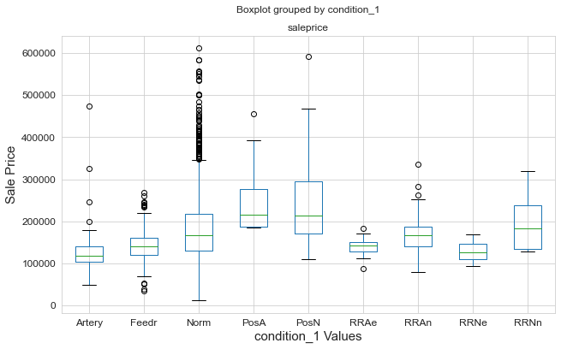
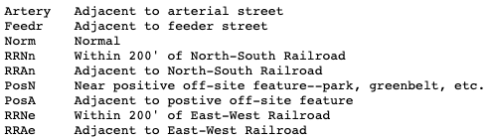
Location

Slide 10
Who will find the model useful?
Buyers : Will be able to figure out if they are overpaying or underpaying
Sellers: Will know what to do to improve the value of their home
Investors: Will be able to know what locations to invest in

Slide 11
Limitations of model
Data is only 4 years long and out of date
Factors such as inflation may not have been taken into account for over the years
Model is only applicable to Ames, Iowa and cannot be generalized to other regions.

Slide 12

Thank you very much

