Slide 2
Cost benefit analysis
$$Cost−Benefit=Nett Gain or Loss$$
Fixed Costs
Cost of Vehicles
Cost of Manpower
Administrative costs
Fixed at 20% of variable
costs
Variable costs
Cost of chemicals sprayed
from each spray truck
Cost of spraying the
area each truck can cover at
the max speed and the min
speed
Calculatable benefits
Savings from cost of
hospitalization for each WNV fever - infected patient
Savings from median productivity costs of each Chicago worker.

Slide 3
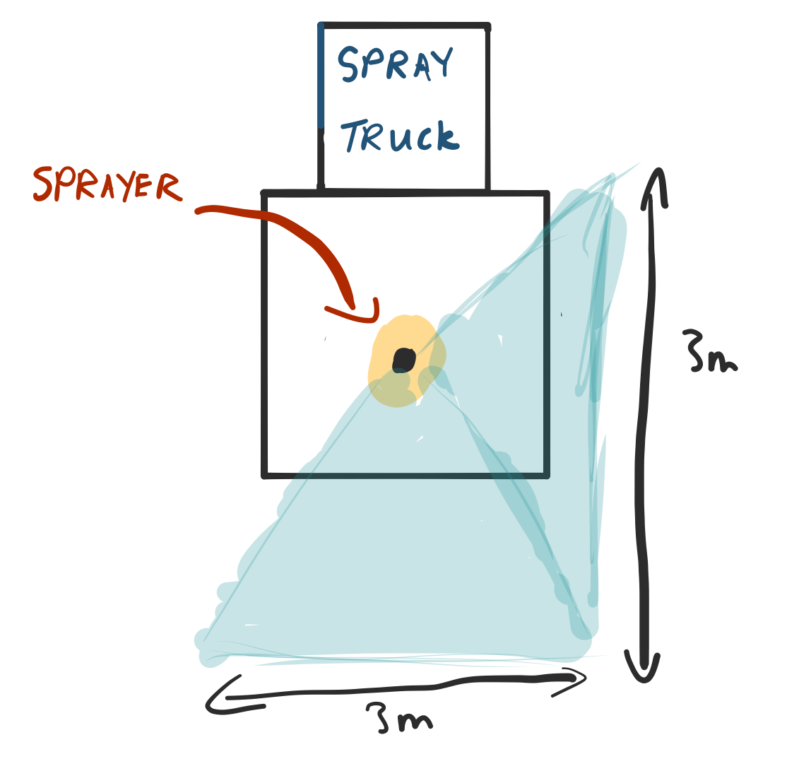
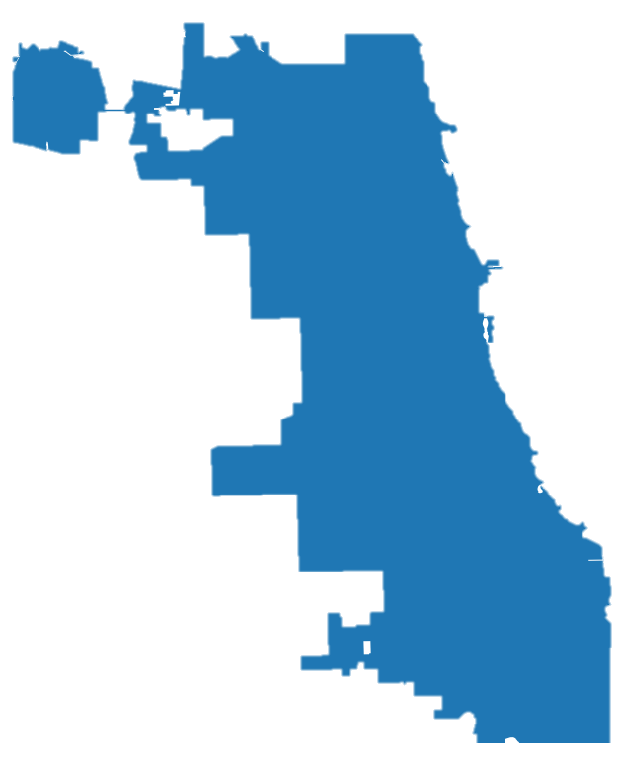
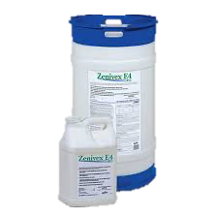
Costs - Assumptions
606.1 km²
Coverage = 9 m²
Speed: 16 to 24 km/h
Sprays: 0.5 gallons/min
^{Cost: USD $80 /}
^{US Gallon}

Slide 4


Benefits - Assumptions
^{Median income: USD $55,295}
⁽²⁰¹⁷⁾
Hospitalisation costs: USD $25,000 per hospital stay
⁽²⁰¹⁷⁾

Slide 5
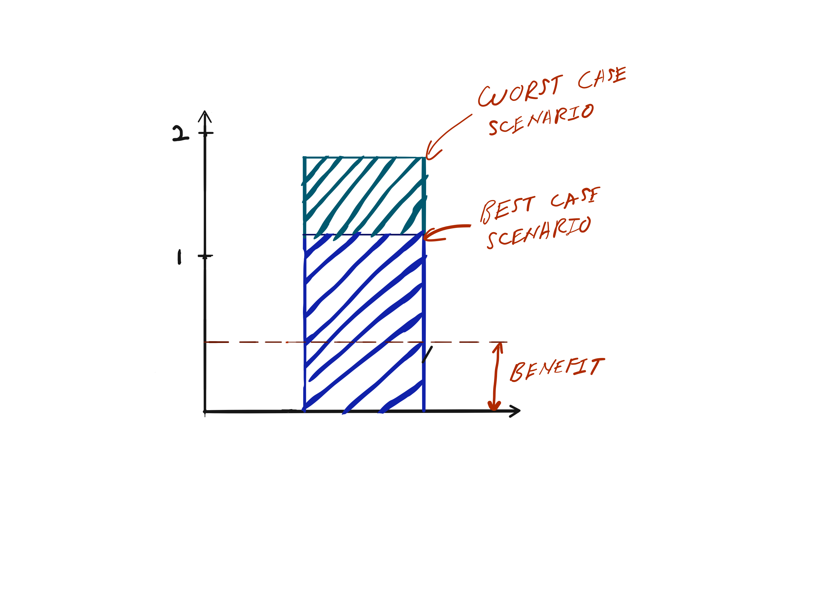
Cost-Benefit Analysis
Millions (USD $)

Slide 6
Recommendations and next steps
After studying the effectiveness of spraying and given its high cost:
Re-examine the effectiveness of spraying Zenivex™. Evidence points towards the ineffectiveness of the chemical.
Develop mosquito spraying regimes in a more organised and evidence-driven manner
Examine new ways of controlling the mosquito population that may cost less than spraying the whole of Chicago.

