Slide 1






Customer Churn
Intelligence Analysis
Data-driven insights for strategic customer retention
10,000
20%
0.80
Total Customers
Churn Rate
Predicted Probability
| From Database Setup to Actionable Business Intelligence |
| ALL FILES/QUERIES EMBEDDED IN LINKS(Github) |
| Kindly Explore |

Slide 2




Problem Statement
Customer churn represents a critical business challenge that directly impacts revenue growth and long-term sustainability.
20%
Revenue Loss Impact
Current Churn Rate
High churn rates lead to significant revenue loss and hinder business growth potential
2,037 out of 10,000 customers
$$$
Limited Visibility
Revenue at Risk
Lack of comprehensive understanding of factors contributing to customer churn
Significant financial impact
Banking Sector Challenge
Reactive Approach
In the competitive banking landscape, understanding and predicting customer churn is essential for developing effective retention strategies and maintaining market position.
Current strategies are reactive rather than predictive, missing early intervention opportunities
Solution Need: Data-driven intelligence for proactive customer retention

Slide 3








Analysis Questions
Key research questions that guided our comprehensive churn investigation
1
Most Churned Category Identification
Which customer segment (by geography and gender) shows the highest churn rate across all categories?
Goal: Identify high-risk customer segments for targeted retention strategies
2
Total Churned Customers Quantification
What is the exact number of customers who have churned from our customer base?
Goal: Establish baseline metrics for churn rate calculation and impact assessment
3
Overall Customer Base Analysis
What is the total number of customers in our database for analysis context?
Goal: Calculate accurate churn percentage and understand scale of analysis
Analysis Approach
These targeted questions form the foundation of our data-driven approach to understanding customer churn patterns, enabling the development of predictive model and actionable business intelligence.

Slide 4










Technical Infrastructure Setup
Robust database environment and data architecture for comprehensive churn analysis
1
SQL Server Setup
2
Database Creation
Microsoft SQL Server 2022
Bank_Churn_DB
Windows Operating System
Dedicated churn analysis database
SQL Server 2022 Installation
Customers table with optimized schema
Local data loading configuration
Appropriate data types and constraints
Optimized for efficient data import and query performance
Schema designed to reflect dataset structure accurately
Access All The Queries on my Github
Database Schema Implementation
Access All the Queries in My Github Repo
CREATE DATABASE
Bank_Churn_DB
;
GO
USE
Bank_Churn_DB
DB/table Creation: Click Here
;
GO
CREATE TABLE
Customers
(
CustomerId
INT PRIMARY KEY
,
Most Churned Category Identification: Click Here
Surname
NVARCHAR(255)
,
CreditScore
INT
,
Geography
NVARCHAR(255)
,
Gender
NVARCHAR(255)
,
Total Churned Customers Quantification: Click Here
Age
INT
,
Tenure
INT
,
Balance
DECIMAL(10, 2)
,
NumOfProducts
INT
Overall Customer Base Analysis: Click Here
,
HasCrCard
BIT
,
IsActiveMember
BIT
,
EstimatedSalary
DECIMAL(10, 2)
,
Exited
BIT
);
GO
13
10K
SSMS
Data Fields
Records Capacity
Import Method

Slide 5










Data Pipeline & Power BI Integration
Seamless data flow from SQL Server to interactive business intelligence dashboard
Data Import
SQL Analysis
DirectQuery
Dashboard
Bank_Churn.csv loaded via SSMS import feature
Queries executed for churn insights
Real-time connection to SQL Server
Interactive visualizations and insights
10,000 Records
3 Key Queries
Live Data
8 Visuals
DirectQuery Advantages
Custom Measures Created
Real-time Data
Dashboard always displays current information
Total Customers
COUNT of all customer records
No Data Import
Queries database directly without copying data
Data Security
Churned Customers
Maintains single source of truth
COUNT where Exited = 1
Churn Rate
Churned / Total * 100
Prediction Parameters
CreditScore, Age, NumOfProducts

Slide 6






Dashboard Overview & Key Metrics
Comprehensive Power BI dashboard providing interactive churn intelligence
10K
2,037
20%
0.40
Total Customers
Churned Customers
Churn Rate
Predicted Probability
Interactive Power BI Dashboard
Real-time
Interactive
Predictive
8
4
3
13
Visualizations
Parameters
Geographies
Data Fields

Slide 7
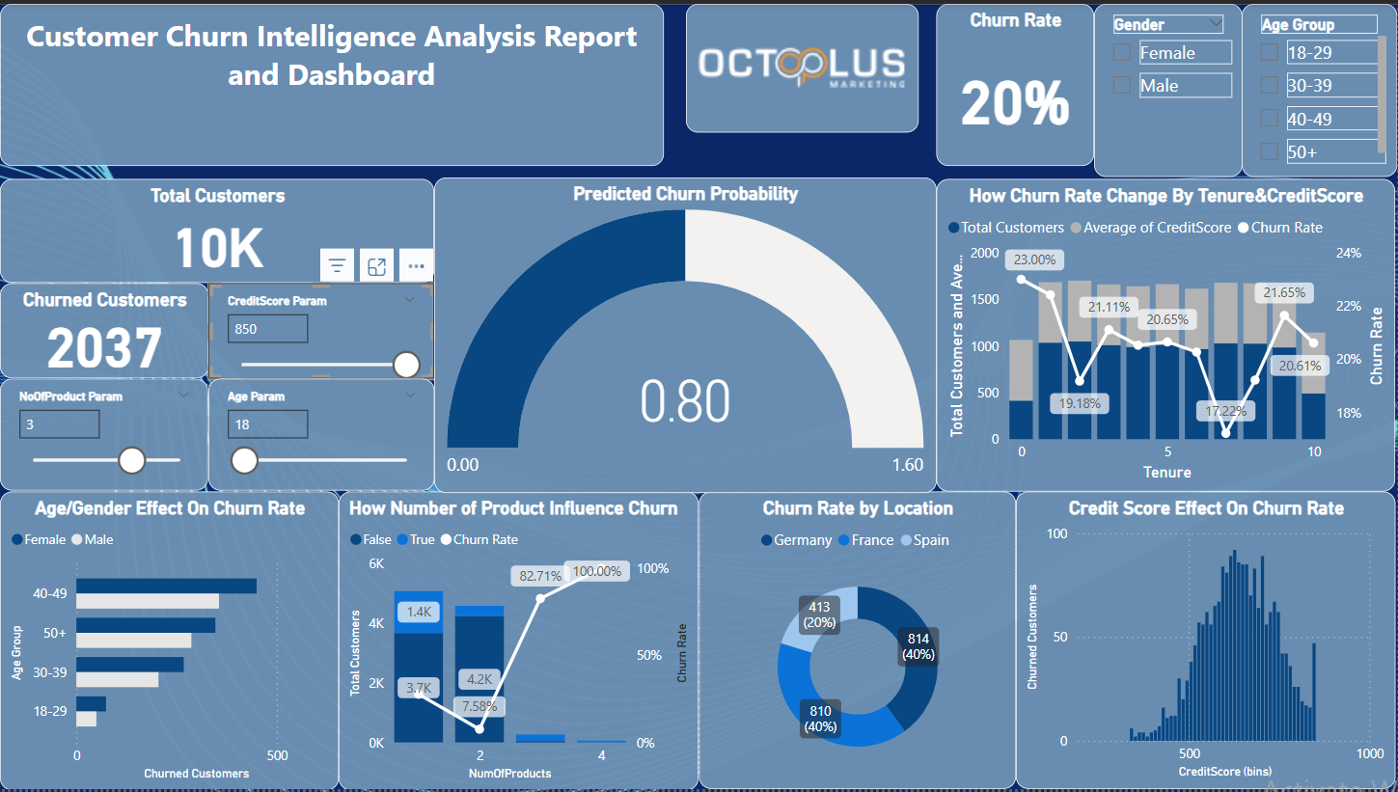
Dashboard(Download PBI file HERE)

Slide 8
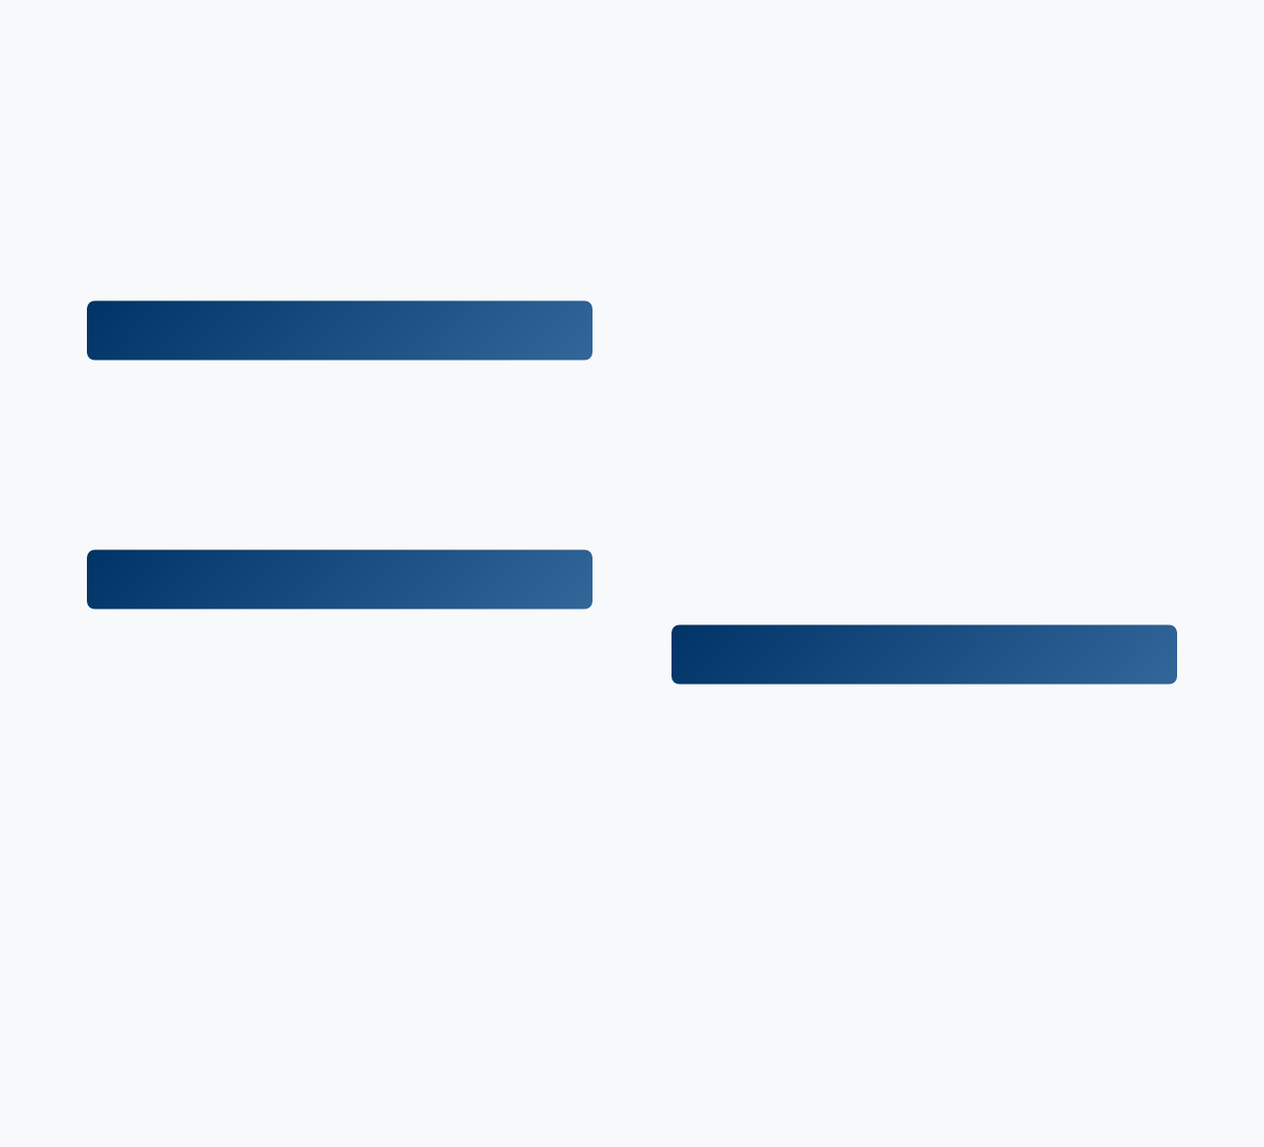






Intelligence & Insights Analysis
Key findings from comprehensive dashboard analysis revealing critical churn patterns
Highest Risk Segment
Product Portfolio Risk
France, Female: 460 churned customers
4 Products
100% Churn
3 Products
82.71% Churn
Female customers, particularly in 40-49 and 50+ age groups, show significantly higher churn rates across all geographies.
1-2 Products
Lower Churn
Counter-intuitive finding: customers with more products show dramatically higher churn rates, suggesting bundle dissatisfaction.
Credit Score Pattern
600-700 range shows highest churn concentration
Tenure Patterns
Customers with moderate credit scores represent the largest portion of churned customers, indicating potential dissatisfaction with service offerings.
Critical periods: 0, 5, and 10 years
Churn rate fluctuates significantly with tenure, showing peaks at key milestone years requiring proactive intervention.
Geographic Insights
40%
40%
20%
Predictive Intelligence
France
Germany
Spain
France and Germany show equal high churn rates, while Spain demonstrates better customer retention.
Credit Score
Balance
350-850 range
Account balance
Age
Products
18+ years
1-4 products
Interactive parameters enable scenario analysis for proactive churn prediction and intervention strategies.

Slide 9








Strategic Recommendations
Actionable business strategies based on churn analysis insights
High Priority Actions
URGENT
Strategic Initiatives
STRATEGIC
Targeted Retention Campaigns
Proactive Engagement
Focus on female customers aged 40+ in France and Germany
Outreach at critical tenure milestones (0, 5, 10 years)
Impact: 460+ at-risk customers
Impact: Prevent milestone churn
Product Portfolio Review
Predictive Model Implementation
Investigate why 3+ product customers churn at 82.71%
Use churn probability model for early intervention
Impact: Bundle optimization needed
Impact: Proactive retention
Credit Score Interventions
Personalized Offers
Develop strategies for 600-700 credit score segment
Tailored incentives based on customer risk profile
Impact: Largest churned segment
Impact: Customized retention
Implementation Roadmap
Q1
Q2
Q3
Q4
Immediate Actions
Strategic Development
Implementation
Optimization
• Targeted campaigns
• Predictive model
• Personalized offers
• Performance review
• Product review
• Engagement programs
• Automated alerts
• Model refinement
• Credit score analysis
• Process optimization
• Staff training
• Continuous improvement

Slide 10








Project Outcome &
Business Impact
Comprehensive data analysis pipeline delivering actionable intelligence for strategic customer retention
Robust Infrastructure
Actionable Insights
Predictive Intelligence
Complete data pipeline from SQL Server setup to interactive Power BI dashboard
Clear identification of high-risk segments and churn patterns for targeted interventions
Interactive predictive model enabling proactive customer retention strategies
10,000 Records Analyzed
4 Prediction Parameters
8 Key Visualizations
Delivered Business Value
Technical Achievements
Strategic Impact
Complete SQL Server database implementation
Identified highest-risk customer segments
DirectQuery Power BI integration for real-time data
Revealed counter-intuitive product portfolio risks
Interactive dashboard with predictive capabilities
Enabled data-driven retention strategies
Comprehensive data analysis and visualization
Provided foundation for sustainable growth
Project Success Metrics
20%
2,037
460
0.40
Churn Rate Identified
At-Risk Customers
Highest Risk Segment
Prediction Accuracy

