Slide 1

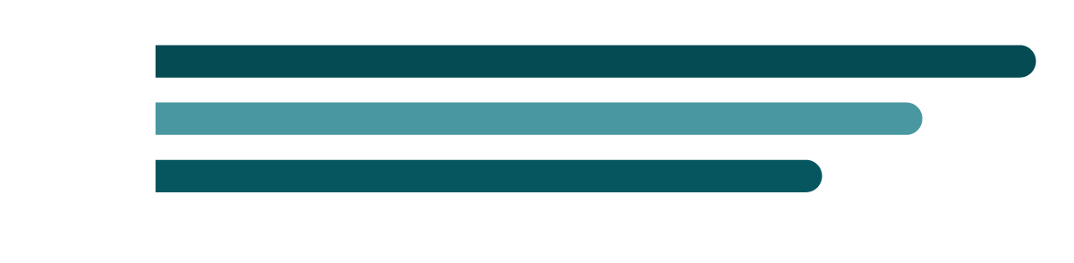
Credit Facility Case Study
Identify growth opportunities, optimize channel strategies, and enhance customer satisfaction
Ogbonna Ngwu
ngwuogbonnaprince@gmail.com
Alternative Slide Access
Case study access link: CLICK HERE

Slide 2

Case
Overview
1
Task 1: Business Performance Analysis
2
Task 2: Customer Feedback Analysis
3
Task 3: Market Research Analysis
4
Task 4: Market Data Analysis
Products: BNPL, Business Loan, Personal Loan

Slide 3
Analysis Framework Diagram
01
Insight and recommendation
Data cleaning/new feature generation
05
Goal: Growth Opportunities
02
Intelligence Dashboard development
Business Performance analysis
04
03
Customer feedback, market resaerch and market data analysis
New feature generated: Converted(Application volume * Conversion rate), Profit(Revenue * Margin)
NB: This is a flexible intelligence report open to changes. It would be way better if given the opportunity to ask the many questions I had on business Objectives that could have influenced the recommendations

Slide 4
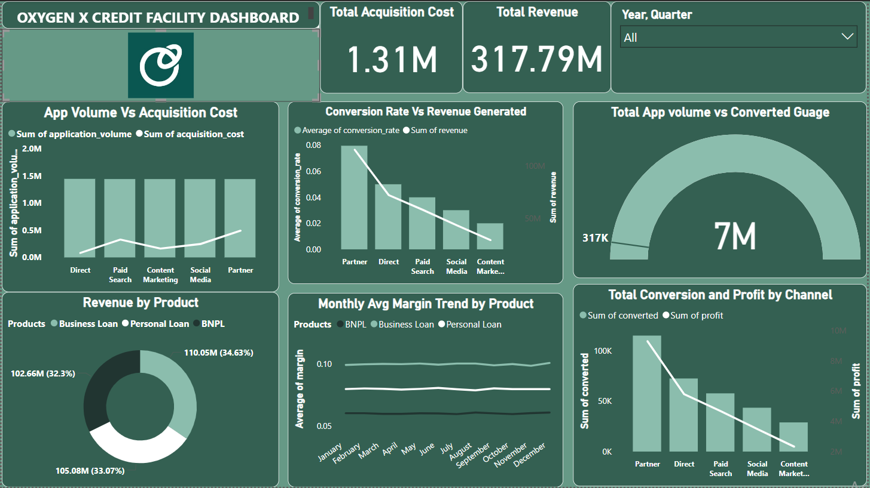
Business Performance Dashboard

Slide 5
Business Performance Insights
Insights
Insights
Application Volume vs. Acquisition Cost by Channel: Application volume is relatively equal across channels, but acquisition costs vary, with higher costs observed in channels: Direct and Paid Search.
Conversion Rate and Revenue by Channel: The Partner channel has the highest conversion rate and revenue, suggesting strong relationships in this channel. Content Marketing, however, has the lowest conversion rate, hinting that the messaging might not fully resonate with the target audience.
4.53%(317k) of total application volume(7M) was approved. Indicating more room for optimised credit approval means and technology.
Revenue and Margin by Product: Revenue distribution among products (Business Loan, Personal Loan, and BNPL) is fairly balanced. However, margins vary by product, indicating areas for cost optimization.
Monthly Margin Trends: Margins remain steady throughout the year, but Business Loans with the highest margin has slight increases in months of Nov-Dec. This could be a seasonal effect or a reflection of effective promotional efforts.
Profit and Conversion by Channel: Partner and Direct channels drive the highest profits, aligning with their strong conversion rates. Lower-performing channels, such as Content Marketing, could benefit from revised strategies or reduced investment.

Slide 6
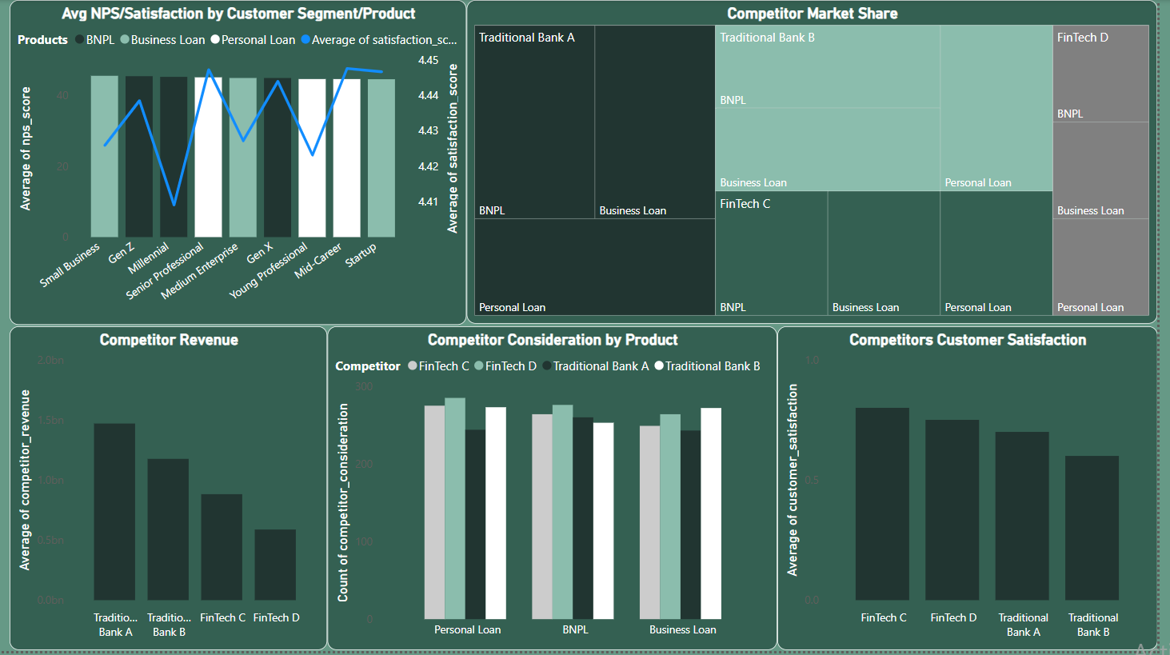
Customer Feedback,market research,market Data Dashboard

Slide 7
Feedback/Market and Competitor Insights
Insights
Insights
NPS and Satisfaction Scores: Different customer segments exhibit varying levels of satisfaction and NPS scores across FinTechLend's product offerings. For instance, Small Business and Gen Z segments show fluctuations, suggesting diverse expectations.
Customer Satisfaction by Competitor: FinTech competitors are achieving higher average satisfaction scores compared to traditional banks, highlighting FinTechLend’s opportunity to further differentiate in customer service and product innovation.
Competitor Revenue Comparison: Traditional banks dominate in terms of revenue, with Traditional Bank A leading. FinTechLend may need targeted strategies to capture a share from these well-established players and validated market.
Market Share by Product and Competitor: Traditional banks hold a large share in the BNPL and Business Loan markets, while FinTechs are catching up, especially in Personal Loans. This indicates potential for FinTechLend to grow in these segments by emphasizing their unique value proposition.

Slide 8
Recommendation and Strategic Positioning for Growth
Expand Targeted Efforts in High-Converting Channels.
Focus on the Partner Channel: Since the Partner channel has the highest conversion rate and profit, FinTechLend should strengthen these relationships, perhaps by offering exclusive benefits or co-marketing initiatives.
Re-evaluate Low-Performing Channels: Content Marketing shows low conversion rates, so consider refining the messaging or reallocating budget toward more profitable channels.
Enhance Differentiation in Customer Service.
FinTechLend is competitive in satisfaction scores, but there's room to further differentiate from traditional banks, especially for Gen Z and Small Business segments. Introducing loyalty programs, personalized experiences, or faster response times could improve satisfaction and loyalty.
Product-Specific Growth Strategies.
Push BNPL in Underpenetrated Segments: BNPL products could be marketed more aggressively to segments that are typically underserved by traditional banks. Educational campaigns highlighting the benefits of BNPL might help increase adoption.
Leverage Personal Loans for Retention: Since FinTechs already have traction with Personal Loans, deepening engagement with this product through cross-selling and upselling e.g. offering Business Loans to personal loan customers, could drive growth.

Slide 9
Recommendation and Strategic Positioning for Growth
Competitive Positioning and Marketing.
Capitalize on FinTech's Satisfaction Advantage: Position FinTechLend as a customer-centric alternative to traditional banks, emphasizing speed, transparency, and customer care. This could help attract customers considering competitors.
Focus on High Revenue Segments: Traditional banks lead in revenue; FinTechLend could focus on capturing market share in high-revenue segments like Small Businesses by promoting flexible financing options tailored to business growth.
Seasonal Promotions to Leverage Margins
Since certain months show slightly higher margins, targeted promotional efforts or discounts during these times might capture seasonal demand effectively, boosting profitability without a significant increase in acquisition costs.
Technology Innovation and AI solutions
Implement machine learning models to enhance creditworthiness analysis and prediction, enabling the business to optimize application volume and streamline the approval process for maximized efficiency and growth.

