Slide 1
Domain Transfer for Punctuation Retrieval
Ng Xing Yu
Intern, IE
30 03 2021
Unclassified

Slide 2
Research Objectives
Look at the NLP task of punctuation retrieval
How to improve performance of model on low or zero-resource domains
Notes:
My research for the past 4 months was on the NLP task of punctuation retrieval – the insertion of punctuation into unpunctuated text, and in particular, how to improve the performance of the punctuation retrieval model on low or zero-resource domains such as flight transcripts

Slide 3
Applications of research
Improving punctuation retrieval performance
Improve performance of other downstream NLP tasks e.g. stance analysis
Improve readability of unpunctuated automated speech transcripts
Improving transfer learning performance
Application to domain transfer for similar NLP tasks such as Named entity tagging
Notes:
There are two main applications of my research. Firstly, by improving the performance of the punctuation retrieval model, we can improve the performance of downstream NLP tasks performed on unpunctuated transcripts. Punctuation retrieval can also be used to improve the readability of transcripts for humans.
Secondly, the ideas for transfer learning can be adapted to other similar NLP tasks such as NER tagging

Slide 4
Punctuation Retrieval
Output of automated speech recognition model
Input:
hello how are you jonnathan
Sequence labelling
hello
how
are
you
jonn
##athan
.
,
?
{ . , ? }
Output:
hello. how are you, jonnathan?
Notes:
Here’s an example of a punctuation retrieval inference process: We take an unpunctuated string, for instance the output of an automated speech recognition model, as input. We tokenize the input, feed the tokens into our language model and obtain punctuation labels for each token which allows us to construct the punctuated sentence.

Slide 5
Domain Transfer
Labelled Domain A
Few Labelled Domain B
Unlabelled Domain B
Model
Improve inference on Domain B
Notes:
The main idea for domain transfer is to maximise the performance of a model on a target domain with low resource, using the few labelled examples or unlabelled examples from the low-resource domain.

Slide 6
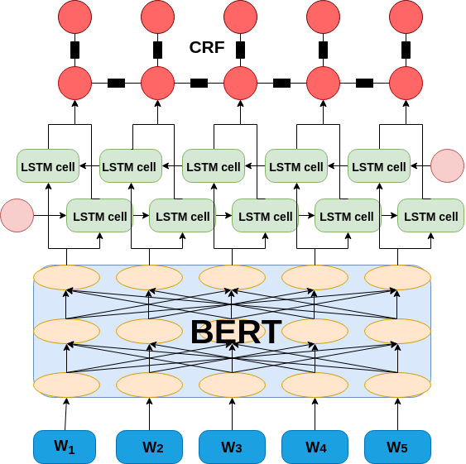
Existing approaches (Punctuation Retrieval)
Use of BiLSTM-CRF or CRF or MLP as punctuation classifier
Use of Transformer to generate hidden word embeddings
panda-baba/bert_punct: Punctuation restoration in ASR text (github.com)
Notes:
I’ll now talk about some existing models used for punctuation retrieval and domain transfer for NLP tasks, before talking about the method I used.
This diagram features 2 main components, a transformer base layer which converts your subwords into hidden embeddings, and a punctuation classifier, in this case a conditional random field over a bilstm layer, which allows the model to jointly consider the entire sequence of punctuation, and predict the most likely sequence, taking neighbouring tokens into consideration.
Some alternative models include using a Multilayer Perceptron as the punctuation classifier or using a LSTM layer to generate the hidden embeddings, but most recent research on punctuation retrieval use something similar to this model.

Slide 7
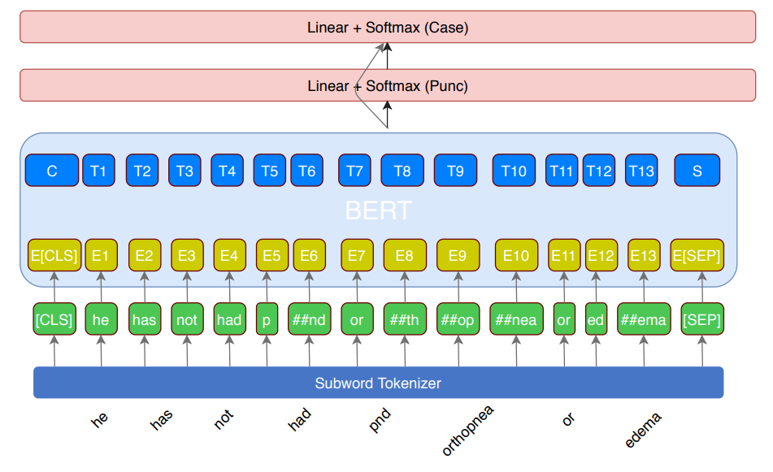
Existing approaches (Punctuation Retrieval)
Joint prediction with other tags such as Capitalisation and NER tags.
Use of prosodic features to improve performance
Notes:
Some research also utilise other labels such as Capitalisation marks or Named entity tags to improve the performance on punctuation retrieval, and others make use of prosodic features such as pause annotation or acoustic information. Some of these approaches would help to improve transfer learning performance on low-resource domains, but I chose to focus solely on textual information with punctuation labels for my research.

Slide 8
Existing approaches (Domain Transfer)
Pre-training on unlabelled target domain data Robust Prediction of Punctuation and Truecasing (arxiv.org)
- Transfer to medical domain with large vocabulary difference from pre-trained models
Use of a learning-curriculum based on decreasing similarity to target domain data. It starts training using examples of greater similarity to target domain, and successively learns harder examples, to improve training efficiency. Domain Adaptation with BERT-based Domain Classification and Data Selection (aclweb.org)
Notes:
There are some research done on domain transfer for NLP tasks. The first research by a team from amazon looks at improving the performance on punctuation and capitalisation retrieval for the medical domain. Their main challenge is in overcoming the large vocabulary difference between the Wikipedia corpus and their medical domain, which would result in poor performance when finetuning the model for punctuation retrieval. Their solution was to perform further pretraining using unlabelled in-domain data.
Another approach by another team from amazon looks at the use of a learning curriculum which gives the model examples of increasing difficulty, in their case of decreasing similarity to the target domain. They demonstrate that their method improves the ability of their model to handle a domain shift between their source and target.

Slide 9
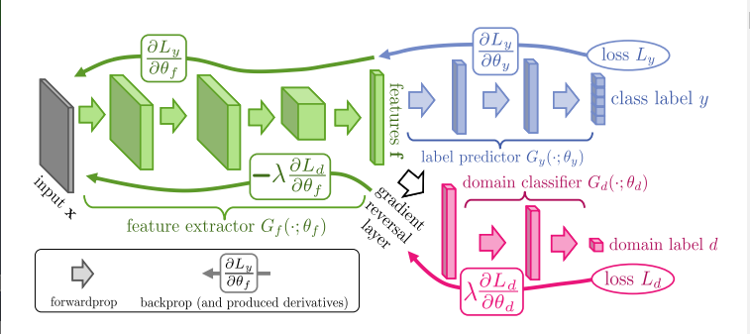
Existing approaches (Domain Transfer)
Use of domain classifier with gradient reversal layer to maximise domain invariance
Unsupervised Domain Adaptation by Backpropagation (arxiv.org)
Notes:
This method features a domain classifier and a gradient reversal layer, with the aim of maximising domain invariance in share layers, which is often just the transformer layers for NLP tasks. This method works by backpropagating the negative gradient of the domain loss, which reduces the ability of the shared layers in the model to differentiate between the various domains. Thus, the model would only learn features common across all domains, and prevent it from overfitting on the training domain.
This method was used by

Slide 10
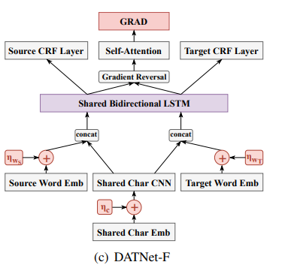
Existing approaches (Domain Transfer)
Use of domain classifier with gradient reversal layer to maximise domain invariance
Dual Adversarial Neural Transfer for Low-Resource Named Entity Recognition (aclweb.org)

Slide 11
My approach
Mask
Transformer
Concat.
MLP
Input Tokens
Punct. logits
Grad. Reverse &
Pooling
MLP
Domain logits
Position
Punct. labels
Domain labels
Domain loss
Aggregate
Punct. loss
Total Loss
- Use of domain classifier with gradient reversal
- Concatenate domain logits with transformer output, as input to punctuation classifier

Slide 12
My approach
Mask
Transformer
Concat.
MLP
Input Tokens
Punct. logits
Grad. Reverse &
Pooling
MLP
Domain logits
Position
Punct. labels
Domain labels
Domain loss
Aggregate
Punct. loss
Total Loss
Maximise Domain invariance of unfrozen layers in transformer
Allow domain specific features captured by the domain logits to be used by the punctuation classifier similar to the dual-adversarial transfer

Slide 13
My Approach
Input:
hello how are you johnathan
Tokenize
hello
how
are
you
john
##athan
Transformer
###
###
###
###
###
###
: Hidden states
Pool -> Domain classifier
Domain 0:
0.9
Domain logits:
Domain 1:
0.1
###
###
###
###
###
###
Concat
0.9
0.9
0.9
0.9
0.9
0.9
0.1
0.1
0.1
0.1
0.1
0.1
Punctuation classifier
.
,
?

Slide 14

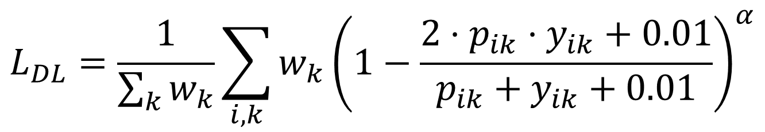
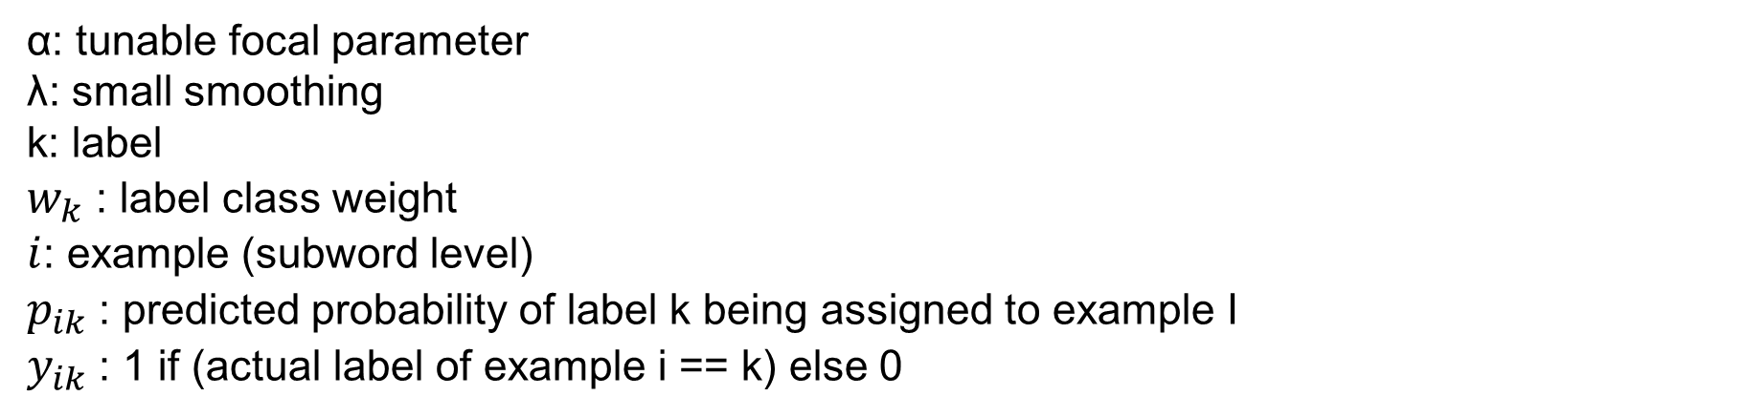
My approach
Use of Macro-average Dice Loss to improve class imbalance.
Dice Coefficient: $D\left(y,\tilde{y}\right)=\frac{2\left|y∩\tilde{y}\right|}{\left|y\right|+\left|\tilde{y}\right|}$
Similarity measure
$$L_{DL}=\frac{1}{\sum_{k}{w_{k}}}\sum_{i,k}{w_{k}{\left(1−\frac{2⋅p_{ik}⋅y_{ik}+0.01}{p_{ik}+y_{ik}+0.01}\right)}^{α}}$$
α: tunable focal parameter
λ: small smoothing
k: label
$w_{k}$: label class weight
$i$: example (subword level)
$p_{ik}$: predicted probability of label k being assigned to example I
$y_{ik}$: 1 if (actual label of example i == k) else 0

Slide 15
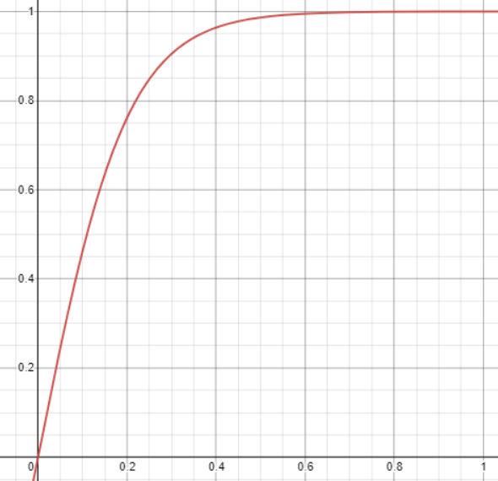
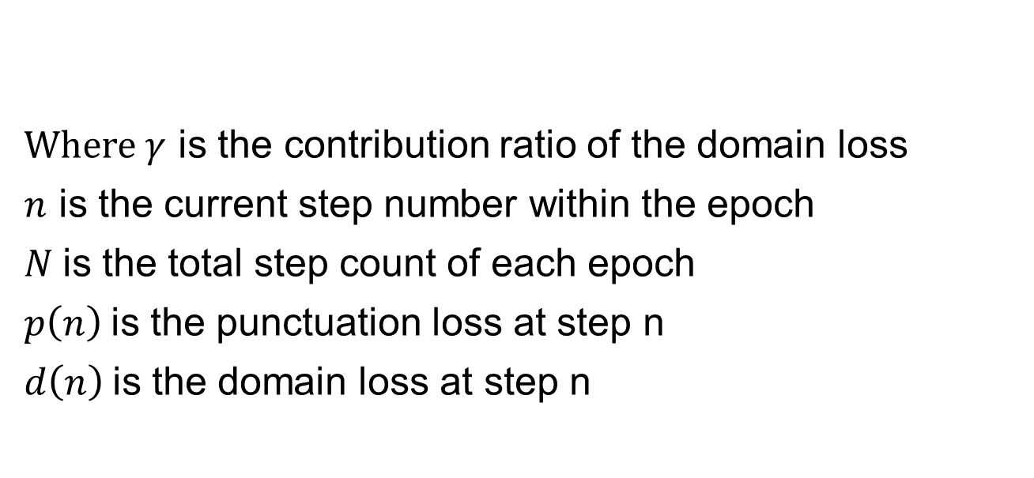
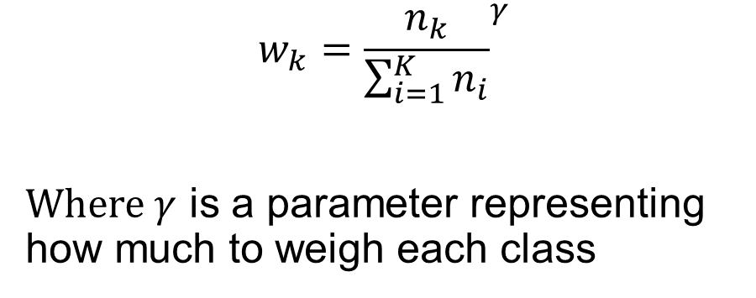
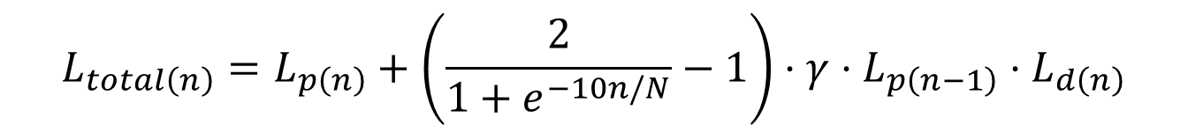
My approach
Use of Class weight
$$w_{k}={\frac{n_{k}}{\sum_{i=1}^{K}{n_{i}}}}^{γ}$$
Where $γ$ is a parameter representing how much to weigh each class
$$L_{total\left(n\right)}=L_{p\left(n\right)}+\left(\frac{2}{1+e^{−10n/N}}−1\right)⋅γ⋅L_{p\left(n−1\right)}⋅L_{d\left(n\right)}$$
Aggregate Loss calculation
Where $γ$ is the contribution ratio of the domain loss
$n$ is the current step number within the epoch
$N$is the total step count of each epoch
$p\left(n\right)$is the punctuation loss at step n
$d\left(n\right)$is the domain loss at step n

Slide 16
Experimental setup
Datasets
IWSLT 2012 dataset
Ted Talks dataset
Open Subtitles dataset
Switchboard dataset
- Pre-process
- Chronological split 0.8 0.1 0.1
- Use switchboard dataset as the low-resource dataset, discarding most of the labels in the train dataset.

Slide 17
Experimental setup
Oversampling to handle domain dataset imbalance
Domain 1
Domain 2
repeat
repeat
Batch size 4
Single batch (4 examples per domain), stride of 32 tokens
128 tokens

Slide 18
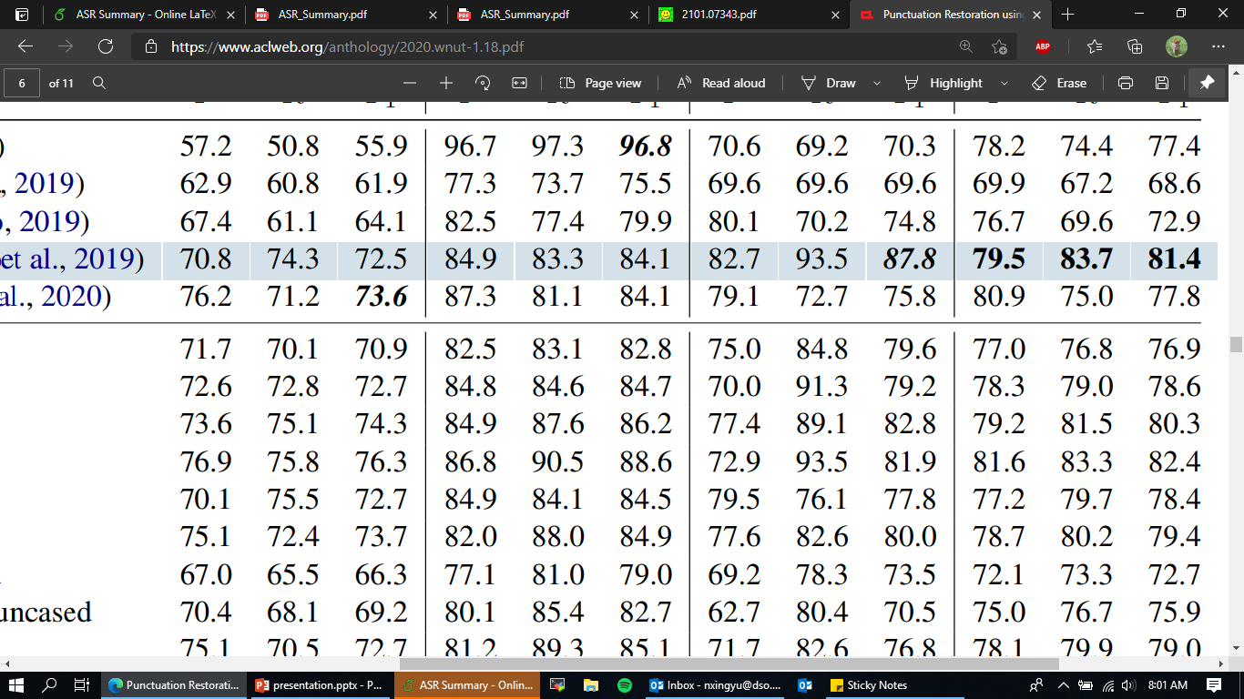
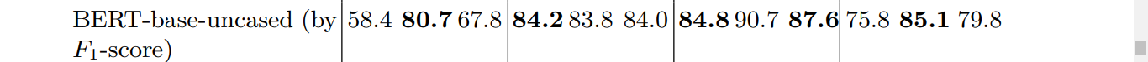
Results
Electra more effective than BERT
Compare performance on BERT base uncased with existing research
Alam et al. (2020) Punctuation restoration using transformer models for high-and lowresource languages : 76.9
Nagy et al. (2021) Automatic punctuation restoration with BERT models : 79.8
Baseline: trained without looking at domain features

Slide 19

Results
Table row numbers
Use of Stride effective [2, 4]
Augmentation cause performance to drop (Alam et al.) [2, 3]
Dice loss with no class weight > Cross Entropy Loss with class weight ($γ$ = 1.0) [2, 6]
Class weight not necessary for dice loss [2, 5]
1
2
3
4
5
6
SWI: switchboard, TED: Ted Talks, OPE: Open Subtitles, IWSLT: IWSLT 2012 Punct. dataset
Baseline: trained without looking at domain features
Notes:
I thought that augmentation would help the performance slightly, as Punctuation Restoration using Transformer Models for Resource-Rich and -Poor Languages (noisy-text.github.io) saw an improvement when using augmentation, since augmentation can serve as a form of regularisation, create new examples and make it more robust to word errors which is common in the Switchboard corpus. I went to take a second look at their paper and found that my augmentation strategy was slightly different with a higher rate of augmentation than theirs at 0.56 compared to 0.4.

Slide 20
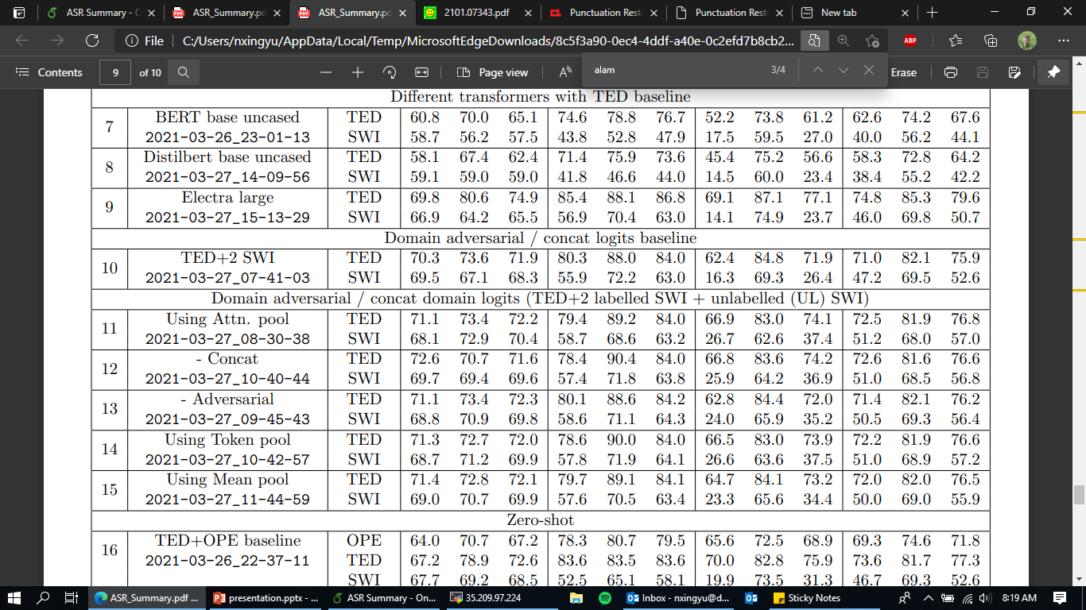
Results
Proposed method seems effective in improving performance on both low and high resource domains
The adversarial component seems more important than the concat component
1
2
3
4
5
6
2, 5, 6: Both Concat and Adversarial
TED + 2 SWI: train with TED and just 2 examples from SWI

Slide 21
Results
Proposed method seems effective in improving performance on both low and high resource domains
The adversarial component seems more important than the concat component
1
2
3
4
Confusion matrix for SWI
5
Predicted\Actual | Blank | Comma | Period | Question
Blank | 167466 | 5479 | 665 | 53
Comma | 10998 | 33751 | 4614 | 175
Period | 2742 | 6280 | 13097 | 213
Question | 490 | 822 | 710 | 737
6
Many cases where commas are inserted to denote breaks in sentence

Slide 22
Results
In the case of zero-resource, the proposed method training on two high-resource domains improves the performance of the model slightly
Inclusion of unlabelled zero-resource domain examples appears to improve performance of zero-resource domain labelling.
1
2
3
4
3, 4: Both Concat and Adversarial

Slide 23
Sample inference from SWI / OPE corpus
Query: My name's Mary Dell, and live in the Dallas, Texas area where there's a lot of
Result: my name's mary dell, and live in the dallas, texas area, where there's a lot of
pollution . Okay, and I'm up in Wisconsin … Oh. … uh, my name is Terry … Uh-huh. … pollution. okay. and i'm up in wisconsin. oh, uh, my name is terry. uh, huh.
and, uh, in the small town we don't, but, uh, we're not that far from the city where
and, uh, in the small town, we don't, but, uh, we're not that far from the city where
there's tons of pollution. Yes. Okay, I'll go ahead and start recording that, Okay.
there's tons of pollution. yes. okay, i'll go ahead and start recording that, okay.
Query: so the Federal Reserve is buying the Treasury's debt. And the Treasury is
so the federal reserve is buying the treasury's debt, and the treasury is
getting that money to, mostly, Americans, in some imperfect but remarkably large way.
getting that money to mostly americans in some imperfect, but remarkably large way.
Notes:
There are cases where various answers exist, such as the second example, where putting a comma between the words anna and smith would result in a different meaning. This will impact nlp tasks like coreference resolution, but should not affect tasks like sentiment analysis or NER.

Slide 24
Sample inference from switchboard corpus
Query : I thank my mother, Anna, Smith and John
Result: i thank my mother, anna smith and john.
Other possible results: i thank my mother, Anna, Smith and John
END of presentation
Notes:
There are cases where various answers exist, such as the second example, where putting a comma between the words anna and smith would result in a different meaning. This will impact nlp tasks like coreference resolution, but should not affect tasks like sentiment analysis or NER.

