Slide 1

What makes TikTok' videos super popular
3 statistical charts for New York Times:
Music
Duration
Sentiment
Group 9
Shijun Ma
Ching Yin Wong
Josephine Chiang
Yi Ling Ng
Source: TikTok

Slide 2
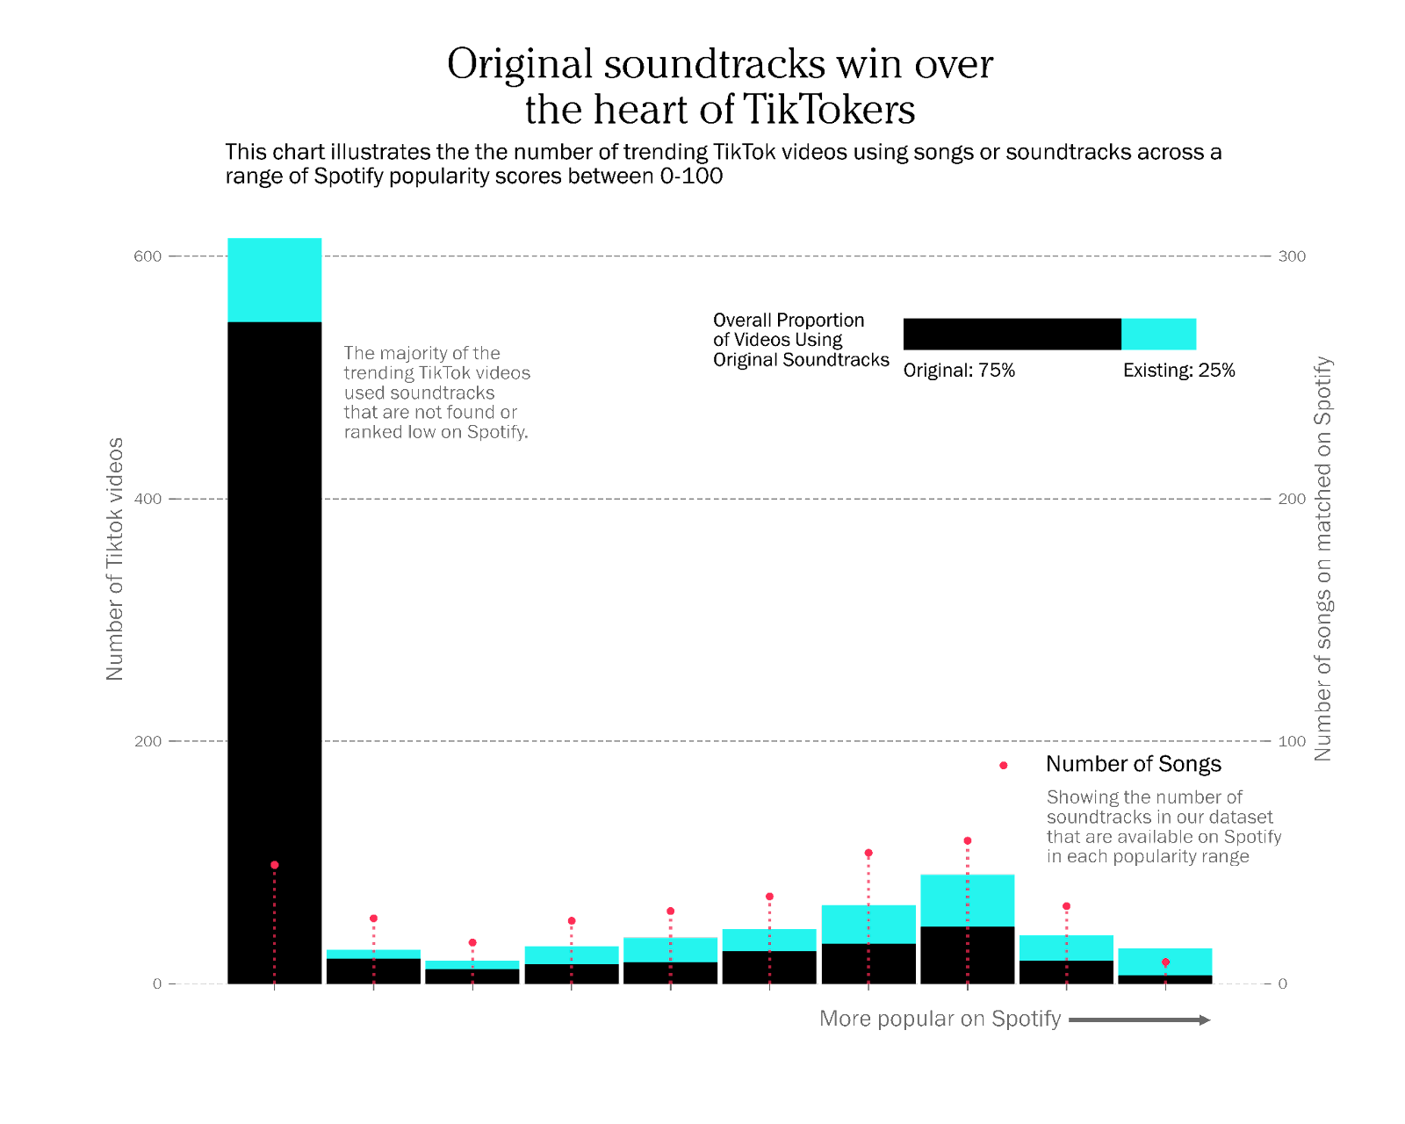
What makes TikTok' videos super popular: Music
Stacked histogram:
represent the distribution of Spotify popularity of soundtracks used in trending videos
Separated by original vs existing to see how the split evolves
Lollipop plot:
shows the number of songs matched on Spotify for each popularity range
provides the context of proportion between number of songs matched and number of trending videos made
Bar chart on top right:
shows the overall proportion of original vs existing soundtracks used by trending videos
also acts as a legend for the stacked histogram

Slide 3
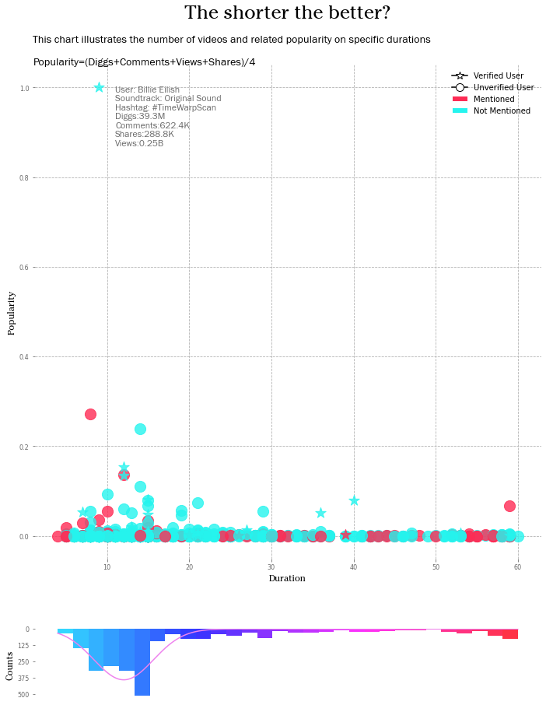
What makes TikTok' videos super popular: Duration
Scatter plot:
Demonstrates the popularity and duration of each video and their distribution;
User verified and whether the video mentions others or not is used to provide alternative information about the video, Verified users are represented by stars and non-verified by circles, with video has others mentioned in description marked in red and vice versa in blue;
The popularity is calculated according to the four measures: diggs, comments, shares and views.
Histogram:
Illustrates the distribution of video lengths, the shorter the duration, the more colours tend to be cooler and conversely warmer. The curve presents a fat-tailed distribution of the video duration;
Notably, the features of the most popular points are marked on the graph to provide more intuitive insight into the characteristics of the video.
Notes:
Scatter plot: coordinate axes, x = duration y = popularity
Other dimensions: mentioned;verified, color fitted the tiktok color scheme
Calculation of popularity, and why?
Billie
Histogram: distribution of duration
Insights: The graph demonstrates that for the 1,000 popular TikTok videos in the dataset. The majority duration is within 5-20s, and the shorter videos are relatively far more popular. The most popular video is from Billie Ellish and is less than 10s. The short duration of TikTok videos enables users to access information and entertain themselves in a very short time. Most video creators are non-verified, reflecting that everyone could gain great attention on TikTok. However, verified users’ videos can be more popular. The mention feature allows TikTok videos to be interactive, with half of the videos shown mentioning others in the video. Thus, the figure reveals that a) TikTok videos are short, b) ordinary people can easily gain attention, and c) videos are interactive.

Slide 4
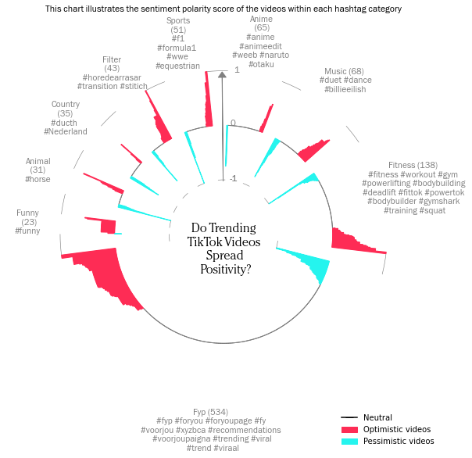
What makes TikTok' videos super popular: Sentiment
Circular bar plot:
Shows the top 45 hashtags separated into 9 categories, with each category grouped by their popularity.
Demonstrates the polarity of each videos in each hashtag category.
Can maximise the use of space than a standard bar chart.
Consists of hashtag category arranged from the lowest polarity to the highest polarity to enable a clear understanding of the distribution of positive and negative videos.
Overall, a wide range of sentiments is found, but positive videos appear more frequently in viral TikTok videos.

Slide 5
Thank you for reading!
Journalist:
Shijun Ma Ching Yin Wong Josephine Chiang Yi Ling Ng

