Slide 1
Module 1: Single-Area OSPFv2 Concepts
Instructor Materials
Enterprise Networking, Security, and Automationv7.0
(ENSA)
Notes:
Cisco Networking Academy Program
Enterprise Networking, Security, and Automationv7.0 (ENSA)
Module 1: Single-Area OSPFv2 Concepts

Slide 2
Instructor Materials – Module 1 Planning Guide
This PowerPoint deck is divided in two parts:
Instructor Planning Guide
Information to help you become familiar with the module
Teaching aids
Instructor Class Presentation
Optional slides that you can use in the classroom
Begins on slide # 10
Note: Remove the Planning Guide from this presentation before sharing with anyone.
For additional help and resources go to the Instructor Home Page and Course Resources for this course. You also can visit the professional development site on netacad.com, the official Cisco Networking Academy Facebook page, or Instructor Only FB group.
Notes:
2

Slide 3
What to Expect in this Module
To facilitate learning, the following features within the GUI may be included in this module:
Feature | Description
Animations | Expose learners to new skills and concepts.
Videos | Expose learners to new skills and concepts.
Check Your Understanding(CYU) | Per topic online quiz to help learners gauge content understanding.
Interactive Activities | A variety of formats to help learners gauge content understanding.
Syntax Checker | Small simulations that expose learners to Cisco command line to practice configuration skills.
PT Activity | Simulation and modeling activities designed to explore, acquire, reinforce, and expand skills.

Slide 4
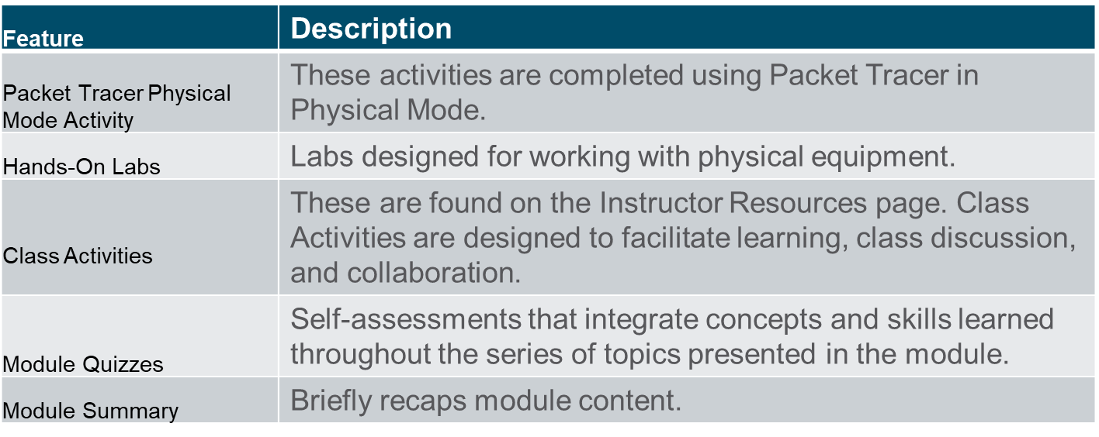
What to Expect in this Module (Cont.)
To facilitate learning, the following features may be included in this module:

Slide 5
Check Your Understanding
Check Your Understanding activities are designed to let students quickly determine if they understand the content and can proceed, or if they need to review.
Check Your Understanding activities do not affect student grades.
There are no separate slides for these activities in the PPT. They are listed in the notes area of the slide that appears before these activities.
Notes:
5

Slide 6
Packet Tracer Physical Mode Activities
These activities are completed using Packet Tracer in Physical Mode.
They are designed to emulate the corresponding Labs.
They can be used instead of the lab when access to physical equipment is not possible.
These activities often do not have the level of scaffolding that is present in PT activities that immediately precede these activities.
Notes:
6

Slide 7
Module 1: Activities
What activities are associated with this module?
Page # | Activity Type | Activity Name | Optional?
1.0.3 | Video | Download and Install Packet Tracer | Recommended
1.0.4 | Video | Getting Started in Cisco Packet Tracer | Recommended
1.0.5 | Packet Tracer Physical Mode | Logical and Physical Mode Exploration | Recommended
1.1.7 | Check Your Understanding | OSPF Features and Characteristics | Recommended
1.2.1 | Video | OSPF Packets | Recommended
1.2.5 | Check Your Understanding | OSPF Packets | Recommended
1.3.1 | Video | OSPF Operation | Recommended
1.3.7 | Check Your Understanding | Operation | Recommended
1.4.2 | Module Quiz | Single-Area OSPFv2 Concepts | Recommended
Notes:
7

Slide 8
Module 1: Best Practices
Prior to teaching Module 1, the instructor should:
Review the activities and assessments for this module.
Try to include as many questions as possible to keep students engaged during classroom presentation.
Topic 1.1
Ask the students or have a class discussion
Discuss and clarify what a ‘link’ is in terms of a link-state routing protocol.
What is the primary benefit to the use of Multiarea OSPF?
Notes:
8

Slide 9
Module 1: Best Practices (Cont.)
Topic 1.2
Ask the students or have a class discussion
Discuss the different types of LSAs and what kind of information they carry.
What is the primary job of the OSPF Hello Packet?
Topic 1.3
Ask the students or have a class discussion
In a multiaccess network with 10 connected routers, how many adjacencies would be formed without the DR/BDR being used?
How does OSPF use the sequence numbers assigned to link state information?
Notes:
9

Slide 10
Module 1: Single-Area OSPFv2 Concepts
Enterprise Networking, Security, and Automation v7.0
(ENSA)
Notes:
Cisco Networking Academy Program
Enterprise Networking, Security, and Automationv7.0 (ENSA)
Module 1: Single-Area OSPFv2 Concepts

Slide 11
Module Objectives
Module Title: Single-Area OSPF Concepts
Module Objective: Explain how single-area OSPF operates in both point-to-point and broadcast multiaccess networks.
Topic Title | Topic Objective
OSPF Features and Characteristics | Describe basic OSPF features and characteristics.
OSPF Packets | Describe the OSPF packet types used in single-area OSPF.
OSPF Operation | Explain how single-area OSPF operates.
Notes:
11
1 – Single-Area OSPFv2
1.0.2 – What will I learn to do in this Module?

Slide 12
1.1 OSPF Features and Characteristics
Notes:
1 - Single-Area OSPFv2 Concepts
1.1 - OSPF Features and Characteristics

Slide 13
OSPF Features and Characteristics Introduction to OSPF
OSPF is a link-state routing protocol that was developed as an alternative for the distance vector Routing Information Protocol (RIP). OSPF has significant advantages over RIP in that it offers faster convergence and scales to much larger network implementations.
OSPF is a link-state routing protocol that uses the concept of areas. A network administrator can divide the routing domain into distinct areas that help control routing update traffic.
A link is an interface on a router, a network segment that connects two routers, or a stub network such as an Ethernet LAN that is connected to a single router.
Information about the state of a link is known as a link-state. All link-state information includes the network prefix, prefix length, and cost.
This module covers basic, single-area OSPF implementations and configurations.
Notes:
1 - Single-Area OSPFv2 Concepts
1.1 - OSPF Features and Characteristics
1.1.1 - Introduction to OSPF

Slide 14
OSPF Features and Characteristics Components of OSPF
All routing protocols share similar components. They all use routing protocol messages to exchange route information. The messages help build data structures, which are then processed using a routing algorithm.
Routers running OSPF exchange messages to convey routing information using five types of packets:
Hello packet
Database description packet
Link-state request packet
Link-state update packet
Link-state acknowledgment packet
These packets are used to discover neighboring routers and also to exchange routing information to maintain accurate information about the network.
Notes:
1 - Single-Area OSPFv2 Concepts
1.1 - OSPF Features and Characteristics
1.1.2 - Components of OSPF

Slide 15
OSPF Features and Characteristics Components of OSPF (Cont.)
OSPF messages are used to create and maintain three OSPF databases, as follows:
Database | Table | Description
Adjacency Database | Neighbor Table | List of all neighbor routers to which a router has established bi-directional communication. This table is unique for each router. Can be viewed using the show ip ospf neighbor command.
Link-state Database (LSDB) | Topology Table | Lists information about all other routers in the network. The database represents the network LSDB. All routers within an area have identical LSDB. Can be viewed using the show ip ospf database command.
Forwarding Database | Routing Table | List of routes generated when an algorithm is run on the link-state database. Each router's routing table is unique and contains information on how and where to send packets to other routers. Can be viewed using the show ip route command.
Notes:
1 - Single-Area OSPFv2 Concepts
1.1 - OSPF Features and Characteristics
1.1.2 - Components of OSPF (Cont.)

Slide 16
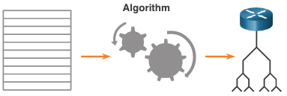
OSPF Features and Characteristics Components of OSPF (Cont.)
The router builds the topology table using results of calculations based on the Dijkstra shortest-path first (SPF) algorithm. The SPF algorithm is based on the cumulative cost to reach a destination.
The SPF algorithm creates an SPF tree by placing each router at the root of the tree and calculating the shortest path to each node. The SPF tree is then used to calculate the best routes. OSPF places the best routes into the forwarding database, which is used to make the routing table.
Notes:
1 - Single-Area OSPFv2 Concepts
1.1 - OSPF Features and Characteristics
1.1.2 - Components of OSPF (Cont.)

Slide 17
OSPF Features and Characteristics Link-State Operation
To maintain routing information, OSPF routers complete a generic link-state routing process to reach a state of convergence. The following are the link-state routing steps that are completed by a router:
Establish Neighbor Adjacencies
Exchange Link-State Advertisements
Build the Link State Database
Execute the SPF Algorithm
Choose the Best Route
Notes:
1 - Single-Area OSPFv2 Concepts
1.1 - OSPF Features and Characteristics
1.1.3 - Link-State Operation

Slide 18
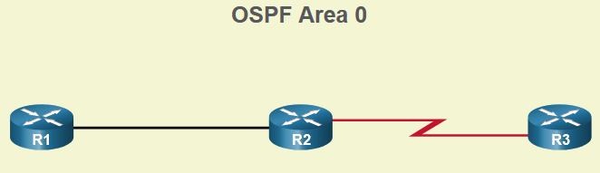
OSPF Features and Characteristics Single-Area and Multiarea OSPF
To make OSPF more efficient and scalable, OSPF supports hierarchical routing using areas. An OSPF area is a group of routers that share the same link-state information in their LSDBs. OSPF can be implemented in one of two ways, as follows:
Single-Area OSPF - All routers are in one area. Best practice is to use area 0.
Multiarea OSPF - OSPF is implemented using multiple areas, in a hierarchical fashion. All areas must connect to the backbone area (area 0). Routers interconnecting the areas are referred to as Area Border Routers (ABRs).
The focus of this module is on single-area OSPFv2.
Notes:
1 - Single-Area OSPFv2 Concepts
1.1 - OSPF Features and Characteristics
1.1.4 - Single-Area and Multiarea OSPF

Slide 19
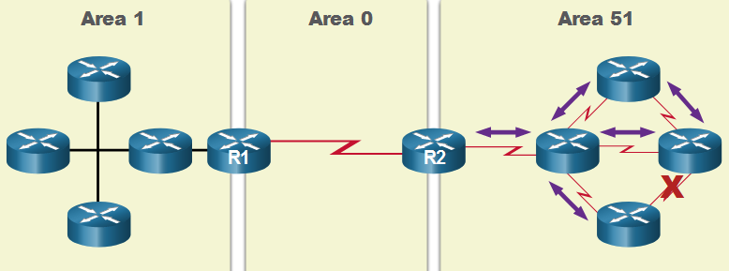
OSPF Features and Characteristics Multiarea OSPF
The hierarchical-topology design options with multiarea OSPF can offer the following advantages.
Smaller routing tables - Tables are smaller because there are fewer routing table entries. This is because network addresses can be summarized between areas. Route summarization is not enabled by default.
Reduced link-state update overhead - Designing multiarea OSPF with smaller areas minimizes processing and memory requirements.
Reduced frequency of SPF calculations -– Multiarea OSPF localize the impact of a topology change within an area. For instance, it minimizes routing update impact because LSA flooding stops at the area boundary.
Notes:
1 - Single-Area OSPFv2 Concepts
1.1 - OSPF Features and Characteristics
1.1.5 - Multiarea OSPF

Slide 20
OSPF Features and Characteristics OSPFv3
OSPFv3 is the OSPFv2 equivalent for exchanging IPv6 prefixes. OSPFv3 exchanges routing information to populate the IPv6 routing table with remote prefixes.
Note: With the OSPFv3 Address Families feature, OSPFv3 includes support for both IPv4 and IPv6. OSPF Address Families is beyond the scope of this curriculum.
OSPFv3 has the same functionality as OSPFv2, but uses IPv6 as the network layer transport, communicating with OSPFv3 peers and advertising IPv6 routes. OSPFv3 also uses the SPF algorithm as the computation engine to determine the best paths throughout the routing domain.
OSPFv3 has separate processes from its IPv4 counterpart. The processes and operations are basically the same as in the IPv4 routing protocol, but run independently.
Notes:
1 - Single-Area OSPFv2 Concepts
1.1 - OSPF Features and Characteristics
1.1.6 - OSPFv3
1.1.7 - Check Your Understanding - OSPF Features and Characteristics

Slide 21
1.2 OSPF Packets
Notes:
1 - Single-Area OSPFv2 Concepts
1.2 - OSPF Packets

Slide 22
OSPF Packets Video - OSPF Packets
This video will cover the following packet types:
Hello
Database Description (DBD)
Link-State Request (LSR)
Link-State Update (LSU)
Link-State Acknowledgment (LSAck)
Notes:
1 - Single-Area OSPFv2 Concepts
1.2 - OSPF Packets
1.2.1 - Video - OSPF Packets

Slide 23
OSPF Packets Types of OSPF Packets
The table summarizes the five different types of Link State Packets (LSPs) used by OSPFv2. OSPFv3 has similar packet types.
Type | Packet Name | Description
1 | Hello | Discovers neighbors and builds adjacencies between them
2 | Database Description (DBD) | Checks for database synchronization between routers
3 | Link-State Request (LSR) | Requests specific link-state records from router to router
4 | Link-State Update (LSU) | Sends specifically requested link-state records
5 | Link-State Acknowledgment (LSAck) | Acknowledges the other packet types
Notes:
1 - Single-Area OSPFv2 Concepts
1.2 - OSPF Packets
1.2.2 – Types of OSPF Packets

Slide 24
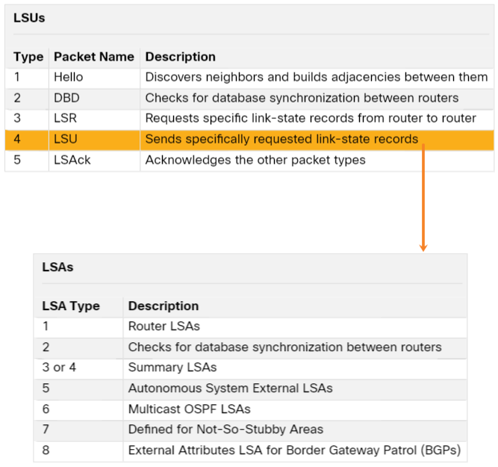
OSPF Packets Link-State Updates
LSUs are also used to forward OSPF routing updates. An LSU packet can contain 11 different types of OSPFv2 LSAs. OSPFv3 renamed several of these LSAs and also contains two additional LSAs.
LSU and LSA are often used interchangeably, but the correct hierarchy is LSU packets contain LSA messages.
Notes:
1 - Single-Area OSPFv2 Concepts
1.2 - OSPF Packets
1.2.3 – Link-State Updates

Slide 25
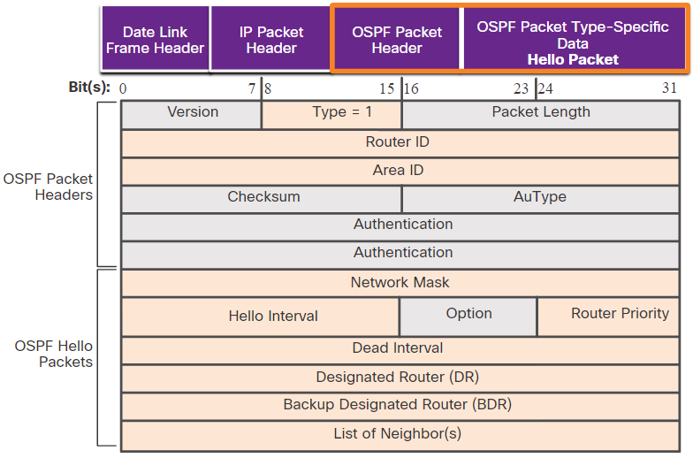
OSPF Packets Hello Packet
The OSPF Type 1 packet is the Hello packet. Hello packets are used to do the following:
Discover OSPF neighbors and establish neighbor adjacencies.
Advertise parameters on which two routers must agree to become neighbors.
Elect the Designated Router (DR) and Backup Designated Router (BDR) on multiaccess networks like Ethernet. Point-to-point links do not require DR or BDR.
Notes:
1 - Single-Area OSPFv2 Concepts
1.2 - OSPF Packets
1.2.4 – Hello Packet
1.2.5 – Check Your Understanding – OSPF Packets

Slide 26
1.3 OSPF Operation
Notes:
1 - Single-Area OSPFv2 Concepts
1.3 - OSPF Operation

Slide 27
OSPF Operation Video - OSPF Operation
This video will cover the 7 states of OSPF operation:
Down state
Init state
Two-way state
ExStart state
Exchange state
Loading state
Full state
Notes:
1 - Single-Area OSPFv2 Concepts
1.3 - OSPF Operation
1.3.1 - Video - OSPF Operation

Slide 28
OSPF Operation OSPF Operational States
State | Description
Down State | No Hello packets received = Down. Router sends Hello packets. Transition to Init state.
Init State | Hello packets are received from the neighbor. They contain the Router ID of the sending router. Transition to Two-Way state.
Two-Way State | In this state, communication between the two routers is bidirectional. On multiaccess links, the routers elect a DR and a BDR. Transition to ExStart state.
Notes:
1 - Single-Area OSPFv2 Concepts
1.3 - OSPF Operation
1.3.2 - OSPF Operational States

Slide 29
OSPF Operation OSPF Operational States (Cont.)
State | Description
ExStart State | On point-to-point networks, the two routers decide which router will initiate the DBD packet exchange and decide upon the initial DBD packet sequence number.
Exchange State | Routers exchange DBD packets. If additional router information is required then transition to Loading; otherwise, transition to the Full state.
Loading State | LSRs and LSUs are used to gain additional route information. Routes are processed using the SPF algorithm. Transition to the Full state.
Full State | The link-state database of the router is fully synchronized.
Notes:
1 - Single-Area OSPFv2 Concepts
1.3 - OSPF Operation
1.3.2 - OSPF Operational States (Cont.)

Slide 30
OSPF Operation Establish Neighbor Adjacencies
To determine if there is an OSPF neighbor on the link, the router sends a Hello packet that contains its router ID out all OSPF-enabled interfaces. The Hello packet is sent to the reserved All OSPF Routers IPv4 multicast address 224.0.0.5. Only OSPFv2 routers will process these packets.
The OSPF router ID is used by the OSPF process to uniquely identify each router in the OSPF area. A router ID is a 32-bit number formatted like an IPv4 address and assigned to uniquely identify a router among OSPF peers.
When a neighboring OSPF-enabled router receives a Hello packet with a router ID that is not within its neighbor list, the receiving router attempts to establish an adjacency with the initiating router.
Notes:
1 - Single-Area OSPFv2 Concepts
1.3 - OSPF Operation
1.3.3 - Establish Neighbor Adjacencies

Slide 31
OSPF Operation Establish Neighbor Adjacencies (Cont.)
The process routers use to establish adjacency on a multiaccess network:
1 | Down to Init State | When OSPFv2 is enabled on the interface, R1 transitions from Down to Init and starts sending OSPFv2 Hellos out of the interface in an attempt to discover neighbors.
2 | Init State | When a R2 receives a hello from the previously unknown router R1, it adds R1’s router ID to the neighbor list and responds with a Hello packet containing its own router ID.
3 | Two-Way State | R1 receives R2’s hello and notices that the message contains the R1 router ID in the list of R2’s neighbors. R1 adds R2’s router ID to the neighbor list and transitions to the Two-Way State. If R1 and R2 are connected with a point-to-point link, they transition to ExStart If R1 and R2 are connected over a common Ethernet network, the DR/BDR election occurs.
4 | Elect the DR & BDR | The DR and BDR election occurs, where the router with the highest router ID or highest priority is elected as the DR, and second highest is the BDR
Notes:
1 - Single-Area OSPFv2 Concepts
1.3 - OSPF Operation
1.3.3 - Establish Neighbor Adjacencies (Cont.)

Slide 32
OSPF Operation Synchronizing OSPF Databases
After the Two-Way state, routers transition to database synchronization states. This is a three step process, as follows:
Decide first router: The router with the highest router ID sends its DBD first.
Exchange DBDs: As many as needed to convey the database. The other router must acknowledge each DBD with an LSAck packet.
Send an LSR: Each router compares the DBD information with the local LSDB. If the DBD has more current link information, the router transitions to the loading state.
After all LSRs have been exchanged and satisfied, the routers are considered synchronized and in a full state. Updates (LSUs) are sent:
When a change is perceived (incremental updates)
Every 30 minutes
Notes:
1 - Single-Area OSPFv2 Concepts
1.3 - OSPF Operation
1.3.4 - Synchronizing OSPF Databases

Slide 33
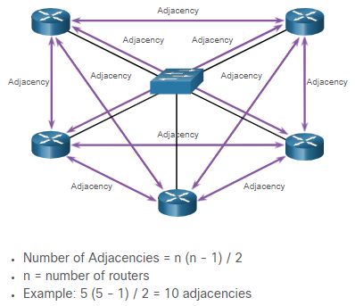
OSPF Operation The Need for a DR
Multiaccess networks can create two challenges for OSPF regarding the flooding of LSAs, as follows:
Creation of multiple adjacencies - Ethernet networks could potentially interconnect many OSPF routers over a common link. Creating adjacencies with every router would lead to an excessive number of LSAs exchanged between routers on the same network.
Extensive flooding of LSAs - Link-state routers flood their LSAs any time OSPF is initialized, or when there is a change in the topology. This flooding can become excessive.
Notes:
1 - Single-Area OSPFv2 Concepts
1.3 - OSPF Operation
1.3.5 – The Need for a DR

Slide 34
OSPF Operation LSA Flooding with a DR
An increase in the number of routers on a multiaccess network also increases the number of LSAs exchanged between the routers. This flooding of LSAs significantly impacts the operation of OSPF.
If every router in a multiaccess network had to flood and acknowledge all received LSAs to all other routers on that same multiaccess network, the network traffic would become quite chaotic.
On multiaccess networks, OSPF elects a DR to be the collection and distribution point for LSAs sent and received. A BDR is also elected in case the DR fails. All other routers become DROTHERs. A DROTHER is a router that is neither the DR nor the BDR.
Note: The DR is only used for the dissemination of LSAs. The router will still use the best next-hop router indicated in the routing table for the forwarding of all other packets.
Notes:
1 - Single-Area OSPFv2 Concepts
1.3 - OSPF Operation
1.3.6 - LSA Flooding with a DR
1.3.7 – Check Your Understanding – OSPF Operation

Slide 35
1.4 Module Practice and Quiz
Notes:
1 - Single-Area OSPFv2 Concepts
1.4 - Module Practice and Quiz

Slide 36
Module Practice and Quiz What Did I Learn In This Module?
Open Shortest Path First (OSPF) is a link-state routing protocol that was developed as an alternative for the distance vector Routing Information Protocol (RIP).
OSPF is a link-state routing protocol that uses the concept of areas for scalability.
A link is an interface on a router. A link is also a network segment that connects two routers, or a stub network such as an Ethernet LAN that is connected to a single router.
All link-state information includes the network prefix, prefix length, and cost.
All routing protocols use routing protocol messages to exchange route information. The messages help build data structures, which are then processed using a routing algorithm.
Routers running OSPF exchange messages to convey routing information using five types of packets: the Hello packet, the database description packet, the link-state request packet, the link-state update packet, and the link-state acknowledgment packet.
OSPF messages are used to create and maintain three OSPF databases: the adjacency database creates the neighbor table, the link-state database (LSDB) creates the topology table, and the forwarding database creates the routing table.
The router builds the topology table using results of calculations based on the Dijkstra SPF (shortest-path first) algorithm. The SPF algorithm is based on the cumulative cost to reach a destination. In OSPF, cost is used to determine the best path to the destination.
Notes:
1 - Single-Area OSPFv2 Concepts
1.4 - Module Practice and Quiz
1.4.1 - What Did I Learn In This Module?

Slide 37
Module Practice and Quiz What Did I Learn In This Module?
To maintain routing information, OSPF routers complete a generic link-state routing process to reach a state of convergence: Establish Neighbor Adjacencies, Exchange Link-State Advertisements, Build the Link State Database, Execute the SPF Algorithm, Choose the Best Route
With single-area OSPF any number can be used for the area, best practice is to use area 0.
Single-area OSPF is useful in smaller networks with few routers.
With multiarea OSPF, one large routing domain can be divided into smaller areas, to support hierarchical routing. Routing still occurs between the areas (interarea routing), while many of the processor intensive routing operations, such as recalculating the database, are kept within an area.
OSPFv3 is the OSPFv2 equivalent for exchanging IPv6 prefixes. Recall that in IPv6, the network address is referred to as the prefix and the subnet mask is called the prefix-length.
OSPF uses the following link-state packets (LSPs) to establish and maintain neighbor adjacencies and exchange routing updates: 1 Hello, 2 DBD, 3 LSR, 4 LSU, and 5 LSAck.
LSUs are also used to forward OSPF routing updates, such as link changes.
Hello packets are used to: Discover OSPF neighbors and establish neighbor adjacencies, Advertise parameters on which two routers must agree to become neighbors, and Elect the Designated Router (DR) and Backup Designated Router (BDR) on multiaccess networks like Ethernet. Point-to-point links do not require DR or BDR.
Notes:
1 - Single-Area OSPFv2 Concepts
1.4 - Module Practice and Quiz
1.4.1 - What Did I Learn In This Module?

Slide 38
Module Practice and Quiz What Did I Learn In This Module?
Some important fields in the Hello packet are type, router ID, area ID, network mask, hello interval, router priority, dead interval, DR, BDR and list of neighbors.
The states that OSPF progresses through to do reach convergence are down state, init state, two-way state, ExStart state, Exchange state, loading state, and full state.
When OSPF is enabled on an interface, the router must determine if there is another OSPF neighbor on the link by sending a Hello packet that contains its router ID out all OSPF-enabled interfaces.
The Hello packet is sent to the reserved All OSPF Routers IPv4 multicast address 224.0.0.5. Only OSPFv2 routers will process these packets.
When a neighboring OSPF-enabled router receives a Hello packet with a router ID that is not within its neighbor list, the receiving router attempts to establish an adjacency with the initiating router.
After the Two-Way state, routers transition to database synchronization states, which is a three step process:
Multiaccess networks can create two challenges for OSPF regarding the flooding of LSAs: the creation of multiple adjacencies and extensive flooding of LSAs.
Notes:
1 - Single-Area OSPFv2 Concepts
1.4 - Module Practice and Quiz
1.4.1 - What Did I Learn In This Module?

Slide 39
Module Practice and Quiz What Did I Learn In This Module?
A dramatic increase in the number of routers also dramatically increases the number of LSAs exchanged between the routers.
This flooding of LSAs significantly impact the operation of OSPF. If every router in a multiaccess network had to flood and acknowledge all received LSAs to all other routers on that same multiaccess network, the network traffic would become quite chaotic. This is why DR and BDR election is necessary.
On multiaccess networks, OSPF elects a DR to be the collection and distribution point for LSAs sent and received. A BDR is also elected in case the DR fails.
Notes:
1 - Single-Area OSPFv2 Concepts
1.4 - Module Practice and Quiz
1.4.1 - What Did I Learn In This Module?

Slide 40
Module 1: Single-Area OSPFv2 Concepts New Terms and Commands
single-area OSPFv2
multiarea OSPF
OSPFv3
link-state routing protocol
distance vector routing protocol
hello packet
database descriptor packet (DBD)
link-state request packet (LSR)
link-state update packet (LSU)
link-state acknowledgment packet (LSAck)
link-state database
adjacency database
forwarding database
Dijkstra shortest-path first (SPF)
neighbor adjacency
OSPFv3 Address Families
link-state advertisement
router ID
designated router
backup designated router
down state
Init state
two-way state
ExStart state
Exchange state
loading state
full state

