Slide 1
Module 13: Network Virtualization
Instructor Materials
Enterprise Networking, Security, and Automationv7.0
(ENSA)
Notes:
Cisco Networking Academy Program
Enterprise Networking, Security, and Automationv7.0 (ENSA)
Module 13: Network Virtualization

Slide 2
Instructor Materials – Module 13 Planning Guide
This PowerPoint deck is divided in two parts:
Instructor Planning Guide
Information to help you become familiar with the module
Teaching aids
Instructor Class Presentation
Optional slides that you can use in the classroom
Begins on slide # 9
Note: Remove the Planning Guide from this presentation before sharing with anyone.
For additional help and resources go to the Instructor Home Page and Course Resources for this course. You also can visit the professional development site on netacad.com, the official Cisco Networking Academy Facebook page, or Instructor Only FB group.
Notes:
2

Slide 3
What to Expect in this Module
To facilitate learning, the following features within the GUI may be included in this module:
Feature | Description
Animations | Expose learners to new skills and concepts.
Videos | Expose learners to new skills and concepts.
Check Your Understanding(CYU) | Per topic online quiz to help learners gauge content understanding.
Interactive Activities | A variety of formats to help learners gauge content understanding.
Syntax Checker | Small simulations that expose learners to Cisco command line to practice configuration skills.
PT Activity | Simulation and modeling activities designed to explore, acquire, reinforce, and expand skills.

Slide 4
What to Expect in this Module (Cont.)
To facilitate learning, the following features may be included in this module:
Feature | Description
Hands-On Labs | Labs designed for working with physical equipment.
Class Activities | These are found on the Instructor Resources page. Class Activities are designed to facilitate learning, class discussion, and collaboration.
Module Quizzes | Self-assessments that integrate concepts and skills learned throughout the series of topics presented in the module.
Module Summary | Briefly recaps module content.

Slide 5
Check Your Understanding
Check Your Understanding activities are designed to let students quickly determine if they understand the content and can proceed, or if they need to review.
Check Your Understanding activities do not affect student grades.
There are no separate slides for these activities in the PPT. They are listed in the notes area of the slide that appears before these activities.
Notes:
5

Slide 6
Module 13: Activities
What activities are associated with this module?
Page # | Activity Type | Activity Name | Optional?
13.1.1 | Video | Cloud and Virtualization | Recommended
13.1.6 | Check Your Understanding | Cloud Computing | Recommended
13.2.7 | Check Your Understanding | Virtualization | Recommended
13.3.4 | Check Your Understanding | Virtual Network Infrastructure | Recommended
13.4.1 | Video | Software-Defined Networking | Recommended
13.4.5 | Check Your Understanding | Software-Defined Networking | Recommended
13.5.2 | Video | Cisco ACI | Recommended
13.5.8 | Check Your Understanding | Controllers | Recommended
13.6.1 | Lab | Install Linux in a Virtual Machine and Explore the GUI | Recommended
13.6.3 | Module Quiz | Network Virtualization | Recommended
Notes:
6

Slide 7
Module 13: Best Practices
Prior to teaching Module 13, the instructor should:
Review the activities and assessments for this module.
Try to include as many questions as possible to keep students engaged during classroom presentation.
Topic 13.1
Ask the students or have a class discussion
What cloud services do you have experience using?
Discuss the differences between the different types of clouds and what students have experienced.
Topic 13.2
Ask the students or have a class discussion
Compare and contrast Abstraction Layers and how they interact with the TCP/IP Model.
What are the downsides to using Virtualization? Is there an organization too small to take advantage of it?
Notes:
7

Slide 8
Module 13: Best Practices (Cont.)
Topic 13.3
Ask the students or have a class discussion
Why is a Type 2 Hypervisor not appropriate for an enterprise setting?
What is the reason over-allocation is an accepted practice in some cases?
Topic 13.4
Ask the students or have a class discussion
Discuss the difference between the Control and Data planes.
What is the difference between OpenFlow and OpenStack?
Topic 13.5
Ask the students or have a class discussion
Discuss the differences between the different types of SDN?
Describe what is meant by a Spine-Leaf Topology?
Notes:
8

Slide 9
Module 13: Network Virtualization
Enterprise Networking, Security, and Automation v7.0
(ENSA)
Notes:
Cisco Networking Academy Program
Enterprise Networking, Security, and Automationv7.0 (ENSA)
Module 13: Network Virtualization

Slide 10
Module Objectives
Module Title: Network Virtualization
Module Objective: Explain the purpose and characteristics of network virtualization.
Topic Title | Topic Objective
Cloud Computing | Explain the importance of cloud computing.
Virtualization | Explain the importance of virtualization.
Virtual Network Infrastructure | Describe the virtualization of network devices and services.
Software-Defined Networking | Describe software-defined networking.
Controllers | Describe controllers used in network programming.
Notes:
10

Slide 11
13.1 Cloud Computing
Notes:
13 - Network Virtualization
13.1 - Cloud Computing

Slide 12
Cloud Computing Video - Cloud and Virtualization
This video will cover the following:
Data centers
Cloud computing (SaaS, PaaS, and IaaS)
Virtualization (Type 1 Hypervisor, Type 2 Hypervisor)
Notes:
13 - Network Virtualization
13.1 - Cloud Computing
13.1.1 - Video - Cloud and Virtualization

Slide 13
Cloud Computing Cloud Overview
Cloud computing addresses a variety of data management issues:
Enables access to organizational data anywhere and at any time
Streamlines the organization’s IT operations by subscribing only to needed services
Eliminates or reduces the need for onsite IT equipment, maintenance, and management
Reduces cost for equipment, energy, physical plant requirements, and personnel training needs
Enables rapid responses to increasing data volume requirements
Notes:
13 - Network Virtualization
13.1 - Cloud Computing
13.1.2 - Cloud Overview

Slide 14
Cloud Computing Cloud Services
The three main cloud computing services defined by the National Institute of Standards and Technology (NIST) in their Special Publication 800-145 are as follows:
Software as a Service (SaaS) - The cloud provider is responsible for access to applications and services that are delivered over the internet.
Platform as a Service (PaaS) - The cloud provider is responsible for providing users access to the development tools and services used to deliver the applications.
Infrastructure as a Service (IaaS) - The cloud provider is responsible for giving IT managers access to the network equipment, virtualized network services, and supporting network infrastructure.
Cloud service providers have extended this model to also provide IT support for each of the cloud computing services (ITaaS). For businesses, ITaaS can extend the capability of the network without requiring investment in new infrastructure, training new personnel, or licensing new software.
Notes:
13 - Network Virtualization
13.1 - Cloud Computing
13.1.3 - Cloud Services

Slide 15
Cloud Computing Cloud Models
There are four primary cloud models:
Public clouds - Cloud-based applications and services made available to the general population.
Private clouds - Cloud-based applications and services intended for a specific organization or entity, such as the government.
Hybrid clouds - A hybrid cloud is made up of two or more clouds (example: part private, part public), where each part remains a separate object, but both are connected using a single architecture.
Community clouds - A community cloud is created for exclusive use by a specific community. The differences between public clouds and community clouds are the functional needs that have been customized for the community. For example, healthcare organizations must remain compliant with policies and laws (e.g., HIPAA) that require special authentication and confidentiality.
Notes:
13 - Network Virtualization
13.1 - Cloud Computing
13.1.4 - Cloud Models

Slide 16
Cloud Computing Cloud Computing versus Data Center
These are the correct definitions of data center and cloud computing:
Data center: Typically, a data storage and processing facility run by an in-house IT department or leased offsite. Data centers are typically very expensive to build and maintain.
Cloud computing: Typically, an off-premise service that offers on-demand access to a shared pool of configurable computing resources. These resources can be rapidly provisioned and released with minimal management effort.
Data centers are the physical facilities that provide the compute, network, and storage needs of cloud computing services. Cloud service providers use data centers to host their cloud services and cloud-based resources.
Notes:
13 - Network Virtualization
13.1 - Cloud Computing
13.1.5 - Cloud Computing versus Data Center
13.1.6 - Check Your Understanding - Cloud Computing

Slide 17
13.2 Virtualization
Notes:
13 - Network Virtualization
13.2 - Virtualization

Slide 18
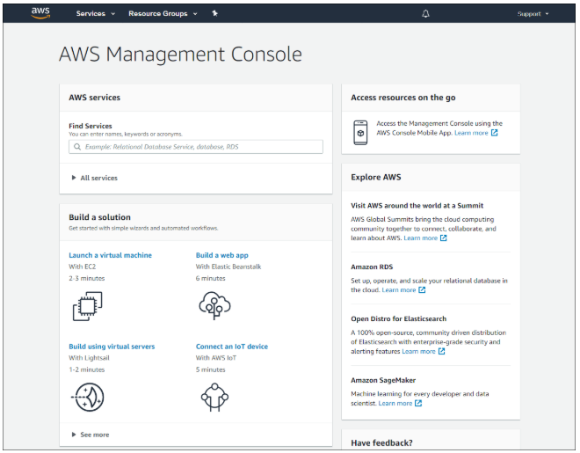
Virtualization Cloud Computing and Virtualization
The terms “cloud computing” and “virtualization” are often used interchangeably; however, they mean different things. Virtualization is the foundation of cloud computing. Without it, cloud computing, as it is most-widely implemented, would not be possible.
Virtualization separates the operating system (OS) from the hardware. Various providers offer virtual cloud services that can dynamically provision servers as required. These virtualized instances of servers are created on demand.
Notes:
13 - Network Virtualization
13.2 - Virtualization
13.2.1 - Cloud Computing and Virtualization

Slide 19
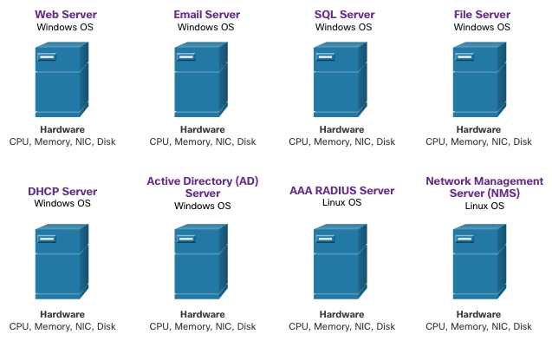
Virtualization Dedicated Servers
Historically, enterprise servers consisted of a server OS, such as Windows Server or Linux Server, installed on specific hardware. All of a server’s RAM, processing power, and hard drive space were dedicated to the service provided (e.g., Web, email services, etc.).
When a component fails, the service that is provided by this server becomes unavailable. This is known as a single point of failure.
Dedicated servers were generally underused. They often sat idle for long periods of time, waiting until there was a need to deliver the specific service they provide. These servers wasted energy and took up more space than was warranted by the amount of service provided. This is known as server sprawl.
Notes:
13 - Network Virtualization
13.2 - Virtualization
13.2.2 - Dedicated Servers

Slide 20
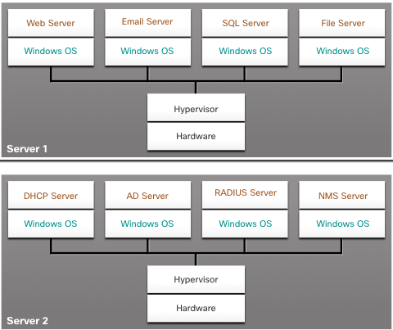
Virtualization Server Virtualization
Server virtualization takes advantage of idle resources and consolidates the number of required servers. This also allows for multiple operating systems to exist on a single hardware platform.
The use of virtualization normally includes redundancy to protect from a single point of failure.
The hypervisor is a program, firmware, or hardware that adds an abstraction layer on top of the physical hardware. The abstraction layer is used to create virtual machines which have access to all the hardware of the physical machine such as CPUs, memory, disk controllers, and NICs.
Notes:
13 - Network Virtualization
13.2 - Virtualization
13.2.3 - Server Virtualization

Slide 21
Virtualization Advantages of Virtualization
One major advantage of virtualization is overall reduced cost:
Less equipment is required
Less energy is consumed
Less space is required
These are additional benefits of virtualization:
Easier prototyping
Faster server provisioning
Increased server uptime
Improved disaster recovery
Legacy support
Notes:
13 - Network Virtualization
13.2 - Virtualization
13.2.4 - Advantages of Virtualization

Slide 22
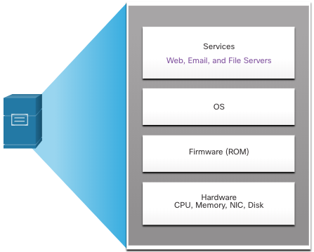
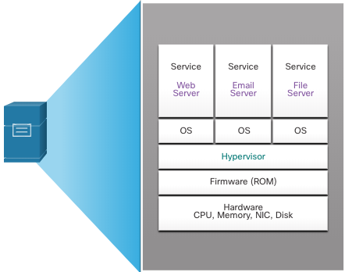
Virtualization Abstraction Layers
A computer system consists of the following abstraction layers: Services, OS, Firmware, and Hardware.
At each of these layers of abstraction, some type of programming code is used as an interface between the layer below and the layer above.
A hypervisor is installed between the firmware and the OS. The hypervisor can support multiple instances of OSs.
Notes:
13 - Network Virtualization
13.2 - Virtualization
13.2.5 - Abstraction Layers

Slide 23
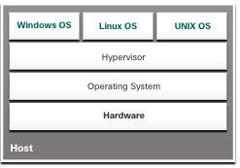
Virtualization Type 2 Hypervisors
A Type 2 hypervisor is software that creates and runs VM instances. The computer, on which a hypervisor is supporting one or more VMs, is a host machine. Type 2 hypervisors are also called hosted hypervisors.
A big advantage of Type 2 hypervisors is that management console software is not required.
Notes:
13 - Network Virtualization
13.2 - Virtualization
13.2.6 - Type 2 Hypervisors
13.2.7 - Check Your Understanding - Virtualization

Slide 24
13.3 Virtual Network Infrastructure
Notes:
13 - Network Virtualization
13.3 - Virtual Network Infrastructure

Slide 25
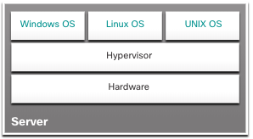
Virtual Network Infrastructure Type 1 Hypervisors
Type 1 hypervisors are also called the “bare metal” approach because the hypervisor is installed directly on the hardware. Type 1 hypervisors are usually used on enterprise servers and data center networking devices.
With Type 1 hypervisors, the hypervisor is installed directly on the server or networking hardware. Then, instances of an OS are installed on the hypervisor, as shown in the figure. Type 1 hypervisors have direct access to the hardware resources. Therefore, they are more efficient than hosted architectures. Type 1 hypervisors improve scalability, performance, and robustness.
Notes:
13 - Network Virtualization
13.3 - Virtual Network Infrastructure
13.3.1 - Type 1 Hypervisors

Slide 26
Virtual Network Infrastructure Installing a VM on a Hypervisor
Type 1 hypervisors require a “management console” to manage the hypervisor. Management software is used to manage multiple servers using the same hypervisor. The management console can automatically consolidate servers and power on or off servers as required.
The management console provides recovery from hardware failure. If a server component fails, the management console automatically moves the VM to another server. Cisco Unified Computing System (UCS) Manager controls multiple servers and manages resources for thousands of VMs.
Some management consoles also allow server over allocation. Over allocation is when multiple OS instances are installed, but their memory allocation exceeds the total amount of memory that a server has. Over allocation is a common practice because all four OS instances rarely require the all their allocated resources at any one moment.
Notes:
13 - Network Virtualization
13.3 - Virtual Network Infrastructure
13.3.2 - Installing a VM on a Hypervisor

Slide 27
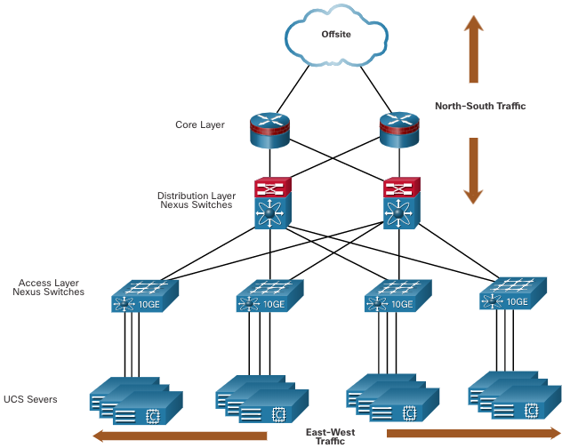
Virtual Network Infrastructure The Complexity of Network Virtualization
Server virtualization hides server resources. This can create problems when using traditional network architectures.
VMs are movable, and the network administrator must be able to add, drop, and change network resources and profiles to support their mobility. This process would be manual and time-consuming with traditional network switches.
Traffic flows differ from the traditional client-server model. Typically, there is a considerable amount of traffic being exchanged between virtual servers (East-West traffic) that changes in location and intensity over time. North-South traffic is typically traffic destined for offsite locations such as another data center, other cloud providers, or the internet.
Notes:
13 - Network Virtualization
13.3 - Virtual Network Infrastructure
13.3.3 - The Complexity of Network Virtualization

Slide 28
Virtual Network Infrastructure The Complexity of Network Virtualization (Cont.)
Dynamic ever-changing traffic requires a flexible approach to network resource management. Existing network infrastructures can respond to changing requirements related to the management of traffic flows by using Quality of Service (QoS) and security level configurations for individual flows. However, in large enterprises using multivendor equipment, each time a new VM is enabled, the necessary reconfiguration can be very time-consuming.
The network infrastructure can also benefit from virtualization. Network functions can be virtualized. Each network device can be segmented into multiple virtual devices that operate as independent devices. Examples include subinterfaces, virtual interfaces, VLANs, and routing tables. Virtualized routing is called virtual routing and forwarding (VRF).
Notes:
13 - Network Virtualization
13.3 - Virtual Network Infrastructure
13.3.3 - The Complexity of Network Virtualization
13.3.4 - Check Your Understanding - Virtual Network Infrastructure

Slide 29
13.4 Software-Defined Networking
Notes:
13 - Network Virtualization
13.4 - Software-Defined Networking

Slide 30
Software-Defined Networking Video - Software-Defined Networking
This video will cover the following:
Network Programming
SDN (Open Network Foundation, OpenFlow, and OpenStack)
Controllers
Notes:
13 - Network Virtualization
13.4 - Software-Defined Networking
13.4.1 - Video - Software-Defined Networking

Slide 31
Software-Defined Networking Control Plane and Data Plane
A network device contains the following planes:
Control plane - This is typically regarded as the brains of a device. It is used to make forwarding decisions. The control plane contains Layer 2 and Layer 3 route forwarding mechanisms, such as routing protocol neighbor tables and topology tables, IPv4 and IPv6 routing tables, STP, and the ARP table. Information sent to the control plane is processed by the CPU.
Data plane - Also called the forwarding plane, this plane is typically the switch fabric connecting the various network ports on a device. The data plane of each device is used to forward traffic flows. Routers and switches use information from the control plane to forward incoming traffic out the appropriate egress interface. Information in the data plane is typically processed by a special data plane processor without the CPU getting involved.
Notes:
13 - Network Virtualization
13.4 - Software-Defined Networking
13.4.2 - Control Plane and Data Plan

Slide 32
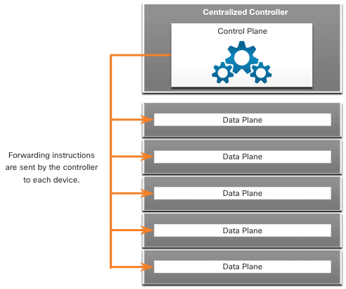
Software-Defined Networking Control Plane and Data Plane (Cont.)
CEF is an advanced, Layer 3 IP switching technology that enables forwarding of packets to occur at the data plane without consulting the control plane.
SDN is basically the separation of the control plane and data plane. The control plane function is removed from each device and is performed by a centralized controller. The centralized controller communicates control plane functions to each device. Each device can now focus on forwarding data while the centralized controller manages data flow, increases security, and provides other services.
Notes:
13 - Network Virtualization
13.4 - Software-Defined Networking
13.4.2 - Control Plane and Data Plan (Cont.)

Slide 33
Software-Defined Networking Control Plane and Data Plane (Cont.)
The management plane is responsible for managing a device through its connection to the network.
Network administrators use applications such as Secure Shell (SSH), Trivial File Transfer Protocol (TFTP), Secure FTP, and Secure Hypertext Transfer Protocol (HTTPS) to access the management plane and configure a device.
The management plane is how you have accessed and configured devices in your networking studies. In addition, protocols like Simple Network Management Protocol (SNMP), use the management plane.
Notes:
13 - Network Virtualization
13.4 - Software-Defined Networking
13.4.2 - Control Plane and Data Plan (Cont.)

Slide 34
Software-Defined Networking Network Virtualization Technologies
Two major network architectures have been developed to support network virtualization:
Software-Defined Networking (SDN) - A network architecture that virtualizes the network, offering a new approach to network administration and management that seeks to simplify and streamline the administration process.
Cisco Application Centric Infrastructure (ACI) - A purpose-built hardware solution for integrating cloud computing and data center management.
Notes:
13 - Network Virtualization
13.4 - Software-Defined Networking
13.4.3 - Network Virtualization Technologies

Slide 35
Software-Defined Networking Network Virtualization Technologies (Cont.)
Components of SDN may include the following:
OpenFlow - This approach was developed at Stanford University to manage traffic between routers, switches, wireless access points, and a controller. The OpenFlow protocol is a basic element in building SDN solutions.
OpenStack - This approach is a virtualization and orchestration platform designed to build scalable cloud environments and provide an IaaS solution. OpenStack is often used with Cisco ACI. Orchestration in networking is the process of automating the provisioning of network components such as servers, storage, switches, routers, and applications.
Other components - Other components include Interface to the Routing System (I2RS), Transparent Interconnection of Lots of Links (TRILL), Cisco FabricPath (FP), and IEEE 802.1aq Shortest Path Bridging (SPB).
Notes:
13 - Network Virtualization
13.4 - Software-Defined Networking
13.4.3 - Network Virtualization Technologies (Cont.)

Slide 36
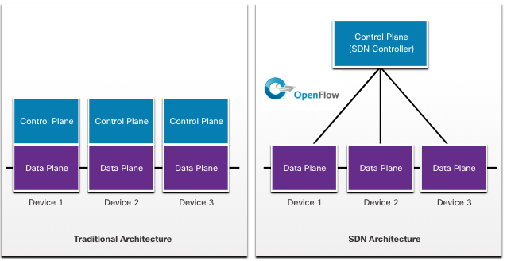
Software-Defined Networking Traditional and SDN Architectures
In a traditional router or switch architecture, the control plane and data plane functions occur in the same device. Routing decisions and packet forwarding are the responsibility of the device operating system. In SDN, management of the control plane is moved to a centralized SDN controller. The figure compares traditional and SDN architectures.
Notes:
13 - Network Virtualization
13.4 - Software-Defined Networking
13.4.4 - Traditional and SDN Architectures

Slide 37
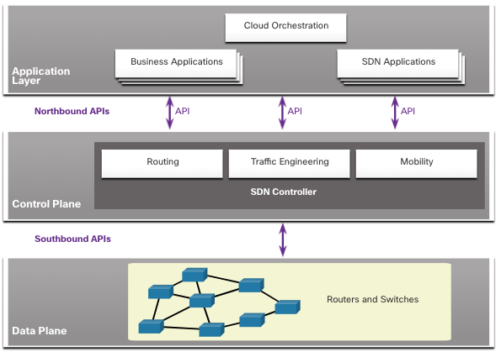
Software-Defined Networking Traditional and SDN Architectures (Cont.)
The SDN controller is a logical entity that enables network administrators to manage and dictate how the data plane of switches and routers should handle network traffic. It orchestrates, mediates, and facilitates communication between applications and network elements.
The complete SDN framework is shown in the figure. Note the use of Application Programming Interfaces (APIs). An API is a standardized definition of the proper way for an application to request services from another application.
The SDN controller uses northbound APIs to communicate with the upstream applications, helping network administrators shape traffic and deploy services. The SDN controller uses southbound APIs to define the behavior of the data planes on downstream switches and routers. OpenFlow is a widely implemented southbound API.
Notes:
13 - Network Virtualization
13.4 - Software-Defined Networking
13.4.4 - Traditional and SDN Architectures (Cont.)
13.4.5 - Check your Understanding - Software-Defined Networking

Slide 38
13.5 Controllers
Notes:
13 - Network Virtualization
13.5 - Controllers

Slide 39
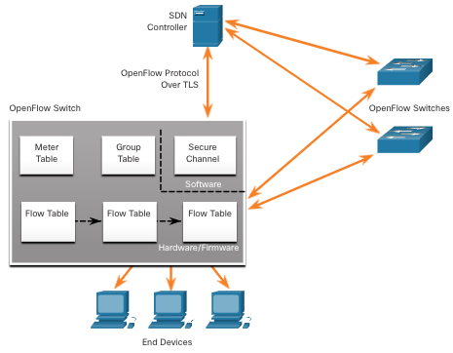
Controllers SDN Controller and Operations
The SDN controller defines the data flows between the centralized control plane and the data planes on individual routers and switches.
Each flow traveling through the network must first get permission from the SDN controller, which verifies that the communication is permissible according to the network policy.
All complex functions are performed by the controller. The controller populates flow tables. Switches manage the flow tables.
Notes:
13 - Network Virtualization
13.5 - Controllers
13.5.1 - SDN Controller and Operations

Slide 40
Controllers SDN Controller and Operations (Cont.)
Within each switch, a series of tables implemented in hardware or firmware are used to manage the flows of packets through the switch. To the switch, a flow is a sequence of packets that matches a specific entry in a flow table.
The three table types shown in the previous figure are as follows:
Flow Table - This table matches incoming packets to a particular flow and specifies the functions that are to be performed on the packets. There may be multiple flow tables that operate in a pipeline fashion.
Group Table - A flow table may direct a flow to a Group Table, which may trigger a variety of actions that affect one or more flows.
Meter Table - This table triggers a variety of performance-related actions on a flow including the ability to rate-limit the traffic.
Notes:
13 - Network Virtualization
13.5 - Controllers
13.5.1 - SDN Controller and Operations (Cont.)

Slide 41
Controllers Video - Cisco ACI
Very few organizations actually have the desire or skill to program the network using SDN tools. However, the majority of organizations want to automate the network, accelerate application deployments, and align their IT infrastructures to better meet business requirements. Cisco developed the Application Centric Infrastructure (ACI) to meet these objectives in more advanced and innovative ways than earlier SDN approaches.
Cisco ACI is a hardware solution for integrating cloud computing and data center management. At a high level, the policy element of the network is removed from the data plane. This simplifies the way data center networks are created.
Notes:
13 - Network Virtualization
13.5 - Controllers
13.5.2 - Video - Cisco ACI

Slide 42
Controllers Core Components of ACI
There are three core components of the ACI architecture:
Application Network Profile (ANP) - An ANP is a collection of end-point groups (EPG), their connections, and the policies that define those connections.
Application Policy Infrastructure Controller (APIC) - APIC is a centralized software controller that manages and operates a scalable ACI clustered fabric. It is designed for programmability and centralized management. It translates application policies into network programming.
Cisco Nexus 9000 Series switches - These switches provide an application-aware switching fabric and work with an APIC to manage the virtual and physical network infrastructure.
The APIC is positioned between the APN and the ACI-enabled network infrastructure. The APIC translates the application requirements into a network configuration to meet those needs.
Notes:
13 - Network Virtualization
13.5 - Controllers
13.5.3 - Core Components of ACI

Slide 43
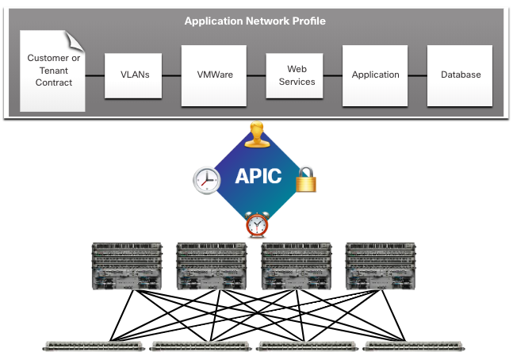
Controllers Core Components of ACI (Cont.)
Notes:
13 - Network Virtualization
13.5 - Controllers
13.5.3 - Core Components of ACI (Cont.)

Slide 44
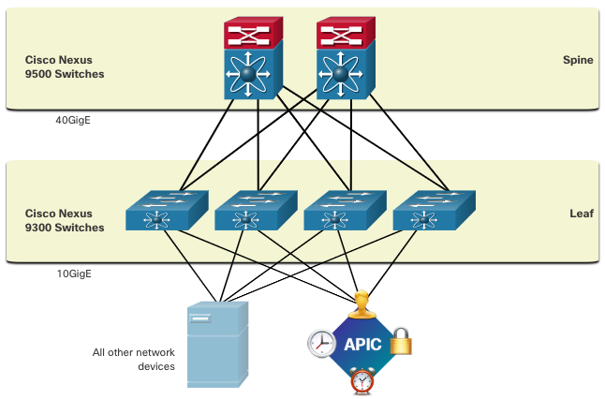
Controllers Spine-Leaf Topology
The Cisco ACI fabric is composed of the APIC and the Cisco Nexus 9000 series switches using two-tier spine-leaf topology, as shown in the figure. The leaf switches attach to the spines, but they never attach to each other. Similarly, the spine switches only attach to the leaf and core switches (not shown). In this two-tier topology, everything is one hop from everything else.
When compared to SDN, the APIC controller does not manipulate the data path directly. Instead, the APIC centralizes the policy definition and programs the leaf switches to forward traffic based on the defined policies.
Notes:
13 - Network Virtualization
13.5 - Controllers
13.5.4 - Spine-Leaf Topology

Slide 45
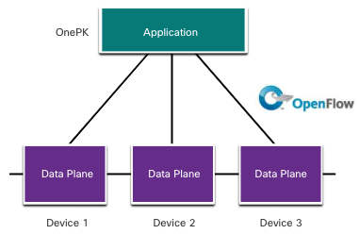
Controllers SDN Types
The Cisco Application Policy Infrastructure Controller - Enterprise Module (APIC-EM) extends ACI aimed at enterprise and campus deployments. To better understand APIC-EM, it is helpful to take a broader look at the three types of SDN:
Device-based SDN: Devices are programmable by applications running on the device itself or on a server in the network, as shown in the figure.
Notes:
13 - Network Virtualization
13.5 - Controllers
13.5.5 - SDN Types

Slide 46
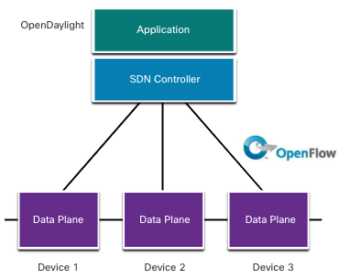
Controllers SDN Types (Cont.)
Controller-based SDN: Uses a centralized controller that has knowledge of all devices in the network, as shown in the figure. The applications can interface with the controller responsible for managing devices and manipulating traffic flows throughout the network. The Cisco Open SDN Controller is a commercial distribution of OpenDaylight.
Notes:
13 - Network Virtualization
13.5 - Controllers
13.5.5 - SDN Types (Cont.)

Slide 47
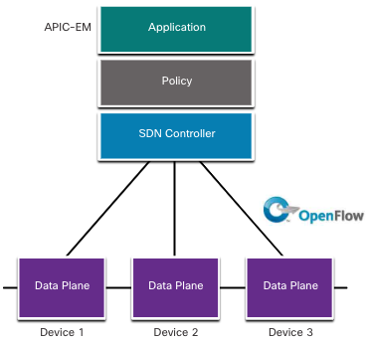
Controllers SDN Types (Cont.)
Policy-based SDN: Similar to controller-based SDN where a centralized controller has a view of all devices in the network, as shown in the figure. Policy-based SDN includes an additional Policy layer that operates at a higher level of abstraction. It uses built-in applications that automate advanced configuration tasks via a guided workflow and user-friendly GUI. No programming skills are required. Cisco APIC-EM is an example of this type of SDN.
Notes:
13 - Network Virtualization
13.5 - Controllers
13.5.5 - SDN Types (Cont.)

Slide 48
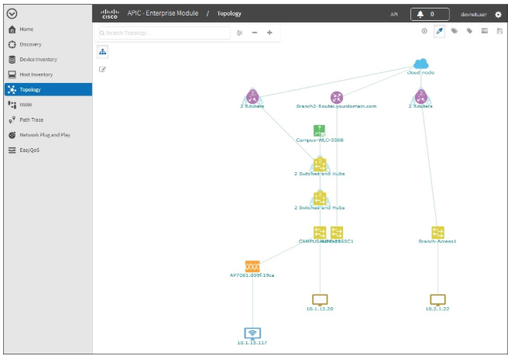
Controllers APIC-EM Features
Cisco APIC-EM provides a single interface for network management including:
Discovering and accessing device and host inventories.
Viewing the topology (as shown in the figure).
Tracing a path between end points.
Setting policies.
Notes:
13 - Network Virtualization
13.5 - Controllers
13.5.6 - APIC-EM Features

Slide 49
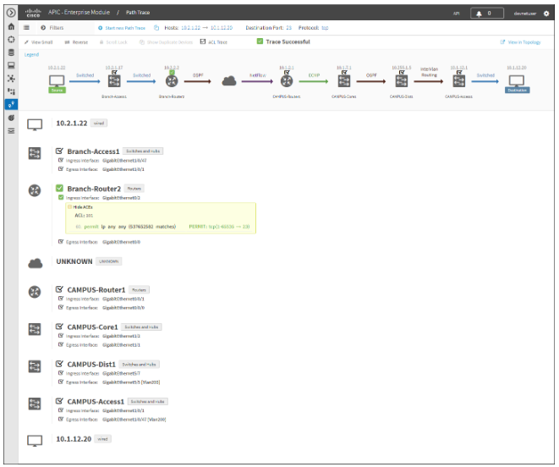
Controllers APIC-EM Path Trace
The APIC-EM Path Trace tool allows the administrator to easily visualize traffic flows and discover any conflicting, duplicate, or shadowed ACL entries. This tool examines specific ACLs on the path between two end nodes, displaying any potential issues. You can see where any ACLs along the path either permitted or denied your traffic, as shown in the figure. Notice how Branch-Router2 is permit all traffic. The network administrator can now make adjustments, if necessary, to better filter traffic.
Notes:
13 - Network Virtualization
13.5 - Controllers
13.5.7 - APIC-EM Path Trace
13.5.8 - Check Your Understanding - Controllers

Slide 50
13.6 Module Practice and Quiz
Notes:
13 – Network Virtualization
13.6 - Module Practice and Quiz

Slide 51
Module Practice and Quiz Lab - Install Linux in a Virtual Machine and Explore the GUI
In this lab, you will install will complete the following objective;
Prepare a Computer for Virtualization
Install a Linux OS on the Virtual Machine
Explore the GUI
Notes:
13 – Network Virtualization
13.6 - Module Practice and Quiz
13.6.1 - Lab - Install Linux in a Virtual Machine and Explore the GUI

Slide 52
Module Practice and Quiz What Did I Learn In This Module?
Cloud computing involves large numbers of computers connected through a network that can be physically located anywhere. Cloud computing can reduce operational costs by using resources more efficiently.
The three main cloud computing services defined by the National Institute of Standards and Technology (NIST) are Software as a Service (SaaS), Platform as a Service (PaaS), and Infrastructure as a Service (IaaS).
The four types of clouds are public, private, hybrid, and community.
Virtualization is the foundation of cloud computing. Virtualization separates the operating system (OS) from the hardware.
Virtualization reduces costs because less equipment is required, less energy is consumed, and less space is required. It provides for easier prototyping, faster server provisioning, increased server uptime, improved disaster recovery, and legacy support.
With Type 1 hypervisors, the hypervisor is installed directly on the server or networking hardware. A Type 2 hypervisor is software that creates and runs VM instances. It can be installed on top of the OS or can be installed between the firmware and the OS.
Notes:
13 – Network Virtualization
13.6 - Module Practice and Quiz
13.6.2 – What Did I Learn In This Module?

Slide 53
Module Practice and Quiz What Did I Learn In This Module? (Cont.)
Type 1 hypervisors are also called the “bare metal” approach because the hypervisor is installed directly on the hardware. Type 1 hypervisors have direct access to the hardware resources and are more efficient than hosted architectures. They improve scalability, performance, and robustness.
Type 1 hypervisors require a “management console” to manage the hypervisor.
Server virtualization hides server resources, such as the number and identity of physical servers, processors, and OSs from server users. This practice can create problems if the data center is using traditional network architectures.
Traffic flows in the data center differ substantially from the traditional client-server model. Typically, a data center has a considerable amount of traffic being exchanged between virtual servers (East-West traffic) and can change in location and intensity over time. North-South traffic occurs between the distribution and core layers and is typically traffic destined for offsite locations such as another data center, other cloud providers, or the internet.
Two major network architectures have been developed to support network virtualization: Software-Defined Networking (SDN) and Cisco Application Centric Infrastructure (ACI).
Components of SDN may include OpenFlow, OpenStack, and other components.
Notes:
13 – Network Virtualization
13.6 - Module Practice and Quiz
13.6.2 – What Did I Learn In This Module? (Cont.)

Slide 54
Module Practice and Quiz What Did I Learn In This Module? (Cont.)
A network device contains a control plane and a data plane. The control plane is regarded as the brains of a device.
SDN is basically the separation of the control plane and data plane. The control plane function is removed from each device and is performed by a centralized controller
The SDN controller is a logical entity that enables network administrators to manage and dictate how the data plane of switches and routers should handle network traffic.
The data plane, also called the forwarding plane, is typically the switch fabric connecting the various network ports on a device, and is used to forward traffic flows.
The management plane is responsible for managing a device through its connection to the network.
The SDN controller is a logical entity that enables network administrators to manage and dictate how the data plane of switches and routers should handle network traffic.
Cisco developed the Application Centric Infrastructure (ACI) which is more advanced and innovative than earlier SDN approaches.
Cisco ACI is a hardware solution for integrating cloud computing and data center management.
At a high level, the policy element of the network is removed from the data plane. This simplifies the way data center networks are created.
Notes:
13 – Network Virtualization
13.6 - Module Practice and Quiz
13.6.2 – What Did I Learn In This Module? (Cont.)

Slide 55
Module Practice and Quiz What Did I Learn In This Module? (Cont.)
The three core components of the ACI architecture are Application Network Profile (ANP), Application Policy Infrastructure Controller (APIC), and Cisco Nexus 9000 Series switches.
The Cisco ACI fabric is composed of the APIC and the Cisco Nexus 9000 series switches using two-tier spine-leaf topology.
When compared to SDN, the APIC controller does not manipulate the data path directly. Instead, the APIC centralizes the policy definition and programs the leaf switches to forward traffic based on the defined policies.
There are three types of SDN: Device-based SDN, Controller-based SDN, and Policy-based SDN.
Policy-based SDN includes an additional Policy layer that operates at a higher level of abstraction. Policy-based SDN is the most robust, providing for a simple mechanism to control and manage policies across the entire network.
Cisco APIC-EM is an example of policy-based SDN. Cisco APIC-EM provides a single interface for network management including discovering and accessing device and host inventories, viewing the topology, tracing a path between end points, and setting policies.
The APIC-EM Path Trace tool allows the administrator to easily visualize traffic flows and discover any conflicting, duplicate, or shadowed ACL entries. This tool examines specific ACLs on the path between two end nodes, displaying any potential issues.
Notes:
13 – Network Virtualization
13.6 - Module Practice and Quiz
13.6.2 – What Did I Learn In This Module? (Cont.)
13.6.3 – Module Quiz – Network Security Concepts

Slide 56
Module 13: Network Virtualization New Terms and Commands
cloud computing
Software as a Service (SaaS)
Platform as a Service (PaaS)
Infrastructure as a Service (IaaS)
IT as a Service (ITaaS)
public clouds
private clouds
hybrid clouds
community clouds
virtualization
abstraction layers
type 1 hypervisor
type 2 hypervisor
bare metal server
software-defined networking
control plane
data plane
management plane
Cisco Application Centric Infrastructure (ACI)
OpenFlow
OpenStack
Application Network Profile (ANP)
Application Policy Infrastructure Controller (APIC)
spin-leaf topology
device-based SDN
controller-based SDN
policy-based SDN
Application Policy Infrastructure Controller - Enterprise Module (APIC-EM)
APIC-EM path trace

